Slide 1
ARES Operation Meeting
Summary of week 11 / 2023
Willi Kuropka, on behalf of the ARES crew

Slide 2
Summary of week 10
Mon. 13th March | Tue. 14th March | Wed. 15th March | Thu. 16th March | Fri. 17th March
Tunnel closed in the afternoon Ebeam setup and 2um laser transmission through EA chamber | Laser alignment Check coarse timing using gated camera timing scan over night using the synchronization timing shifter | Rechecking of spatial overlap and coarse timing More timing scans | Rechecking of spatial overlap and coarse timing More timing scans | Rechecking of spatial overlap and coarse timing Try to measure the laser beam size at the IP More timing scans
 |  | Drift of mean momentum and momentum spread over night
Tunnel open in the morning
Achievements
Difficulties
Notes

Slide 3
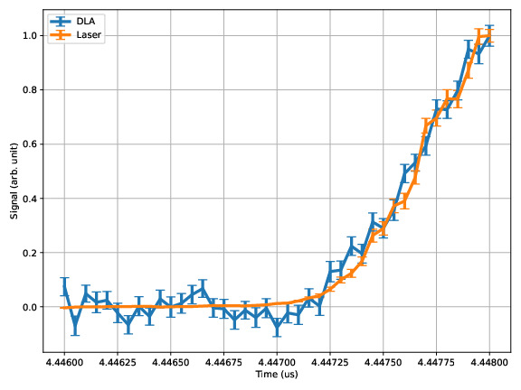
Rough laser to ebeam timing
Scanned the delay of the gated camera

Slide 4
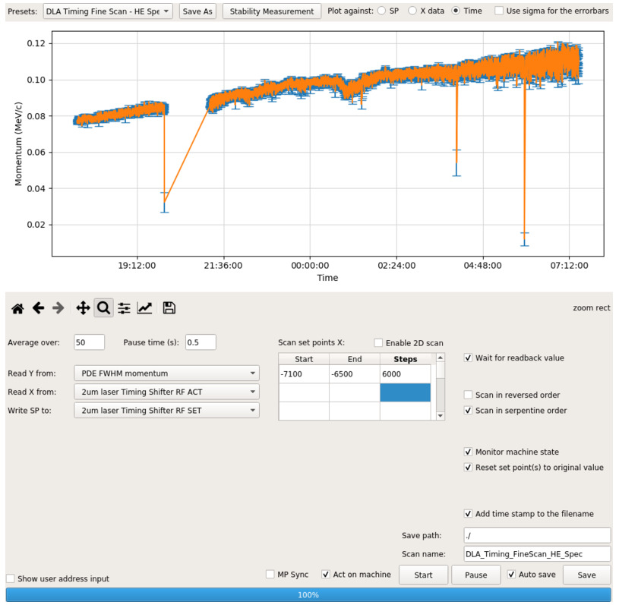
Drift overnight

Slide 5
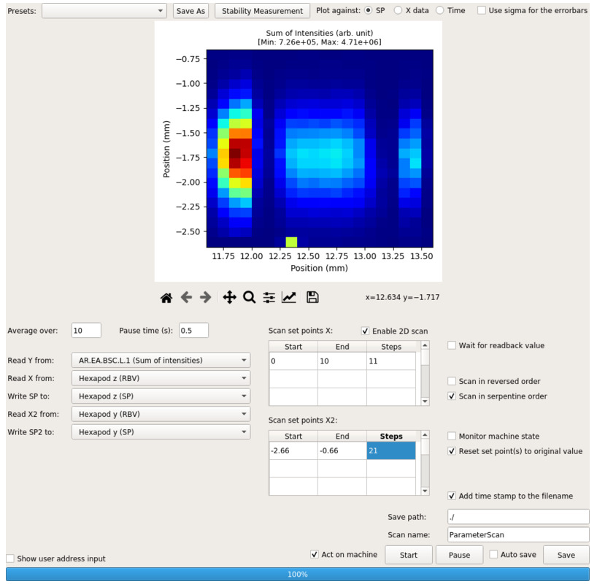
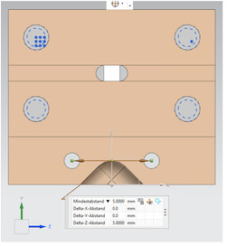
Laser position
Scanning the DLA position

Slide 6
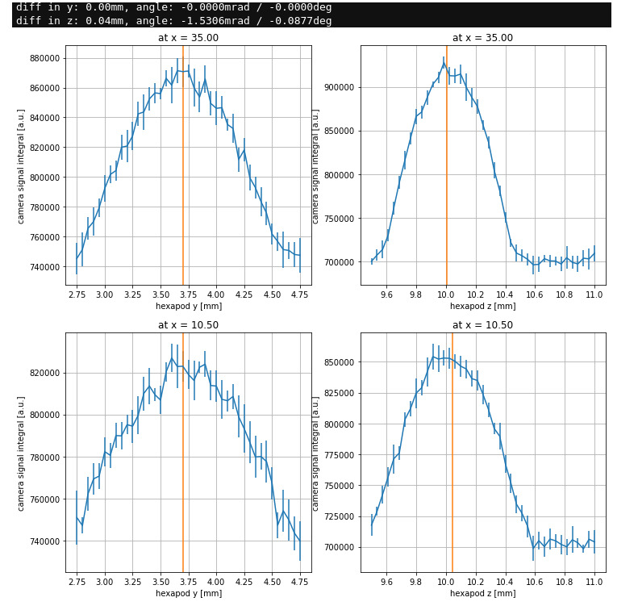
Laser angle
Scanning the alignment channels at different positions along the laser beam trajectory

Slide 7
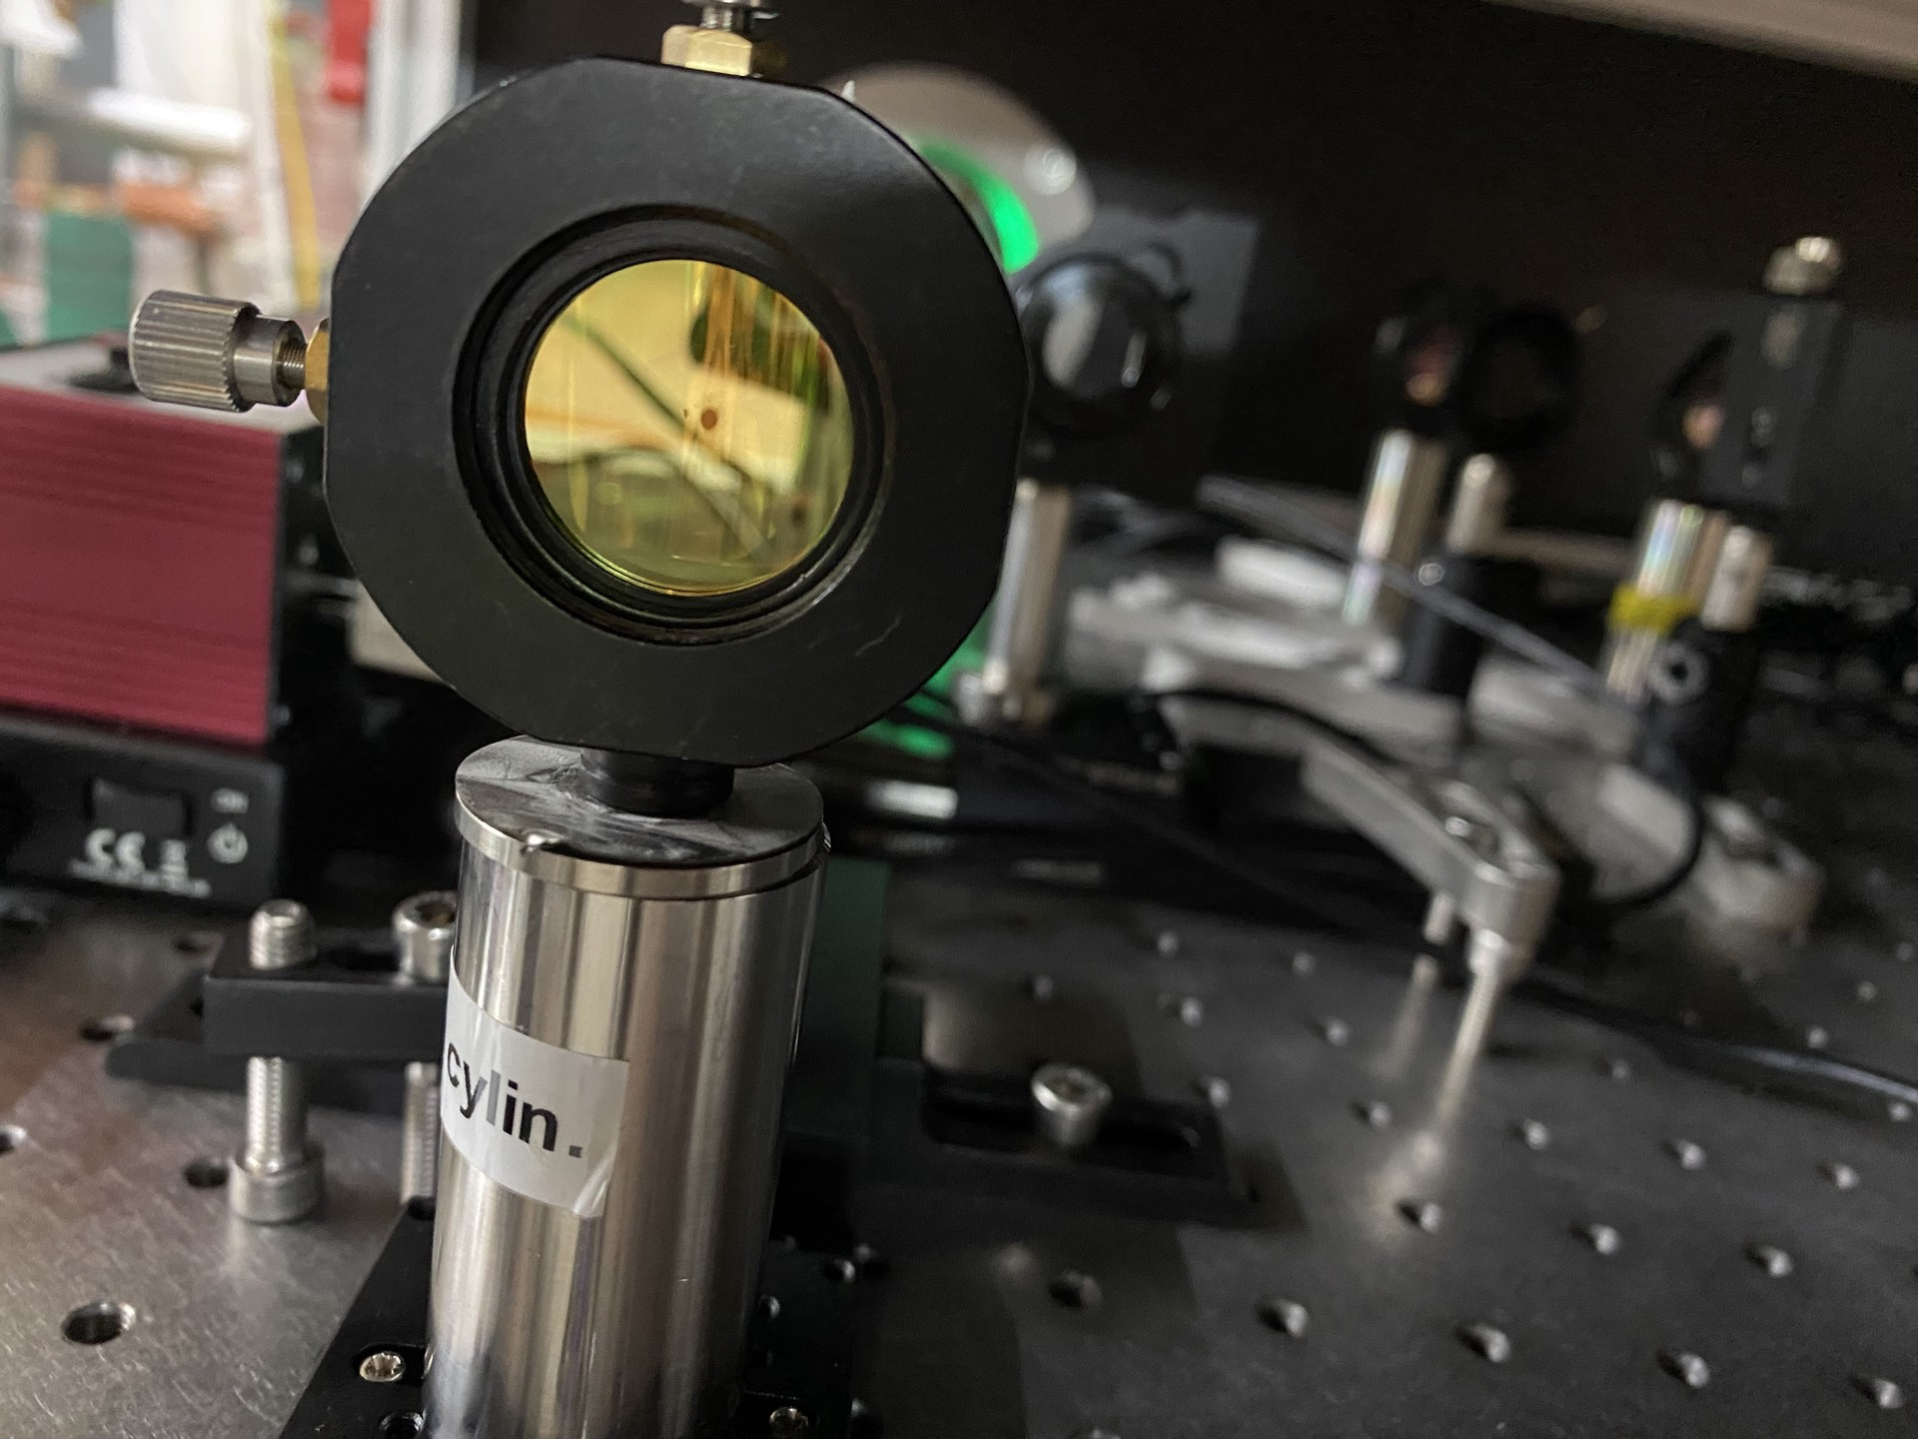
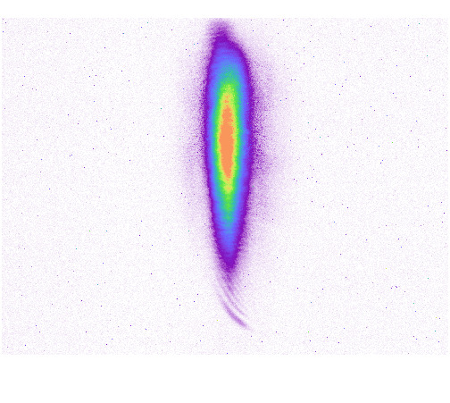
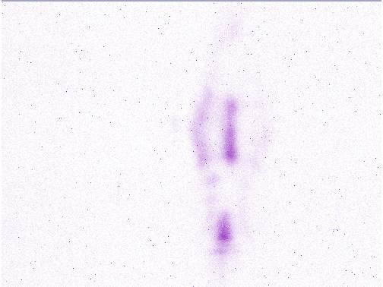
Damaged lens
Before and after…

Slide 8
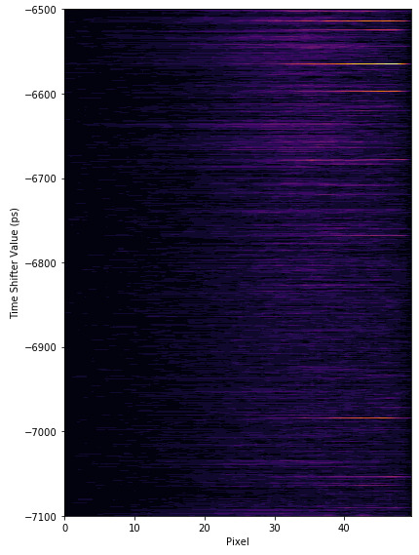
Timing scan
Averaged Normalized recentered spectra laser on minus laser off…

Slide 9
Today
Tunnel visit – Ventilation system
MDI toroid tests
Scintillating fiber BLM installation
MVS cathode box installation
ACHIP laser tests/setup in the tunnel…exchange a damaged lens

Slide 10
Schedule
Week 12
Date | Shift Leader
20.03. | -
21.03. | ACHIP Team
22.03. | ACHIP Team
23.03. | ACHIP Team
24.03. | ACHIP Team
If you want to learn or join the shift: please give the shift leader a call (BKR 2840 / SINBAD Box 2454)

