Slide 1
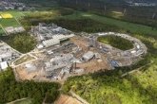
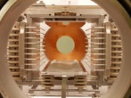
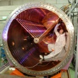
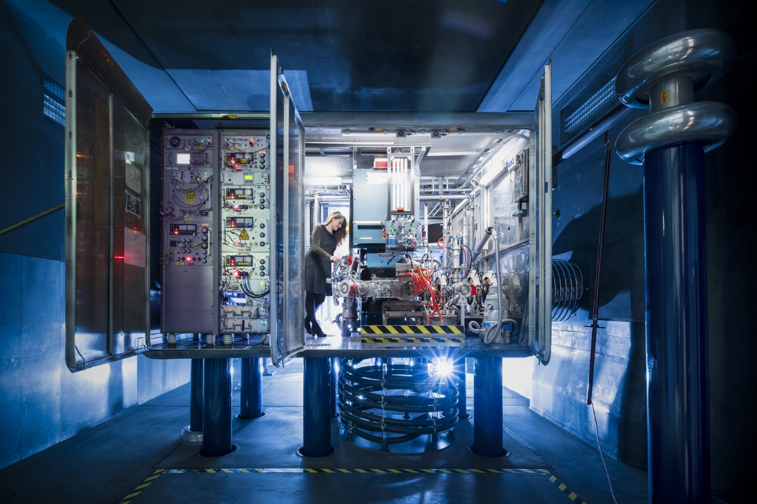

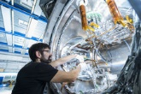

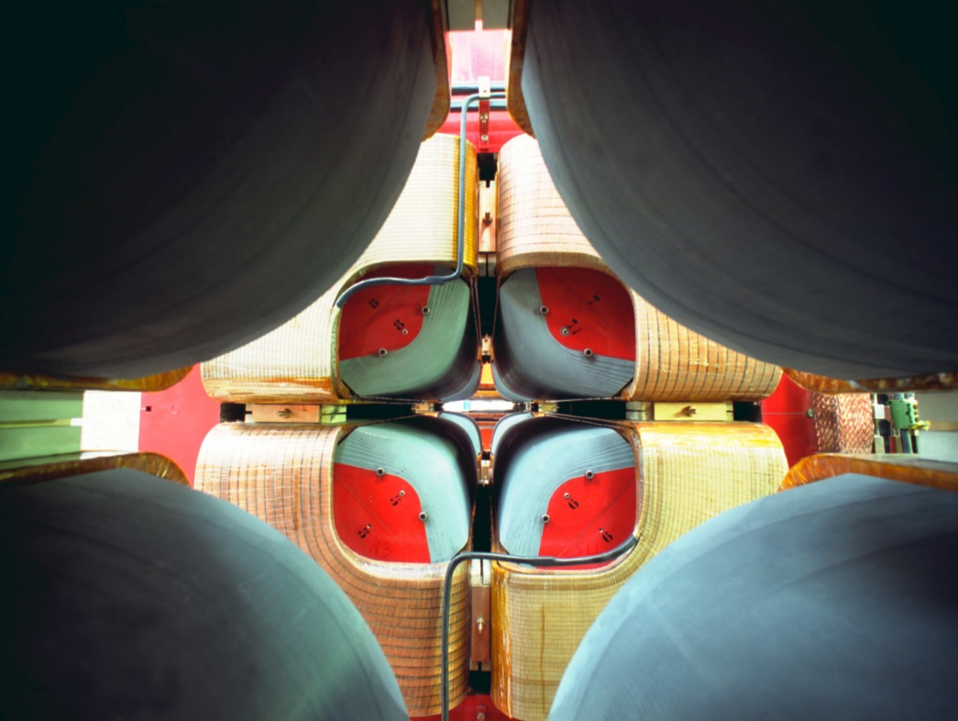
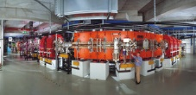
Welcome in Darmstadt to the 12th ARD-ST3 Workshop
03. – 05. Juli 2024
Thank you very much for your participation and contributions!

Slide 2
Program Overview: Today
Goal of the Workshop:
Scientific exchange on Beam Control, Diagnostics and Dynamics
Networking and collaborations between Helmholtz-Centers
Today’s program:
13:00 to 14:35 Facility Overview
14:35 to 14:40 Group photo, don’t miss it
14:40 to 15:10 Coffee break (if not done, please use this break for registration)
15:10 to 16:10 Tutorial on Cryogenic Techniques
16:10 to 16:15 Short break and distribution to groups
16:15 to ≈17:45 Guided tour
18:15 (sharp): Busses to the Greet Hotel leave in front of the lecture hall

Slide 3
Program Overview: Thursday and Friday
Location: Greet Hotel
Lunch is included on Thursday and Friday
Thursday program:
8:30 to 10:10 Facility Overview (note: start at 8:30)
10:30 to 11:30 Tutorial on Ele.-mag. Field Simulations
11:30 to 11:50 Special topical talk
13:00 to 14:20 Session on Beam Dynamics
14:40 to 16:00 Session on Beam Diagnostics
16:10 to 18:10 Speed talks and poster on Beam Diagnostics
18:30 (sharp) Busses to conference dinner (individual return with public transportation)
Friday program:
8:30 to 9:50 Session on Beam Control (note: start at 8:30)
10:00 to 12:00 Speed talks and poster on Beam Control and Dynamics
12:00 to 12:20 Summary & discussion on PoF 5, closing
about 13:30 End of Workshop
Remark: Workshop shifted to Greet Hotel as there is the Summer Festival at GSI on Thursday afternoon

Slide 4
Talks, Speed Talks and Posters
Thursday program:
16:10 to 18:10: Speed talks and poster on Beam Diagnostics
Each poster presenter should give a maximal 3 min talk
Maximal 3 pages presentation, pdf-format
Upload not later than Wednesday 22:00 i.e. today (pdf-format); we will combine all talks in one file
Please upload your poster in pdf-format as well (deadline: end of workshop)
Friday program:
10:00 to 12:00: Speed talks and poster on Beam Control and Dynamics
Upload not later than Thursday 12:00 (pdf-format); we will combine all talks in one file
For regular talks please obey:
Upload your talk at least 2 hours prior to the start of the related session
Upload the pptx and pdf version (no automatic conversion to pdf)
Please contact the session chair prior to the session

Slide 5
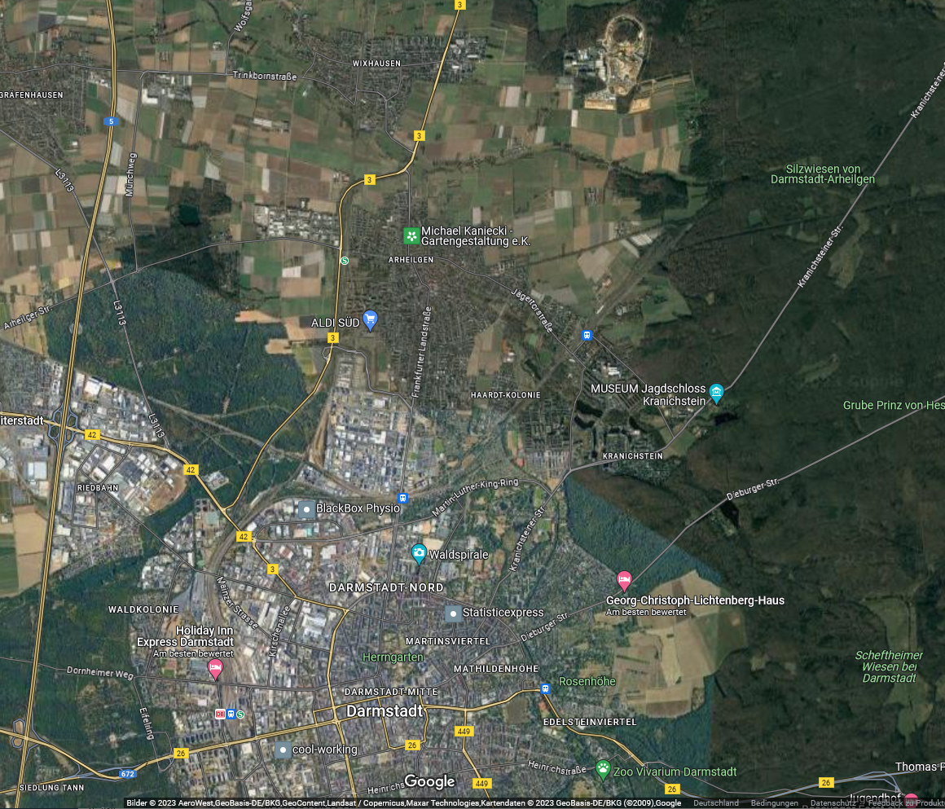

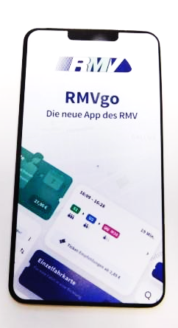
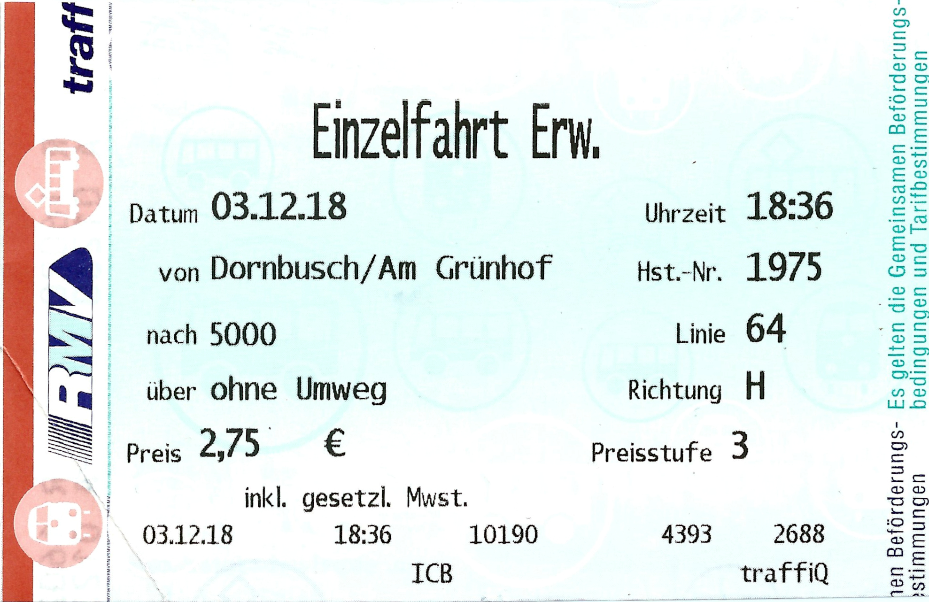
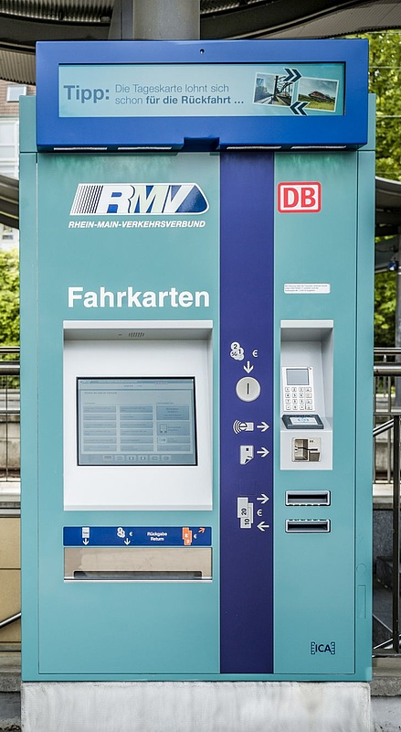
Overview Darmstadt
GSI
Public transportation:
Verkehrsverbund RMV
S-Bahn
Bus
Today:
Bus at 18:15
Tram
Please download
RMVgo
Conference Dinner, Thursday
Weißer Schwan, Frankfurter Landstr. 190
Ticket:
Bus: At bus driver
Tram: Machine at station
Buy just before departure!
No extra stamp required
GSI ↔ City centre:
Duration ≈30 min
1 km
City Centre (main square ‚Luisenplatz‘)
Hbf
Hotel
Deutschlandticket
is valid

Slide 6

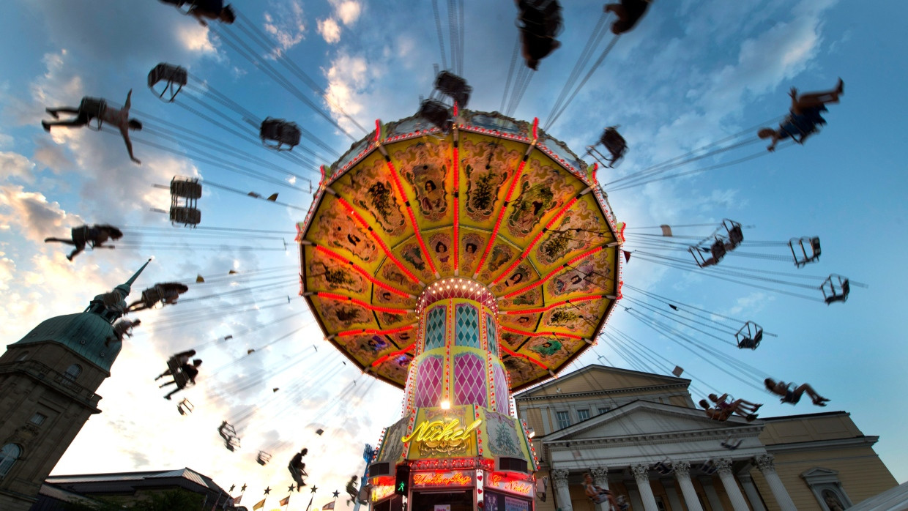
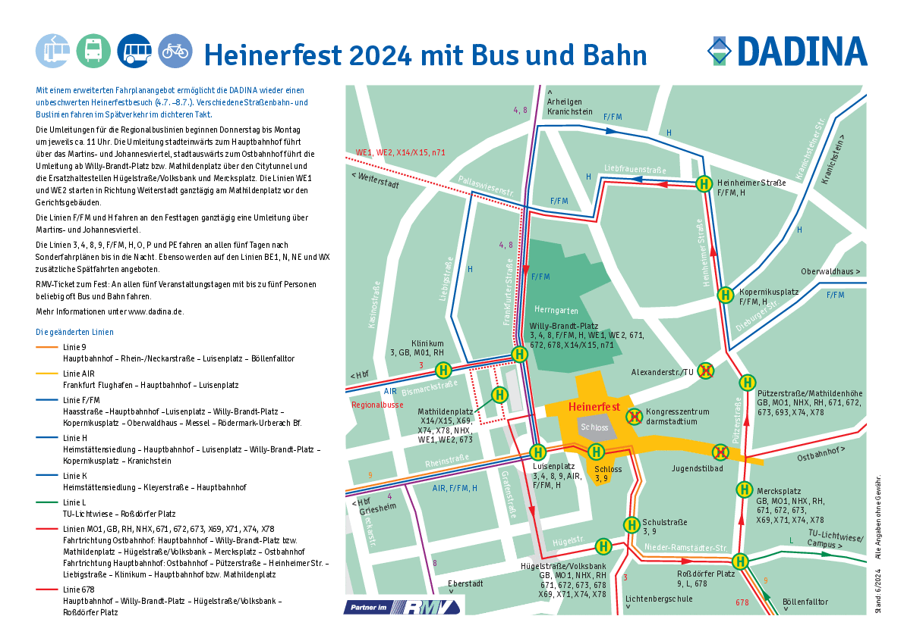
Care: Modified Tram & Bus Routes due to ‘Heinerfest’ Th. from 11:00
Public transportation:
Verkehrsverbund RMV
Please download
RMVgo
Ticket:
Bus: At bus driver
Tram: Machine at station
Buy just before departure!
No extra stamp required
Schedule:
See RMVgo
Deutschlandticket
is valid

Slide 7
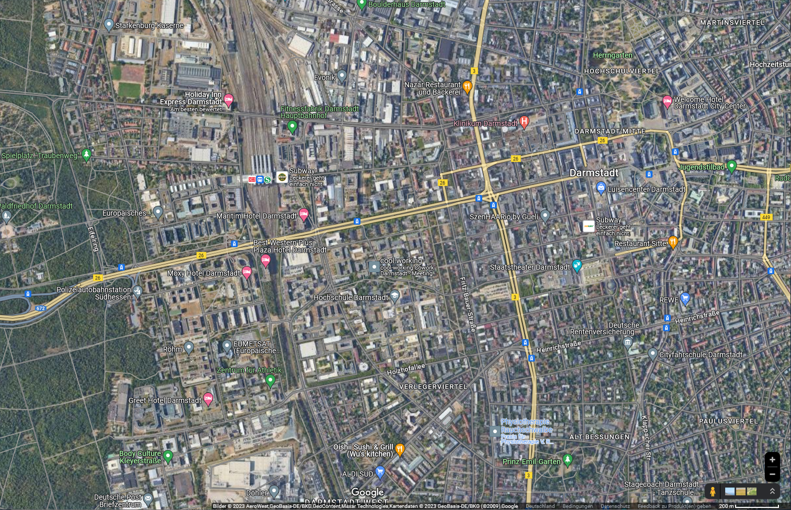
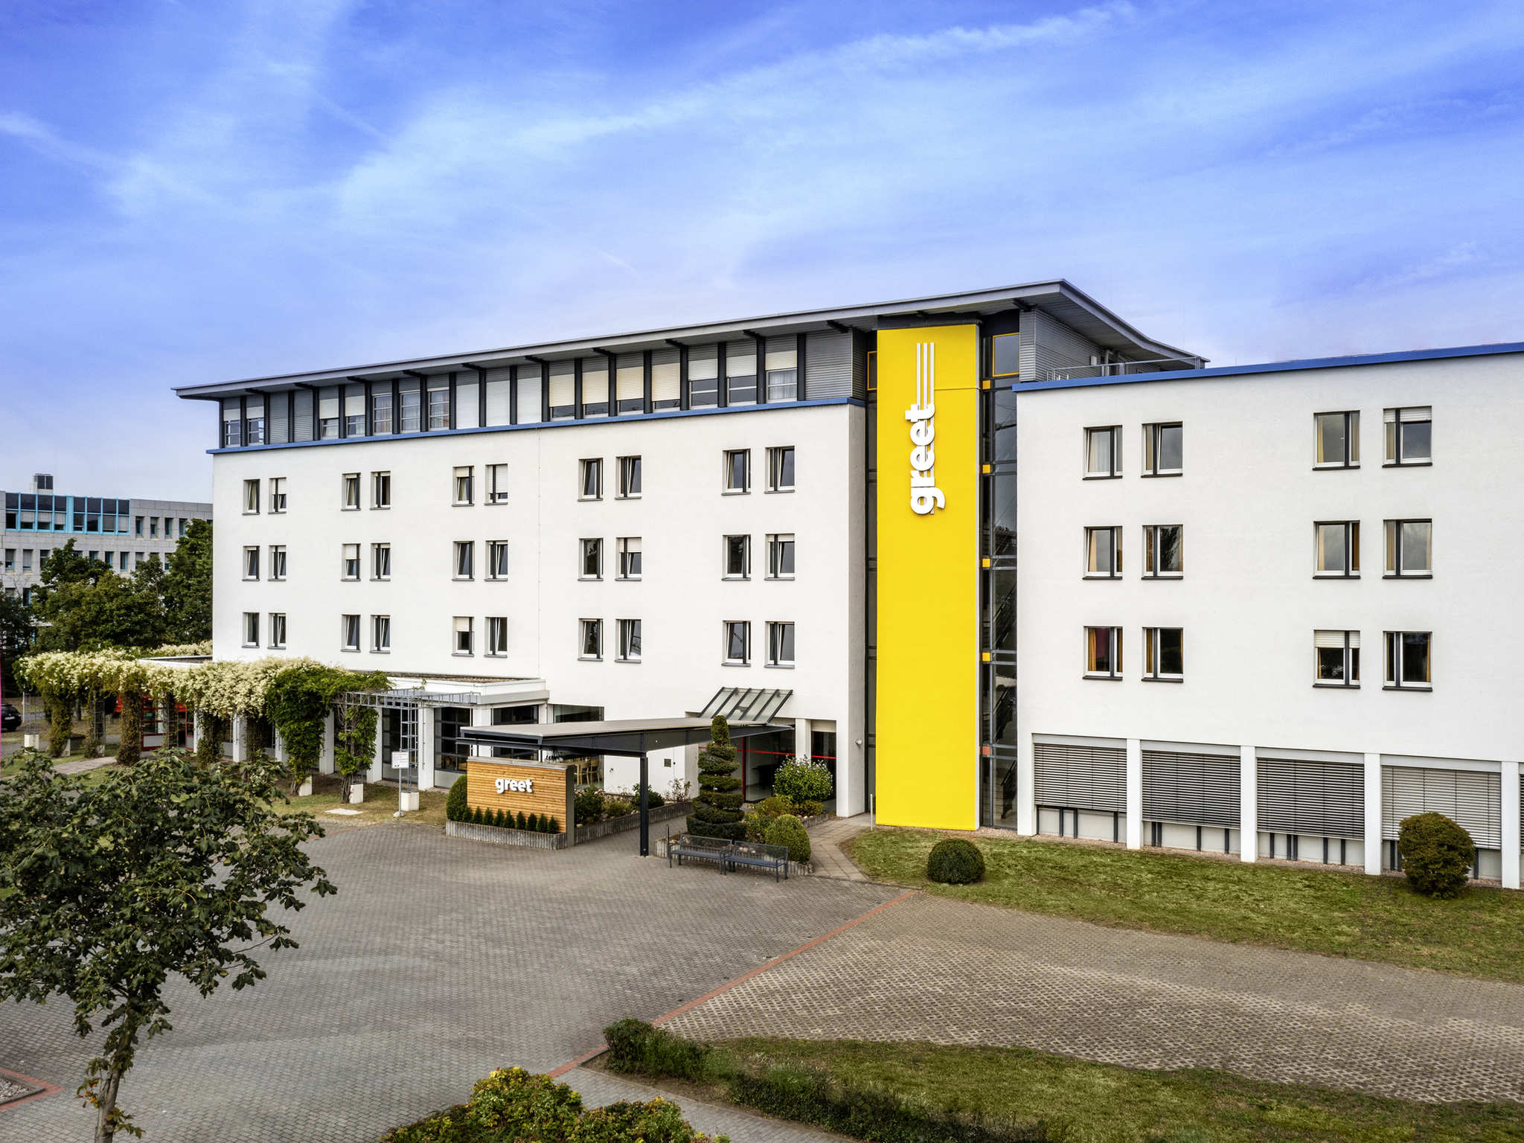
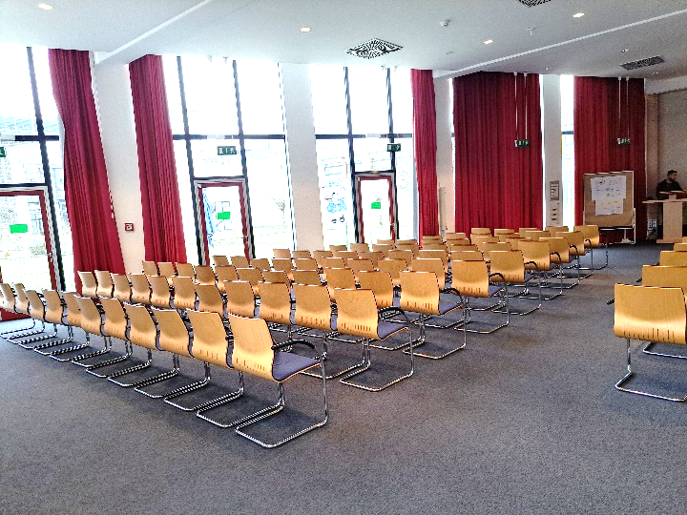
Location Greet Hotel
Today:
18:15 bus to hotel
Thursday and Friday:
Start of Workshop
at 8:30 in Greet Hotel,
Room ‘Berlin’
Thursday:
18:30 bus to dinner
(Weißer Schwan,
Frankfurter Landstraße 190, individual return via tram)
Hauptbahnhof
S-Bahn S3
City centre, Luisenplatz
Greet Hotel
Hilpertstraße 27
Bus ’K’ only up to 20:00
500 m

Slide 8
Guided Tour today 16:15: Safety Instruction
Please obey the following rule for the guide tour:
Six groups are available:
→ Please distributed related to the color code on your batch
Stay within your group
→ In case you lost your group: Please come to the lecture hall !
Follow the instruction of the group guide
Do not touch anything
Stay within the path; some locations marked by yellow strips on the floor
Watch your head & steps, there might be noise etc.
Stay within the foreseen time schedule
The bus to the Greet Hotel leave at 18:15 (sharp) in front of the lecture hall

Slide 9
Welcome in Darmstadt to the 12th ARD-ST3 Workshop
03. – 05. Juli 2024
Good discussions and enjoy the Workshop!

