Slide 1
Overview of ultrafast electron scattering activities
Raffael Niemczyk
Institute of Radiation Physics · FWKE · Raffael Niemczyk · r.niemczyk@hzdr.de · www.hzdr.de

Slide 2
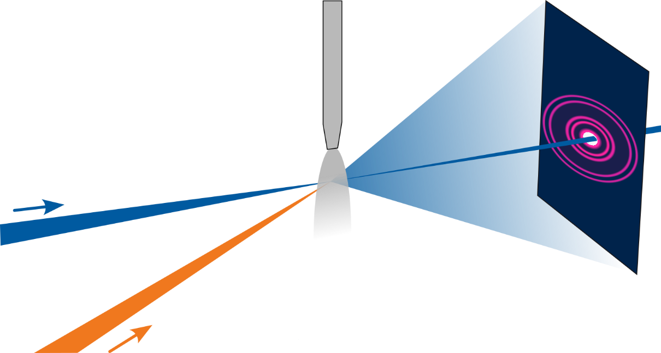
Ultrafast Electron Diffraction (UED)
Experiment Principle
    Diffraction tells molecular structure
    X-ray diffraction powerful, but parts remain unseen
    Atoms and electrons detected by electron diffraction
    Typical: Pump-probe experiment
      Laser excitation starts sample reaction
      Ultra-short electron bunch probes sample
      Diffraction pattern reveals sample structure
Electron
beam
Sample
Diffraction
pattern
Optical pump

Slide 3
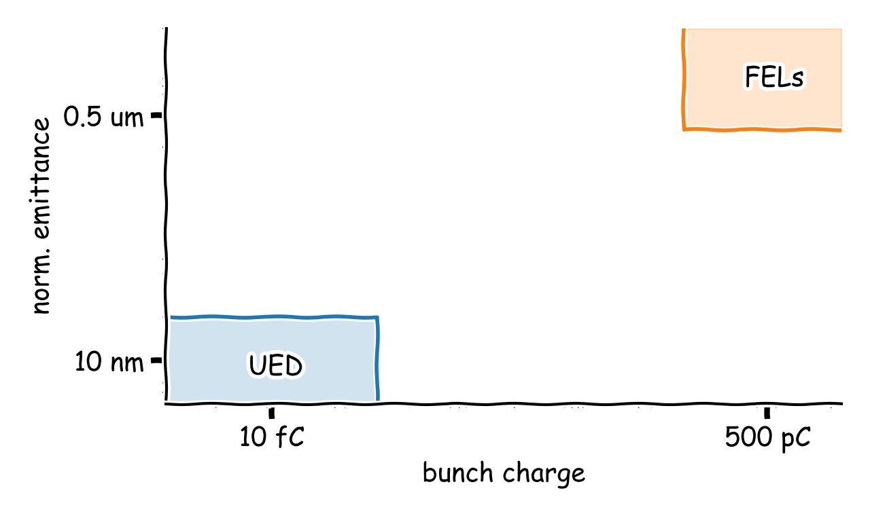
Ultrafast Electron Scattering
Compared to x-rays & keV electrons
    Compared to x-rays
      Stronger interaction (4 – 6 magnitudes higher)
      Less e-beam energy required
        Smaller machine
      Better visibility of lighter atoms
      Same/similar analysis software/hardware
    Compared to keV electrons
      Smaller space charge forces
        Higher brightness
        Shorter bunches
      Less sensitive to E- & B-fields
      Relativistic → no dephasing → Better time resolution

Slide 4
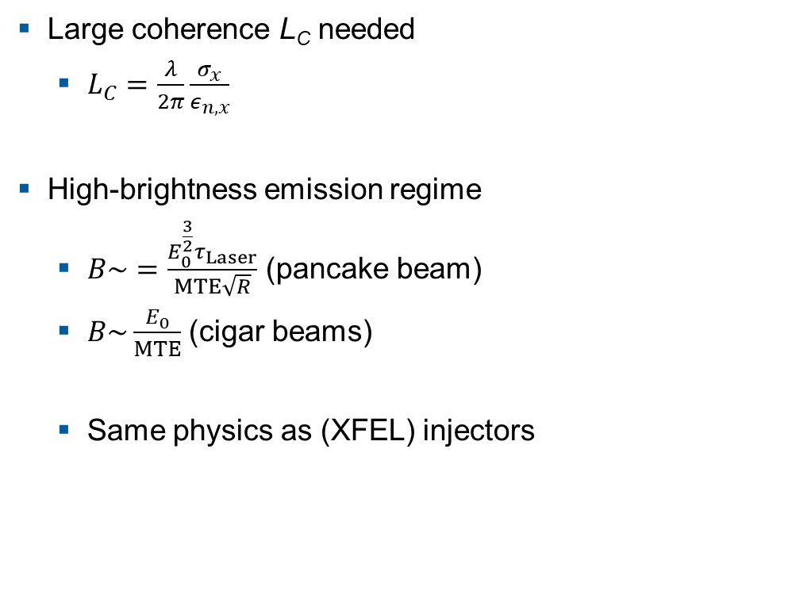
Ultrafast Electron Scattering
Pros & cons
    Large coherence L_{C} needed
      $L_{C}=\frac{λ}{2π}\frac{σ_{x}}{ε_{n,x}}$
    High-brightness emission regime
      $B\sim =\frac{E_{0}^{\frac{3}{2}}τ_{Laser}}{MTE\sqrt{R}}$ (pancake beam)
      $B\sim \frac{E_{0}}{MTE}$ (cigar beams)
      Same physics as (XFEL) injectors

Slide 5
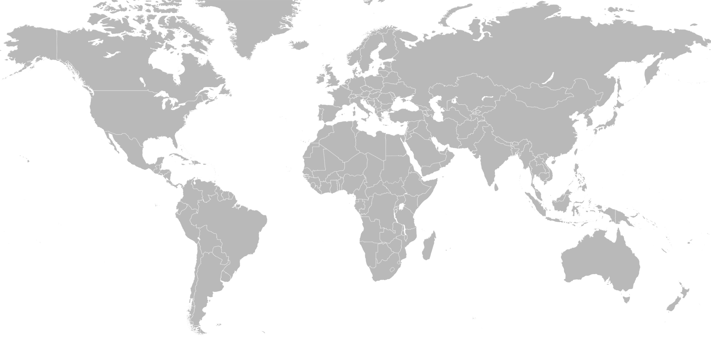
Ultrafast Electron Scattering
Activities worldwide
PKU
THU
STFC
DESY
KAERI
LBNL
DELTA
BNL
Osaka
SLAC
HZB
HZDR
SJTU
UCLA

Slide 6
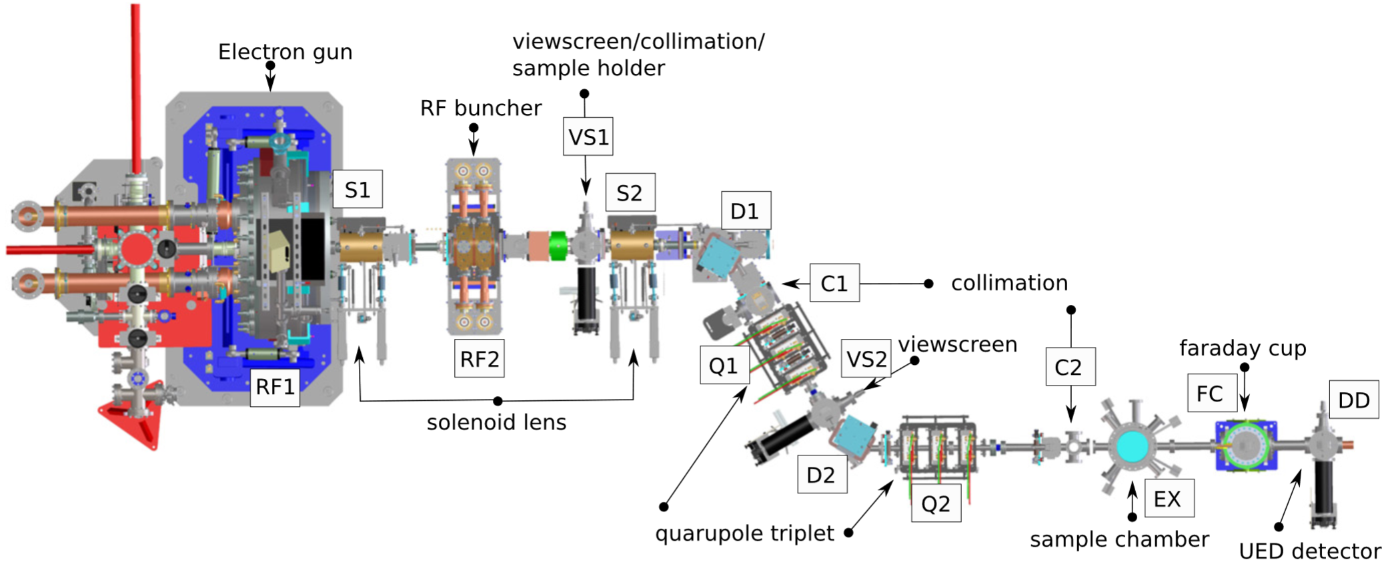
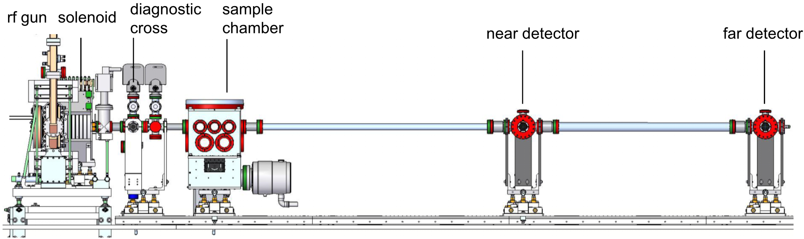
UED beamlines
Selection of setups
    LBNL UED beamline ‘HiRES’
      1 MHz
      E < 1 MeV
      APEX gun (cw)820 keV)
    SLAC UED beamline ‘ASTA’
      E ~ 3.7 MeV
      Rep. rate 120 Hz
      Liquid/gaseous samples

Slide 7
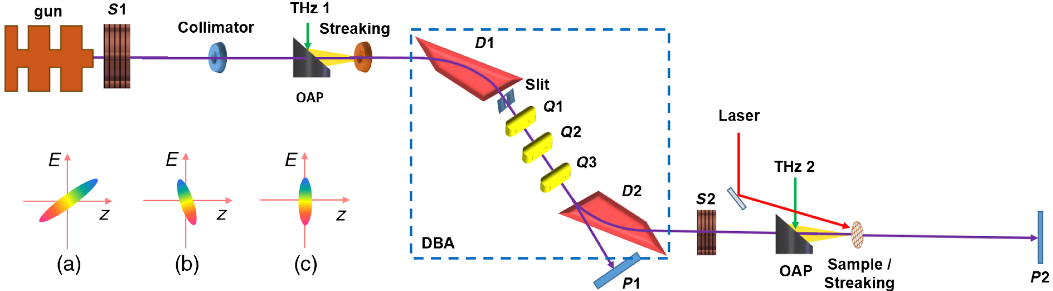
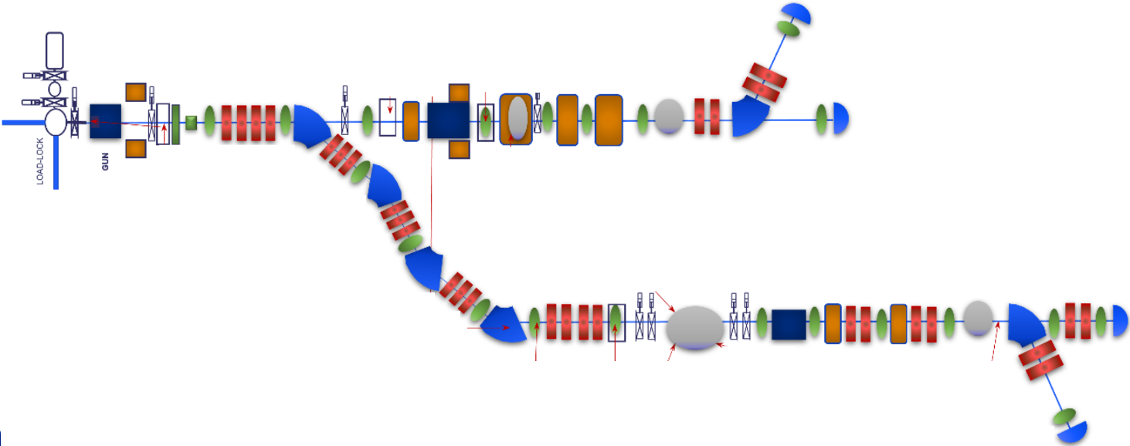
UED beamlines
Cont’d
    Shanghai Jiao Tong University
      S band gun (3 GHz)
      DBA optics
      Time resolution
        50 fs FWHM
    ‘RUEDI’
      Funding granted: 124 M£
      S band gun (3 GHz)
      Beamline for imaging & diffraction
Sample chamber
Imaging/Microscopy
Diffraction
Sample chamber

Slide 8
Within Helmholtz…

Slide 9
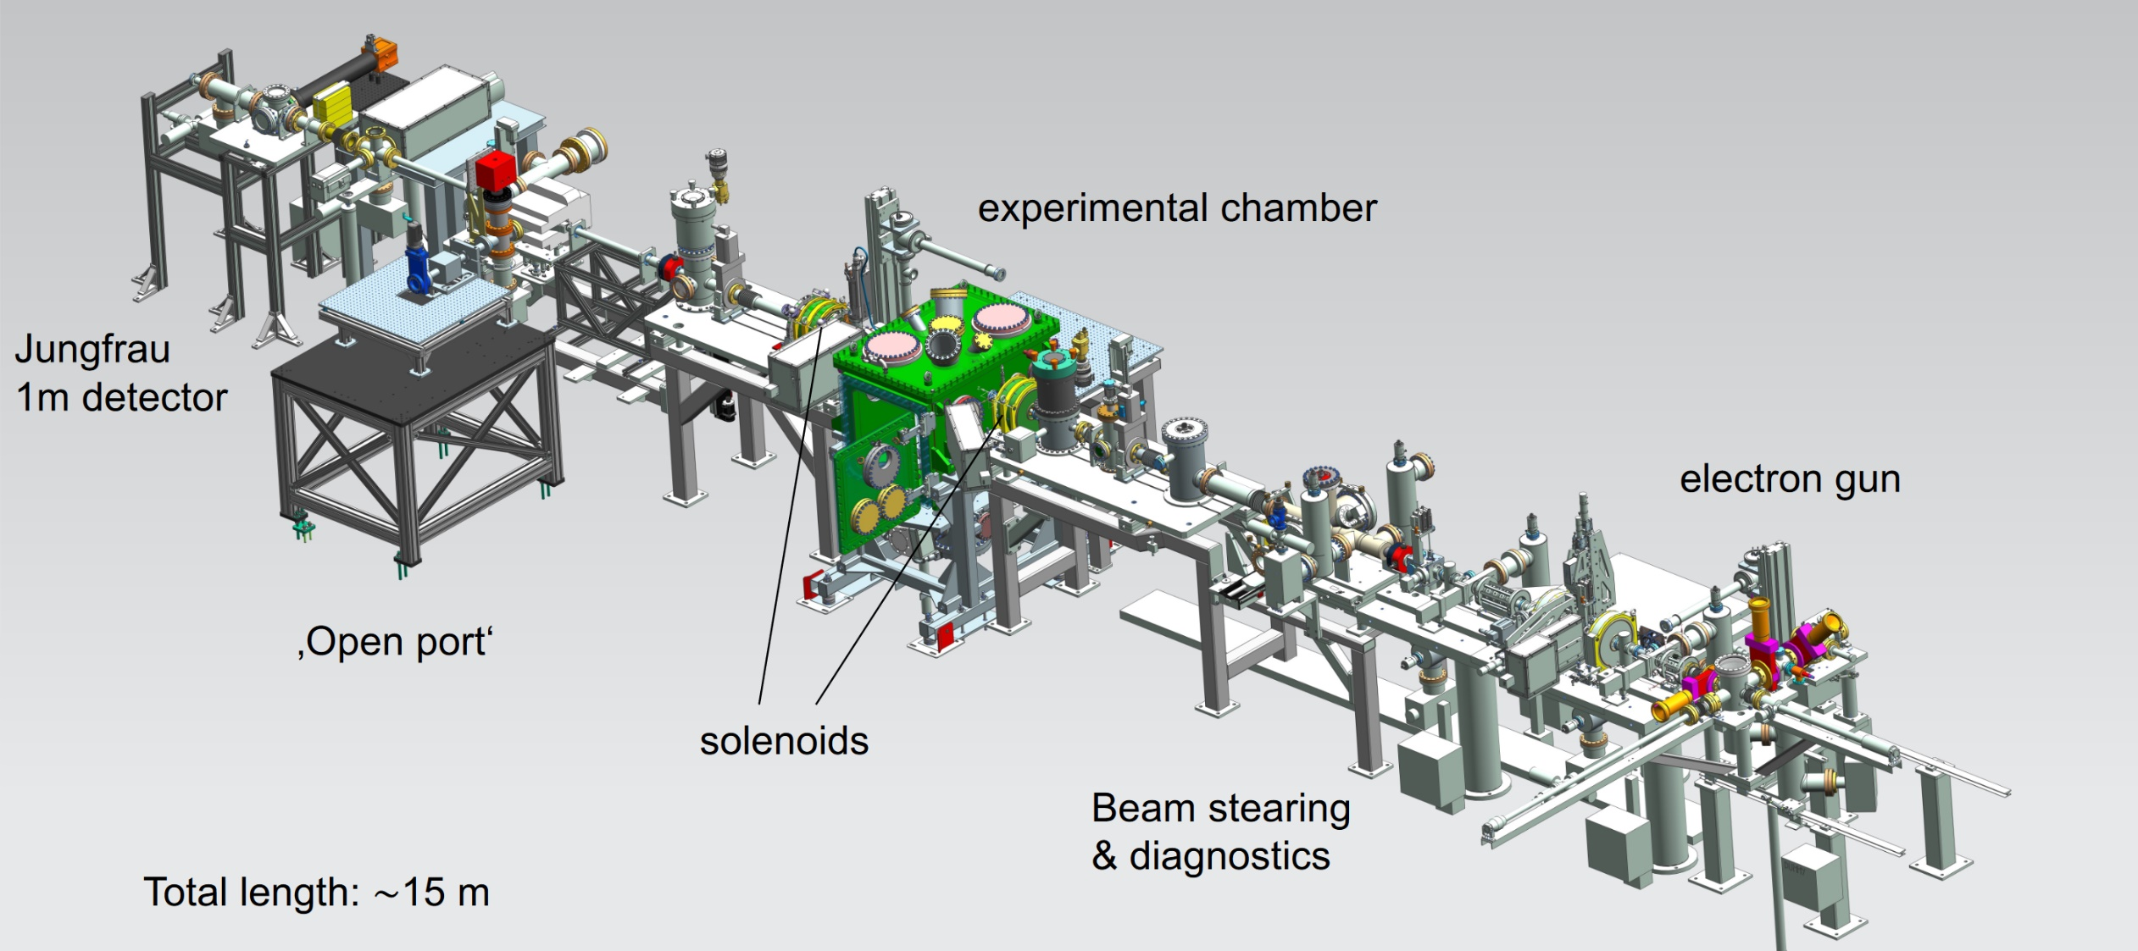
REGAE at DESY
Relativistic Electron Gun for Atomic Exploration
Average energy | 3 – 5 MeV
Energy spread | ~5 keV
Bunch charge | 10 – 200 fC
Bunch length | > 20 fs
Beam size | 5 – 500 µm
Trans. emittance | 10 – 100 nm

Slide 10
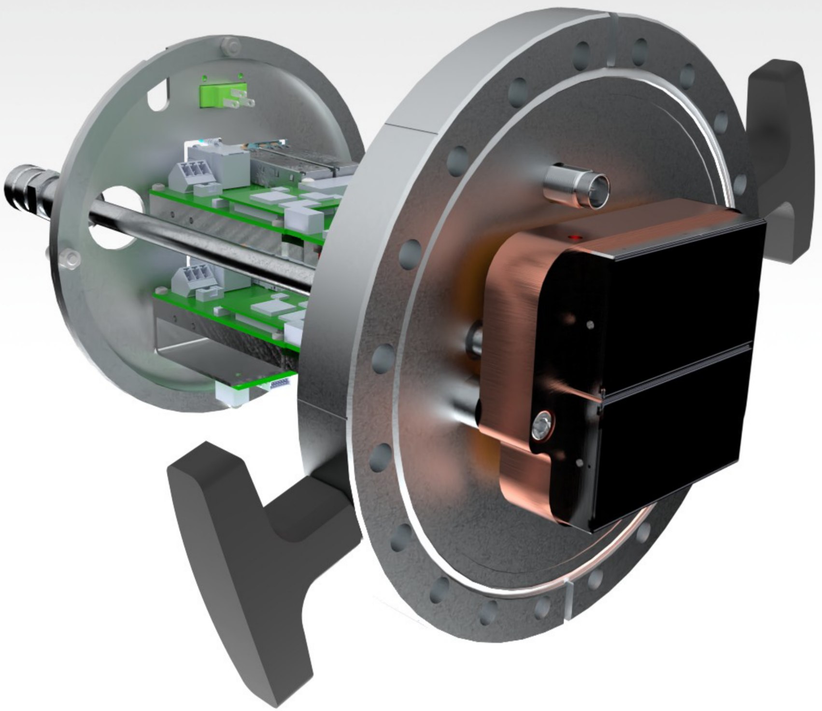
REGAE
Jungfrau 1M detector for direct electron detection
    Initially developed as X-FEL detector
      Detector group at PSI
    Direct electron detection
      Characterized at CLARA [1]
      Integrating detector
      High dynamic range (3 gain steps)
      ~10% absorption at 3 MeV
      Gate function for dark current suppression
    >10 times higher signal-to-noise ration that scintillator screen based detection
[1] E. Fröjdh et al., JINST 17 C12004 (2022)

Slide 11
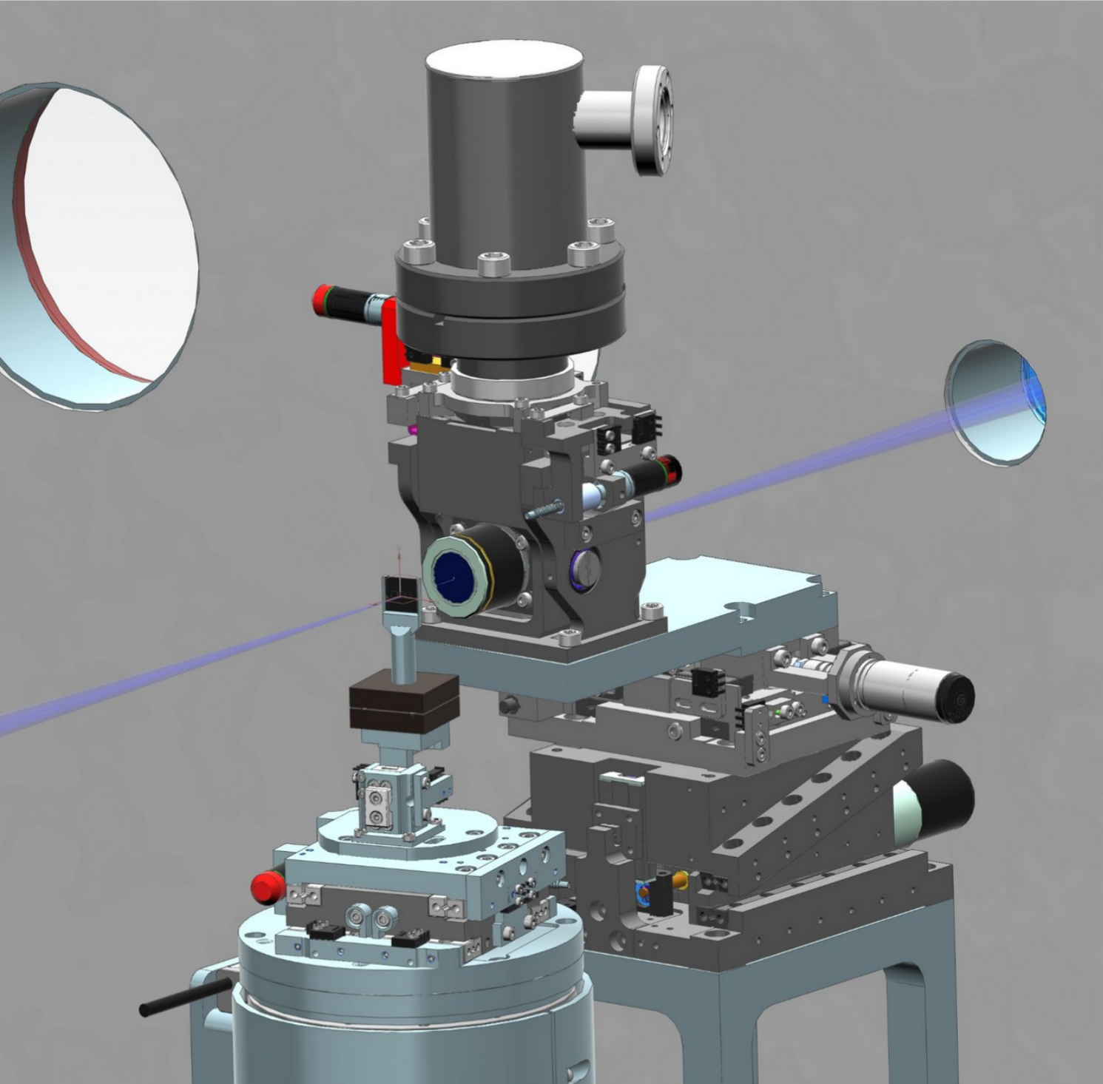
REGAE
Goniometer in sample chamber: e-Roadrunner
    Fully UHV compatible
    High-precision rotation axis
      Full 360 degree rotation
      Angular resolution: 0.0001 degree
    Centering stage:
      12 mm travel range in x,y,z
      Positioning accuracy of 1 µm
    Upgrade plans:
      Cryogenic sample cooling
      Robotic sample loading through load-lock system

Slide 12
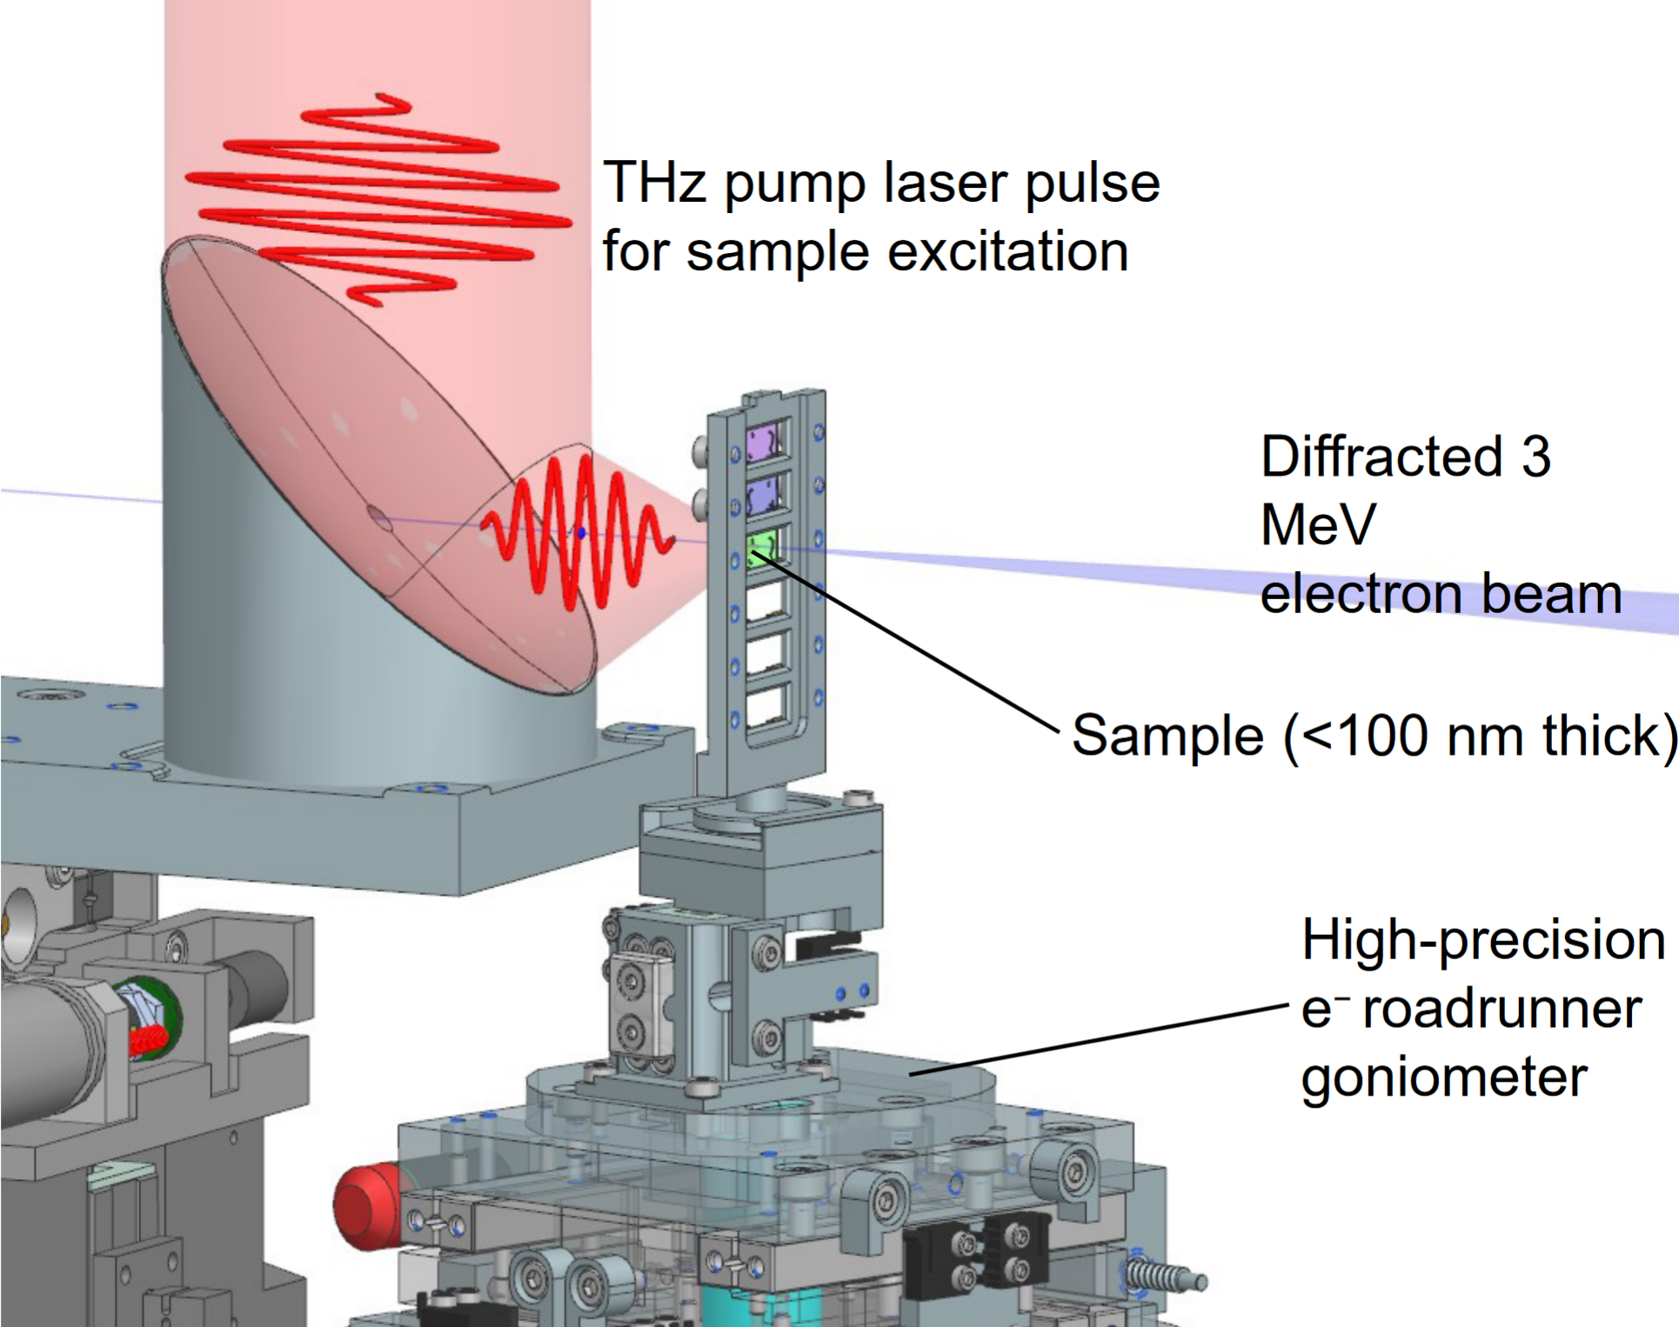
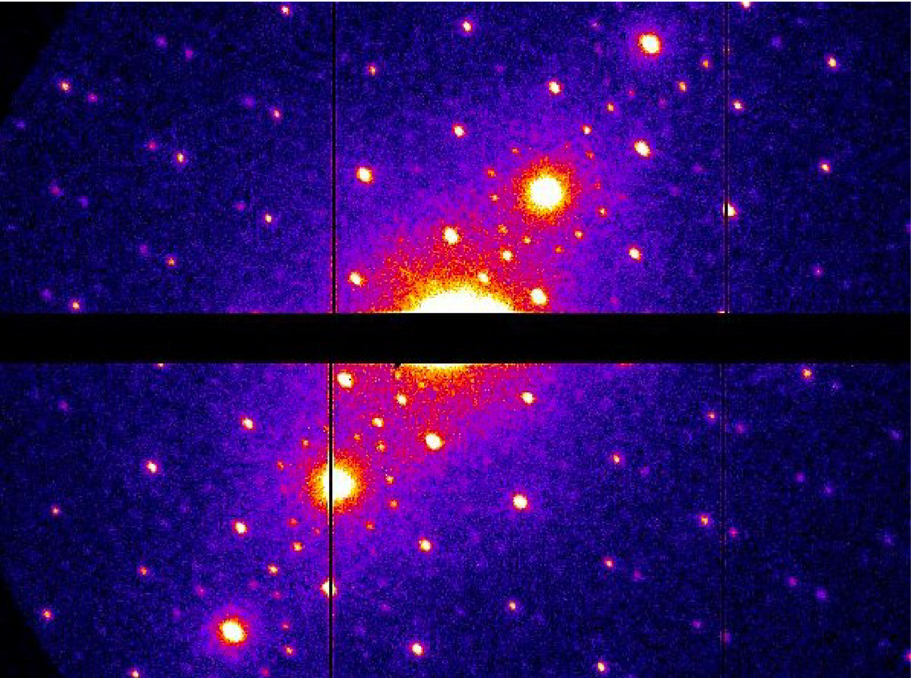
REGAE
Pumping possible with THz, IR, VIS, UV
3 MeV electron diffraction pattern of a TaS₂ sample, recorded at REGAE, showing superlattice reflections of a charge density wave

Slide 13
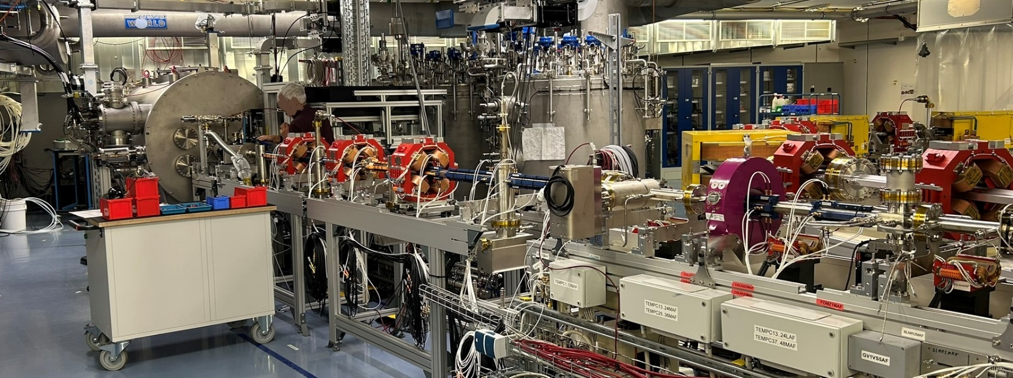
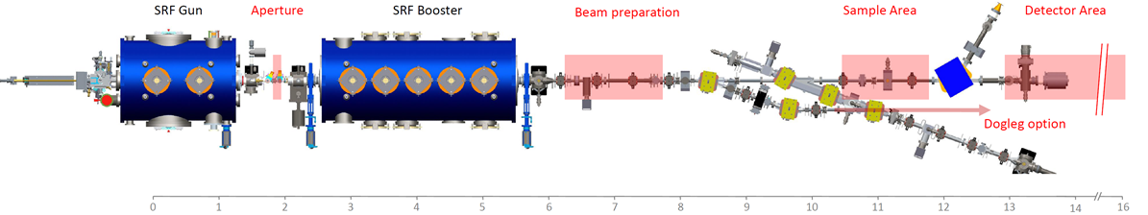
SEALab at HZB
Superconducting Electron Accelerator Laboratory
    Beamline for diffraction & imaging
      Optics developed
      Partners on-site/close
    SRF gun prepared
      Conditioning started
    First beam planned Oct./Nov.
Beam energy | 1 – 3.5 MeV
Max. avg. current | 2.5 µA
Bunch charge | > 50 fC
RF frequency | 1.3 GHz
RMS Bunch length | 0.02 – 2 ps
Trans. emittance | 30 nm

Slide 14
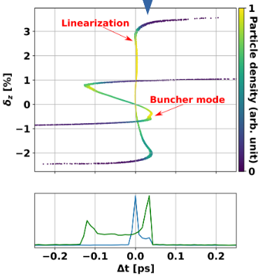
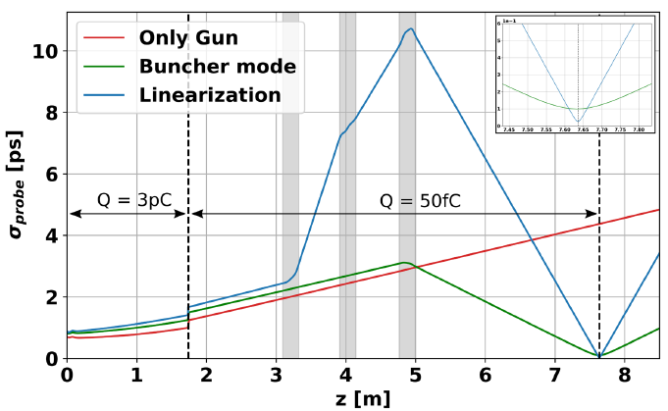
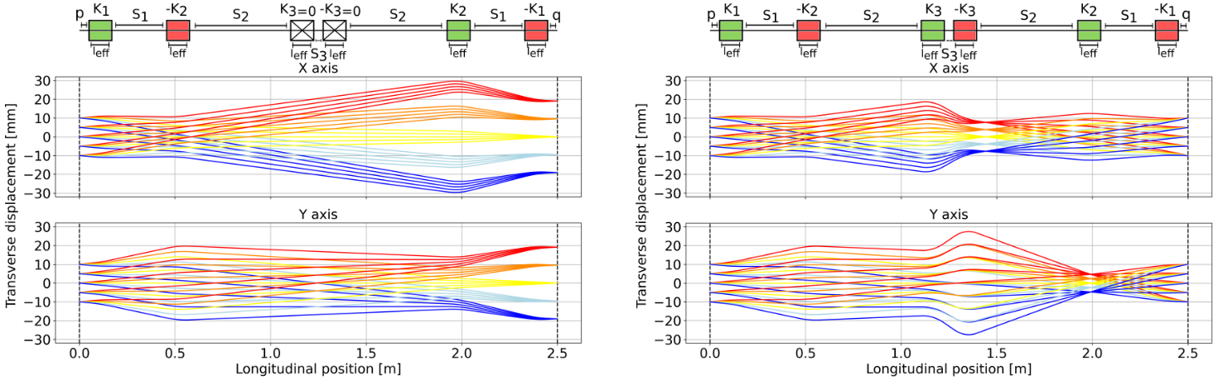
SEALab
Superconducting Electron Accelerator Laboratory
    Flexible accelerator & magnet system
      SRF gun & 3 booster cavities
    Allows strong bunch compression
    Allows jitter/TOF reduction
    Magnets allows quick change between imaging & diffraction
    Excellent setup for tests of beam dynamics, instrumentation, controls, & synchronization

Slide 15
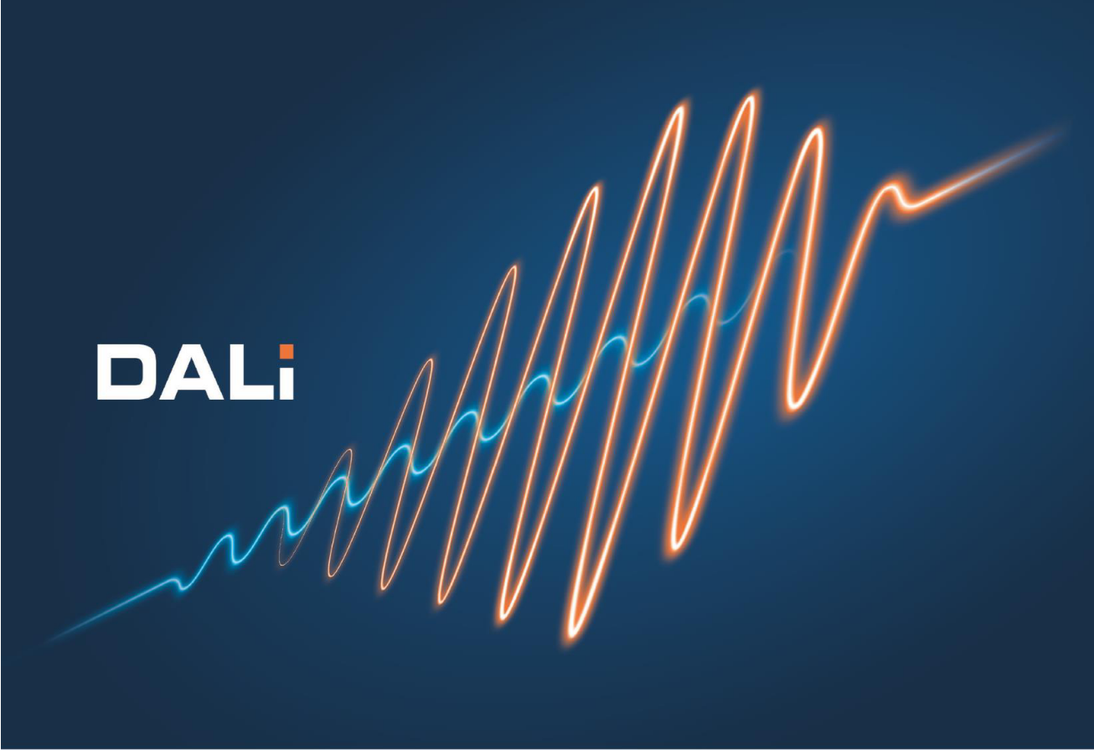
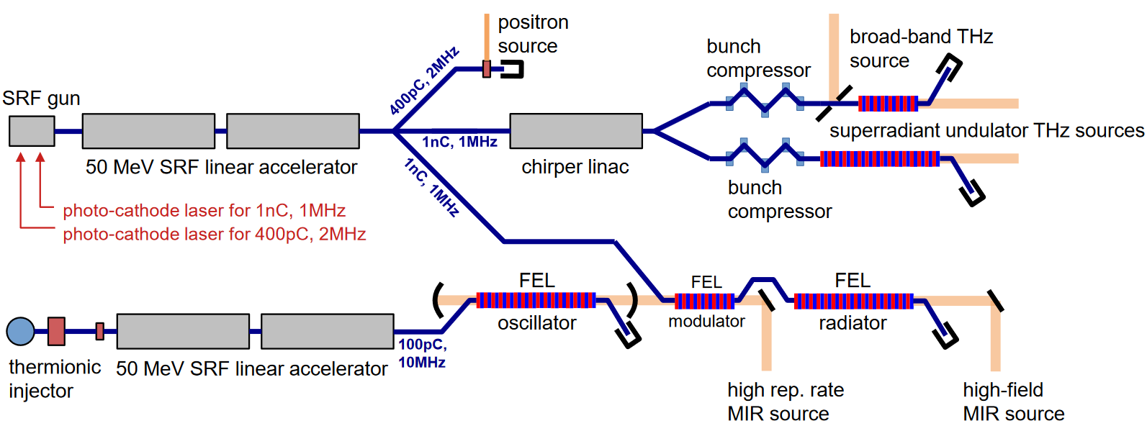
DALI at HZDR
Dresden Advanced Light Infrastructure
    DALI: Follow-up facility for ELBE
      Several THz sources
      Positron sources
      MeV UED

Slide 16

MeV UED at HZDR
Dresden Advanced Light Infrastructure
    THz & positron user facility DALI
    MeV UED instrument at DALI
      SRF Gun as electron source
      Probe lattice in superconducting states
      Addition: Liquid & gas-phase experiments
 | Superradiant MIR-THz | Broadband THz | MIR-THz FEL Oscillator
Wavelength range | 10 µm – 3 mm | 120 µm – 3 mm | 10 – 120 µm
Frequency range | 0.1 – 30 THz | 0.1 – 2.5 THz | 2.5 – 30 THz
Pulse energy | 100 – 1000 µJ | 100 µJ | 10 µJ
Repetition rate | 0.1 – 1 MHz | 0.1 – 1 MHz | 10 MHz
Pulse length (rms) | 0.2 – 15 ps | 0.2 ps | 1 – 25 ps
Bandwidth | 0.5 – 15 % | 100 % | 0.5 – 3.0 %

Slide 17
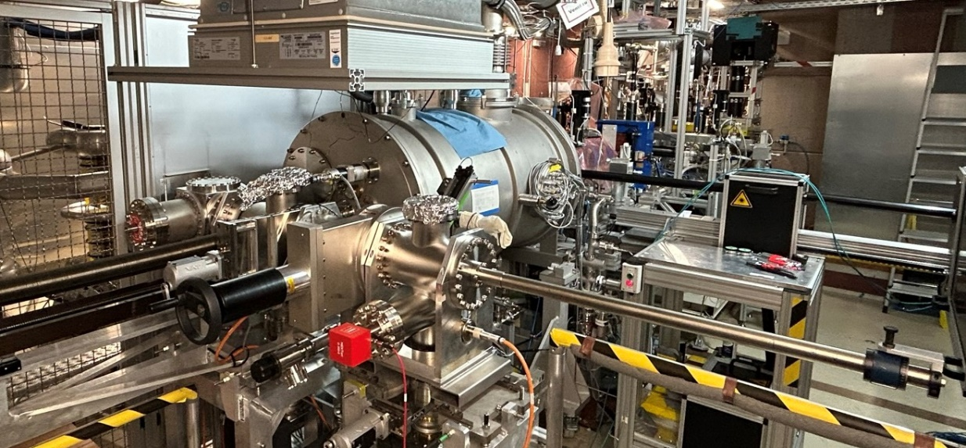
MeV UED at HZDR
ELBE
    SRF Gun tests for UED applications
    Gun characterization for UED settings
      Test samples installed
      Further UED upgrades in process
    Beam time limited by user operation
      Non-invasive experimental setup needed
        Standard cathode
        Laser beamline adjustments: small spot sizes
      Detector station
        EMCCD camera in purchase
Average energy | 3 – 6 MeV
Repetition rate | 1 MHz
Bunch charge | ~100 fC
Bunch length | 2.5 ps (rms)
Trans. emittance | 30 nm

Slide 18
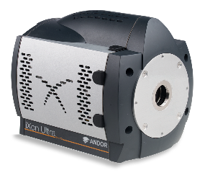
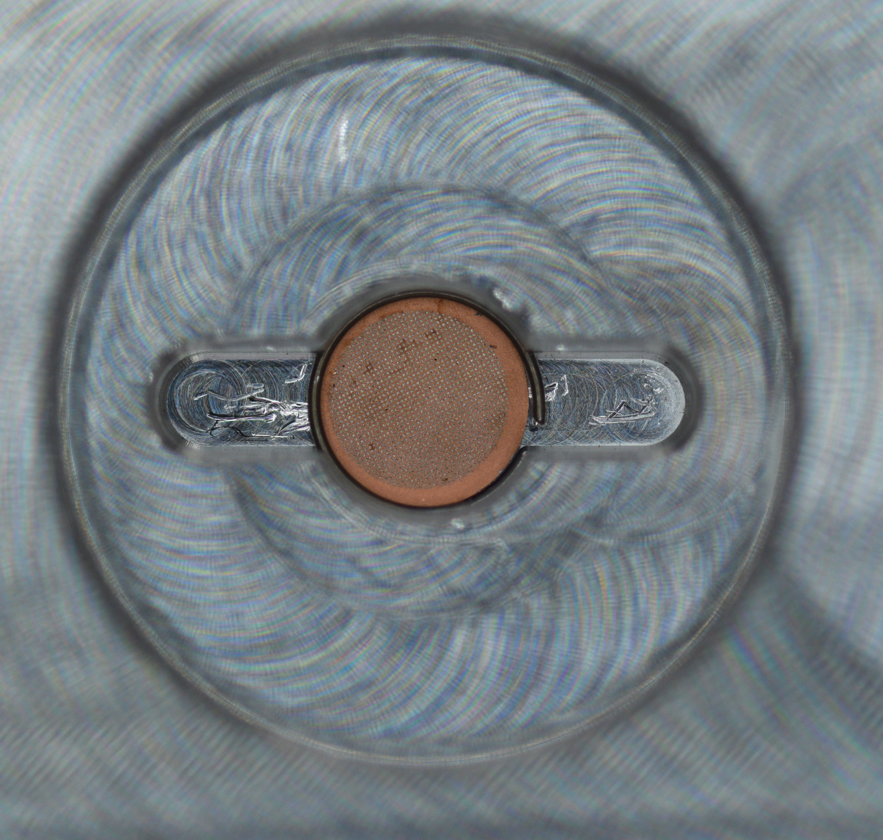
MeV UED at HZDR
Simulation: Test experiment at ELBE
    First experiments in diagnostics beamline
    No disturbance of user operation
      Only quick changes to laser beamline: 100 µm diameter
      No exchange of cathode possible: Cs₂Te
      Detector: Quick hardware exchange needed
    Static experiment: Long pulses okay
Screen station 3
Screen station 4
Screen station 1
SRF Gun II
Screen station 2
Quadrupole triplet
Solenoid

Slide 19
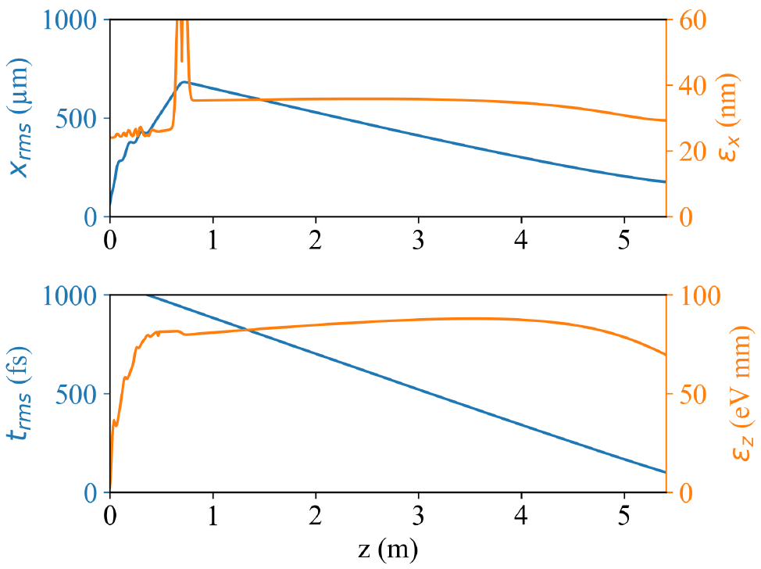
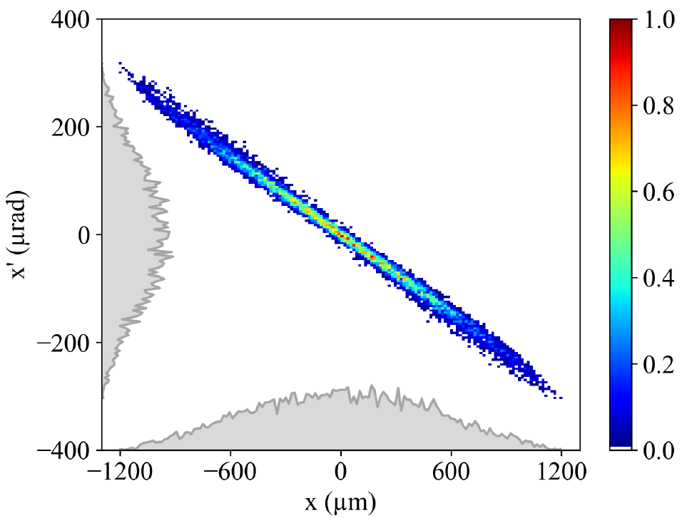
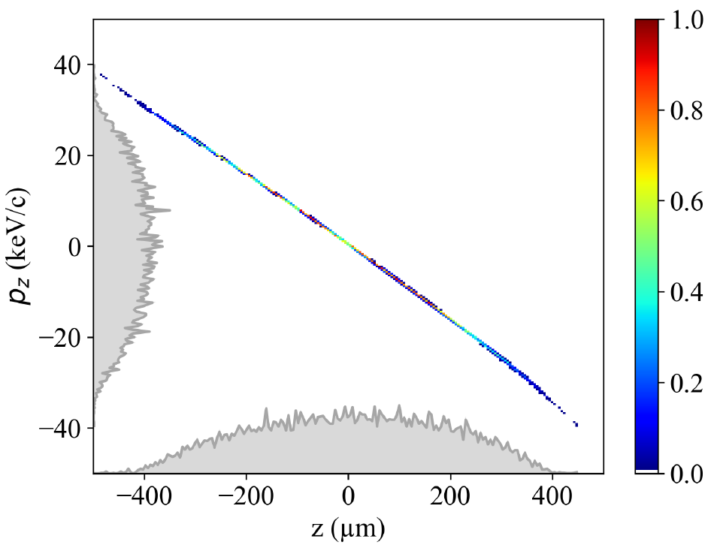
MeV UED at HZDR
Simulation: Test experiment at ELBE
    ASTRA simulations
      30 MV/m peak gun gradient
      2.5 ps (rms) laser pulse length
      100 µm diameter (Cs₂Te)
      100 fC
    Only solenoid, no extra quadrupole focusing
    Gun at off-crest phase
      Check bunching capabilities
      Short bunch at detector possible
    Linearity in phase spaces
      Stronger focus possible
z = 2.41 m
z = 2.41 m
ε = 36 nm
σ = 480 µm

Slide 20
Summary
UED summary
    UED activity at DESY, HZB, & HZDR
      Coordination, but only few people
      Different statuses
      REGAE: Strong push towards user operation
    Synergies with photo injectors
      Cathode gradient
      Mean transverse energy
      Repetition rate
      Stability
    Synergy with synchrotrons & XFELs: Detectors

Slide 21

Outlook
UED outlook
    UED user workshop next week
      Develop & cultivate user community
    Open goals:
      Bunch length & profile measurement
      UED time resolution: Towards 5 fs? 1 fs?
        Most stable machine needed
    Machine optimization: AI applicable
      Fewer knobs & lower beam power
Thanks to
Klaus Flöttmann & Alke Meents
Thorsten Kamps
J. Michael Klopf
UED user workshop

Slide 22
    Contact
    Helmholtz-Zentrum Dresden-Rossendorf
    www.hzdr.de
    Raffael Niemczyk Institut für Strahlenphysik r.niemczyk@hzdr.de +49 (0) 351 260 2205

Slide 23
Detectors and instrumentation
UED summary
    Jungfrau 1M for detection of diffraction image
      Excellent for now, development in long future needed
    TDC and THz streaking for bunch length/profile
    Arrival time correction
    Improve time resolution?

Slide 24
Introduction
Comparison of electron diffraction with other methods
    MeV UED vs. x-ray diffraction
      Scattering cross section: 10⁵ higher
      Shorter wavelength: 0.3 pm vs. 100 pm
      Size, cost, access
    MeV UED vs keV UED
      Higher brightness & charge
      At speed of light: Higher time resolution
      Penetration depth
        Allows for thicker (100 nm) samples

Slide 25
Ultrafast Electron Scattering
Pros & cons: Compared to x-rays
    Many high-brightness injectors in Germany
      Local expertise
      Parameters differ
    Compact facilities
    Beam manipulation ‘easy’
    Space charge limits electron bunch density
    X-ray detectors usable for MeV UED
      Jungfrau 1M

Slide 26
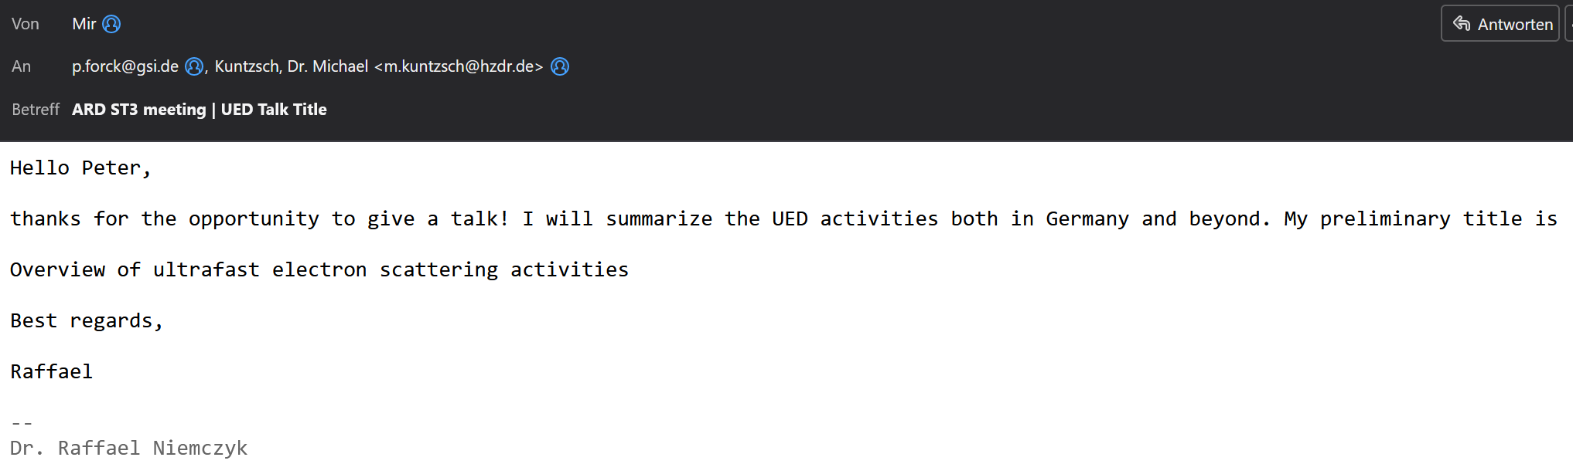
Goal of my talk
For Raffael
    Convince H. Schlarb of tasks within POV V
    Give people overview of UED activities
    Show what DESY, HZB, and we are doing
    Diffraction detection is good with Jungfrau 1M detector
    THz streaking/ bunch length measurements next best thing
      No strong user community
    Quick change between imaging and diffraction mode seems interesting for users

Slide 27
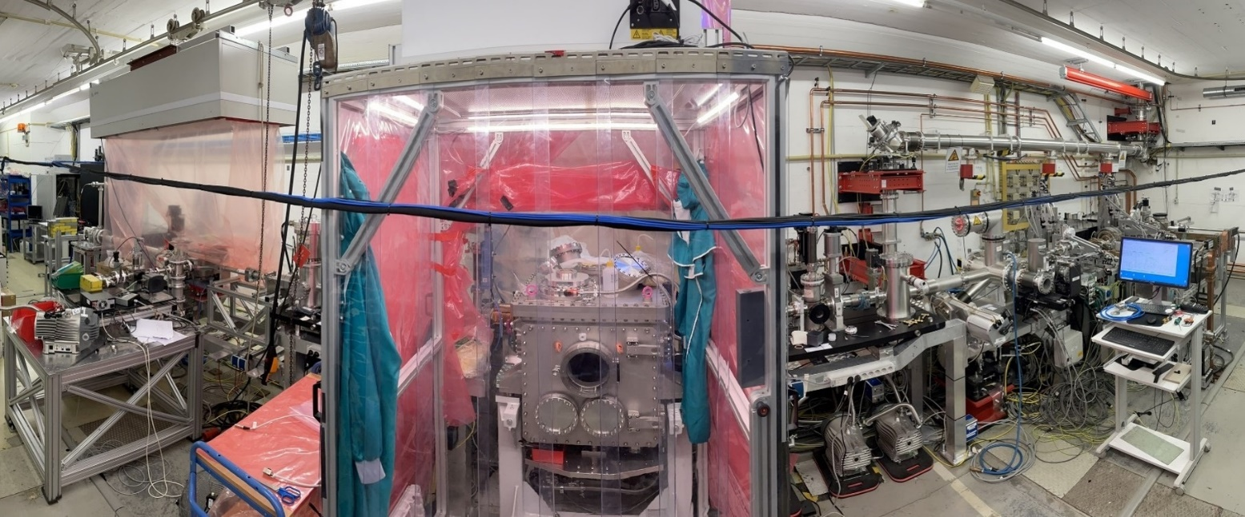
REGAE
Relativistic Electron Gun for Atomic Exploration
    Located at DESY
    Burst-mode S band gun, buncher, TDC
      Electron diffraction
      Time-resolved microscopy
      THz streaking
Average energy | 3 – 5 MeV
Energy spread | ~5 keV
Bunch charge | 10 – 200 fC
Bunch length | > 20 fs
Beam size | 5 – 500 µm
Trans. emittance | 10 – 100 nm

Slide 28
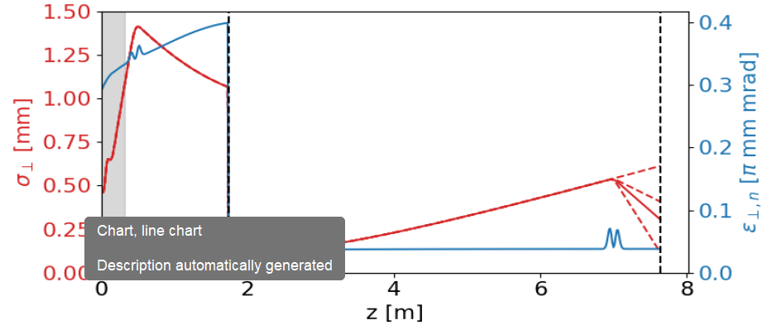
SEALab
Superconducting Electron Accelerator Laboratory
    dsafasdfasdf

Slide 29
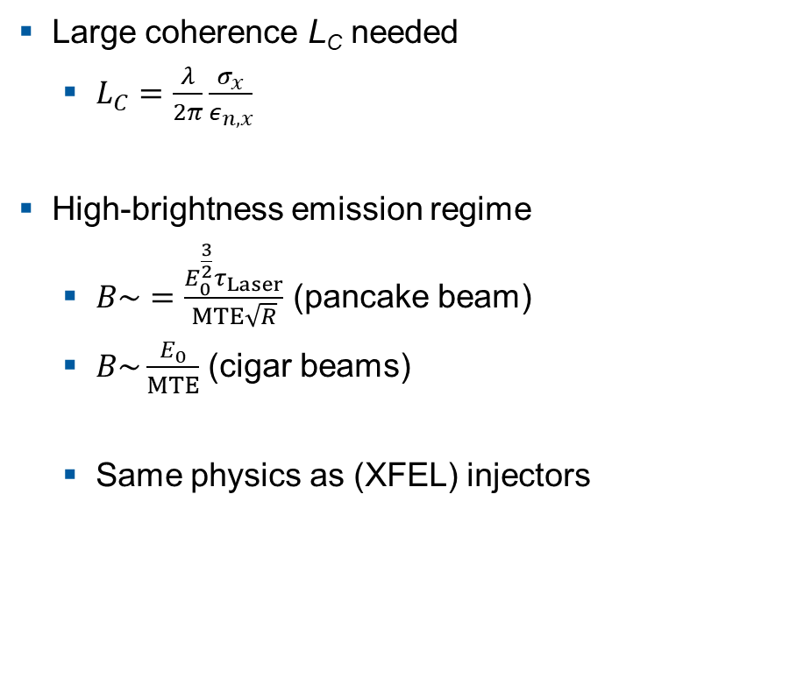
Ultrafast Electron Scattering
Pros & cons
    Large coherence L_{C} needed
      $L_{C}=\frac{λ}{2π}\frac{σ_{x}}{ε_{n,x}}$
    High-brightness emission regime
      $B\sim =\frac{E_{0}^{\frac{3}{2}}τ_{Laser}}{MTE\sqrt{R}}$ (pancake beam)
      $B\sim \frac{E_{0}}{MTE}$ (cigar beams)
      Same physics as (XFEL) injectors

Slide 30
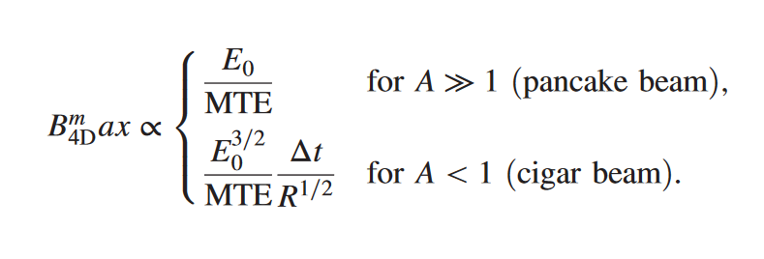

Ultrafast Electron Scattering
Pros & cons
    Large coherence L_{C} needed
      $L_{C}=\frac{λ}{2π}\frac{σ_{x}}{ε_{n,x}}$
    High-brightness emission regime
      $B=\frac{E_{0}^{\frac{3}{2}}τ_{Laser}}{σ^{2}\sqrt{R}Δz}$
      $B=\frac{E_{0}}{σ^{2}Δz}$
      Same as (XFEL) injectors

