Slide 1
Detector Development Particle Physics at DESY
Ties Behnke
Ties Behnke
First PIER Detector Workshop, June 1, 2023

Slide 2
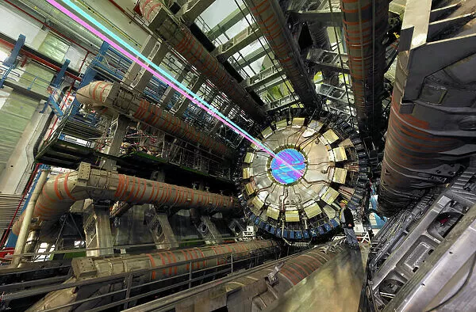
Detectors and Particle Physics
Detectors are central elements of the science we do Detectors are enablers of break-through science
Detectors drive technology with a broad impact far beyond our research

Slide 3
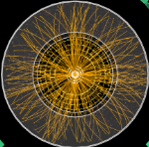
Detector R&D at DESY FH
Preparing tomorrows experiments
LHC Experiments
Very complex events
Very high multiplicities
Hostile environment
Higgs factory
Much simpler events
Lower multiplicity
Benign environment
Precision
Granularity
Low material
Low power
High speed
LHC 12 TeV collision
ILC event display, 250 GeV

Slide 4
Detector R&D at DESY FH
Preparing tomorrows experiments
LHC Experiments
Very complex events
Very high multiplicities
Hostile environment
Higgs factory
Much simpler events
Lower multiplicity
Benign environment
Dark Matter Searches
Axion Experiments
QED Experiments (LUXE)
Gravitational Wave experiments
Precision
Granularity
Low material
Low power
High speed
LHC 12 TeV collision
ILC event display, 250 GeV

Slide 5
What is required
Defining goals
Detector Requirements
Physics Studies
Impact parameter resolution
σ(d₀) < 5 ⊕ 10 / (p[GeV] sin^{3/2}θ) μm
Transverse momentum resolution
σ(1/p_{T}) = 2 x 10⁻⁵ GeV⁻¹ ⊕ 1 x 10⁻³ / (p_{T} sin^{1/2}θ)
Jet energy resolution
3-4% (around E_{jet} ~100 GeV)
Hermeticity
θ_{min} = 5 mrad
~ LHC / 2
H→bb,cc,ττ
Total σ(e+e-→ZH)
Z/W/H→jj; H→invisible
H→invisible; BSM
Future collider experiments
Spatial resolution
Granularity to enable particle flow
Speed
~ LHC / 10
~ LHC / 2
~ LHC / 3
ALPS II experiment
Single photon detection
Extreme sensitivity
Extreme background supression
Dark Matter/ Axion searches
Extreme sensitivity
Low background
Stable operation

Slide 6
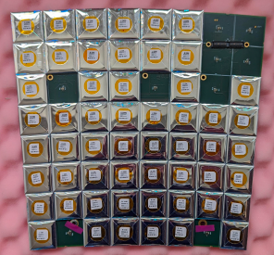
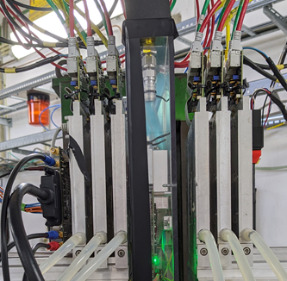
Particle Physics at DESY
Silicon tracking detectors
Granular calorimeters
A strategy for detectors
Technology Openness
Quantum Detectors
Test and integration center
Software and Simulation
Data handling and transfer

Slide 7
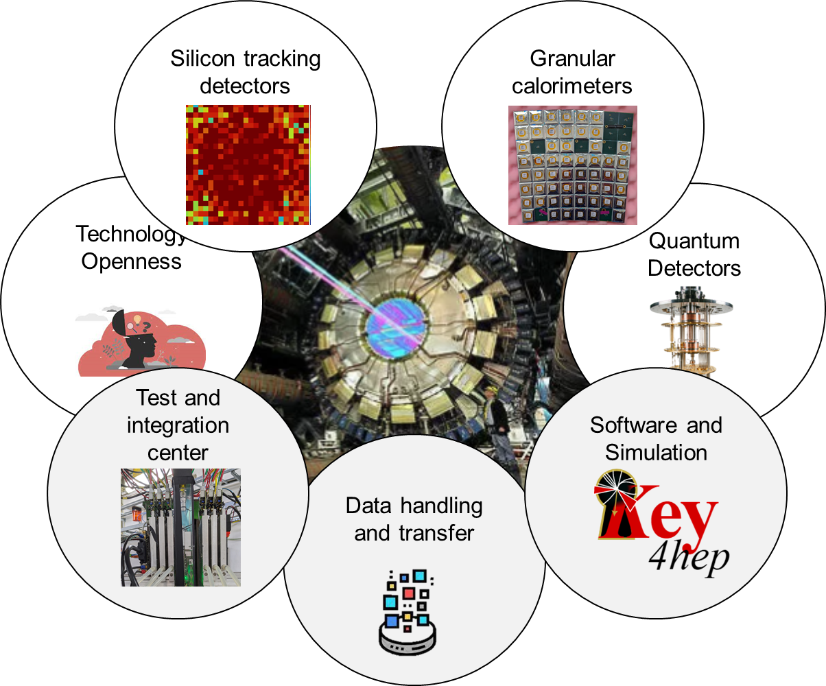
Particle Physics at DESY
A strategy for detectors
DESY Astroparticle Physics
DESY Photon Science
DESY M Division
Detector R&D Collaborations

Slide 8
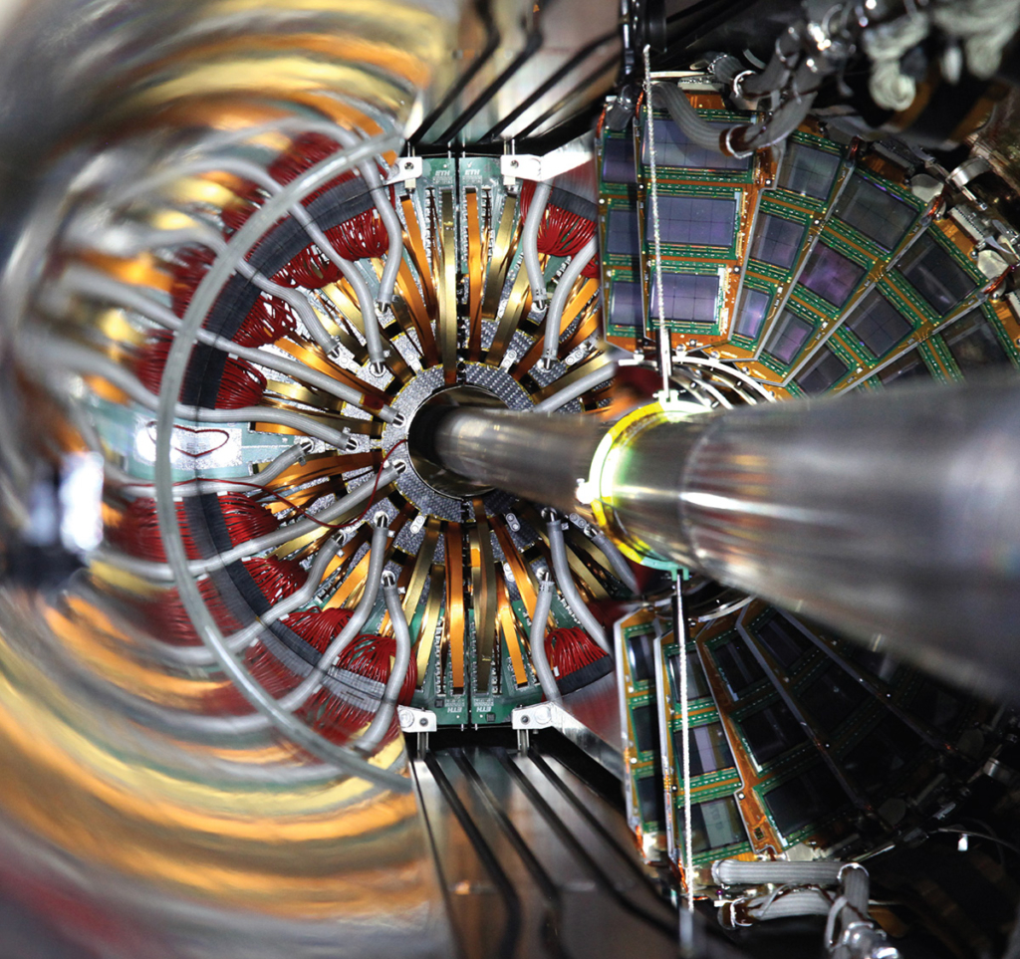
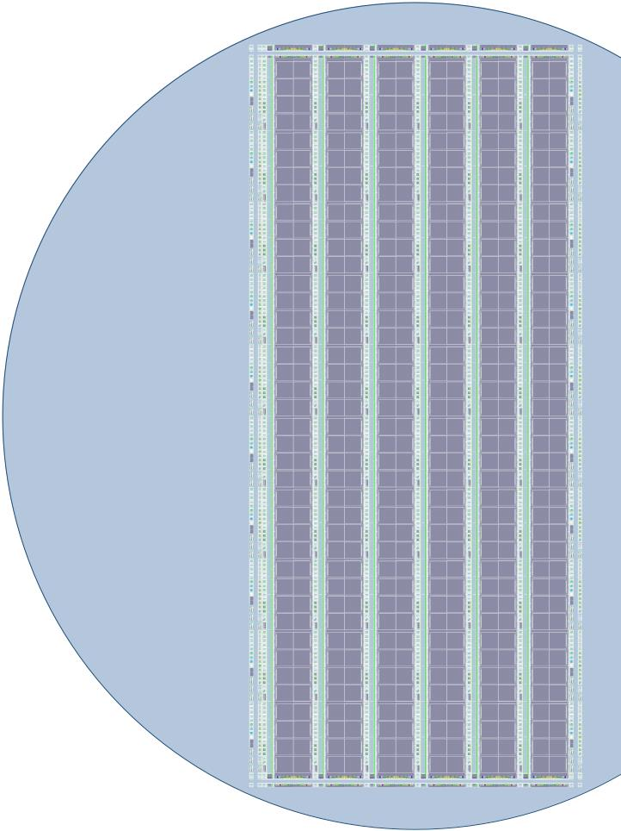
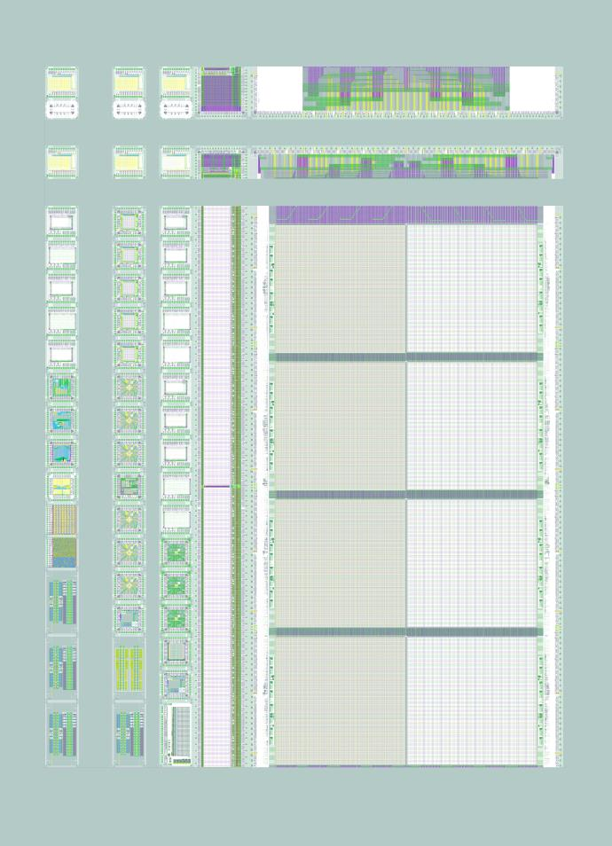
Pixel detector of the next generation
Preparing now for the tomorrows science
Next generation pixel detectors:
Excellent resolution
Good timing
Low material
Limit the data rate
cheap
Tangerine project:
Pathfinder project towards the next generation
MAPS sensor based on 65nm imaging process
Collaboration with CERN
Extensive simulations now being validated with testbeam data from first prototypes
New prototypes H2M, D-I, D-II expected back from dicing within next weeks

Slide 9
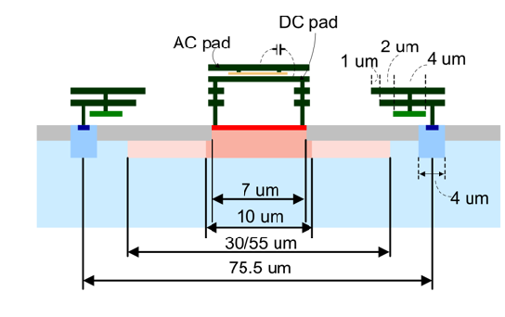
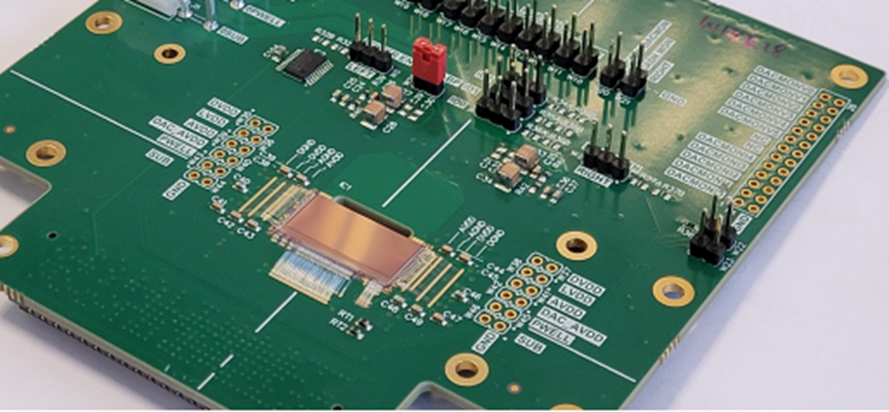
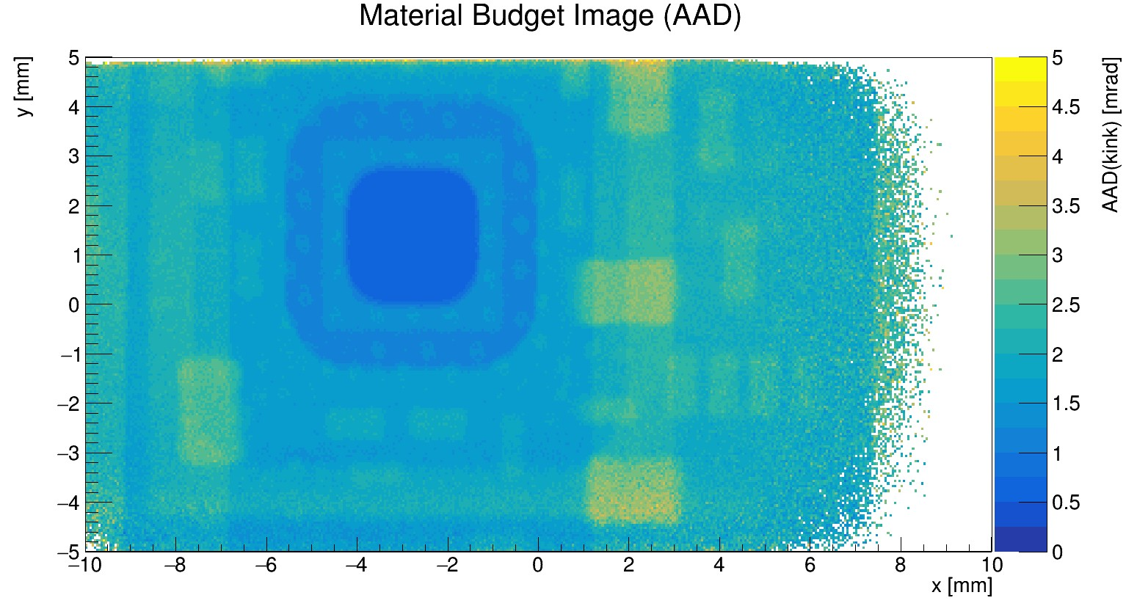
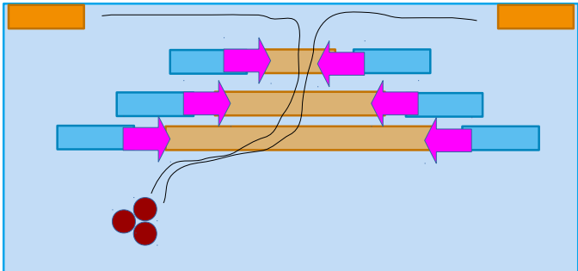
Technology openness
Looking into alternatives
Explore several alternative technologies
Geared towards specific applications
Explore new concepts
Remain technology open
List is not complete
Passive CMOS
strips
“simple” design
Low local power
Low dose implant strip design
MALTA2:
128 nm technology
Pixel detector
Radiation hard
Digital SiPM
Monolithic Silicon PM
Timing
ELAD sensor
Breaking the pixel-size problem
Conceptual development

Slide 10
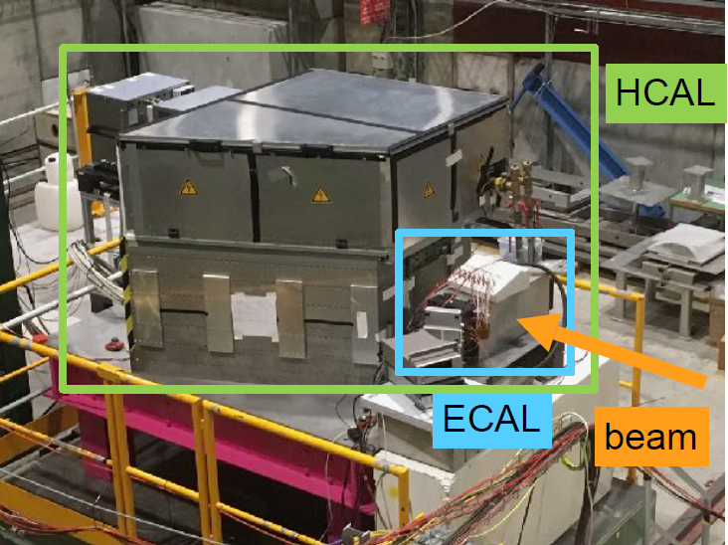
Granular Calorimeter
Particle flow as the method of choice for future detectors
Requires highly granular systems
DESY has a long history and leadership position in SiPM-on-tile calorimeter systems (CALICE)
Topic of strategic importance for any future HEP experiment
Strong expertise at DESY
Application to the CMS upgrade
Technology is used in nearly all future collider proposals

Slide 11
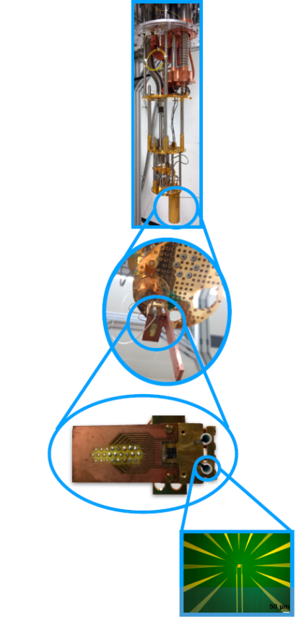
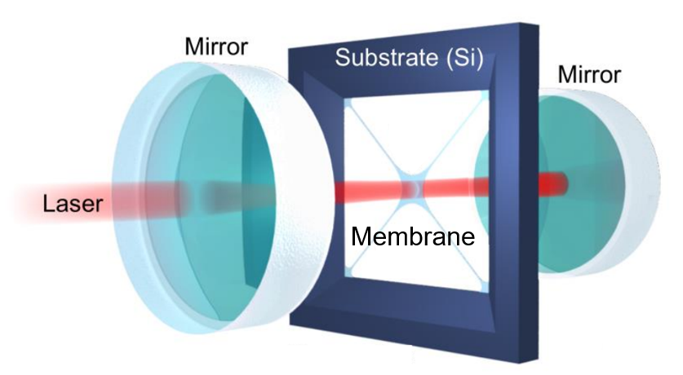
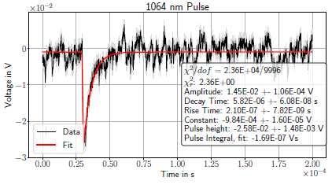
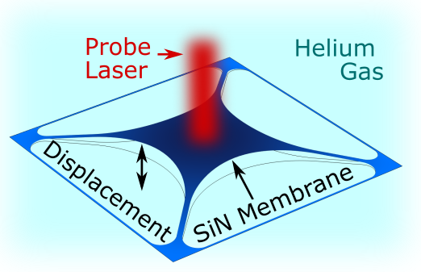
Quantum Detectors
Transition Edge Sensor systems
Extemely low dark rates
Single photon detection: 1/day
Application: ALPS
direct dark matter search
HF gravitational wave search
measurements for quantum computing
Fundamental research
Detector for gravitational waves
Probe membrane movement at extreme precision inside optical cavity
Application as pressure sensor of unprecedented precision (10 decades range)

Slide 12
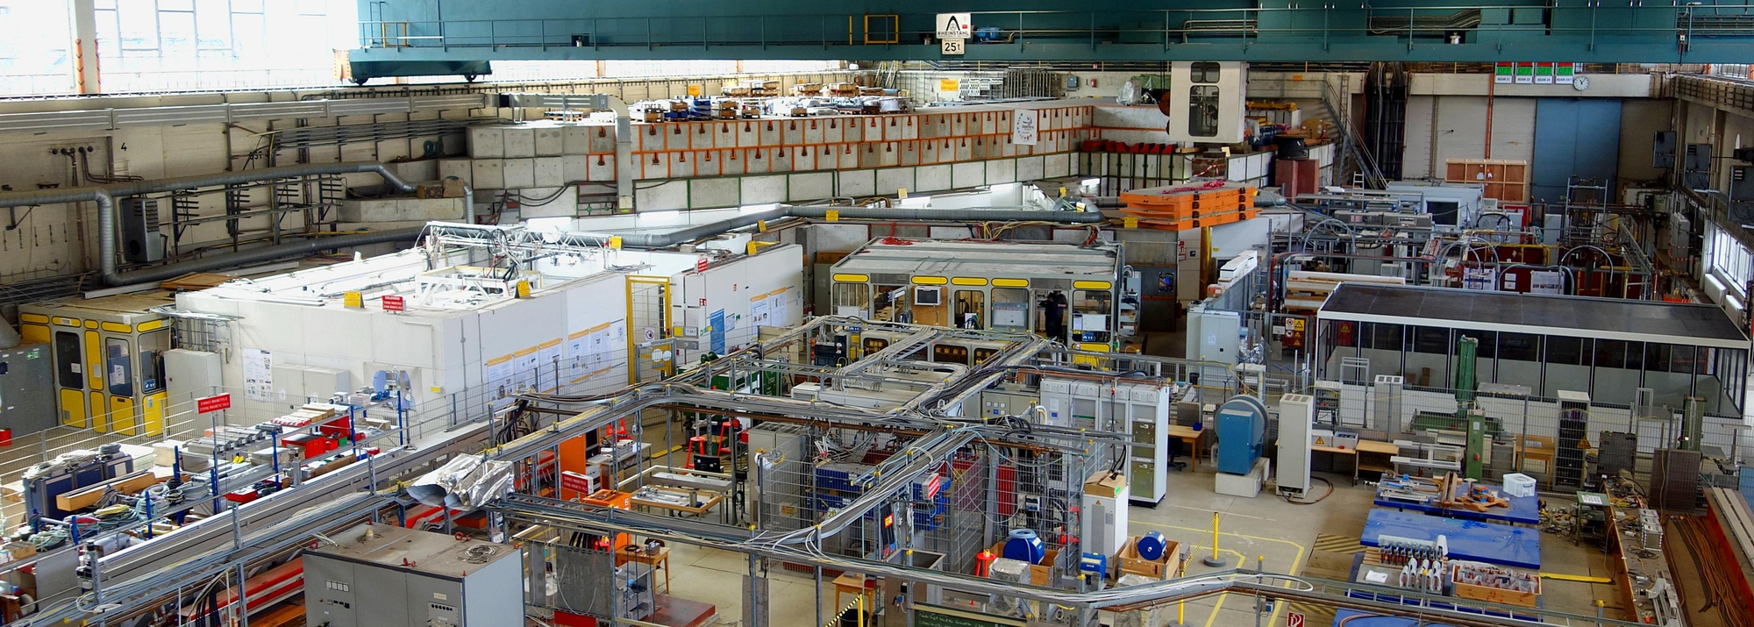
Infrastructures
Make things possible
DESY test beam
Detector assembly facility
Detector development needs infrastructures
DESY provides a broad range of infrastructures which are relevant for detector R&D
Detector assembly facility – test beam – work shops – technical support

Slide 13
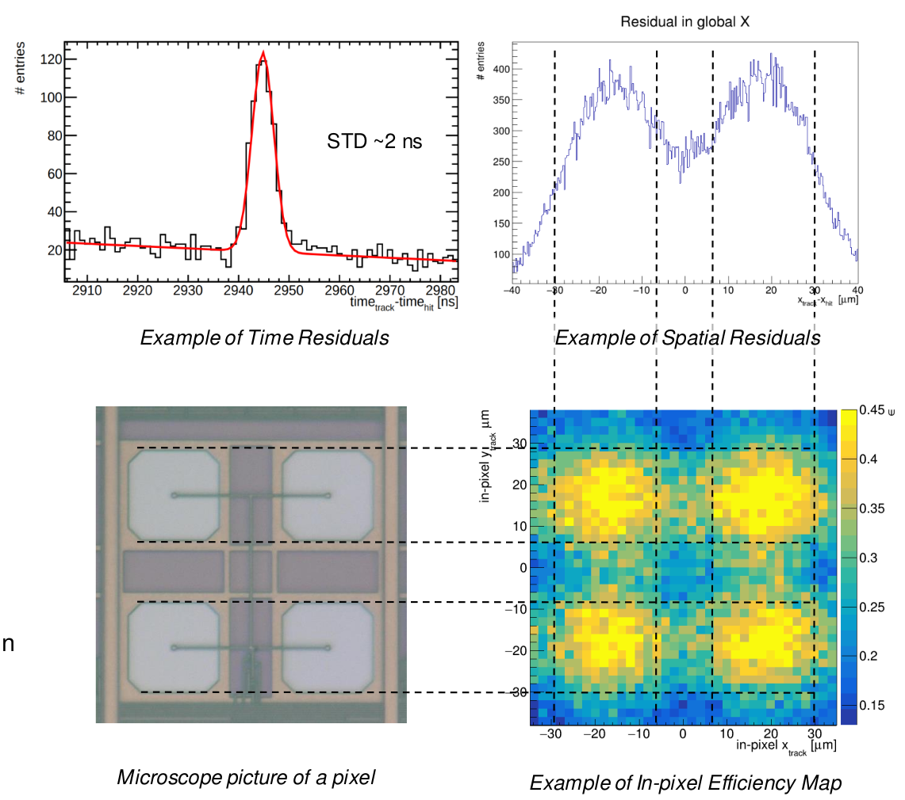
Software
Tools are infrastructures
Allpix²
Corryvreckan
Framework for test-beam
Many packages
Simplify reconstruction of test-beam data
allpix2 as a general simulation Package for Silicon detectors
Growing user community
Common software as a forum to discuss simulation methods and issues

Slide 14
The Detector Platform
Communication
Coordination
Development
Dissemination
Innovation
The next step
Combine all detector development activities within particle physics under one roof: FH detector platform
Liaise centrally with other players on the campus: DESY other divisions, UHH, etc.

Slide 15
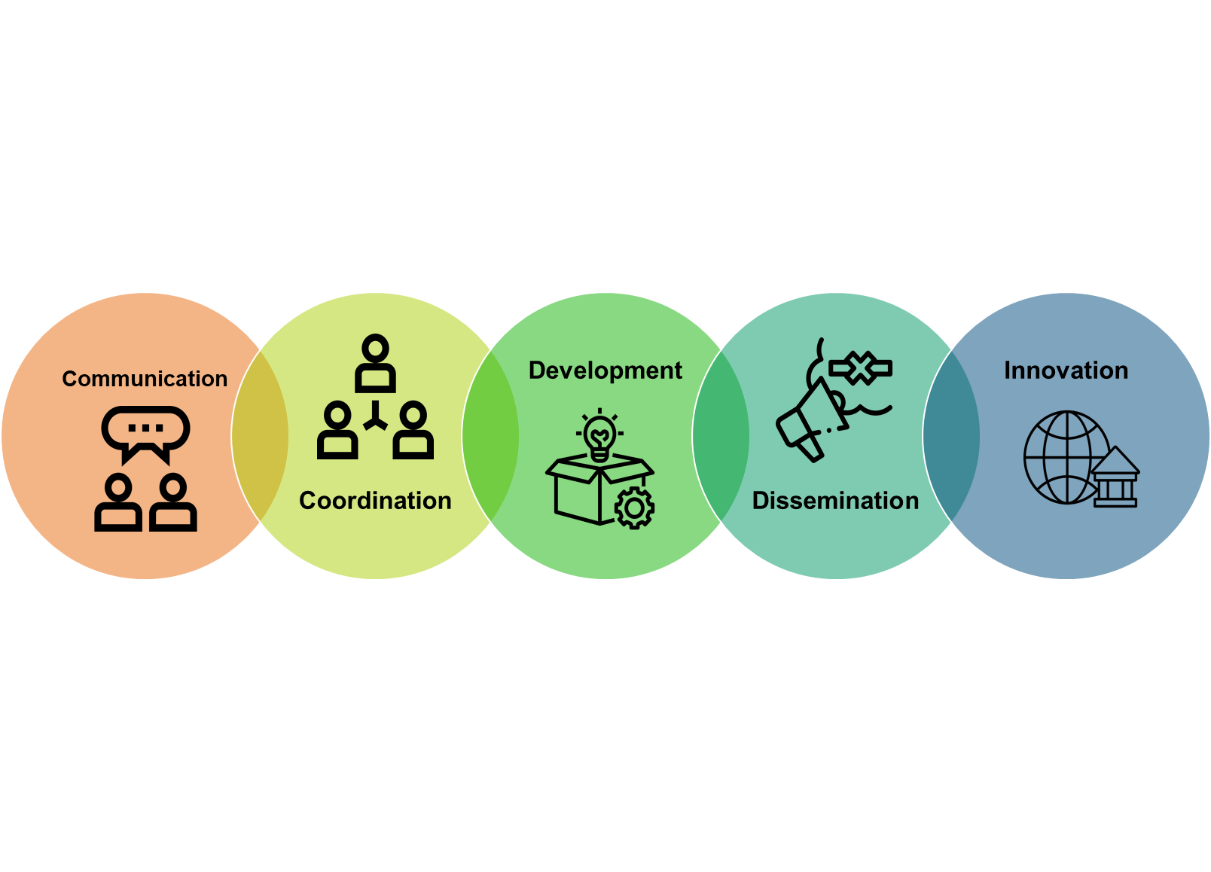
Detectors at DESY FH
A coherent effort by DESY FH to prepare for the future
Detector platform central element of the strategy
Strategic R&D Focus of effort on few technologies
High resolution Silicon pixel detectors
High granularity calorimeters
System competence
Important contributions to strategic experiments
Participation in future collider program
Strong on-site program with specific technological demands

Slide 17
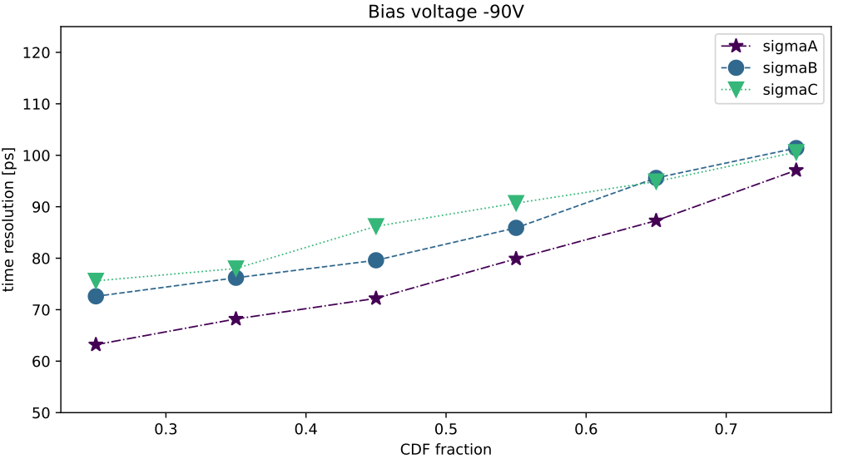
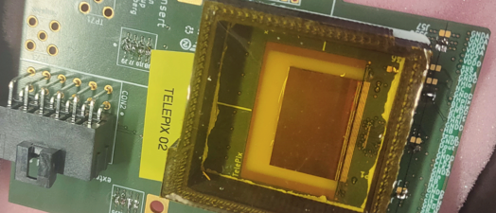
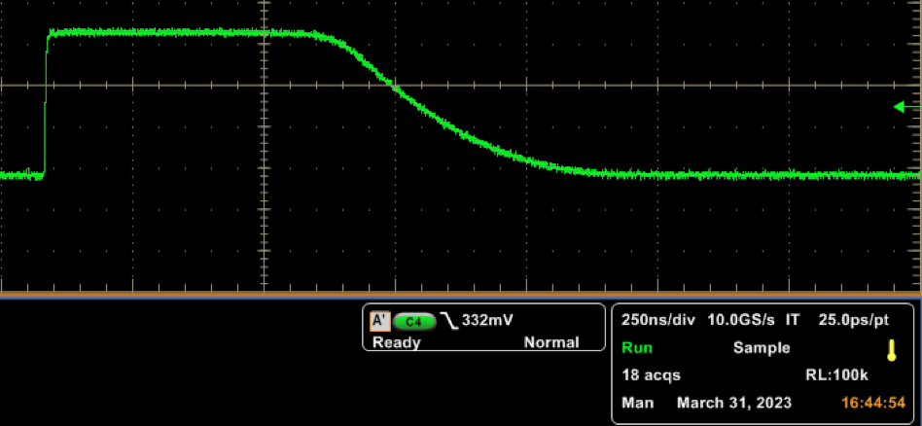
Test beam instrumentation
Test beam telescopes as a demonstrator platform
Add timing capabilities to the test beam telescope
TelePix2 chip as first order timing
- HV CMOS sensor
- 4ns tagging ok
PRELIMINARY
Testbeam data
Pixelated LGAD (55 um, timepix3/4 readout)
Goal: construct a plane for the test-beam telescope to provide excellent timing to the user

Slide 18
The Detector Platform
Communication
Coordination
Development
Dissemination
Innovation
The next step
‘12
‘18
Matter and Technologies
DESY 2030
FTX formed
Det Task Force
Det Platform
‘19
‘21
‘23

Slide 19
FH Detector Platform
Communication
FH Platforms for Detector R&D
Within FH, the activity “Detector R&D” is of high relevance for the scientific research done within the division, connects to most of the FH groups, offers large synergies with the other DESY science divisions, and has great promise for technology development for society at large. This activity will benefit from a new horizontal structure across the FH groups - henceforth called “platform for detector R&D” - to foster the development of ideas and solution of problems through sharing of expertise.
The overarching goal of the platform is to foster communication and strengthen the technological development in the areas of detector development across the boundaries of the FH groups and to foster stronger connections to scientists in the other divisions. All activities that could aid to achieve this should be considered.
The success of the platforms depends crucially on a close integration and cooperation with the different FH groups, who contribute to the platforms.

Slide 20
Detector Platform
Coordination and Development
In detail, the charge the DetRD platforms is to
Define priorities within DetRD, in relation e.g. with the European Strategy of Particle Physics, the HGF MT topic, the other DESY divisions and the promise for both research and technology development.
Coordinate the activities in the area of DetRD across the FH groups, in close cooperation with the relevant FH groups.
Liaise with the relevant program structures within the Helmholtz association (in particular DTS and DMA in MT, and MU), with other DESY divisions, potentially with activities at partner universities (especially UHH), and with DESY ITT on the topics of innovation and technology transfer.

Slide 21
Detector Platform
Dissemination
Act as a central point-of-contact for people interested to participate in the technical developments within FH, coordinate funding applications (Helmholtz, third party, ..)
Organise scientific events in the field of detector R&D
Develop a coherent career development plan for instrumentation scientists and provide mentoring to early-career scientists in these areas.
Maintain a list of bachelor / master / Ph.D. student opportunities that can be used for recruitment purposes.
The platform is represented by two coordinators
The platform is part of the FH divisional structures and communication stream
The platform controls some resources for detector R&D, personnel however remains in the groups

Slide 22
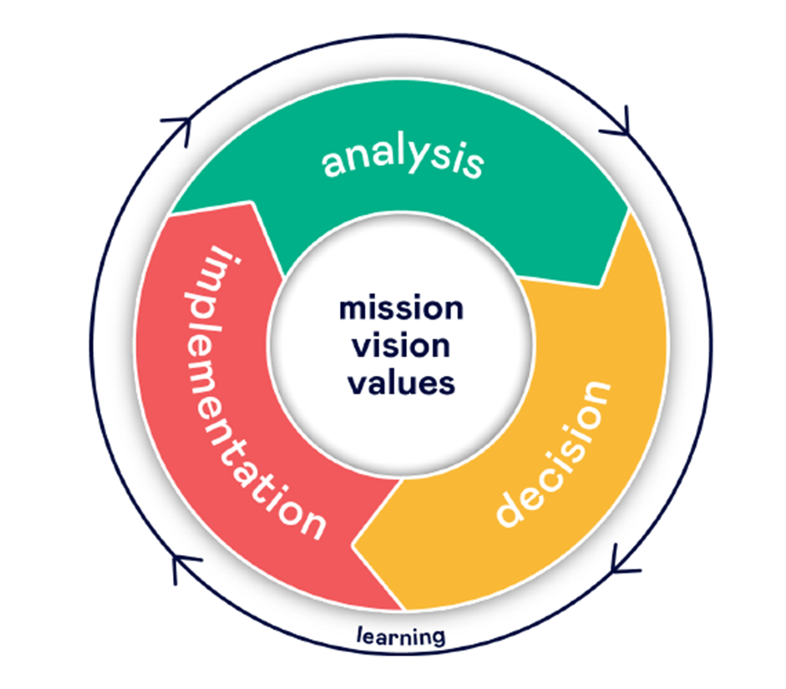
Detectors at DESY FH
Where are we
Our Ambition:
Outstanding competence in our capability to design and build complex detector systems (60%)
Leadership in selected technological areas which are needed to address our science program (30%)
Retain a level of agility in the technologies and system aspects we work on to be able to identify quickly newly emerging areas of technologies and science relevant for detectors. (10%)
Our Selling Points:
Demonstrated system competence
Access to technologies and services
Access to unique infrastructures: testbeam, DAF, …
Our Strategy:
Monolithic active Silicon Pixel Detectors: technological priority
Technological lead in SiPM – on – tile Systems
Detector integration center
Fast Data transfer: Silicon photonics
Expertise in key interconnect technologies
Expertise in other detector technologies: cryogenic detectors, others

Slide 23
A Silicon Strategy in the making
Monolithic as a choice
Ultimate goal: A tracking sensor with superb spatial resolution (< 10 um single hit resolution) and excellent timing resolution (O(100 ps)) at low power consumption
Main technological direction:
Monolithic CMOS technology
65nm as a promising technological development
Explore alternatives
Current phase: exploratory R&D, different directions will converge towards a common system
Additional focused developments where required by the science
Example test beam telescopes

