Slide 1
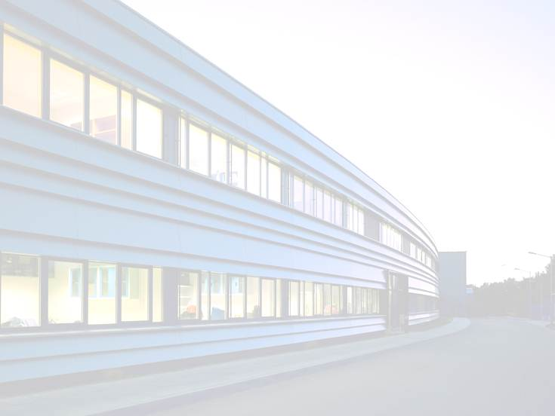
PIER - Partnership for Innovation, Education and Research

Slide 2
Partnership for Innovation, Education and Research
Strategic partnership between DESY and Universität Hamburg (UHH), established in 2011
Aim is to foster cooperation through joint projects, joint appointments, workshops, seed funding schemes…
Focuses on four future-oriented research fields and two interdisciplinary competence areas
PIER
Research and Competence Areas
Particle and astroparticle physics
Nanoscience
Photon science
Infection and structural biology
Accelerator research
Theoretical physics

Slide 3
PIER Structure
PIER Commission
Leading management representatives of DESY and UHH
PIER Executive Board
Senior DESY and UHH scientists
PIER Office
Staff employed by either DESY or UHH
PIER Scientists
DESY and UHH scientists (PhD level to senior scientist)
Notes:
Commission: consists of leading management representatives of DESY and UHH and is in charge of all strategic and long-term decisions
PIER Commission meetings take place once a year. In addition, there are the so-called “Austauschtreffen”, exchange meetings, between members of the DESY directorate and the UHH Präsidium and MIN faculty that are more informal and that take place about four times a year.
Executive Board: consists of senior DESY and UHH scientists from the PIER research and competence fields; responsible for the operational decisions and activities of PIER
Board meetings take place every approximately every two months, so six times a year.
PIER Office team: staff conceptualize and carry out events and activities according to the decisions of the PIER Executive Board; take care of all administrative matters concerning PIER
PIER Scientists: DESY or UHH researchers from the PIER research and competence fields can register as PIER Scientsts. They are regularly informed about PIER calls, services, and events by email. Registration as a PIER Scientist is a prerequisite for any PIER Idea Fund application.

Slide 4
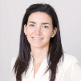
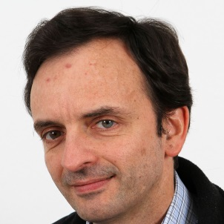
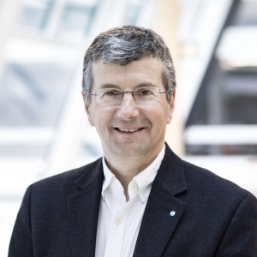
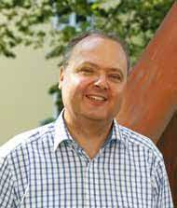
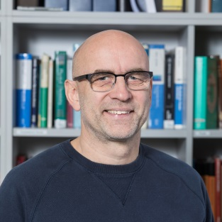
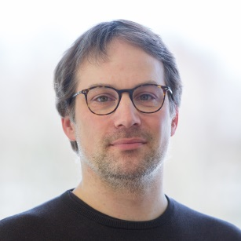
PIER Executive Board
Head of the PIER Executive Board
Prof. Francesca Calegari
(DESY)
Particle and astroparticle physics
Accelerator research
Dr. Ties Behnke
(DESY)
Prof. Günter Sigl
(UHH)
Prof. Wim Leemans
(DESY)
Prof. Wolfgang Hillert
(UHH)
Infection and structural biology
Theoretical physics
Prof. Markus Glatzel
(UKE)
Prof. Chris Meier
(UHH)
Prof. Volker
Schomerus (DESY)
Prof. Michael
Thorwart (UHH)
Photon Science
Education
Prof. Francesca
Calegari (DESY)
Prof. Andreas
Hemmerich (UHH)
Prof. Daniela
Pfannkuche
(UHH)
Nanoscience
Innovation
Dr. Saša Bajt
(DESY)
Prof. Alf Mews
(UHH)
Prof. Nils Huse
(UHH)

Slide 5
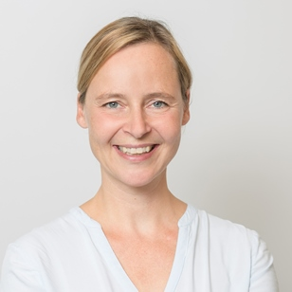
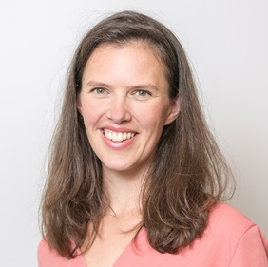
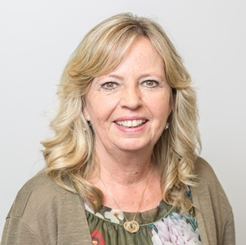
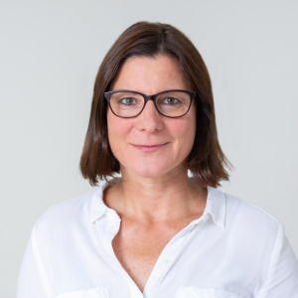
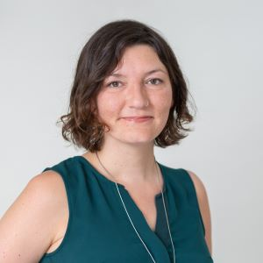
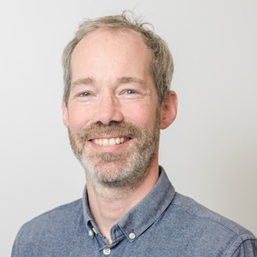
PIER Office Team
 | PIER boards (organization and preparation of PIER Commission and PIER Executive Board meetings) PIER Research (Seed Projects calls, administration of PIER Idea Fund) PIER Innovation (organization of startup workshops and seminars…) PIER International (HH-MIT/BOS project…) General PIER topics…
 | PIER Education: PIER Helmholtz Graduate School (PHGS) PIER Education Platform (PEP)
Dr. Marion Stange
Coordinator PIER
Franziska Klink
Administrative Coordinator PIER
Gaby Keidel
Team Assistent
Stefanie Tepass
Lead Coordinator
PHGS
Sinikka Seidl
Team Assistent
Mirko Siemssen
Skills Trainings

Slide 6
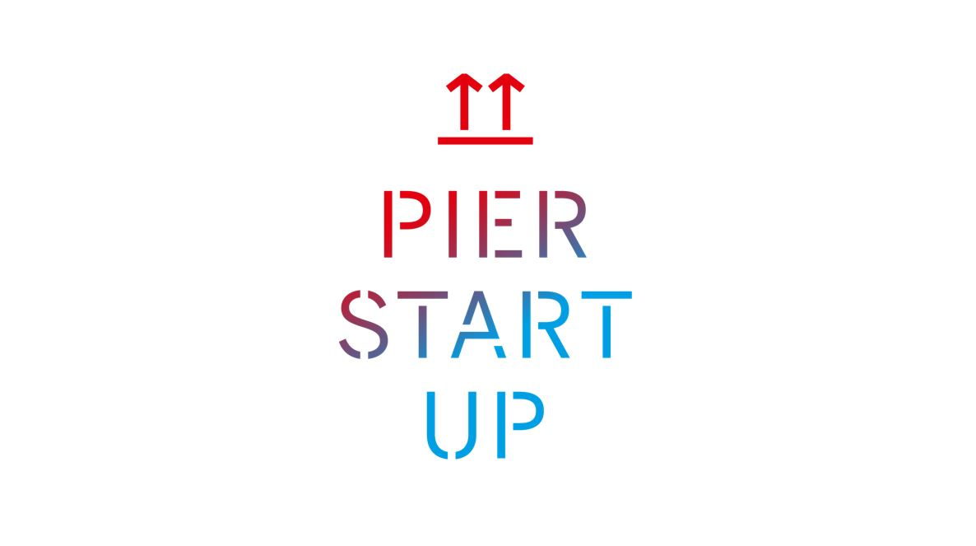
The “I” in PIER: Innovation
Aim:
Establish an innovation-friendly culture on the Hamburg Bahrenfeld research campus
Train junior researchers on topics related to innovation / startups
Inform researchers about innovation-related activities and services of UHH and DESY
Activities:
PIER Innovation Lunch Talk, e.g. 2022:
Dr. Axel Schönbeck (ILP, UHH)
Dr. Frank Holtrup, Haystack Oncology
Dr. Peter Gaal / Daniel Schmidt, TXProducts UG
PIER Startup Bootcamp Workshops
Design Thinking (24 March 2023)
Founding a Startup as a Non-EU Citizen (5 May 2023)
Business Modeling (29 September 2023)
Market Analysis for Startups (3 November 2023)
Finance, Funding & Business Plan (8 December 2023)
YES/PIER-Workshop „From Potential to Prototype“ (7 July 2023)
Workshop in cooperation with the Young Entrepreneurs in Science program (YES) of the Falling Walls Foundation

Slide 7
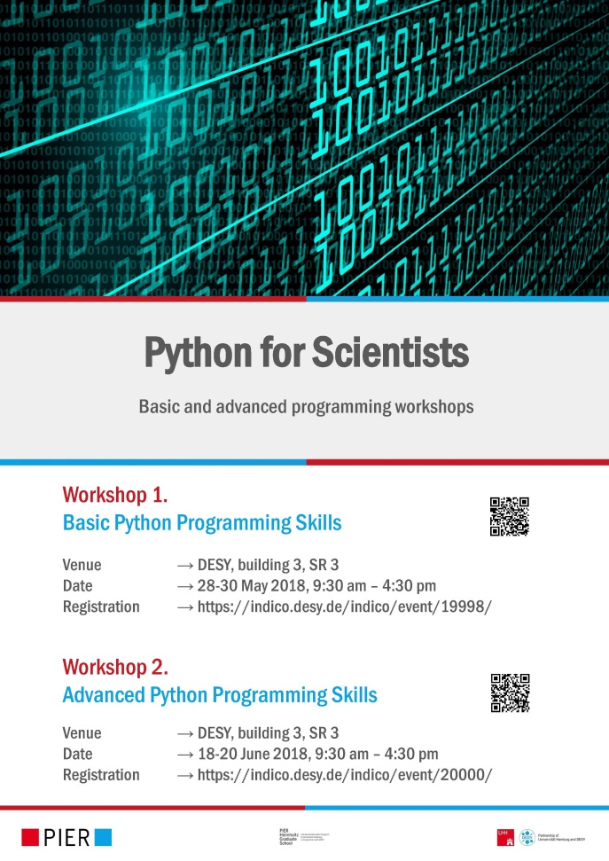
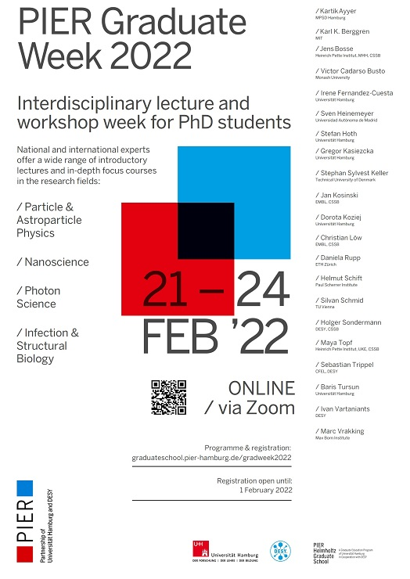
The “E” in PIER: Education
PIER Helmholtz Graduate School
Jointly funded by DESY, Universität Hamburg and the Helmholtz Association 2013-2019
Was made permanent in 2020
Around 350 members (most of them with DESY contract, around 60 full members with UHH contract)
PIER Education Platform
Established in 2020 (developed out of the skills & career program of the PHGS)
Graduate schools/ structures on campus can participate in PEP by Material Resources come from: PHGS, QU, CUI/AIM, HELIOS, DASHH (and for specific events/courses also collaboration with IMPRS UFAST)

Slide 8
The “R” in PIER: Research
PIER Idea Fund
Available funding amount per year:
220k € (100k € DESY, 100k € UHH, 20k € UKE)
What is the aim?
Enable researchers of DESY and UHH and/or UKE to identify complementary strengths
Facilitate the use of synergies
Promote the development of future joint research projects with external funding
Who is eligible for funding?
DESY, UHH and UKE researchers
Projects must involve researchers from both DESY and UHH (and/or UKE)
PIER Seed Projects Call 2023
24 April 2023 → deadline (24 proposals were submitted)
May/June 2023 → reviews are obtained (min. of two per proposal)
4 July 2023 → selection committee meeting
1 Sept. 2023 → start of funding period
PIER Seed Projects
PIER Workshops
PIER Short Visits
PIER
Idea Fund

Slide 9
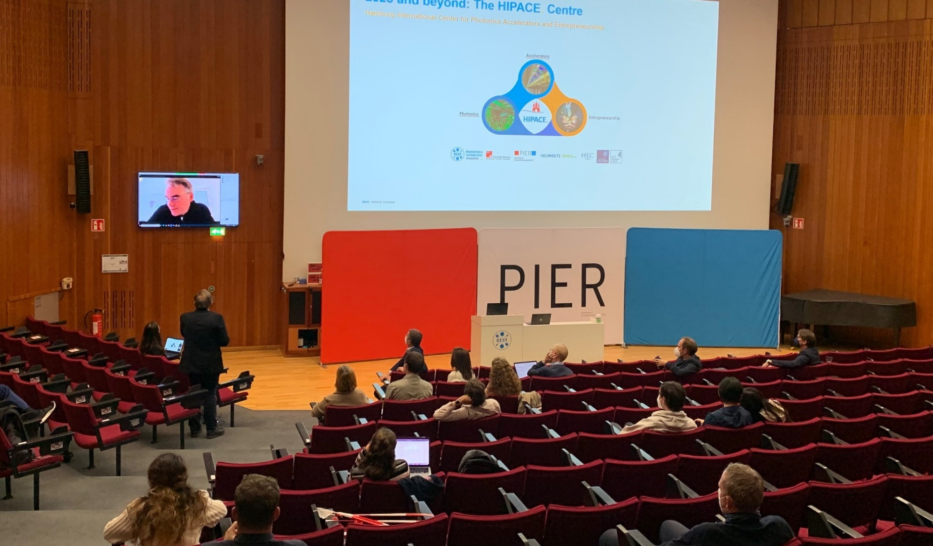
PIER Research: research perspectives workshops
Aim:
Explore potential for future collaboration activities between DESY and UHH researchers (as well as further research partners) in specific fields
Offer networking opportunities for DESY and UHH researchers in Bahrenfeld
Format:
Half-day to full-day workshops on specific topics connected to one or several of the PIER research fields
Scientific program is put together by 2-3 workshop chairs (recruited from among the PIER Scientists from the respective field)
PIER provides financial and organizational support:
Reservation of rooms
Handling of registrations
Promotion of events via email, website, calendars, social media, posters etc.
Preparation of name tags
Funding for and organization of catering for coffee breaks etc.
Technical and organizational support during the event
…

Slide 10
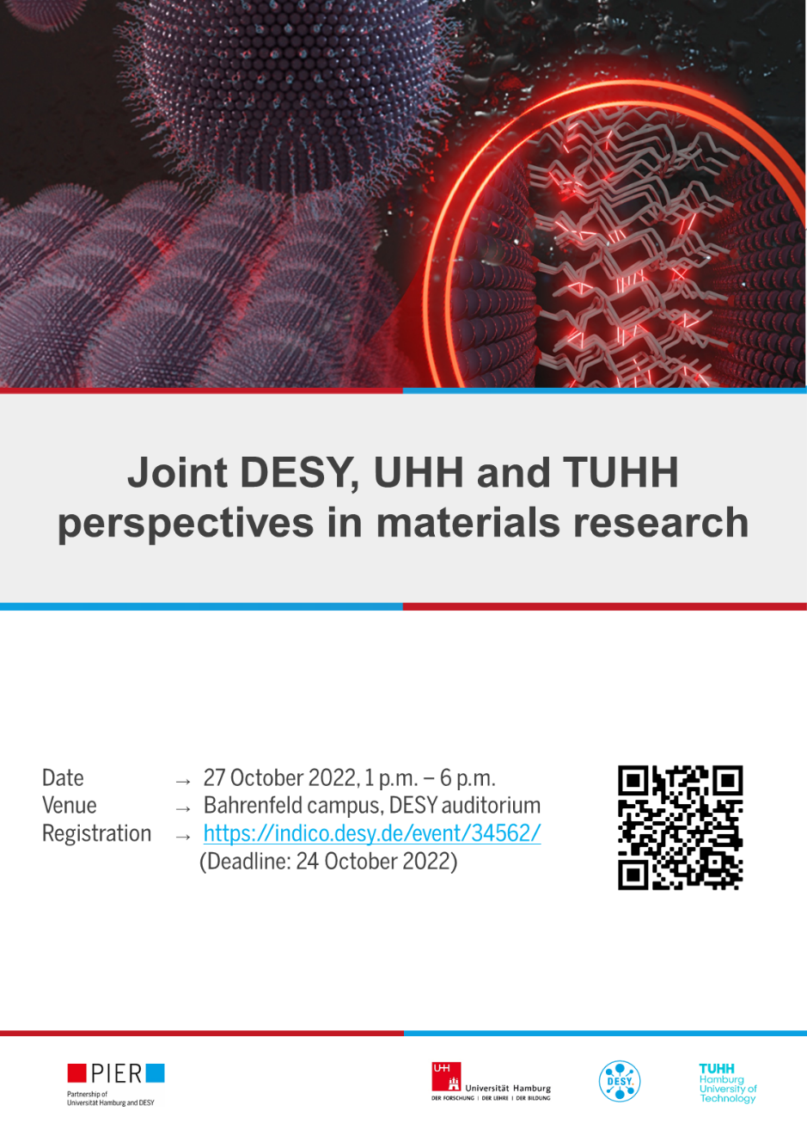
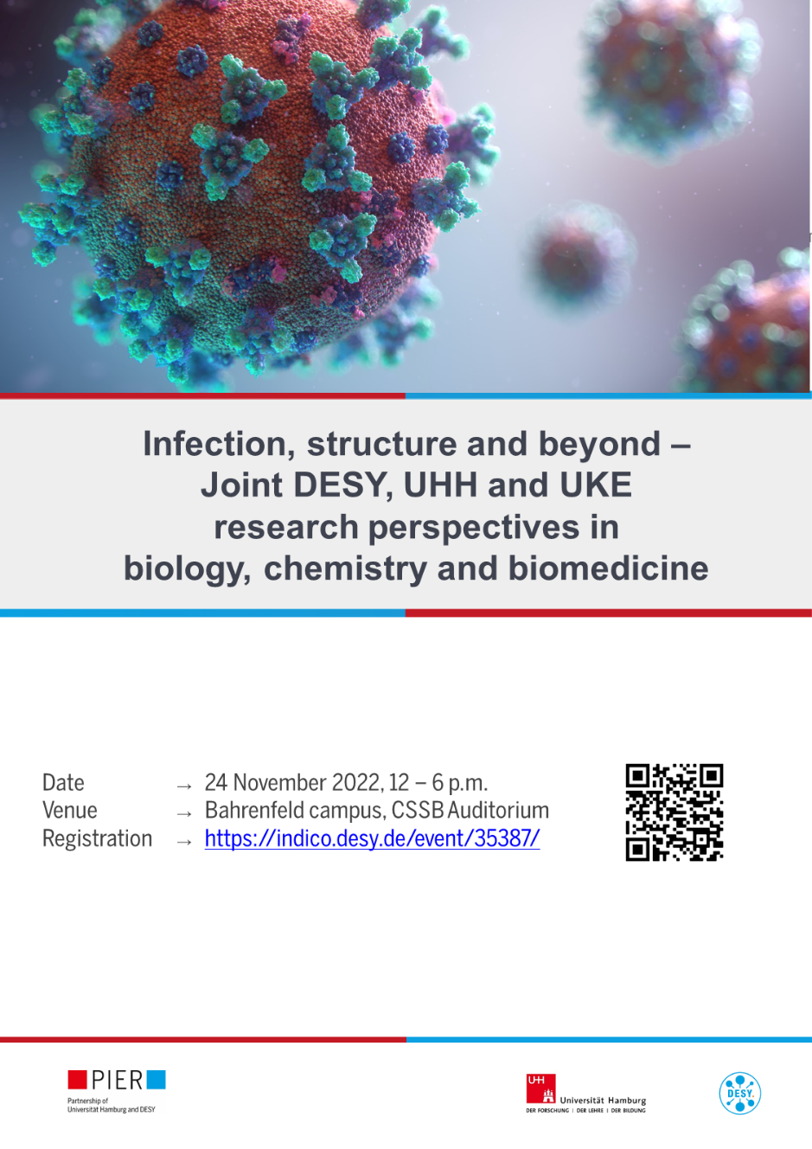
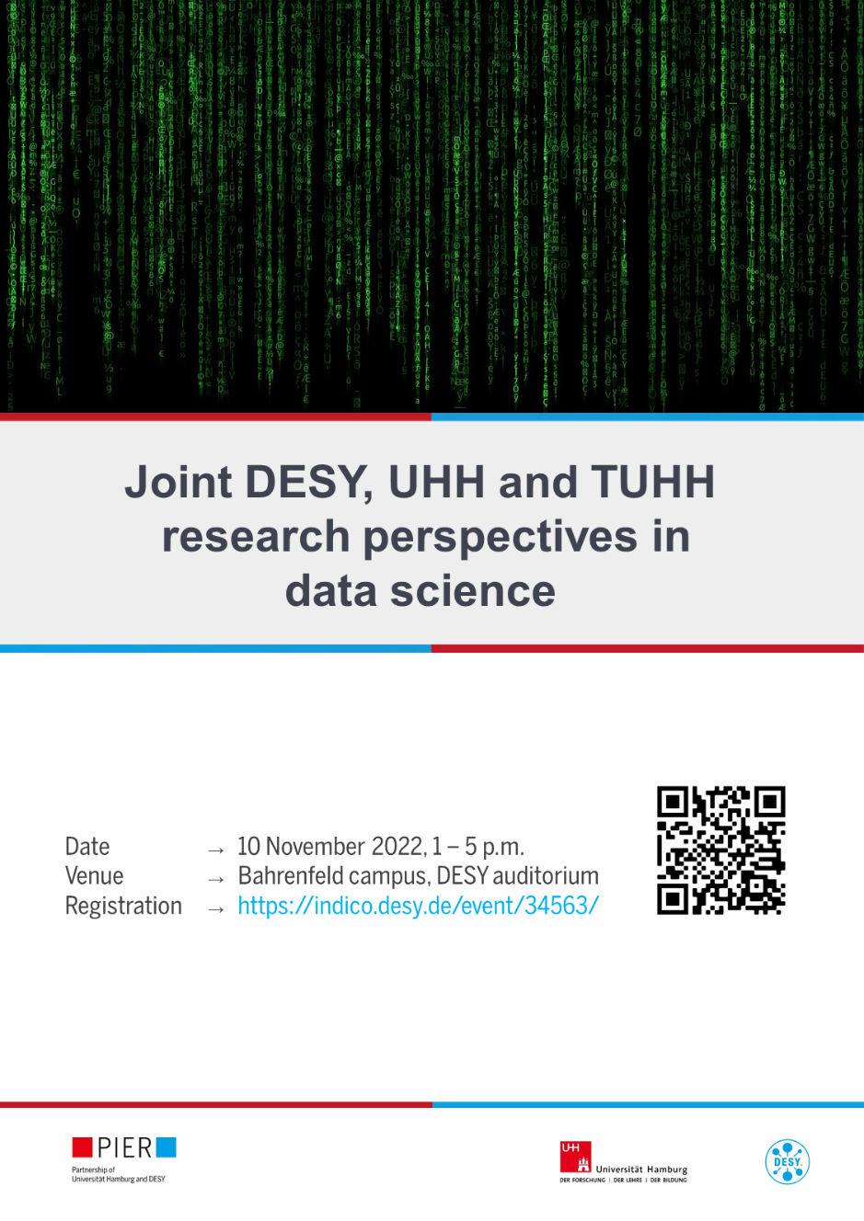
PIER Research: research perspectives workshops
Workshops on joint research perspectives of DESY and Universität Hamburg (and possibily further research partners) in specific fields
Workshops 2022:
Biology, chemistry & biomedicine
Data science
Materials research
Photon & accelerator science
Quantum technologies & quantum computing
Water research
Workshops 2023/2024:
Quantum technologies & quantum computing (13/14 April 2023)
Detector research (1 June 2023)
Structure, dynamics and function of stress-induced compartments (10 July 2023)
Photon science & accelerators (fall 2023, date tba)
Data science (fall 2023, date tba)
Cavity materials engineering (fall/winter 2023, date tba)
Water research (early spring 2024, date tba)
Gravitational waves and multi-messenger physics (early spring 2024, date tba)

