Slide 1



Machine Learning for Bad Image Rejection in Serial Crystallography
Vahid Rahmani
Photon Science - Detector Group (FS-DS)
PIER workshop,2023

Slide 2
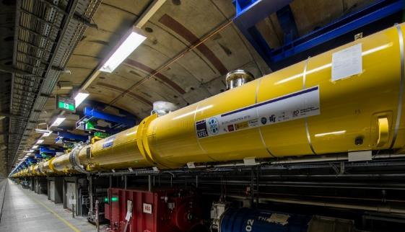
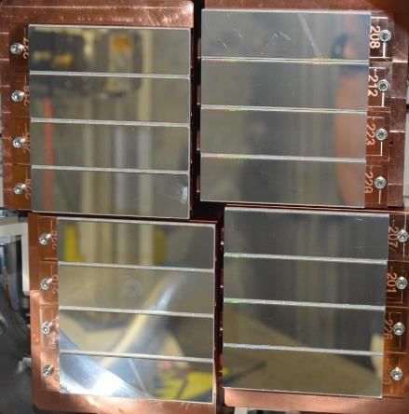
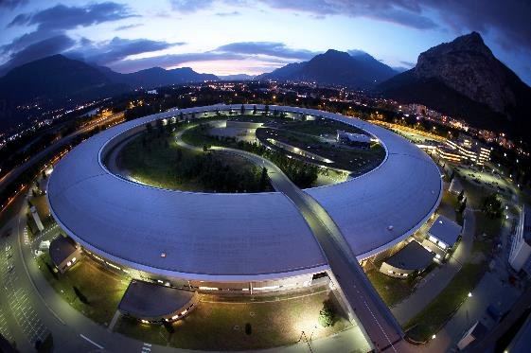
Machine learning for bad image rejection in serial crystallography • Vahid Rahmani • 01.06.2023
Drivers for increasing data rates in photon science
New facilities
New detectors
Free electron lasers (Eu.XFEL)
Multi-megapixel cameras
Currently 1000s of frames/second
Developing CoRDIA – over 100,000 fps
4th generation synchrotrons (ESRF-EBS, PETRA-IV)
AGIPD detector

Slide 3
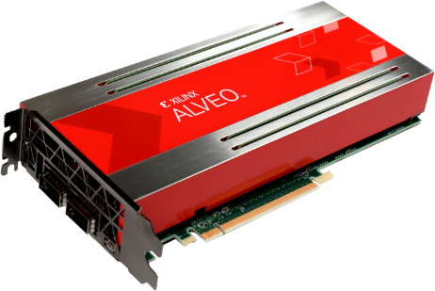
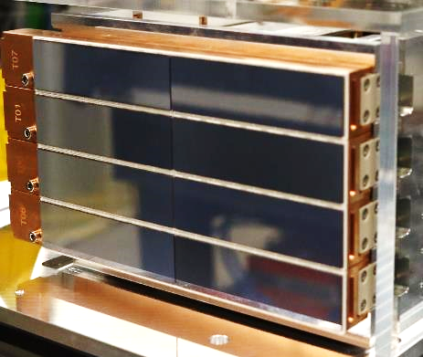

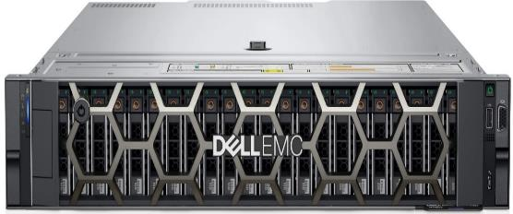
Machine learning for bad image rejection in serial crystallography • Vahid Rahmani • 01.06.2023
Goal – first phase of data reduction close to the detector
Detector module e.g. CoRDIA
Detector PC layer with accelerator cards
Facility central computing
Data reception, image correction, data reduction

Slide 4
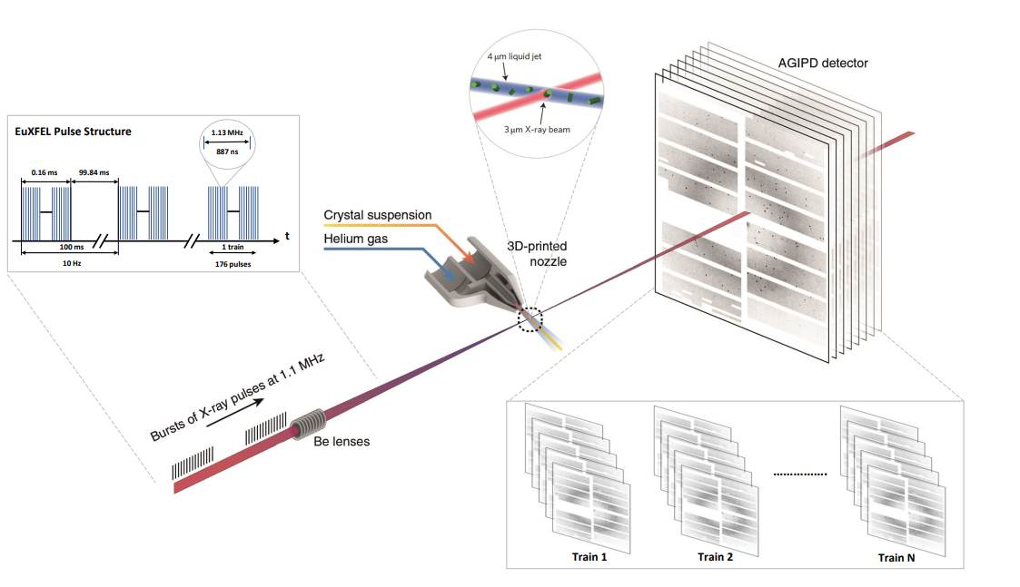
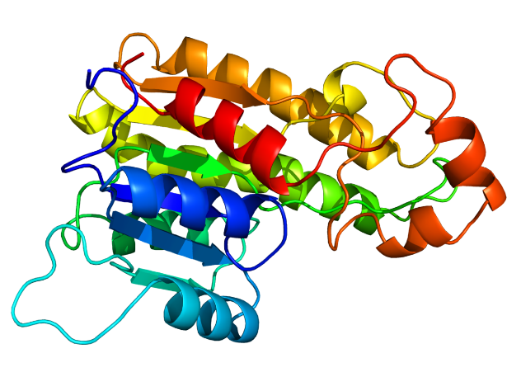
Machine learning for bad image rejection in serial crystallography • Vahid Rahmani • 01.06.2023
Typical experiment at Eu.XFEL
3D model of sample
AGIPD can measure up to:
352 frames at 1.1 MHz
2520 frames per second
This experiment:
15 and 30 frame at 1.1 MHz
150 and 300 frames per second

Slide 5

Machine learning for bad image rejection in serial crystallography • Vahid Rahmani • 01.06.2023
Rejecting bad images
In some experiments, a high proportion of images are bad.
All images (good and bad) are saved to disk during the experiment
European XFEL - up to 3500 images per second with current detectors
Future experiments - up to 100.000 images per second with new detectors
In serial crystallography, A typical value of the percentage of recorded images containing crystal diffraction, referred to as hit fraction, is about 5-10%, but hit fractions even lower than 0.1% have been observed in some experiments.

Slide 6
Machine learning for bad image rejection in serial crystallography • Vahid Rahmani • 01.06.2023
Why Machine Learning?
Machine learning could reject a reasonable proportion of bad images early in processing, to reduce the workload on later storage and processing
There are well-established non-machine-learning techniques (e.g. in Cheetah), but these often require expert tuning of parameters; our goal is to develop a method that doesn't rely on tuning.
Where possible, we want to find computationally cheap methods of inference.

Slide 7
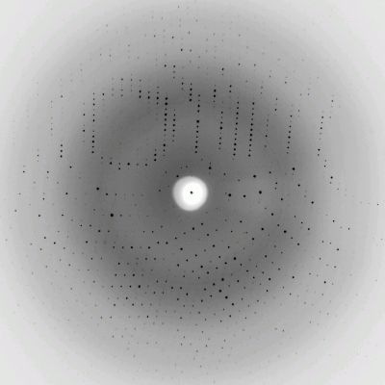
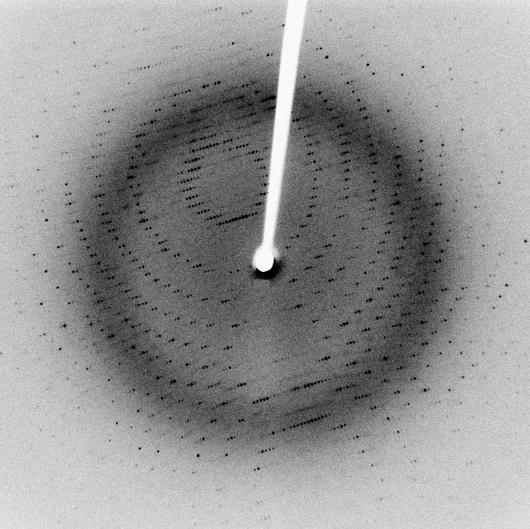
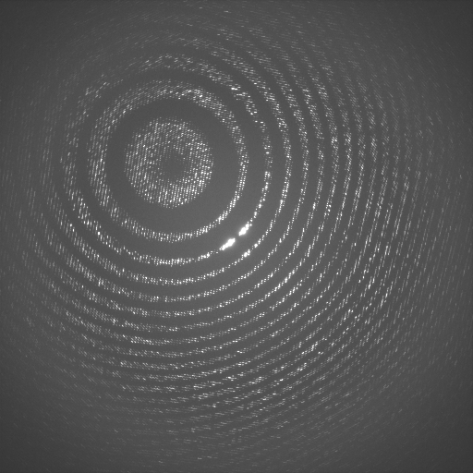
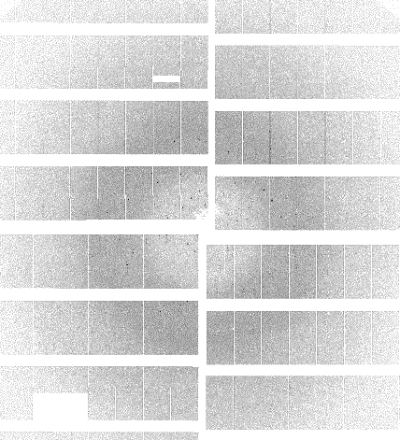
Machine learning for bad image rejection in serial crystallography • Vahid Rahmani • 01.06.2023
Machine Learning Challenge
Our ideal goal of data reduction research is propose a pipeline to works on any type of diffraction pattern recorded by any detector.
Different diffraction pattern form different detectors and samples

Slide 8
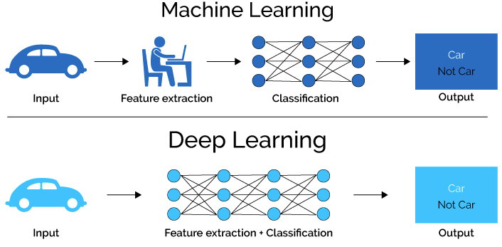
Machine learning for bad image rejection in serial crystallography • Vahid Rahmani • 01.06.2023
Difference between ML and DL

Slide 9
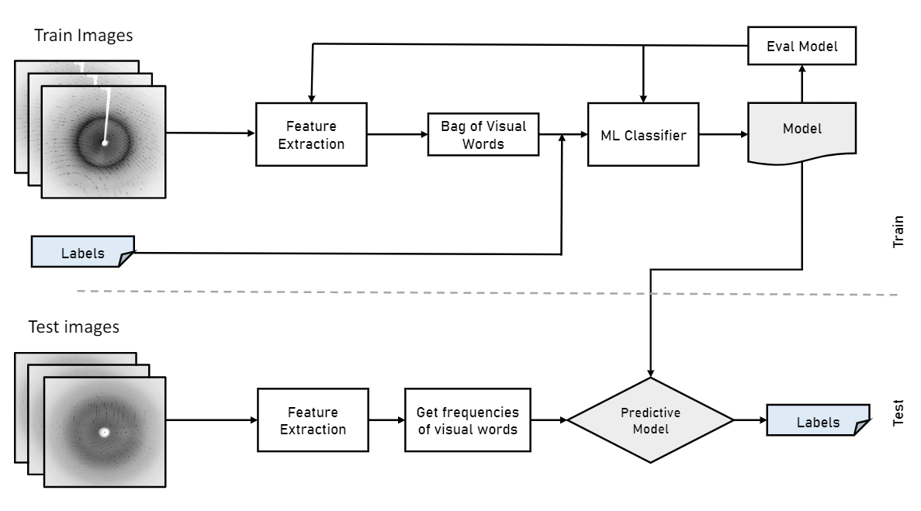
Machine learning for bad image rejection in serial crystallography • Vahid Rahmani • 01.06.2023
Proposed method - pipeline
Computing feature vectors
Computing feature vectors

Slide 10
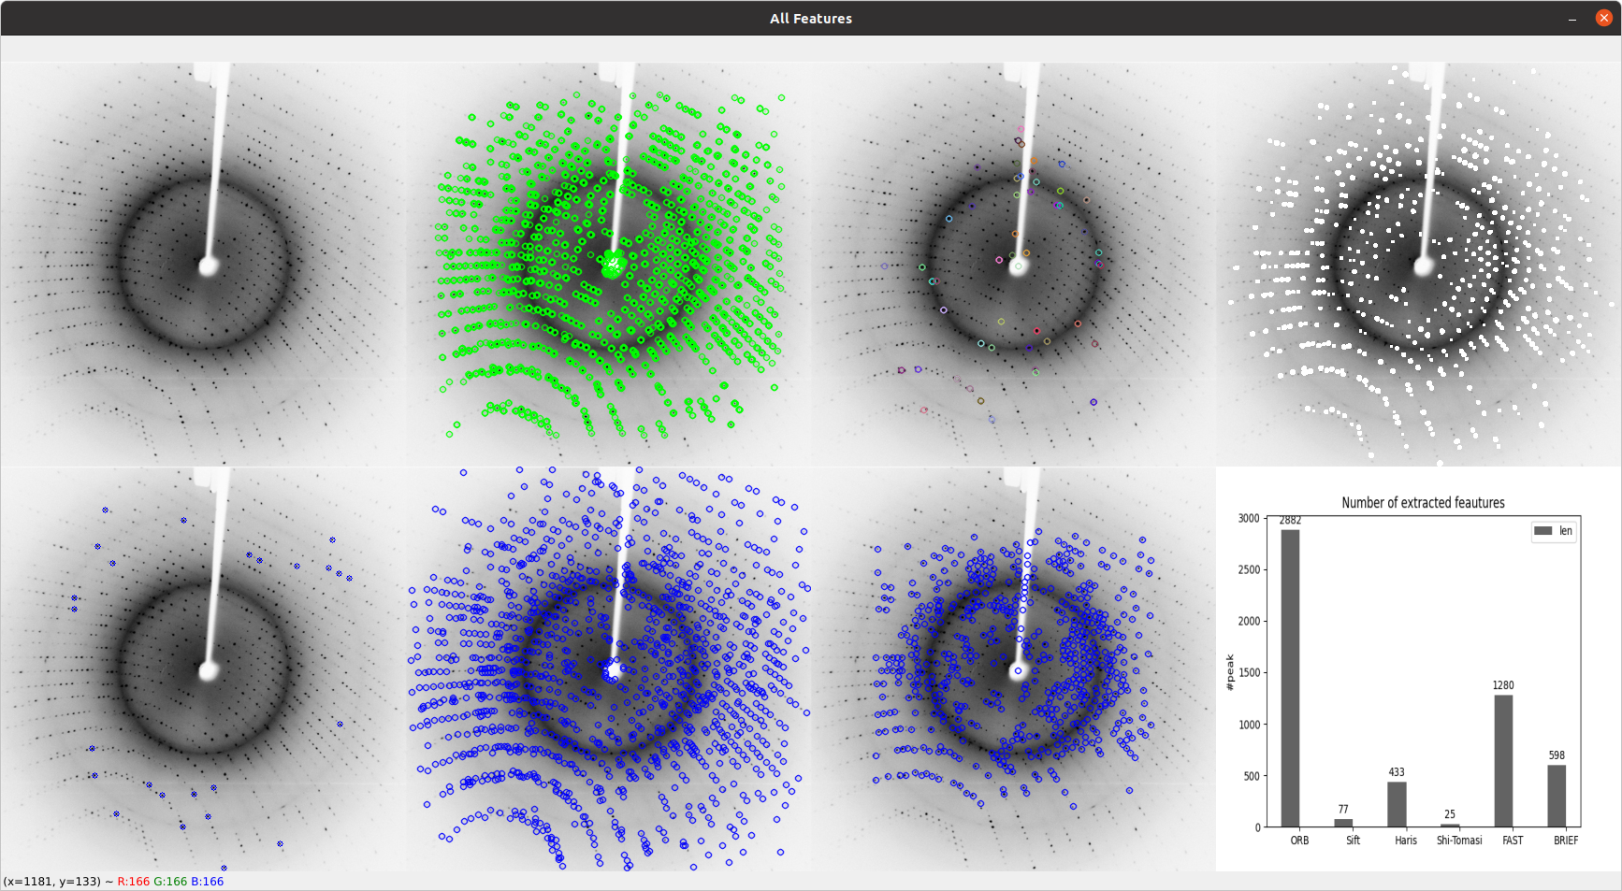
Machine learning for bad image rejection in serial crystallography • Vahid Rahmani • 01.06.2023
Handcrafted feature extraction
Original
ORB
SIFT
Haris
Shi-Tomasi
BRISK
BRIEF

Slide 11
Machine learning for bad image rejection in serial crystallography • Vahid Rahmani • 01.06.2023
Handcrafted feature extraction
We use different Machine Learning classifiers to categorize diffraction patterns, comparing the performance of four supervised machine learning models:
Multi layer perceptron (MLP)
Support Vector Machine (SVM)
Random Forest (RF)
Naive Bayes classifier (NB)
Our experimental results show that the Multi layer perceptron (MLP) achieves better results in classifying images as Hit or Miss.

Slide 12
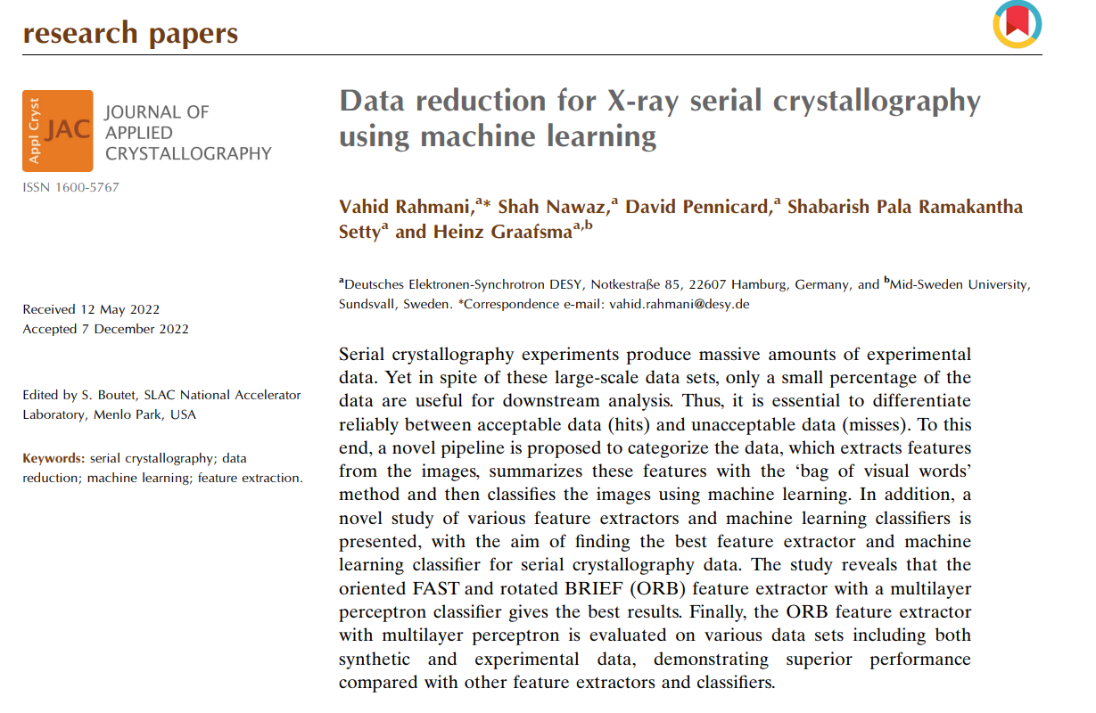
Machine learning for bad image rejection in serial crystallography • Vahid Rahmani • 01.06.2023
More Details

Slide 13
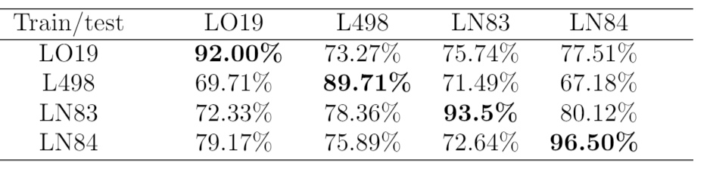
Machine learning for bad image rejection in serial crystallography • Vahid Rahmani • 01.06.2023
Cross-dataset training/testing challenge
Domain gap is the biggest challenge that we are facing in the proposed pipeline.
Confusion matrix for success rates of classification with Cross-dataset training and testing for ORB+MLP
Solution:
Combine datasets and then train the model
Extract robust features which are independent of the experiment

Slide 14
Machine learning for bad image rejection in serial crystallography • Vahid Rahmani • 01.06.2023
Solving Domain Gap
Previous method:
ORB (Oriented FAST and Rotated BRIEF)
+
Model
FAST
Key point detection
BRIEF
Descriptor
Generating feature vectors
New method:
MP-FAST
Model
MP-FAST
Key point detection
Generate Image
Descriptor

Slide 15
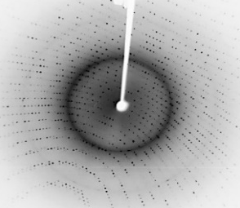
Machine learning for bad image rejection in serial crystallography • Vahid Rahmani • 01.06.2023
New Method – focus on AGIPD data
Train Images
Eval Model
Artifact Reduction
MP-FAST
Generating Image descriptor
ML Classifier
Model
Train
Labels
Test images
Artifact Reduction
MP-FAST
Image descriptor
Predictive Model
Labels
Test

Slide 16
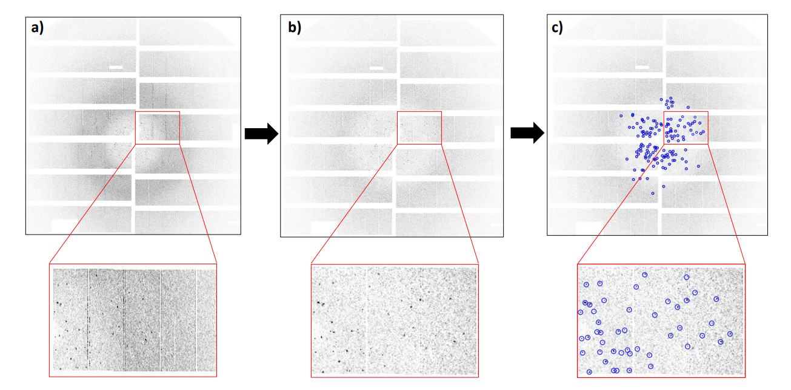
Machine learning for bad image rejection in serial crystallography • Vahid Rahmani • 01.06.2023
Proposed Method
ROI detection: Modified and parallelized Features from accelerated segment test (MP-FAST)
Input images and recorded by AGIPD detector.
image after artifact reduction (c) MP-FAST key points (Peak) detection.

Slide 17
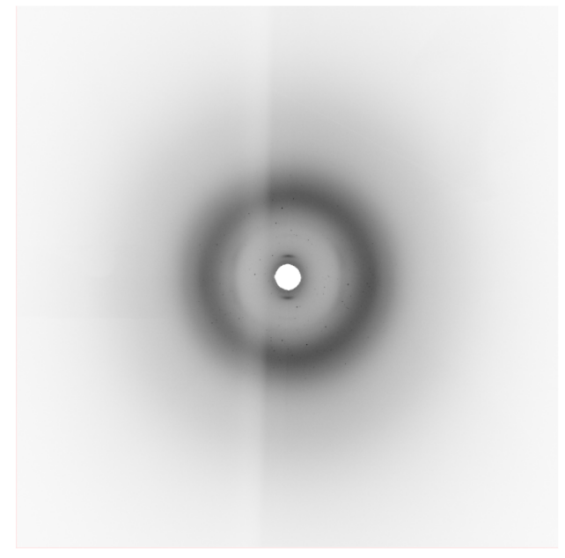
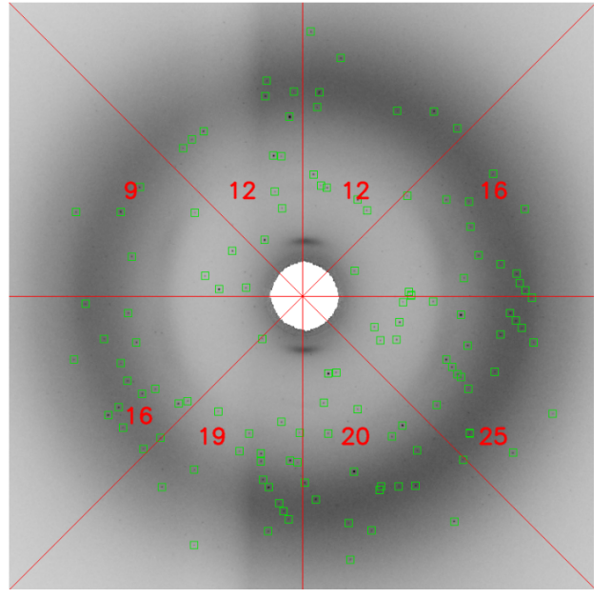
Machine learning for bad image rejection in serial crystallography • Vahid Rahmani • 01.06.2023
Proposed Method
Generating image descriptor
$$Image_Descriptor=[12,16,25,20,19,16,9,12]$$

Slide 18
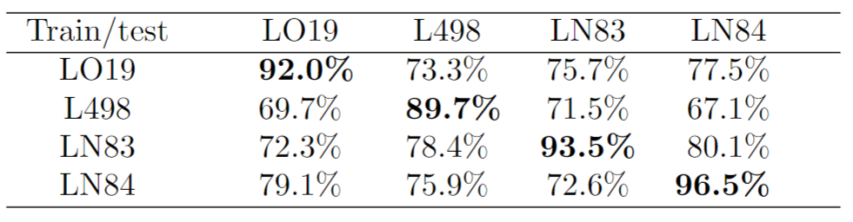
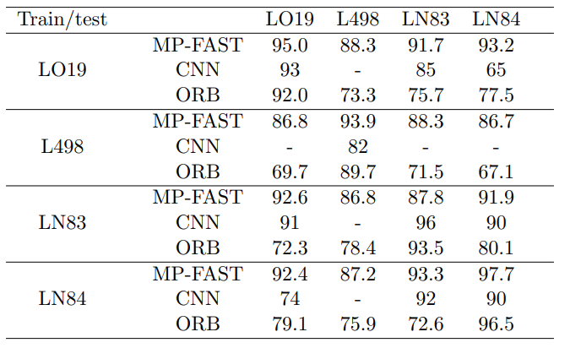
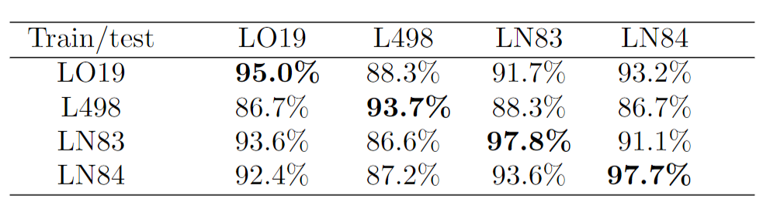
Machine learning for bad image rejection in serial crystallography • Vahid Rahmani • 01.06.2023
Experimental Results
Classification performance (%) with cross-dataset training and testing for our proposed method compared with the CNN method and ORB+MLP
The success rate of classification with Cross-dataset training and
testing by ORB features
The success rate of classification with Cross-dataset training and
testing by MP-FAST features

Slide 19
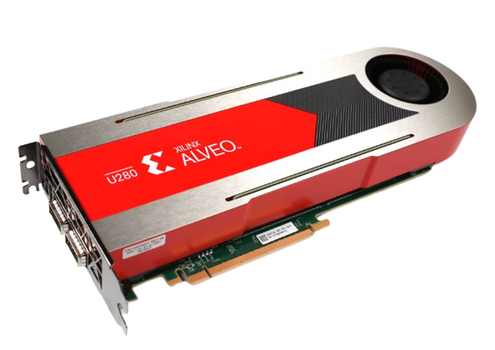


Machine learning for bad image rejection in serial crystallography • Vahid Rahmani • 01.06.2023
Improve Time Performance
Parallelization MP-FAST on CPU, GPU, and FPGA
Processor: i5-10310U
Base Frequency 1.70 GHz
Cache 6 MB
Total Core: 4
Total Threads: 8
Graphic Processor: GA102
CUDA core: 10496
Tensor: 328
Memory size= 16GB
Architecture: 16nm UltraScale+
HBM size: 8GB
2 x 16GB DDR4 RDIMM
2 Ethernet ports (100 Gb/s each)

Slide 20
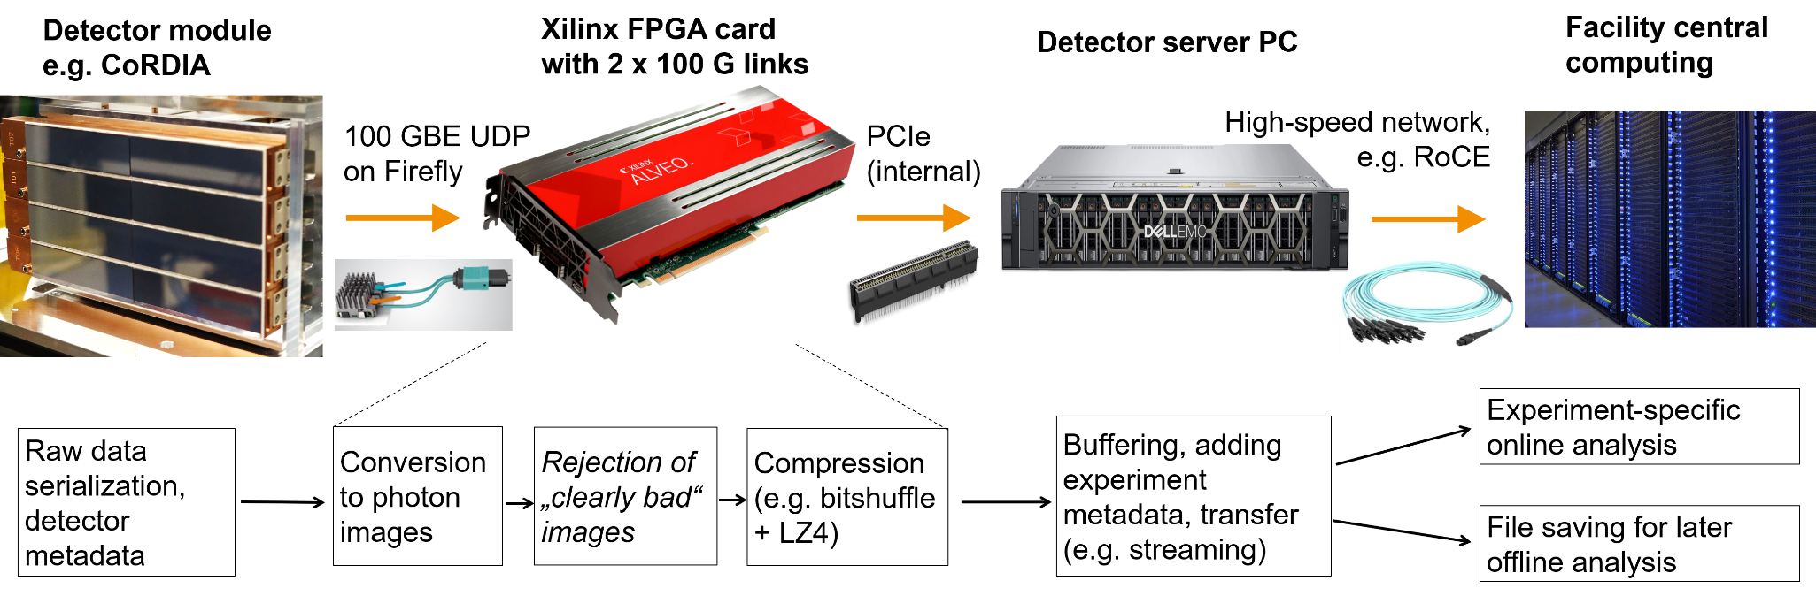
Machine learning for bad image rejection in serial crystallography • Vahid Rahmani • 01.06.2023
Data reception and processing
In our current generation of detectors, PCs with standard network cards receive and process detector data
In the future, accelerator cards with built-in network links could do data reception, image correction, and data reduction

Slide 21
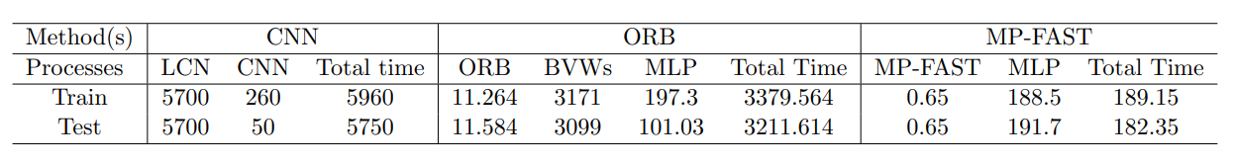
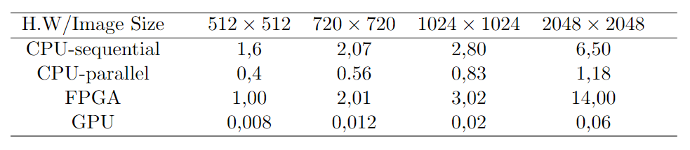
Machine learning for bad image rejection in serial crystallography • Vahid Rahmani • 01.06.2023
Results
The MP-FAST execution time performance (per one image) for CPU, GPU, and FPGA card ( < 1% resources)
Processing time (ms) for various components of our proposed method compared with the CNN[12] and the ORB [10] on 64 images.
Execution Time Performance for feature extraction (in milliseconds).

Slide 22

Machine learning for bad image rejection in serial crystallography • Vahid Rahmani • 01.06.2023

Slide 23
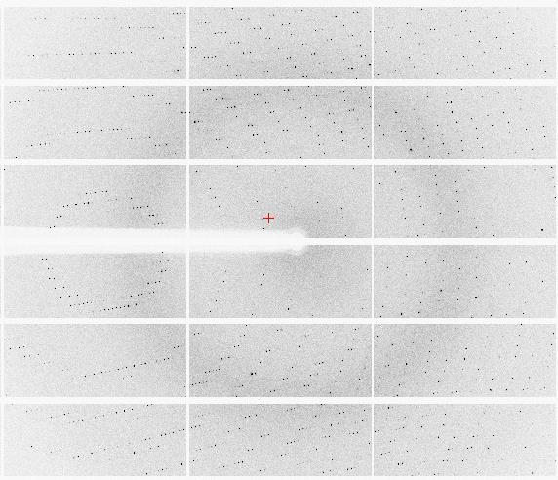


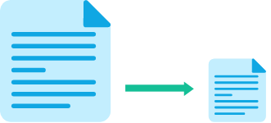
Machine learning for bad image rejection in serial crystallography • Vahid Rahmani • 01.06.2023
Possible Solutions
Data preprocessing
(e.g. 2D image -> 1D profile)
Image compression
(lossless, lossy…)
Vetoing uninteresting data
Insert bad image here
Intensity
Radius

Slide 24
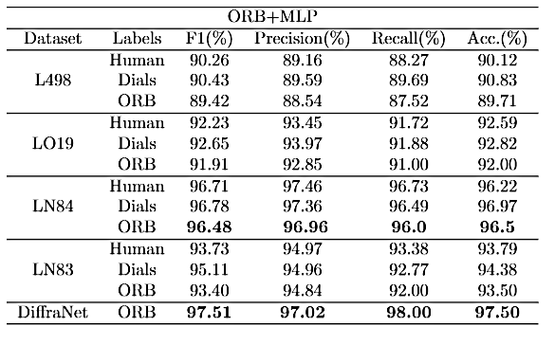
Machine learning for bad image rejection in serial crystallography • Vahid Rahmani • 01.06.2023
Classification results

Slide 25
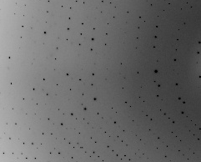
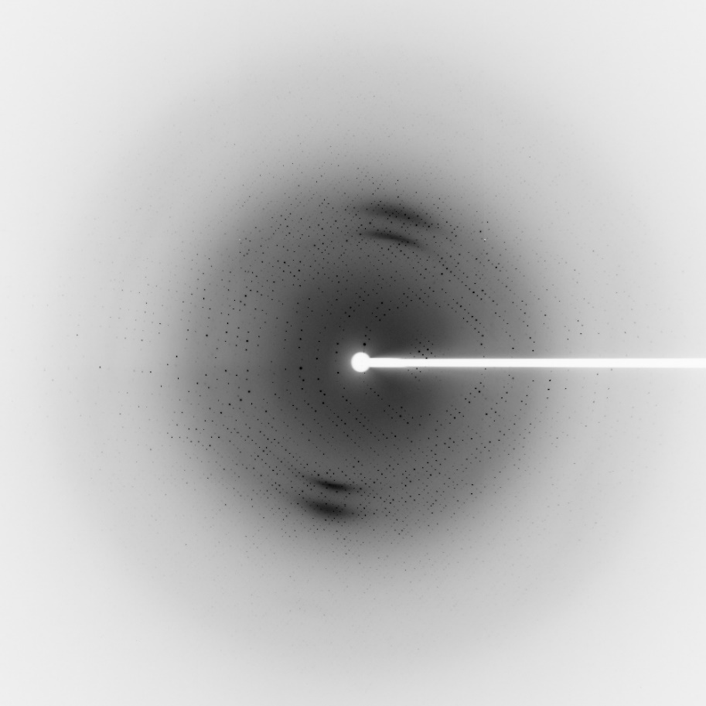









Machine learning for bad image rejection in serial crystallography • Vahid Rahmani • 01.06.2023
Handcrafted features
$$v_{1}=[…]$$
$$v_{2}=[…]$$
$$v_{4}$$
$$v_{3}$$
$$v_{7}$$
$$v_{8}$$
$$v_{5}$$
$$v_{6}$$
$$v_{9}$$
Feature extraction= Key point detection + key point description

Slide 26
Machine learning for bad image rejection in serial crystallography • Vahid Rahmani • 01.06.2023
Summery
We have investigated Machine Learning and deep learning applications for data reduction on serial crystallography
Various feature extraction methods and machine learning classification models were implemented.
A new algorithm (MP-FAST) has been introduced for solving the domain gap problem.
Proposed methods were tested on the different datasets from different detectors.
planning to run the algorithms on the Alveo Xilinx FPGA card (doing classification as much as possible close to the detector )
Compression of our data reduction methods with other methods and algorithms

Slide 27
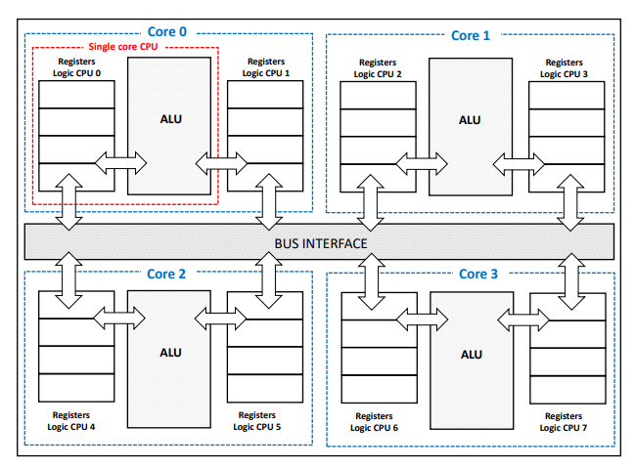
Machine learning for bad image rejection in serial crystallography • Vahid Rahmani • 01.06.2023
Improve Time Performance
Processor: i5-10310U
Base Frequency 1.70 GHz
Cache 6 MB
Total Core: 4
Total Threads: 8
MP-FAST key point detection on the image can be divided into 8 threads, each of which can be assigned to a different virtual core. partitioning the diffraction pattern image into 8 modules and running the MP-FAST algorithm concurrently on each thread.

Slide 28
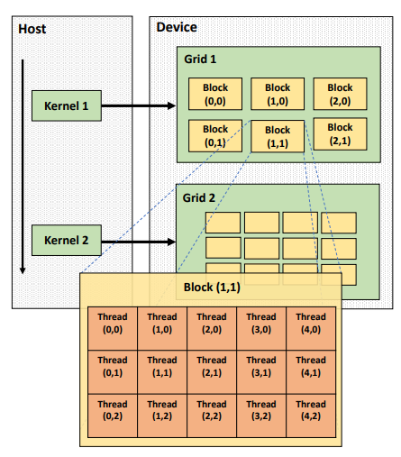
Machine learning for bad image rejection in serial crystallography • Vahid Rahmani • 01.06.2023
Improve Time Performance
Graphic Processor: GA102
CUDA core: 10496
Tensor: 328
Memory size= 16GB
To construct the CUDA kernel for MP-FAST, a block of 16 × 16 threads was utilized.
Subsequently, the input image was partitioned into a grid of (W+15)/16 × (H+15)/16 blocks.

Slide 29
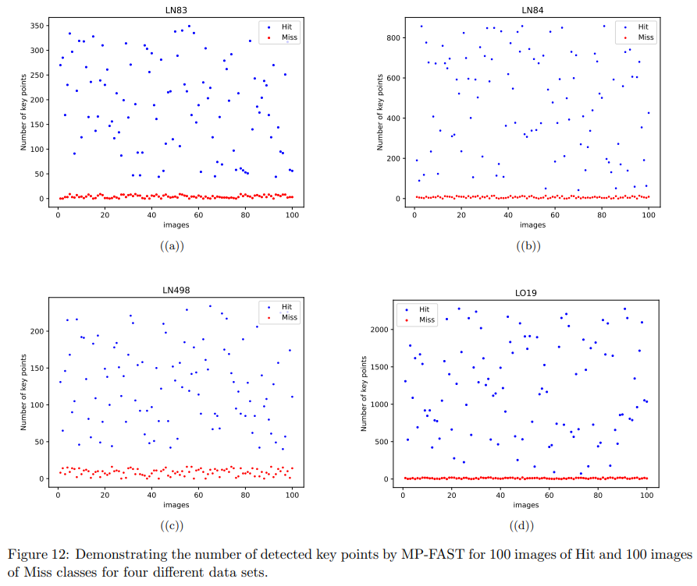
Machine learning for bad image rejection in serial crystallography • Vahid Rahmani • 01.06.2023

Slide 30
Machine learning for bad image rejection in serial crystallography • Vahid Rahmani • 01.06.2023
Improve Time Performance
Architecture: 16nm UltraScale+
HBM size: 8GB
2 x 16GB DDR4 RDIMM
2 Ethernet ports (100 Gb/s each)
The FPGA implementation of MP FAST was aimed at processing one pixel per clock cycle. A ring buffer is used to hold 4 lines of the image (3 for processing, and 1 for loading) with one new pixel being loaded each clock cycle.

