Slide 1




Cascaded laser proton acceleration
well beyond 100 MeV energy
Tim Ziegler^{1,2},
S. Assenbaum^{1,2}, C. Bernert^{1,2}, F.-E. Brack^{1,2}, T. E. Cowan^{1,2}, N. Dover^{3,4}, M. Garten^{1,2}, L. Gaus^{1,2}, I. Goethel^{1,2},
H. Kiriyama³, T. Kluge¹, S. Kraft¹, F. Kroll¹, J. Metzkes-Ng¹, M. Nishuichi³, M. Reimold^{1,2}, M. Rehwald^{1,2},
H.-P. Schlenvoigt¹, M. E. P. Umlandt^{1,2}, M. Vescovi^{1,2}, U. Schramm^{1,2} & K. Zeil¹
Helmholtz-Zentrum Dresden-Rossendorf, Dresden, Germany
Technische Universität Dresden, Dresden Germany
Kansai Photon Science Institute, National Institutes for Quantum and Radiological Science & Technology, Kyoto, Japan
John Adams Institute for Accelerator Science, Imperial College London, London, United Kingdom
9th Annual Helmholtz Matter and Technologies Meeting 2023

Slide 2
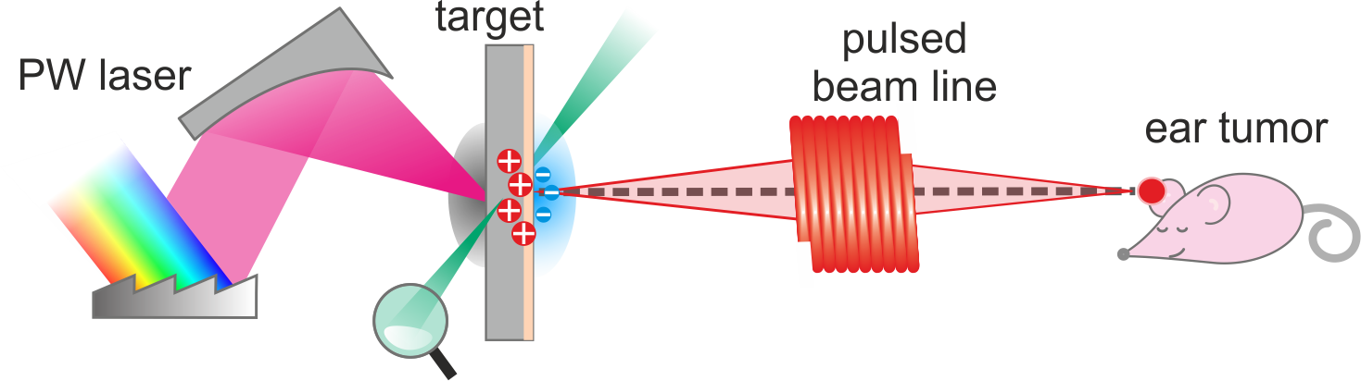

Laser-driven proton sources for high dose rate radiobiology
proton beam generation
beam transport
application
Radiobiological studies are among the most challenging application experiments for a laser acceleration facility
major hurdles: performance, instrumentation, readiness and stability level
plasma source: broadband (spatial + spectral), rep. rate, fluctuations

Slide 3
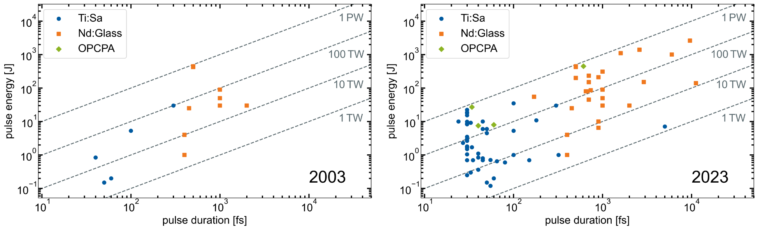
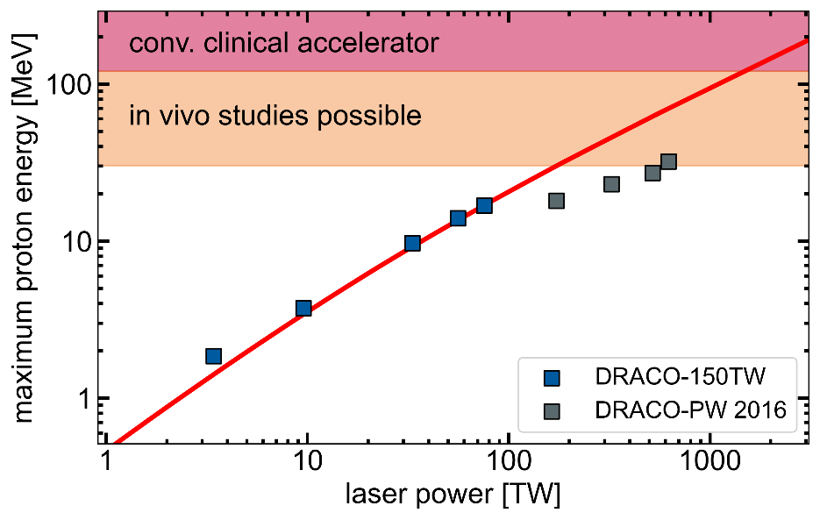
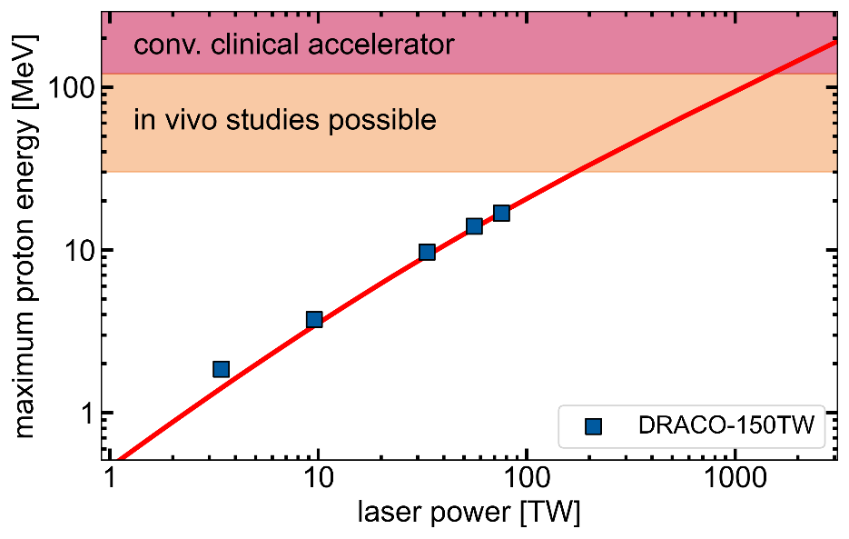
Development of laser-driven proton acceleration
  ~20 MeV@Ti:Sa laser <5 J laser energy
  in-vitro radbiology
  PW-class Ti:Sa laser
  2000
  ~60 MeV@NOVA >400 J laser energy
  2005-2009
  2010
  2015

Slide 4
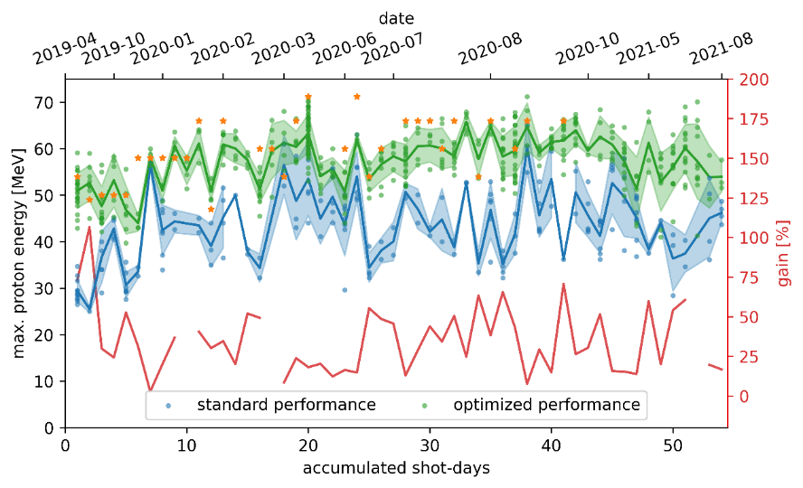
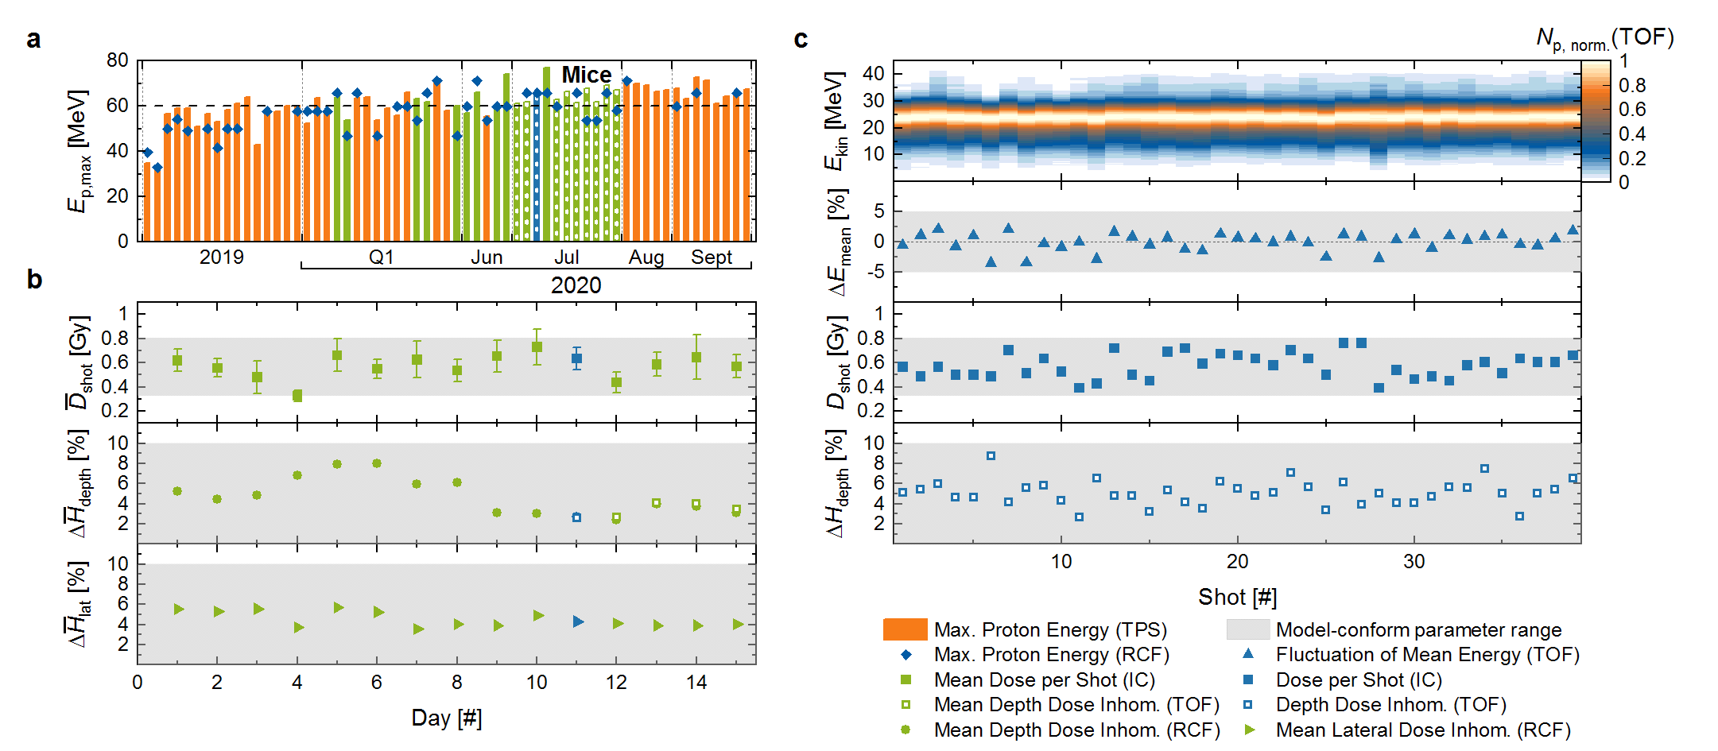
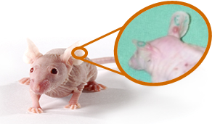
Demonstration of accelerator readiness at HZDR
T. Ziegler, et al., Sci. Reports 11, 7338 (2021)
F. Kroll, et al., Nature Physics 18.3 (2022)
optimisation procedure for enhanced beam quality (>60 MeV in routine operation)
stable proton beam generation over months
In total 47 mice at HZDR (7 proton irradiated)
4 ± 0.3 Gy dose delivery precision
3 weeks of irradiation-readiness at DRACO-PW
accelerator readiness + stability benchmarked via application-specific parameters

Slide 5
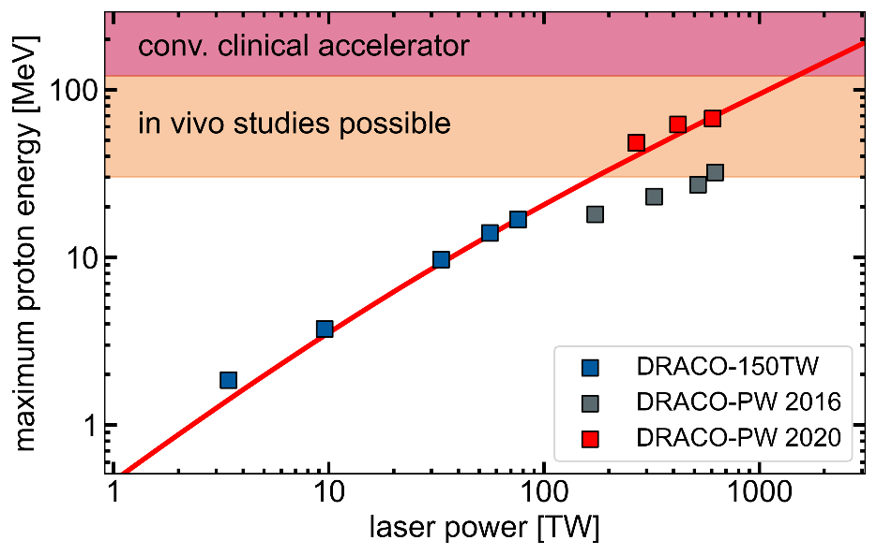
Development of laser-driven proton acceleration
  ~20 MeV@Ti:Sa laser <5 J laser energy
  in-vitro radbiology
  PW-class Ti:Sa laser
  3D in-vivo irradiation
  2000
  ~60 MeV@NOVA >400 J laser energy
  2005-2009
  2010
  2015
  2020

Slide 6

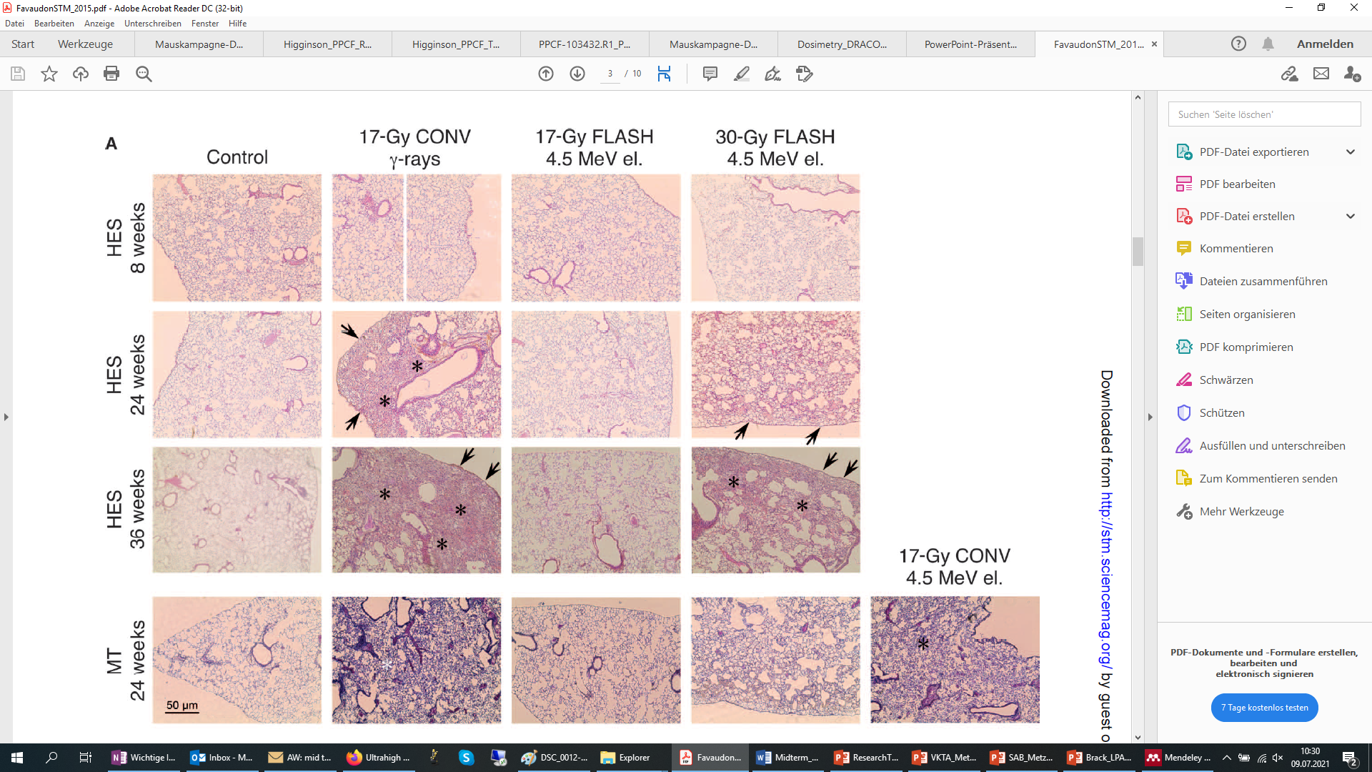
What‘s next?
  ultrahigh dose-rate FLASH
  irradiation increases the differential response between normal and tumor tissue in mice
  plasma-accelerators inherently deliver ultrashort part. bunches
  increase acc. performance (energy + particle yield)
  Favaudon et al. Sci. Transl. Med. 2014

Slide 7
Plasma density tailoring for advanced acceleration regimes
TNSA
Magneto vortex acc.
TNSA
Relativistic transparency
Snavely PRL(2000), Clark PRL (2000)
Henig PRL(2009), Yin POP (2011), D’humieres POP (2015),
Higginson Nat Commun (2018), Gonzales-Izquierdo ApplSci (2018)
Bulanov & Esirkepov PRL (2007)
laser mostly
reflected
laser mostly
absorbed
laser mostly
transmitted
$$n_{e}>{γn}_{c}$$
$$n_{e}\sim {γn}_{c}$$
$$n_{e}<{γn}_{c}$$
plasma
density
> 10²³ cm⁻³
~10²¹ cm⁻³ = n_{critical} [800nm]
< 10²⁰ cm⁻³
opaque target
near-critical density
transparent target
foil
pre-expansion by preceding light

Slide 8
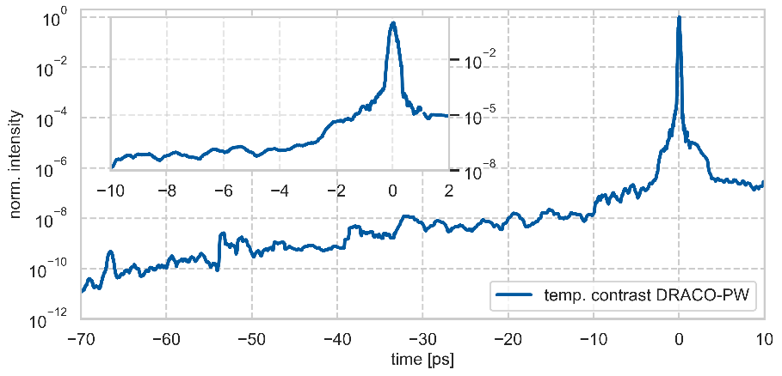
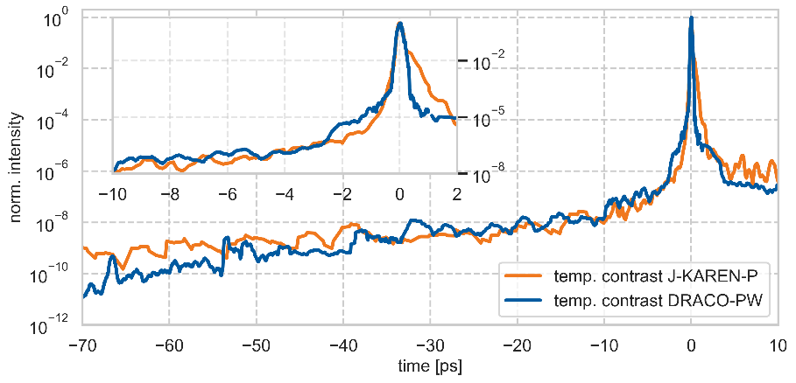
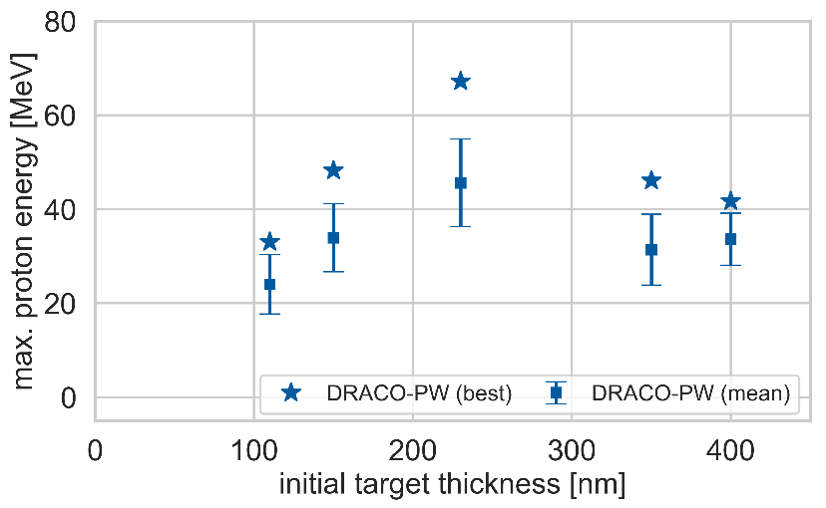
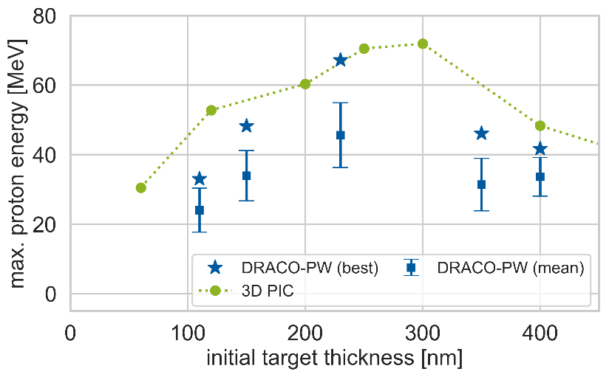
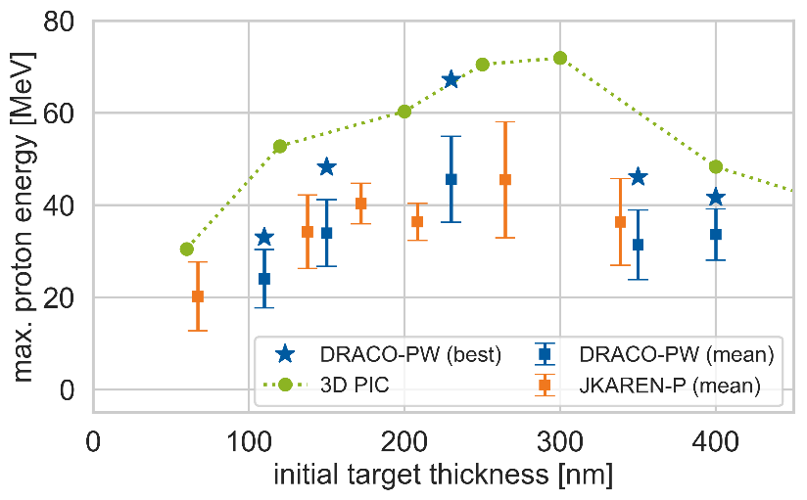
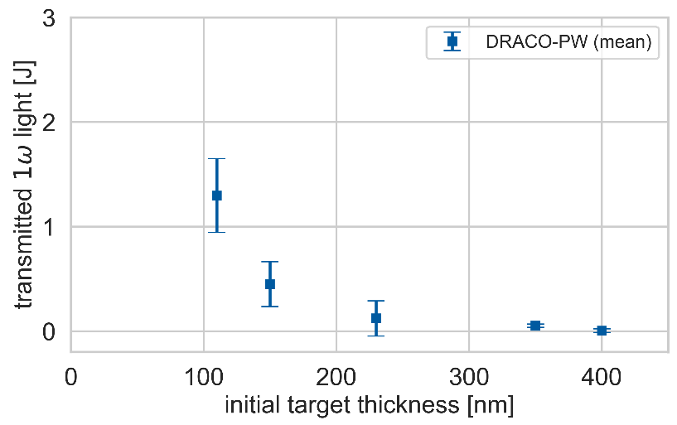
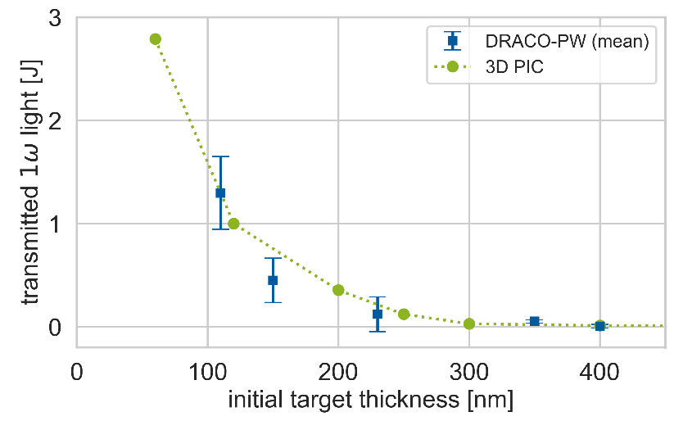
Relativistically transparent targets enhance ion energies
2D hydrodynamic simulation
3D PIC simulation
enhanced proton energies at optimal thickness
onset of transparency at optimal thickness
targets get transparent during interaction
→ increased absorption + coupling into ions
comparison to other high-power laser systems
→ excellent agreement
N. Dover & T. Ziegler et al., Light Sci Appl (2023)

Slide 9
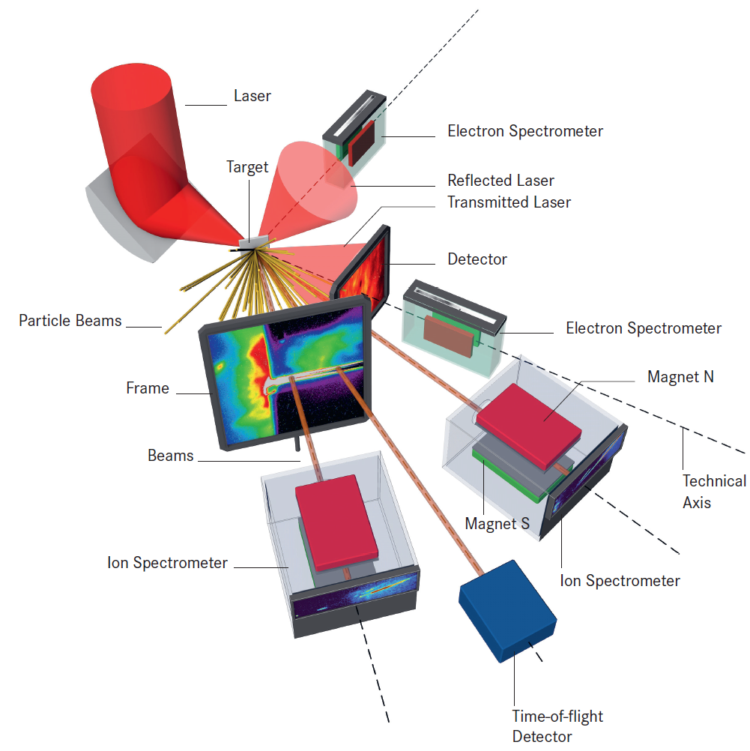
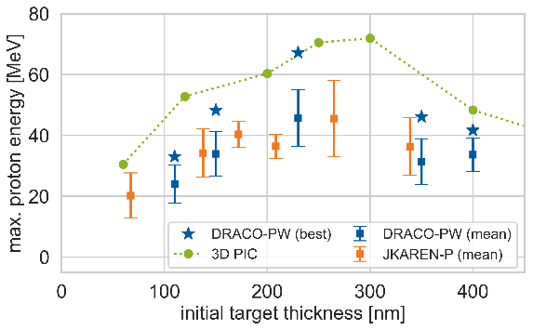
Experimental setup for relativistic transparency regime
DRACO-PW
E_{L} = 22.4 J (on target), τ = 30 fs
F/2.3 OAP → 2.3 µm (FWHM)
I_{peak} = 6.5 x 10²¹ W/cm² (a₀=55)
targets: 250±25 nm Formvar foils

Slide 10
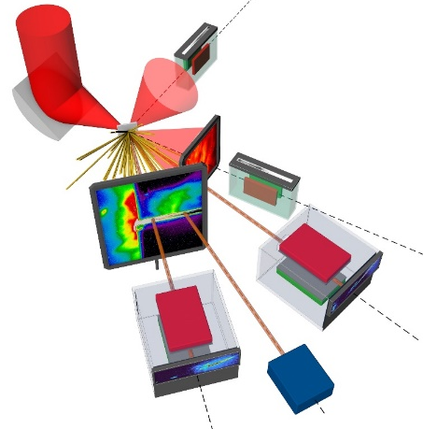
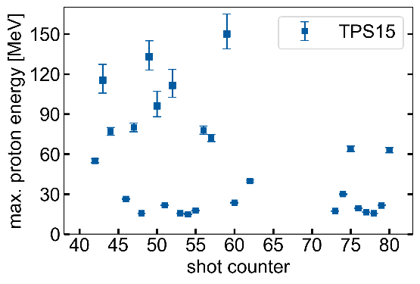
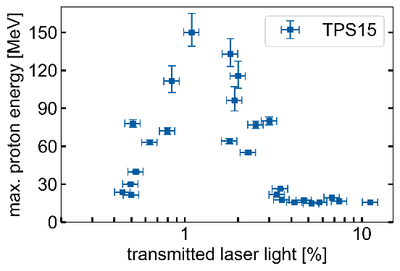
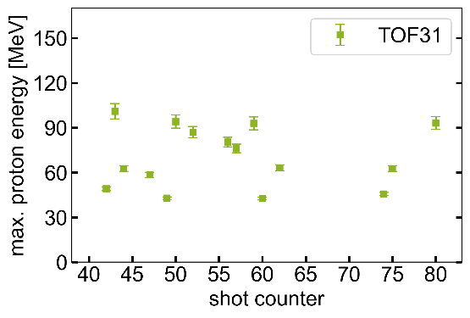
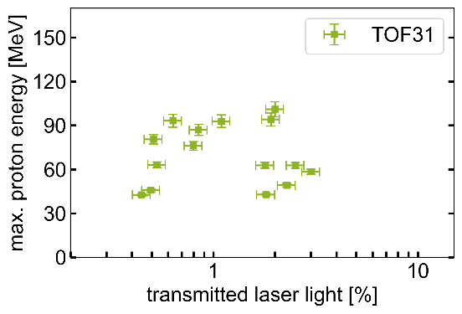
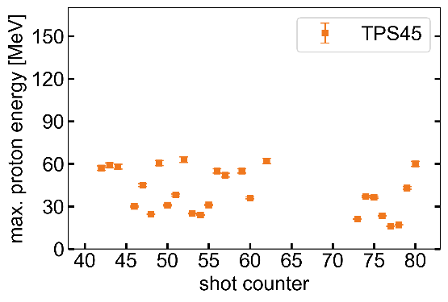
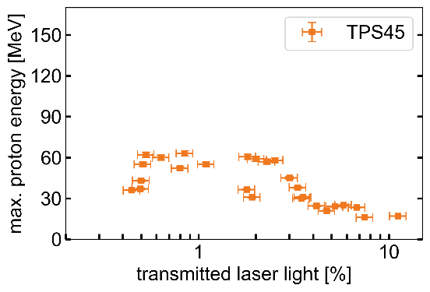
Highest energies in 15° direction / correlation to transmitted light
high shot-to-shot fluctuations
proton energies >100MeV at 15° & 31°
trans. light suited to identify optimal performance regime
correlation: trans. light - laser-target conditions

Slide 11
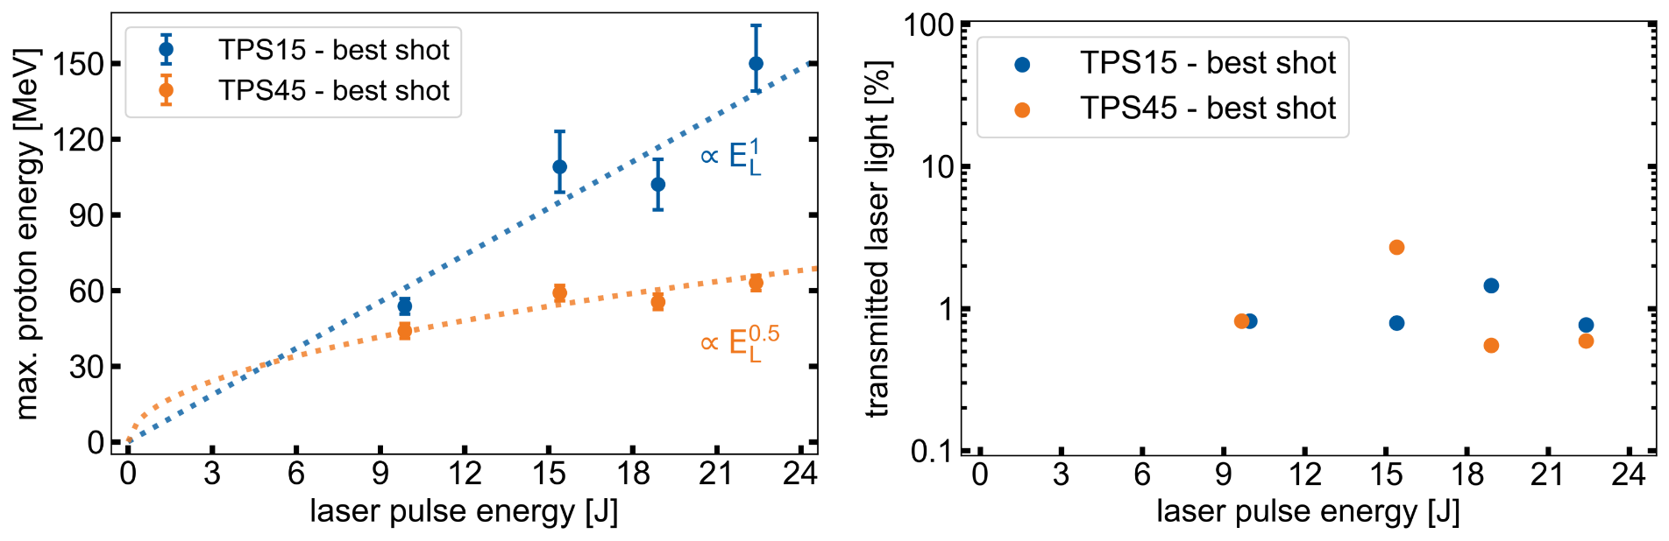
Laser energy scaling of relativistic transparency regime
T. Ziegler et al. (in review)

Slide 12
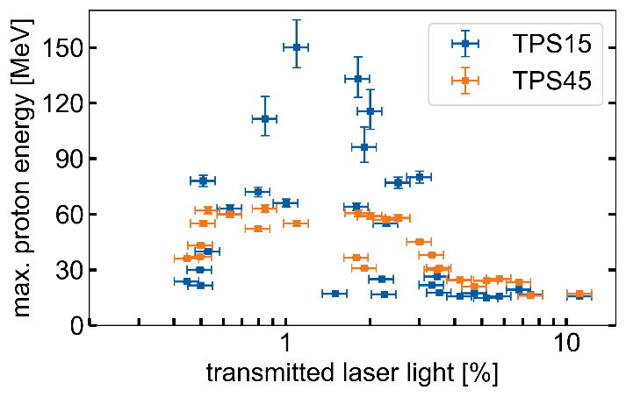
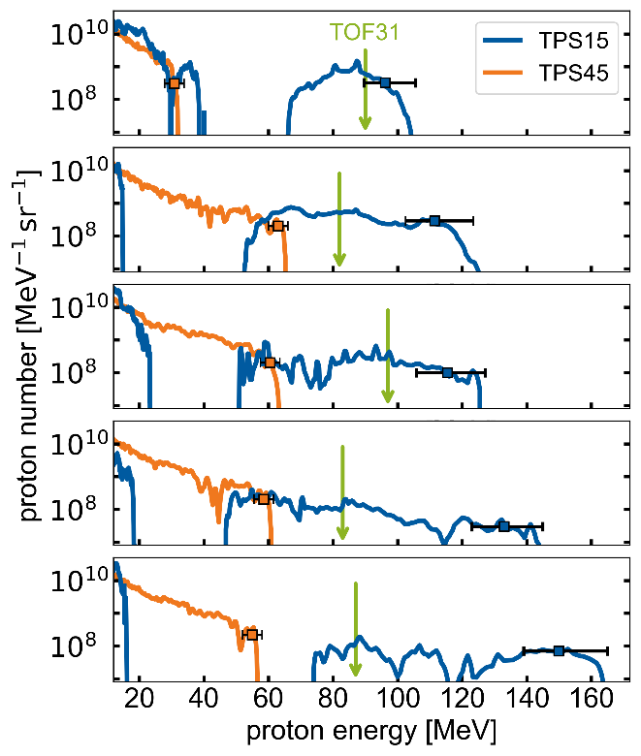
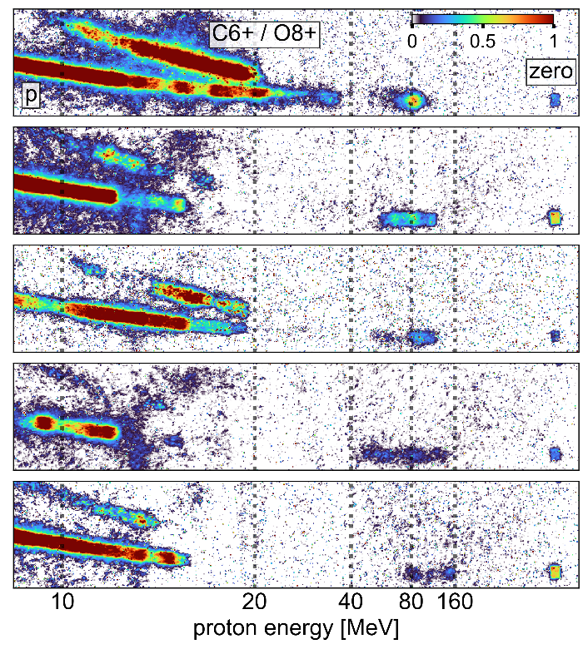
High energy component features spectral modulation
TPS45: one component
  exp. decay up to ~60MeV
TPS15: two components (bi-modal)
  exp. decay up to 15-40MeV
  separated high-energy component up to 150MeV
T. Ziegler et al. (in review)

Slide 13
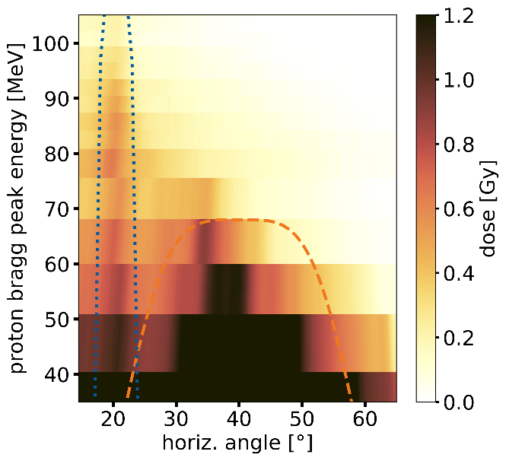
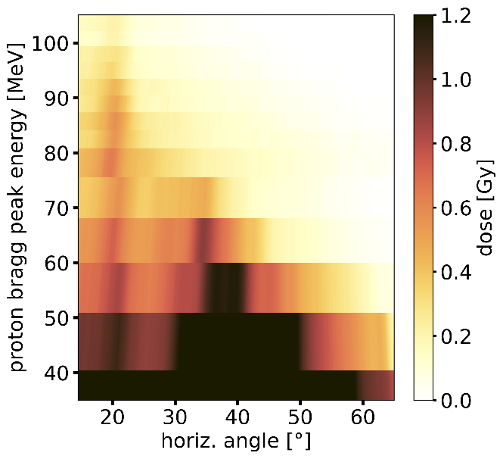
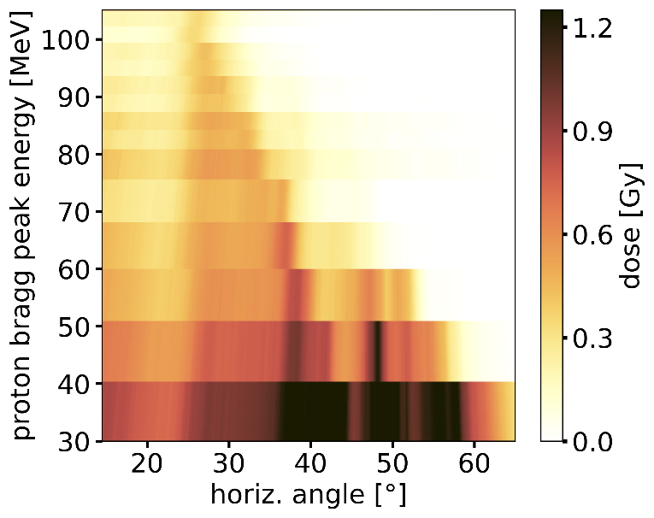
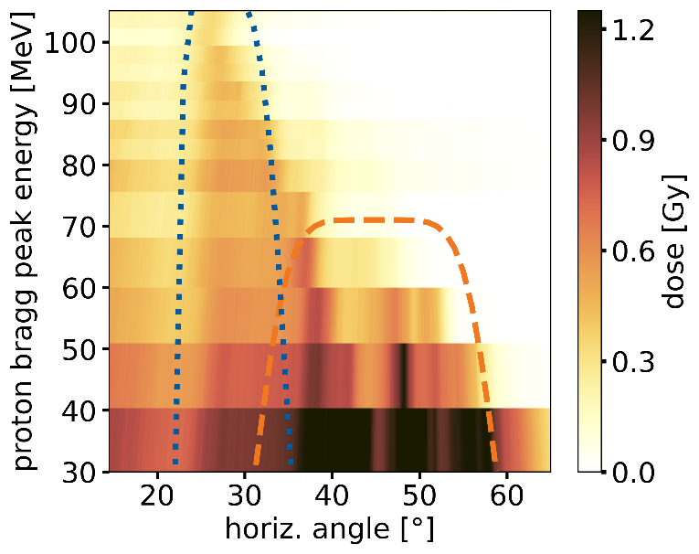
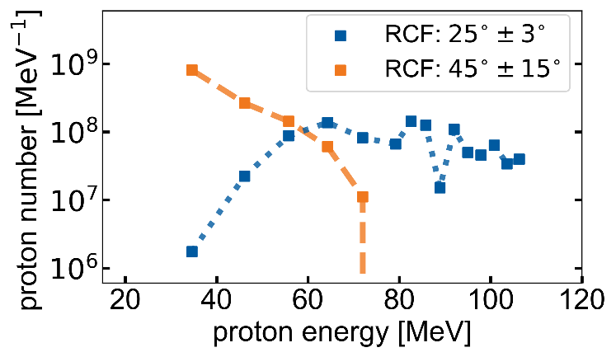
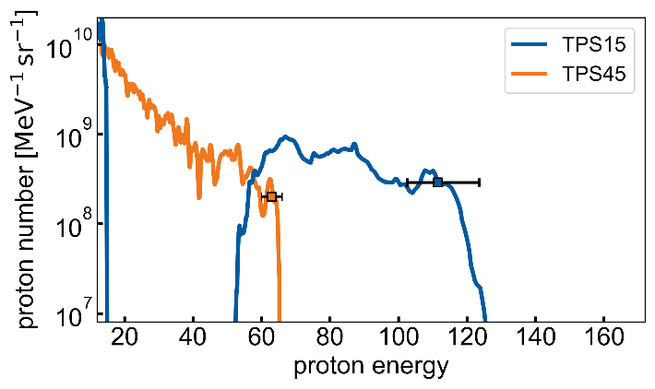
Radio-chromic films confirm spectral energies and directionality
bi-modal feature (low + high-energy component)
high-energy component with reduced divergence
high-energy component shifted towards laser axis
particle numbers match to TPS results
T. Ziegler et al. (in review)

Slide 14
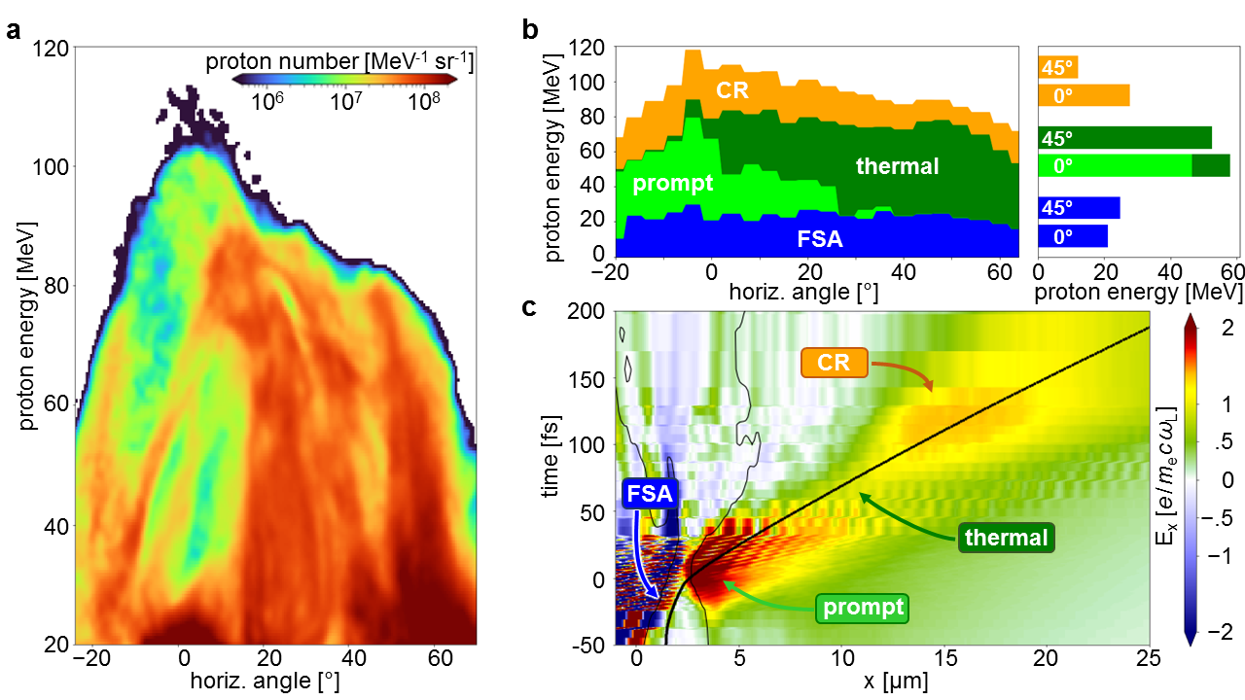

3D PIC simulations reveal a cascade of acc. regimes
Experimental data
Simulation data
multiple mechanisms contribute to energy gain:
FrontSide Acceleration (FSA)
prompt electrons
thermal sheath
Coulomb Repulsion (CR)
acceleration cascade

Slide 15

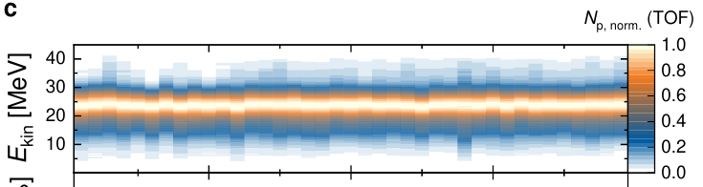
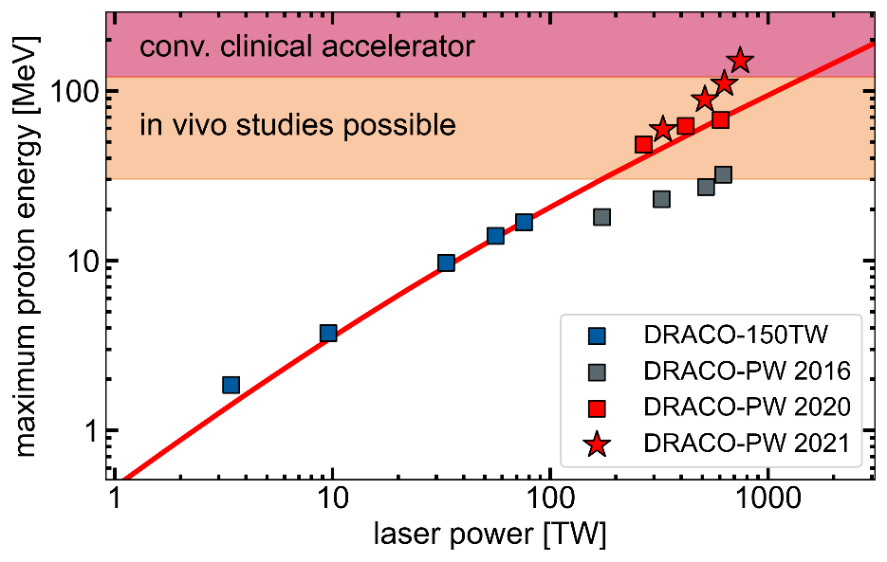
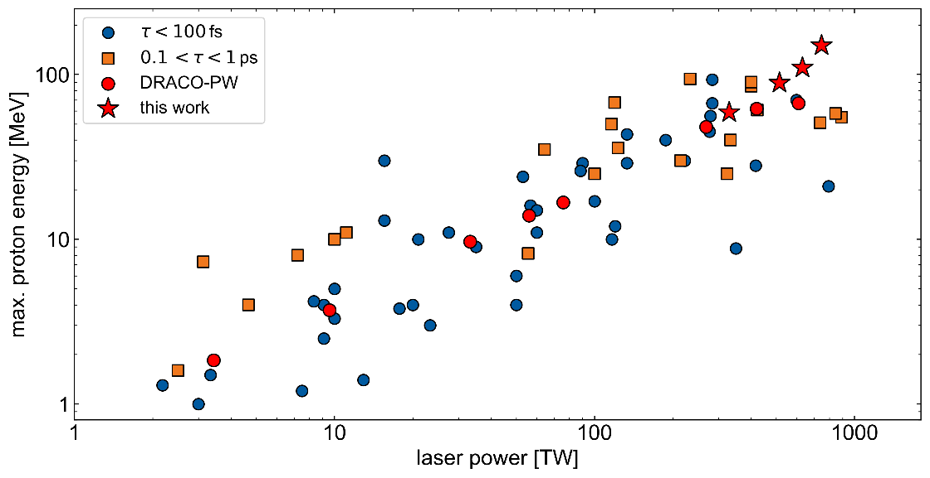
Systematic radiobiology studies with laser-driven ion beams are feasible
stable beam generation >60MeV → accelerator readiness reached
directed high energy beam >100 MeV → control needed

Slide 16


J. Pawelke, E. Beyreuther, K. Brüchner, E. Bodenstein, L. Karsch, E. Lessmann, M. Krause, E. Troost, N. Cordes, C. Richter, et al.
K. Zeil, J. Metzkes-Ng, C. Bernert, F. Brack, M. Garten, L. Gaus, S. Kraft, F. Kroll, M. Rehwald, M. Reimold, H.-P. Schlenvoigt, M.E.P. Umlandt, T. Kluge, M. Garten, I. Goethel
D. Albach, S. Bock, R. Gebhardt, U. Helbig, M. Löser, T. Püschel, M. Siebold et al.
T. E. Cowan, R. Sauerbrey, U. Schramm
N. P. Dover, A. Kon, M. Nishiuchi, H. Kiriyama et al.
Thank you!

