Slide 1

Data Management & Analysis
Michael Bussmann
Topic Speaker

Slide 2
Research Field Matter
Enabling science through frontier digital technologies
enables science by frontier digital technologies

Slide 3


Research Field Matter
Enabling autonomous, intelligent experiments

Slide 4
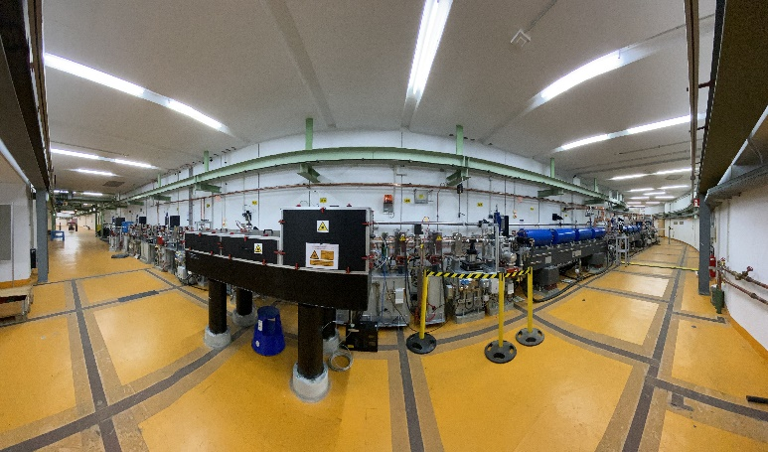
Research Field Matter
Autonomous accelerators
Autonomous accelerators
Prototypes towards fully autonomous, self-optimizing accelerators using machine learning.
Zero-shot sim2real transfer from high speed simulation to the real ARES accelerator @SINBAD.
Uses reinforcement learning to optimize accelerator performance, outperforming human optimisation.
Presented at IPAC & ICML.

Slide 5
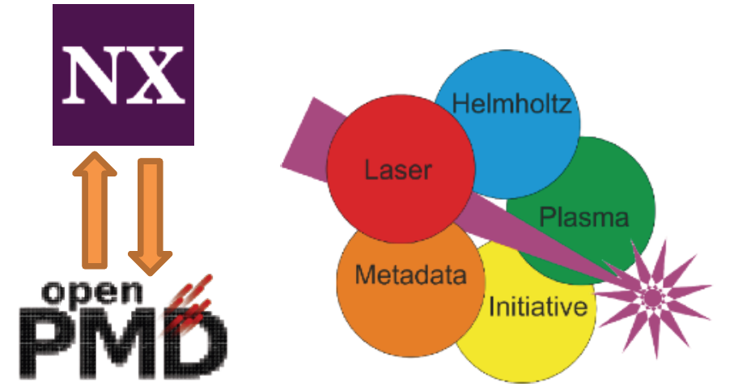
Research Field Matter
Autonomous beamlines
Full beamline optimisation for compact FELs driven by laser-plasma accelerators
COXINEL beamline
Laser-driven electron accelerator providing ultrashort nC bunches
Chicane setup for seeding the FEL
Compact FEL
Challenges:
Limited diagnostics → New detectors
Nonlinear dynamics → Understanding accelerators
Using normalizing flows one can create an invertible surrogate model of the complete beamline.
HELMPI

Slide 6
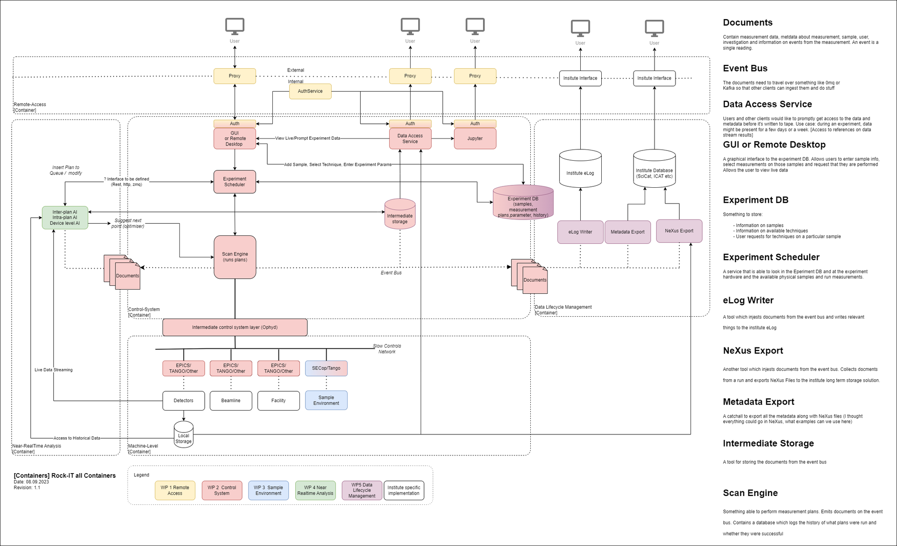
Research Field Matter
Autonomous experiments
ROCK-IT project
ROCK-IT aims at providng a prototype for a complete autonomous experiment at a beamline.
With catalysis as the selected application area, this includes
intelligent control systems
fast, scalable data analysis
autonomous accelerator operation
beamline optimization via feedback
experiment optimization
metadata collection

Slide 7
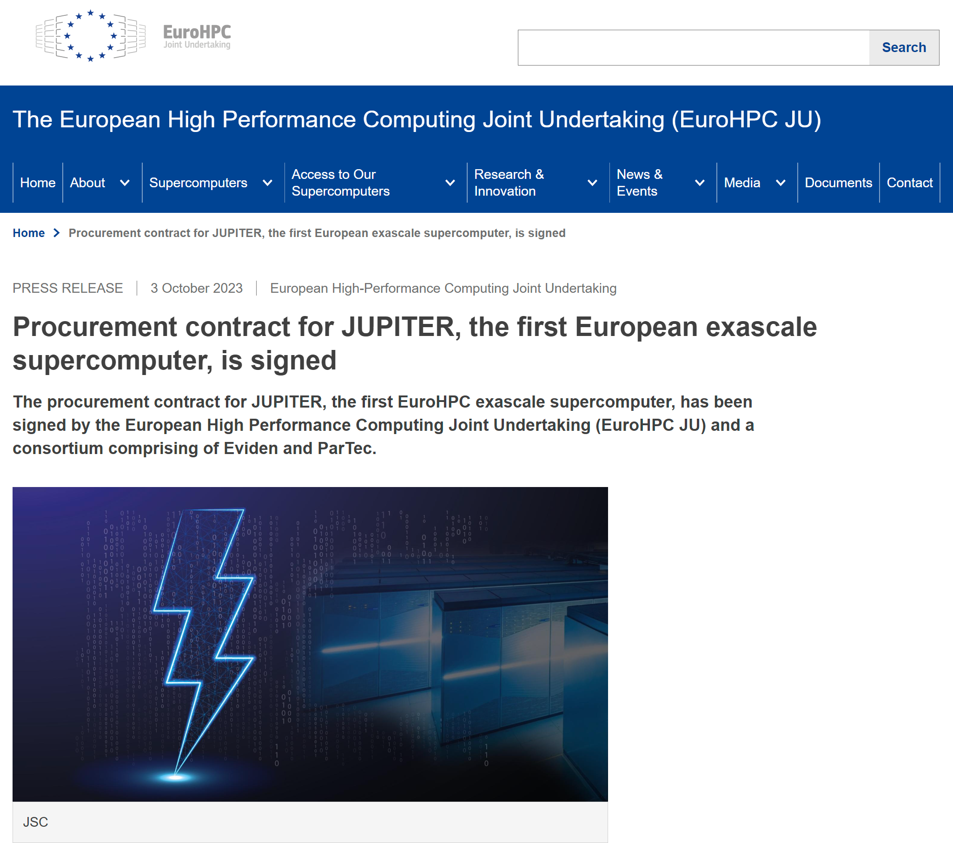
Research Field Matter
Enabling Technologies: Exascale Computing
Exascale computing as the frontier compute technology
Large-scale HEP simulations
Plasma simulations
In DMA we develop both the applications but also key components necessary to use such large-scale high performance computer systems for our science.

Slide 8
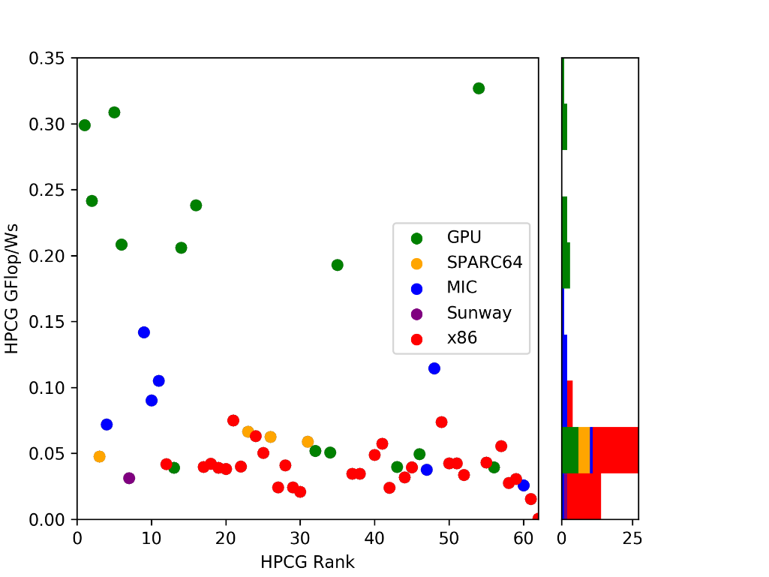
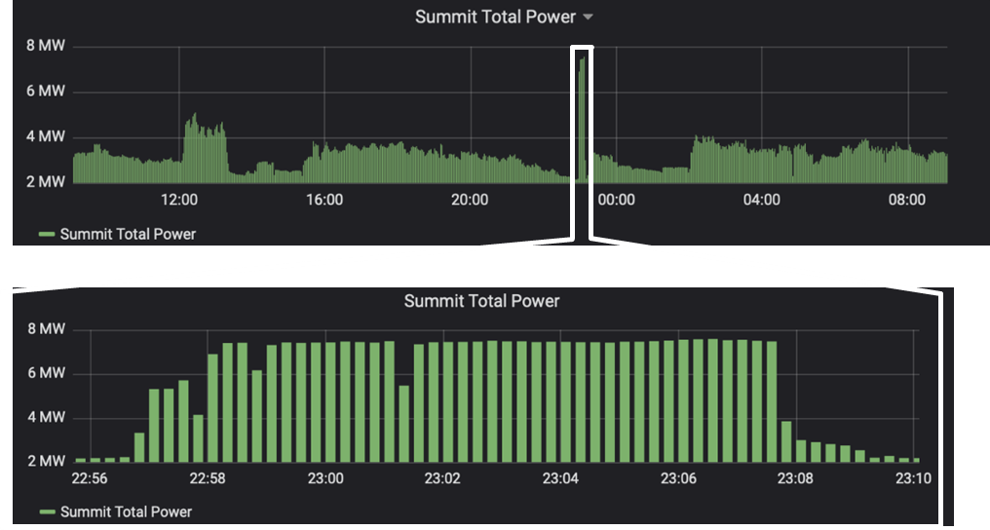
Research Field Matter
Better hardware, optimized software, better algorithms

Slide 9
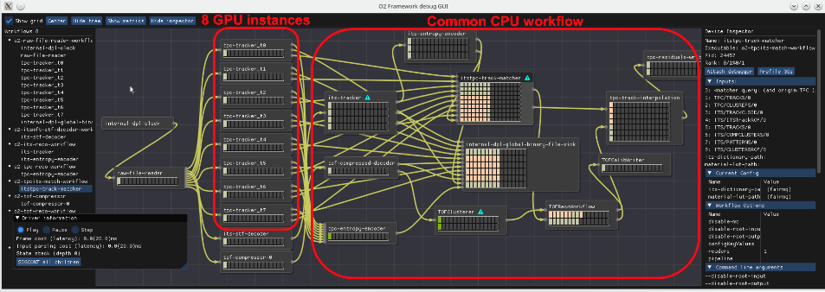
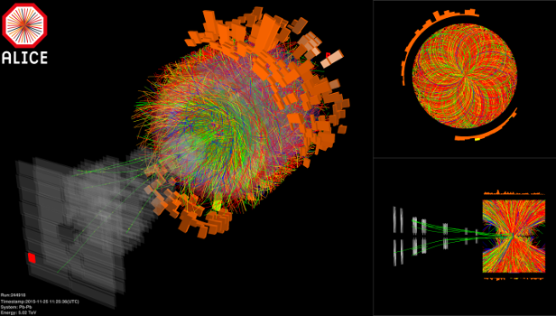
Research Field Matter
Integrating HPC into online experimental workflows
Alice O² with FAIRMQ + DDS + ODC
Modern heterogeneous compute systems are complex to use and provide dedicated resources for a variety of analysis and simulation workflows.
Optimum mapping of compute resources to the needs of experiments now requires to make use of large-scale high performance compute resources.
Breaking down complex workflows and dynamically distributing them on heterogeneous HPC systems is a key prerequisite to optimally use these systems.

Slide 10
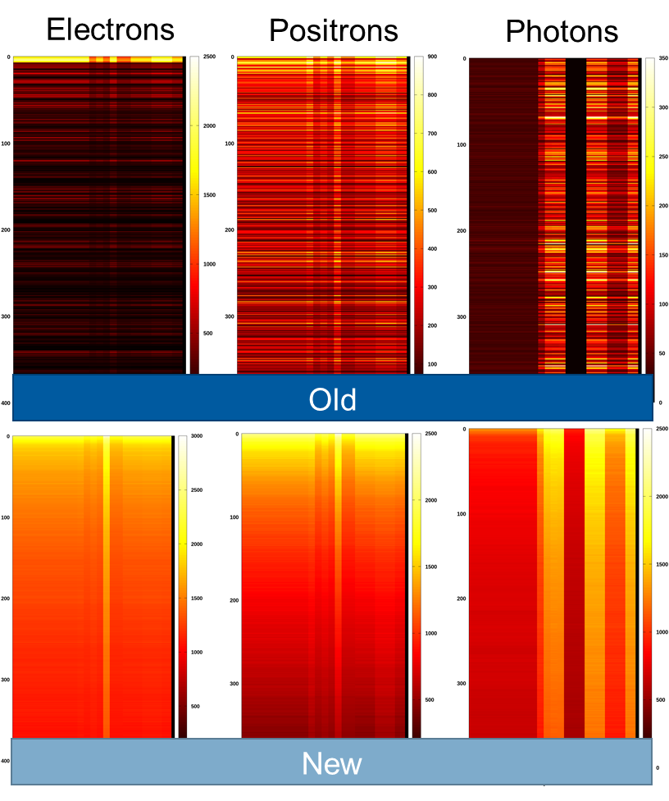




Research Field Matter
Common solutions for experiments & simulations
Exascale software stack for scalable data analytics & high performance computing
Heterogeneous computing with CPUs, GPUs, FPGAs
F.A.I.R. I/O, data streaming and open data formats
True cross-community use:
HEP, Photon Science, Neutron Science, Astrophysics, Plasma Science, Life science

Slide 11
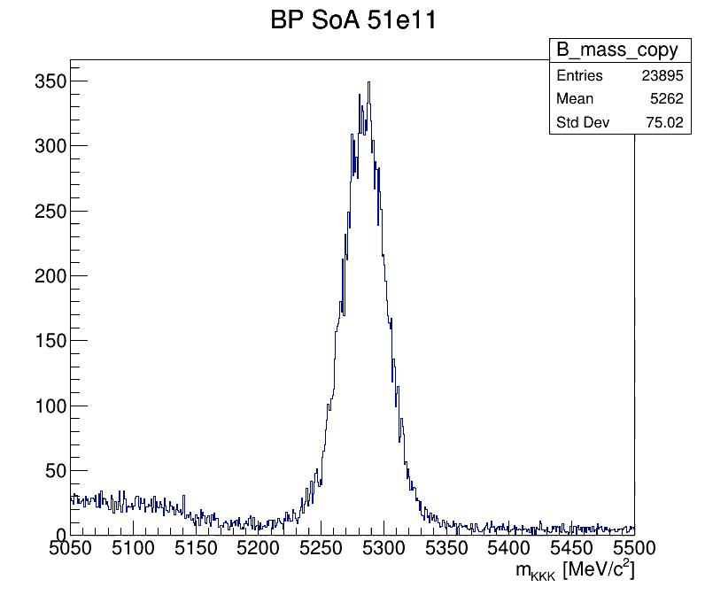
Research Field Matter
Common solutions for experiments & simulations
Analysis result with different mantissa bits
Optimizing data layouts
Reducing data sparsity
Reducing data volume
Reducing floating point computational cost
Reducing data rate
Increasing parallelism
Accelerating time to solution at constant hardware needs
All while keeping the relevant results with a given accuracy

Slide 12
Research Field Matter
Surrogate modeling in high energy physics
Diffusion models for EM Calorimeter showers
Generative AI as surrogate for expensive simulations
Full Geant4 simulations replaced by diffusion models (often used to create fake AI images)
Speadups of up to 46x on CPUs and up to 1873x on GPUs measured
Need to benchmark against full detector simulation workflows for reconstruction and analysis

Slide 13
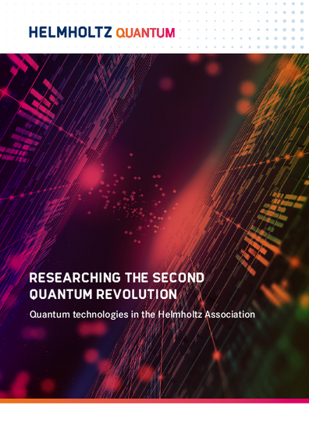
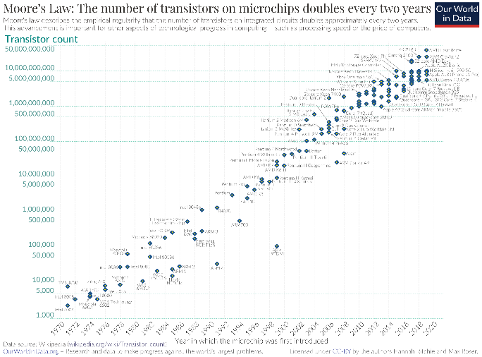
Research Field Matter
Enabling Technologies: Quantum Computing
Quantum simulations and machine learning as post-Moore and post-von-Neumann alternatives
Complex field theory simulations
Complex detector surrogate models
Many-body quantum systems

Slide 14
Research Field Matter
Quantum machine learning for HEP detector simulations
Quantum Computing for Particle Physics
Quantum Generative Adverserial Networks for fast detector simulations in Particle Physics.
Quantum Machine Learning can be used to develop surrogate models of particle detector signals of complex particle showers.
Standard detector simulations using Geant4 become increasingly resource demanding on classical compute devices.
Surrogate modeling using quantum algorithms can potentially reduce resource use.

Slide 15
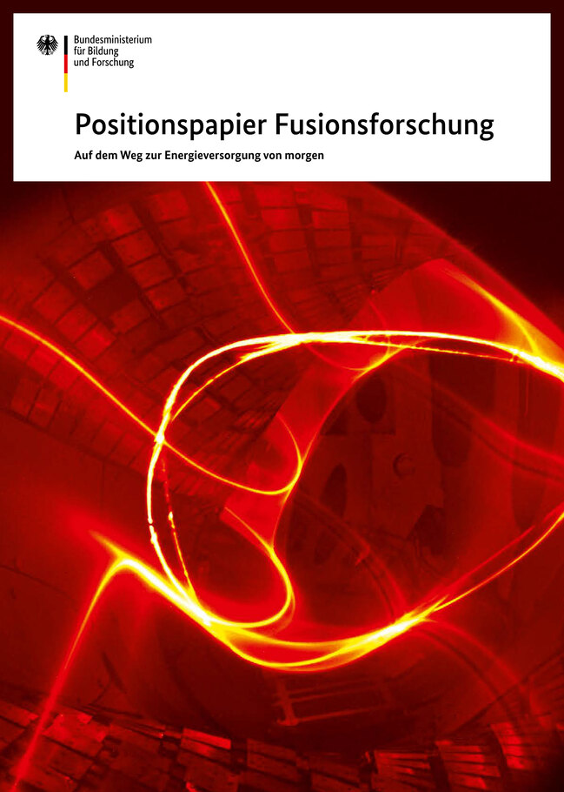
Research Field Matter
Providing competence
Fusion as a potential future energy source complementing regenerative energy
Needs understanding and control of underlying physics
Needs appropriate diagnostic tools and optimized drivers
Needs control and optimization of fusion process
Requires close cross-fertilization of modeling capabilities and technical implementation.

Slide 16
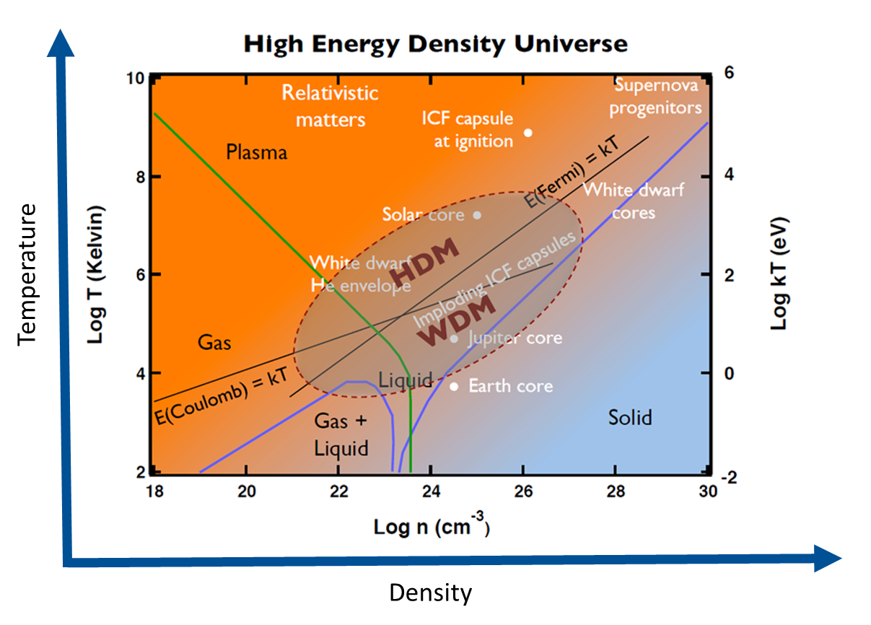
Research Field Matter
Bridging orders of magnitude in density and temperature

Slide 17
Research Field Matter
Fundamental understanding (many-body quantum systems)
Understanding hydrogen (and elements beyond) at extreme densities and temperatures
Usng ab-inition many-body quantum simulations and a new understanding of imaginary-time correlation functions one can now predict the structure and dynamics of warm dense hydrogen.
X-Ray Thomson Scattering experiments can now reveal fundamental properties of matter without the use of large-scale modeling or model assumptions.

Slide 18
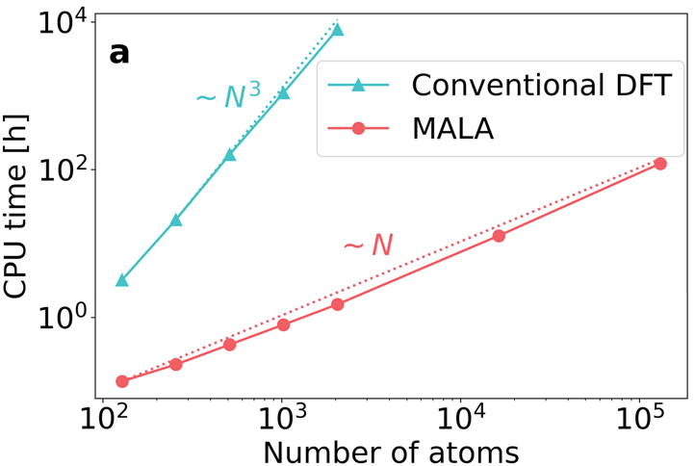

Research Field Matter
Structure & function of matter under extreme conditions
Multi-scale simulations of
matter under extreme conditions
For applications such as ICF we need multi-scale modeling of matter under extreme conditions.
This requires to connect the fundamental quantum
many-body dynamics with material properties and functions.
Machine learning surrogate models help to accelerate simulations and enable simulations at system sizes hitherto inaccessible.

Slide 19
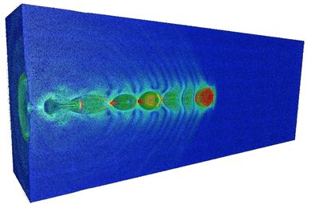

Research Field Matter
Exascale plasma physics for digital twins
Realistic digital twins of plasma systems
Exascale simulations of plasma dynamics at keV to MeV temperatures across a large range of densities requires Exascale capabilities
The simulation codes developed for this stem from ARD research in plasma cceleration but has since been adapted to understanding matter under extreme conditions as needed for inertial confinement fusion and magnetic confinement fusion.

Slide 20
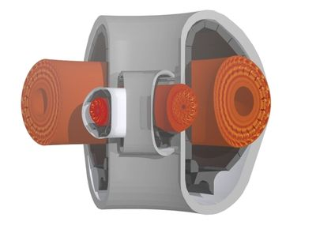

Research Field Matter
Exascale simulations for applications in plasma physics
Plasma-PEPSC
One of 4 European Centers of Excellence for Exascale Computing on Plasma Simulations for next generation supercomputers in Europe.
For the first time close collaboration between laser plasma and fusion community.
Laser-matter interaction
Matter under extreme conditions
Inertial confinement fusion
Magnetic confinement fusion

Slide 21
Research Field Matter
Enabling science through frontier digital technologies
provides sustainable digital solutions
engages with user communities
creates synergies
fosters talents
transfers knowledge
looks forward

Slide 22

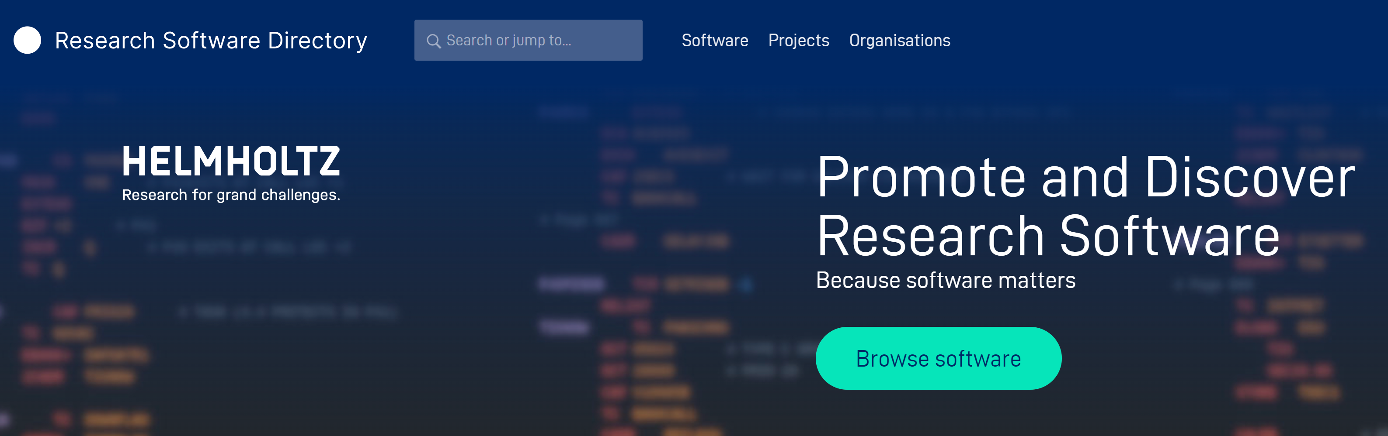
Research Field Matter
Sustainable solutions – Software = research infrastructure
DMA sustains ESCAPE Open-source scientific software
and service repository.
This provides not just the software but important metadata
for sustainable development and use of research software.
DMA teams up with Helmholtz Research Software
Directory, connecting it to the ESCAPE OSSR,
which combines the curation capabilities of
ESCAPE OSSR with the the active development of
research software solutions

Slide 23
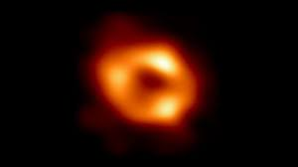
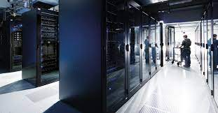
Research Field Matter
Engaging with user communities
Joint ErUM-Data / NFDI / DMA workshop on
Synergies in research data management
@MPI for Astrophysics, March 13th-14th 2023
DMA Synergy Workshop
strengthen synergies among facilities and communities
blueprint for a data lifecycle management prototype
@DESY, Nov. 8th-10th 2023

Slide 24

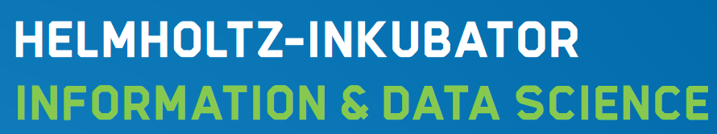


Research Field Matter
Creating synergies
Matter data-centric
science challenges
Sustainable data life
cycle from facilities to
user communities
Coordination with
European RIs
Developing & sharing
solutions

Slide 25














Research Field Matter
Creating synergies

Slide 26
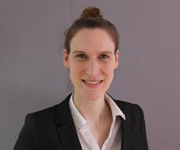

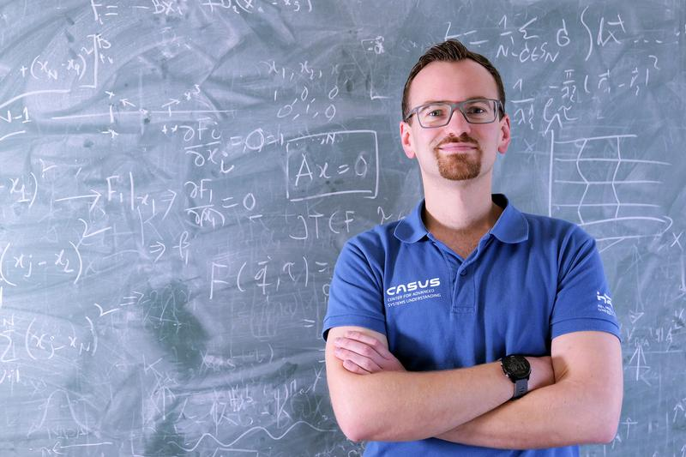

Research Field Matter
Fostering Talents
Annika Eichler Professor at TUHH since 2022
Intelligent control of particle accelerators
Tobias Dornheim received ERC starting grant in 2022
Warm dense matter research

Slide 27
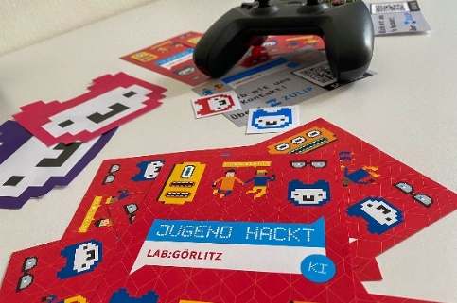


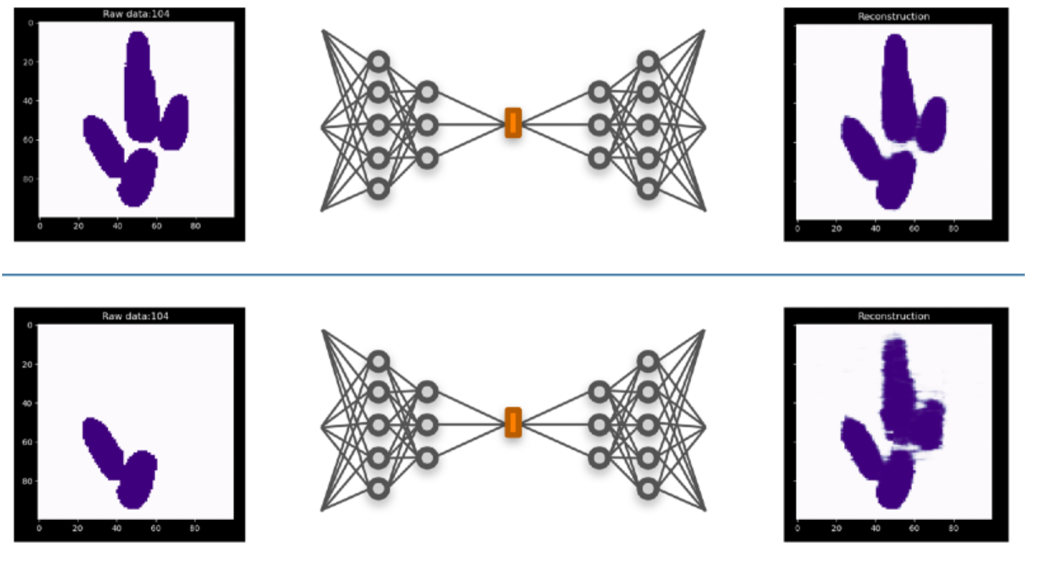
Research Field Matter
Transferring knowlegde
Jugend hackt Laboratory Görlitz 2nd place
Sächsischer Digitalpreis 2022
MALA suite for ML-accelerated multiscale modeling of
Matter under extreme conditions R&D 100 prize winner
in 2023
Reconstruct mising toes in dinosaur footprints by
generative models developed in photon science

Slide 28
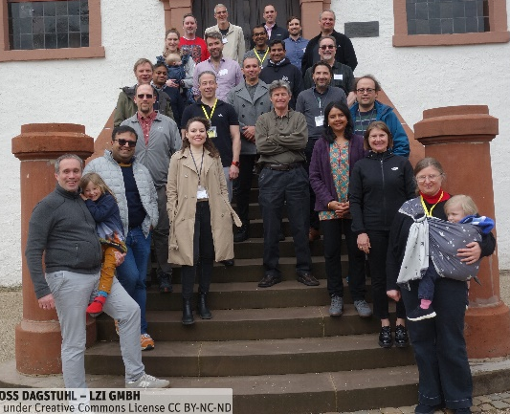




Research Field Matter
Looking forward
„Targeted challenge-driven access“ enabled by „intelligent, autonomous, integrated facilities“
Focus on data-driven science across user communities, taking up challenges, enabling discoveries
Frontier science through use of frontier technologies (AI, Exascale, Quantum, Edge, Cloud)
Intelligent, target-driven facility operation enabled by AI-integration of Machines, Experiments & Simulations

Slide 29
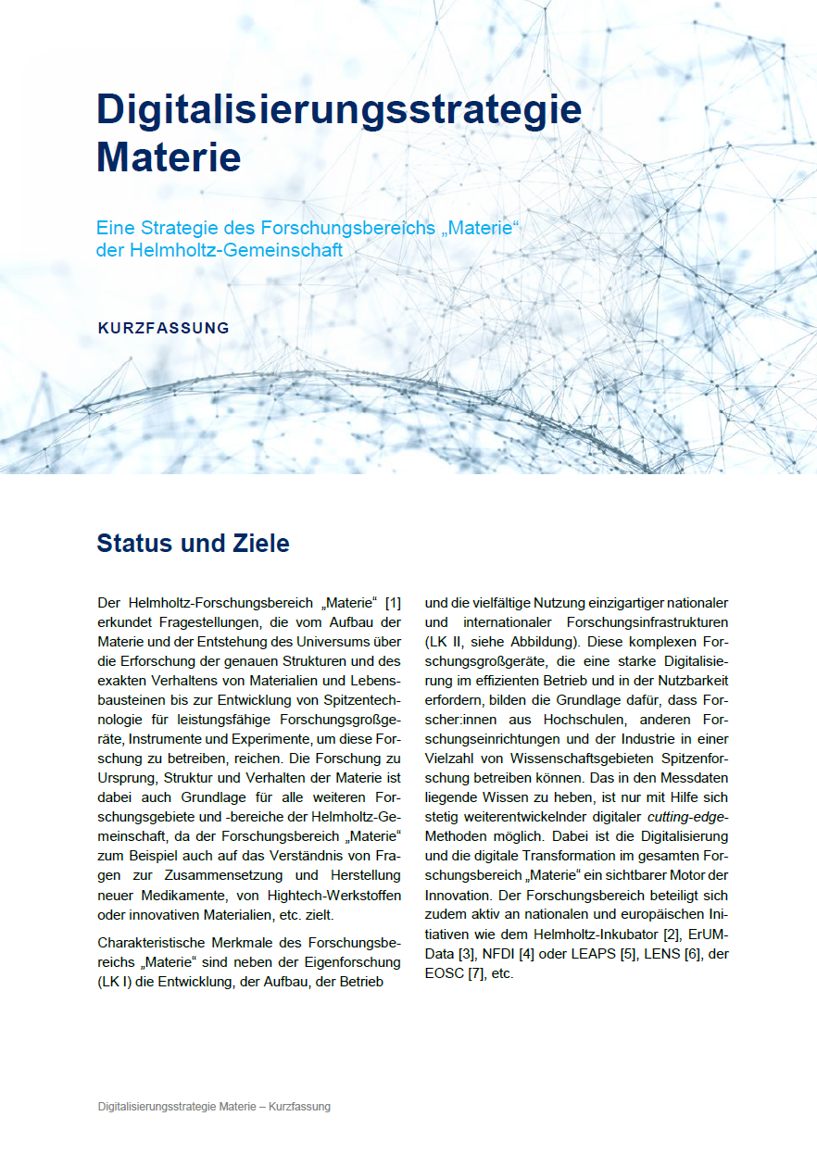
Research Field Matter
Digitalisation Strategy
A digitalisation strategy aligned with all Helmholtz centers in Matter for the whole Research Field.
Set up for cross research field collaboration
Fitting to the strategic position paper “Digitalisierungsstrategie der Helmholtzgemeinschaft”
Concrete measures to reach the goals of the strategy

Slide 30
Research Field Matter
Digitalisation Strategy
Enabling frontier science through federated compute, data and service infrastructures across centres and communities
Sustaining technological leadership in scientific simulation, data analytics and machine/experiment control through cutting edge technologies such as AI, Exascale and Quantum Computing
Providing an integrated support infrastructure for the diverse user communities of our research infrastructure
Supporting user communities in disseminating and using scientific data in an open, sustainable and F.A.I.R. way (Open Science!)
Developing and building large-scale research infrastructures using modern IT technologies
Developing and using intelligent and autonomous systems for maintenance/operation of machines, instruments & experiments
Using resources sustainably, from energy to materials, from data to software
Fostering the careers of young researchers in computer, information and data science
Cooperating with industry partners on applied research
Growing transfer of knowledge and technologies to industry and society both nationally and internationally

Slide 31
Research Field Matter
Looking back and ahead
The Matter digitalization strategy is a forward looking approach towards data-driven science in Matter
Third-party funded initiatives have helped to support an otherwise underfunded topic
Since 2019 funding of AI, Exascale computing, data-driven science has taken up pace
DMA will adjust to this new landscape, must define interfaces between facilities and user communities
DMA will leverage synergies with the third-party funded activities and invest in new technologies
DMA will → set priorities for realising the Matter digitalisation strategy → focus on core competencies → select and provide key components & solutions

Slide 32
Research Field Matter
Towards POF V
Requirements
Data
Sustainability
Discovery
Challenge-driven
Opportunities
Technologies
Intelligence
Automation
Facilities

Slide 33
Research Field Matter
Towards POF V
Key components & solutions
Autonomous experiments
Autonomous, intelligent facilities
Current
End POF IV
POF V

Slide 34
Research Field Matter
Data
Towards POF V
DMA will focus on key building blocks for data-driven science
Focus on excellent data-driven science that is sustainable
  Intelligent data reduction for science
  Integrated infrastructure from edge to data center
  F.A.I.R., open data, synergies with communities
Algorithms for frontier technologies as science drivers
  AI, Exascale, Quantum, Edge, Cloud, federated, …
  Intelligent algorithms (analysis, control, …)
  Sustainable, reusable solutions
Autonomous, intelligent, integrated systems
  Combine machines, experiments, simulations and human users to steer towards discoveries
  Enable targeted, challenge-driven access
  Connect facilities and user communities
  Optimize usage of facilities (discovery, impact, challenges, energy, …)
Autonomous, intelligent facilities for data-driven science
Algorithms
Systems

