Slide 1
Metallic Magnetic Calorimeters Applied for Precision X-Ray Spectroscopy of
He-like Uranium
Philip Pfäfflein
Helmholtz Institute Jena
9. Annual MT Meeting, 11/10/2023

Slide 2
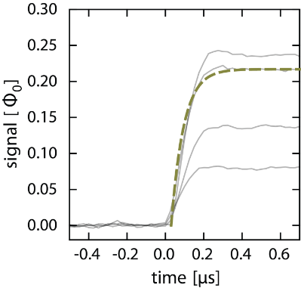
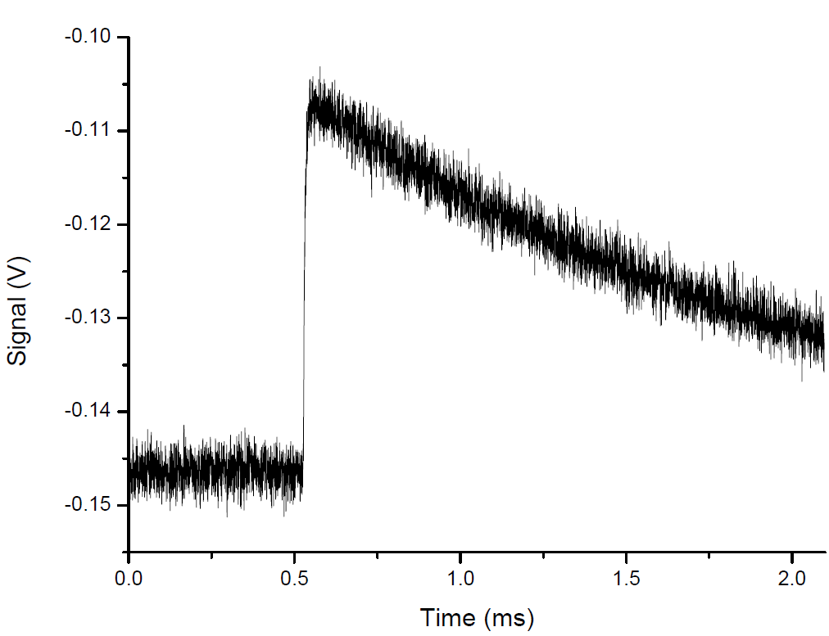
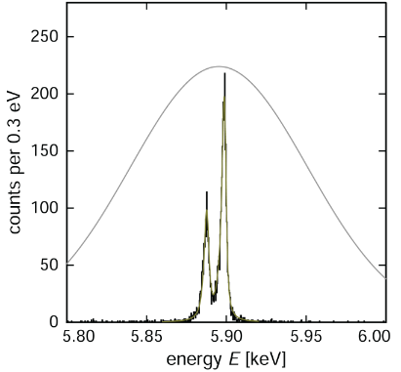
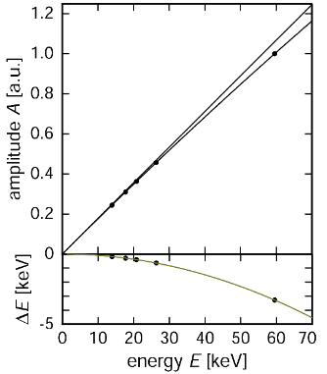


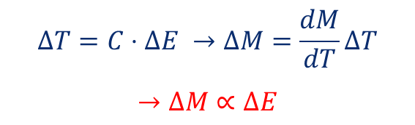
Metallic Magnetic Calorimeter (MMC)
Fast signal rise time
Developed by the group of C. Enss and A. Fleischmann in Heidelberg:
maXs: microcalorimeter arrays for high-resolution X-ray spectroscopy at GSI/FAIR
Photon: $ΔE$
Decay constant: few ms
High energy resolution
⁵⁵Mn, K_{α}
Known characteristic
Signal: $ΔM →ΔΦ$
$$ΔT=C⋅ΔE →ΔM=\frac{dM}{dT}ΔT$$
$$→ΔM∝ΔE$$
Rise time: few µs

Slide 3
maXs Detector System: Design Considerations
Trade-off between active area and stopping power as sensor volume (=heat capacity) determines energy resolution.

Slide 4
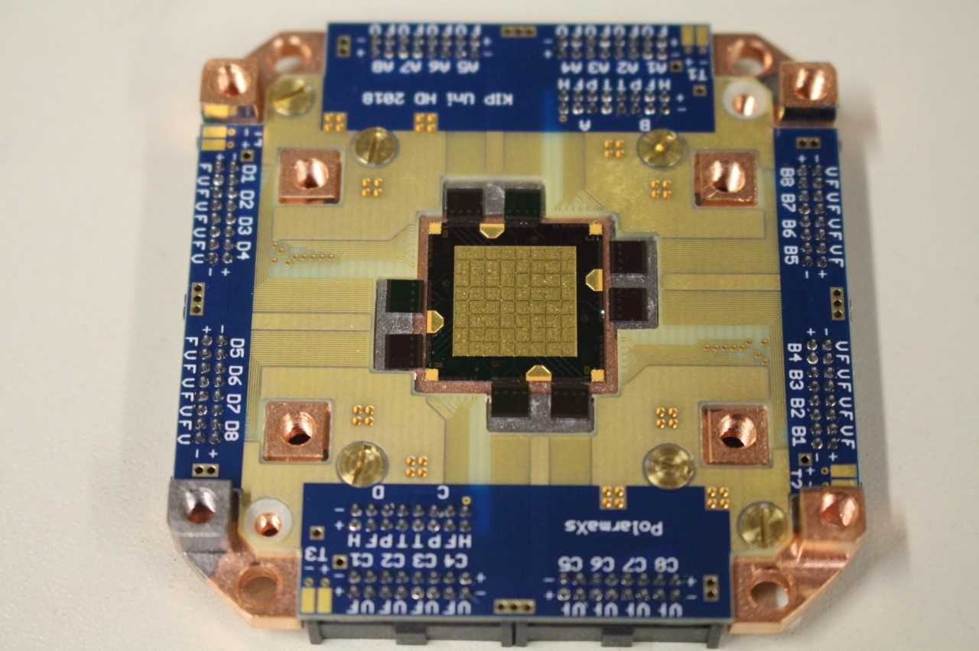
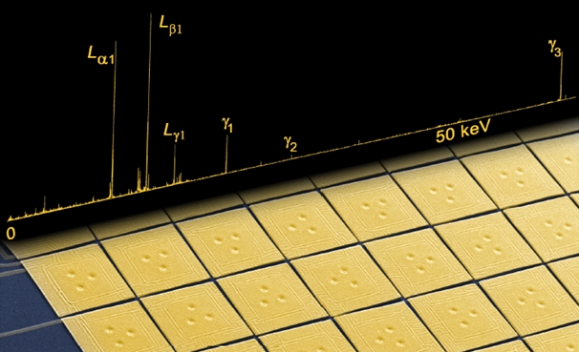

maXs-100 an MMC Optimized for 100 keV Photons
Detector parameters:
Active area: | 100 mm² (64 pixels, 1.25 x 1.25 mm² each)
FWHM at 60 keV: | 60 eV
Efficiency (QE) at 100 keV: | > 40%
maXs-100
Kα₂
Kα₁
z
y
x
w
Measurement :
A. Gumberidze et al., PRL 032712 (2004)
developed within
Notes:
Area comparable to high res semiconductor detectors

Slide 5
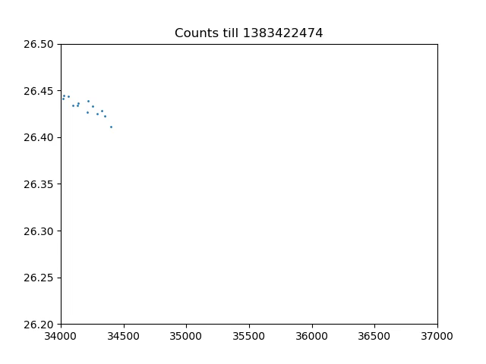
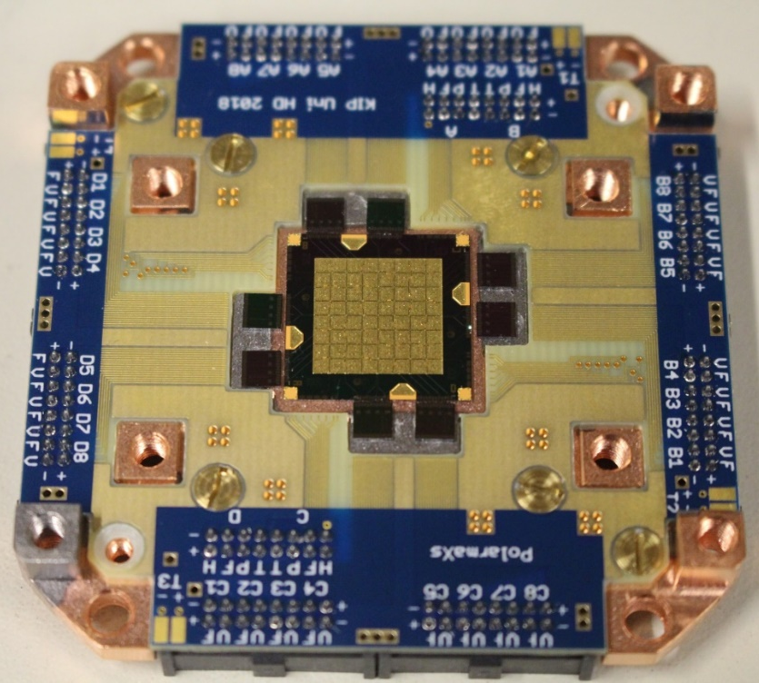
Temperature Dependant Gain of Microcalorimeters
Detector characteristics differ per pixel
Especially the gain is temperature sensitive
Gain varies with time
Application of extensive post processing necessary on a per pixel level
a)
b)
>1keV
„Gain“
d)
c)
<90eV
„Temperature“

Slide 6
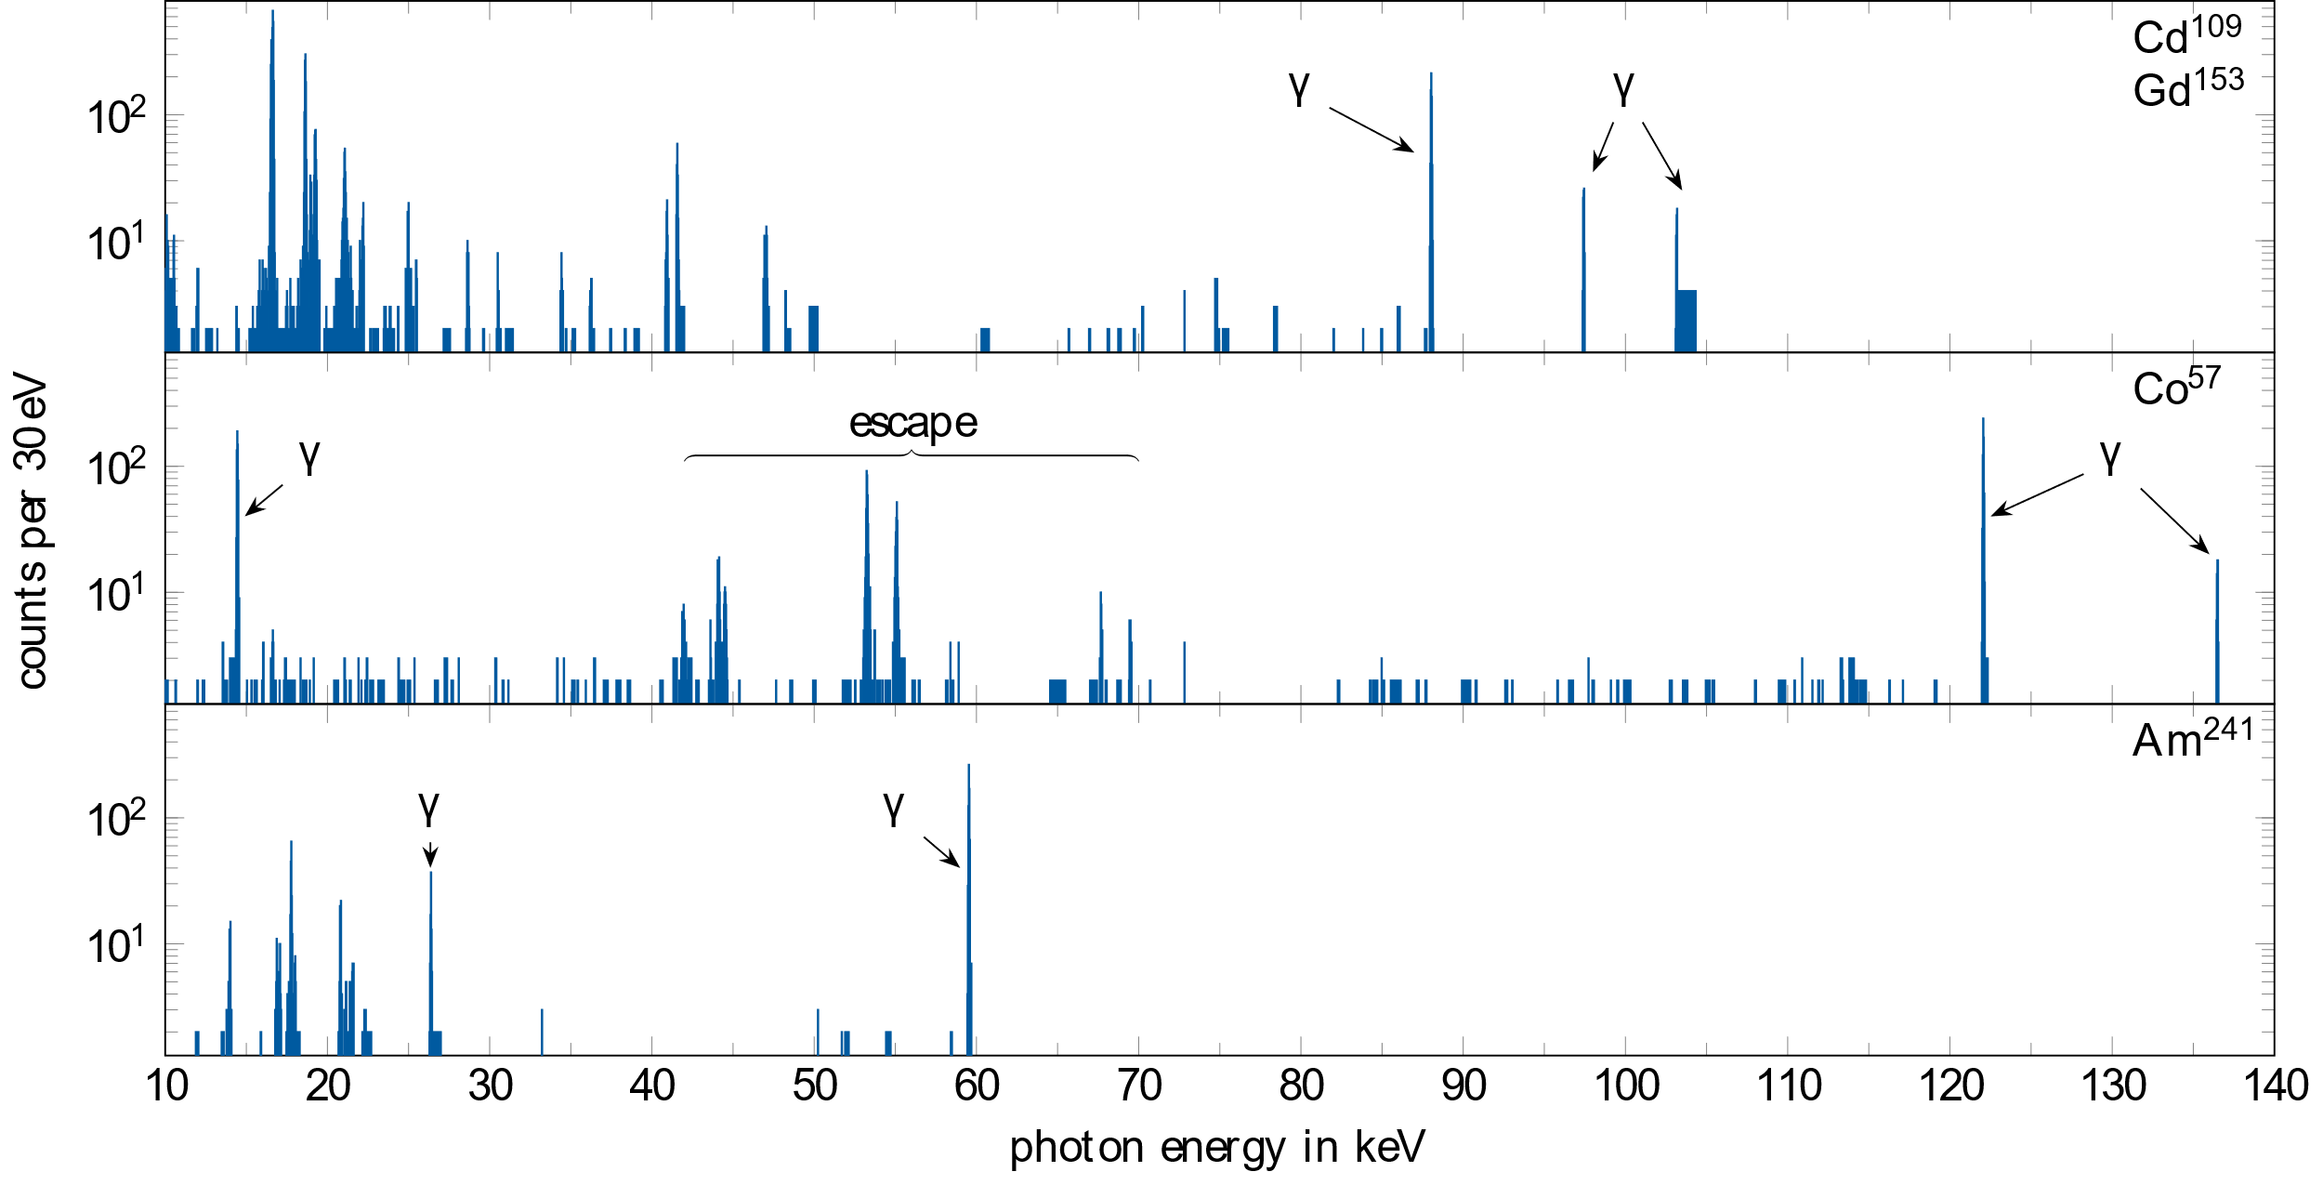
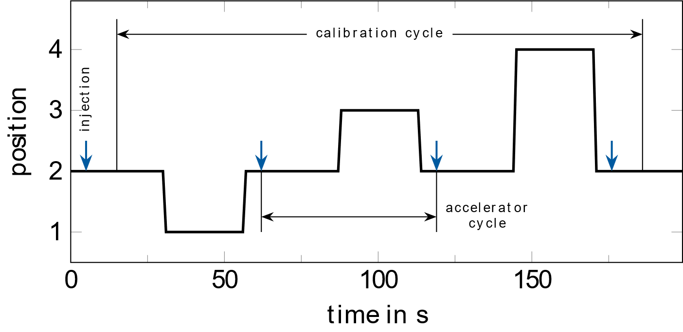
Continuous Calibration
foundation of high accuracy measurement
requirements:
  Well known line close to lines of interest
  MMCs require constant tracking of gain characteristic (calibration)
features:
  readout of source position → fed into DAQ
  continuous synchronised calibration
Notes:
Keep it short: pulsed nature of detector operation leaves significant amount of time for continous calibration.

Slide 7
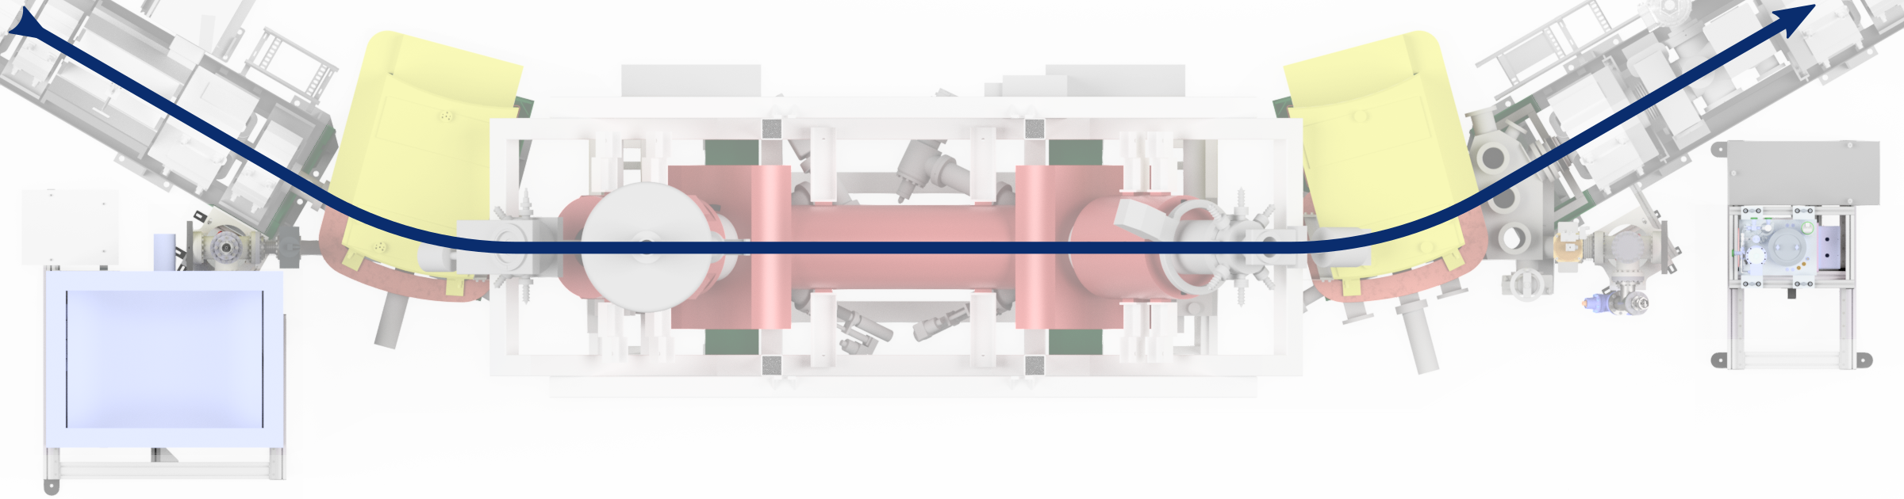
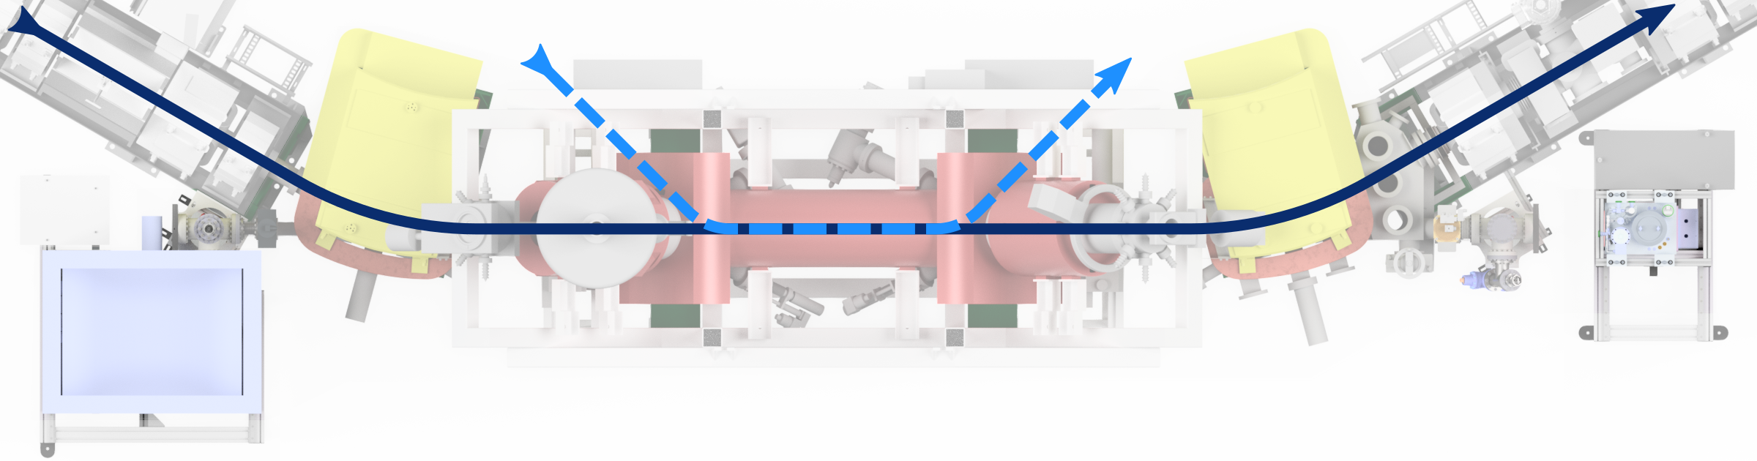
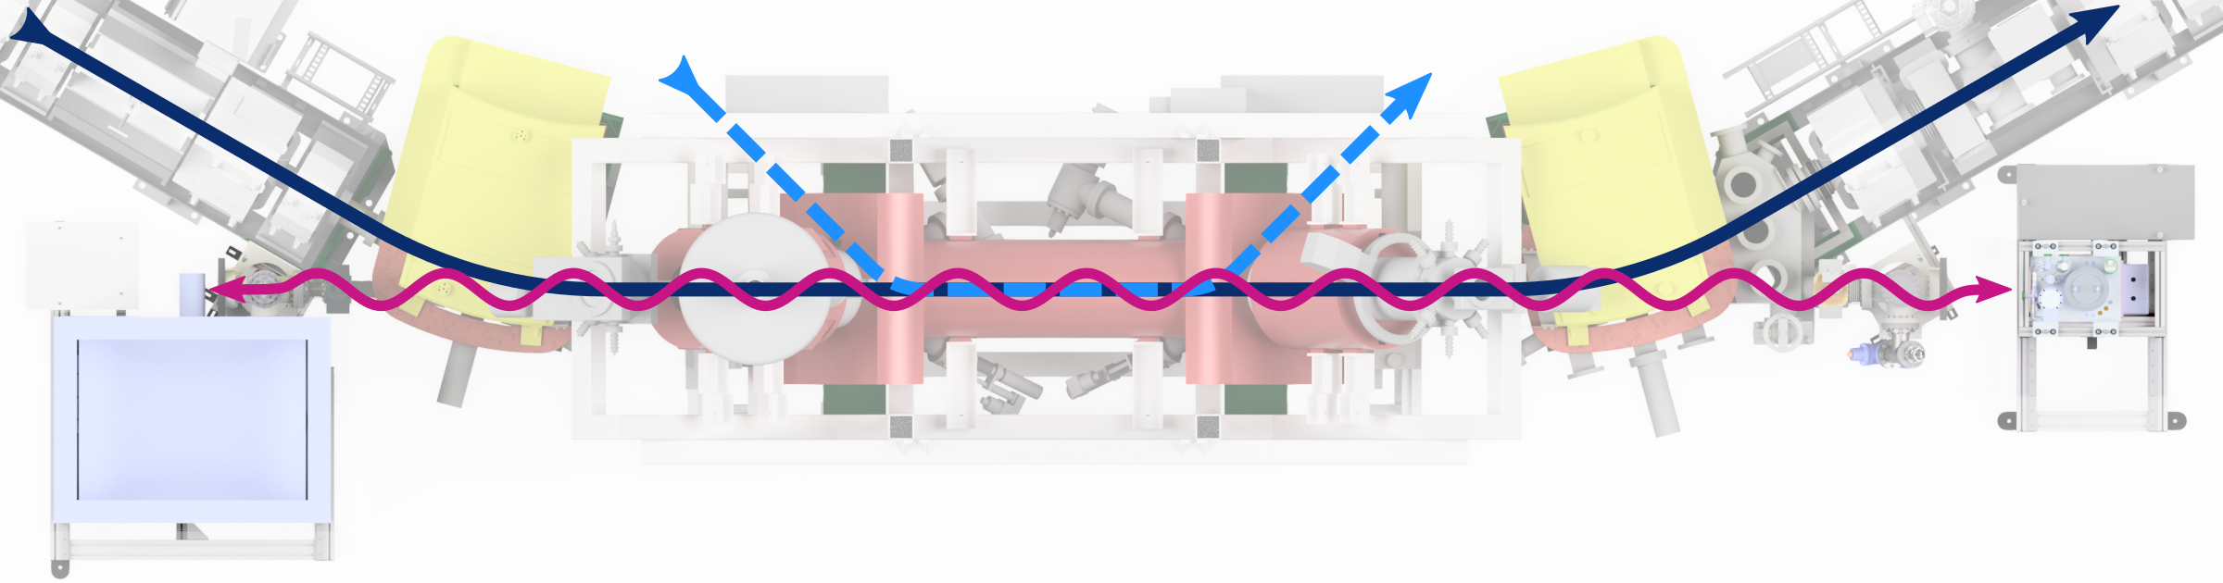
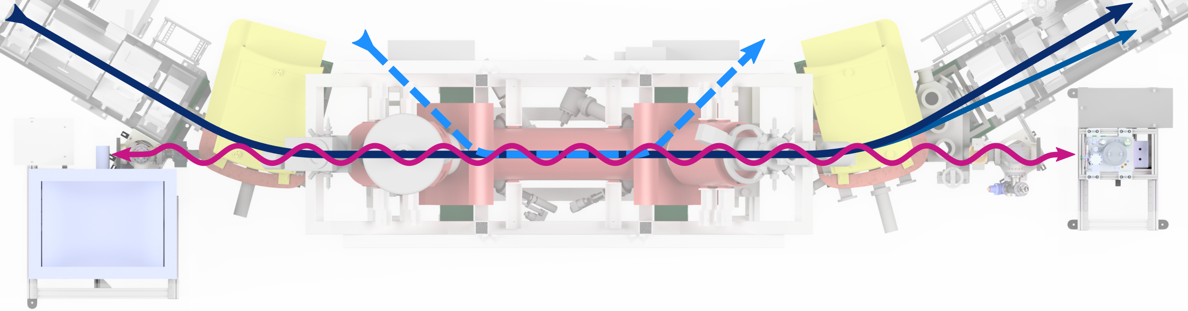

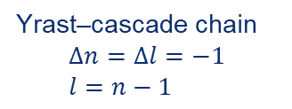
Experimental Approach: Production of Excited HCI
s
p
d
f
l=96
l=97
l=98
l=99
free electron
n =100
n = 99
E_{kin}
continuum
n = 4
M-shell
n = 3
L-shell
Yrast–cascade chain
$$Δn=Δl=−1 \\ l=n−1$$
n = 2
ħω
particle detector
K-shell
n = 1
electron beam
U⁹¹⁺
U⁹⁰⁺
x-ray detector
x-ray detector

Slide 8
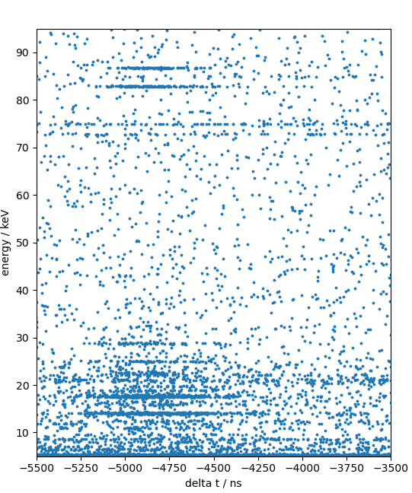
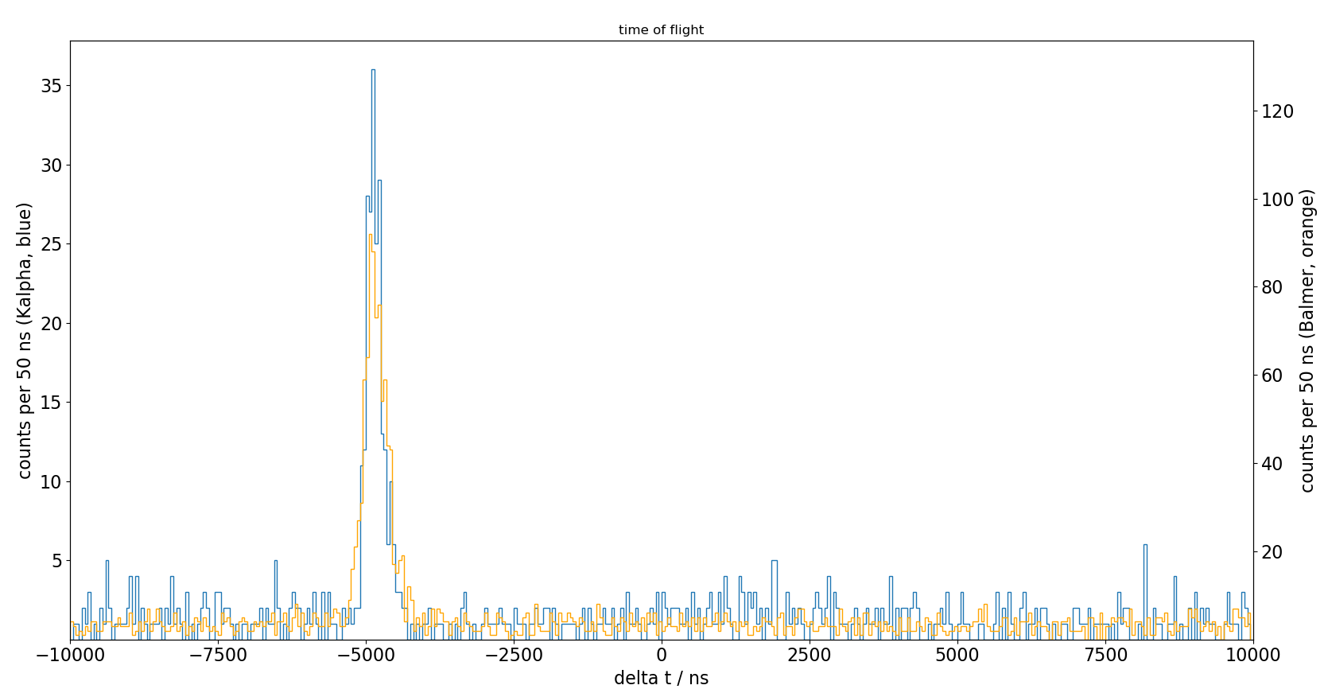
Background Suppression via Coincidences with U⁹⁰⁺ Ions
First utilisation of time resolution of the maXs detector for suppression of background radiation via coincident measurement with down-charged ions.
time of flight photon signal vs particle detector signal
Coincidence Peak
Δt ≈ 300 ns FWHM
Balmer
K_{α}

Slide 9
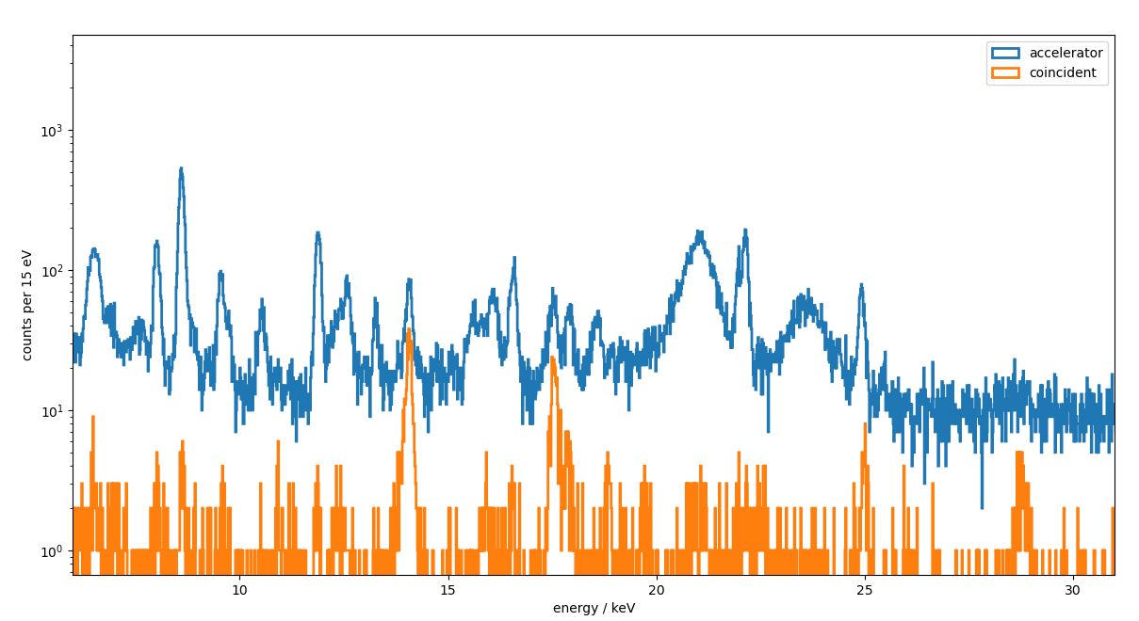
Background Suppression via Coincidences with U⁹⁰⁺ Ions
[1s_{1/2}, 3d_{5/2}] → [1s_{1/2},2p_{3/2}]
[1s_{1/2}, 3d_{3/2}] → [1s_{1/2}, 2p_{1/2}]
Preliminary Results

Slide 10
A Glimpse at the Balmer Region
180°
Preliminary Results
0°

Slide 11
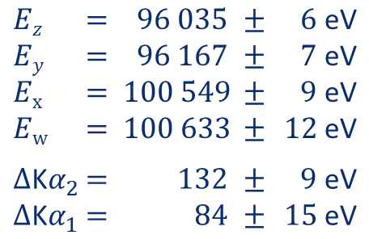
Measured Spectra of the Kα-transitions
74 eV
¹P₁
³P₂
Kα₁ (w)
Kα₁ (x)
180°
Kα₂
Kα₁
¹S₀
³P₀
142 eV
³P₁
z
y
x
w
³S₁
Kα₂ (z)
Kα₂ (y)
¹S₀
Preliminary Results
Preliminary results
(to be published soon):
0°
Kα₂
Kα₁
$$Ez$$ | $$=$$ | $$96 035$$ | $$±$$ | $$6 \text{eV}$$
$$Ey$$ | $$=$$ | $$96 167$$ | $$±$$ | $$7 \text{eV}$$
$$Ex$$ | $$=$$ | $$100 549$$ | $$±$$ | $$9 \text{eV}$$
$$Ew$$ | $$=$$ | $$100 633$$ | $$±$$ | $$12 \text{eV}$$
$$Δ\text{K}α_{2}$$ | $$=$$ | $$132$$ | $$±$$ | $$9 \text{eV}$$
$$Δ\text{K}α_{1}$$ | $$=$$ | $$84$$ | $$±$$ | $$15 \text{eV}$$
z
y
x
w
Preliminary Results

Slide 12
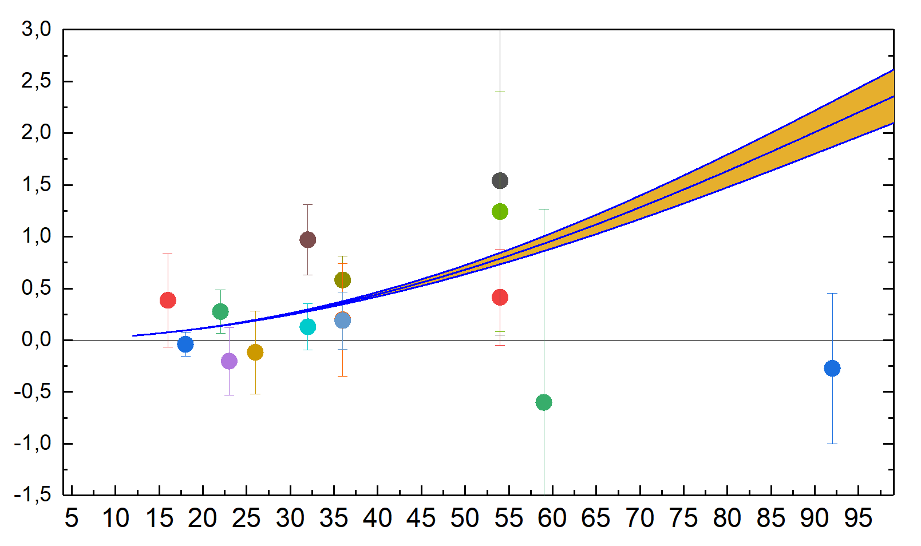
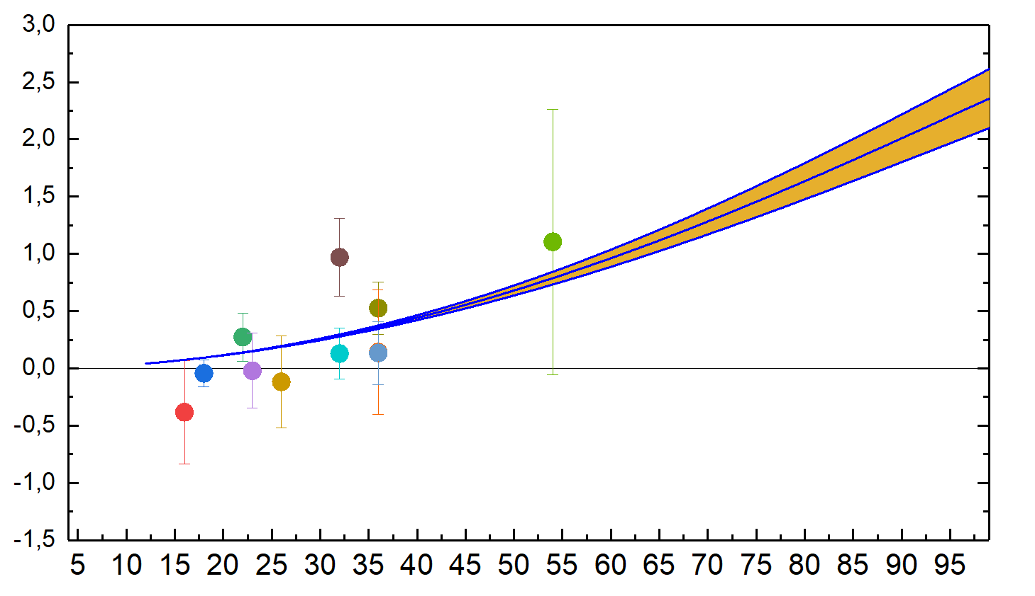
Measured Spectra of the Kα-transitions
74 eV
¹P₁
³P₂
Kα₁ (w)
Kα₁ (x)
180°
Kα₂
Kα₁
¹S₀
³P₀
142 eV
³P₁
z
y
x
w
³S₁
Kα₂ (z)
Kα₂ (y)
¹S₀
Preliminary Results
y - line
Discrepancy scales with Z⁴
PRL 109, 153001 (2012)
but highly disputed
0°
Kα₂
Kα₁
z
y
x
w
PRELIMINARY
(exp.-theory)/theory*10⁵
No data for Z > 59 available
Atomic number Z

Slide 13





Summary and Outlook
Summary:
Two maXs-100 MMCs have been used to obtain high resolution spectra at CRYRING@ESR in the energy range 10 – 120 keV
Correction of temperature dependant gain has been adapted to include 4 readings
Timing capabilities of MMC detectors have been used in a coincidence measurement
MMCs have proven to reliably work in the harsh EM-environment even close to kicker magnet
Outlook:
Further development of data analysis routines
Application of lower energy maXs-detectors as well as higher pixel count MMCs
Further optimisation of MMC specific cryostats

Slide 14















A Shoutout to the Involved Colleagues and Funding Agencies
S. Bernitt
O. Forstner
Ch. Hahn
M. O. Herdrich
E. B. Menz
T. Over
G. Weber
B. Zhu
Th. Stöhlker
S. Allgeier
A. Fleischmann
M. Friedrich
D. Hengstler
P. Kuntz
C. Enss
Z. Andelkovic
J. Glorius
A. Gumberidze
F. Herfurth
A. Kalinin
M. Lestinsky
B. Löher
N. Petridis
R. S. Sidhu
U. Spillmann
S. Trotsenko
Everybody involved
M. Kiﬀer
F. M. Kröger
M. Kubullek
S. Ringleb
A. Borovik
P.-M. Hillenbrand
A. Warczak
L. Duval
42 shifts (=14 days) of beam time at CRYRING@ESR had been granted for E138 (Lamb shift study on H-like Uranium)

Slide 15
Appendix

Slide 16
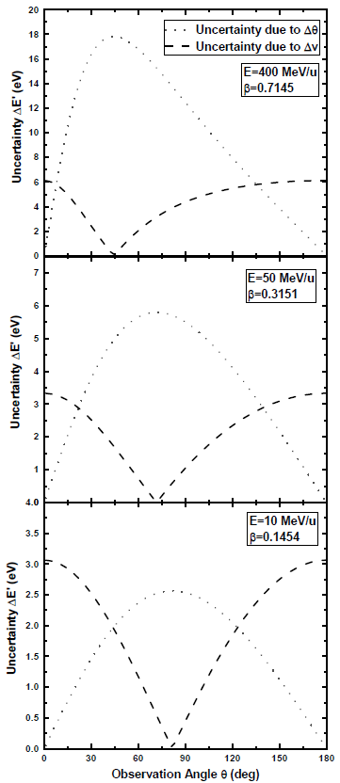
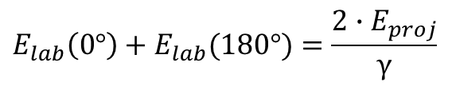
Advantages of Microcalorimeters at CRYRING Electron Cooler
Uncertainties due to relativistic Doppler shift are greatly reduced at a low beam energy and with two detectors at 0° and 180°.
$$E_{lab}\left(0°\right)+E_{lab}(180°)=\frac{2∙E_{proj}}{γ}$$
E_{lab}: Photon energy in the laboratory system
E_{proj}: Photon energy in the emitter system

Slide 17
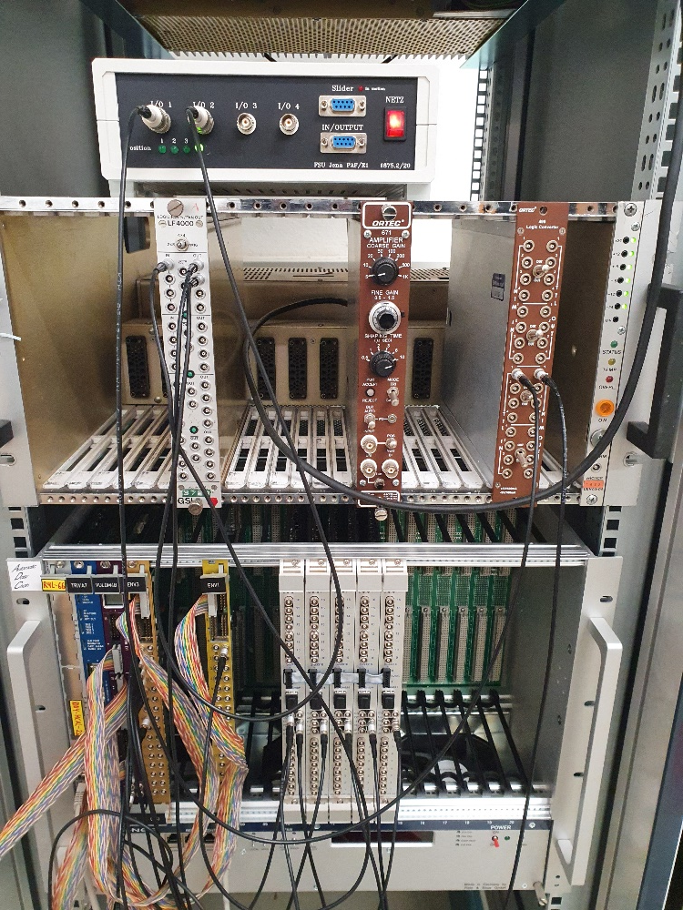
New MBS-based DAQ Systems for maXs-detectors
Digitized Detector Signal
Common: SQUID-electronics
using the same type of 16 channel struck ADCs
Newly tested: MBS based DAQ producing lmd files
Advantages: Seamless integration into heterogeneous detector environment at GSI/FAIR.
First test and evaluation of the data in July and the following months. Two major bugs where found and could be fixed till now.

Slide 18
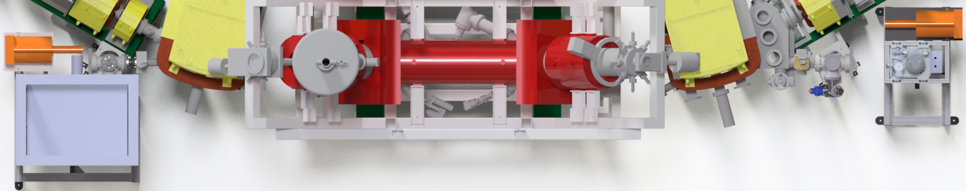
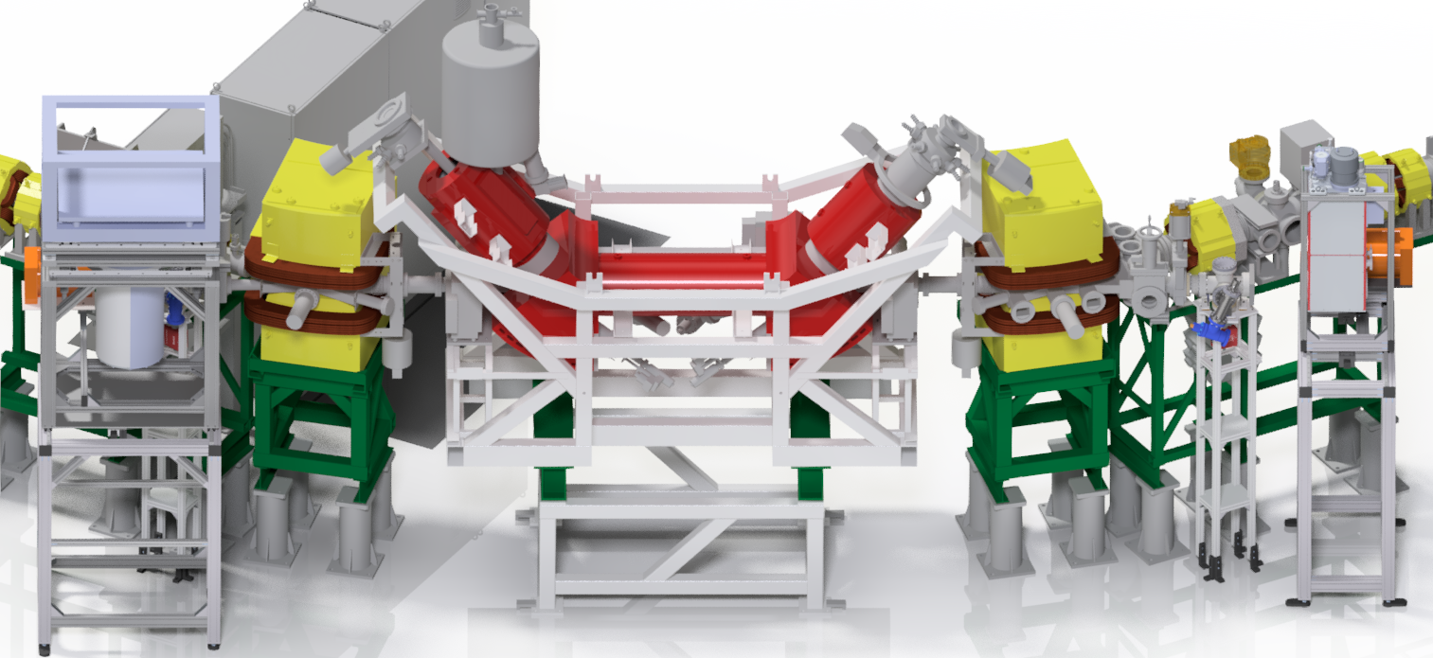
The New Experimental Setup at CRYRING@ESR
Key features:
0° and 180° observation angles
Insensitivity to geometrical misalignment
Beryllium windows ①
High transmission also in the low photon-energy range
Energy calibration ②
Control of detector response function
High-resolution microcalorimeter detectors ③
Improved line centroid determination
3
2
1
180°
0°
1
2
3

Slide 19
Precision of the maXs Detector
²⁴¹Am spectrum
Single Pixel Signal
FWHM:
13.18 eV
Total Spectrum
FWHM:
16.38 eV

Slide 20
Accuracy of the maXs Detector
Combined
²⁴¹Am & ²³³U source
²⁴¹Am lines: calibration
²³³U lines: benchmarking
Al shield to suppress low energy radiation
MMC
Al shield
26.3463 keV
0.0015 keV
42.43513 keV
0.00023 keV
59.53998 keV
0.00094 keV
E_{meas}
(E_{meas}–E_{lit})
29.17887 keV
–0.00283 keV
54.70327 keV
–0.00053 keV
Am γ
Am γ
Th γ
Th γ
Th γ

Slide 21
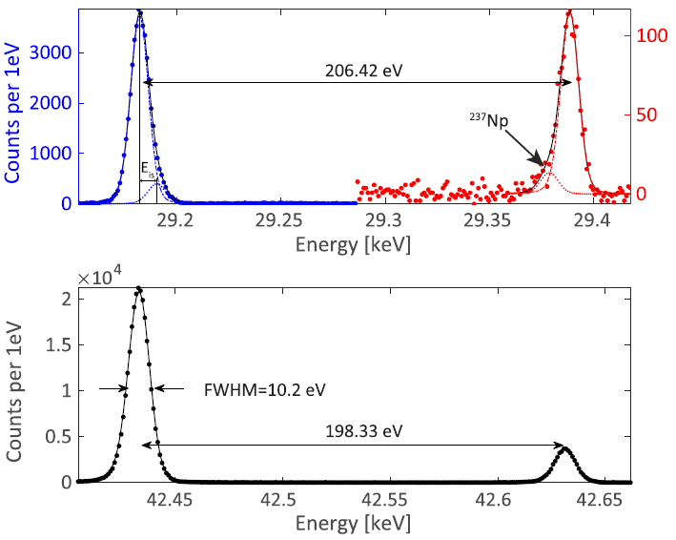
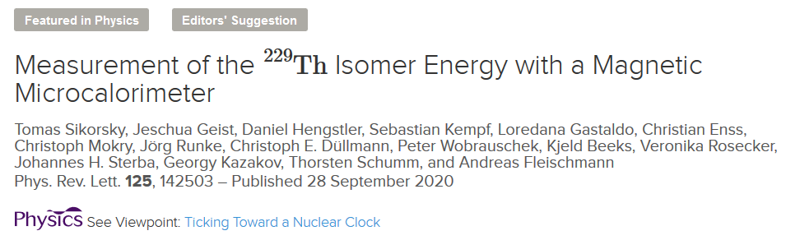
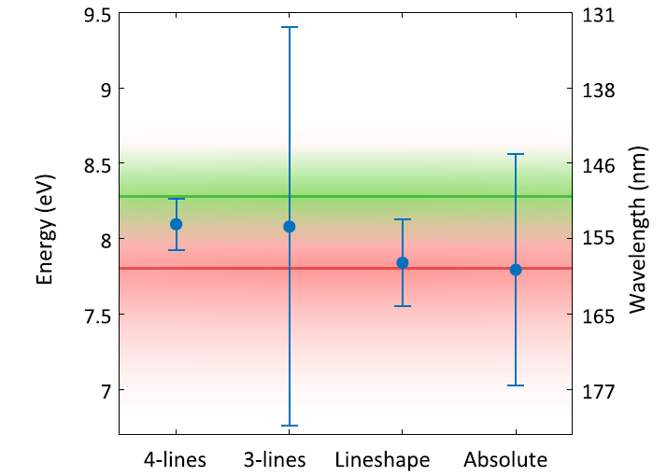
Successful Deployment of a maXs-type Detector in a Precision Experiment
measured with maXs-30
E_{isomer} = 8.10 ± 0.17 eV

Slide 22
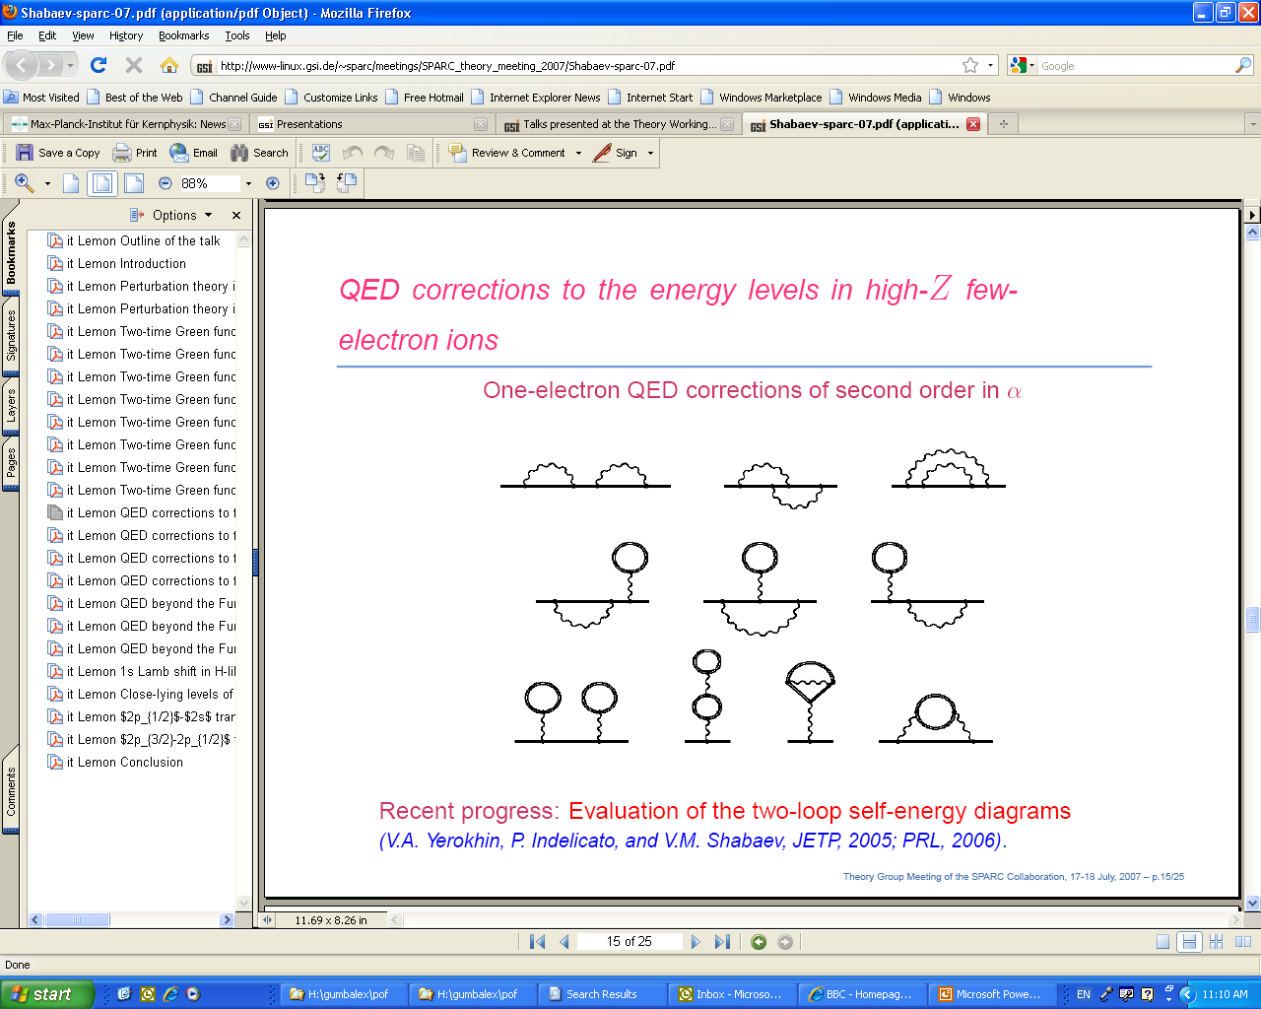
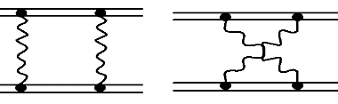
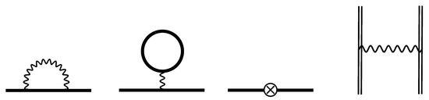
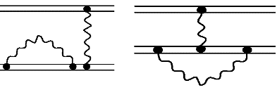
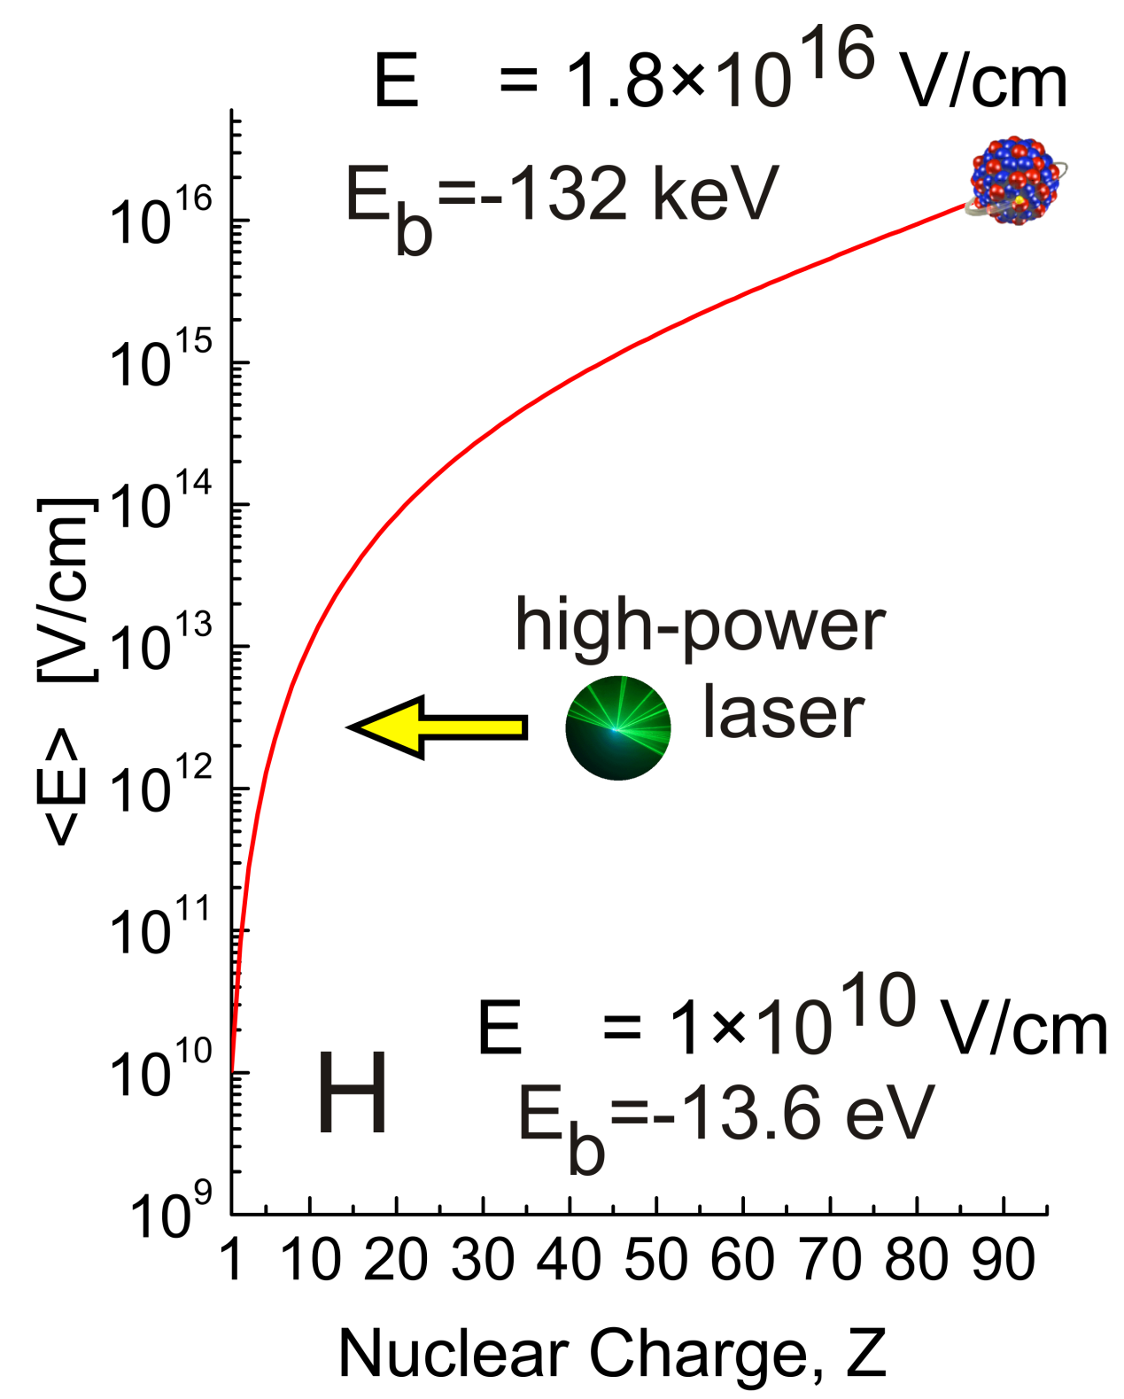
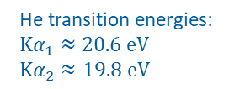
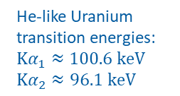
He-Like Atomic/Ionic Systems
Kα₂
Kα₁
74 eV
¹P₁
He transition energies:
$$\text{K}α_{1}≈20.6 \text{eV}$$
$$\text{K}α_{2}≈19.8 \text{eV}$$
³P₂
He-like Uranium
transition energies:
$$\text{K}α_{1}≈100.6 \text{k}\text{eV}$$
$$\text{K}α_{2}≈96.1 \text{k}\text{eV}$$
E1 (Kα₁)
w
M2 (Kα₁)
x
¹S₀
³P₀
³P₁
³S₁
142 eV
Measurement :
A. Gumberidze et al.,
PRL 032712 (2004)
M1 (Kα₂)
z
E1 (Kα₂)
y
¹S₀
Notes:
Scientific relevance: Relativistic electron-electron interaction at extreme field strengths.

