Slide 1

Sustainable particle acelerators for use in fundamental research – the high efficient superconducting heavy ion HElmholtz LInear ACcelerator HELIAC
Maksym Miski-Oglu
GSI Helmholtzzentrum für Schwerionenforschung, Darmstadt, Germany
Helmholtz Institute Mainz, Mainz, Germany
9th annual meeting of the programme "Matter and Technologies"
10, Oktober, 2023

Slide 2
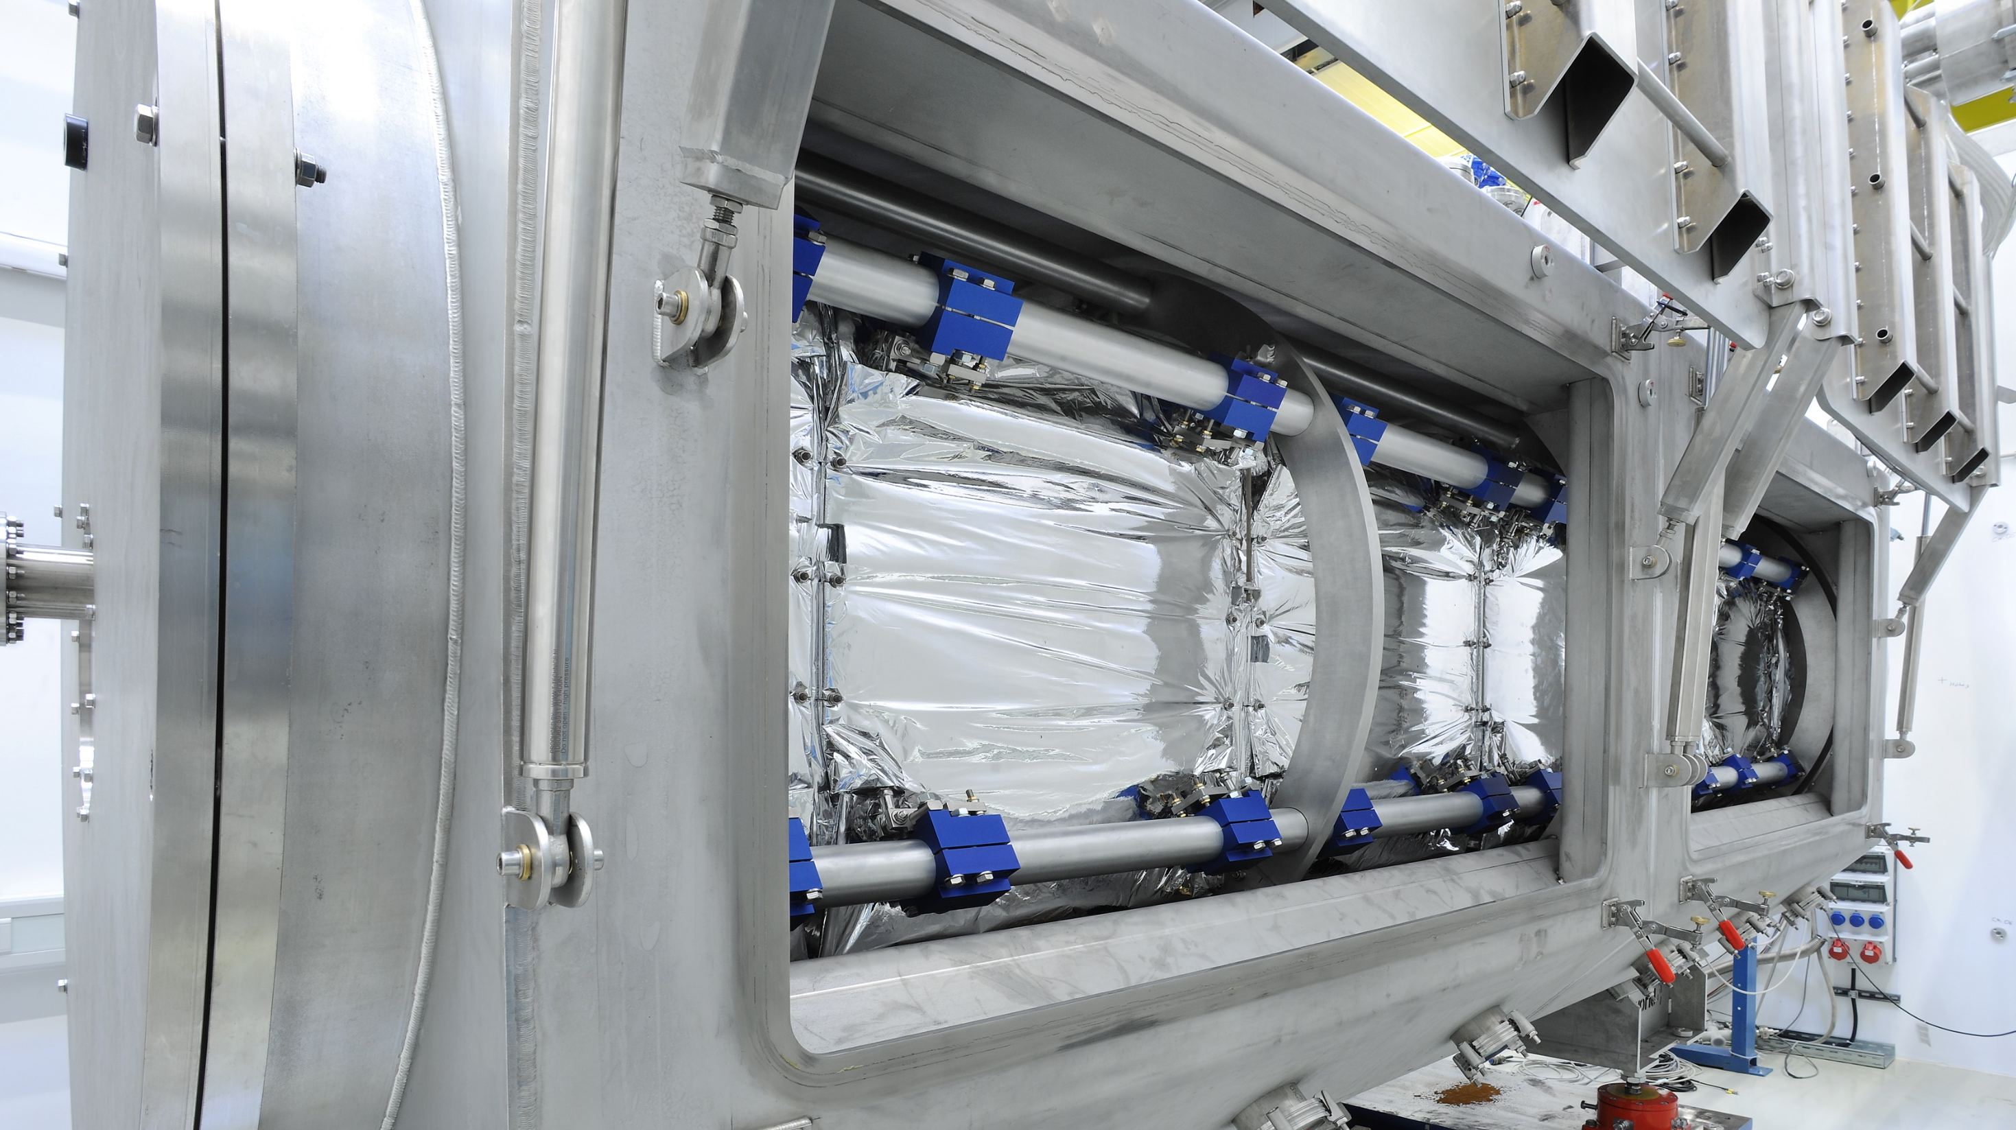
Motivation
GSI-Heavy Ion UNILAC
Typical UNILAC-power consumption
HElmholtz LInear ACcelerator
Typical HELIAC-power consumption
Further sustainability efforts

Slide 3
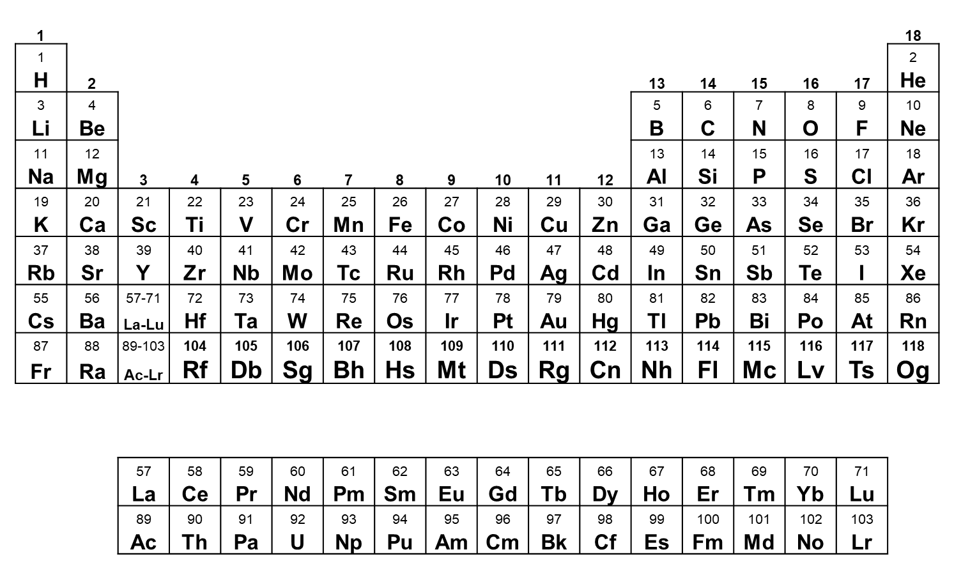
Motivation: Sustainability Challenge
  Fundamental research often requires large-scale equipment → high performance (heavy ion) particle accelerators as FAIR/GSI:
    Nuclear structure
    Material science
    Biophysics
    …
  Increasingly high costs for primary energy to operate!
  Primary task for the future of people and society …
  → Gaining scientific knowledge & simultaneously operate with max. energy-efficiency???
Periodic Table of Elements
Broad program on synthesis, nuclear structure, atomic physics and chemical studies...
New elements discovered at GSI

Slide 4
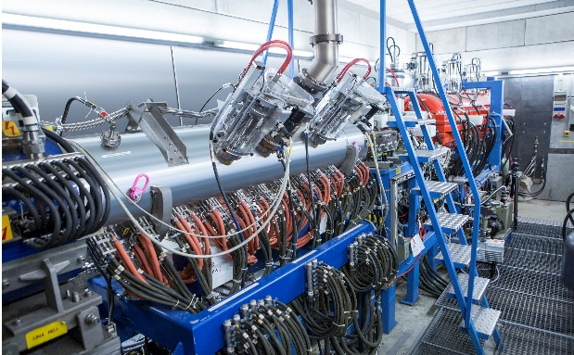
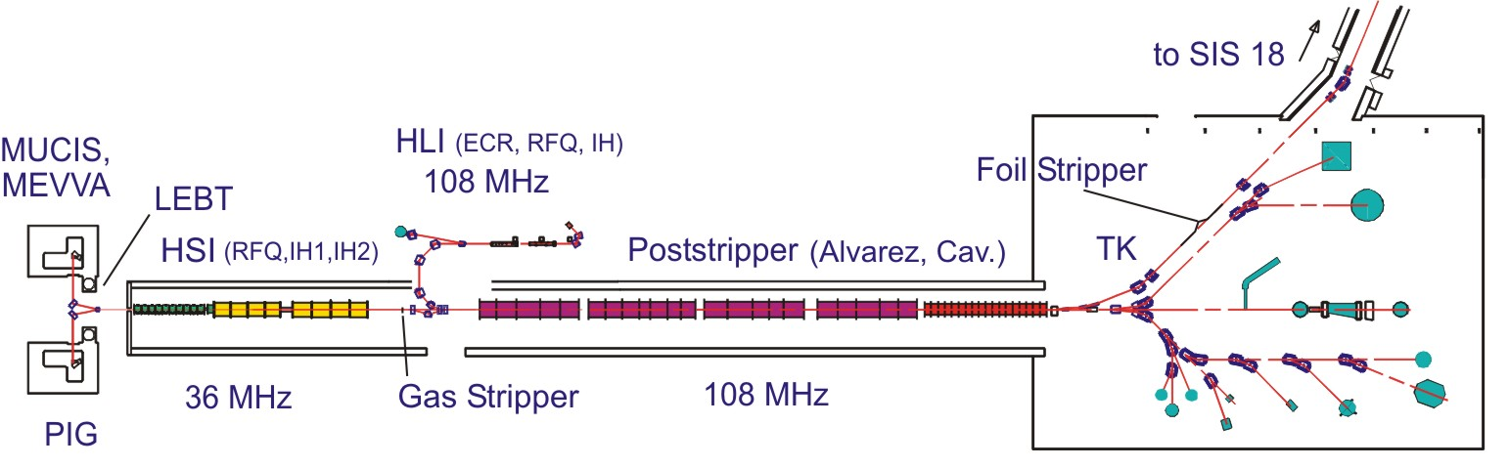
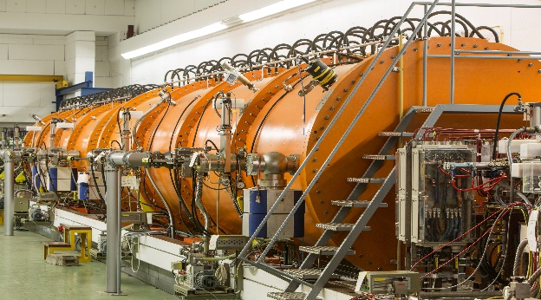
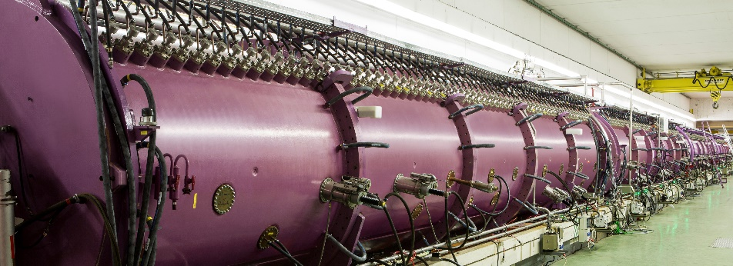
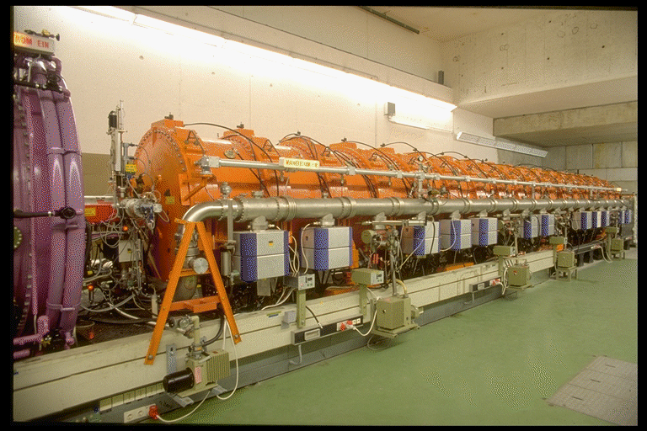
GSI UNIversal Linear ACcelerator
0.1 emA, p⁺ (MUCIS)
4.5 emA, ²³⁸U²⁸⁺ (MeVVa)
High Charge State Injector (1991)
1 pμA, ⁴⁸Ca ( ECR)
1 pμA, ⁵⁰Ti (PIG/ECR)
High Current Injector (1999)
Poststripper/Alvarez (1975)
Single Gap Resonators (1975)

Slide 5
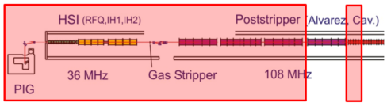
UNILAC-Power Consumption
HSI/RFQ – Super Lens – IH1&IH2 (Rf, 30%): 600kW
Poststripper/A1 – A3 (Rf, 30%): 1900kW
3x Single Gap Resonators (RF): 190 kW
Power supplies/HSI-Quads + Dipoles/Charge separator: 70 kW
Power Supplies/Poststripper-Quads: 145kW
Beam diagnostics: 100kW
Cooling water: 1200kW
Basic load/UNILAC: 650kW
PIG-ion source: 40kW
tot. from grid: 4895 kW (25% duty factor)
6 months operating time:
4.895 MW x 24h x 30 days x 6 months ≈ 21 GWh
Typical heavy ion beam operation:
A/Z = 26 (HSI)
A/Z = 6 (poststripper)
W_{kin} = 7.5 MeV/u
A3-intermediate energy/7.1 MeV/u
3×Single Gap Resonator/0.4 MeV/u
RF-duty factor = 30%
Challenge: decrease energy consumption per ion on target!

Slide 6
HELIAC-Layout
HELIAC has been optimized for the needs of the UNILAC users, in particular TASCA, SHIP & materials research and
could be used as SIS18-injector for medium high intensities!
HelmoltzLinearAccelerator – HELIAC
CM4 dedicated to mat. res. (energy booster)
Normal-Conducting Injector
Superconducting Accelerator
Source
Parameter | Unit | Value
Output energy | MeV/u | 1.4
RF Cavities |  | 6
Operation mode |  | cw
A/Z |  | ≤ 6
Parameter | Unit | Value
Output energy | MeV/u | 3.5 – 7.3
Beam current | mA | ≤ 1
Operation mode |  | cw
A/Z |  | ≤ 6
RF Cavities | # | 12
RF Bunchers | # | 4
Transversal Focussing | 2 Solenoids per Cryom.
Parameter | Unit
Type | ECR
Frequency | 18 GHz

Slide 7
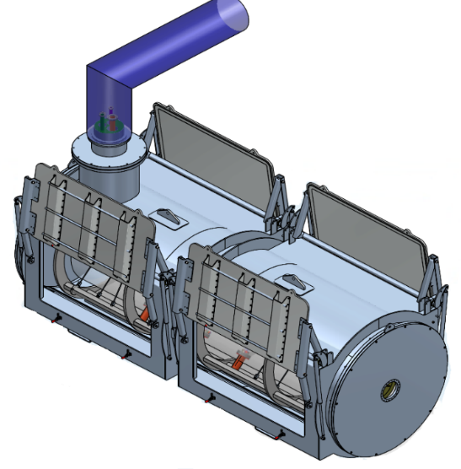
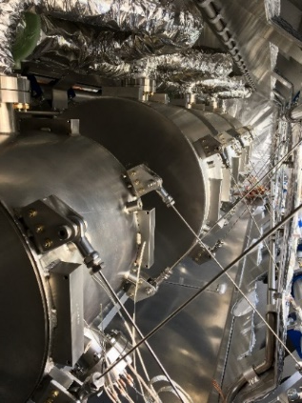
Cryomodule Qualification
A standard cryomodule (3 CHs + 1 Buncher) has been designed, technically laid out and built (CM1)!
HELIAC-CM1
3 Crossbar H-Mode RF-cavities
1 Crossbar H-Mode Rebuncher cavity
2 superconducting 10T-Solenoids
Cryomodule 1

Slide 8
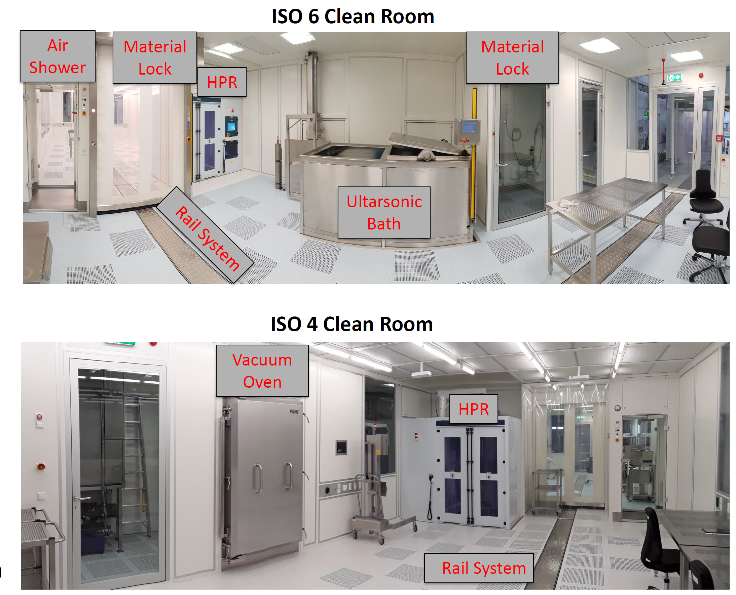
Clean Room Infrastructure @ HIM
The unique HIM infrastructure is used to process superconducting RF cavities and assemble complete accelerator strings!
Unique infrastructure for SRF R&D@HI-Mainz
2 interconnected clean rooms: 42m² (ISO6)+42m² (ISO4)
Ultra high purity water supply (18MΩ/cm)
Ultrasonic bath and conductance rinse (outer surfaces preparation)
High Pressure Rinse (HPR) applying 100 bar-removal of particulates & contamination from inner surfaces of vacuum bellows, cavities, solenoids …..
Weekly cleaning by external company
Ready for cryomodule assembly!

Slide 9
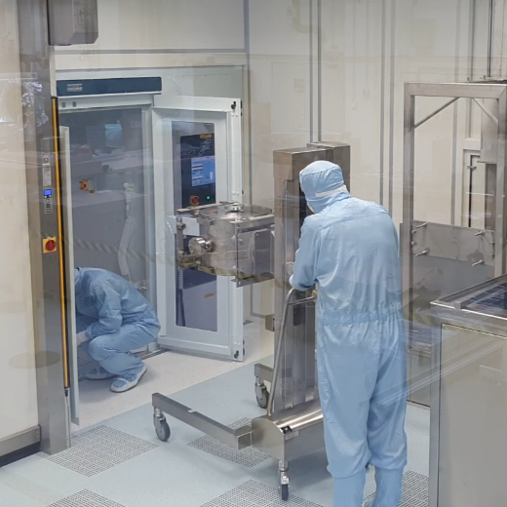
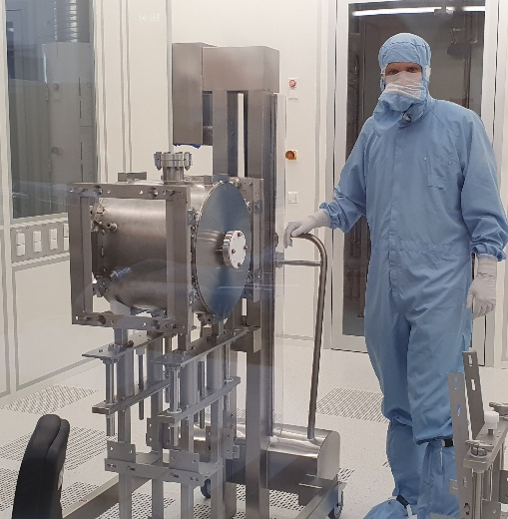
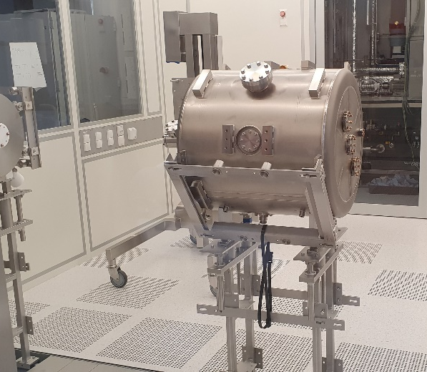
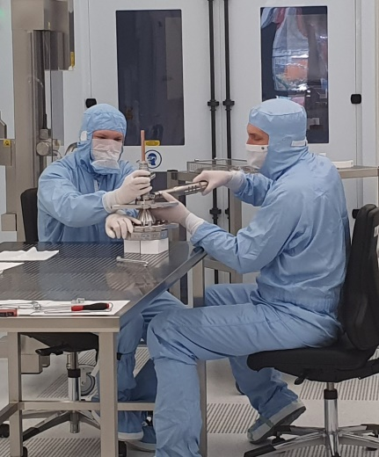
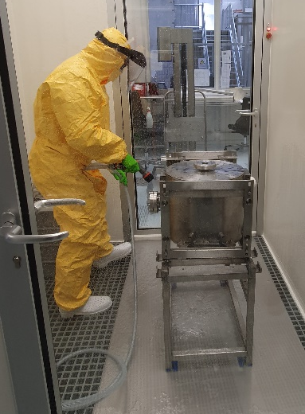
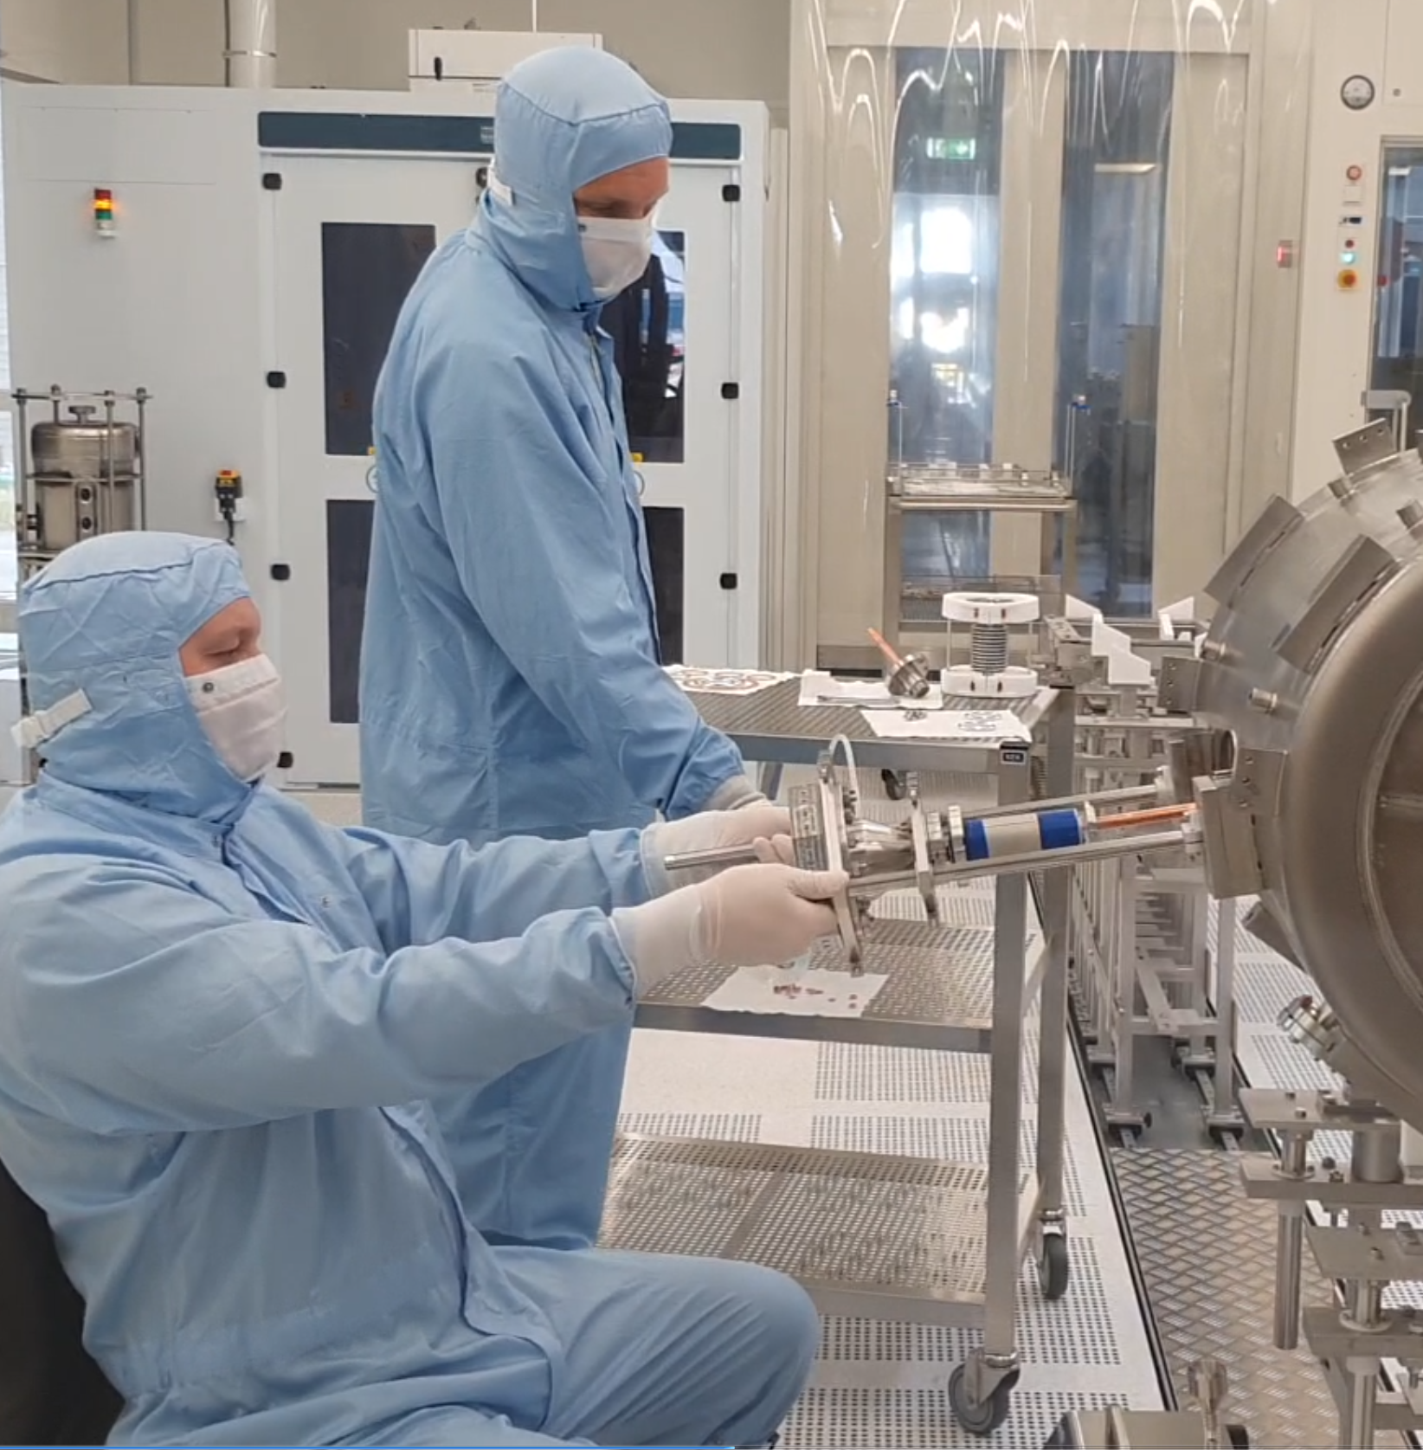
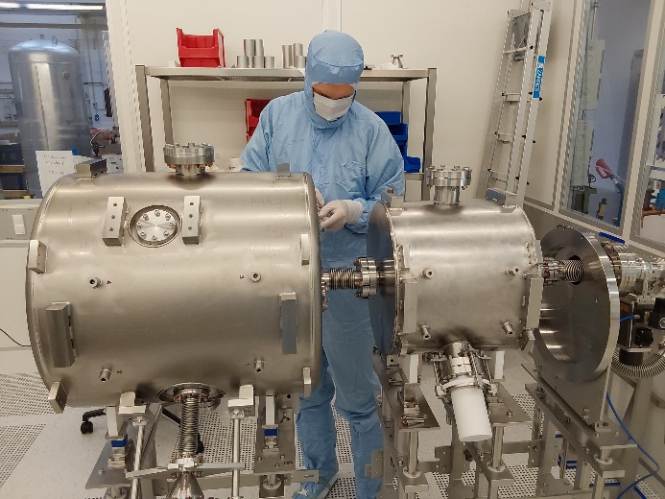
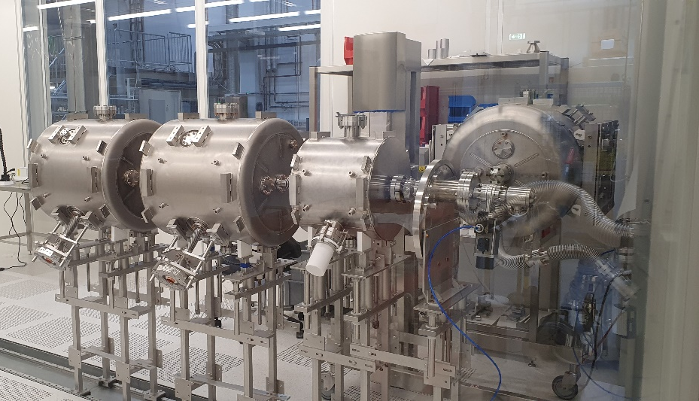
Assembly in clean room (2022-2023)
cleaning of S2 in material lock
transfer to HPR
with lifter
gear to trolley stand
CH2 on trolley stand
Assembly of
rf-power coupler
integration of rf–power coupler with CH2
Interconnection of
CH2 with S2
Part of string S2, CH2, CH1
with bellow

Slide 10
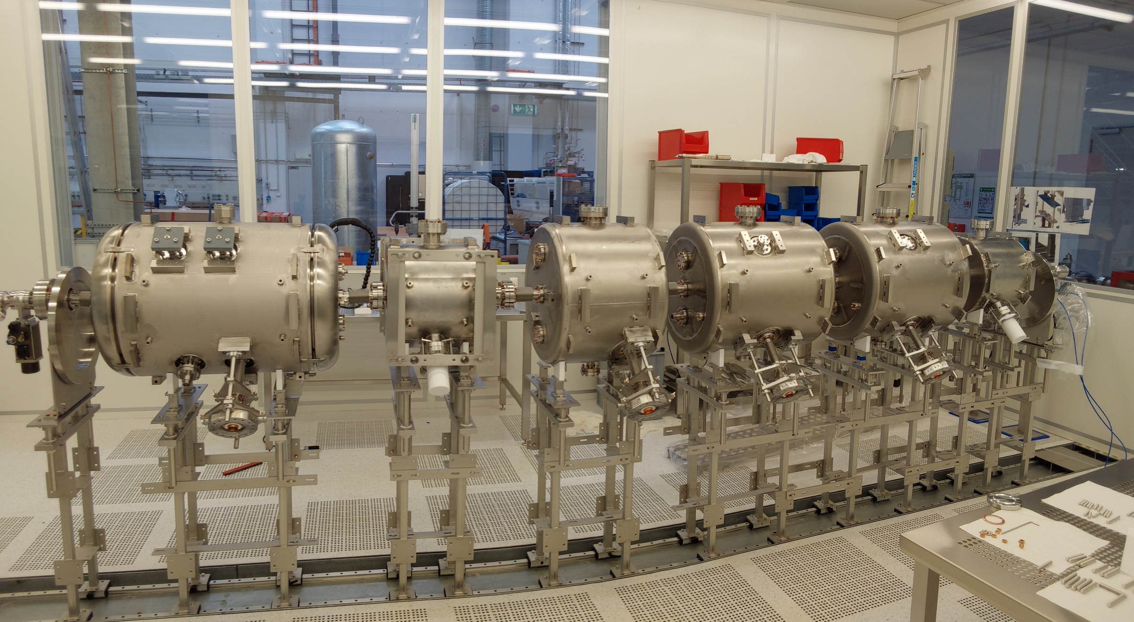
07.02.2023

Slide 11
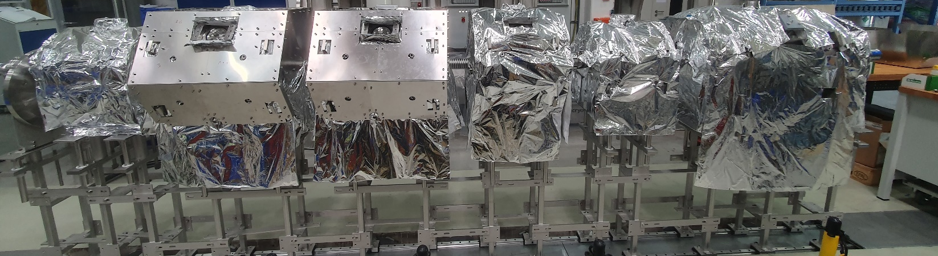
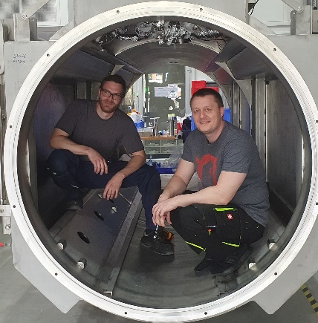
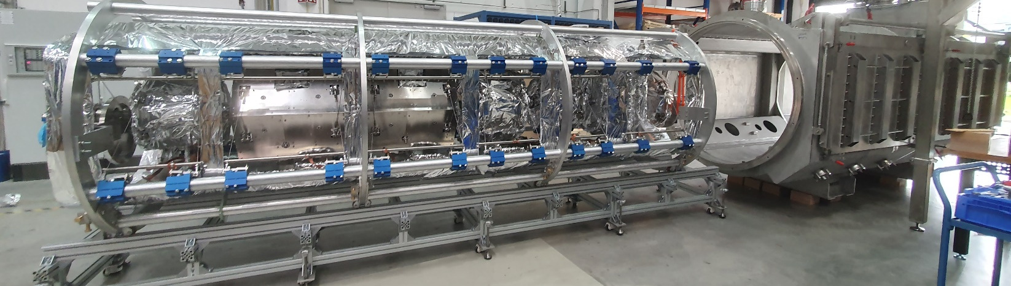
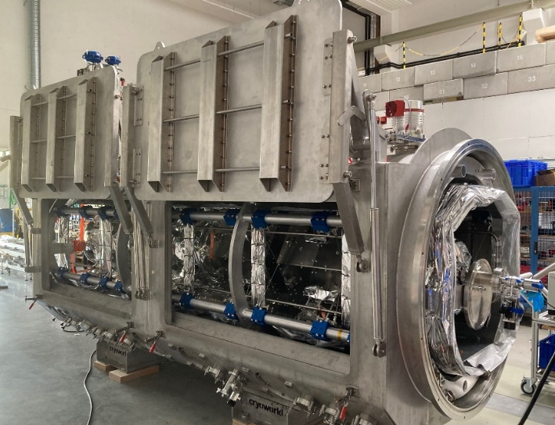
Accelerator String Integration into Cryostat
Acceleration string mounted on individual trolleys
empty cryostat
Acceleration string mounted inside suspension frame
…integrated with cryostat

Slide 12
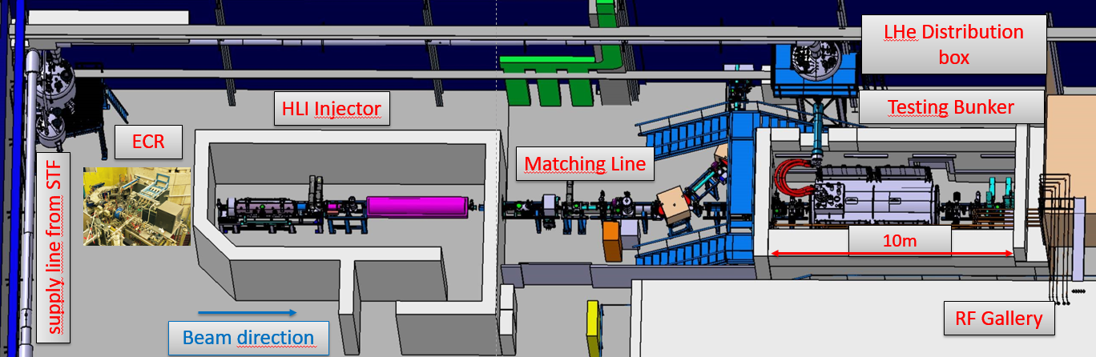
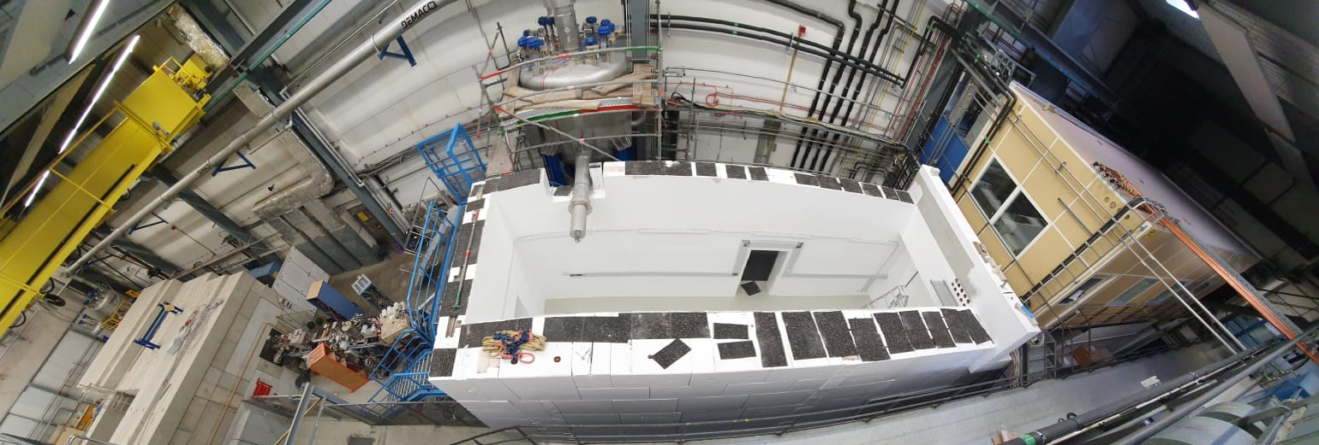
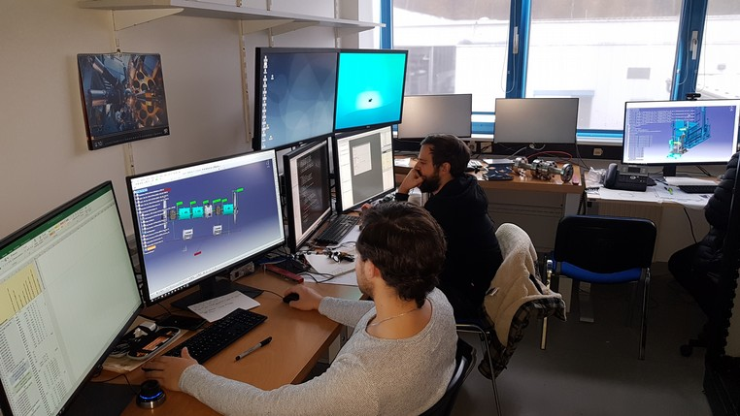
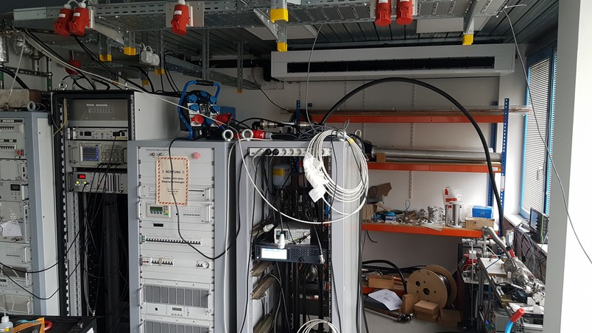
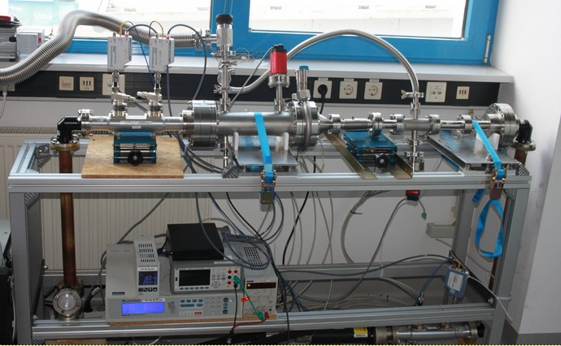
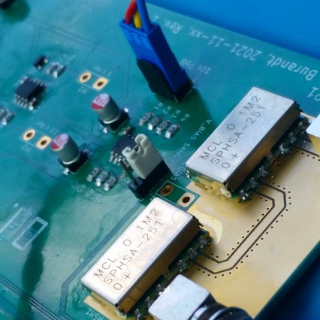
Test Site @ GSI
Setup of Advanced Dem. test site @ GSI
Radiation cave behind HLI injector
Control room
RF supply room
Test bench for high power couplers
Electronic lab
Beam line to GSI‘s HLI as injector
Link to cryo plant
Advanced Demonstrator setup allows first user experiments
Test site allows qualification of CM1-CM4
Commissioning with beam of first cryogenic module
scheduled for November 2023
~10m
Source
RF Amplifiers
Electronics
Lab
Power coupler Test Bench
Control Room

Slide 13
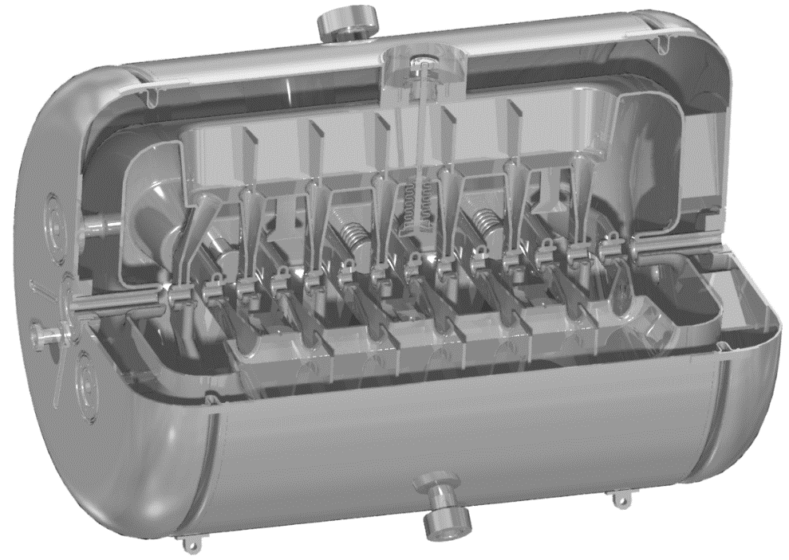
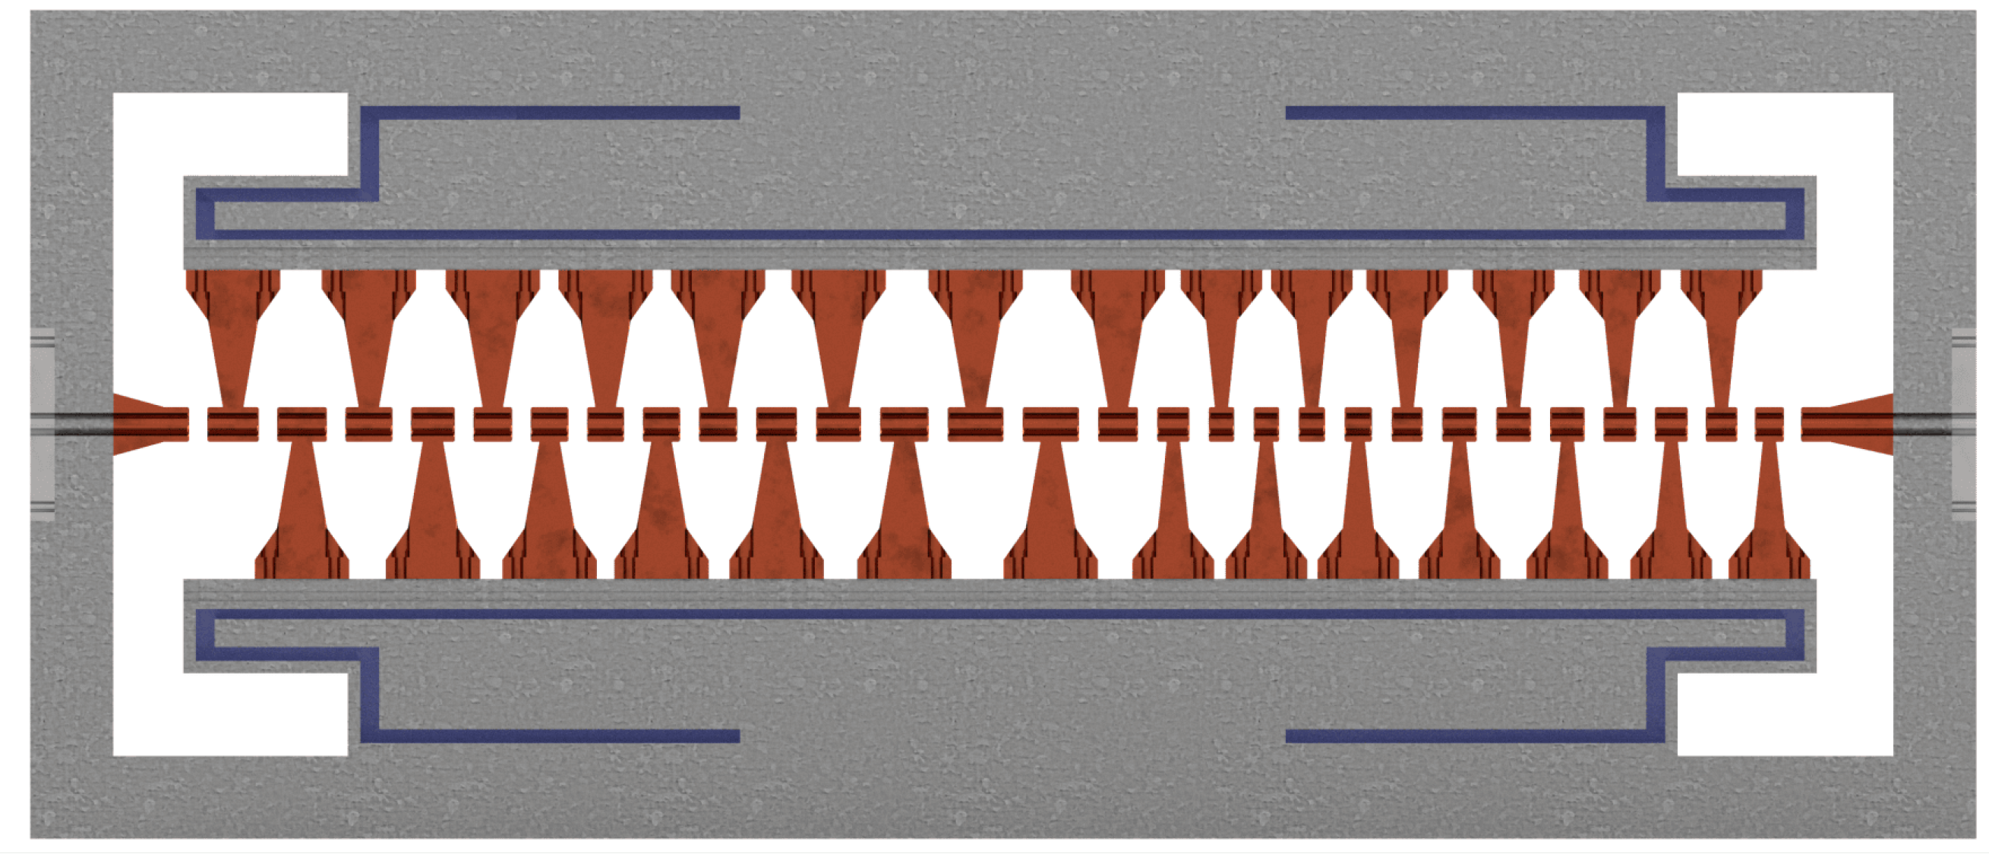
Normal vs. Superconducting
Frequency | 108.408MHz
Number of gaps | 29
Effective Length (βλ/2) | 1.3 m
Quality factor Q₀ | 2⋅10⁴
Acc. gradient | 3 MV/m
Total voltage | 4 MV
Peak E-field | 29 MV/m
RF-Power Amplifier | 30 kW
Frequency | 216.816 MHz
Number of gaps | 15
Effective Length (βλ/2) | 0.691 m
Quality factor Q₀ | 1.3⋅10⁹
Acc. gradient | 5.8 MV/m
Total voltage | 3.4 MV
Peak E-field | 37 MV/m
RF-Power Amplifier | 3 kW
extremely high Q0
higher surface E-field
low power consumption

Slide 14
HELIAC-Power Consumption (typical heavy ion beam operation )
ECR (14 GHz): 230kW
nc-Injector-Linac/new (RFQ + 2×IH + Buncher => HF) (cw)
  RFQ: 150kW
  IH1: 35kW
  IH2: 85KW
Cooling Water (Injector+sc-HELIAC): 200kW
CM1-4 (16 Rf-amplifiers each 3kW Rf-power, Efficiency: ≈ 60%): 80kW
cryo supply/STF:
  16 CH-cavities (≈10W per cavity => 160W + 120W (standby) + 80W loss at He-transport-system, incl. shield: 1W@4K cryo power applying 350W el. connected power: 130kW
Power supplies/HLI+Matching Line: 150 kW
Beam Diagnostics: 50kW
A/Z = 6
W_{kin} = 7.5 MeV/u
nc-Injector
4×Cryomodules
RF-duty factor = 100%
tot. from grid: 1110kW (c.w.)
1.5 months operating time:
1.11 MW x 24h x 30days x 1.5 months ≈1.2GWh

Slide 15
Sustainability
Electrical energy consumption
UNILAC vs. HELIAC
(for identical particle number on target
HELIAC (sc): A/Z= 6, 7.5 MeV/u, cw-operation (1.5 month) → 1.2GWh
UNILAC (nc): A/Z 26 (HSI), A/Z = 6 (poststripper), 7.5 MeV/u (A3-intermediate energy/7.1 MeV/u +3xERs), 30% RF-duty factor (6 month) → 21 GWh
For typical beam time:
>90% less power consumption
Energy savings for 6 months of operation (HELIAC vs. UNILAC) ≈ 16.4 GWh
Energy savings for 6 months UNILAC-experiment vs. 1.5 months/HELIAC ≈ 20 GWh

Slide 16

Further sustainability efforts
  Very ambitious challenge: Combining state-of-the-art cooling techniques to achieve 2 K with newly developed extremely complex superconducting accelerating-cavity
  Efficiency Gain Factor of
  another factor of 2
  (versus 4k operated CH-cavities)
CAD drawing of a multi-cell CH-mode cavity. The structure is highly complex to be able to satisfy the user needs regarding ion species, energy, intensity and quality of the beam

Slide 17

Fitting into the field of sustainable value chains
  R&D of novel 2K accelerator technology
    enabling innovation, sustainably foster education and technology transfer, and improve healthcare by addressing the challenge of limited resources
    Sustainable Development Goals of Unated Nations:
    #4 “Quality Education”
    #7 “Affordable and Clean Energy”
    #9 “Industry, Innovation and Infrastructure”
  + positive impact on the SDGs:
    #3 “Ensure healthy lives”
    #13 “Take urgent action to combat climate change”
    #14 “Life below water”
    #15 “Conserve and sustainably use the oceans, …”
    (through materials and life sciences)

Slide 18
Save Energy, build HELIAC!

