Slide 1

HTS Developments at KIT and GSI
Tiemo Winkler, GSI
on behalf of colleagues from KIT and GSI
10.10.2023
9th MT Days, KIT / Karlsruhe

Slide 2


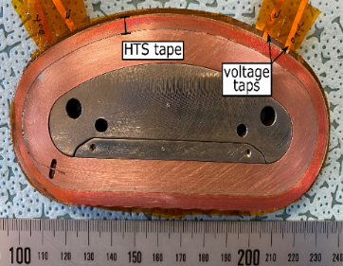
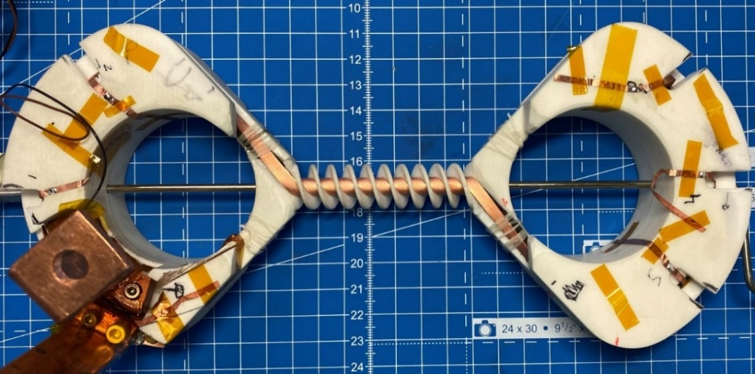
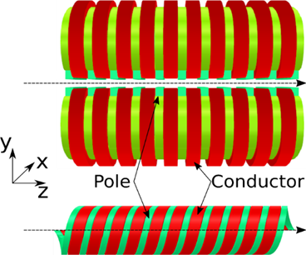
HTS compact undulator
4 mm, non-insulated ReBCO tape
Goal:
VR
Hel.
High-field (B ≥ 2 T)
Small-period undulator λ_{u} = 13 mm
iron core
Two different prototype coils
Vertical racetrack (VR)
Helical undulator (Hel.)
λ = 13 mm
    Successfully powered
Vertical racetrack
Up to ≈ 300% I_{c} at LN₂
Up to ≈ 110% I_{c} at LHe
Helical undulator
S. C. Richter et al. (2023) IEEE Trans. Appl. Supercond. 33(5) 4100207
S. C. Richter, PhD. thesis, KIT (2023)
Courtesy of S. C. Richter
Notes:
Main challenges:
Bending radii < 5 mm,
Quench protection

Slide 3
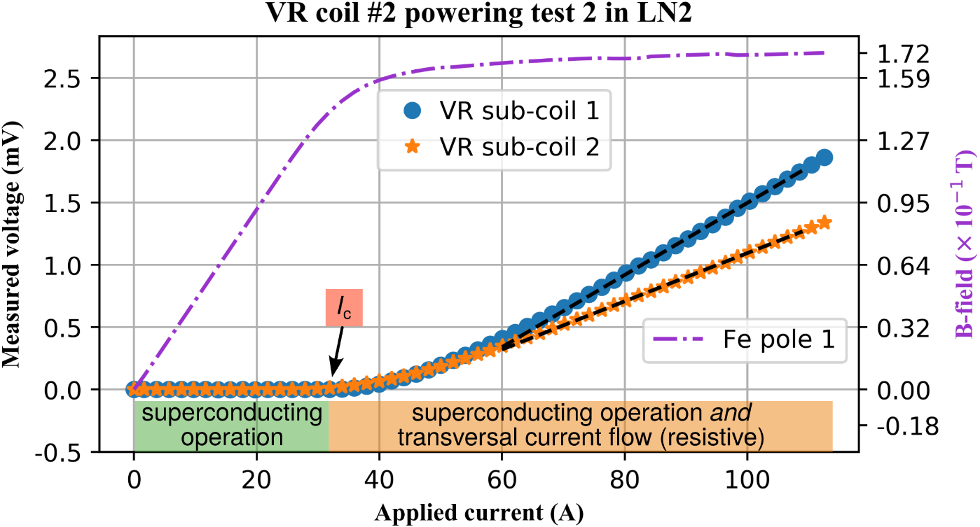
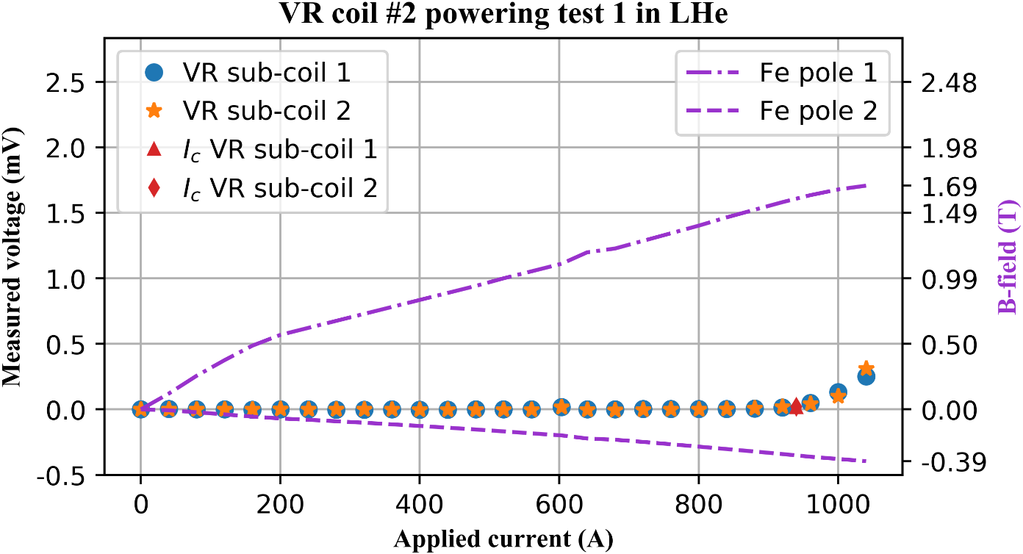
HTS compact undulator
4 mm, non-insulated ReBCO tape
Goal:
VR
Hel.
High-field (B ≥ 2 T)
Small-period undulator λ_{u} = 13 mm
iron core
Two different prototype coils
Vertical racetrack (VR)
Helical undulator (Hel.)
    Successfully powered
LN₂
Up to ≈ 300% I_{c} at LN₂
LHe
Up to ≈ 110% I_{c} at LHe
S. C. Richter et al. (2023) IEEE Trans. Appl. Supercond. 33(5) 4100207
S. C. Richter, PhD. thesis, KIT (2023)
Courtesy of S. C. Richter
Notes:
Main challenges:
Bending radii < 5 mm,
Quench protection

Slide 4

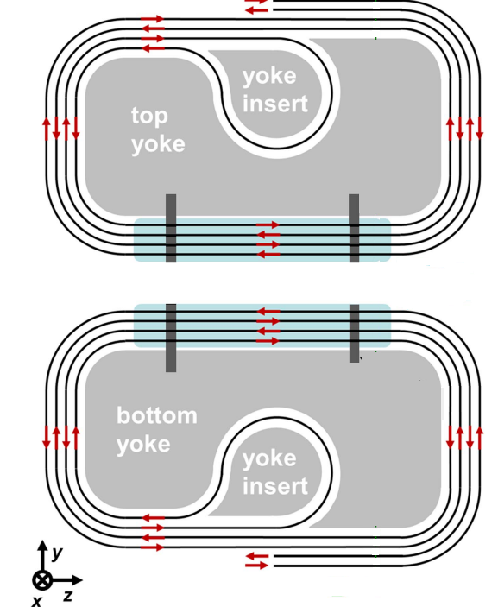
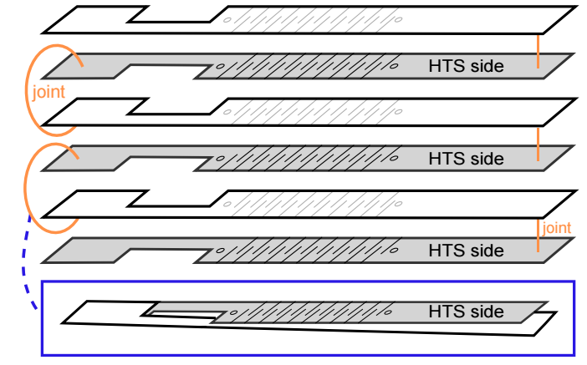
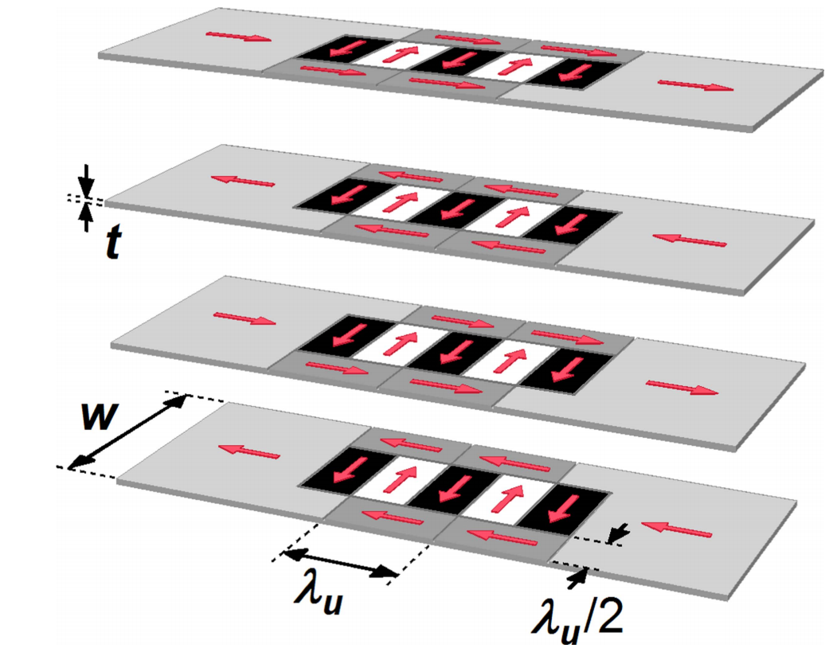
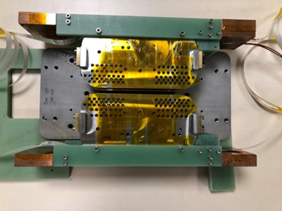
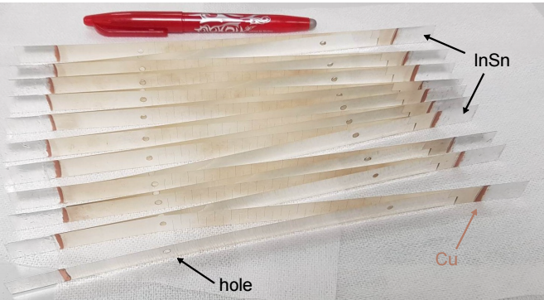
HTS laser-structured undulator
30 layers of laser-scribed REBCO tapes, width of 12 mm and thickness of 55 μm
Two different prototype coils
Jointless winding
Stacked design (reduces HTS usage by 75%)
12 periods per tape, λ_{u} = 8 mm
Jointless design
Stacked design
T. Holubek et al., Supercond. Sci. Technol. 30, 115002 (2017)
D. Astapovych et al., FEL2022 Proceedings, WEP45 (2022)
B. Krasch et al., MT-28 (2023), to be published in IEEE (TAS)
Courtesy of D. Saez de Jauregui & A. Grau
Notes:
The grooves in each layer force the current in a defined path, creating a sinusoidal field
HTS tape is bent over the droplet-shape-block, inserted inside the yoke brings a jointless winding
In stacked design, individually structured tapes are stacked and soldered alternating at the tape ends. This novel design reduces the need for HTS material by 75% (sustainability).

Slide 5
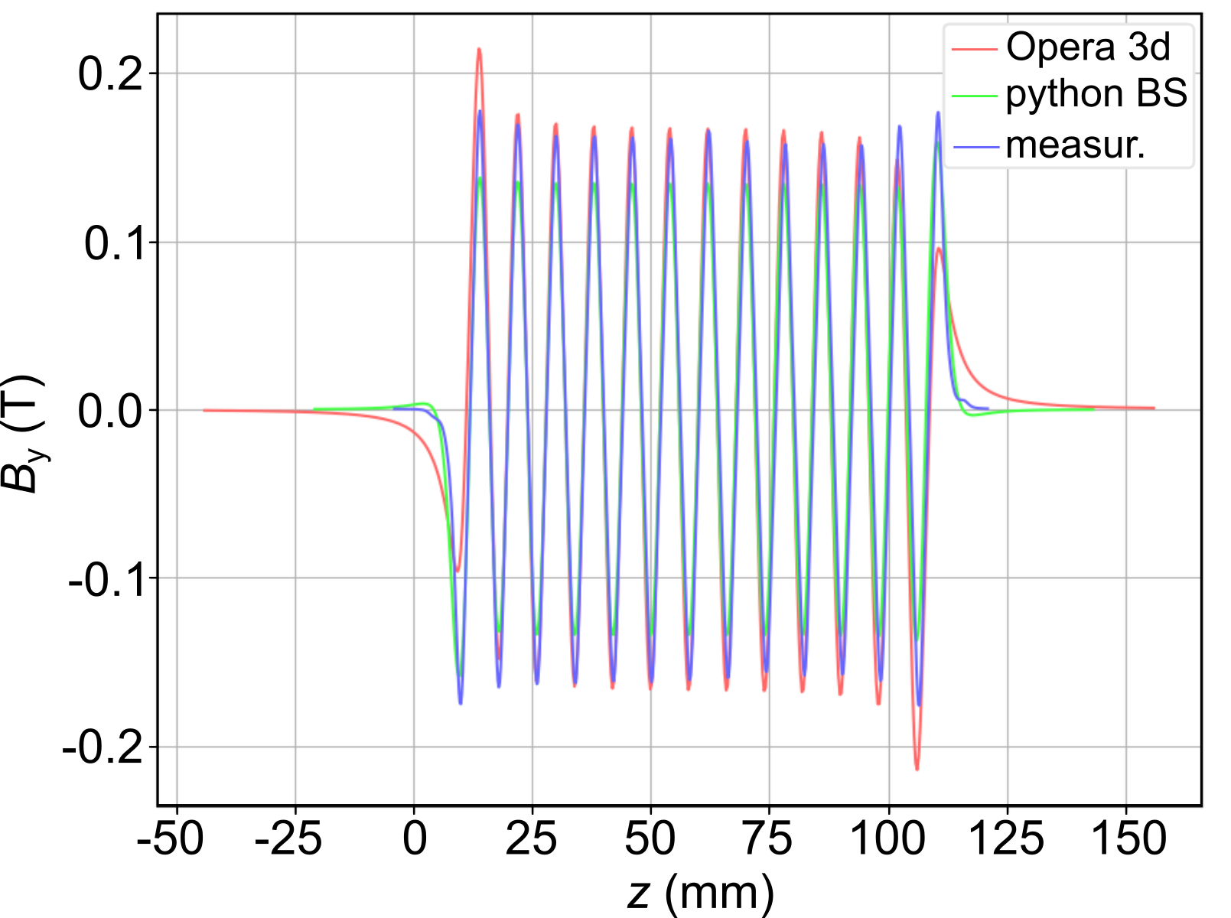
HTS laser-structured undulator
30 layers of laser-scribed REBCO tapes, width of 12 mm and thickness of 55 μm
Two different prototype coils
Jointless winding
Stacked design (reduces HTS usage by 75%)
Successfully tested in LHe @ 4.2 K
T. Holubek et al., Supercond. Sci. Technol. 30, 115002 (2017)
D. Astapovych et al., FEL2022 Proceedings, WEP45 (2022)
B. Krasch et al., MT-28 (2023), to be published in IEEE (TAS)
Courtesy of D. Saez de Jauregui & A. Grau
Notes:
The grooves in each layer force the current in a defined path, creating a sinusoidal field
HTS tape is bent over the droplet-shape-block, inserted inside the yoke brings a jointless winding
In stacked design, individually structured tapes are stacked and soldered alternating at the tape ends. This novel design reduces the need for HTS material by 75% (sustainability).

Slide 6
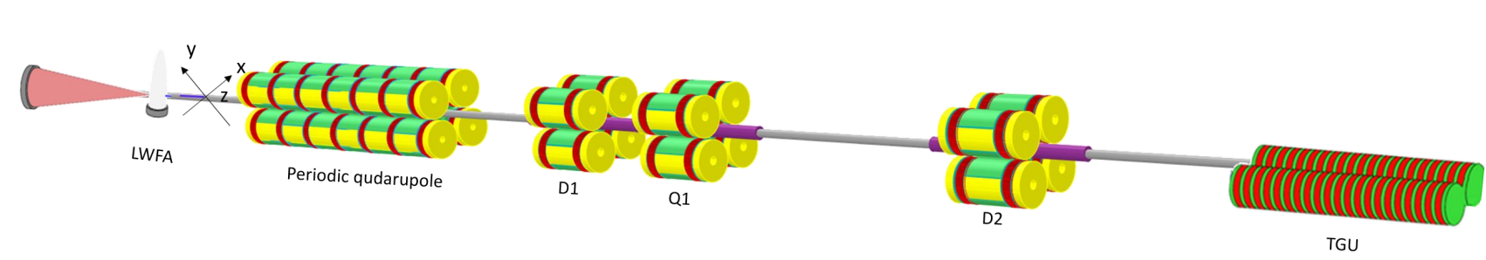
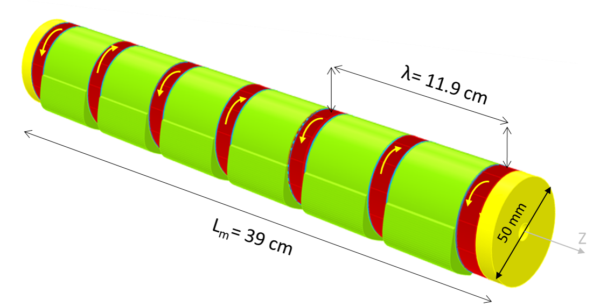
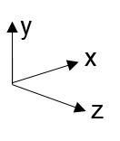
HTS transport line
Goal:
Lab-scaled transport line for LPAs
High strength miniture magnets Simple coils
400 MeV
Novel iron–core periodic magnets:
Using pancake coils were designed
Half a period was demonstrated
λ = 11.9 cm
L_{m} = 39 cm
S. Fatehi et al. IPAC23, WEODC1 (2023)
S. Fatehi, PhD. thesis, KIT (2023)
Courtesy of S. Fatehi
Notes:
LPA: Laser Plasma Accelerators
LWFA: Laser wake field accelerator
TGU: Transverse Gradient Undulator

Slide 7
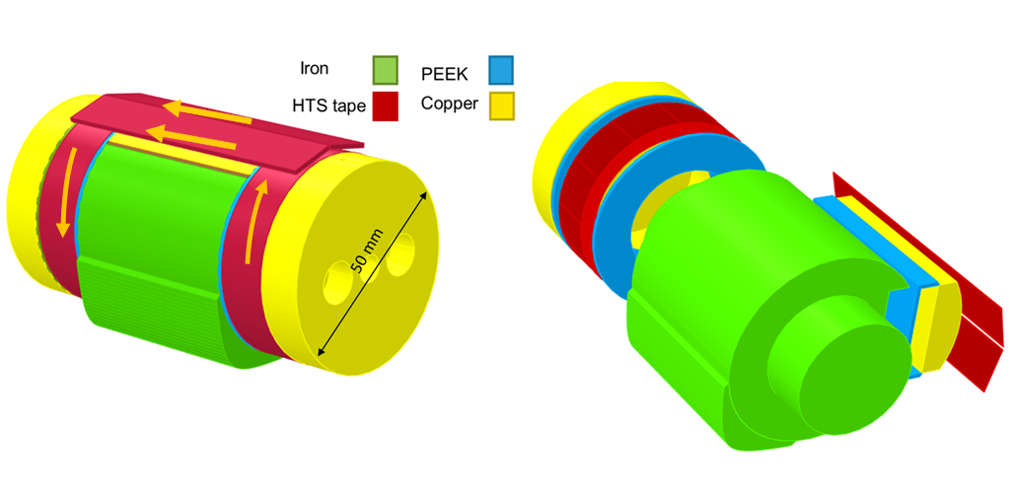
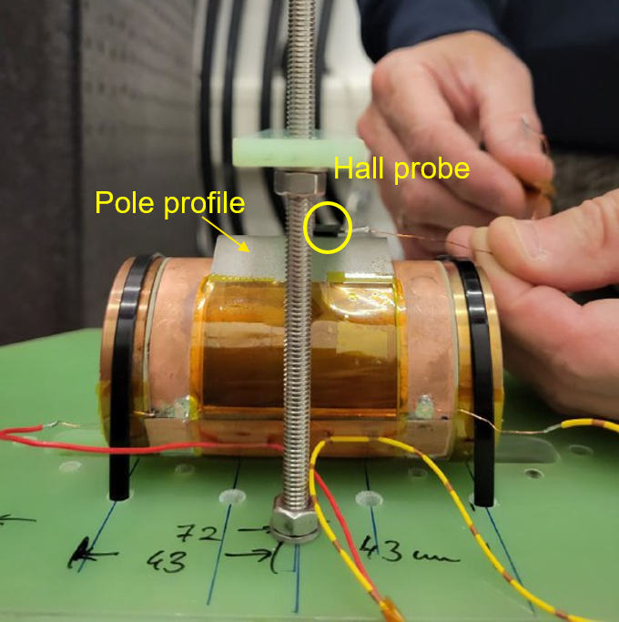
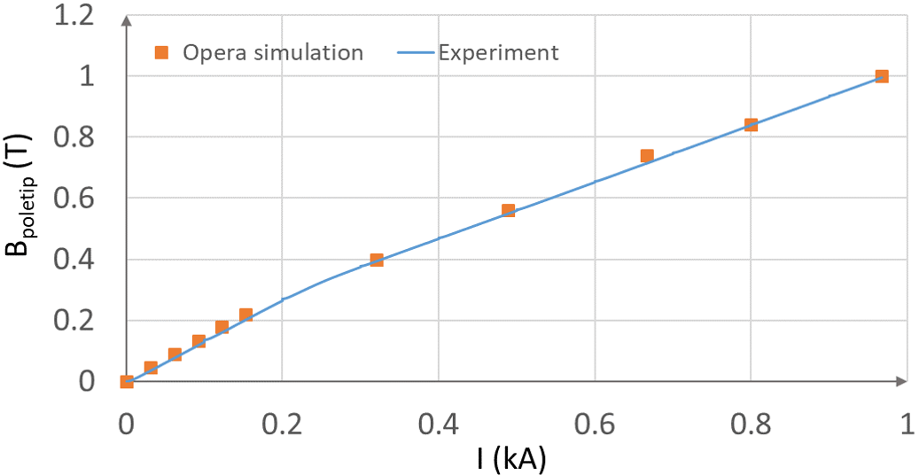
HTS transport line
12 mm, non-insulated ReBCO tape
Goal:
Lab-scaled transport line for LPAs
High strength miniture magnets Simple coils
Novel iron–core periodic magnets:
Using pancake coils were designed
Half a period was demonstrated
    Successfully powered & tested:
In LN₂ and LHe up to 1 kA Showing no degradation
S. Fatehi et al. IPAC23, WEODC1 (2023)
S. Fatehi, PhD. thesis, KIT (2023)
Courtesy of S. Fatehi

Slide 8



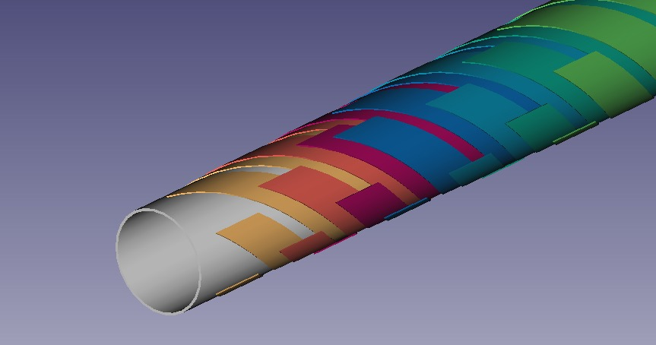

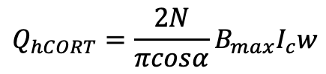
HTS cable development
I.FAST development
Goal:
Round HTS cable for fast ramped applications: 30 kA @ 7 T
Magnetization loss
dependent on superconductor dimensions:
Multiple steps to deal with high losses:
  Striation of tapes
  Higher operating temperature
  Longer cycle duration
  Adapt Magnet design
$$Q_{hCORT}=\frac{2N}{πcosα}B_{max}I_{c}w$$
This project has received funding from the European Union’s Horizon 2020 Research and Innovation programme under GA No 101004730.

Slide 9
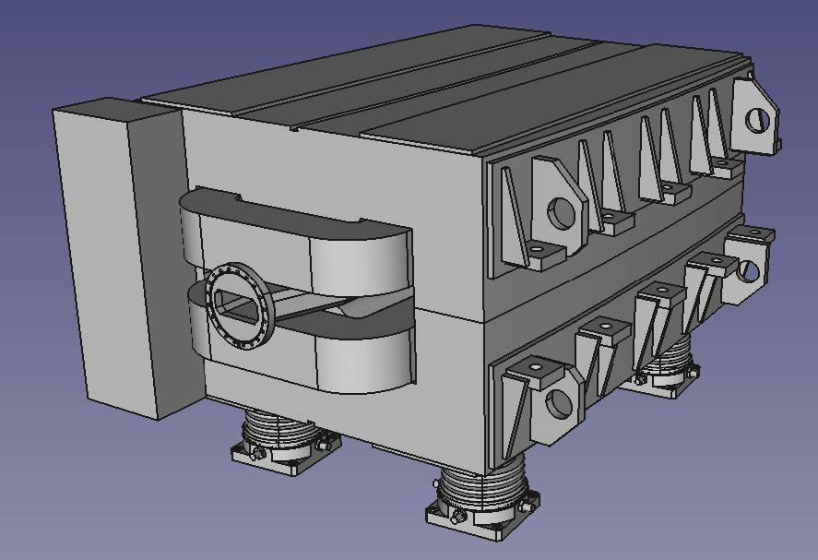
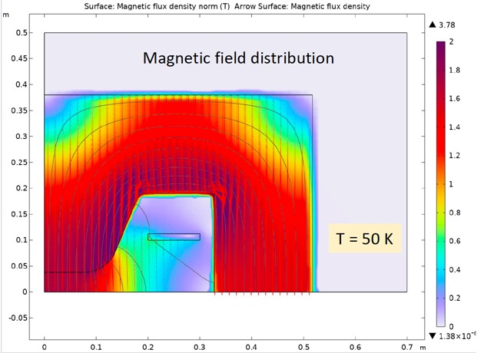
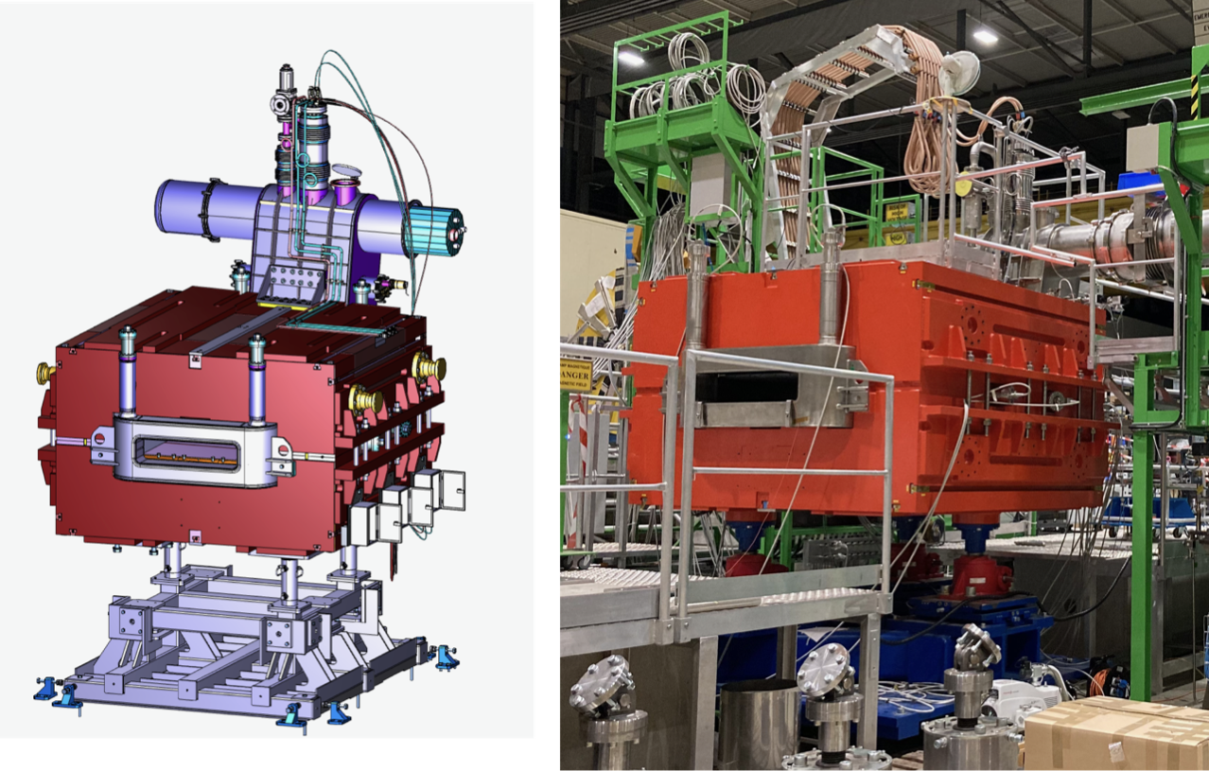
HTS beam transfer magnet
Goal:
Upgrade superferric magnets with HTS coils. Minimal changes in infrastructure
Affected component
18 Tm infrastructure at GSI is H-windowframe magnet using pancake coils
Activities:
Ongoing study for AC loss per cycle
  AC loss in order of 1 kJ/cycle
  AC loss highly affected by position of coil in yoke
Ongoing study for conceptual design including mechanics, cooling and basic coil design
S-FRS Dipole FoS

Slide 10
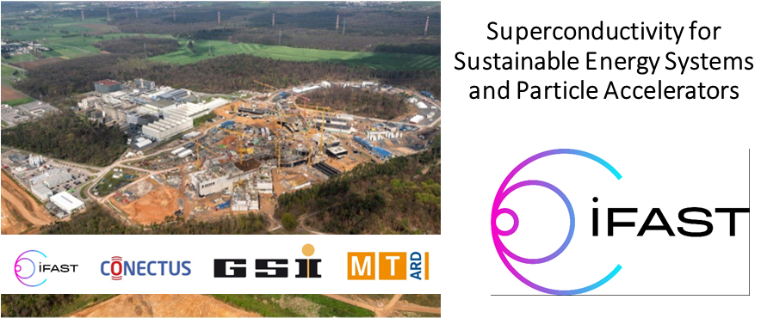

GSI
18 - 20 October 2023
https://indico.gsi.de/event/17548/
Topics:
- Research Infrastructures and Facilities
- Low Loss and Energy Efficient Accelerator R&D
- Industry
- Technology Transfer and Cooperation

Slide 11
Questions?
Thank you to my colleagues from KIT for the slide preparation

