Slide 1

First EEHG lasing at FLASH and future prospectives
Eugenio Ferrari on behalf of the Xseed team
Seeding Pillar Leader
9th Annual MT meeting
Karlsruhe, 10.10.2023

Slide 2
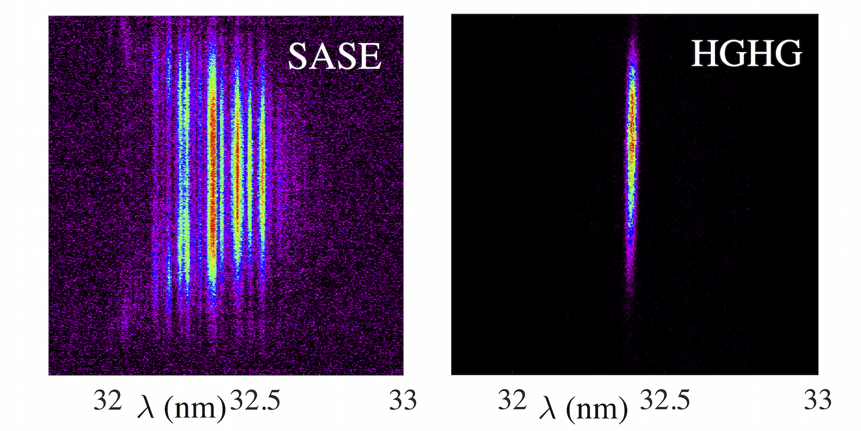
Why seeding?
Single-pass Free Electron Lasers (FELs) can amplify the noise present in the electron beam density profile obtaining powerful SASE radiation.
Using instead an “external” electromagnetic field (a seed) it is possible to initiate the FEL process in a deterministic way.
The properties of the output FEL radiation are inherited and determined by the seed itself.
Seeded
Compared to SASE, seeding can be more compact and produces nearly fully temporally coherent output pulses.
Spectral parameters can be controlled.

Slide 3
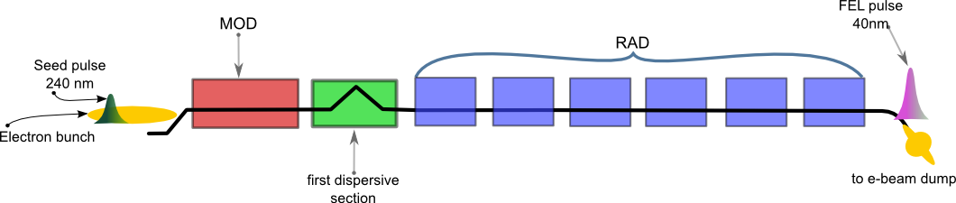
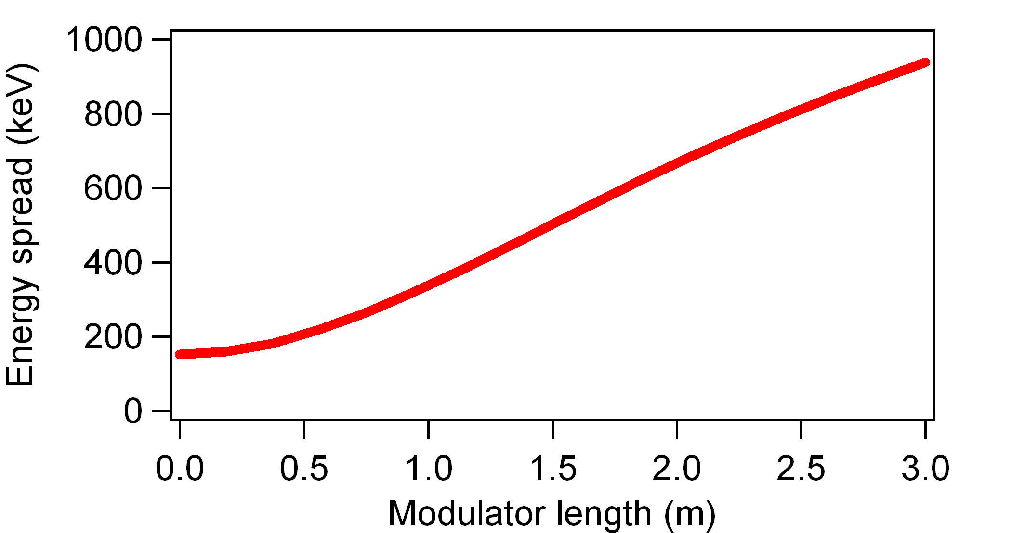
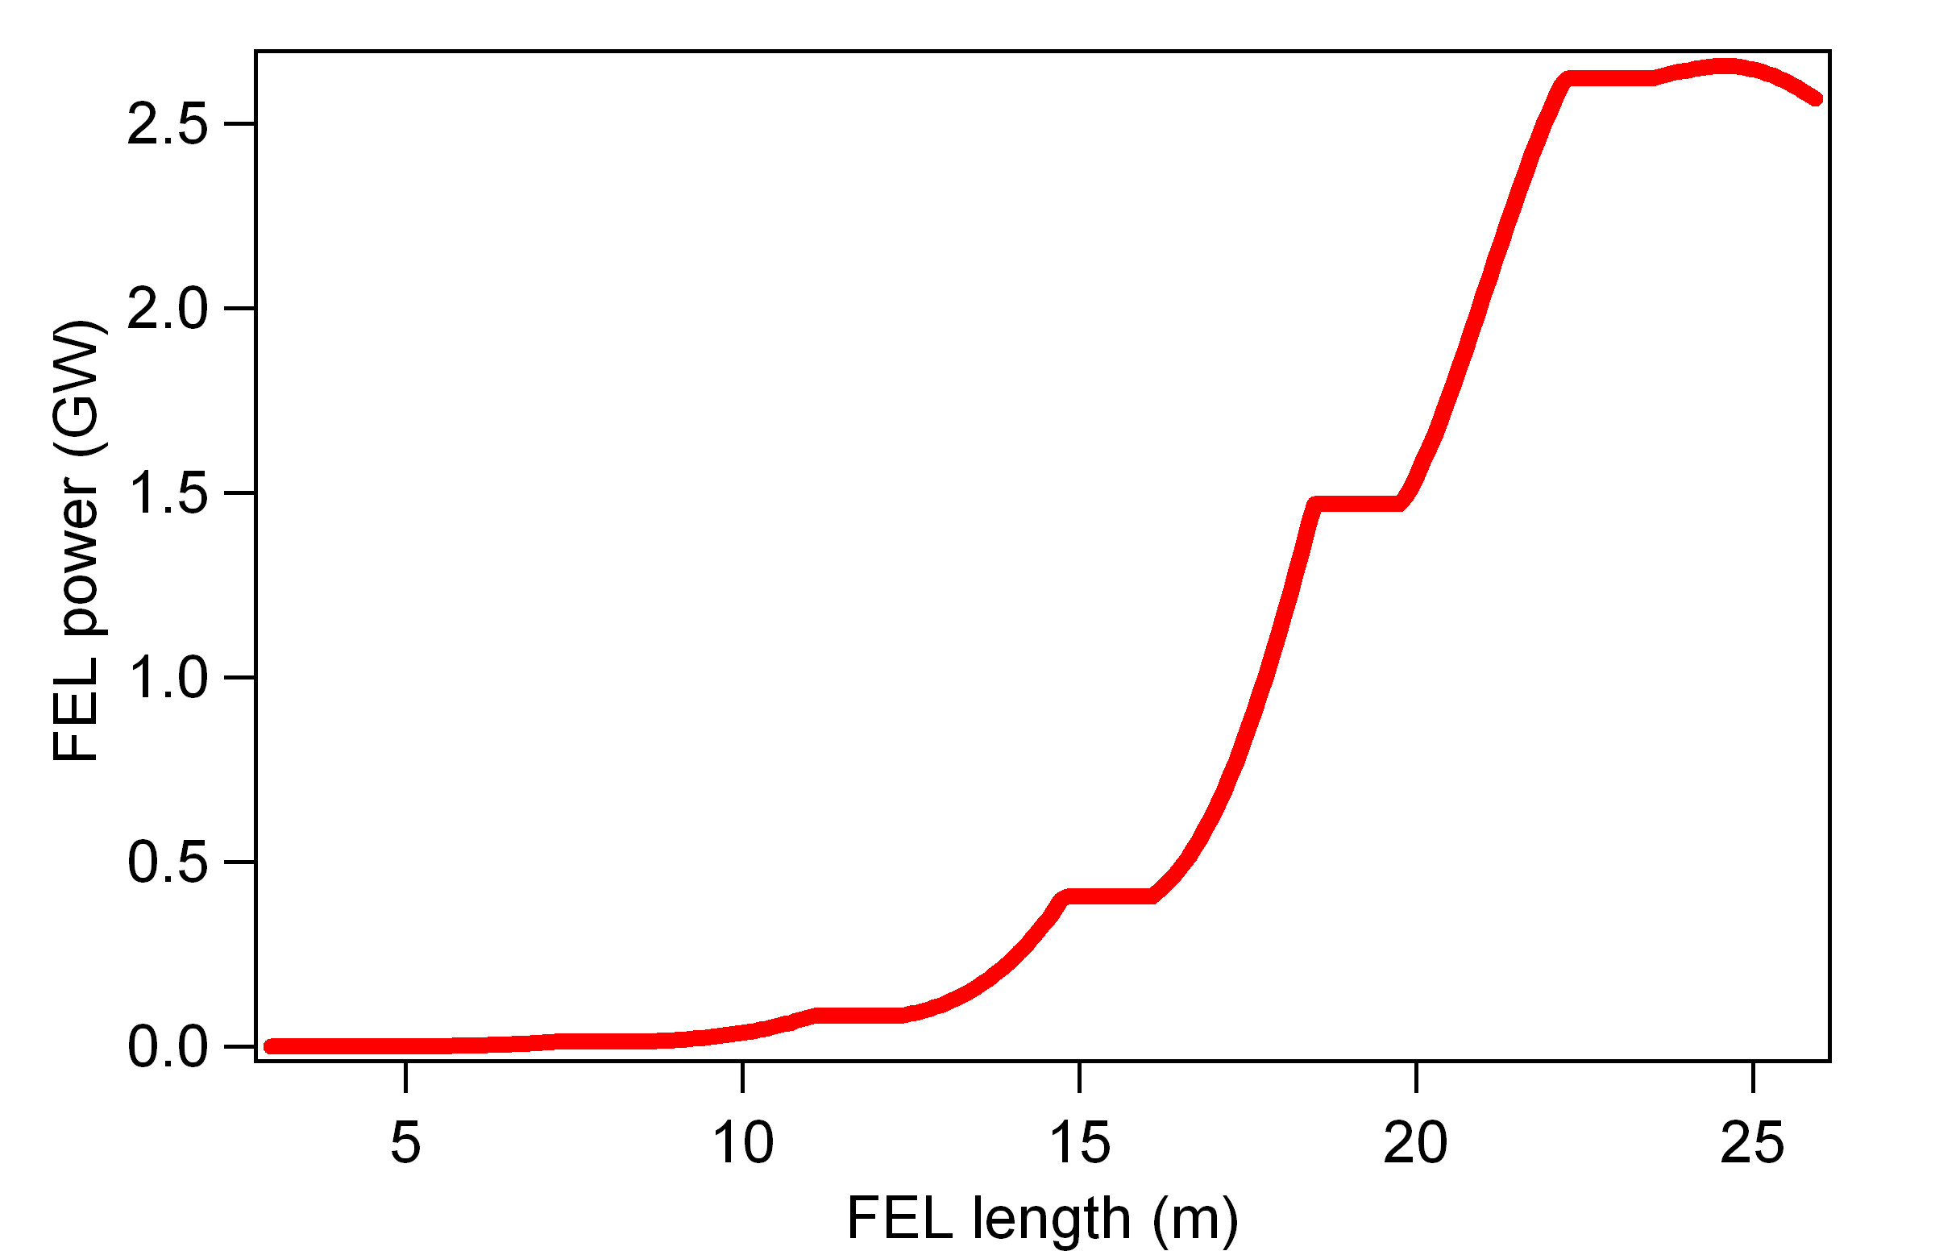
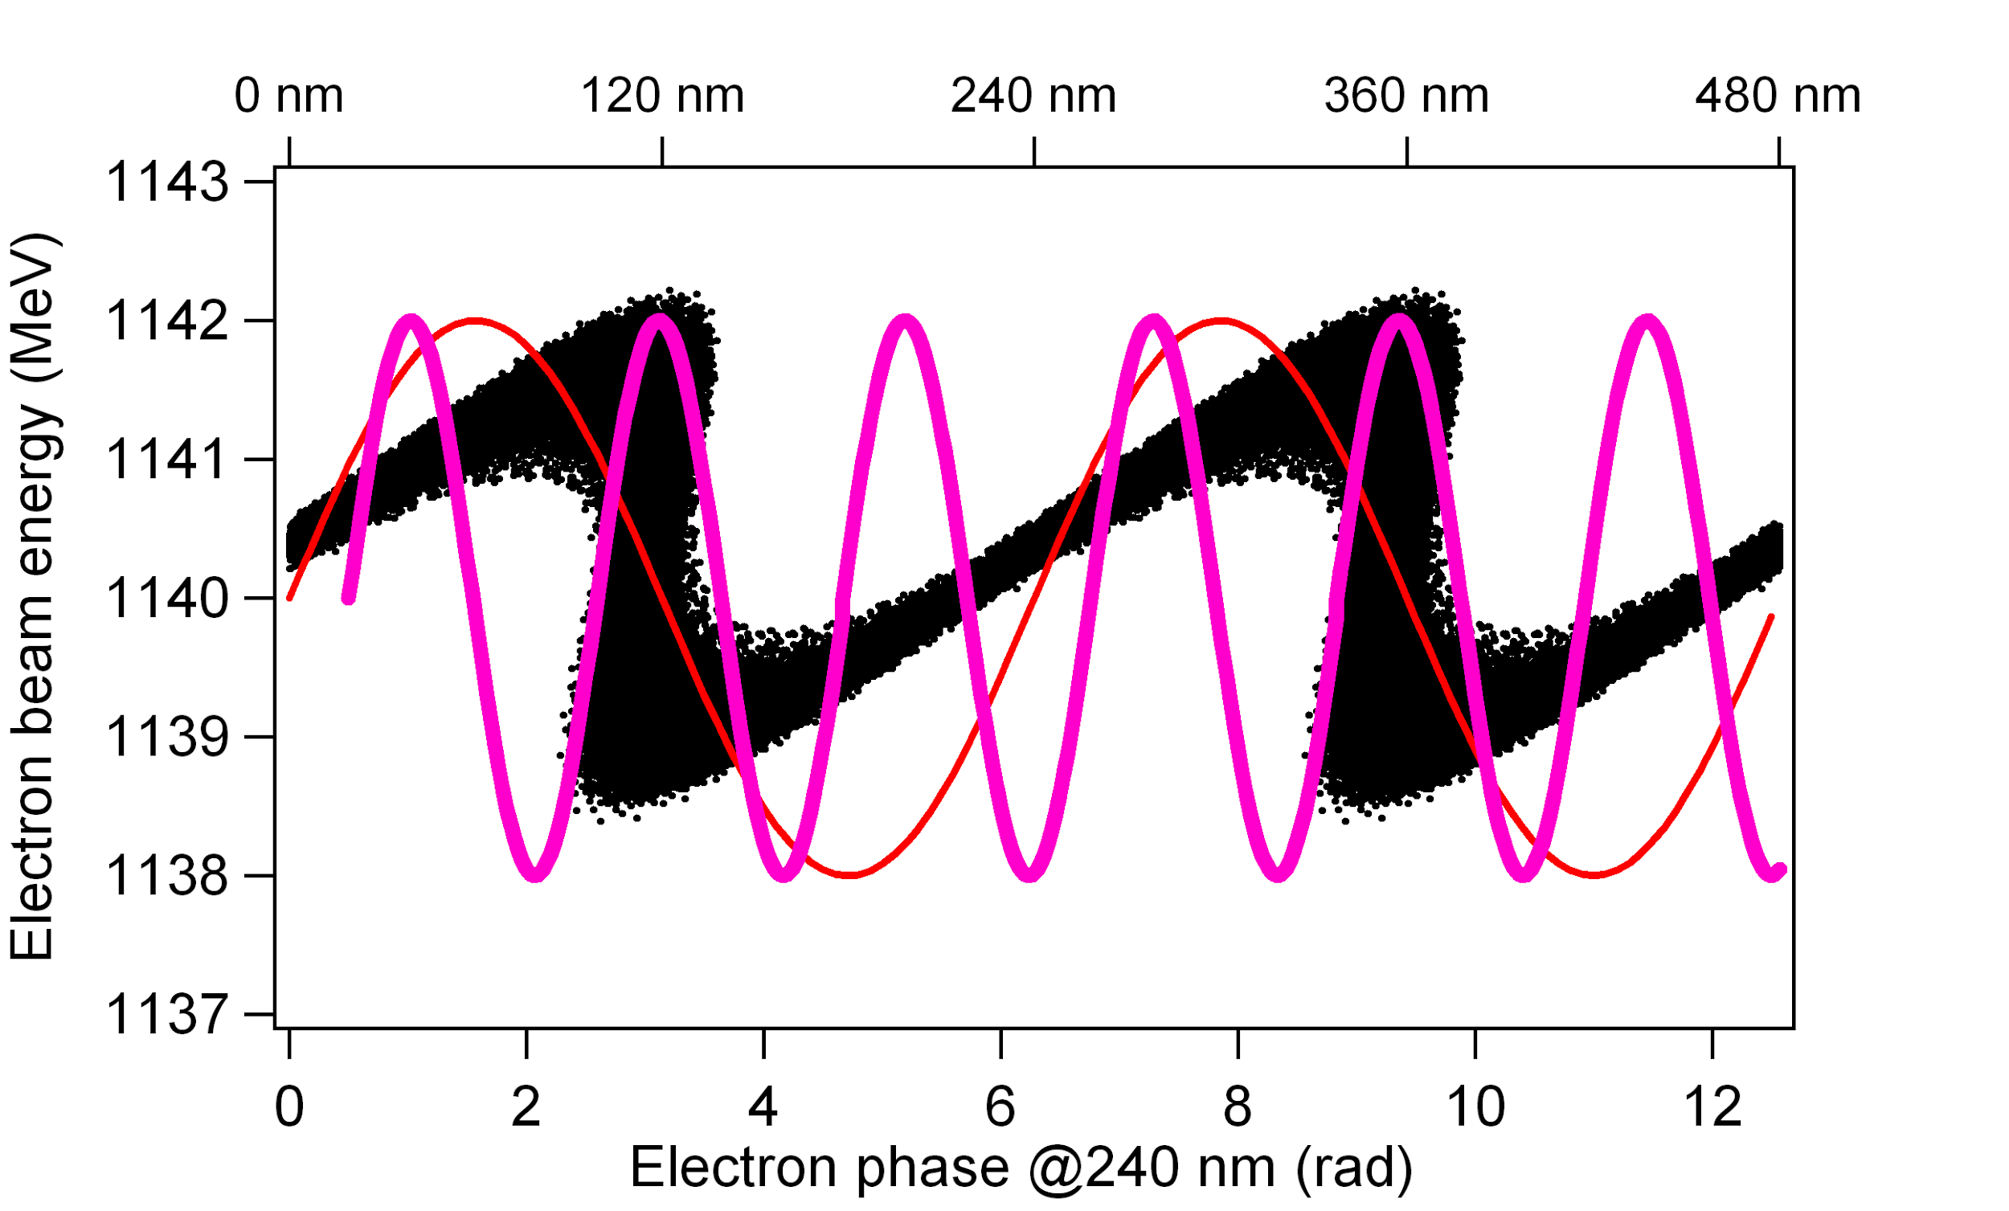
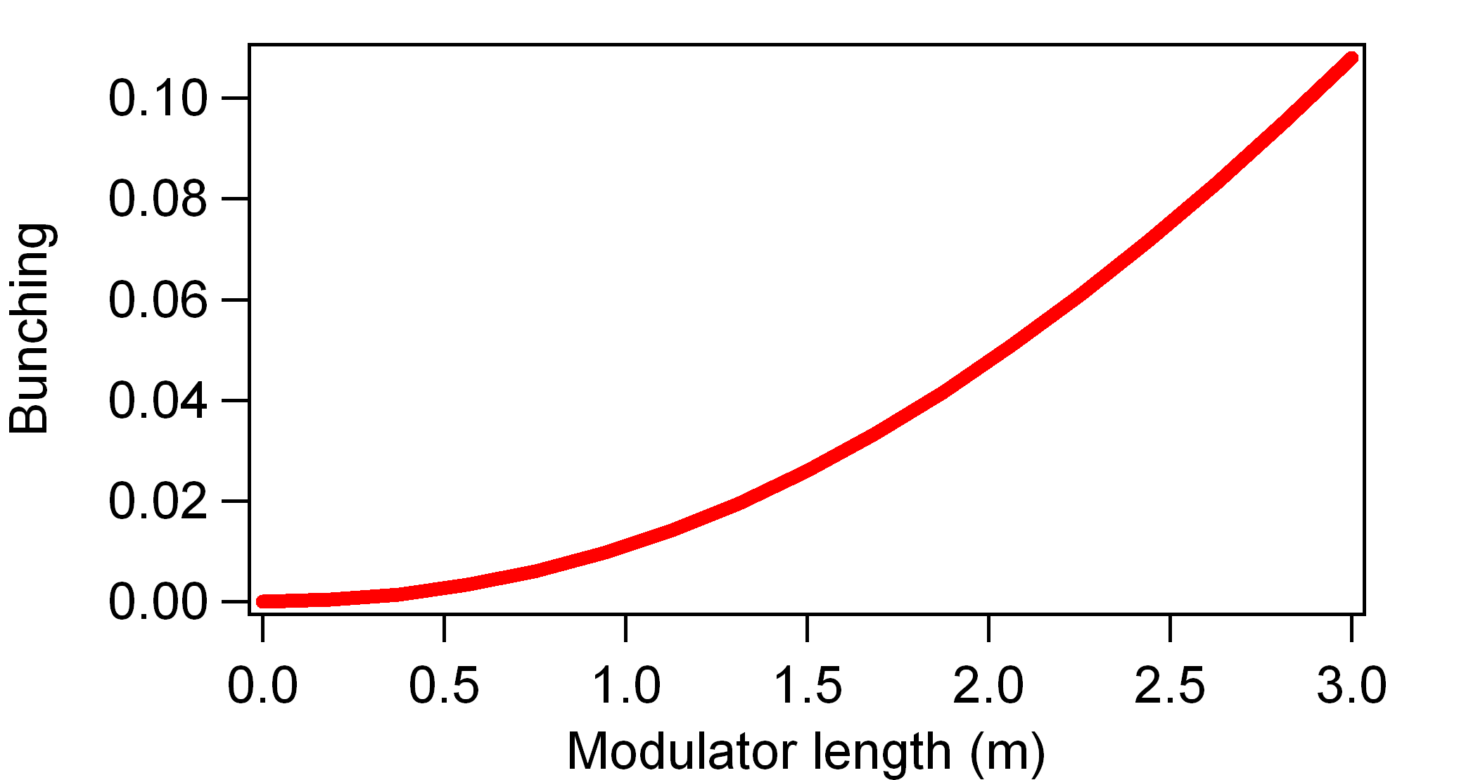
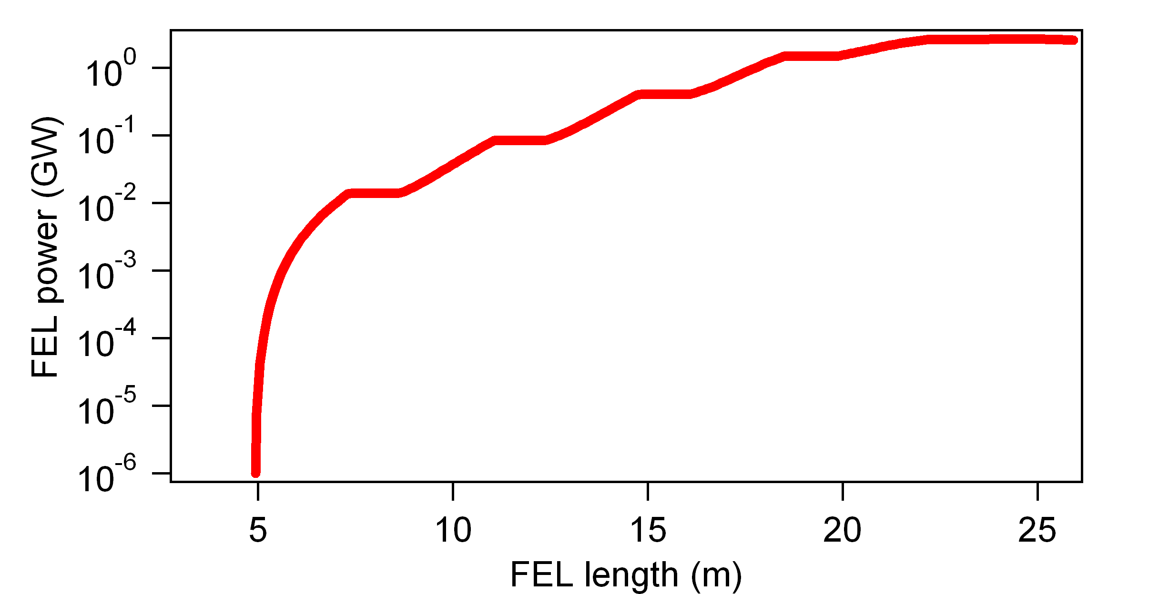
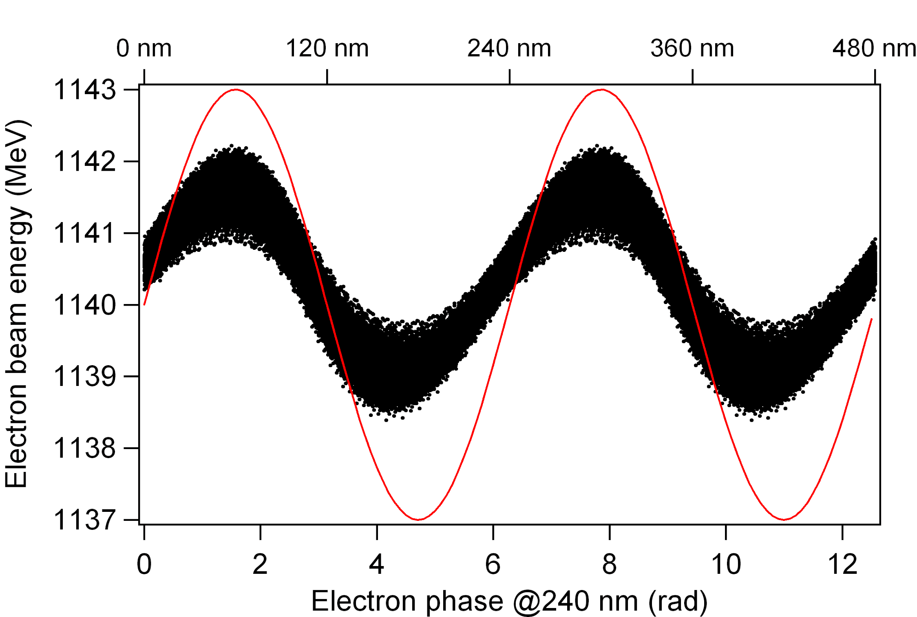
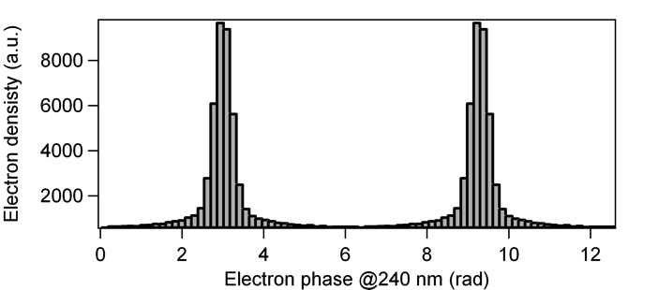
What seeding?
High Gain Harmonic Generation
(HGHG)
Modulator
Dispersive section
Radiator

Slide 4
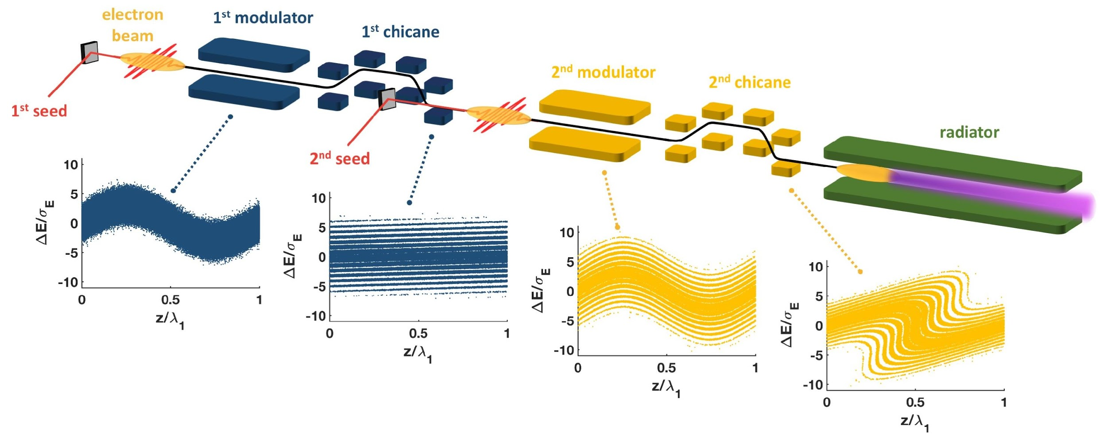
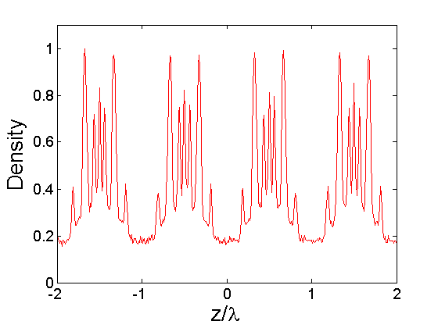
What seeding?
Echo Enabled Harmonic Generation
(EEHG)
A first laser generates an energy modulation in electron beam.
A strong chicane creates stripes in the longitudinal phase space.
A second laser imprints an energy modulation.
The second chicane converts the energy modulation into harmonic density modulation.
B₁
A₁
B₂
A₂
G. Stupakov, PRL, 2009
D. Xiang, G. Stupakov, PRST-AB, 2009

Slide 5
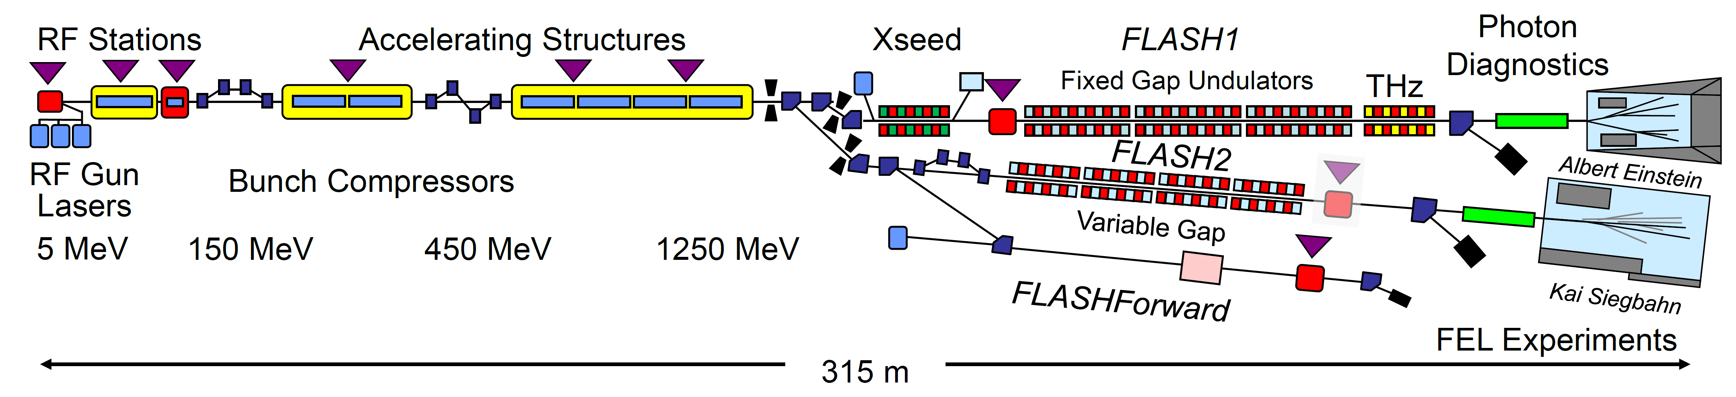
Where seeding?
Xseed: Seeding experiment in FLASH
Parameter | Electrons
Energy | 680 MeV
Emittance | ~0.6 mm mrad
Energy spread | ~100 keV
Charge | 400 pC
Current | ~500 A
Chirp | ~15 MeV/ps
Parameter | Seed 1, 2
Wavelength | 267 nm
Pulse duration | ~200 fs
Pulse energy (max) | ~200 µJ
Parameter | Modulators | Radiators
Segments | 2 | 3+1
Polarization | Horizontal / Vertical | Horizontal
Period | 200 mm | 33 mm / 31 mm
# Periods | 14 | 3 x 60 / 120
K max | ~10 | ~3

Slide 6
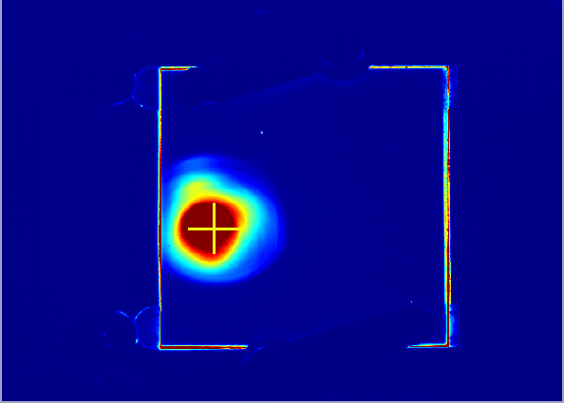
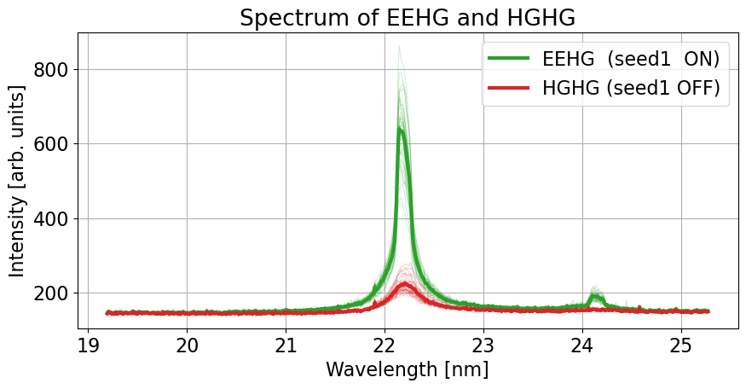
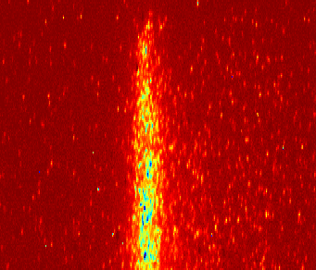
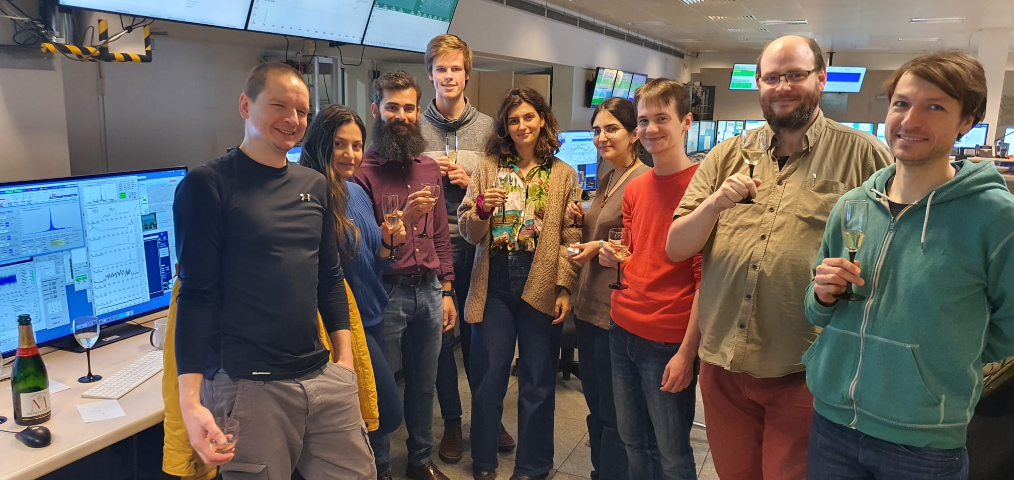
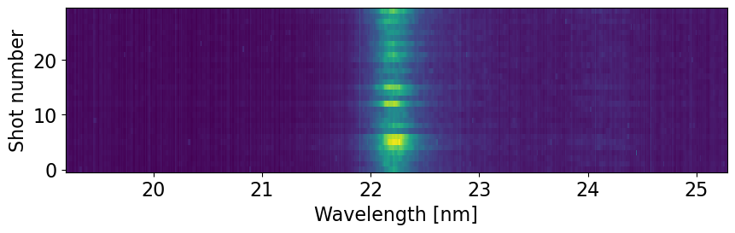
WOW seeding!
First EEHG at FLASH (March 2023)
FLASH2 parallel SASE (25 nm)
Single shot spectrum
h = 12
Wavelength
h = 11
EEHG single shot spectral stability
Happy team!

Slide 7
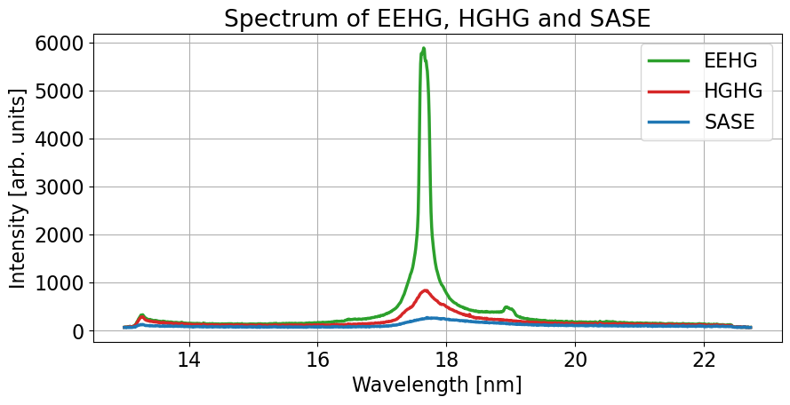
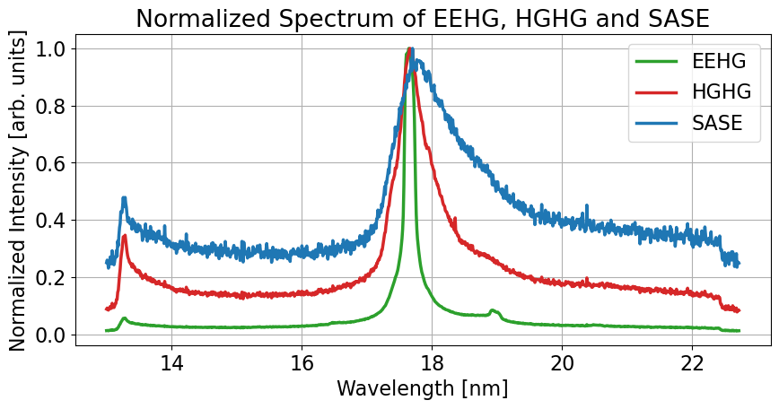
Spectral properties
Comparison between EEHG, HGHG and SASE at H15
Normalized average spectrum (1000 shots)
Average spectrum (1000 shots)

Slide 8
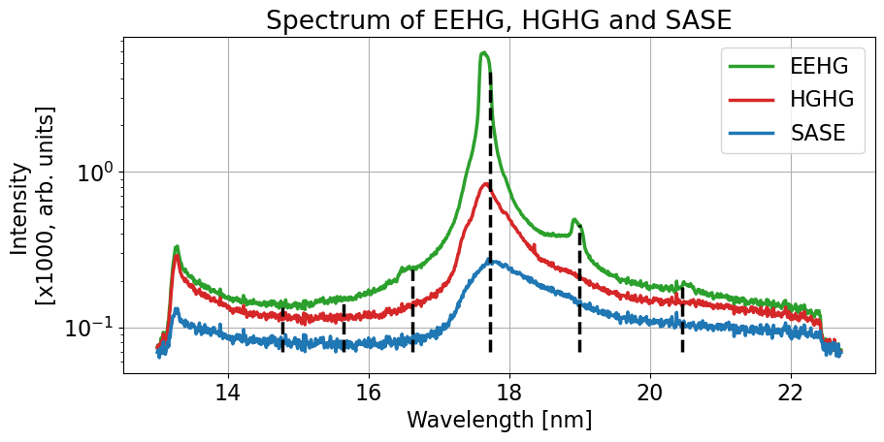
Some additional harmonics
H13 to H18
h = 15
h = 14
h = 16
h = 13
h = 18
h = 17

Slide 9
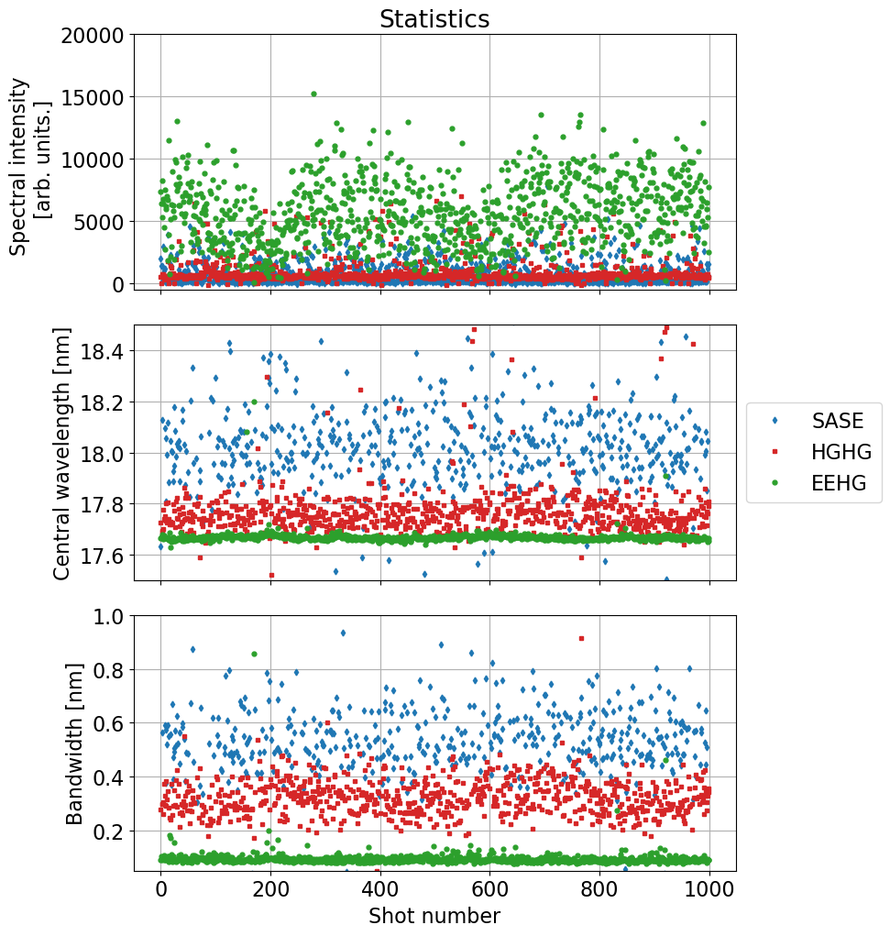
Spectral statistics
Comparison between EEHG, HGHG and SASE (H15)
Gaussian fitting of the spectrum.
Working point optimized for EEHG, just opening/closing seed1 shutter.
Data points most probably limited by the resolution of the spectrometer.
We start to observe the impact of long term drifts.
Re-established seeding signal from scratch machine in less than 10 hours.

Slide 10
Next plans for Xseed
Seeding efforts till mid 2024
Seeding and laser heater.
  Study the effect of the laser heater on the performance (spectrum) of seeding (HGHG and EEHG)
Lasing in seeding mode using the main FLASH1 undulator.
  Fixed gap undulator
Explore EEHG at higher harmonics (h = 75, 4nm).
Learning to operate a seeding beamline in parallel to SASE FLASH2.
  Feedbacks, flexibility
Keep improving the operation of the chicanes.

Slide 11
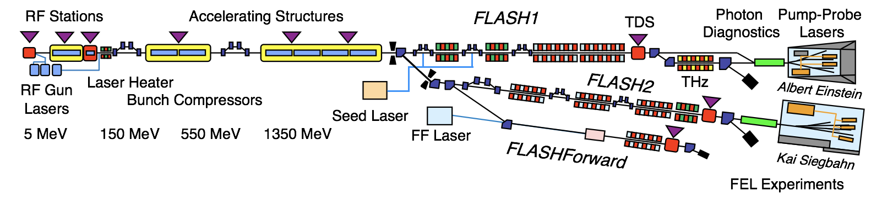
FLASH now vs. 2025
FLASH2020+ Upgrades of the facility

Slide 12
FLASH now vs. 2025
FLASH2020+ Upgrades of the facility
Phase 0
Energy upgrade
3rd BC (FLASH2)
TDS (FLASH2)
Injector Laser
Afterburner FLASH2
Phase 1
Variable gap undulators (FLASH1)
Pump-probe laser (FLASH1)
Phase 1+
High rep. rate seeding (FLASH1)
Photon diagnostics (FLASH1)
Flexible pump-probe
New beamlines
Phase 2
New variable gap undulators
Chicanes for new lasing concepts (FLASH2)
Laser heater in 1st BC
New 2nd BC
Shutdown 2021/22
Shutdown 2024/25
2023

Slide 13
External seeding in FLASH1
FLASH1
THz
User experiments with 1 MHz coherent pulses in soft-X-ray
Combination of HGHG and EEHG:
Fully coherent pulses with
variable wavelength (60 – 4 nm)
tens of fs duration and
1MHz repetition rate.
Variable polarization: Apple III radiators
Successful seeding relies on high
quality e-beam and seed lasers:
• Upgrade of accelerator → shutdown 2021/22
• R&D for optimal laser
Seed 1: 343 nm, 100 MW, 500 fs
Seed 2: 297-317 nm, 300 MW, 50 fs

Slide 14
Summary and conclusions
We demonstrated EEHG seeding on Xseed at FLASH.
  Spectra measured up to H15 (17.7 nm), clear signal at H20 (13.3 nm)
  In parallel with SASE lasing in FLASH2.
We have a clear seeding studies program till the next shutdown.
  Main focus on laser heater impact and short wavelengths, procedures.
  All efforts, developments and lessons learned are directly applicable to the restart after the shutdown.
After the upcoming shutdown (mid 2025) FLASH1 will become a unique, externally seeded FEL beamline delivering fully coherent pulses at 1 MHz in the soft-X-rays for user experiments.

Slide 15
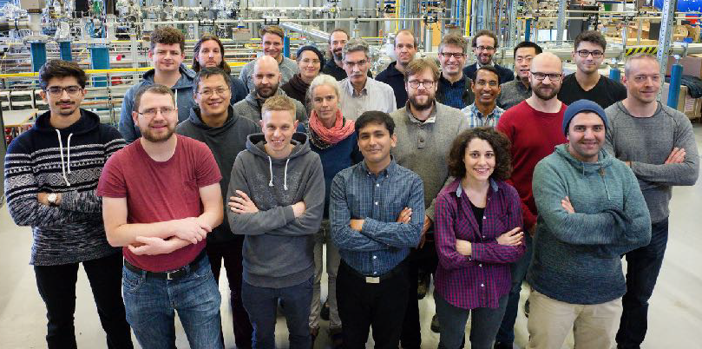
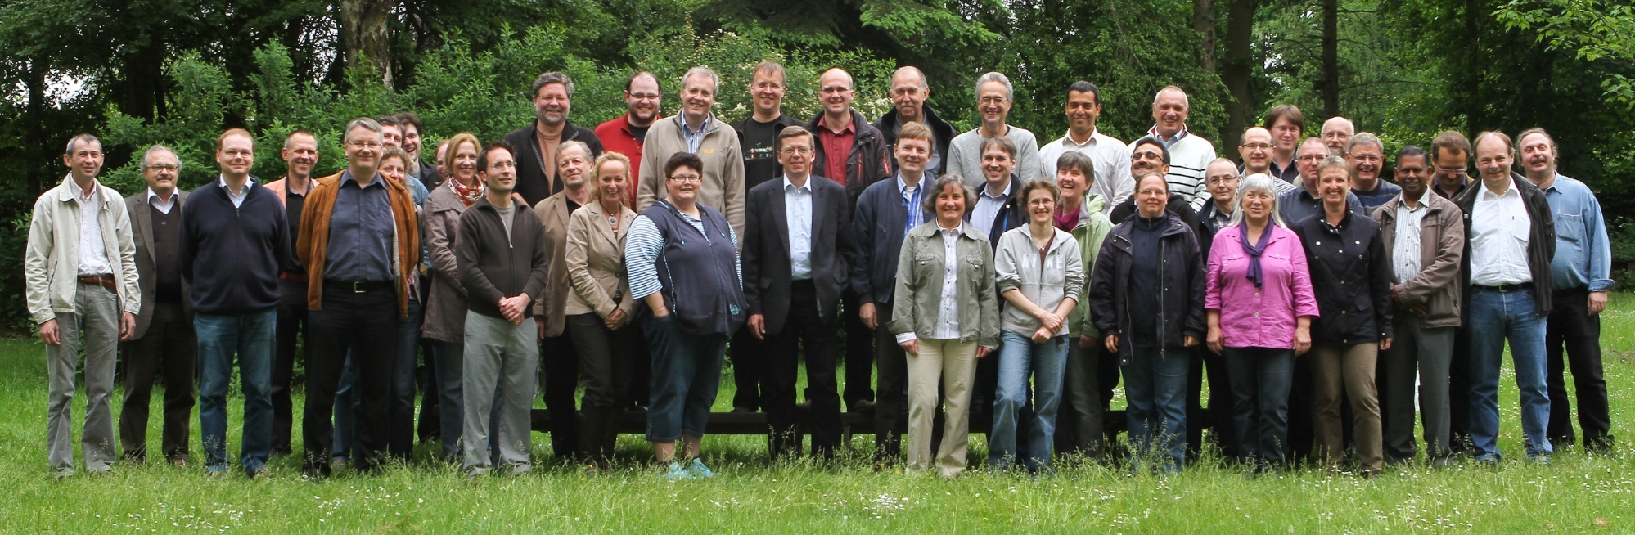
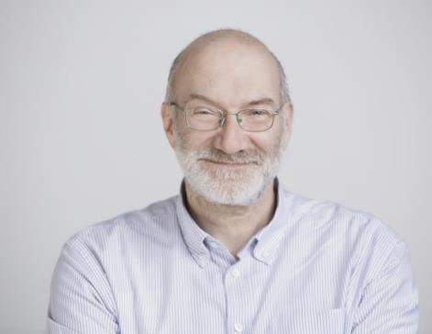

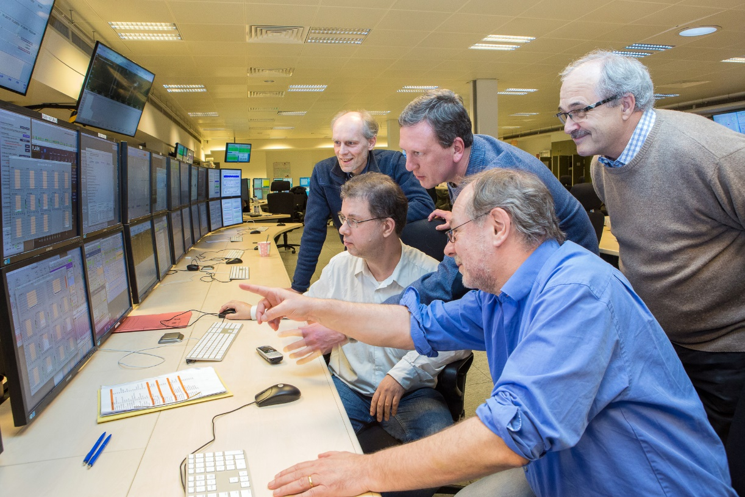
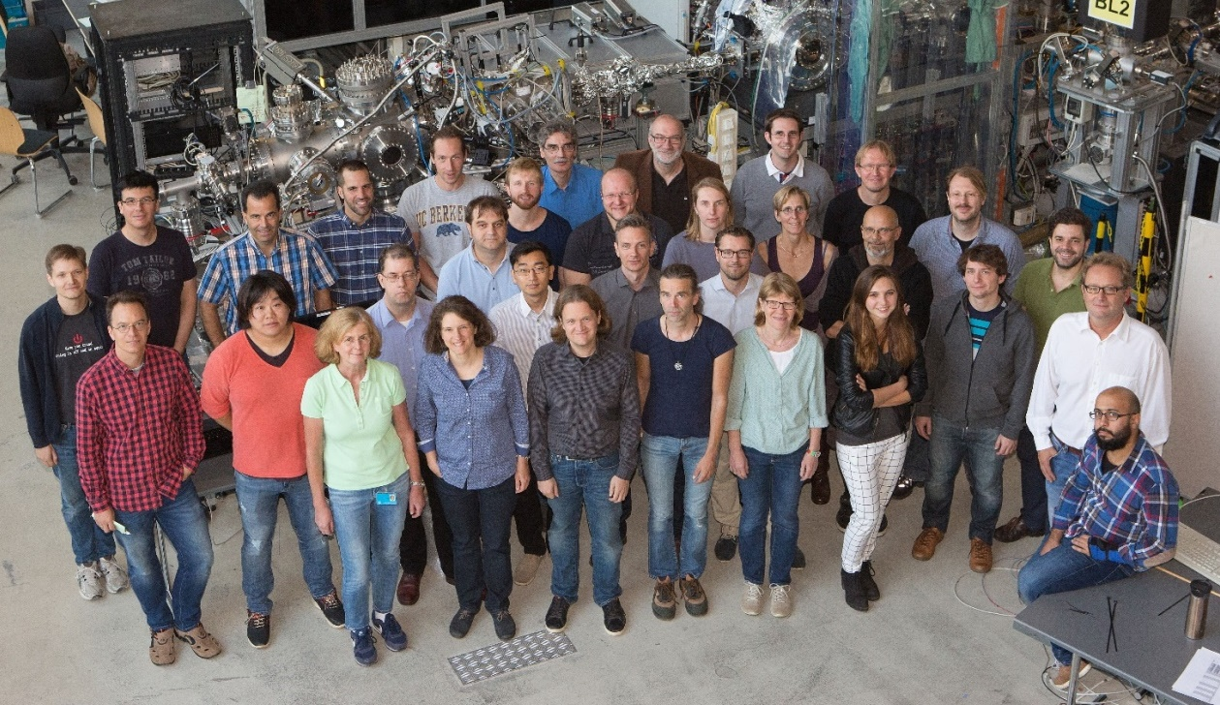

FLASH
A Team Effort
Accelerator Lasers Photon Science
FLASH

Slide 16
Thank you for your attention!
Eugenio Ferrari
MPY
eugenio.ferrari@desy.de

