Slide 1
ARES Operation Meeting
Summary of week 12 / 2023
Willi Kuropka, on behalf of the ARES crew

Slide 2
Summary of week 12
Mon. 21th March | Tue. 22th March | Wed. 23th March | Thu. 24th March | Fri. 25th March
Tunnel open
Achievements
ACHIP laser alignment
Difficulties
Notes

Slide 3
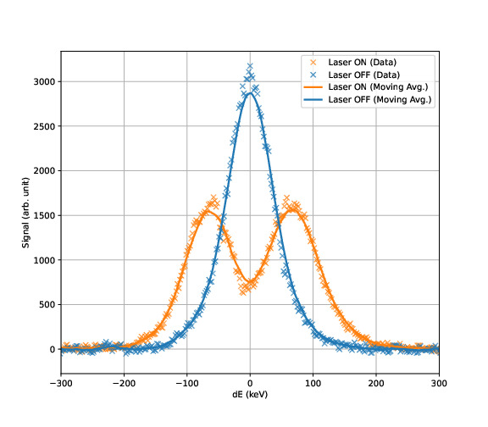
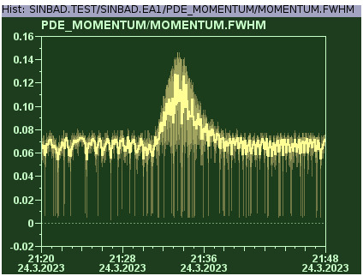
Successful modulation on Sunday
First modulation achieved on Friday night
During laser timing scan
Momentum spectra

Slide 4
This week
X-band RF station site acceptance test

