Slide 1
chATLAS
An AI Assistant for the ATLAS Collaboration
DANIEL MURNANE, GABRIEL FACINI, RUNZE LI, DANIELE DEL SANTO & CARY RANDAZZO
1st Large Language Models in Physics Symposium
February 21, 2024
Notes:
Add Fermilab

Slide 2
chATLAS Overview
Motivation
History of chATLAS
Data Gathering
Infrastructure
Deployment Result: Chat Interface and Demo
Roadmap
Updates, Challenges, and Summary

Slide 3
MOTIVATION
Quickly parsing documentation and twiki
Semantic search and availability of heterogeneous sources of ATLAS information
Summarizing research
Connecting the dots between different groups
Debugging software
Searching and summarizing JIRA and Glance information

Slide 4
HISTORY
In April 2023, initial ATLAS ML Forum meeting to discuss usage of ChatGPT and Github Copilot within ATLAS
In June 2023, presentations on several ongoing works to use LLMs within ATLAS
ATLAS-GPT: Daniel Murnane
ChATLAS: Gabriel Facini
Google Bard + ATLAS: Kaushik De
Analysis Description Language + GPT: Gokhan Unel
Decision made to converge ATLAS-GPT and ChATLAS and create an official prototype
Fortnightly developer meetings kicked off in August 2023
Currently approx. seven part-time contributors
Launched ATLAS-public demo November 16 https://chatlas-flask-chatlas.app.cern.ch/

Slide 5
Data Gathering: How Scraping Began
ATLAS Twiki
CDS
Indico
Start with set of “Starting URLs”
Recursively visit included links
Find all headers, and visit content below
Append metadata of twiki (parent structure, date revised, etc.)
Discover whether the CDS paper has a Gitlab latex repo
If latex exists, pull from repo and (planned) convert to markdown
(Planned) Use unstructured library to parse markdown
If latex does not exist, use nougat library to read PDF (including equations) into markdown
Load event list
Scrape timetable contents (date, title, speaker, etc.)
(Planned) Pull PDF slide decks and minutes
(Planned) Parse in the same way as in CDS

Slide 6
Data Gathering: Volume Measurements
ATLAS Software Docs
Group level Docs
CDS Papers & Notes
Twiki
E-group
Archive
Indico Meetings
PDF Plots
Mattermost
Jira
ATLAS Codebases

Slide 7
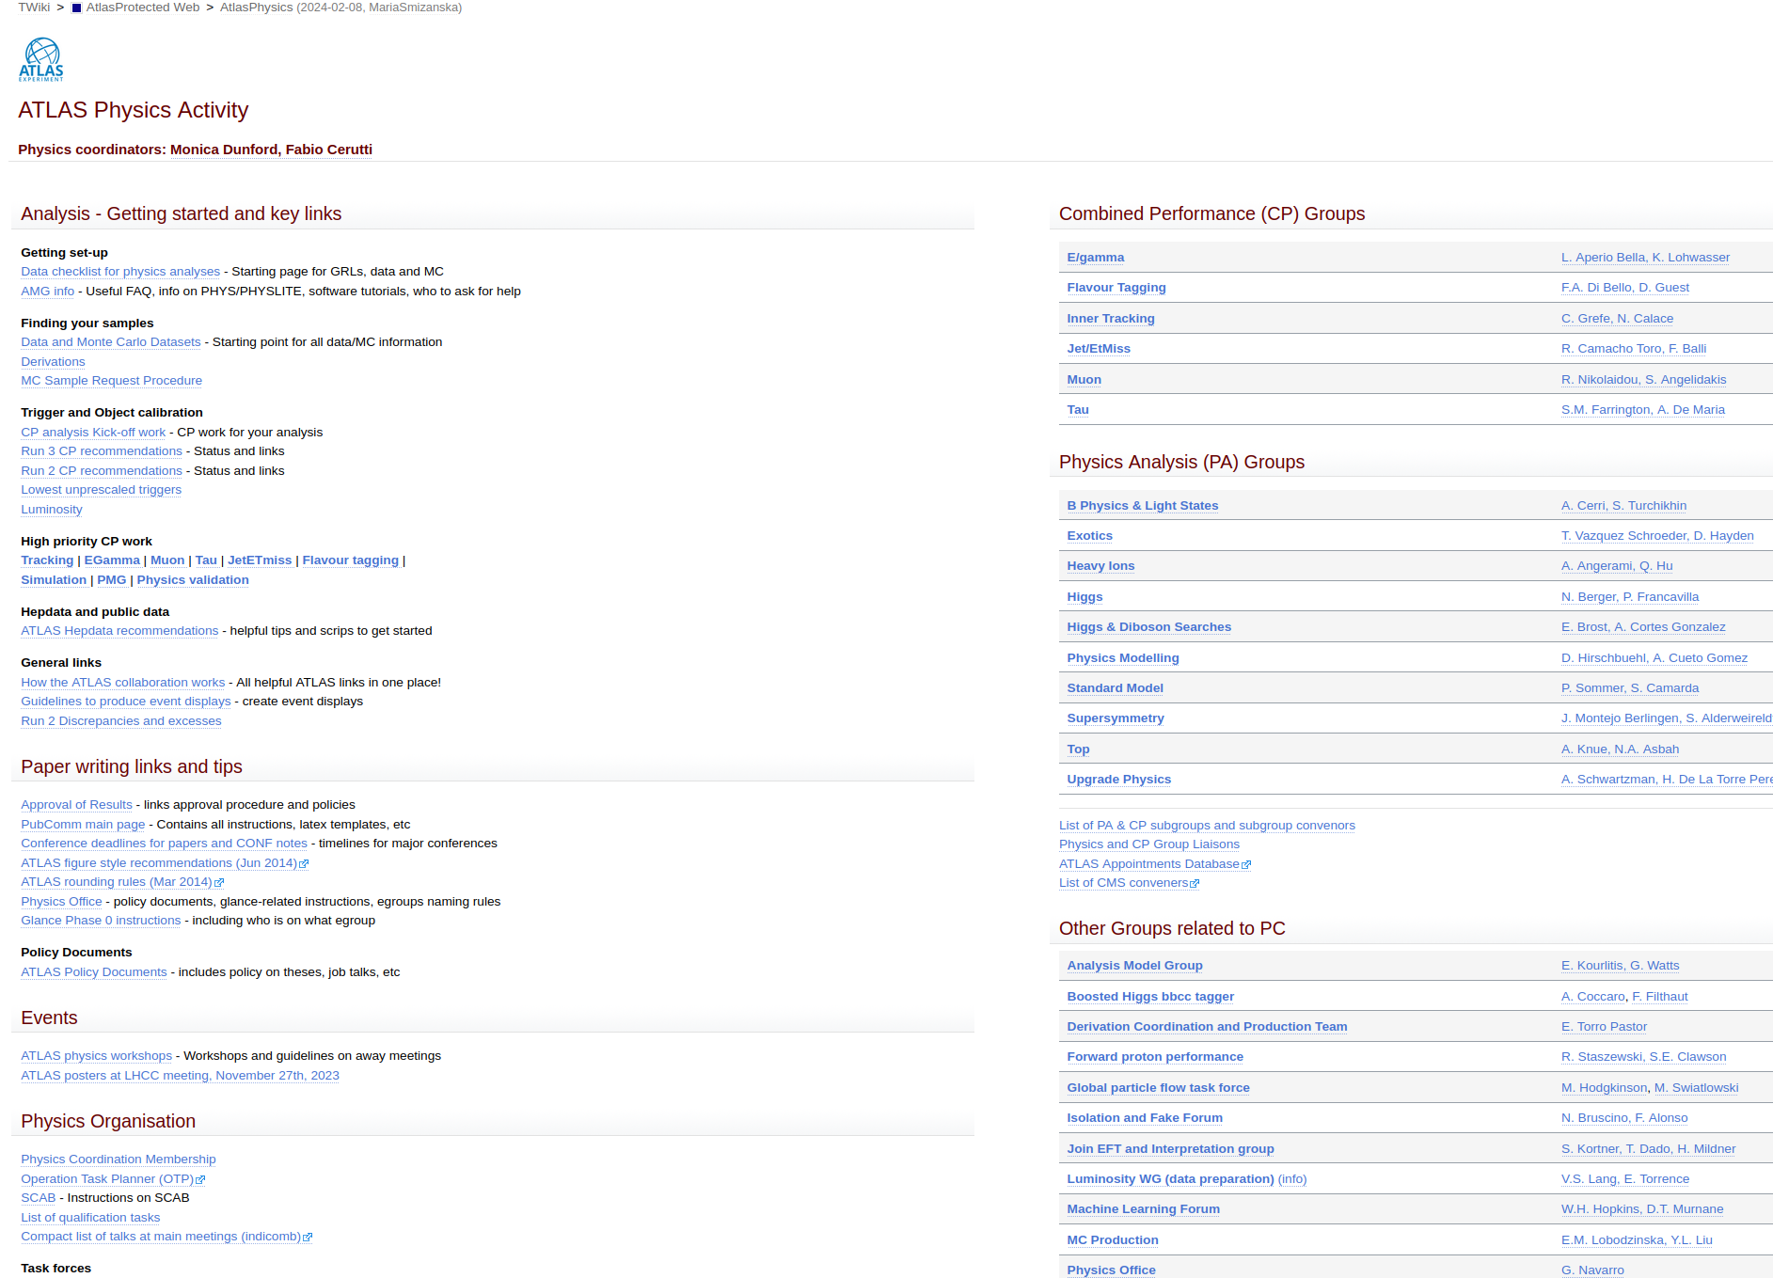
Data Gathering: Volume Measurements and Tool Selection
Twiki
Over 2000 ATLAS Twiki Topics
Using:
BeautifulSoup and auth-get-sso-cookie

Slide 8
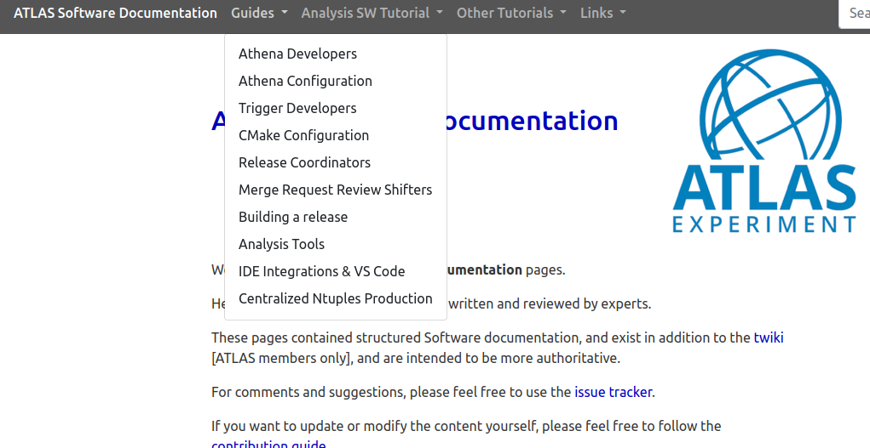
Data Gathering: Volume Measurements and Tool Selection
ATLAS Software Docs
Using:
BeautifulSoup and auth-get-sso-cookie
Hundreds of ATLAS Software Docs

Slide 9
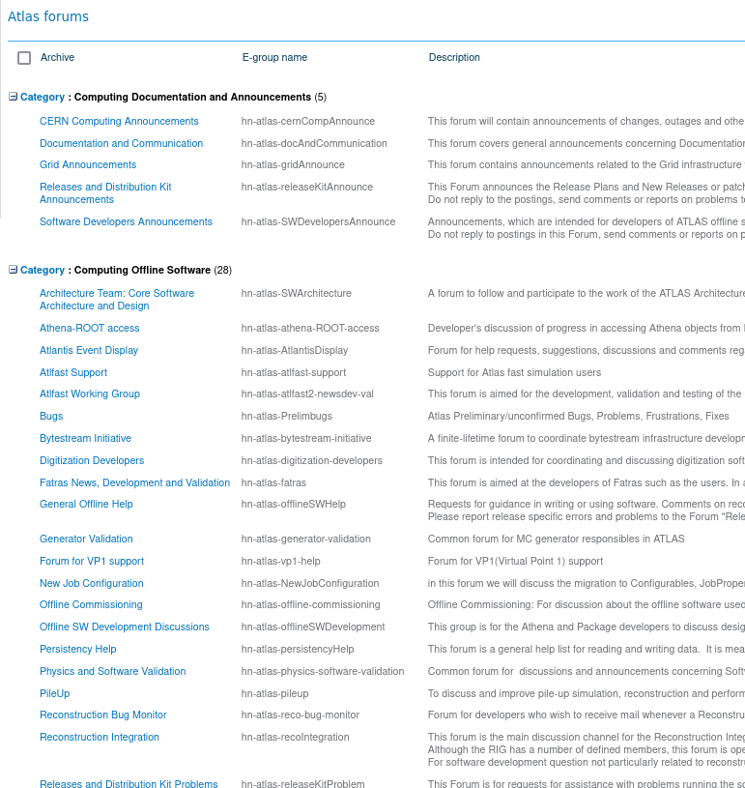
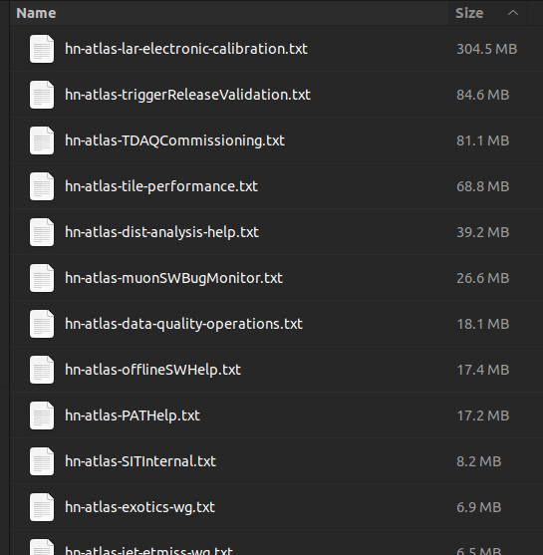
Data Gathering: Volume Measurements and Tool Selection
E-group
Archive
8912 topics x (1-50+ messages) for largest egroup
~ tens of thousands of messages to date
Using:
BeautifulSoup and Selenium

Slide 10
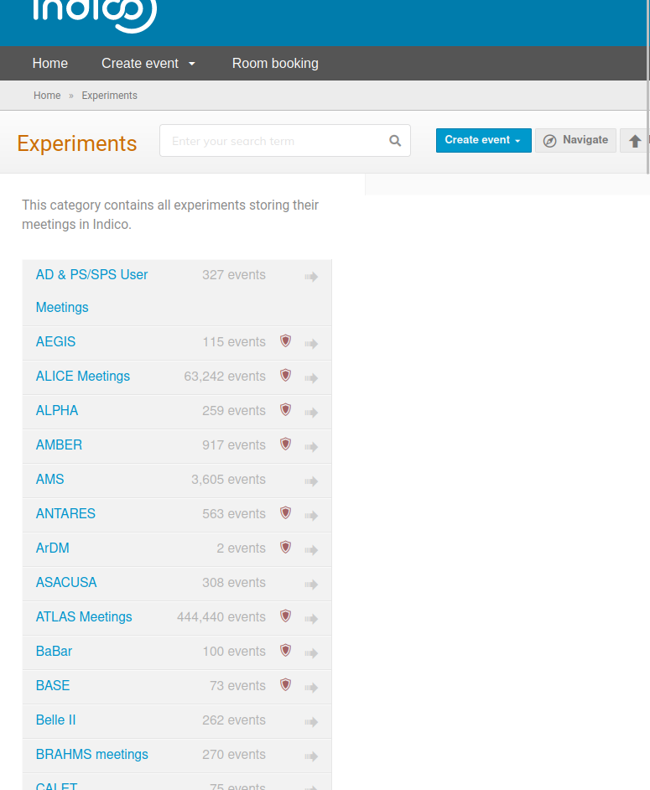
Data Gathering: Volume Measurements and Tool Selection
Indico Meetings
Using:
Nougat and Marker
440,440 ATLAS Indico Meeting Events

Slide 11
Data Gathering: Volume Measurements and Tool Selection
Group level Docs
PDF Plots
Mattermost
Jira
ATLAS Codebases
Using:
Pending further experiments
Measurements Pending - very large

Slide 12
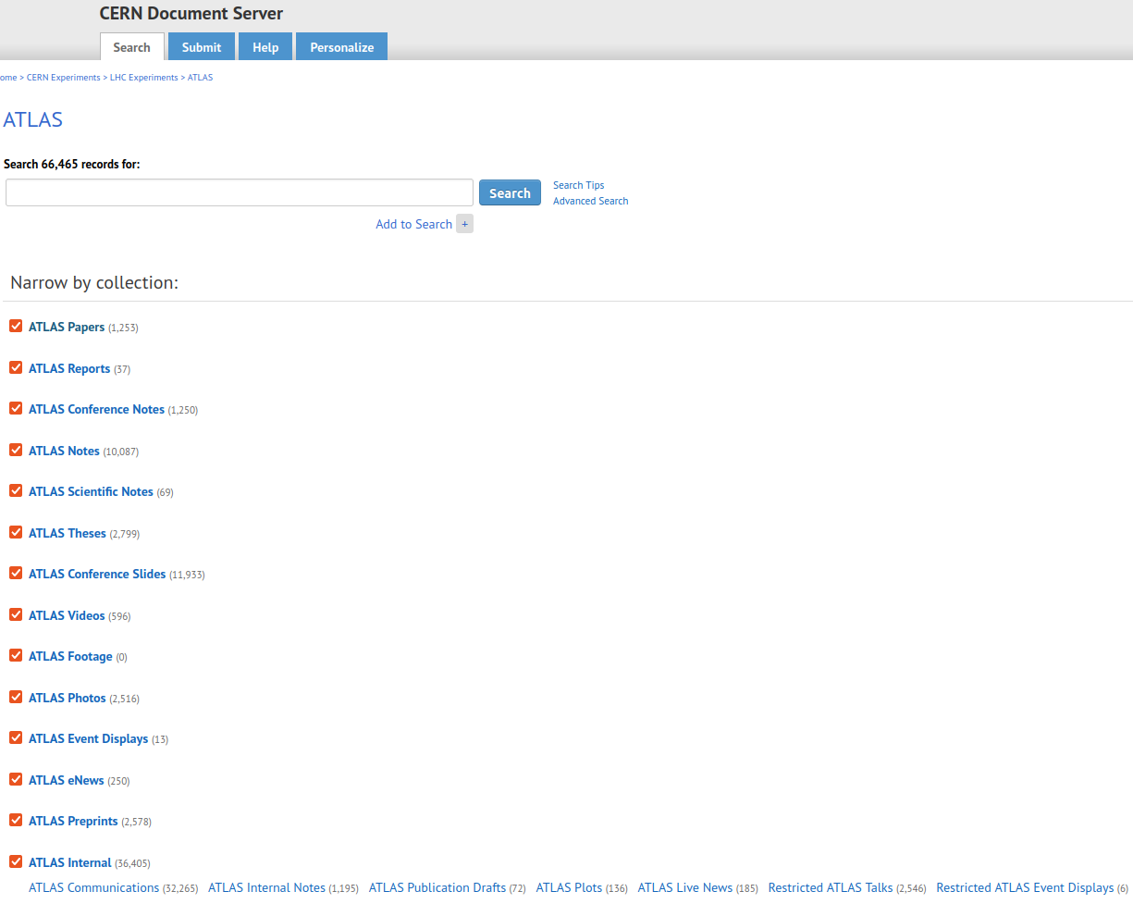
Data Gathering: Volume Measurements and Tool Selection
CDS Papers & Notes
Using:
Nougat and Marker
Total: 66,465 records found
36,405 are Internal including communications, notes, etc.

Slide 13
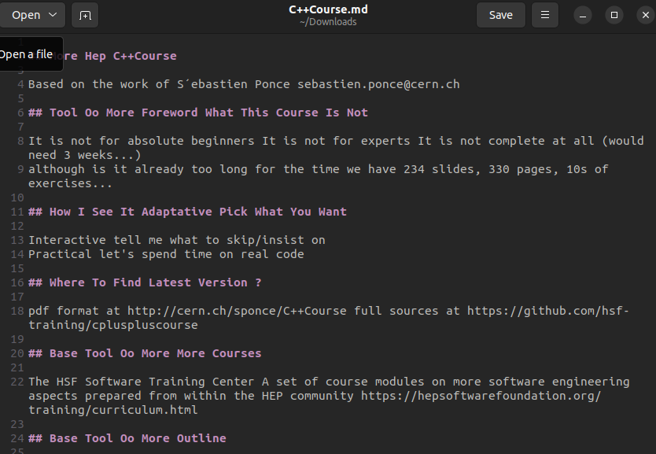
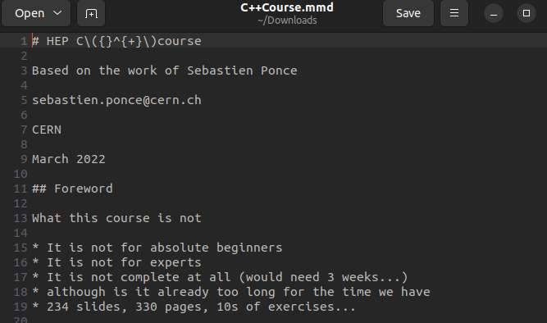
Data Gathering: A Tool Comparison
CDS Papers & Notes
Slides more difficult to process and largest data in volume
Faster
Marker vs Nougat (PDF scraping)

Slide 14
Processing: Chunking and Retrieval
Chunking
(Current) Loop through HTML and Markdown heading sections
If section exceeds 510 tokens, split with SentenceTransformersTokenTextSplitter
Pass chunk through HuggingFace’s sentence-transformers/all-MiniLM-L6-v2 model
(Planned) Use built-in unstructured library to identify chunks
Insert chunk into Chroma database, with metadata of file URL, twiki name
Original Query
K documents
Previous chat
Retrieval
All handled internally by qa = ConversationalRetrievalChain.from_llm( llm=model, retriever=db.as_retriever(), memory=memory, verbose=False,)
LLM Model is GPT-3.5 from OpenAI API, retriever is default Chroma which contains the embedding model, memory is a buffer that retains all previous chat information
Implicit is that the model aggregates all K-documents with a prompt to produce a new question based on the original question and the K-documents
Conversational RetrievalChain
K documents + processed new query

Slide 15
Summary of Gathering and Processing
Summary includes…
Diagram of all the possible ATLAS datasets and how many we have in the Database(DB)
Chunked & Embedded Datasets are ready for or have been added to DB
Stage the progress of each
Over 37% of textualizable ATLAS datasets (minimum)
Hardware upgrades were made to scrape in larger volume
JIR
ATLAS Software Docs
Group level Docs
CDS Papers & Notes
DB
Twiki
E-group
Archive
Indico Meetings
PDF Plots
Mattermost
Jira
ATLAS Codebases
Task
Scrape
2k+ | 500+ | 10k+ | ~1k+ | ~1k+ |  |  |  |  | ~5k+
Convert
Chunk & Embed
Not yet started
In Progress
Complete

Slide 16
Current INFRASTRUCTURE
(PP) = (Possibly Processed)
CERN Openshift
Currently takes ~3 seconds to respond (mostly waiting on OpenAI)
CERN OAuth SSO
Query
Flask Server
User
Query
(PP) Response
OpenAI
LangChain
Embedding Vector
Response
GPT 3.5 / GPT 4
Chroma DB
H.F.S.T Embedding
Conversational RetrievalChain
KNN documents
CERN EOS

Slide 17
Planned
Infrastructure
(PP) = (Possibly Processed)
CERN Openshift
CERN OAuth SSO
Query
Flask Server
Filters:
Which database (Twiki, etc)
Date
Internal/External
“Trustworthiness”
User
Query & Filter
LangChain
Embedding Vector
Response
Llama-7B
on CERN GPUs (KubeFlow?)
Chroma DB
H.F.S.T Embedding
Conversational RetrievalChain
KNN documents
CERN EOS

Slide 18
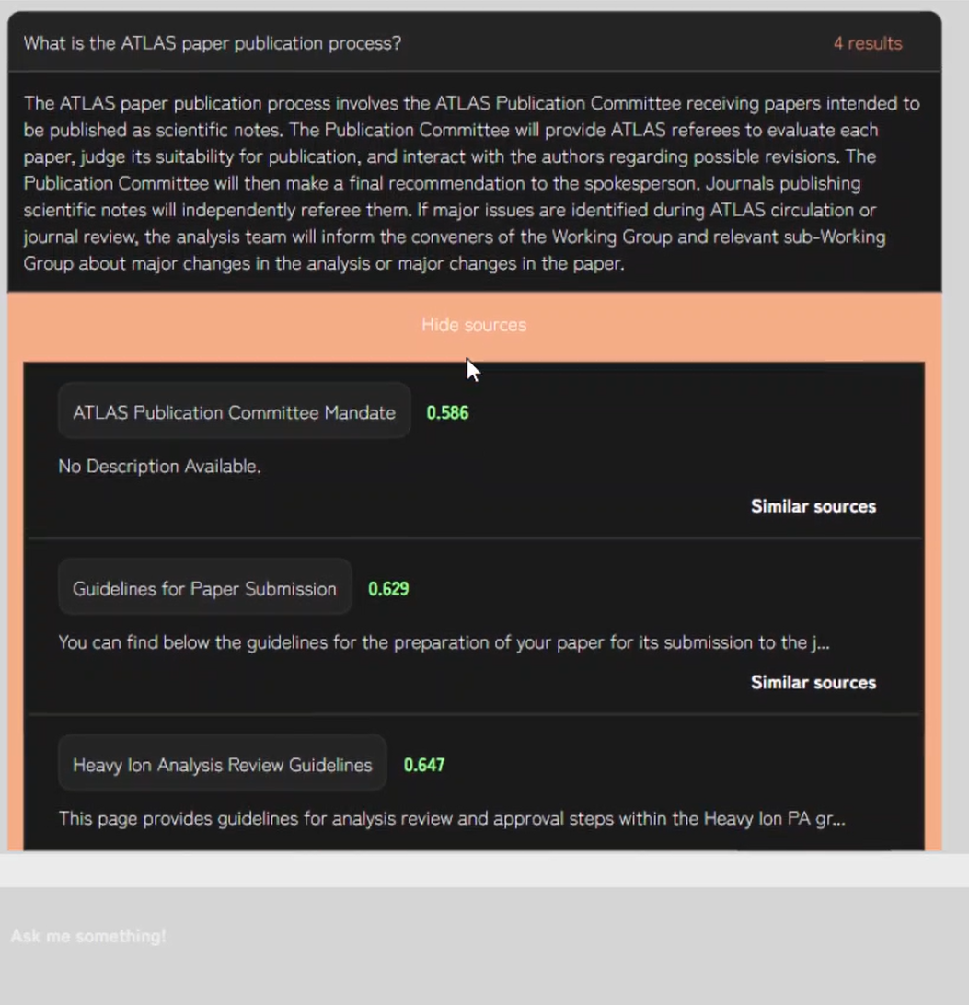
Chat Interface

Slide 19
Chat Interface
Version 1.0 contains everything needed to answer a query
Can cite the top sources used in the response
Has a quick search for similar sources
Input query
LLM response
Source title
Similarity score
Instant similarity search
Next query entry

Slide 20
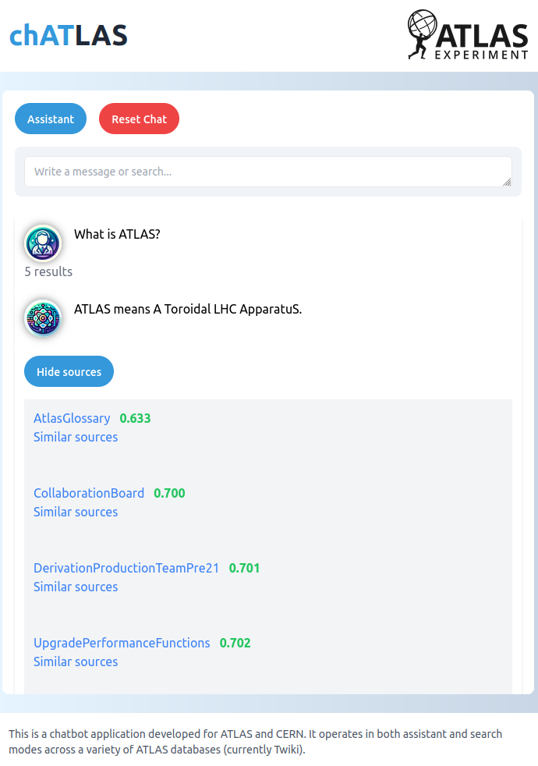
Chat Interface
Version 1.0 contains everything needed to answer a query
Can cite the top sources used in the response
Has a quick search for similar sources
Experimenting with a V2.0 appearance that is lighter, and has a dedicated Assistant mode and Search mode

Slide 21
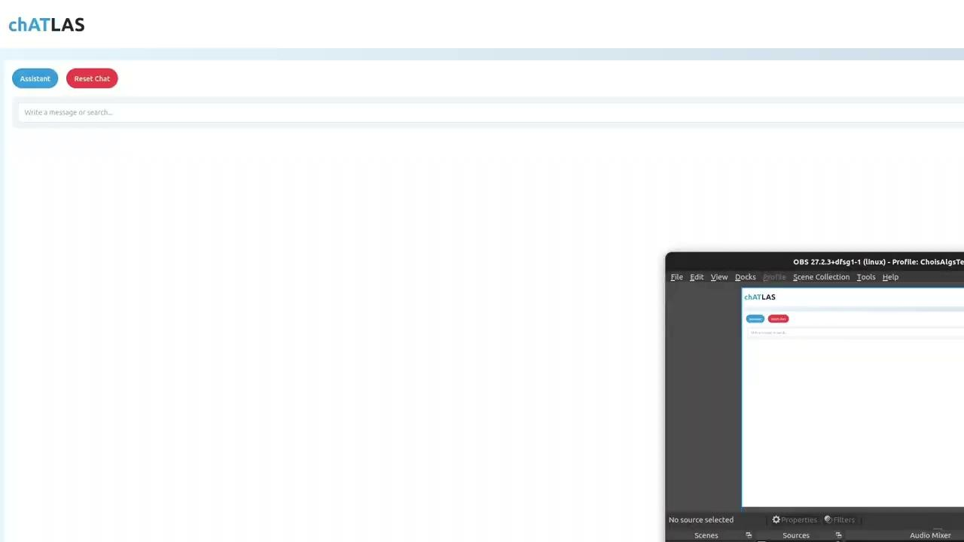
Demo

Slide 22
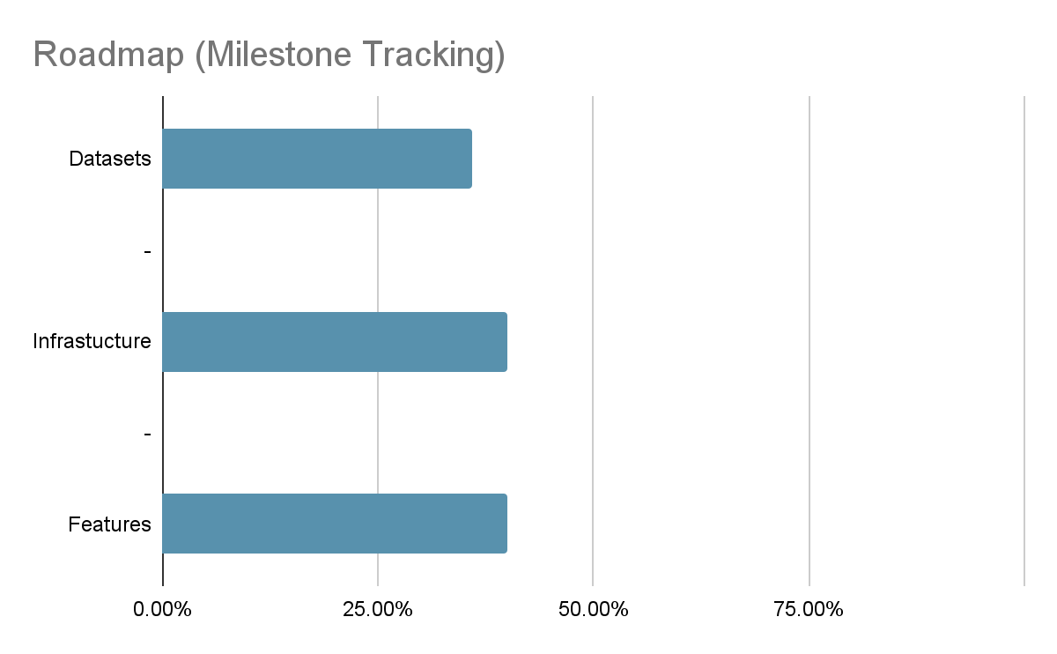
ATLAS Software Docs
ATLAS Codebases
Group level Docs
CDS Papers & Notes
Twiki
E-group
Archive
Indico Meetings
PDF Plots
Mattermost
Jira
HuggingFace & OpenAI API
HuggingFace both Embedding & Completion
More sophisticated document aggregation
Vision model for plots and diagrams
Hugging Face & OpenAI API
HuggingFace both Embedding & Completion
More sophisticated document aggregation
Vision model for plots and diagrams
Fine-tuned Completion Model
Single-query Assistant & Simple search
Filtered search & Continued- conversation Assistant
Integration with Gitlab and IDEs
Integration with other CERN AI Assistants
Agentic – categorize, review papers, monitor Glance and Jira
Single-query
Assistant &
Simple search
Filtered search & Continued- conversation Assistant
Integration with Gitlab and IDEs
Integration with other CERN AI Assistants
Nov ‘23 Jan ’24 March ’24 July ‘24

Slide 23
Recent Updates and Ongoing Work
Studies of the use and performance of different models as well as response optimization via prompt engineering and similarity search techniques
Indico scraping shown previously with Nougat and Marker
Video caption search and embedding
Fine-tuning model research and experiments on either CDS or Twiki
App development, deployment, documentation, etc
Studies on how to include the ATLAS Glossary, and other “Dictionary” or “Reference” type documents - first-layer database search, fine-tuning, or even heuristic hand-engineering (“When is the NSW being upgraded?” - search in Glossary for any words present - place them in parentheses = “When is the NSW (New Small Wheel) being upgraded?”)

Slide 24
Challenges and Suggestions
Getting the data! Highly heterogeneous file types, many behind authorisation walls, many stale or inaccurate, many requiring high levels of post-processing
Community solutions could go a long way: Ensure that any experiment/collaboration databases are easily accessible and exportable. All websites should live in a git repo. All publications should be submitted and saved as latex, and compiled separately. All discussion forums should have anonymisation options. This would have saved ~1 year of data wrangling
Hallucination is still a very real problem [https://www.arxiv-vanity.com/papers/2311.04348/]
A high quality AI assistant probably requires fine tuning, which is an expensive task (less in gpu-hours, more in expert-hours)
Open-source solutions for UI are not particularly flexible. A tool built by+for the scientific community would be very useful! Open-source solutions for backend (retrieval, document aggregation) are perfectly fine.
Codebase integration: experiment codebases are huge, not so well-commented, and non-obvious how to chunk. Perhaps an automated commenting algorithm as a pre-process step?

Slide 25
OPEN QUESTIONS
How to avoid hallucinations? (Integrate latest research?)
How to best “censor” politically incorrect responses (e.g. which analysis team is the best?)
How to measure the quality of responses – LangSmith AI-assisted evaluators? (Metric Development)
What is the best dataset to gather for fine-tuning?
How to anonymize email threads and discussion forums?
We are having a lot of fun building this thing from scratch, but if there was an open-source scientific community framework for AI Assistants, it would be even more fun!

Slide 26
Presentation Summary
Our goal is to create a reliable AI assistant across all ATLAS content
Solved(In Progress) - ATLAS has significant data and presents a logistical challenge that we have largely overcome
Complete - Implemented good semantic (vector embedded) search
Complete - Prototype of AI Assistant
Roadmap - Achieving our goal by Iterative Development
Feedback - Recent Updates, Challenges, Suggestions, and Open Questions

Slide 27
END

