Slide 1
On the way towards sustainable user facilities
Specific contribution Research Field Matter
Denise Völker
Head of Sustainability DESY (on behalf of working group sustainability of the RF MAT)
Notes:
Auf dem Weg zu nachhaltigen Infrastrukturen
Beitrag des Forschungsbereiches Materie zur Nachhaltigkeit

Slide 2
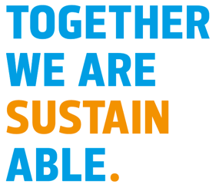
User Facilities and Sustainability
Outline
The challenge
User facilities as part of the solution
Basis and commitment
Overview of status quo and next steps
3.1. Buildings and infrastructures (= Specific responsibility for large scale user facilities)
3.2. Research
3.3. Organizational management
3.4. Human resources
3.5. Supporting processes
Conclusion
2
Notes:
Research infrastructures of the FBMT enable basic research in order to be able to make the world more sustainable and thus contribute to solving the urgent questions of our time.
At the same time, the research infrastructures are working flat out to become more and more sustainable themselves.
To support these efforts, there is a handout from the Ministry of Research, whose 5 functional areas we use as a guide. For the FBMT, the focus is on the functional area “buildings and infrastructures”, because that is the most important point for the large FIS.

Slide 3
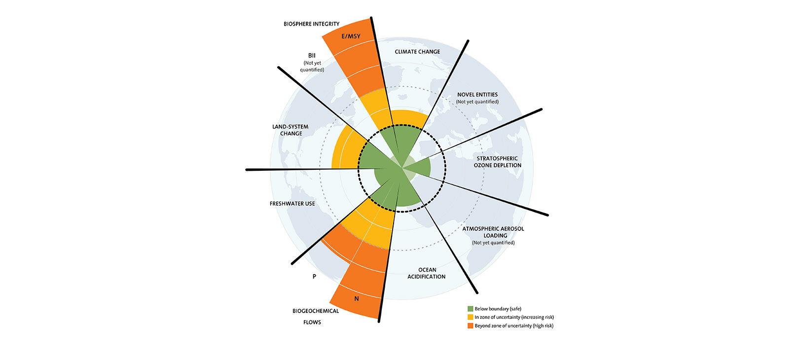
User Facilities and Sustainability
The Challenge(s)
| Planetary Boundaries (including Climate Change)
Credit: J. Lokrantz/Azote based on Steffen et al. 2015
| Unstable energy supply and prices
3
Notes:
Scientific facts: Research Centers as scientific institutions have to act accordingly!
Energy crisis
Warum ist das Thema wichtig?
Klimakrise, Energiekrise, …

Slide 4
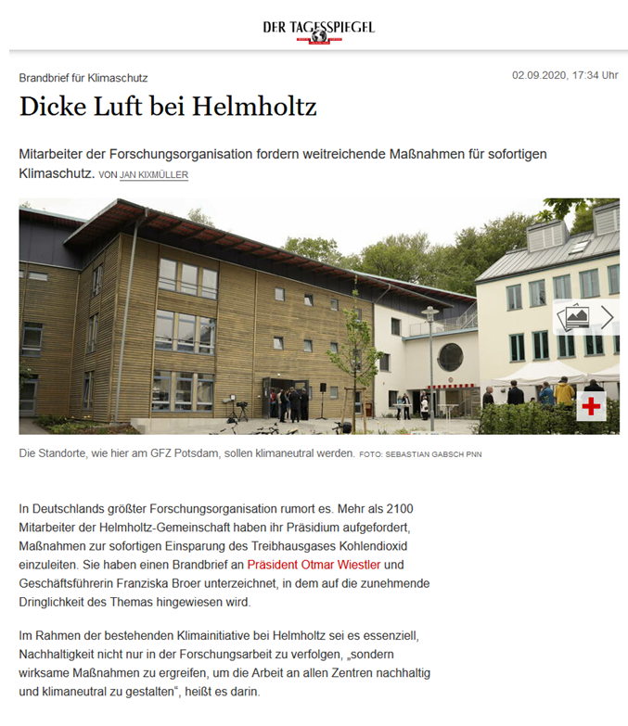
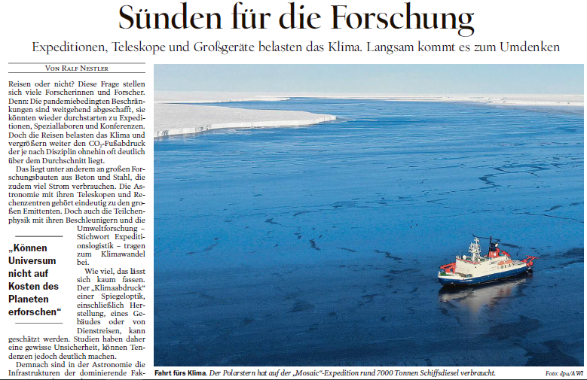
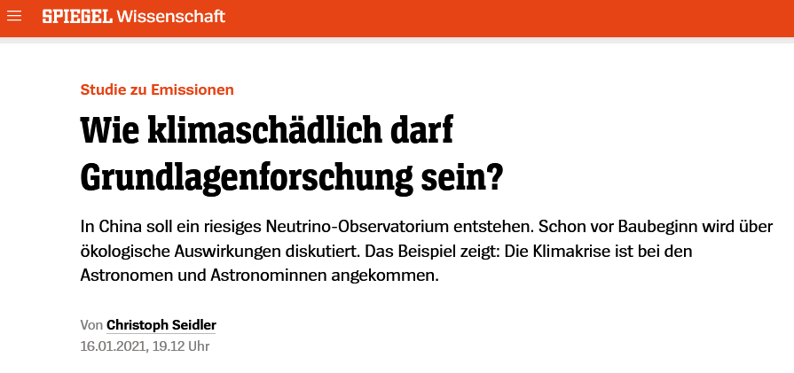
User Facilities and Sustainability
Public Perception
Balancing: Research Infrastructures have to take scientific knowledge into account – without unduly restricting its own scientific work
Trouble‘s brewing @ Helmholtz
Sins for research
How climate-damaging is basic research allowed to be?
4

Slide 5
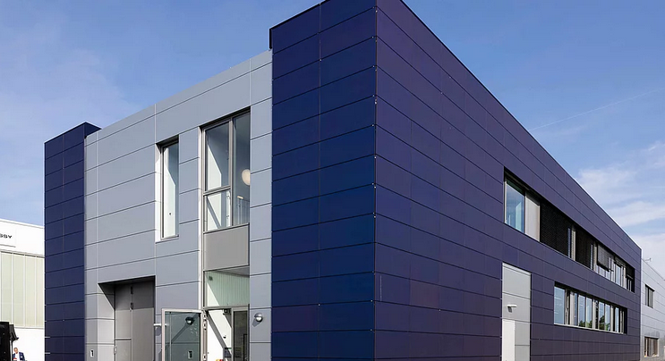
User Facilities and Sustainability
What and How
Sustainable User Facilities
Research for Sustainability = What
Sustainable Research = How
| Contribution UN Sustainable Development Goals
| Usage of eco-power
5
| HZB Living Lab Building-integrated PV
Notes:
Research infrastructures of the FBMT enable basic research in order to be able to make the world more sustainable and thus contribute to solving the urgent questions of our time.
At the same time, the research infrastructures are working flat out to become more and more sustainable themselves.
Sometime these overlap: example development of new solar cells at user facilities and later on these new cells are being used to supply ecopower to that very facility
Just examples, there is much more

Slide 6
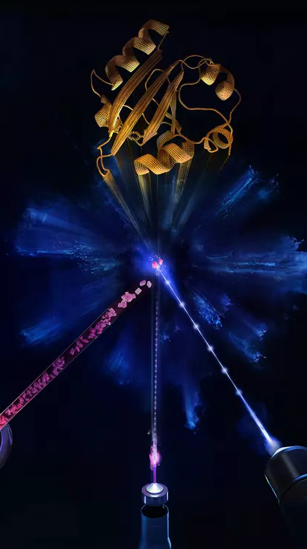
Research for Sustainability
User facilities as part of the solution
Global challenges increase
Detailed understanding of the structure of matter is essential for overcoming these challenges
Deepening this understanding is the mission of the research field Matter
Large scale user facilities with their exceptional capabilities are essential for that
6
Notes:
The last few years have shown that the challenges facing our society continue to increase and require a solution much more quickly. Words such as energy crisis or pandemic situation have had a tangible effect that underscores this. A detailed understanding of the structure of matter and of the processes that determine the function of materials and biological systems is essential for overcoming these challenges. The development and deepening of this understanding is the task of the research area Matter. To this end, the Helmholtz centers in this research area operate a number of internationally leading scientific large-scale devices. Researchers use these to study the most diverse facets of matter, from research into the fundamental properties of matter to the application of innovative and sustainable materials and biosystems. These large devices are - as the name suggests - large and they consume a lot of energy. In view of the societal challenges, the operating centers therefore have two responsibilities. They enable research for a sustainable society, and at the same time great attention must be paid to operating the large devices sustainably. It's not just us (=Helmholtz FB Matter) who do research on the large devices, but the entire national and international community.

Slide 7
Research for Sustainability
User facilities as part of the solution
Examples include:
Tailor-made energy materials
Novel catalysts
Understanding the interaction of molecules, cells and tissue
Quantum materials for the digital revolution
Materials for the circular economy
And many more
7

Slide 8
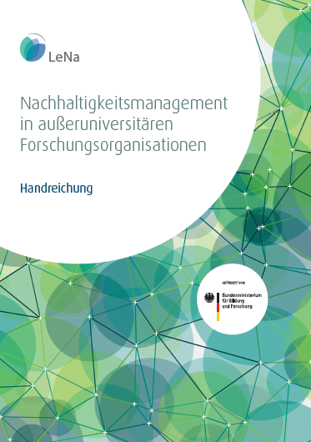
User Facilities and Sustainability
Basis and Commitment
Commitment and common understanding is established
Sustainability commitment and policy of the Helmholtz Association
Handbook for sustainability management in non-university research organisations (LeNa) and its five Fields of Action
8
Notes:
Helmholtz Commitment and Helmholtz policy to be found here: https://www.helmholtz-nachhaltigkeit.de/en/downloads/
LeNa handbook to be found here (available only in German): https://www.nachhaltig-forschen.de/startseite/

Slide 9
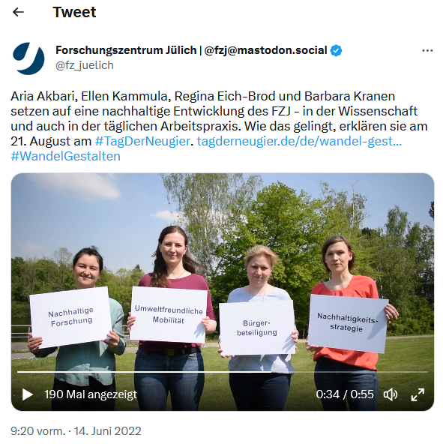
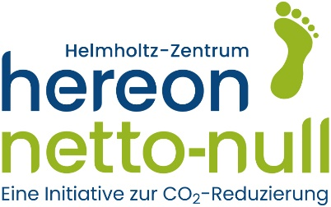
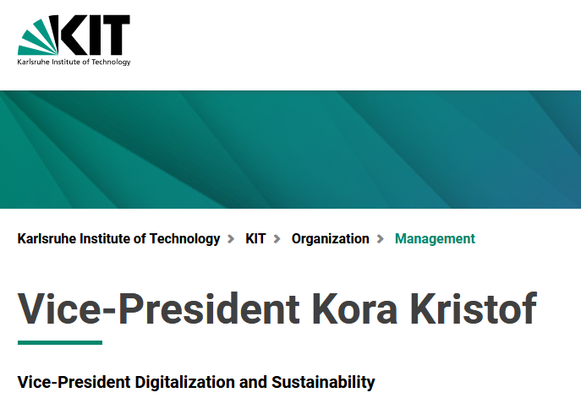
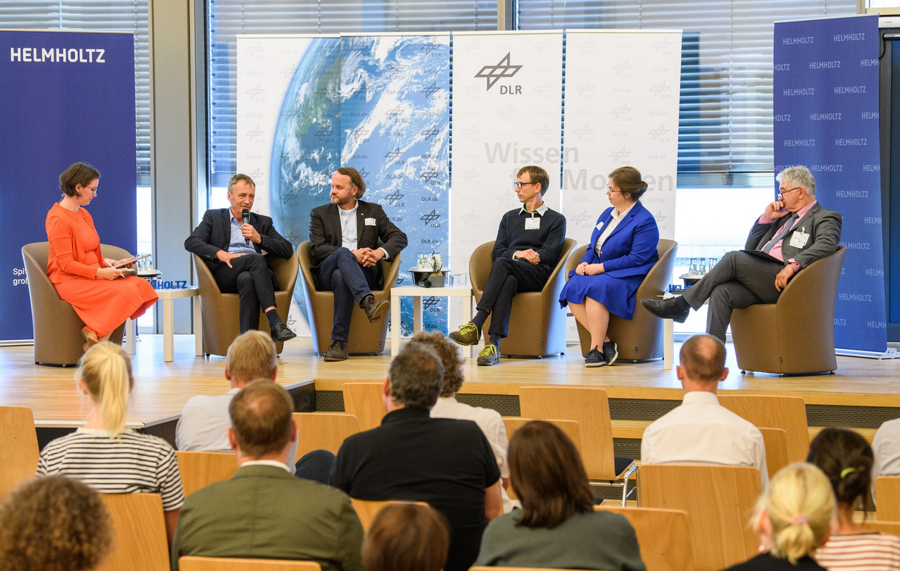
User Facilities and Sustainability
Basis and Commitment
Center level:
Sustainability managers and working groups in place in all centers (top – down)
Grass roots initiatives (bottom – up)
Helmholtz level:
Helmholtz Sustainability Working Group
Sustainability Task Force
Yearly Sustainability Summits (SuSu) next: 10./11.October 2023 at KIT
9
Notes:
Besides the commitment und guidelines also in the practical level a good basis was established during the last years. Each research center of FBMT has a Sustainability manager in place, supported by different kind of management systems.
The Helmholtz-wide grassroots group resonates in all centers of FBMT. Different groups are organized and al lot of networking, also in the international field, is going on.
At Helmholtz level a working group, including coordinator, is established, has monthly check-ins and organizes the yearly Helmholtz-wide Sustainability Summits (SuSu). The FBMT centers are particular active here, as the SuSu 2019/20 took place at DESY and this years SuSu is going to take place at KIT. The working group is being supported by the so called Sustainability task force comprising of representatives of all Helmholtz research fields and was particularly helpful in agreeing on the Helmholtz commitment and policy.
Top-down AND bottom-up
Helmholtz hat verstanden
hat ein eigenes Nachhaltigkeitspapier beschlossen, dass sich an LeNa anlehnt
hat sich organisatorisch aufgestellt
integriert die interessierte bzw. aktive Basis

Slide 10
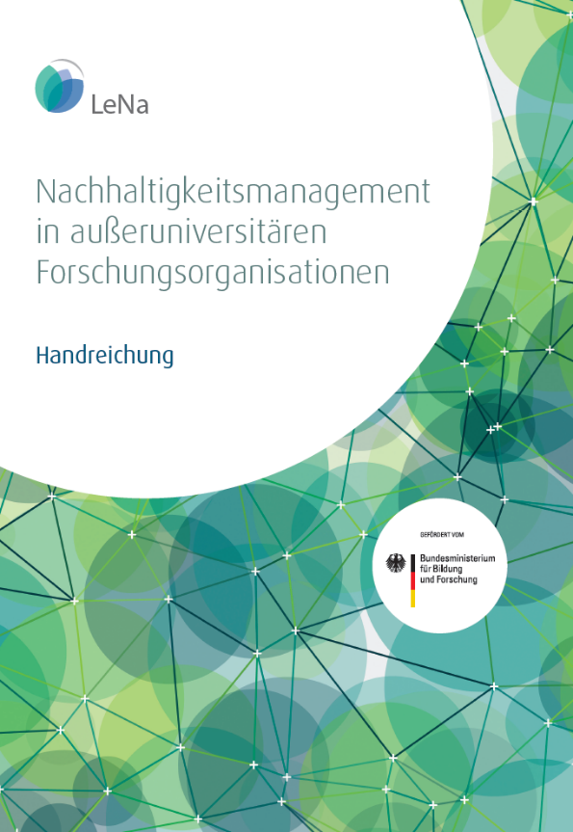
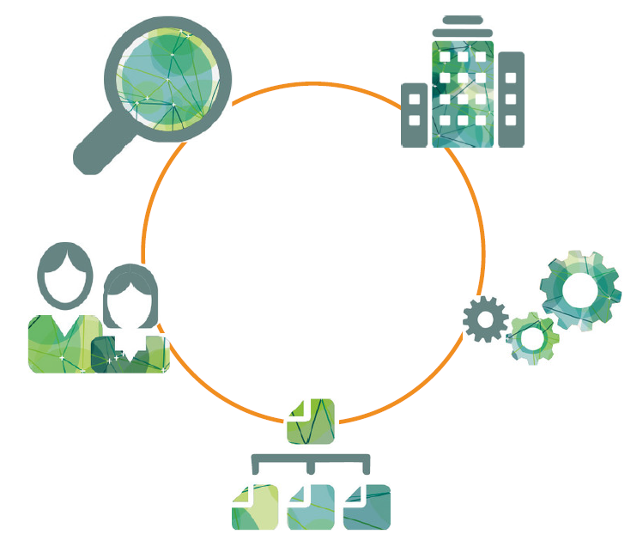
Sustainable Research
Overview LeNa
Sustainability Management in Non-University Research Organisations – Five Fields of Action
Buildings and Infrastructures
Research
Supporting Processes
Human Resources
10
Organisational management
Notes:
sustainability management is a Cross-cutting task with a wide definition
The research area matter of the Helmholtz Association expressly underlines the commitment of the Helmholtz Association to its sustainable development, which was already adopted in 2021. In this commitment, the orientation towards the handout “Sustainability Management for Non-University Research Organizations” (LeNa) is specified. This handout shows the essential fields of action for sustainable development:
- Buildings and infrastructures (focusing on planning and structural design, construction and modernization, operation and management, deconstruction and disposal)
- Research (with a focus on good scientific practice, societal responsibility in research, contributions to solutions for societal challenges)
- Organizational management (with a focus on integrative strategic planning, participatory organizational development, compliance, transfer and exchange)
- Human resources (with a focus on service-oriented personnel management, development and design, networking and cooperation)
Supporting processes (with a focus on procurement, mobility)
LeNa handbook to be found here (available only in German): https://www.nachhaltig-forschen.de/startseite/
For FBMT “buildings and infrastructure” is specifically important as the FIS use and need a lot of resources like energy and materials both for construction as well as operation.

Slide 11
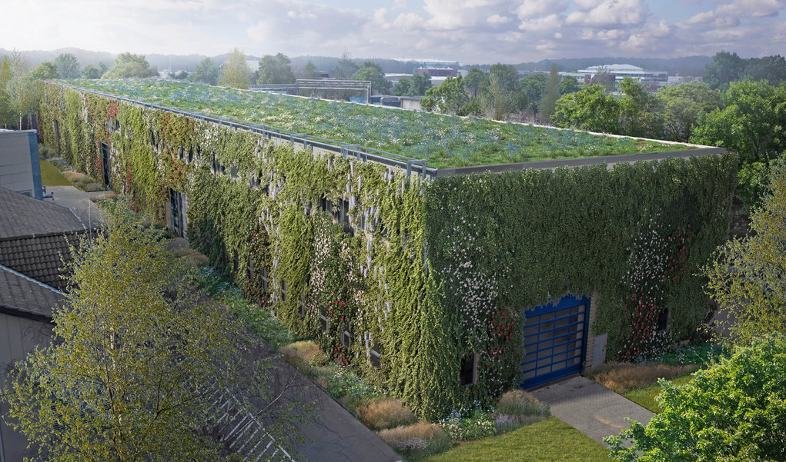
Sustainable Research
1 - Buildings and Infrastructures
Part 1 “Normal” civil construction
Status quo / in preparation:
Energy concepts, Energy management + monitoring
Renewable energy; photovoltaic etc.
Greening of walls and roofs; rainwater management
Waste heat usage and heating optimization
Sustainable civil construction certified by BNB Silver Standard
Next steps:
Implement sustainable construction for all new projects
Find solution to justify higher invest cost by lower operation costs (amortization, intracting)
| DESY Hall 36 Greening
| HZB Living Lab Building-integrated PV
11
Notes:
What is special about FIS? What is the specific responsibility of large scale user facilities?
Large scale civil construction → innovative sustainable construction beyond BNB
Specific technologies needed → innovation, R&D, cooperation (that in turn can be transferred back into economy)
High resource consumption in operation → Focus on energy efficiency and critical materials
not moveable → remote access, mail-in and staff-assisted-experiments
Big data → Green IT and data reduction concepts

Slide 12
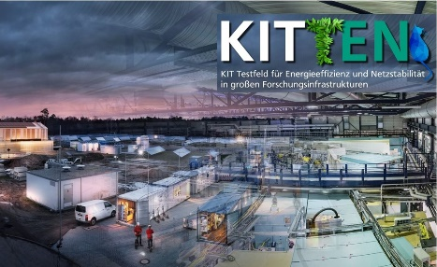
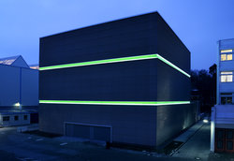
Sustainable Research
1 - Buildings and Infrastructures
Part 2 – Specific technologies and access
Status quo / in preparation:
R&D for more efficient technical components
E.g. Permanent magnets → save energy, but use critical materials
Cooperation with several Living Labs (FB Energy)
Development of remote access (demonstrator)
Digitization of research operations (e.g. Digital LEAPS)
EU and other projects (I.FAST, LEAPS, ESSRI etc.)
Green IT
Next steps:
Life cycle assessment for technical components
Expansion of automatization and remote access
| KIT Test field for energy efficiency and grid stability
| GSI Green IT Cube (supercomputing center)
12
Notes:
!!!! Cross over between research and infra
!!!! Cross over of different research fields (eg. Energy)
This is very specific for the FBMT and here research and infrastructure come together in mutual interest, inspire each other and develop solutions together. Our own research (also stemming from other FB) makes our operations more sustainable. Research centers work on the development of solar cells, energy storage, automatization and other energy efficient technologies, which in turn being used (and will be more in future) on our campuses. These developments are a combination of FBMT and other Helmholtz research fields (mainly Energy).

Slide 13
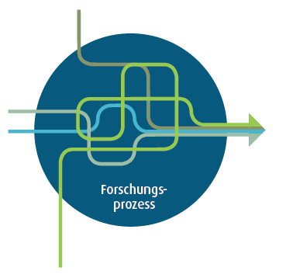
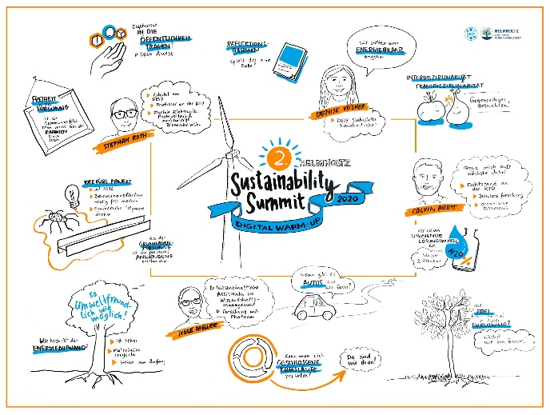
Sustainable Research
2 – How to do research
Status quo and in preparation:
Research in societal responsibility (BMBF supported project: LeNa shape)
Discussion rounds at HGF Sustainability Summits
Next steps:
Results of LeNa shape
More networking and strategic use of developments
Target group-specific communication and training measures to raise awareness
| FZJ components of LeNa shape
13
| HGF Discussion at Sustainability Summit 2019
Notes:
Research (with a focus on good scientific practice, societal responsibility in research, contributions to solutions for societal challenges)
This means it is about what to research on and also the how to do that research
LeNa Shape is a follow up project from the development of the LeNa handbook, supported and financed by BMBF and Helmholtz-coordinated by FZJ – the content is to stir the self reflection of scientists: The reflection framework refers to a research process that is based on a critical and systematic reflection - in the sense of self-reflection and reflection in dialogue with society. Structural conditions, processes, research questions, methods and results as well as their communication, implementation and effects with regard to their contributions to sustainable development should be reflected.
Other examples include: dual-use, ethics in animal testing, fake news, sanctions in science, role of china
Contributions to solutions for societal challenges - see also „part of the solution“ (eg. Sustainable technologies, energy etc.)

Slide 14
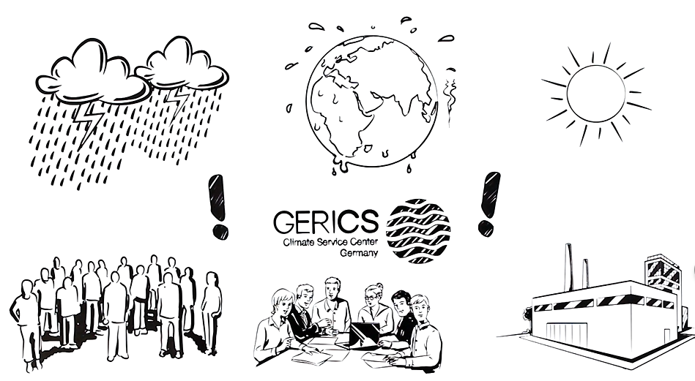
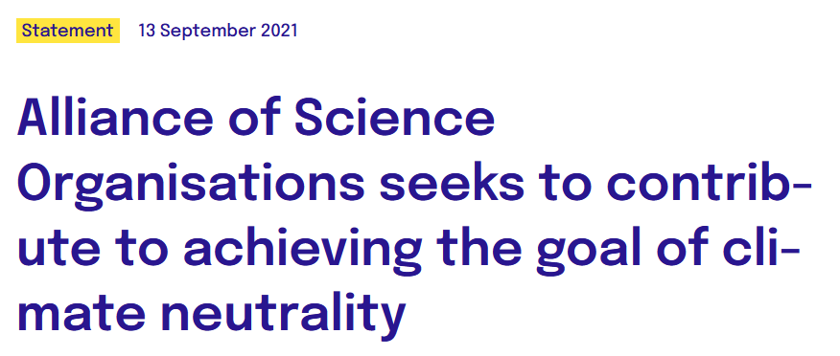
Sustainable Research
3 – Organisational Management
Status quo and in preparation:
Strategy processes
Sustainability Management
Knowledge transfer
Leadership competences
Compliance officer
Next steps:
Update strategies on a regular basis
Formulate climate goals
Support sustainability relevant research and tech transfer
| HEREON Hosting GERICS Climate Service Center Germany
| Alliance of Science Organisations in Germany on Climate Neutrality
14
Notes:
Governance processes determine the superordinate framework in a research organisation. In order to integrate sustainability into the organisation, the management level bears the responsibility for the establishment of an integrative strategy planning and a participative organisational development. Additional tasks are the advancement of a compliance culture as well as the strengthening of knowledge transfer and interaction with society.

Slide 15
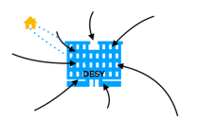
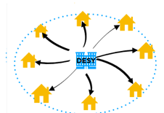
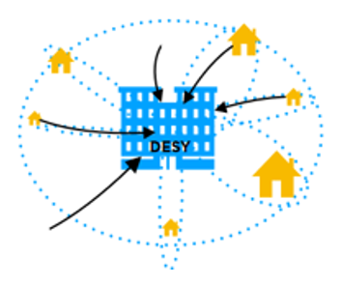
Sustainable Research
4 – Human Resources
Status quo and in preparation:
Mobile work
Strategic HR development
Efforts for diversity, equality
Audit „work and family“
Health management, company-facilitated sports activities
Next steps:
Further develop and monitor mobile work
New hybrid access modes for users
Presence on campus before Covid19 / also for users
Home Office / remote access during Covid19
New work / access concepts after Covid19
15
| Changes in work structures
Notes:
The fields of action in the functional area human resources particularly address the responsibility of the research organisation as an employer to its employees and therefore put a focus on the social goals of sustainable development. Its precondition is a professional human resources management with enough resources to strategically plan and implement human resources management activities. Activities in this field include among others the support of the personnel in their career development, a responsible handling of fixed-term employees, equal opportunities and the appreciation of diversity, health-preserving working conditions and competence development for sustainable and responsible action.

Slide 16
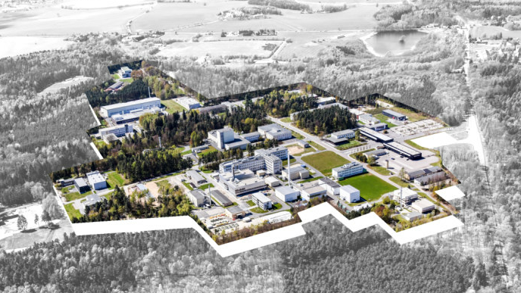
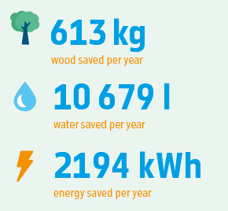
Sustainable Research
5 – Supporting Processes
Status quo and in preparation:
Business travel (reduction, avoid flights, compensation)
Mobility (e-mobility, public transport, bicycle-friendly employer, job-ticket)
Digitization in administration
Next steps:
Expand sustainable procurement
| HZDR Plans for bicycle access and charging stations for E-cars
| DESY Savings by changing campus info to digital
16
Notes:
The field of action supporting processes encompass the procurement processes and the work-related mobility of research organisations and its indirect impacts on environment and society. The purchase of products and services as well as the mobility needs of the employees should be accomplished in an environmentally friendly and a socially acceptable manner.

Slide 17
User Facilities and Sustainability
Conclusion
Sustainability is a big global challenge
User facilities are part of the solution
user facilities have a special responsibility to become ever more sustainable (as they use large amounts of energy and other resources)
of good achievements have been reached the last few years
clear path ahead (including a few challenges to overcome)
17
| Report about workshop in critical materials February 2023 with engagement of all partners in Matter
Notes:
- Sustainability is one of the main challenges of our time. FIS and the research being done at large scale user facilities are part of the solution
- At the same time FIS have a special responsibility to become ever more sustainable while doing research as they use large amounts of resources (e.g. energy and materials)
- A long list of good achievements have been reached the last few years
- And a clear path ahead is visible (including a few challenges to overcome)

