Slide 1
Strategic Advisory Board Matter
Report of the president
Prof. Otmar D. Wiestler
President of the Helmholtz Association
DESY, May 03, 2023

Slide 2
Report of the president
Selection of two new Helmholtz Institutes in 2023
PoF V – steps towards the evaluation process
Zeitenwende - Challenges in the context of recent international developments
Helmholtz Incubator Information & Data Science
Scientific highlights from the research fields

Slide 3
Zeitenwende
Challenges in the context of recent international developments

Slide 4




„Zeitenwende“
50 Million € for rapid response initiatives at Helmholtz
€25 Million for accelerated translation projects in the energy field (each project 6,25 Mio.€)
(coordination H. Hanselka/ Helmholtz Energy)
Accelerated transfer of a next generation of solar cells to mass production
GEOZeit: Geotechnologies towards a significant change in Germany’s energy supply
RESUR: Helmholtz platform for design of robust energy systems and their supply chains
Pilot project towards circular economy and recycling
FZJ, HZB & KIT
GFZ & KIT
FZJ & KIT
HZDR & KIT
€25 Million for strengthening informatics and cybersecurity
0I
€15 million for pilot projects at CISPA
€10 million for pilot projects at KIT
Part of the funds to be used for cooperation with other Helmholtz centers
0I

Slide 5
„Zeitenwende“ and its implications for Helmholtz :
Termination of strategic cooperations with Russia, support programs for scientists of the Ukraine, significant financial challenges
Suspension of cooperation with Russian partners with dire consequences, especially in polar research
Foreseeable loss of contributions by international partners, especially Russia, to major infrastructure projects such as FAIR or European XFEL
Helmholtz support program for refugee scientists from Ukraine: unbureaucratic temporary funding (max. 12 months) for Ukrainian colleagues. So far 46 funded applications, total amount of € 760.000 from INF
Increases in operating costs have direct impact on the budgets of Helmholtz Centers and on our scientific competitiveness
  High additional energy costs (particular relevance for large-scale research infrastructures), above-average increases in salaries in the public sector & significant inflation rates
  Centers must plan their budgets conservatively for the coming years; this may have
  a negative impact on recruitment and infrastructure investments
  Development of contingency plans including internal reallocation of funds
  Research Ministry has set up a contingency fund for energy-intensive research

Slide 6
PoF V
Steps towards the evaluation process

Slide 7
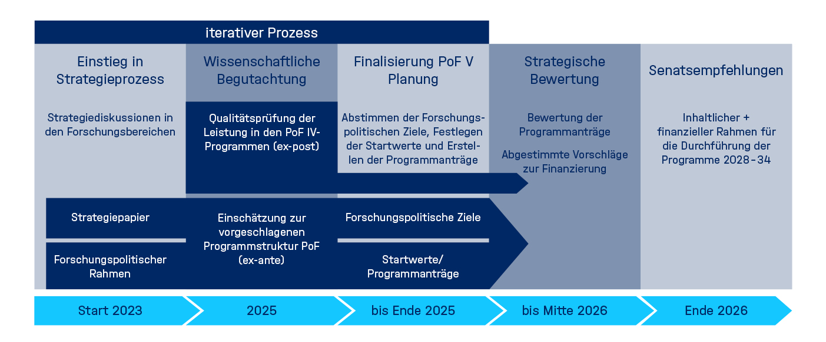
Program-oriented funding (PoF)
Key steps towards Pof V
Iterative process
Initiate strategic planning process
Scientific evaluation
Finalize strategic planning process
Strategic evaluation
Recommendations of the Senate
Strategic discussions in Helmholtz and its research fields
Assessment of the scientific performance in the PoF IV programs (ex-post)
Finalize research policy guidelines, discuss initial budget for programs, write program proposals
Evaluation of program proposals
incl. funding recommendations
…for implementation and funding of the new programs,
2028-34
Strategy paper
Comments on the proposed PoF V structure
(ex-ante)
Research policy guidelines
Research policy framework
Program proposals & their initial budget
Start 2023
2025
until the end of 2025
until mid 2026
end 2026

Slide 8
Program-oriented funding (PoF)
Key steps
Discussions are currently ongoing with all board members to define high potential topics and overarching programs
The Strategic Advisory Boards will be involved in the following activities :
  Search for PoF V reviewers
  Discussion of potential future programs
  Interpretation of the results of the scientific evaluation in 2025

Slide 9
Helmholtz Institutes
Selection of new Helmholtz Institutes in 2023

Slide 10

Helmholtz Institutes
Innovative structures for long-term research collaborations
Joint exploitation of challenging research areas with a long-term perspective
Strong synergistic partnership between Helmholtz and universities to implement innovative joint research strategies, leverage substantial added value, and achieve critical mass
High level of complementarity of the research portfolios
High potential for transfer into practical applications and dissemination
Potential for the recruitment of world-class talents
Helmholtz Center
University
Helmholtz Institute
at University site

Slide 11
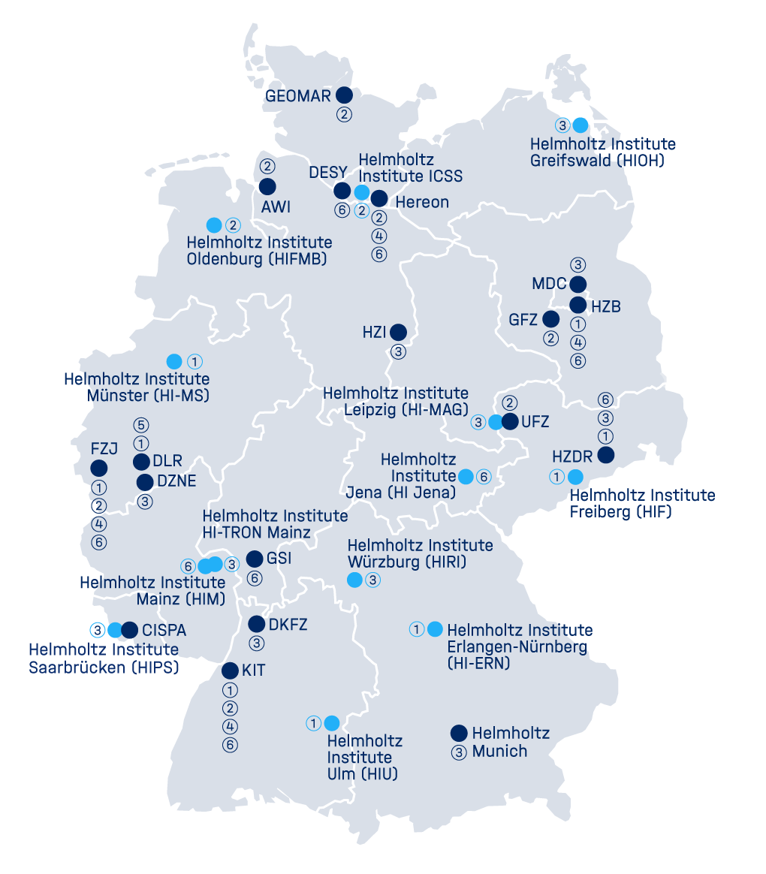
Helmholtz Institutes
Locations
Helmholtz Institute Mainz (HIM), GSI & University Mainz
Helmholtz Institute Jena, GSI, DESY, HZDR & University Jena
Helmholtz Institute Saarbrücken, HZI & University Saarland
Helmholtz Institute Ulm, KIT, DLR & University Ulm
Helmholtz Institute Freiberg, HZDR & University Freiberg
Helmholtz Institute Erlangen-Nürnberg,
FZJ, HZB & University Erlangen-Nürnberg
Helmholtz Institute Münster, FZJ & University Münster
Helmholtz Institute Würzburg, HZI & University Würzburg
Helmholtz Institute Oldenburg, AWI & University Oldenburg
Helmholtz Institute Mainz, DKFZ & University Mainz, TRON
Helmholtz Institute Leipzig,
Helmholtz Munich & University Leipzig
Helmholtz Institute Hamburg, HZG & University Hamburg
Helmholtz Institute Greifswald, HZI & University Greifswald, Greifswald University Hospital, Friedrich-Loeffler-Institut
Research Fields:
(1) Energy, (2) Earth
and Environment, (3) Health, (4) Information,
(5) Aeronautics, Space
and Tansport, (6) Matter

Slide 12
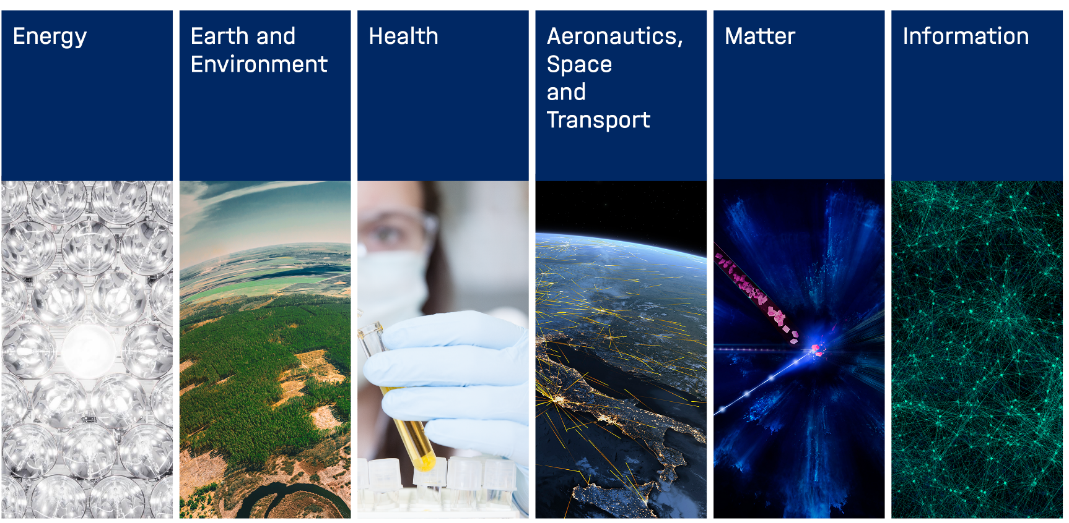
Establishment of new Helmholtz Institutes
Evaluation of 5 applications on site
HIPOLE
HI-UCES
HI-TAC
HIHED
HI-KIEL
Polymers in Energy Applications
Urban Climate & Environmental Sciences
Translational AngioCardio Science
High Energy Density
Digital Implant Research
Chair
Brigitte Voit
Chair
Diane Pataki
Chair
Anja Bosserhoff
Chair
Christian Rüegg
Chair
Carlijn Bouten
Feb 21-22
in Jena
March 29-30
in Freiburg
Jan 31 - Feb 1
in Heidelberg
Feb 28 – Mar 1
in Rostock
Jan 10-11
in Kiel
The research field Aeronautics, Space and Transport is funded by a different ministry and therefore not eligible in this call.

Slide 13
Establishment of new Helmholtz Institutes
Timeline
Call for proposals
On site evaluations
Comparative evaluation
1st Step: Expression of Interest
Discussion and selection within research field
Decision of the Helmholtz Senate
Mai
Nov – Jan
Jan
Oct 7
Jan - March
May / June
June
starting July
2021
2022
2023
Establishment of new Helmholtz Institutes
Jan - Mar, 2023 On-site evaluations of the proposals
April 30, 2023 Deadline for the review report
May 31, 2023 Comparative Evaluation (with panel chairs, cross-reviewers, senate members)
June 2023 Final decision of the Helmholtz Senate
Notes:
Vorderer Teil für die Gutachter interessant? Weglassen?

Slide 14
Helmholtz Institutes
Criteria for the evaluation
Outstanding scientific quality by international standards
New, challenging research areas with a long-term perspective and a clear added value for the research portfolio of the Helmholtz Association and the partner university
High level of complementarity of the research portfolio between Helmholtz and the partner University
High potential for transfer in University, economy, and society & strengthening of transfer culture (e.g. integration in University teaching, promotion of an entrepreneurial mindset and entrepreneurship training)
Potential for the recruitment of talented scientists in an exciting research area, including a convincing proposal to promote young researchers and equal opportunities
Outstanding leadership personality as founding director
Sound and adequate budget plan in the range of 5.5 Mio. € p.a. with substantial contributions of the state and the University, especially in the initial period (2023-2027)
Adequate research building and facilities
Convincing organizational and management concept

Slide 15
Helmholtz Incubator Information & Data Science

Slide 16


Helmholtz Incubator Information & Data Science
Information & Data Science for the research programs
Information & Data Science technologies pose a significant strategic challenge and opportunity for all 18 centers and 6 research fields
Helmholtz has leading expertise in numerous subfields
Helmholtz has excellent data resources and computing infrastructure
Outstanding synergy potentials for all programs when technology, know-how, data and brains interact systematically.
→ Cross-research-domain approaches offer great opportunities
to add value and to support science in all programs !
→ New ways of collaboration across research areas and programs
have been successfully explored !
→ The Helmholtz Incubator was created to address these tasks
and has delivered impressive results for over five years !

Slide 17
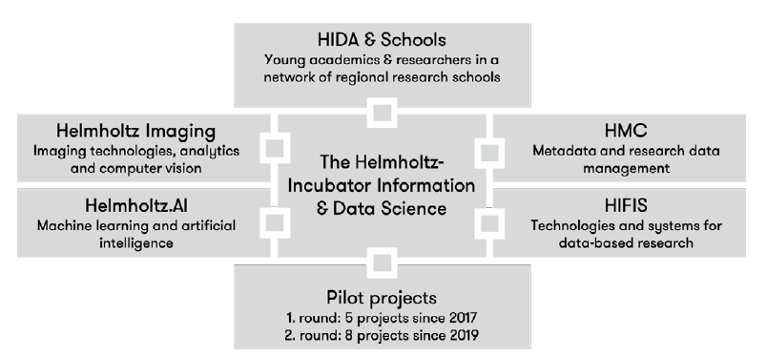
Helmholtz Incubator Information & Data Science
Think tank: 100 experts from all centers meet twice per year
Mission: Address challenges with synergistic and interdisciplinary approaches

Slide 18
Helmholtz Incubator Information & Data Science
Address common challenges for Information & Data Science in five interactive platforms
Helmholtz AI
Helmhotz Imaging
Helmholtz Metadata Collabortion
Helmholtz Federated IT Services
Helmholtz Information and Data Academy
These platforms are intended to
catalyze exchange and the transfer of know-how and expertise within Helmholtz,
as a permanent structure, continuously leverage synergies,
promote collaboration in key technology areas,
train a new generation of data scientists
increase the overall impact of I&DS in the entire Helmholtz Association

Slide 19
Scientific highlights from the research fields

Slide 20
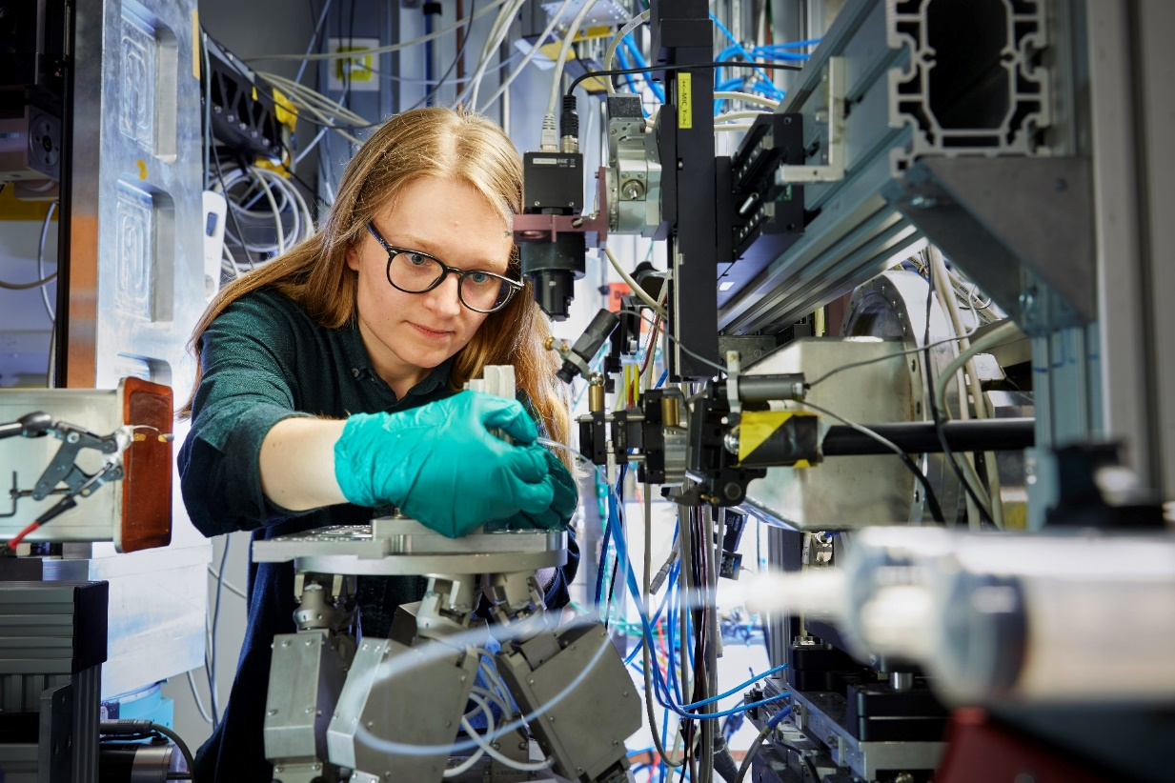
Helmholtz high-impact research
Helmholtz initiatives, national and international activities
Helmholtz Quantum:
From basic research to application
Helmholtz Climate Initiative:
“Net Zero 2050” (Mitigation) and “Adaptation to extreme events”
Energy System 2050:
Concrete understandings and technological solutions
LOHC:
Future technology for green hydrogen (Helmholtz H2-cluster)
Applied AI:
Earth observation, robotics, autonomous vehicles, matter data, digital health
Future predictions for integrated mobility:
Land, water, airspace, outer space
National Center for Tumor Diseases:
Translational cancer research at a national scale
European XFEL:
Map atomic details of biological structures, molecular movies, interior planetary processes
MOSAiC:
International Arctic expedition with Polarstern
Human Brain Project:
FET flagship computational neuroscience and brain simulations

Slide 21
Scientific highlight from the research field
Earth and Environment
Earthquake in Turkey/Syria on 6 February 2023
GFZ has been conducting seismic monitoring in the country since the 1980s
AI-based algorithms significantly expand earthquake
catalog (fore- and aftershocks): unique insights
Analysis of foreshocks for prediction signatures
Comparison of fault movement, ground shaking, and losses
with predictions from risk models
Technical/scientific support of the Turkey's Disaster and Emergency Management Authority (AFAD)
Development (with AFAD) of an improved monitoring network (focus on Istanbul and Izmir)
Earthquake-resistant constructions and building regulations
Kwiatek, G. et al. Months-long preparation of the 2023 MW 7.8 Kahramanmaraş earthquake, Türkiye. Submitted to Nature

Slide 22
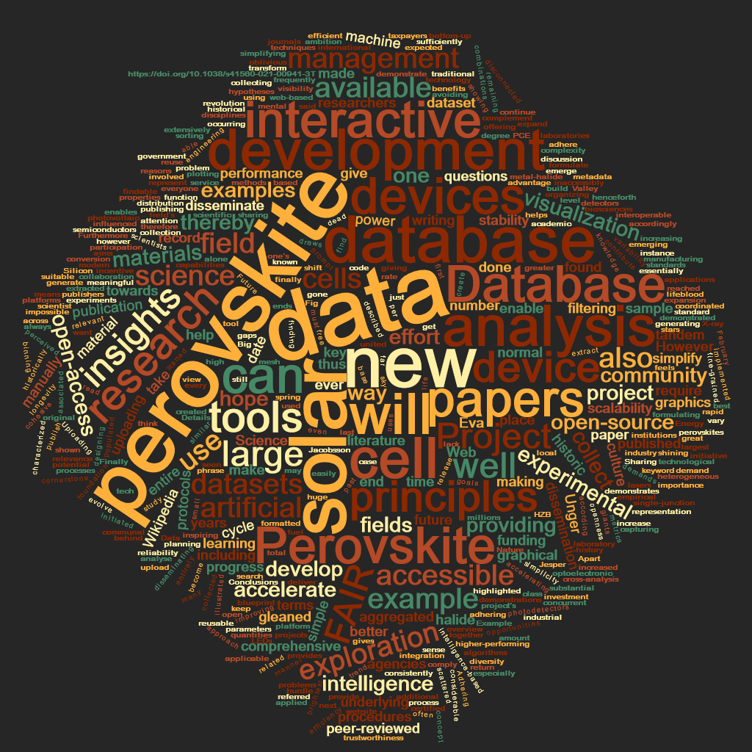
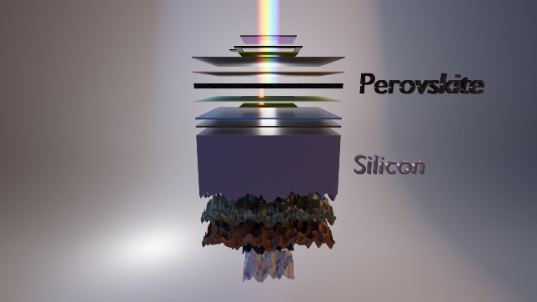
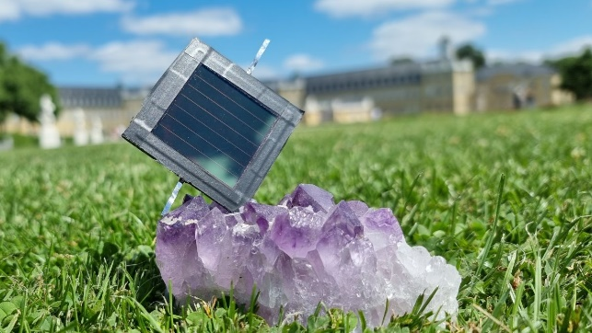
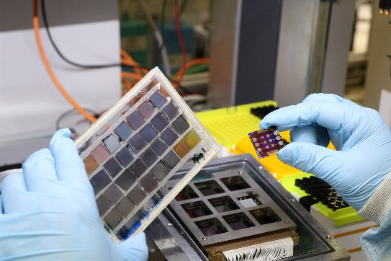
Scientific highlight from the research field
Energy
Next generation of solar cells
World record efficiency for silicon-perovskite tandem solar cell (HZB)
Worldwide first Perovskite/Perovskite tandem solar module (KIT)
Perovskite solar cell with ultra-long stability (HI ERN, FZJ)
Wiki and open access database for Perovskite solar cell research based on 15,000 publications (lead by HZB)
www.helmholtz-berlin.de
www.helmholtz-berlin.de
www.kit.edu
www.fz-juelich.de
Notes:
Abschnitt aus Bundesbericht Energieforschung:
Helmholtz Energy nimmt in der Erforschung und Entwicklung künftiger hocheffizienter, kostengünstiger und nachhaltiger Photovoltaiktechnologien weltweit eine Spitzenposition ein. Ein wesentliches Zielsystem sind Tandemsolarzellen auf der Basis von kristallinem Silizium in Kombination mit neuartigen Halbleitern mit großer Bandlücke aus der Klasse der Metall-Halid-Perowskite. Dies wird durch die folgenden Forschungshighlights auf dem Gebiet der Perowskit-Solarzellen eindrucksvoll demonstriert:
O Tandemsolarzelle aus einer Silizium-Unterzelle und einer Perowskit-Topzelle schafft 32,5 Prozent Wirkungsgrad
O Weltweit erstes Perowskit/Perowskit-Tandem-Solarmodul: Am KIT wurden innovative Materialwissenschaften und Prozess-Know-how kombiniert. Das erlaubte die Entwicklung einer Technologie für die Produktion erster vollständig mit industriell skalierbaren Methoden hergestellter Perowskit/Perowskit-Tandem-Solarmodule, die Wirkungsgrade von bis zu 19,1% aufweisen und das bei geringen Skalierungsverlust von weniger als 5% (rel.).
O Perowskit-Solarzelle mit ultralanger Haltbarkeit: Forschende des Helmholtz-Instituts Erlangen-Nürnberg des FZ Jülich haben eine Variante der Perowskit-Solarzelle vorgestellt, die durch ihre besondere Stabilität hervorsticht. In Tests bei erhöhter Temperatur und Beleuchtung über 1450 Betriebsstunden behielt die Zelle auf Perowskitbasis 99 Prozent ihres anfänglichen Wirkungsgrads bei.
O Ein Wiki für die Perowskit-Solarzellenforschung: Aus mehr als 15 000 Fachveröffentlichungen hat ein internationales Expertenteam unter der Leitung des HZB Daten zu Metallhalogenid-Perowskit-Solarzellen gesammelt und eine Datenbank dafür entwickelt. Die Datenbank mit ihren Visualisierungsoptionen und Analysetools ist Open Source und soll den Überblick über rasch anwachsenden Wissensstand sowie die offenen Fragen in dieser spannenden Materialklasse ermöglichen.

Slide 23
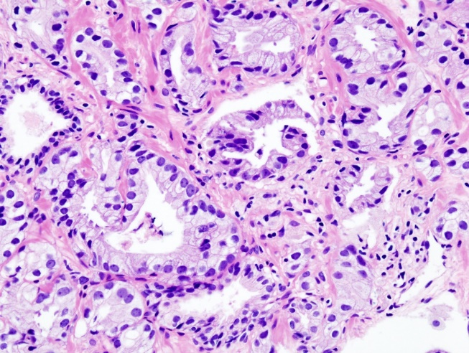
Scientific highlight from the research field
Health
Lutetium-177 PSMA-617 for the treatment of prostate cancer
With 70,000 new cases/year, prostate cancer is the most common cancer and the second most common cause of cancer death among men in Germany.
Majority of all prostate cancer cells express the surface molecule PSMA (prostate specific membrane antigen). PSMA is virtually absent from other somatic cells.
Lutetium-177 PSMA-617 is a ligand coupled with radioactive Lutetium-177. It accumulates in the tumor and delivers its lethal dose of radiation.
Invented and patented by DKFZ, the University of Heidelberg and Heidelberg University Hospital.
Introduced into clinical trials by ABX GmbH in Radeberg, developed by Novartis until FDA approval.
Approval in USA in March 2022 and Europe in December 2022
Light microscopic image of a prostate adenocarcinoma
© Wikipedia/KGH

Slide 24
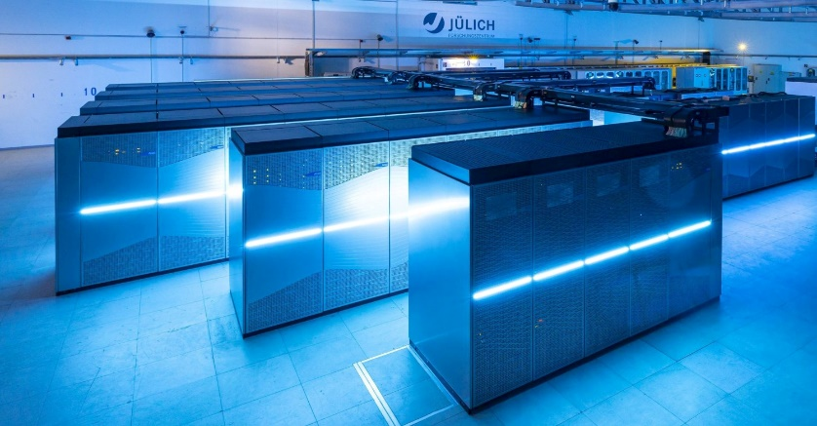
Scientific highlight from the research field
Information
Exascale Supercomputing
European High Performance Computing Joint Undertaking (EuroHPC JU) has chosen FZJ as the site of Europe's first exascale computer
JUPITER – Joint Undertaking Pioneer for Innovative and Transformative Exascale Research will be installed on the Jülich campus starting in 2023
Funding of EUR 500 million by EuroHPC and Germany (BMBF, MKW NRW)
JUWELS at FZJ (Copyright: Forschungszentrum Jülich / Sascha Kreklau)
One trillion (“1” followed by 18 zeros) calculations per second
Should help to solve important and urgent scientific questions such as climate change, strategies to combat pandemics, and sustainable energy production, while also enabling the intensive use of artificial intelligence and the analysis of large data volumes

Slide 25

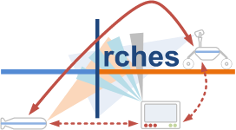
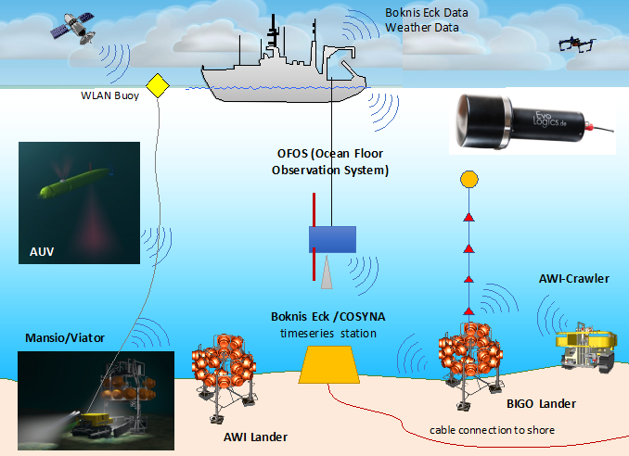
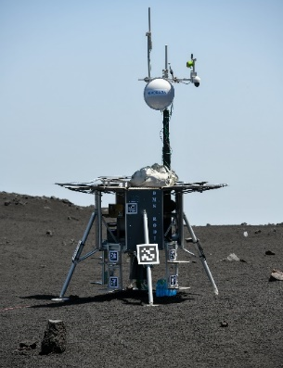
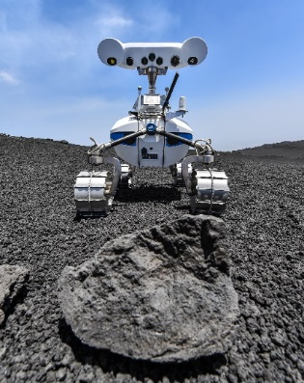
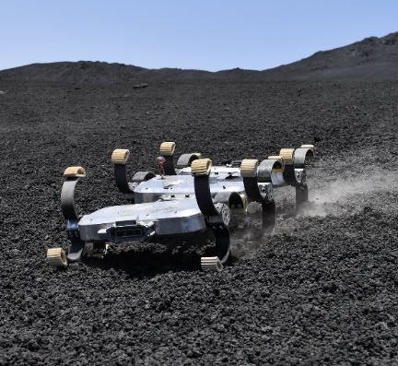
Scientific highlight from the research field
Aeronautics, Space and Transport
ARCHES (Autonomous Robotic Networks to Help Modern Societies)
Development of heterogeneous, autonomously linked up and integrated robotic systems
DLR-Demonstration: rock sampling on the Etna volcano (Sicily) with subsequent analysis and communication of the results to a control center.
Fields of application from exploration of the solar system (DLR) to technical crisis intervention and environmental monitoring of the oceans (AWI)
Other potential fields of application: innovative medical devices,
logistics and autonomous urban transport.

Slide 26
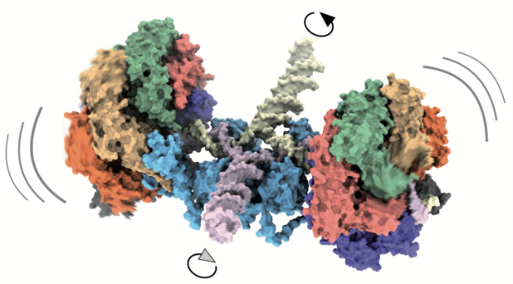
Scientific highlight from the research field
Matter
MML: Mechanism of an ATP-driven molecular motor
DNA recombination is a process that ensures genetic diversity in all forms of life: two DNA double strands separate into their four individual arms and recombine crosswise. A cross-shaped Holliday junction was discovered as early as 1964; it moves along the DNA with the help of a molecular machine (RuvAB).
With the aid of time-resolved cryo-electron microscopy (cryo-EM) at CSSB and the high-performance computing facility at DESY , the mechanism of the underlying ATP-driven molecular motor has been elucidated.
J. Wald, D. Fahrenkamp, et al.: Mechanism of AAA+ ATPase-mediated RuvAB–Holliday junction branch migration. Nature 609, 630–639 (2022).
Illustration: RuvAB-Holliday junction complex where the RuvB motors rotate together with the DNA substrate during recombination

Slide 27
Thank you so much for all your support !

