Slide 1
From Matter to Materials and Life
Thomas Stöhlker and Andreas Stierle

Slide 2








PROGRAM MML: From Matter to Materials and Life
Research on the structure, dynamics, and function of matter, materials and life
Mission Shaping and enabling forefront research with large-scale facilities
Unique insights into properties of matter, materials, and life, inaccessible on conventional laboratory scale;
providing access / support for an interdisciplinary national and international user community;
essential contributions to solving major challenges ranging from energy to health.
2

Slide 3
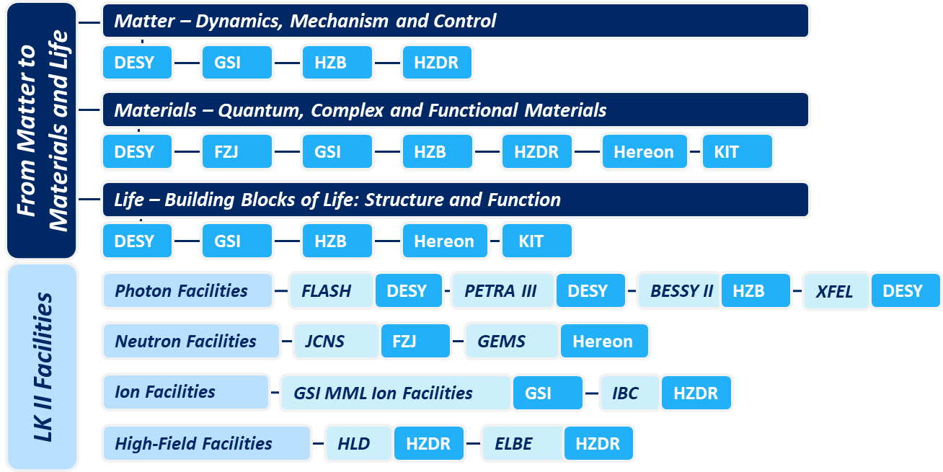
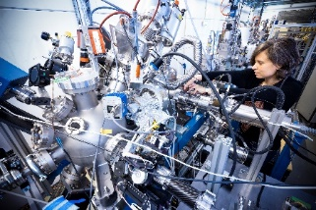
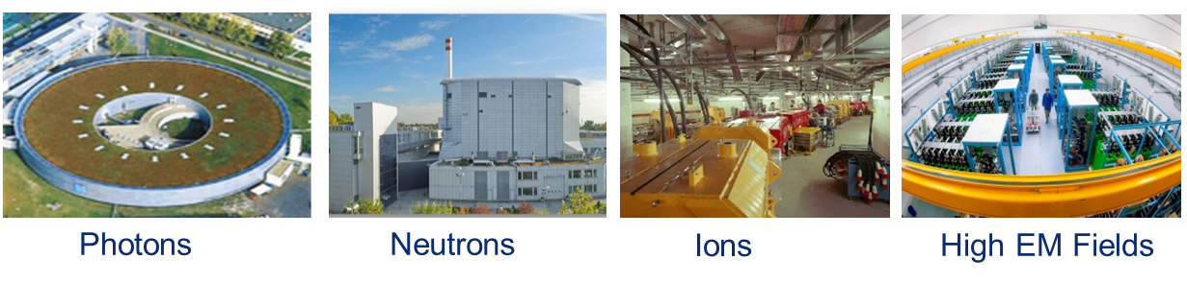
The Topic Structure of the Program
From Matter to Materials and Life
User support
3

Slide 4
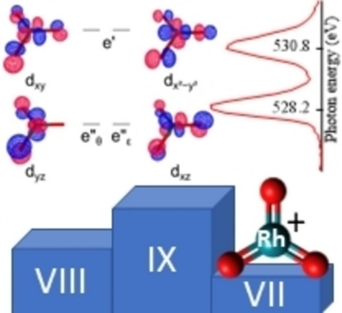
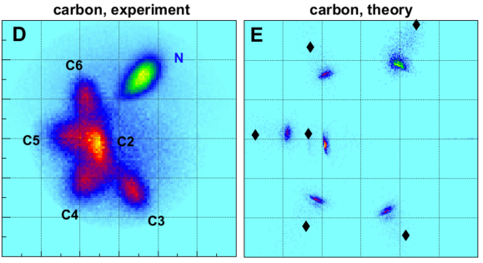
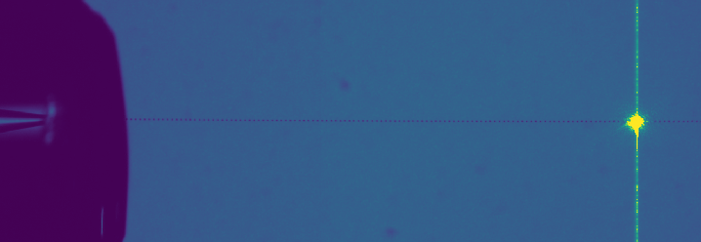
Matter: Dynamics, Mechanisms, and Control
Scientific focus: Fundamental aspects of the structure and dynamics of matter and its interaction with light
Selected Highlights 2022
Single-molecule imaging via XFEL-driven Coulomb explosion
The highest oxidation state of rhodium
Refractive index of extremely supercooled water
R. Boll et al., Nature Phys. 18, 423 (2022)
M. da Silva Santos et al., Angew. Chem. 134, e202207688 (2022)
C. Goy et al., J. Phys. Chem. Lett 13, 11872 7 (2022)
4

Slide 5
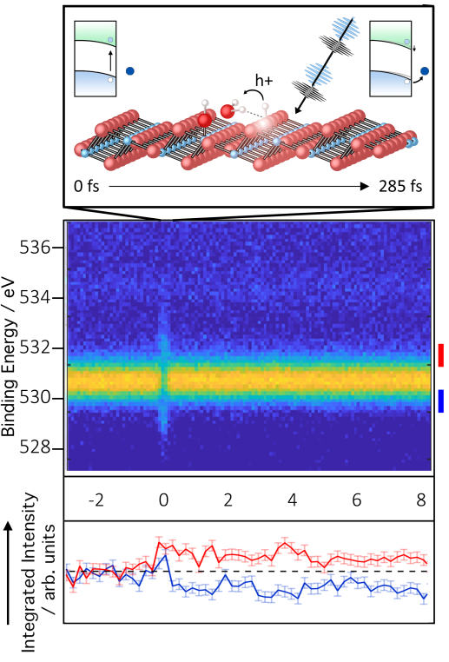
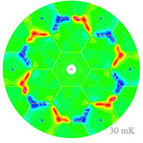
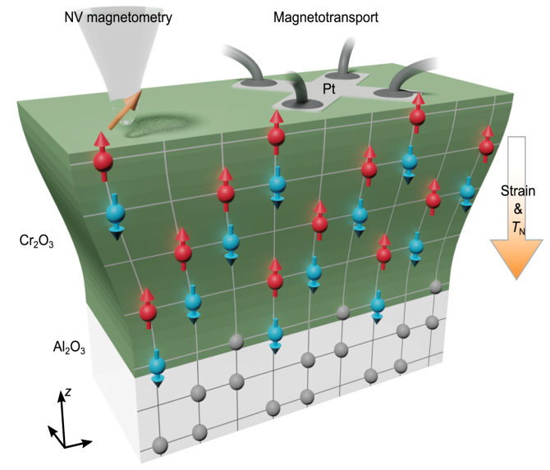
Materials: Quantum, Complex and Functional Materials
Scientific focus: Investigation of complex (multi-functional) materials for new applications
Selected Highlights 2022
Chiral quantum state detected
New flexomagnetic effect
Decoding ultrafast surface dynamics
W. Schweika et al., Phys. Rev. X 12, 021029 (2022)
P. Makushko et al., Nat. Commun. 13, 6745 (2022)
M. Wagstaffe et al., Phys. Rev. Lett 130, 108001 (2023)
5

Slide 6
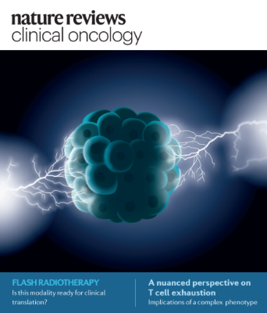
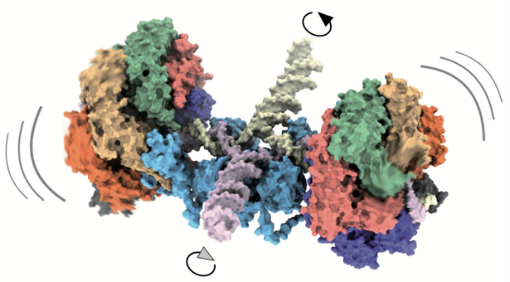
Life Science: Building Blocks of Life – Structure and Function
Scientific focus: Decoding of complex biological structures and processes for next generation of new drugs and particle therapy
Selected Highlights 2022
Mechanism of an ATP-driven molecular motor
Large-scale crystallographic fragment screening
FLASH radiotherapy
J. Wald et al., Nature 609, 630 (2022)
T. Barthel et al., J. Med. Chem. 65, 14630 (2022)
M.-C. Vozenin et al., Nat. Rev. Clin. Oncol. 19 791 (2022)
6

Slide 7
From Matter to Materials and Life
Senate Recommendations: Overview
Recommendation | Page/Appendix
Make clear what the major challenges are that MML can address with their facilities and competence, and where the Helmholtz Association is going to play a leading role | 17
Strengthen the commitment to THz methodology and science even more to become a world leader in the ongoing "THz revolution” | 18
Improve coordination between materials and instrument researchers and scientists at large-scale facilities | 19
Continue to support the Helmholtz mission and Helmholtz scientists by providing new measurement capabilities at large-scale facilities for users | 20
Pursue outstanding, scientifically broad-based life science in the first stage of the program as proposed, ensuring that the valuable coherence of the biological research is maintained during PoF IV through joint meetings | 21
7

Slide 8
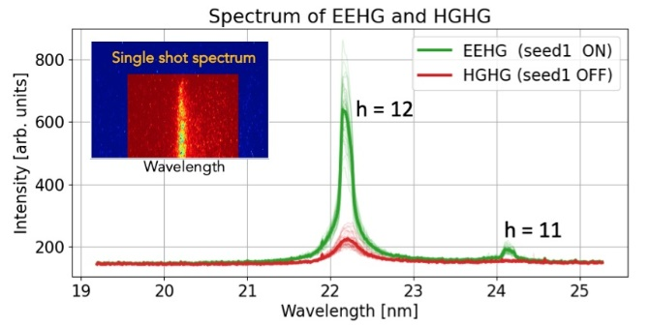
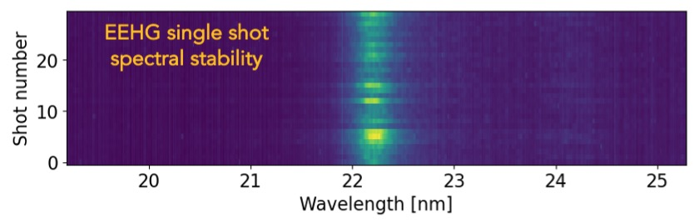
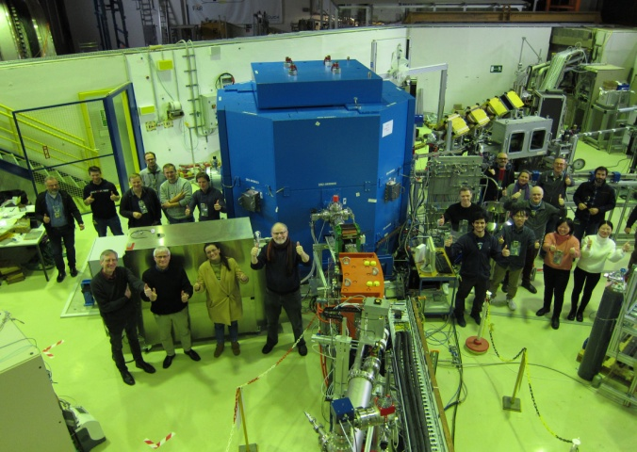
Large-Scale Infrastructures (LKII): Substantial Achievements
From Matter to Materials and Life
sFLASH: FIRST Echo-Enabled HG LASING
PHOTONS
First beam on target on Dec. 12, 2022,
with 3 beamlines in operation
NEUTRONS
proton beamline from cyclotron (45 MeV; pulsed)
target-moderator-reflector (TMR) unit
cold methane moderator
three experimental stations in operation
8

Slide 9
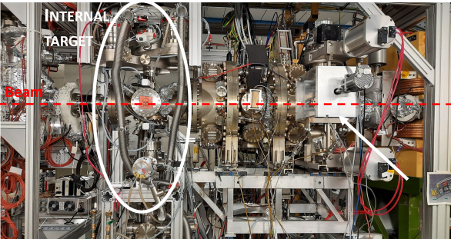
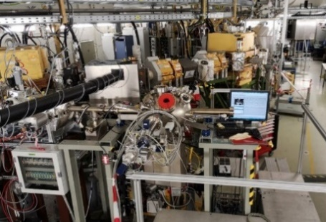
Large-Scale Infrastructures (LKII): Substantial Achievements
From Matter to Materials and Life
CRYRING@ESR in full user operation
IONS
Atomic and astro-physical reaction studies for stored highly charged ions at low energies;
Ion solid interaction as a function of potential and kinetic energy;
Sputtering and surface processes;
Interaction with 2D materials.
USER OPERATION AT HLD
HIGH FIELDS
Typical user experiment by British group;
YbB₁₂ is unconventional, so-called Kondo insulator;
Above about 47 T metallic state;
Quantum oscillations allow comparison with band structure and comparison with oscillations in the insulating state.
9

Slide 10
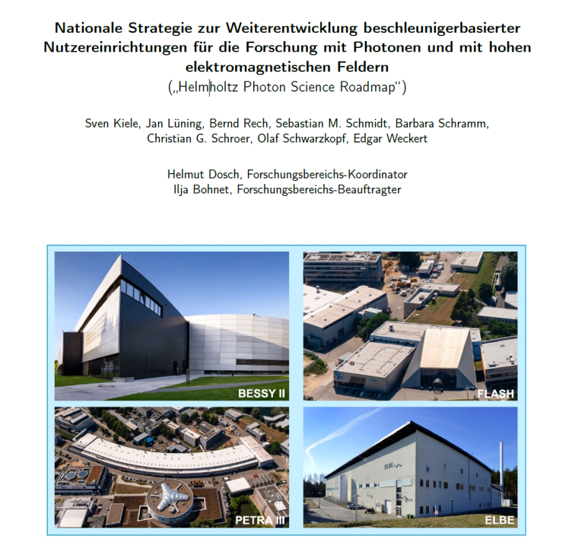
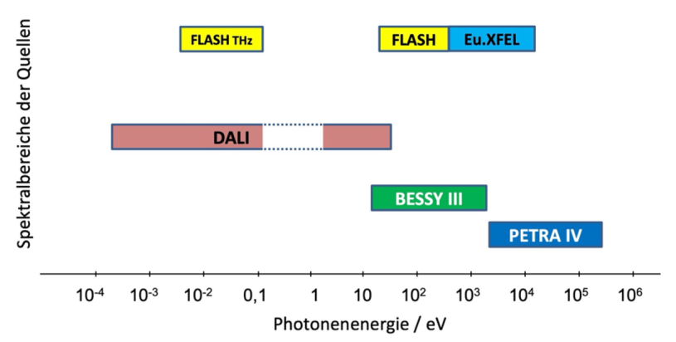

From Matter to Materials and Life
Significant Developments in Research Infrastructures
Maintain and enhance world-leading capabilities for forefront science;
Coherent upgrade plans for large-scale facilities shaping national and European strategy plans.
Joint Helmholtz Photon Science Roadmap
(PETRA IV, BESSY III, DALI, FLASH2020+)
spectral regimes of sources
photon energy / eV
Complementary X-ray energy regimes (BESSY III and PETRA IV) and operation modes for VUV/soft x-ray experiments (DALI and FLASH2020+).
Coordinated with
10

Slide 11

From Matter to Materials and Life
Significant Developments in Research Infrastructures
Maintain and enhance world-leading capabilities for forefront science;
Coherent upgrade plans for large-scale facilities shaping national and European strategy plans.
Joint Helmholtz Photon Science Roadmap
(PETRA IV, BESSY III, DALI, FLASH2020+)
PETRA IV: Proposal finished → ready to go, project start mid 2024
BESSY III: CDR Phase → construction start 2029/30
DALI: CDR in final stage
spectral regimes of sources
photon energy / eV
Complementary X-ray energy regimes (BESSY III and PETRA IV) and operation modes for VUV/soft x-ray experiments (DALI and FLASH2020+).
Coordinated with
11

Slide 12
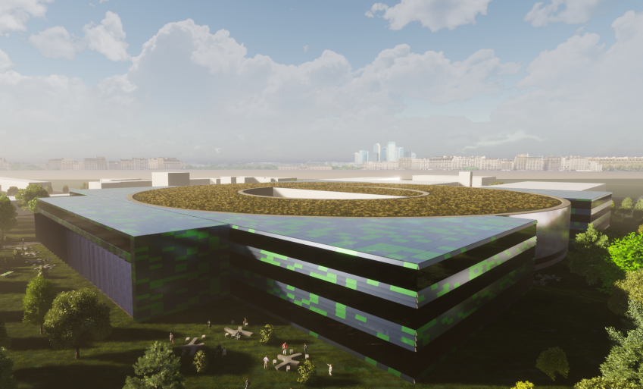
From Matter to Materials and Life
Significant Developments in Research Infrastructures
BESSY III Pre-CDR submitted to FIS commission
Cost projection: 976 Mio €
Overall assessment „outstanding“ in written review
  „BESSY III will certainly play a central role in the scientific areas explained in the document.[…] USPs are the facility’s leadership as a key enabler of metrology with SR.“
  „Envisaging BESSY III not only as a synchrotron source but as a more complete research infrastructure […] is also an excellent choice“
  „The local expertise at BESSY, in science and in all core technologies, is among the best in the world.“
Recommendation for full application of the FIS commission
Confirmation anticipated by Helmholtz Members’ Assembly on April 25th & Helmholtz Senate on June 20th
12
Notes:
Hier bitte auf die Struktur des Forschungsbereiches (beteiligte Zentren, programmatische Aufstellung, Grafik) und die wesentlichen Entwicklungen des Forschungsbereiches im Berichtsjahr eingehen.

Slide 13
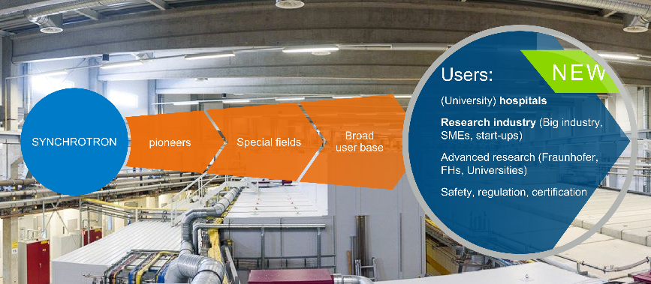
From Matter to Materials and Life
Significant Developments in Research Infrastructures
PETRA IV project proposal ready for submission
Cost projection: 1541.8 Mio €
Overall assessment in written review
  “The new accelerator technology will enable new scientific research opportunities.”
  “For the Helmholtz Association, and especially for the field of matter, the project is considered to be of great strategic importance.”
  “PETRA IV will be one of the best top light sources world wide and thus the place for top research.”
Recommendation for full application of the FIS commission
Helmholtz Members’ Assembly on April 21st, 2020: PETRA IV is part of the Helmholtz Roadmap for Research Infrastructures (published in June 2021).
13
Notes:
Hier bitte auf die Struktur des Forschungsbereiches (beteiligte Zentren, programmatische Aufstellung, Grafik) und die wesentlichen Entwicklungen des Forschungsbereiches im Berichtsjahr eingehen.

Slide 14
From Matter to Materials and Life
Senate Recommendations (LKII facilities): Overview
Recommendation | Page/Appendix
Develop a TDR for PETRA IV and a CDR for BESSY III as part of overall prioritized plans for MBA upgrades to these facilities. | 23
Develop a CDR and a TDR for DALI infrastructure as part of ELBE upgrade | 24
Ensure that synchrotron beamlines have sufficient levels of scientific and technical support for the user community. | 25
Exploit the full range of capabilities for research with neutrons addressing the grand challenge issues in many areas targeted by Helmholtz. | 26
Put the HIBEF facility at the European XFEL in operation during the first few years of the PoF IV period. | 27
For GSI: perform the FAIR Phase-0 in accordance not only with nuclear physics, but also with the MML developments. | 28
For IBC at HZDR: introduce cutting-edge technologies and/or science that will take it to a leadership position in ion beam technology and applications. | 29
14

Slide 15
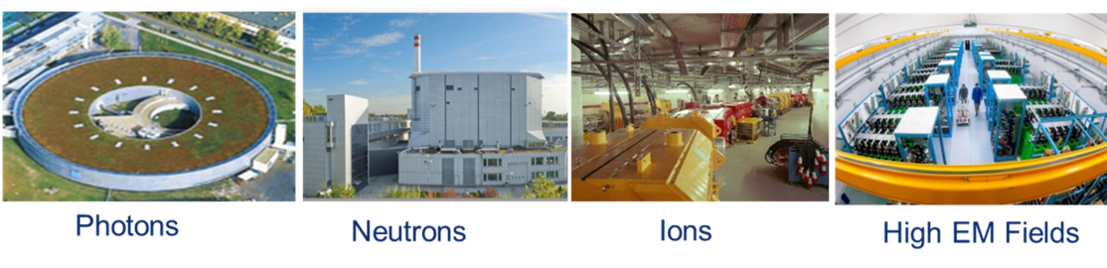
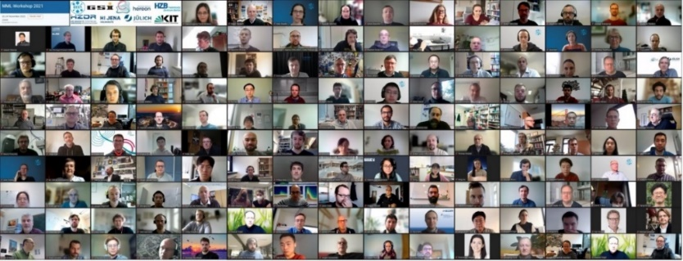
From Matter to Materials and Life
Summary and Outlook
A multitude of research highlights achieved
COVID-19, basically all MML facilities in user operation.
  2022, reduction in protective measures against Corona.
  Sustainable operation: Pushing for Mail-in and Remote-access user operation: funding from the Helmholtz Association for beamline demonstrator.
National/European strategies for Photons, Neutrons, and High Magnetic Fields.
Pushing for the realization of the national roadmap for photon facilities (PETRA IV, BESSY III, DALI, FLASH2020+).
For neutrons: advancing the High Brilliance Neutron Source (HBS).
In 2022, MML workshops (in presence) focused on the Research Topics
Next MML conference (in presence), University of Jena 27nd to 29th of Sept. 2023
15

Slide 16

From Matter to Materials and Life
APPENDIX
Implementation of Senate Recommendations (LKI): pages 17 to 21
Implementation of Senate Recommendations (LKII): pages 23 to 29
16

Slide 17

From Matter to Materials and Life
Recommendations (1)
Make clear what the major challenges are that MML can address with their facilities and competence, and where the Helmholtz Association is going to play a leading role
MML In house research and with their largescale facilities are successfully developing their research and technical programs while quickly addressing emergent needs and new research directions
Fight against Epidemic Outbreaks
  Example of Covid-19 (also part of the innovation pool project FISCOV)
  Airborne Transmission of the SARS Coronavirus: IVF project CORAERO
Essential contributions to the fields of Energy, Health and Materials Research
Essential contributions to the European consortia LEAPS (photons), LENS (neutrons), RADIATE (ions), and EMFL (high fields)
Strong involvement into ARIE (Analytical Research Infrastructures in Europe); bringing together LEAPS, LENS, eDREAM, RADIATE, EMFL, LaserLab. In 2022, Jochen Wosnitza represented ARIE as spokesperson.
T. Barthel et al.,
J. Med. Chem. 65, 14630 (2022)
17

Slide 18
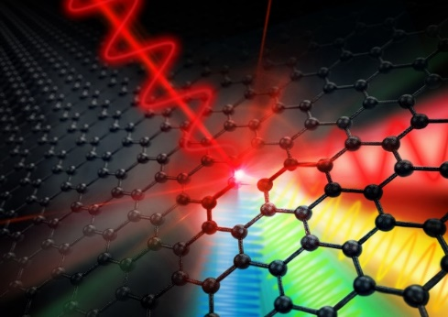
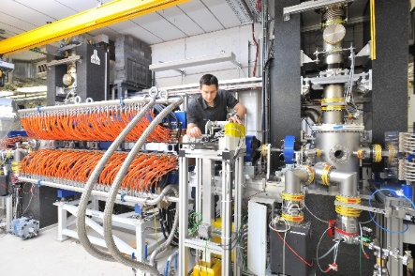
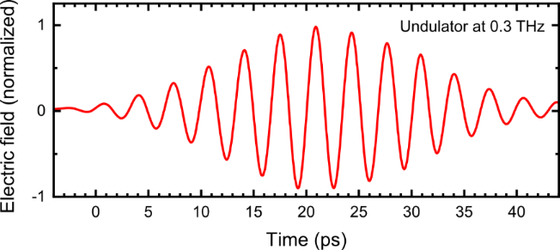
From Matter to Materials and Life
Recommendations (2)
Strengthen the commitment to THz methodology and science even more to become a world leader in the ongoing "THz revolution”
2021: Preliminary CDR of DALI prepared and positively evaluated by HGF ⇒ recommendation of Senate to apply for inclusion on the National Roadmap for Research Infrastructures.
Presently: Work on full CDR, with submission intended in summer/fall 2023;
also design study and experimental test setups for crucial DALI components.
Controlling non-equilibrium phenomena in matter with THz radiation coherently on a femtosecond scale: now at ELBE, in the future at DALI with 100 times higher pulse energy.
THz sources: from ELBE to DALI
18

Slide 19
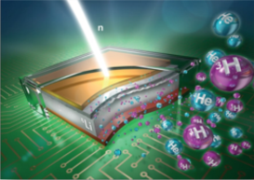
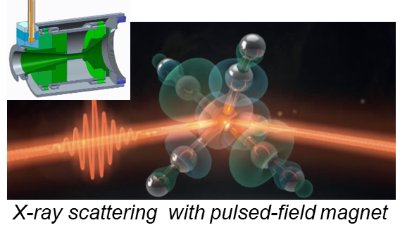
From Matter to Materials and Life
Recommendations (3)
Improve coordination between materials and instrument researchers and scientists at large-scale facilities
Scientists from the various centers work closely together in the innovation pool project Materials Dynamics for Future Quantum Technologies: MaDQuanT and are active in Joint Labs.
Materials - Quantum, Complex and Functional Materials: collaboration is promoted through regular, cross-center and thematically oriented workshops.
Collaboration is strengthened by the engagement in coordinated programs, e.g. in the framework of SFBs and clusters of excellence.
19

Slide 20
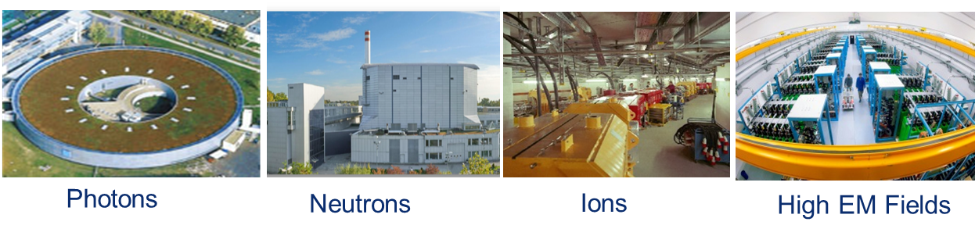
From Matter to Materials and Life
Recommendations (4)
Continue to support the Helmholtz mission and Helmholtz scientists by providing new measurement capabilities at large-scale facilities for users
Synchrotron and FEL sources: further adaptation of capabilities to the needs of the user community is ongoing, including new beamlines (PETRA III – Ext., FLASH2020+, BElChem/CatLab@BESSY II ).
New magnetic-field beamline (planned for ESRF) and sample environment at BESSY
In 2021, the HIBEF facility (combination of the Facility Topics Photons and High Fields) at XFEL has been commissioned. 2022 dipole laser fully implemented.
Neutron facilities: work is being carried out within the Innovation Pool Project HBS on the realization of an alternative, accelerator-based concept for neutron sources.
Ion facilities: full user operation of the new ion storage ring CRYRING@ESR.
20

Slide 21
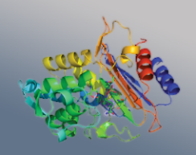
From Matter to Materials and Life
Recommendations (5 and 6)
Pursue outstanding, scientifically broad-based life science in the first stage of the program as proposed, ensuring that the valuable coherence of the biological research is maintained during PoF IV through joint meetings
In the topic Life, collaboration between the scientists involved is promoted through regular, cross-center and thematically oriented workshops.
Participating centers work closely together in the cross-research area innovation pool project FISCOV, in which the large research infrastructures are used for research in fight against Covid-19.
CCA Structural Biology and Biological Processes & Radiation Research: substantial contributions
21

Slide 22
From Matter to Materials and Life
Recommendations for the program-associated large-scale infrastructures (LK II)
22

Slide 23
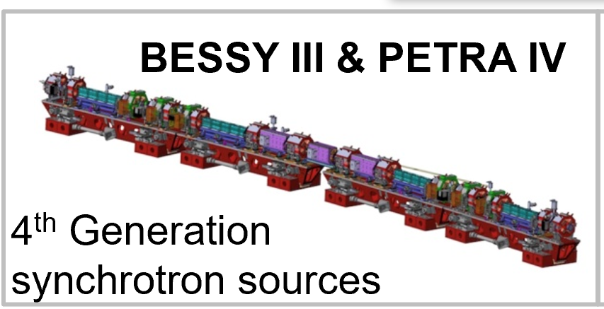
From Matter to Materials and Life
Associated Large-Scale Infrastructure (LK II): Photon Facilities
Develop a TDR for PETRA IV and a CDR for BESSY III as part of overall prioritized plans for MBA upgrades to these facilities.
PETRA IV
Important milestones toward a PETRA IV TDR:
  Updated design of the new storage ring magnet lattice (xxxxx)
  Portfolio of beamlines and experimental stations finalized
  Planning of additional infrastructure and new user services completed
  Funding proposal close to completion
BESSY III: Based on expert workshops and advice by PAC/SAC
  In the reporting year, a preliminary CDR (Pre-CDR) for BESSY III was completed and submit-ted to the FIS Commission of the Helmholtz Association.
23

Slide 24

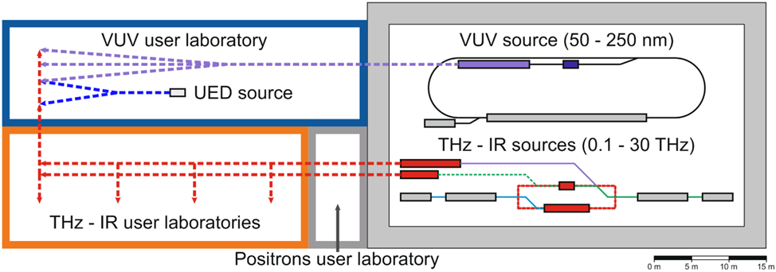
From Matter to Materials and Life
Associated Large-Scale Infrastructure (LK II): Photon Facilities
Develop a CDR and a TDR for DALI infrastructure as part of ELBE upgrade.
2020: A preliminary CDR of the DALI project submitted for inclusion in the Helmholtz Roadmap for Research Infrastructures and positively evaluated by the Helmholtz Association in 2021.
Work has started on a CDR, the submission of which (phase II in the Helmholtz Roadmap process) is planned for summer/fall 2023.
2023: The official inclusion in the Helmholtz Roadmap will take place after a positive evaluation
24

Slide 25

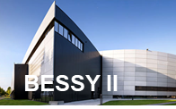
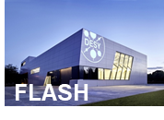
From Matter to Materials and Life
Associated Large-Scale Infrastructure (LK II): Photon Facilities
Ensure that sychrotron beamlines have sufficient levels of scientific and technical support for the user community.
Close contact with the user community is ensured through regular dedicated workshops,
planning new facilities or facility expansions for our users.
substantial user support needed for the expected large amounts of data.
But need for strengthening (more resources and personnel needed)
data management /data handling,
automation.
remote and hybride access / mail-in.
Temporary support (2023 – 2025): funding from the Helmholtz Association for demonstrator beamlines (ROCK-IT).
25
Notes:
ROCK-IT sollte verstetigt werden

Slide 26
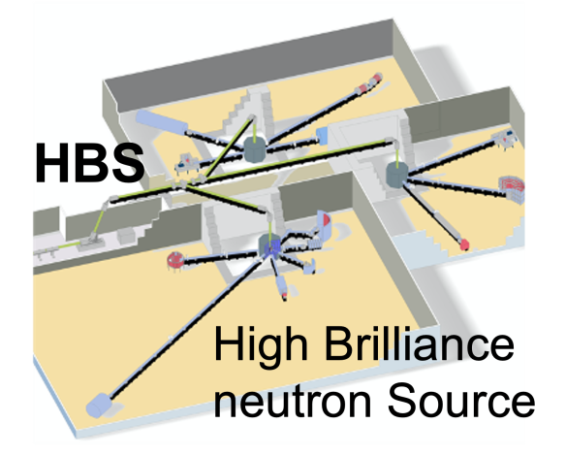


From Matter to Materials and Life
Associated Large-Scale Infrastructure (LK II): Neutron Facilities
Exploit the full range of capabilities for research with neutrons addressing the grand challenge issues in many areas targeted by Helmholtz.
Instrumentation and source development: scientific and societal requirements and opportunities are addressed at a series of workshops and conferences:
- Instrument renewal program MLZ2030
- Helmholtz contribution to the European Spallation Source
- HBS project for a novel accelerator-driven neutron source
Research with neutrons to solve urgent societal problems as presented by strategy paper of the League of advanced European Neutron Sources LENS
The Global Neutron Scientists (GNeuS) Program trains a new generation of excellent neutron scientists
26

Slide 27
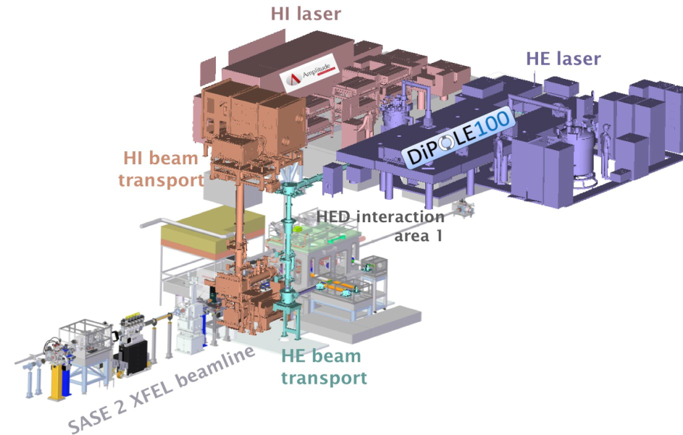
From Matter to Materials and Life
Associated Large-Scale Infrastructure (LK II): High Field Facilities
Put the HIBEF facility at the European XFEL in operation during the first few years of the PoF IV period.
In 2022 several user experiments at HED/HIBEF at EuXFEL, using Diamond Anvil Cells and ReLaX Laser (e.g., relativistic plasmas, laser driven shocks).
DiPOLE laser fully implemented. User-supported commissioning and first user experiments in 2023.
Realization of the HIBEF beamline for materials research experiments at the European XFEL" announced for 2022 was achieved, with the delivery of a pulsed capacitor bank to the HIBEF beamline“ for high-field magnets. Commissioning in 2023.
MML researchers contribute to the EuXFEL instrumentation via the Helmholtz International Beamlines (HIB): SFX continues to contribute critically to the ongoing success of the SPB/SFX instrument through both funding and expert collaboration. For hRIXS, first user experiments performed in 2022.
27

Slide 28
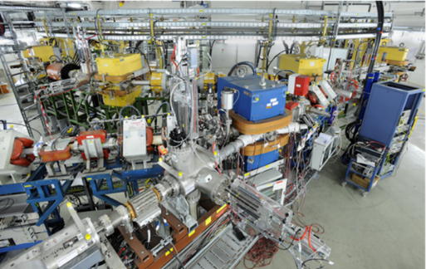
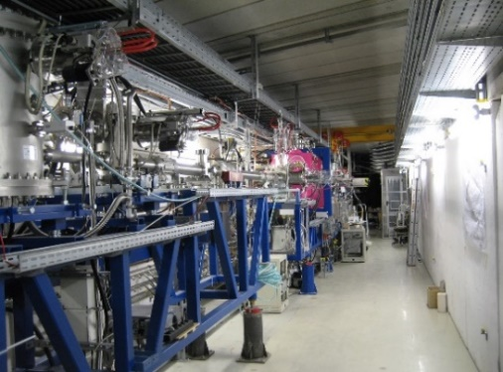
From Matter to Materials and Life
Associated Large-Scale Infrastructure (LK II): Ion Facilities
For GSI: perform the FAIR Phase-0 in accordance not only with nuclear physics, but also with the MML developments.
Since 2020/ 2021 new MML facilities in user operation:
  2020/2021: New ion storage ring CRYRING@ESR (first FAIR facility) commissioned
  2021: Proton microscopy PRIOR in user operation
  2021: New PHELIX laser beam line (200 J; up to 10 ns) to high-energy ion-beam experimental area HHT
  2022: CRYRING@ESR in full user operation
  2022: Commissioning of decelerator for trapping facility HITRAP
  50 % of the user beamtime at GSI in 2024/2025 is assigned to experiments in the realm of MML.
CRYRING
HITRAP
28

Slide 29
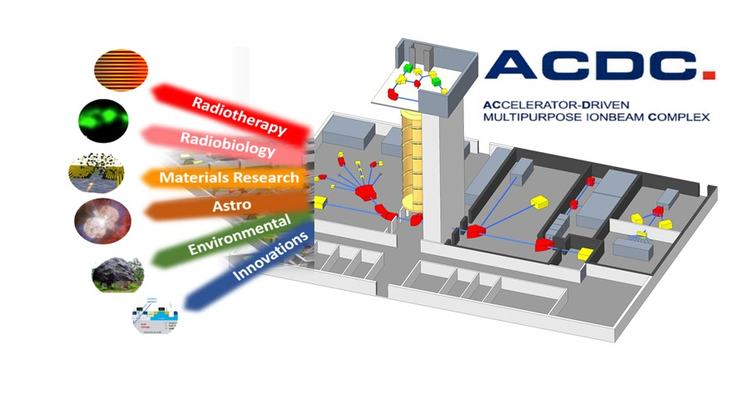
From Matter to Materials and Life
Associated Large-Scale Infrastructure (LK II): Ion Facilities
For IBC at HZDR: introduce cutting-edge technologies and/or science that will take it to a leadership position in ion beam technology and applications.
IBC will strengthen its position as leading ion beam center in materials research
  new analysis methods with highest lateral/depth resolution
  low-energy ion doping and modification of 2D materials
The low-energy ion laboratory commissioned in 2022/23 and enter user operation in 2024
Strengthening of AMS, the future IBC extension ACDC (Accelerator-Driven Multipurpose Ion Beam Complex)
Concept of the research infrastructure has been elaborated. A proposal for funding by the common Helmholtz infrastructure fund for strategic expansion investments can be submitted in 2024.
29

Slide 30
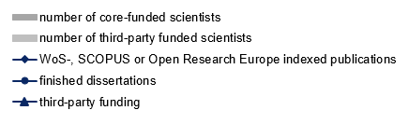
From Matter to Materials and Life
Program development - Indicators
30

