Slide 1
ARES Operation Meeting
Summary of week 13 / 2023
Florian Burkart & Hannes Dinter, on behalf of the ARES crew

Slide 2
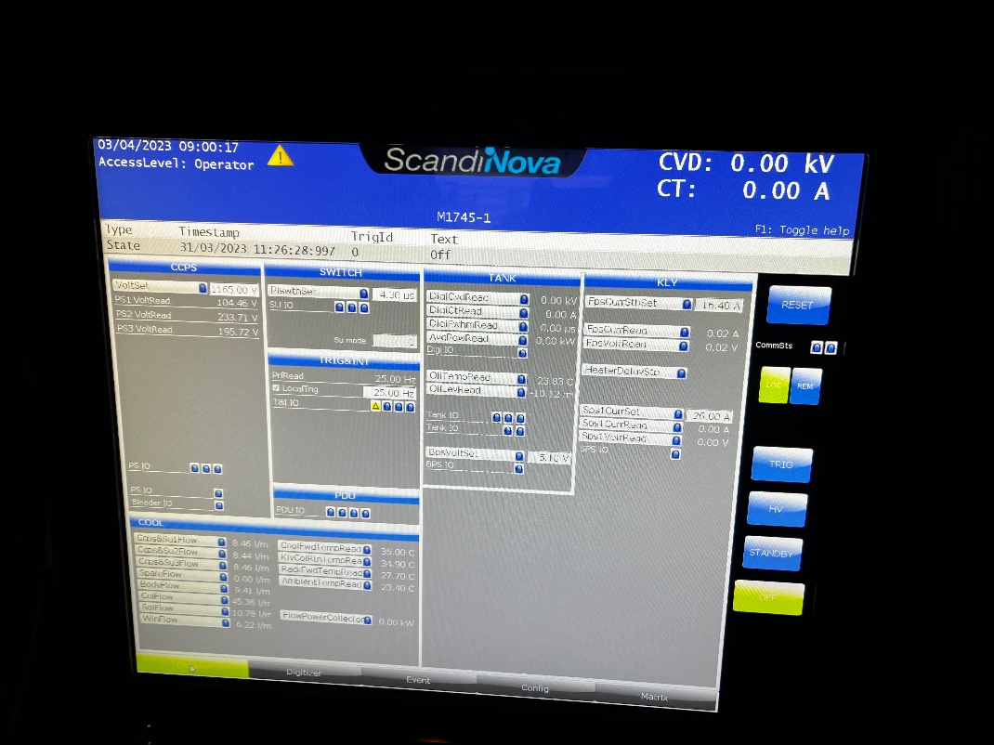
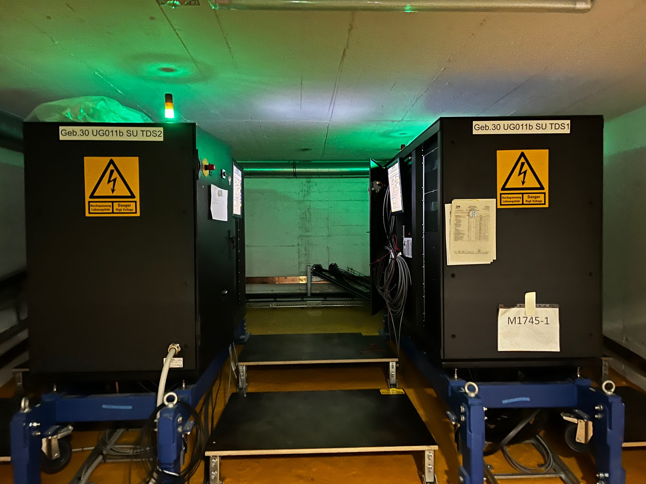
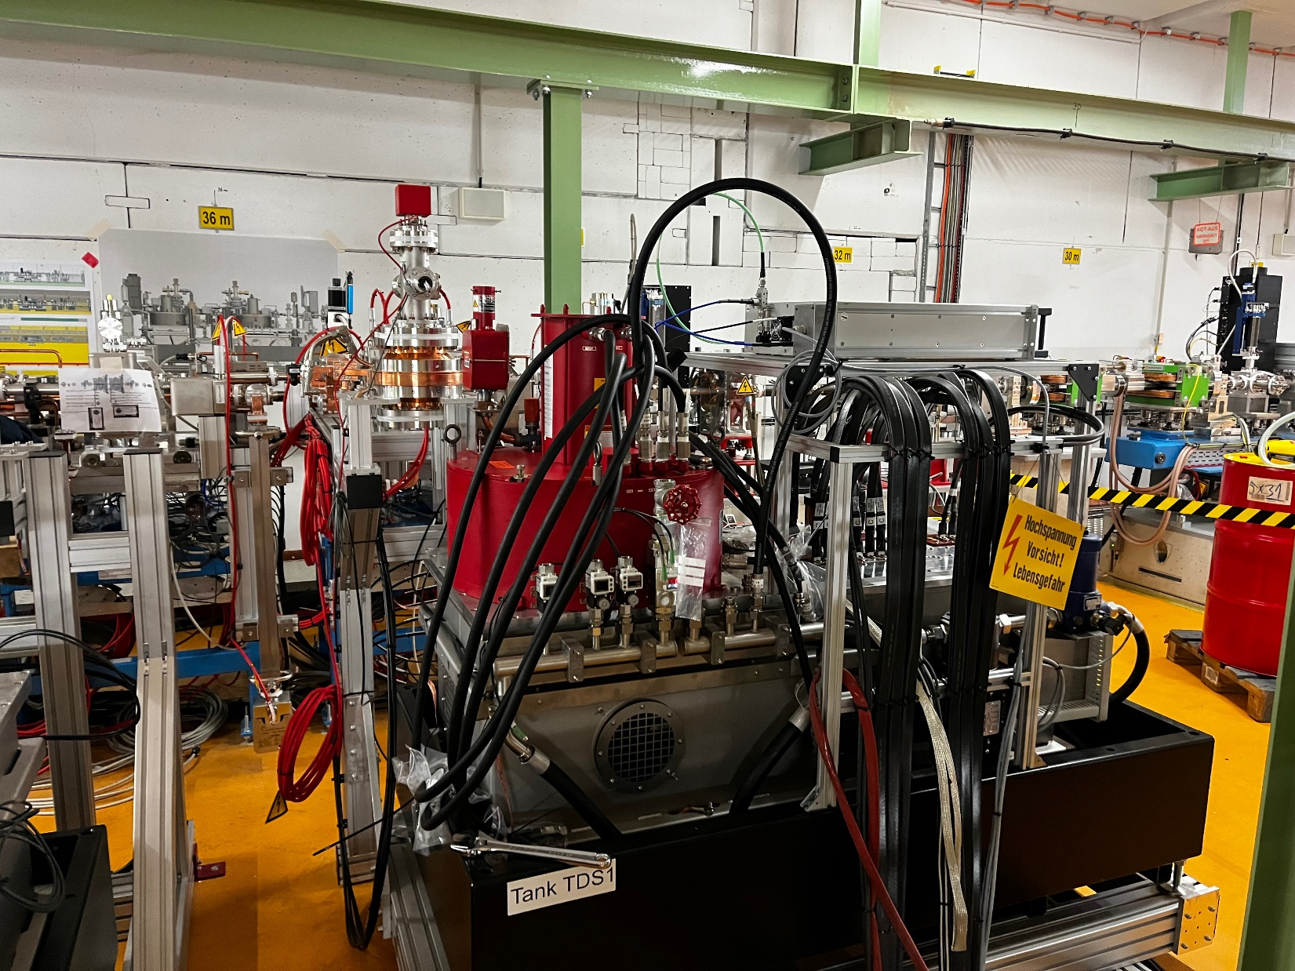
Summary of the last week
SAT of X Band Modulators: OK, but Scandinova will come back to solve a few issues.

Slide 3
Plan for this week / next week
MON: Robo visit
TUE Morning: Student visit at ARES
TUE lunch time: Close ARES
TUE / WED / THU: eCT
TUE: MSK shift
WED: MDI /D3 shift

Slide 4
Schedule
Week 14/15
Date | Shift Leader
3.04. | -
4.04. | Willi / Frank
5.04. | Frank / Hannes
6.04. | Thomas / Hannes
7.04. | -
Date | Shift Leader
10.04. | -
11.04. | Frank
12.04. | Willi / Frank
13.04. | -
14.04. | -
If you want to learn or join the shift: please give the shift leader a call (BKR 2840 / SINBAD Box 2454)

