Slide 1
XFEL Accelerator R&D Status / Final Report NC CW gun and buncher design
Frank Stephan, Houjun Qian
3rd May 2023

Slide 2
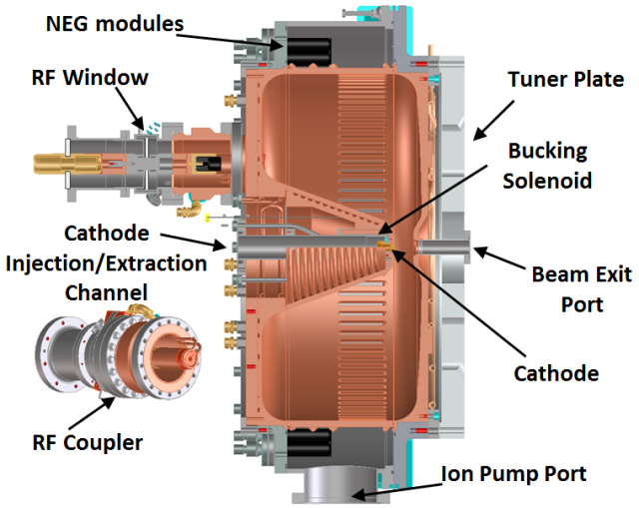
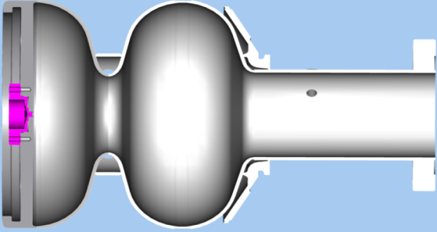
Scope of the R&D activity
A backup injector solution for CW upgrade of European XFEL
Normal conducting CW gun physics design and preliminary technical design
Normal conducting CW buncher physics design
Q3/2018 - Q2/2021 (original plan)
All-SC gun
Main option at DESY
 | All SC gun | NC VHF gun | Unit
Stategy | Main option | Backup option
Freq | 1300 | 1300/6 | MHz
Ecath | 40 | 20-30 | MV/m
E_{emission} | 28 | 20-30 | MV/m
Vgun | 4 | 0.75-0.85 | MeV
t_{laser} | <30 | <60 | ps
Cathode | Pb | Cs₂Te
NC VHF gun
Backup option

Slide 3
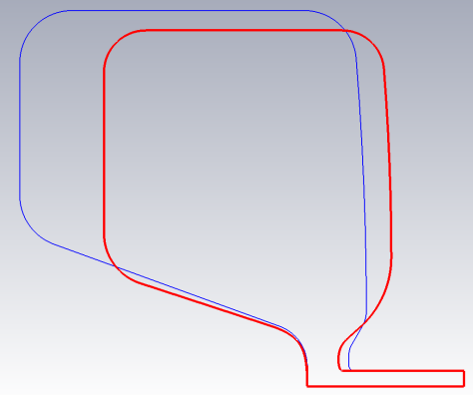
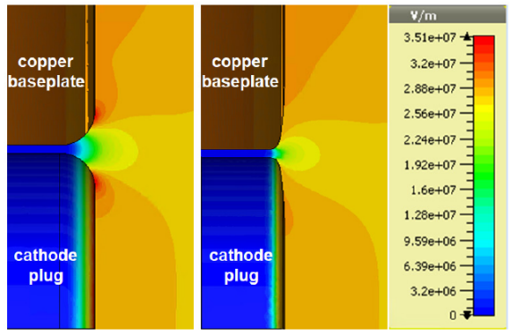
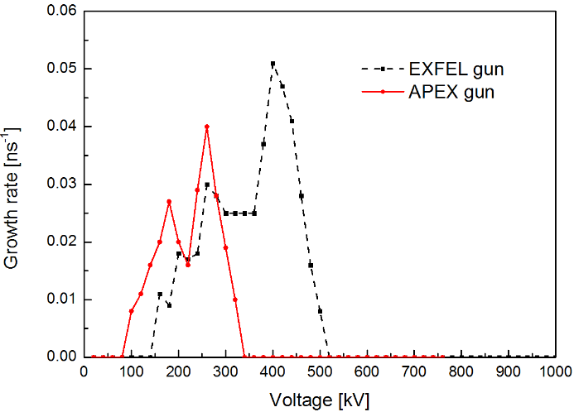
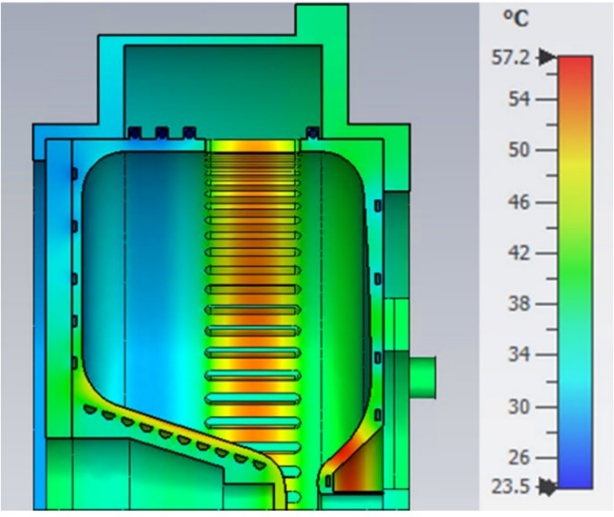
Achievements of R&D activity
APEX gun
DESY gun
RF optimizations of CW gun
A better RF frequency matching XFEL timing system
Higher cathode gradient for better beam quality
Higher shunt impedence
Lower peak field, lower dark current emission field
Multipacting and thermal load analysis
RF Geometry
Dark current emission field
 | LCLS2 VHF gun | NC VHF gun | Unit
Freq | 1300/7 | 1300/6 | MHz
Acc. Gap | 4 | 3 | cm
E_{cath} | 20 | 28 | MV/m
Vgun | 750 | 830 | keV
RF power | 90 | 100 | kW
E_{peak}/E_{cath} | 1.29 | 1.09
E_{plug}/E_{cath} | 1.25 | 1.04
APEX
DESY
Multipacting
Temperature distribution
Shu, Guan, et al. Proc. 10th Int. Particle Accelerator Conf.(IPAC'19).
Shu, Guan, et al. 39th Int. Free Electron Laser Conf.(FEL‘19).

Slide 4
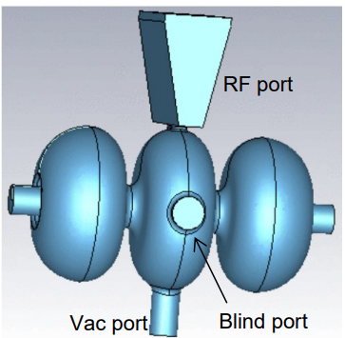
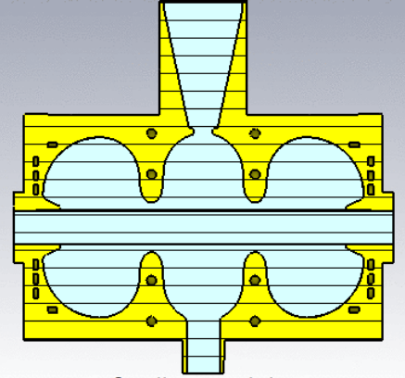
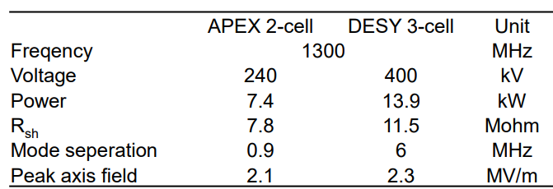
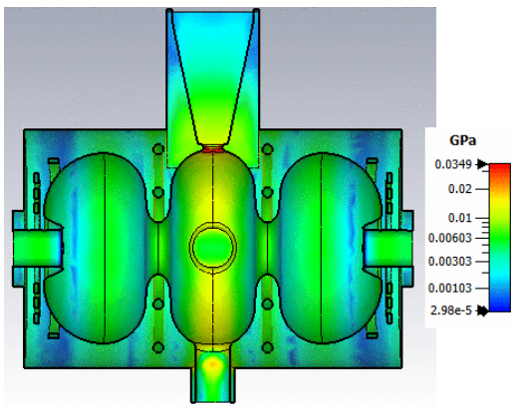
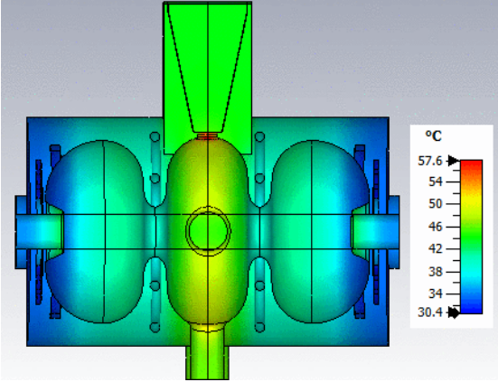
Achievements of R&D activity
RF optimizations of CW buncher (APEX vs DESY)
2 cell → 3 cell
Coaxial coupler → waveguide coupler
Higher buncher voltage for higher gun voltage
Similar heating per cell vs APEX buncher, simple cooling circuit
RF geometry
Cooling circuit
Lal, Shankar, et al. DESY internal report, PUBDB-2021-05027 (2021)
Lal, Shankar, et al. NIMA 1027 (2022): 166220.
Stress distribution
Temperature distribution

Slide 5
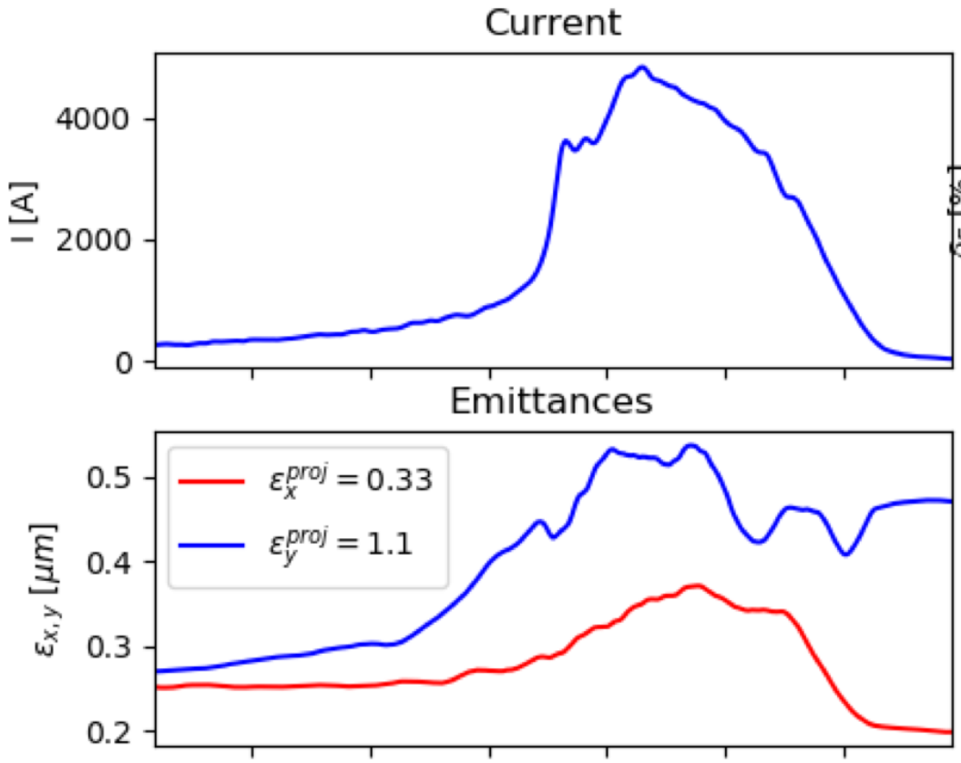
Achievements of R&D activity
CW Injector S2E optimizations
DESY VHF vs LBNL/SLAC VHF
DESY NC vs DESY SC
CW XFEL S2E based on NC VHF gun
By Igor Zagorodnov and M. Dohlus
With conservative injector solution: parabolic laser, 1 µm.rad/mm thermal emittance
100 pC | Normal conducting |  |  | Superconducting |  | Unit
 | LCLS-II | APEX2 | DESY | SLAC | DESY
Freq. | 1300/7 | 1300/8 | 1300/6 | 1300/7 | 1300 | MHz
E_{cath} | ~20 | 30 | 28 | 30 | 40 | MV/m
E_{k} | 0.75 | 1.5 | 0.83 | 1.8 | 4 | MeV
$$ε_{th}/σ_{l}$$ | 0.6 | 0.6 | 0.5 | 0.6 | 0.5 | µm/mm
Buncher | Y | Y | Y | Y | N | /
100% $ε_{n}$ | 0.19 | 0.10 | 0.12 | 0.11 | 0.15 | µm
95% $ε_{n}$ | 0.16 | 0.09 | 0.09 | 0.09 | 0.12 | µm
I_{peak} | 12 | 12 | 7.4 | 12 | 4.6 | A
H. $δP_{z}$ | 3.3 | 3.7 | 1.5 | 1.4 | 4.4 | keV/c
B_{5D} | 457 | 1491 | 1024 | 1387 | 319 | A/µm²
>4kA
Gun
booster
buncher
Shaker, H., et al. 39th Free Electron Laser Conference (FEL'19)

Slide 6
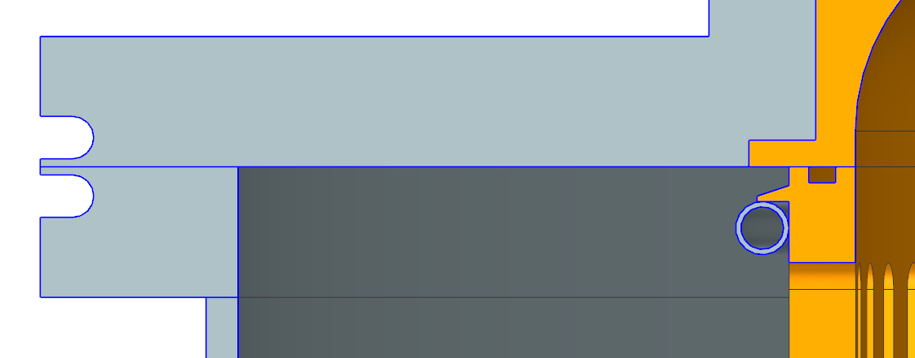
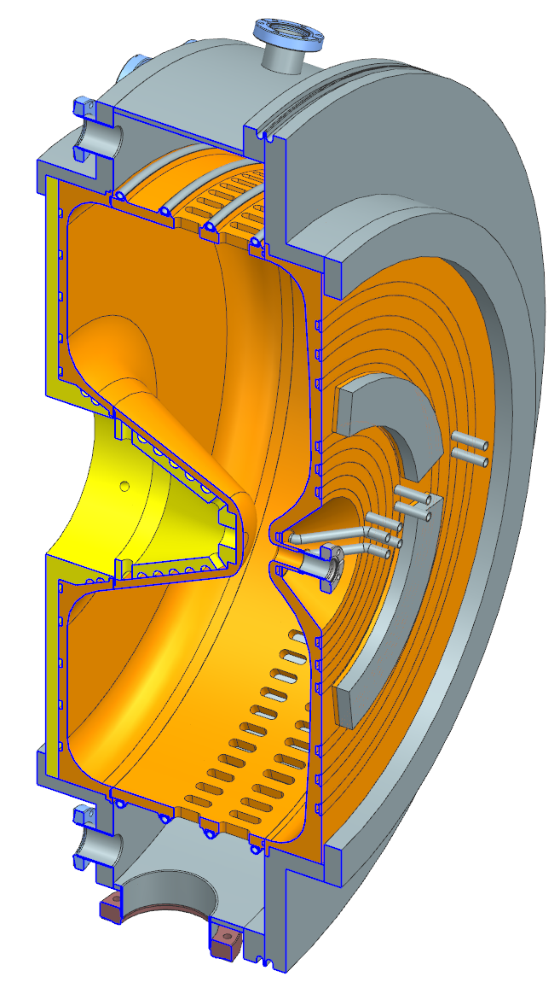
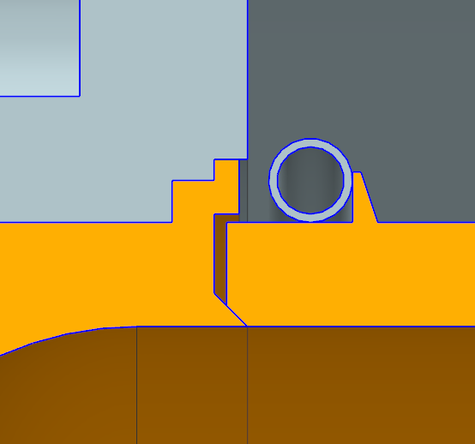
Conceptual technical design work
Design of the vacuum vessel with flanges and details on welding technics
Concept for tuning possibilities
TIG-welding
RF-spring
Design of the water cooling according to simulation results
Surface to be machined for tuning
Details on e-beam welding design
Dimensioning of vacuum slots for reasonable pumping speed
e-beam welding
General considerations on possible manufacturing steps
Sebastian Philipp

Slide 7
Deviations from plan
The final conceptual technical design of NC CW gun is not finished
Reasons
Due to the workload of the main engineer from other projects at DESY Zeuthen (including Gun5 and UltraSAT), it is not possible for him to finish the project. The priority shift for the main engineer was confirmed by the DESY directorate.
The main physicist (Houjun Qian) left DESY in 06.2022.
Consequences
The backup solution stays in the physics design phase without further technical design efforts.
This is in line with DESY strategy.
Currently, SRF gun at DESY has made good progress, so it‘s not urgent to push the backup option into the technical design phase.

Slide 8
Timeline of this R&D activity
Actual timeline of the project
Proposal Timeline | Milestone Description | Actual Timeline
Q3/2018 | Postdoc hired | Q3/2018
Q4/2018 | First beam dynamics results based on APEX-2 design | Q1/2019
Q2/2019 | Reference results for CW injector optimization based on APEX-2 design | Q3/2019
Q4/2019 | Improved design of NC CW gun | Q4/2019
Q2/2020 | New CW injector optimization based on improved NC CW gun design | Q2/2020
Q3/2020 | Improved buncher cavity design | Q3/2020
Q1/2021 | Technical design of NC CW gun Conceptual technical design of NC CW gun | Q2/2021
Q2/2021 | Finish conceptual technical design of NC CW gun | Q4/2022

Slide 9
Outlook / Summary
We have finished the physics design of the CW gun and CW buncher
RF and multi-physics optimizations of the CW VHF gun
RF and multi-physics optimizations of the CW buncher
S2E beam dynamics optimizations of the CW injector, and comparisons to SRF gun and APEX2 gun
Conceptual technical design of NC CW gun is discontinued
The main engineer‘s priority is moved to other projects (gun5 and UltraSAT).
The main physicist left DESY in 06.2022.
list of publications
Shu, Guan, et al. "First design studies of a NC CW RF gun for European XFEL." (IPAC'19).
Shu, Guan, et al. "Multiphysics Analysis of a CW VHF Gun for European XFEL." (FEL‘19).
Shaker, H., et al. "Beam Dynamics Optimization of a Normal-Conducting Gun Based CW Injector for the European XFEL." (FEL‘19).
Lal, Shankar, et al. "Design studies of a continuous-wave normal conducting buncher for European X-ray Free Electron Laser.", DESY internal report, PUBDB-2021-05027 (2021)
Lal, Shankar, et al. "Design studies of a continuous-wave normal conducting buncher for European X-ray Free Electron Laser." Nuclear Instruments and Methods in Physics Research Section A: Accelerators, Spectrometers, Detectors and Associated Equipment 1027 (2022): 166220.

