Slide 1
XFEL Accelerator R&D Status Report
RP-214: Basic CW gun research with the PITZ photo injector
Frank Stephan, Mikhail Krasilnikov, Houjun Qian
03.05.2023

Slide 2
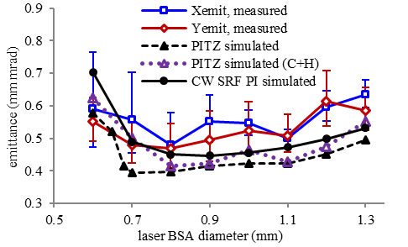
Scope of the R&D activity
Beam dynamics results relevant for electron sources running in CW (HDC) operation → beam quality at different:
  gun gradients from 20MV/m to 60MV/m (assumed to be an upper limit for CW SC gun)
  types of photocathodes: green vs Cs₂Te (reference case), their emission properties / usability at CW gradients
  various shapes of photocathode laser pulse (in close connection to RP-216: Photo Cathode Laser Shaping)
Studies on cathode material, sensitive to the VIS laser (Green cathodes):
  Green cathode production system at LASA INFN Milano setup to deliver green cathodes to PITZ for tests with RF gun at high gradients.
  First tests with KCsSb at PITZ : good QE, lower thermal emittance, short response time, but high dark current and short life time
  Improvements of the green cathode recipe toward high quality green cathodes for CW (HDC) operation
40MV/m, 100pC, Gaussian pulses

Slide 3
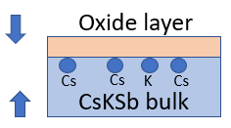
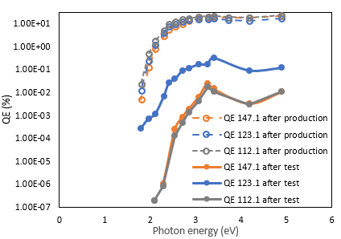
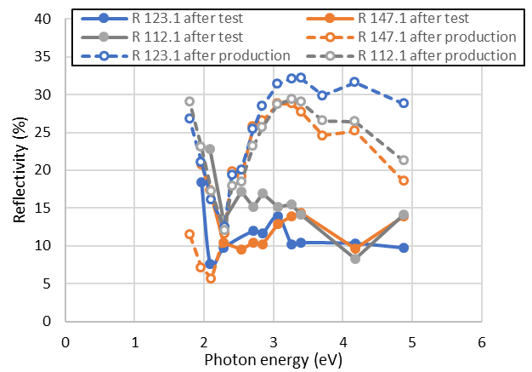
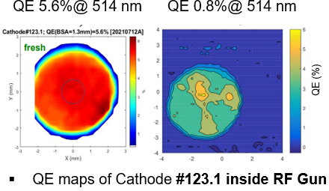
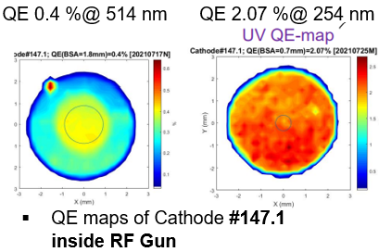
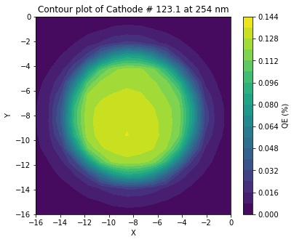
Achievements in 2022: Post-operation optical diagnostic of “tested” KCsSb cathodes
Spectral response + reflectivity measurements have been done for all three cathodes.
  Photoemission threshold (Eg+Ea) increased from 1.8 eV to 2.08 eV for cathode #147.1 and #112.1 (similar like Cs₂Te), however, in the #123.1 case, it is different.
  The spectral response behavior
  of “used” photocathodes shows
  the potential oxidation of
  cathode films.
QE maps are quite uniform in
the UV wavelengths at LASA INFN
similar like measured in the PITZ gun
Spectral response
Reflectivity
Notes:
In 2022, the post-operational optical diagnostic (spectral response and reflectivity) has been measured for the green cathodes which had been tested at PITZ in 2021 with the gun4.2.

Slide 4
Achievements in 2022: Green cathodes
Density functional theory (DFT) studies applied to K₂CsSb and K₃Sb compounds (Cs₂Te reference), to investigated the electronic and optical properties of both materials. The optical properties such as dielectric function, reflectivity, refracting index, and extinction coefficient have been evaluated.
New green cathodes “production” system:
  with “multi-wavelengths” diagnostic setup (real-time photocurrent and reflectivity measurements at different wavelengths, 254 nm – 690 nm) to investigate the chemical and crystal evolution during photocathode growth
  three cathodes (two thick and one thin) have been deposited
  the real-time evolution of reflectivity of two kinds of KCsSb cathodes (thick &thin) reveals that both cathodes may have contained different crystal orientations ➔further detailed surface characterization study should be done in the future
  from the DFT simulations → thick and thin cathodes have a different band gap.
A cathode lifetime study w.r.t temperature of KCsSb cathode has also been done. It was observed that, at least in the new “production” system, the cathode could be survived up to 120ºC. ➔ further detailed “lifetime vs. temperature” studies regarding its robustness w.r.t to higher temperatures should be done in the future

Slide 5
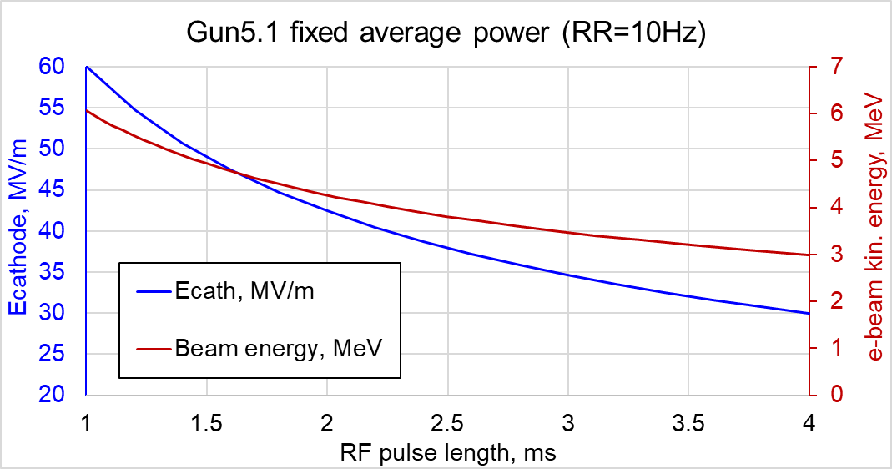
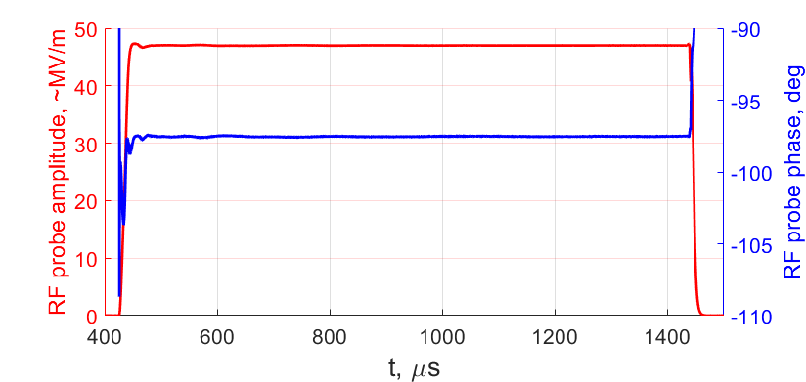
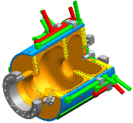
Achievements in the past year: Gun5
Being capable of long RF pulses (with up to 1 ms at 60 MV/m at the cathode), the gun5 (new geometry + RF pickup) is considered for an "extended burst mode" HDC FEL operation (2 ms RF pulse duration) with a correspondingly reduced gradient.
These studies appear to be relevant to the CW gun research and can be seen as another goal of the package.
RF Probe, 1ms

Slide 6
Deviations from plan
Since it was unclear whether the first prototype gun5 (gun5.1, which was installed in 2022 and is still in operation at PITZ) would be installed at the user facilities in Hamburg, green cathode tests were not conducted to reduce the risk of cavity contamination. Currently it is assumed that the gun5.1 is foreseen to stay for operation at PITZ at least until end of 2023 and the next gun5 cavity (gun5.2) is planned to be conditioned at FALCO in the second half of 2023 with consequent installation at PITZ for beam tests.
Based on these assumptions, the possibility of green cathode tests with the gun5.1 at PITZ is now being considered, which is in line with the original goals of this package. The exact scheduling of these tests is determined by the availability of new green cathodes from LASA INFN Milano as well as the impact of the upcoming decommissioning of the MBI laser system and its replacement with the NEPAL-P system.
Since flattop laser pulses from the MBI laser system have not been available for the past few years, neither have the corresponding electron beam characterization. The PITZ laser refurbishment also includes relocation of the ELLA laser system (capable of 3D pulse shaping) and is scheduled for the weeks 17-28/2023, which means no photocathode laser (no electron beam operation) at the PITZ during this period. But after this reconstruction, in addition to the 3D shaped laser pulses from the ELLA system, long flattop (~20ps) laser pulses are expected from the NEPAL-P system, which should be important for beam characterization at CW gun gradients

Slide 7
Timeline of this R&D activity
No flattop laser pulses from the MBI laser system since few years!
→ hope for NEPAL-P
Proposed Date | Milestone Description | Updated Date
Q3/2022 Q4/2023 | Beam characterization and emission properties at 60 MV/m (~upper limit for CW SC gun) with ellipsoidal and other advanced laser pulse shapes and Cs2Te cathodes | partially done Q3/2021
Q2/2021 | First green cathodes are shipped to PITZ for tests | Done
Q3/2022 Q4/2023 | Beam characterization and emission study at realistic NC CW gun gradients (probably in the range 20-30 MV/m) with flat-top laser pulse shapes and Cs2Te cathodes | partially done Q3/2021
Q4/2022* Q1/2024 | Green cathodes are stable enough to allow characterization of emission properties and beam quality | partially done in Q3/2021*
Q1/2023* Q1/2024* | First beam characterization and emission study at realistic NC CW gun gradients (probably in the range 20-30 MV/m) with flat-top laser pulse shapes and green cathodes
Q2/2023* Q4/2023* | Further development of deposition method for the production of green cathodes allows to reach longer lifetime and lower vacuum sensitivity | partially done Q4/2022
Q2/2023* Q4/2023* | Beam characterization and emission study at ~40 MV/m with Cs2Te or/and green cathodes
Q2/2023 Q4/2024* | Robustness of green cathodes is increased so that they can be operated at 60 MV/m
*missed in the written report

Slide 8
Risks to R&D Project
Green cathode production:
  Delays in the LASA INFN Milano system for green cathodes production due to severe COVID-19 issues and tight personnel situation (only 1 PhD student financed who 2023 finishes his PhD)
  Several iterations (production tests) may be required to resolve high dark current and lifetime problems
Advanced shaping of photocathode laser pulses
  Technological difficulties (pulse shape conservation during frequency conversion), mitigation – shaping in green
  Photocathode laser system refurbishment could take longer than planned
Gun5.1 conditioning:
  Took longer than typical gun4.x prototypes
  Still some issues (mini-breakdowns – investigations and further tests are ongoing) to be solved
Other risks:
  Hardware failures (e.g., RF systems)
  Conflicts with other tasks

Slide 9
Outlook / Summary
XFEL Accelerator R&D activities RP-214: Basic CW gun research with the PITZ photo injector in 2023:
  Beam characterization and emission properties
  ➔rather extensive program for 2023
  Further development of deposition method for
  the production of green cathodes allows to reach
  longer lifetime and lower vacuum sensitivity
Major risks:
  Delays in green cathode production / delivery and / or in the photocathode laser system refurbishment
List of publications / conference proceedings connected to this activity
  H. Peng-Wei et al., ”Anomalous correlation between quantum efficiency and transverse momentum spread in semiconductor cathode photoemission” , Phys. Rev. Accel. Beams 25, 053401 (2022).
  M. Krasilnikov et al., “RF Performance of a Next-Generation L-Band RF Gun at PITZ”, Proceedings of the 31st International Linear Accelerator Conference, LINAC2022, Liverpool, UK31st International Linear Accelerator Conference, LINAC22, Liverpool, United Kingdom, 28 Aug 2022 - 2 Sep 2022 JACoW Publishing, Geneva, Switzerland 699-702 (2022) [10.18429/JACoW-LINAC2022-THPOJO03].
  S. Mohanty et al., “Development and Test Results of Multi-Alkali Antimonides Photocathodes in the High Gradient RF Gun at PITZ”, 40th International Free Electron Laser Conference, FEL2022, Trieste, Italy, 21 Aug 2022 - 26 Aug 2022.
  G. Adhikari et al., “Monte Carlo simulation study of Cs2Te”, EWPAA 2022: European Workshop on Photocathodes for Particle Accelerator Applications.
  S. Mohanty et al., “Development and Characterization of Multi-alkali antimonide photocathodes for high-brightness R.F. photoinjectors”,
  submitted submission to a Special Issue edition in "micromachines" of MDPI journal.
Ecath | PC laser shape | Cathode
60MV/m | Flattop+ | Cs2Te
20-30MV/m | Flattop | Cs2Te
40MV/m | Gaussian+ | Cs2Te | green
60MV/m | Flattop | green

