Slide 1
XFEL Accelerator R&D Status Report Development and test of advanced photo cathode laser shaping at PITZ
Frank Stephan, Mikhail Krasilnikov, Matthias Groß
3rd May 2023

Slide 2
Scope of the R&D activity
Future possible CW operation regimes at EuXFEL: lower accelerating gradient at the photo cathode and in the linac
Even shorter radiation wavelength with the existing pulsed EuXFEL
To reach the required beam quality: laser beam shaping towards ellipsoidal pulses - and lower thermal emittance cathodes for 2) – can provide a path
Important for x-ray FELs:
High intensity
Short pulses
(high time resolution)
Protect machine
Low transverse emittance
Linear longitudinal phase space
Minimize beam halo
Reach saturation in undulator
Strong bunch compression
Minimal radiation damage of undulators

Slide 3
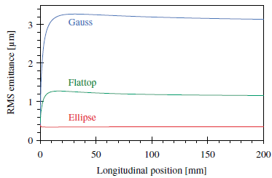
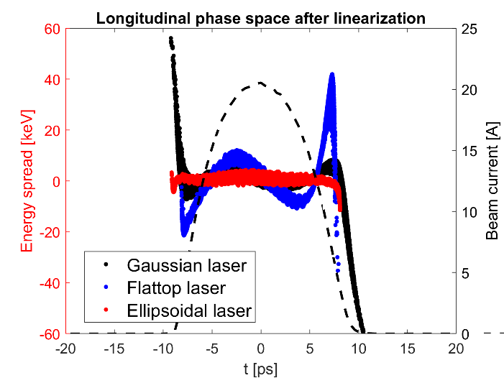
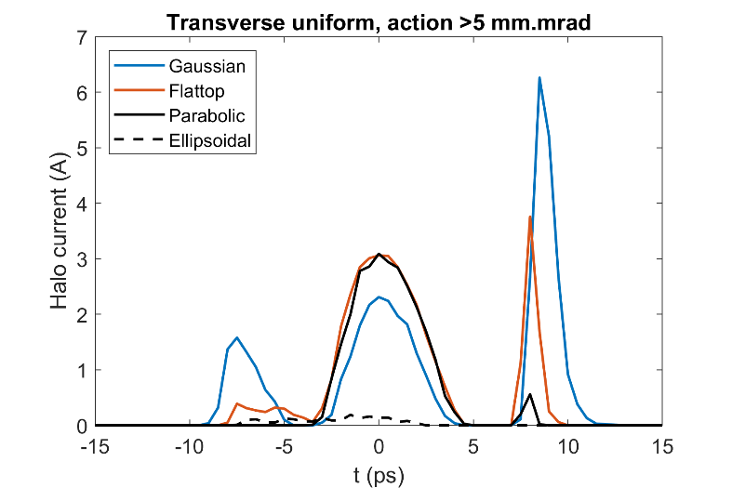
Scope of the R&D activity
Uniformly filled ellipsoid: I.M. Kapchinskii and V.V. Vladimirskii, in Proceedings of the International Conference on High Energy Accelerators, CERN, Geneva (Scientific Information Service CERN, Geneva, 1959), p. 274
Low transverse emittance Linear longitudinal phase space Minimize beam halo
O. J. Luiten, S. B. van der Geer, M. J. de Loos, F. B. Kiewiet, and M. J. van der Wiel, Phys. Rev. Lett. 93, 094802 (2004)
Courtesy: Houjun Qian
Courtesy: Houjun Qian

Slide 4
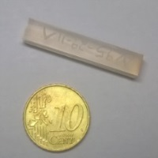
Scope of the R&D activity
Basic principle:
Interface with other XFEL R&D or operation activities: XFEL-RP-214 Basic CW gun Research → photocathodes with high quantum efficiency in the green wavelength range

Slide 5
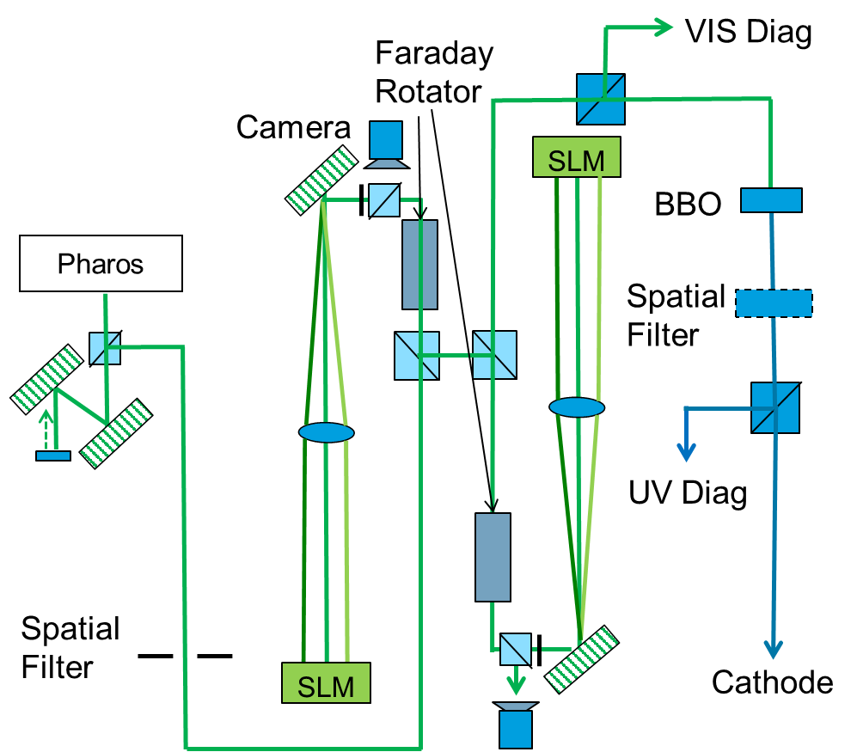
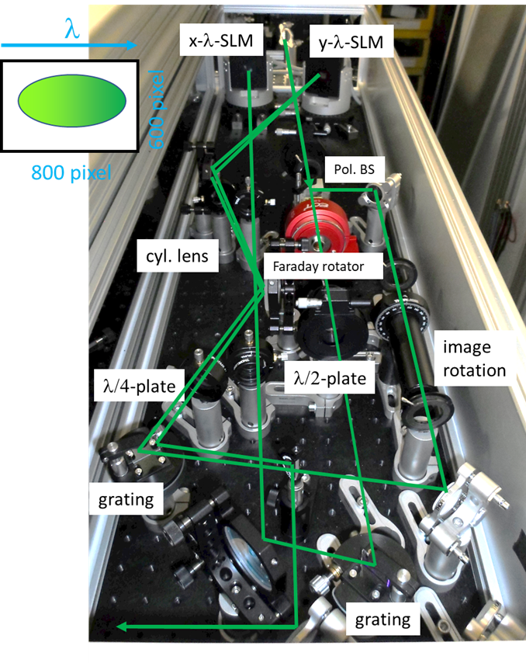
Achievements in the past year
Or none with green photocathodes ☺
Realizing a setup for pulse shaping in the green wavelength: only one SHG frequency conversion step necessary! Currently: 2 SHG conversions needed which has major impact on maintaining laser shape

Slide 6
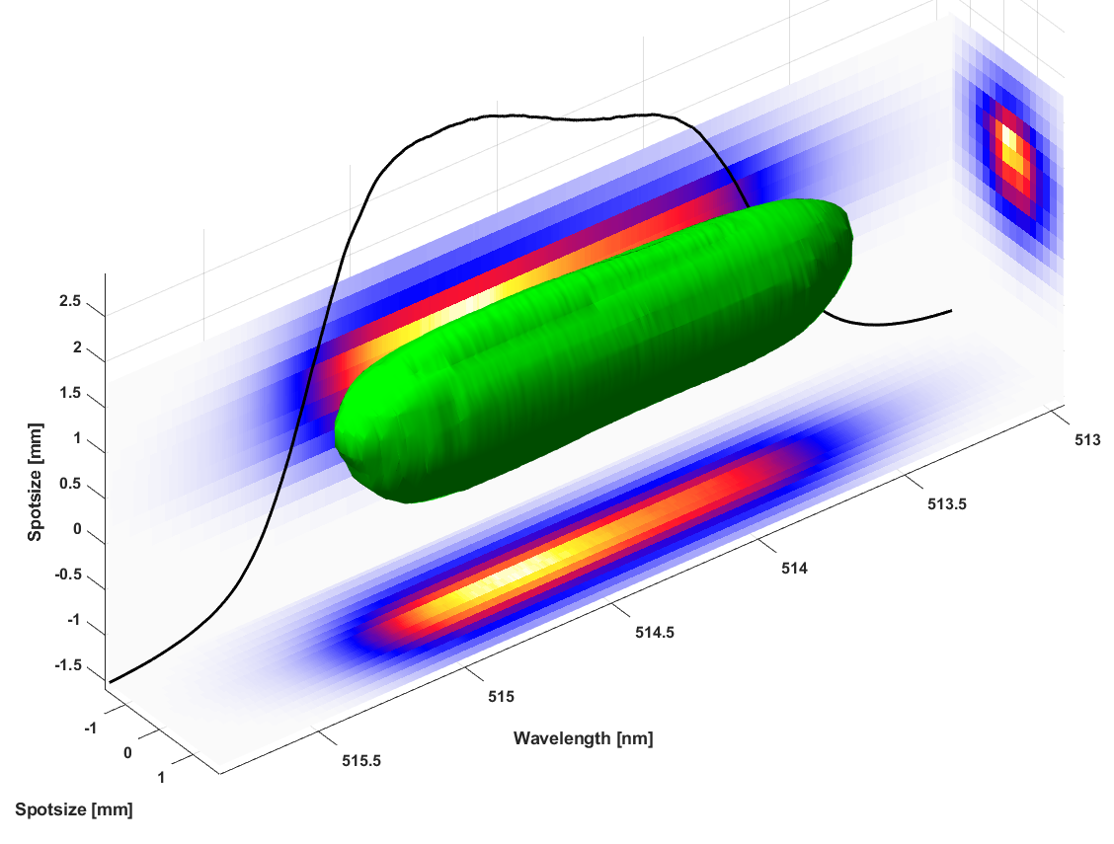
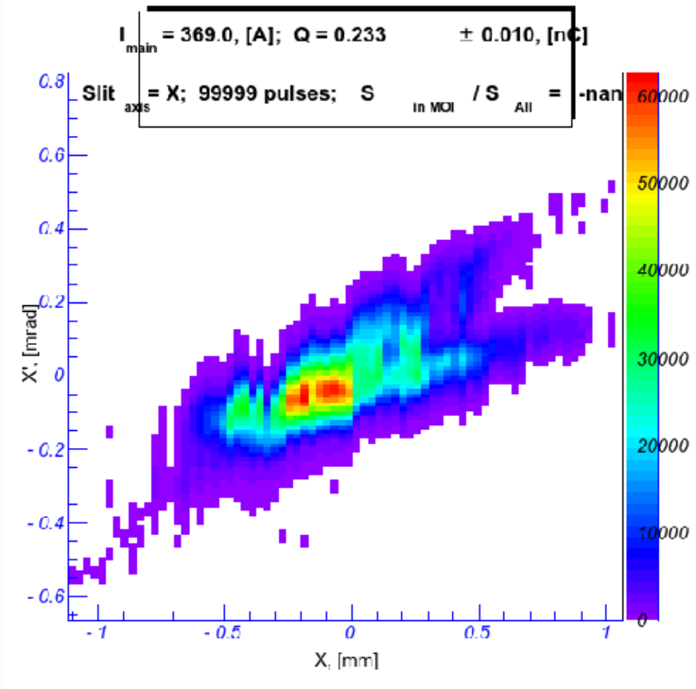
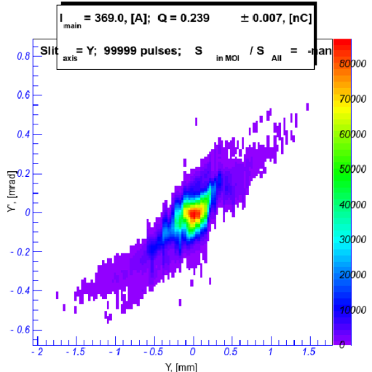
Achievements in the past year
First 3D ellipsoidal shaping test at 515nm wavelength
Beam transport of shaped pulses in UV: emittance measurements of 1D shaped pulses (longitudinal flattop)
250 pC, BSA 1.0 mm,
XYemit= 0.713 +/-
0.023 mm mrad
not optimized
Ongoing work:
Improve beamprofile after shaping
UV conversion and characterization

Slide 7
Deviations from plan
Could not be reached: Report on comparison of UV ellipsoidal shaping with SLM and VBG techniques
State of the art is not at a point where production of needed high quality VBGs with well-defined shape and edge sharpness is possible → No useful comparison possible
Example of characterization:
Consequences: not so severe – mainly work with SLMs and approaching cylinder symmetry in electron bunches: aperture (set diameter of laser pulse); 45° SLMs; space charge, especially with high bunch charge

Slide 8
Timeline of this R&D activity
Proposed Date | Milestone Description | Updated Date
Q2/2022 | Report on comparison of UV ellipsoidal shaping with SLM and VBG techniques | Experiments: Q3/2021 Analysis: Q2/2022; Postponed
Q3/2022 (shifted from 2021) | Flat-top laser pulse generated in green from PHAROS system and characterized on laser table Extension 1: Characterize UV conversion of shaped pulses Extension 2: 250 pC emittance studies with Flat-top pulses (and comparison to Gaussian pulses) | Done: Q4/2022 Q4/2022 Ongoing: Q1/2023
Q2/2022 | First ellipsoidal laser pulse shaping in the green wavelength range on the laser table | Done: Q3/2022
Q4/2022 | Laser pulse transport system is extended to also transport green ellipsoidal laser pulses to photo cathode with corresponding imaging technique preserving the pulse shape | Done: Q3/2022
Q2/2023 | First beam characterization and emission study for ellipsoidal laser pulses in the green wavelength range at reduced gun gradients | postponed to next green cathode campaign
Q4/2023 | Further improvement of ellipsoidal shaping technique by modulating the 3D density distribution
Q2/2024 | Improvements in laser shaping system to allow 24/7 operation at a user facility (this includes the green wavelength range)
Q4/2024 | Technology for optimized ellipsoidal laser shaping at UV and green wavelength is ready to be copied at European XFEL user facility

Slide 9
Risks to R&D Project
PITZ does not have a dedicated laser development lab
During accelerator working periods (typically 2 weeks run + 2 weeks shutdown) the access to the laser system used for pulse shaping as severely limited
Also: all laser experts are also shift leaders, spending time on preparation of shift work etc.
Covid-19 restrictions caused delays which might not be made up for until the end of the project
Major changes in the PITZ laser lab in 2023
The aging MBI laser system will be removed
The pulse shaper setup will be relocated
A new photo cathode laser system (NEPAL-P) will be installed
→ work on pulse shaping will be interrupted for several months

Slide 10
Outlook / Summary
Planned work for 2023:
First beam characterization and emission study for ellipsoidal laser pulses in the green wavelength range at reduced gun gradients
This depends on the work progress at INFN Milano on green cathodes
Further improvement of ellipsoidal shaping technique by modulating the 3D density distribution
This could be delayed due to difficulties during laser lab reorganization
Publications in 2022:
C. Koschitzki, Chirped Pulse Laser Shaping for High Brightness Photoinjectors, 40th International Free Electron Laser Conference, FEL2022, Trieste, Italy, 21 Aug 2022 - 26 Aug 2022 WEAO4 (2022)

