Slide 1
XFEL Accelerator R&D Status CW LLRF Development
Julien Branlard, Annika Eichler
3.5.2023

Slide 2
Scope of the R&D activity
Summary
Improved microphonics detection and detuning control
Development of SRF Gun LLRF
LLRF and CW tests of the 3rd harmonic cryomodule
Modernization of the LLRF system detection chain
LLRF preparation for a CW injector towards a CDR
Interface
Test stand schedule (AMTF, CMTB, Ts4i)
Deliverables
Demonstration of detuning control in CW
LLRF for SRF gun test stand (Ts4i)
LLRF system for 3.9 GHz CW + recommendations for 3.9 GHz module in CW operation
Prototype of next generation ADCs
LLRF CDR (partial) for a CW injector
Very good results, keep working on topic, tests at CMTB/AMTF
Design phase 80%, first components ordered
CW LLRF installation complete, waiting for test next month
Prototyping phase done, now discussion with industrial partner
All of the above will contribute to CDR
Some deliverables are linked to external schedule

Slide 3
Achievements in the past year
Recruitment
We hired 1x PhD and 1x Master student in 2021 (as planned in the proposal)
However, the PhD and the master student decided to stop last year (2022) and pursue other career opportunities
The work was finalized with a conference proceeding + a firmware block (for piezo control safety in CW)
Since then, we have hired a new Master student and have found a new candidate to take over the PhD work (however, this would be a postdoc)
W.H. Syed, A. Bellandi, J. Branlard, and A. Eichler, “Identification of the Mechanical Dynamics of the Superconducting Radio-Frequency Cavities for the European XFEL CW Upgrade”, in Proc. LINAC'22, Liverpool, UK, Aug.-Sep. 2022, pp. 76-79. doi:10.18429/JACoW-LINAC2022-MOPOPA02

Slide 4
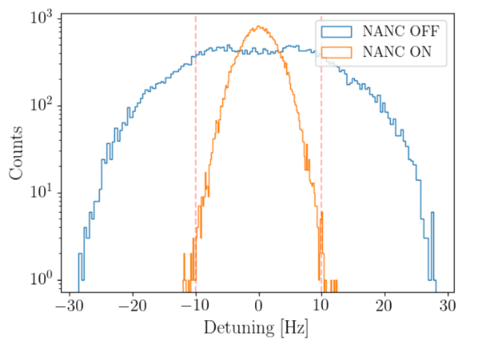
Achievements in the past year
Microphonics suppression
One of the main challenges in CW is resonance control
One MSK member spent 3 months at SLAC (LCLS-II commissioning support)
Developed a narrow-bandwidth active noise cancellation (NANC)
This new functionality was tested and integrated in the LCLS-II firmware
Provides a factor 3 reduction in microphonics
Without this feature, some cavities would not meet the +/- 10 Hz stability specs
Block is now part of LLRF system at DESY (tests at CMTB)
Results presented at Linac 2022
We keep further developing this topic
A. Bellandi et al., “Narrow Bandwidth Active Noise Control for Microphonics Rejection in Superconducting Cavities at LCLS-II”, in Proc. LINAC'22, Liverpool, UK, Aug.-Sep. 2022, pp. 785-788. doi:10.18429/JACoW-LINAC2022-THPOPA21
“Feedforward resonance control for the European X-ray Free Electron Laser High Duty Cycle upgrade”, A. Bellandi et al. Frontiers in Physics, Special Topic Global Developments Towards Continuous-Wave Free-Electron Lasers, 2023

Slide 5
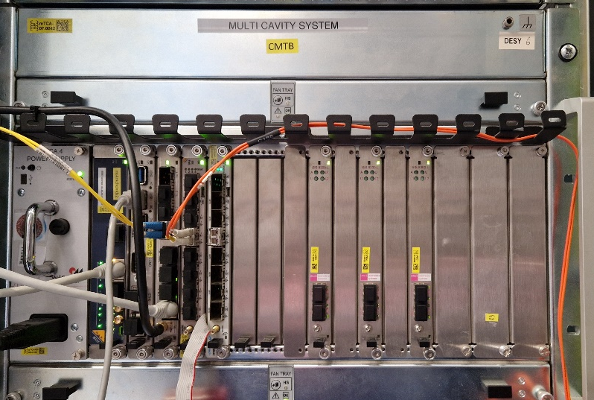
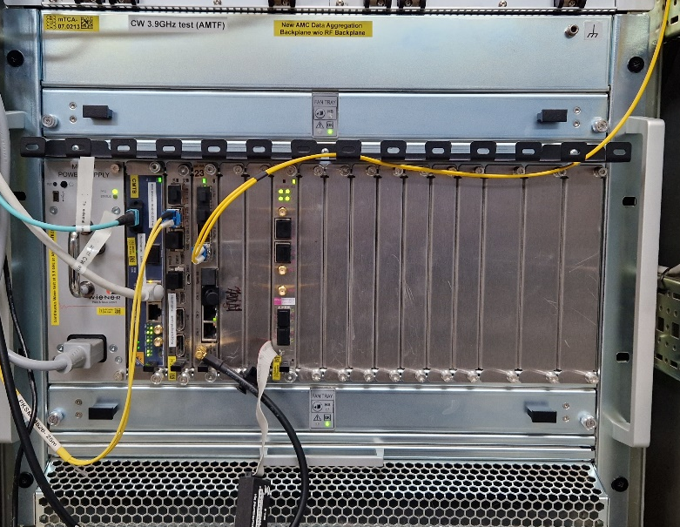
Achievements in the past year
Other outcomes of the collaboration with SLAC
Further development of diagnostics for CW machines
Development of new LLRF systems for CW operation
Single cavity field control (with SSA at AMTF)
Multiple cavity field control (with IOT at CMTB)
G. Martino et al., “Anomaly Detection Based Quench Detection System for CW Operation of SRF Cavities”, in Proc. LINAC'22, Liverpool, UK, Aug.-Sep. 2022, pp. 775-777. doi:10.18429/JACoW-LINAC2022-THPOPA15

Slide 6
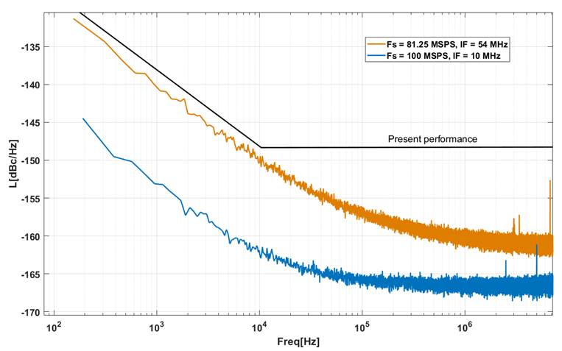
Achievements in the past year
R&D towards next generation digitizers
More accurate ADCs
more accurate field control
more accurate beam control
goal is factor 10
Work on-going
Conceptual design phase
Measurement and prototyping
Discussion with vendor
Find a suitable vendor for future licensed production

Slide 7
Deviations from plan
Hiring difficulty
Had to restart hiring process → delayed work
~ 0.5 - 1 year deviation
Delayed test stand schedule
CMTB delayed (damaged IOT until Spring 2023)
AMTF39 delayed (SSA delivery + TUEV approval delayed until Spring 2023)
Ts4i specifications not clarified until Spring 2023
~ 1 year deviation
Geopolitical situation
COVID19, war in Ukraine → increased delivery times and costs or obsolescence from components

Slide 8
Timeline of this R&D activity
Proposed Date | Milestone Description | Updated Date
Q1/2021 | M2021.1 Master student hired to develop a variable gain resonance controller to recover from monotonic instabilities | Done
Q2/2021 | M2021.2: Piezo controller developed to provide active wideband microphonics cancelation in CW. Demonstration at CMTB | Done
Q4/2022 | M2021.3: PhD student hired to support algorithm development | Q4/2022 (need new hire)
Q3/2021 | M2021.4: LLRF system adapted for CW 3rd harmonic (3.9 GHz) tests at AMTF | Done
Q4/2021 | M2021.5: Model based detuning estimator and quench detection algorithm for CW implemented in FPGA | Done
Q4/2021 | M2021.6: Master student hired to support with CMTB and AMTF CW operations and FPGA development | Done
Q4/2022 | M2022.1: Master student hired to investigate and propose modifications towards data gathering and big-data analysis in CW operation | Work started (need new hire)
Q4/2022 | M2022.2: Evaluation of the current 3rd harmonic cryomodule and recommendation for CW operations regarding the need of piezo | Q4/2023 (CW 3.9 GHz tests postponed)
Q2/2022 | M2022.3: Specifications for the LLRF system of CW gun, including software adaption for on-resonance ramp up, fast protection, resonance control | Work started
Q2/2023 | M2022.4: Preparation and commissioning of the LLRF system for CW gun (depends on gun availability) | Q4/2023 (SRF gun schedule postponed)
Q1/2023 | M2023.1: Evaluation of new generation of ADCs and FPGA boards for CW controller algorithms. Recommendation for HW upgrade at EuXFEL. | Work started
Q2/2023 | M2023.2: Preparation of LLRF system demonstrator for a EuXFEL CW injector (no CW injector available) | Q4/2023 will be an architecture proposal
Q3/2023 | M2023.3: Preparation of a LLRF system demonstrator for CW operations of L3 cryomodules (depends on CMTB availability) | Q4/2023 update postponed (CMTB delay)
Q4/2023 | M2022.4: CW injector operations, results and conclusions regarding the upgrade

Slide 9
Risks to R&D Project
The biggest bottleneck is human resource to perform the R&D work
Finding the right candidate(s)
Training / advising them
But the R&D roadmap is clear
All deliverables will not be finished in time at the end of the 3 year R&D
Due to the delay reasons mentioned earlier
The risk was known at the time of writing the proposal
The deliverables might only be partially fulfilled BUT can be fulfilled within additional time
We plan to apply for a follow-up proposal

Slide 10
Outlook / Summary
There are currently no show stopper
The road map is well defined
Preliminary results are promising
We expect several “key“ tests results this year
Demonstrate CW operation in high gradient, narrow bandwidth (high Q_{L} ) at CMTB → deliverable
Outcome of CW tests of 3.9 GHz cryomodule → deliverable
Results of external QL tuning mechanism (together with MHF) → “game-changer” for CW XFEL
Do you plan a follow-up proposal ? YES
New hire joining this year
Key results coming in this year
Momentum for CW-XFEL has picked-up
Don’t stop now!!!

Slide 11
List of publications
“Identification of the Mechanical Dynamics of the Superconducting Radio-Frequency Cavities for the European XFEL CW Upgrade”, W.H. Syed, A. Bellandi, J. Branlard, and A. Eichler, in Proc. LINAC'22, Liverpool, UK, Aug.-Sep. 2022, pp. 76-79.
“Narrow Bandwidth Active Noise Control for Microphonics Rejection in Superconducting Cavities at LCLS-II”, A. Bellandi et al., in Proc. LINAC'22, Liverpool, UK, Aug.-Sep. 2022, pp. 785-788.
“Feedforward resonance control for the European X-ray Free Electron Laser High Duty Cycle upgrade”, A. Bellandi et al. Frontiers in Physics, Special Topic Global Developments Towards Continuous-Wave Free-Electron Lasers, 2023
“Anomaly Detection Based Quench Detection System for CW Operation of SRF Cavities”, G. Martino et al., in Proc. LINAC'22, Liverpool, UK, Aug.-Sep. 2022, pp. 775-777.
“A MTCA.4 based resonance controller for superconducting cavities”, A. Bellandi, et al. in Proc. IPAC’23, Venice, Italy, May 2023.

