Slide 1
XFEL Accelerator R&D Final Report Intra-Bunch Train Longitudinal Feedback (IBTLF → L-IBFB)
Marie Kristin Czwalinna
03.05.2023
PIs : H.Schlarb, B.Lautenschlager

Slide 2
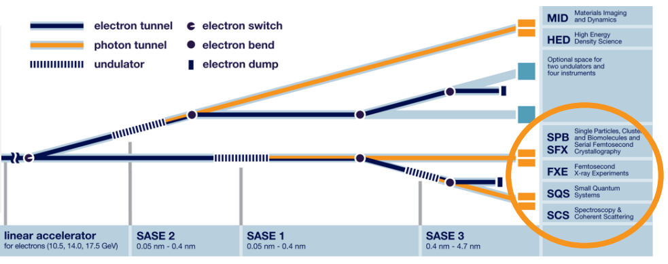
Scope of the R&D activity
Goal of scientific work Achieve ≤10 fs rms arrival time and ≤ 2% rms peak current stability at BC2
interfaces with other operation activities
OP-215 LLRF systems,
OP-325 optical synchronization,
OP-365 special diagnostics,
OP-430 feedbacks
valuable exchange and large progress stability task force activities (2021-2022),
XPD, LAS, FXE, SPB, SQS/SCS, ..
(2021)

Slide 3
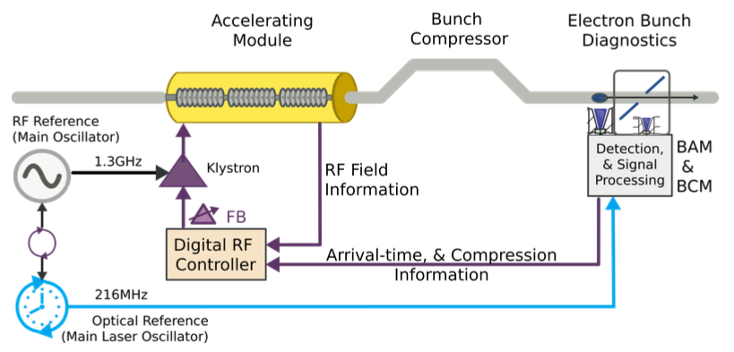
Achievements of the entire R&D project (1)
recruitment of Post-Docs
(2018) control theory,
(2019) firmware development
(2020…2021) Implementation & tests of L-IBFB
adapted to cope with changed requirements
beam regions concept, Q3/2022
Independent
arrival time monitoring,

Slide 4
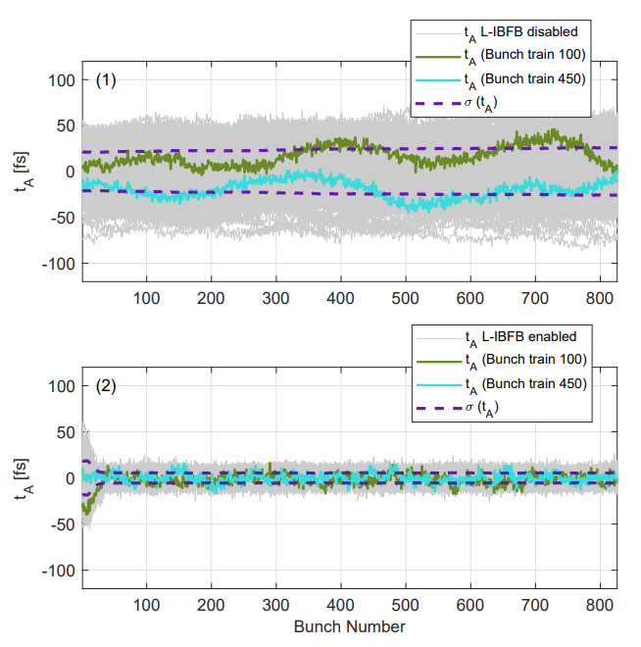
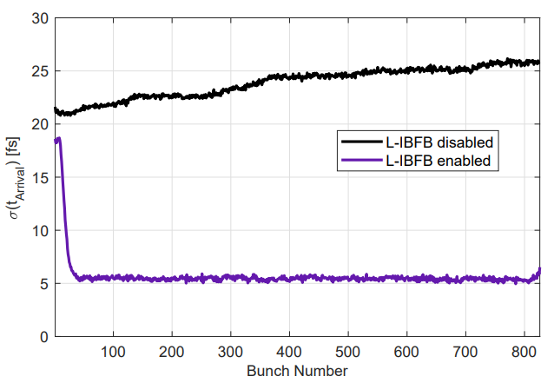
Achievements of the entire R&D project (2)
New feedback structure L-IBFB in operation at EuXFEL (2022)
main goal reached
L-IBFB off
@250pC bunch charge
L-IBFB on
After adaptation of intra-train feedback, → bunch timing jitter < 6fs rms

Slide 5
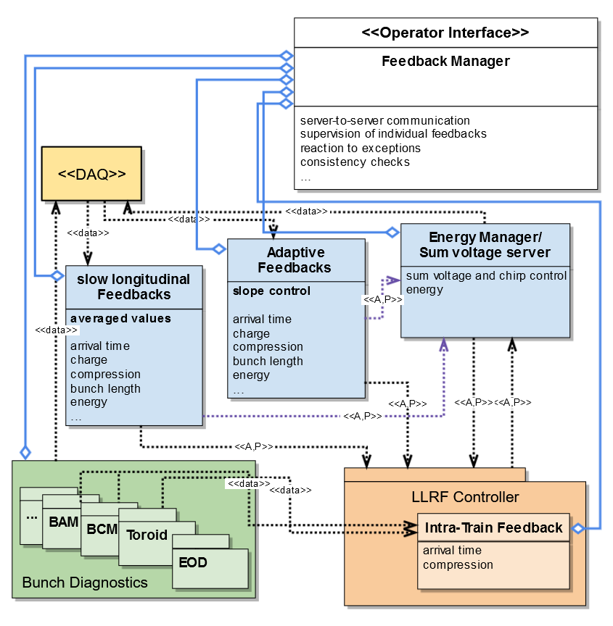
Achievements of the entire R&D project (3)
Concept for global feedback architecture,
Inter-operability,
Robustness,
Connect several architectural layers
Operator interface
High-level layer
Middle layer
Frontend servers
Firmware/hardware
Work in progress,
(2022) started implementation & tests

Slide 6
Deviations from plan
Implementation of fast arrival time feedback on photo-injector laser
in this form not necessary → slow feedback
Establish new feedback architecture → global feedback manager
High complexity
Effort in time and software development
Requires continuation
Direct (low-latency) intercommunication in between RF stations for L-IBFB
Re-evaluate if / how feasible.

Slide 7
Timeline of this R&D activity
Proposed Date | Milestone Description | Updated Date
Q3/2018 | Hire control system expert (Postdoc) | Q4/2018
Q3/2019 | Hire firmware expert (Postdoc) | Q3/2019
… | …
Q3/2021 | Implementation of fast arrival time feedback on photo-injector laser (if the laser permits) | skipped
Q3/2021 | Establish new feedback architecture interlinking L-IBFB with slow L-FB | work in progress
Q2/2022 | New feedback (L-IBFB) structure implemented and in operation at EuXFEL | Q4/2022

Slide 8
Risks to R&D Project
risks associated with our R&D project
Observation of unexpected effects,
Underestimation of complexity

Slide 9
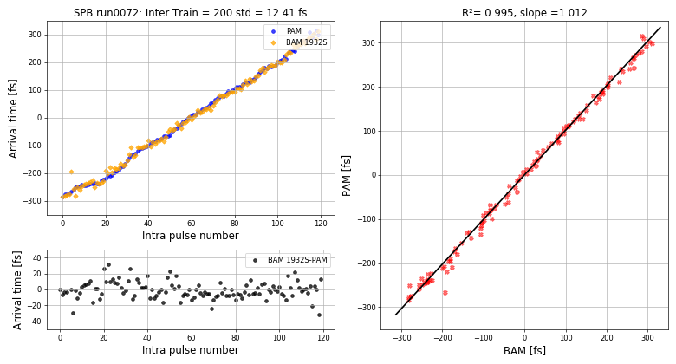
Outlook / Summary (1)
Intra-pulse train correlation,
with timing slope
photon pulse vs. electron bunch
achievements of the entire R&D project
≤10 fs rms electron bunch arrival time stability
@250pC and @100pC
Residual jitter and drift contributions under investigation
provided procedure for operators to setup the L-IBFB
agreed with MXL → L-IBFB in standard operation
PAM
BAM
BAM – PAM
Difference signal (fs)
$σ_{residual}$= 12.4fs
(during low charge operation, @100pC)

Slide 10
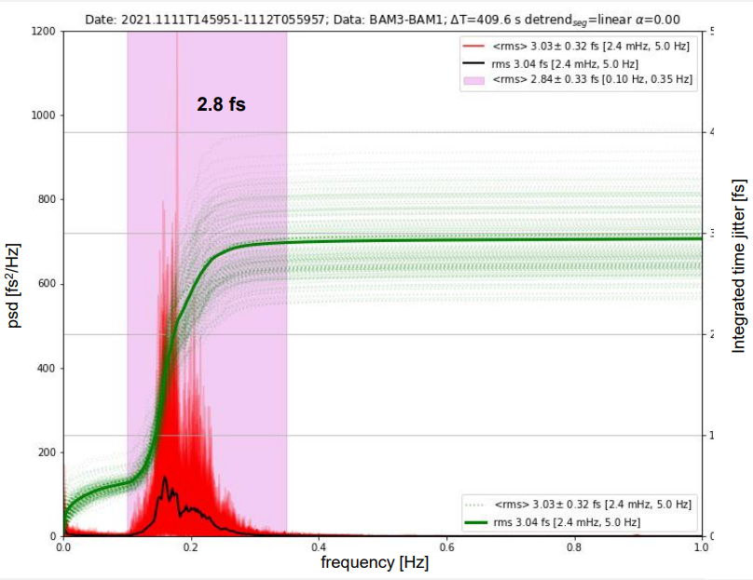
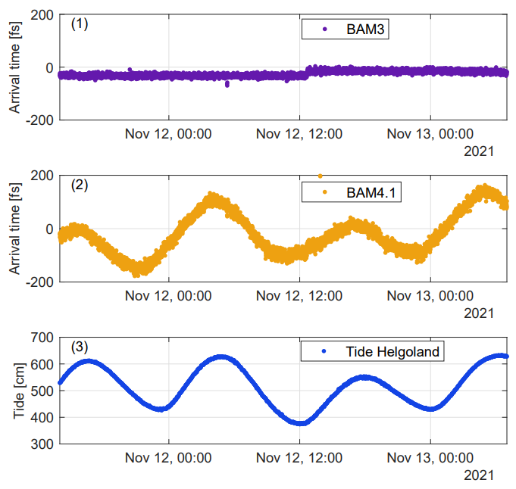
Outlook / Summary (2)
follow-up activities
continuation of activities within OP-365
RnD projects on-going
to predict & correct effect from ground motions
Drift contribution : Tidal waves (+/- 300fs over 12 hour period)
Significant contribution : Ocean waves
At ca. 0.2Hz (~3fs rms over seconds)

Slide 11
Outlook / Summary (3)
List of related publications
conference
IPAC 2021 Invited Talk: Beam arrival stability at European XFEL, M.K. Czwalinna et al, JACoW-IPAC2021-THXB02
FEL 2022 Poster: Achievements And Challenges For Sub-10 fs Long-Term Arrival Time Stability At Large-Scale SASE FEL Facilities, B. Lautenschlager et al
peer-reviewed
Optica Vol. 9 Issue 4 pp. 429-430 (2022), D. Rivas, M.Meyer, et al., High-temporal-resolution X-ray spectroscopy with free-electron and optical lasers, doi.org/10.1364/OPTICA.454920
Joint paper DESY/EuXFEL in preparation (2023)

