Slide 1
XFEL Accelerator R&D Status RP 318: Fresh Slice
Marc Guetg, Weilun Qin

Slide 2
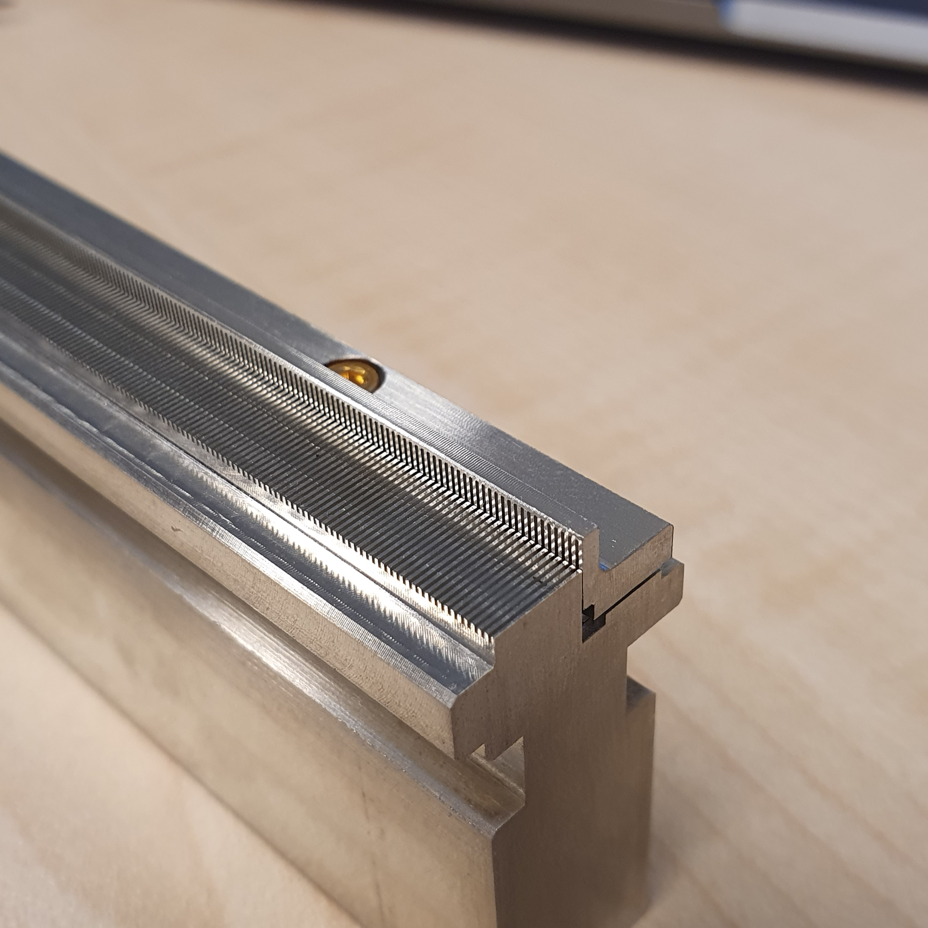
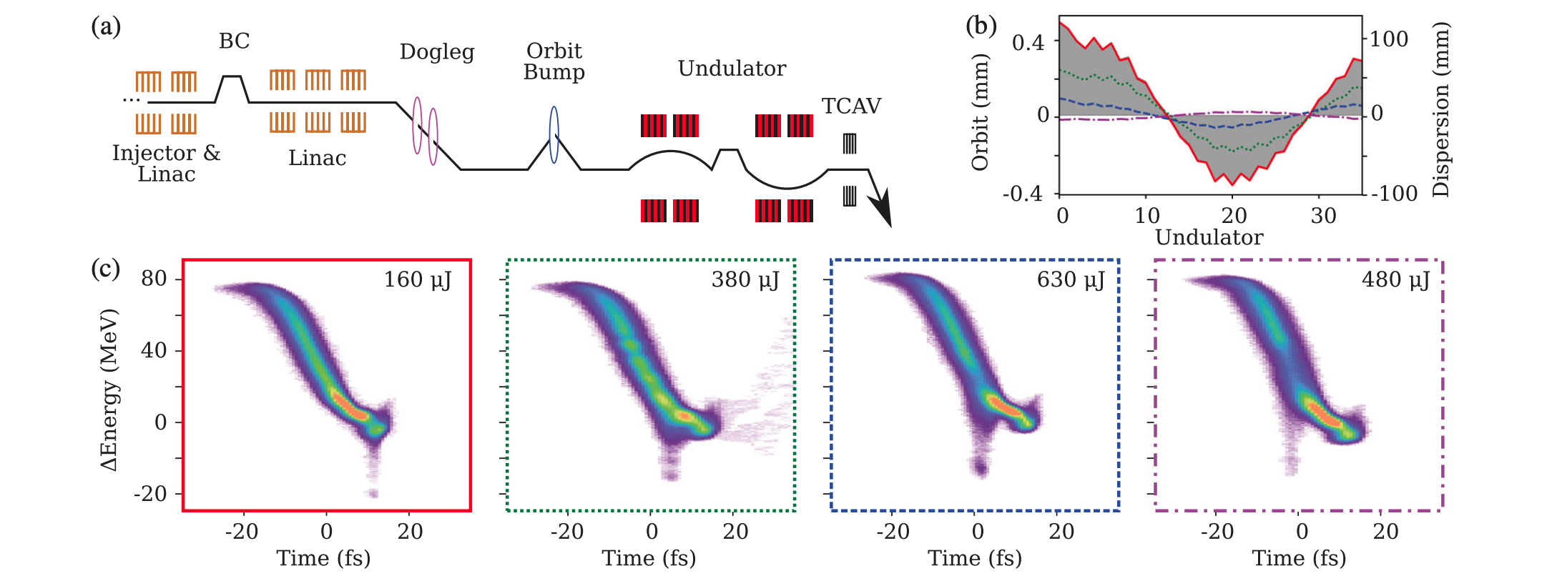
Beam Shaping Wakefield Structure
Selective lasing suppression by creation of beam tilts (wakefield structure)
Lasing window is selected by the orbit within the undulator
Kicker strength is defined by distance of the electrons to the yaw
L-shape to
Kicks in both direction
Reduce higher order modes
Deliverable: Short pulses for SA1/3
Transparent for other beamlines
Allow two colors
Interfaces
MCS, MVS, MEA, MCP
SA1@9keV
M. Guetg et al, Dispersion-Based Fresh-Slice Scheme for Free-Electron Lasers, 10.1103/PhysRevLett.120.264802

Slide 3
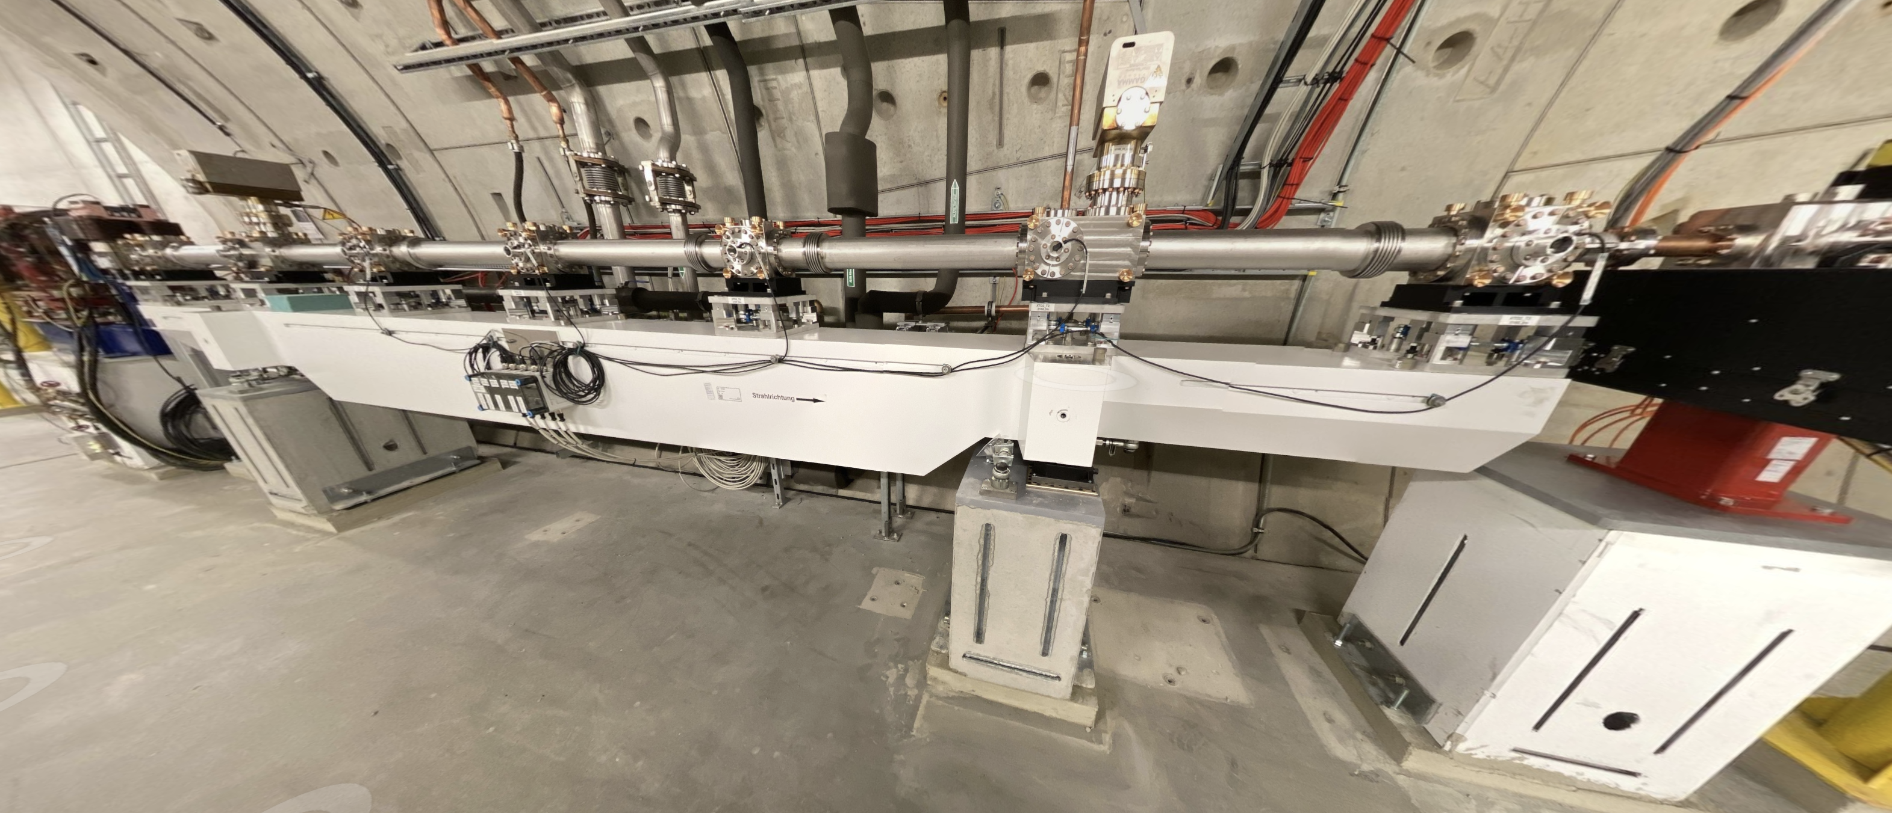
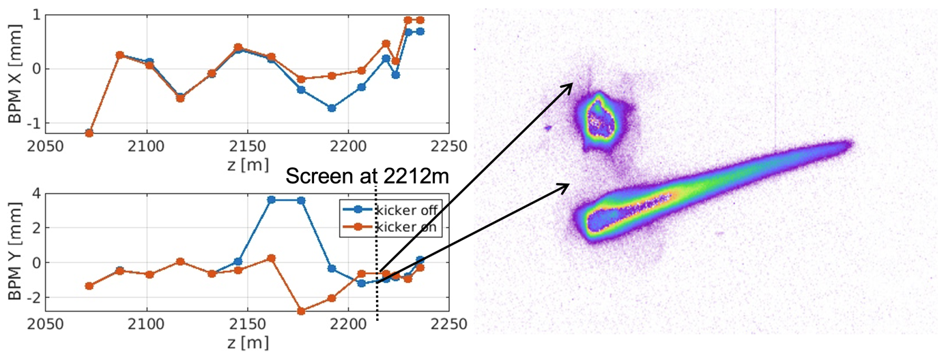
Hardware Installation in T2 Section
Corrugated structure (6 m)
Passive structure
Two additional Quadrupoles
Orbit control
Part of the optics server
Three additional KL Kickers for orbit control
Controllable over the bunch pattern

Slide 4
Alignment of the Wakefield Structure
Precise control of the orbit with respect to the corrugation is key (non-linear effect)
Beam based calibration of correctors in the area (work ongoing)
Angular alignment with respect to the corrugation
Seamless switch between the nominal and special optics
With precalculated mismatch correction

Slide 5
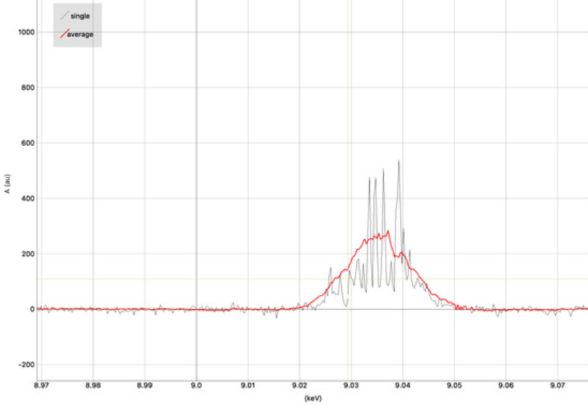
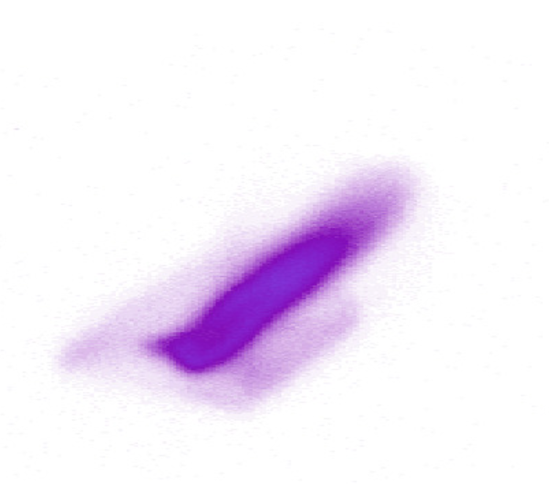
Beam streaking and FEL suppression
No direct temporal diagnostic
We assume pulse shortening from spectral analysis
720uJ, no bump
13eV FWHM B.W.
192uJ, with bump 3mm
8eV FWHM B.W.

Slide 6
Deviations from plan
Installation of the hardware was delayed by 6 months due to corona (supplier)
All Hardware was installed last winter

Slide 7
Timeline of this R&D activity
Date / Period | Milestone Description | New Date/ Period
Q3/19 | PostDoc hired | Done
Q3/20 | PostDoc started | Done
Q1/21 | Simulation framework to study machine parameters | Done
Q2/22 | Generation of two-color lasing with individual delay and color control | Done
Q4/23 | Demonstration of dechirper based fresh-slice | Adjusted
Q2/24 | Multi-stage generation of photons | Adjusted
Q2/24 | User delivery of advanced lasing modes | Adjusted
Q4/24 | Expansion towards novel schemes | Adjusted

Slide 8
Risks to R&D Project
All the required hardware is installed
We do experience higher losses in the dechirper area than expected

Slide 9
Outlook / Summary
Continue the effort to commission the wakefield structure
Further reduce the beam losses
Prepare for eventual user delivery
There will be follow-up efforts on fresh-slice for the south branch (SA2)
Those will likely be covered by the operations
Publications:
Short-range wakefields in an L-shaped corrugated structure, Weilun Qin, Martin Dohlus and Igor Zagorodnov, submitted
CORRUGATED STRUCTURE SYSTEM FOR FRESH-SLICE APPLICATIONS AT THE EUROPEAN XFEL, Weilun Qin, Marc Guetg, Winfried Decking, Erion Gjonaj, Nina Golubeva, Junjie Guo , Shan Liu, Torsten Wohlenberg, Igor Zagorodnov, FEL 2022

