Slide 1
XFEL Accelerator R&D RP 321: S2E Simulations
Marc Guetg, Gianluca Geloni, Christian Grech, Farzad Jafarinia

Slide 2
Scope of S2E Simulations in a nutshell
Parasitic characterization of the photon beam is important for both the machine and the users
Intensity XGM, parasitic
Spectrum HIREX, semi-parasitic
Pointing Screen, destructive
Beam size (source location) Screens, destructive
Deliverable: Virtual Diagnostic to predict pointing and beam size by relying on parasitically measurable properties
BPMs
XGM
Interfaces
MXL (Host)
MCS
FPH
SPB/SFX

Slide 3
Achievements in the past year: Automatization of Data Pipeline
Taskomat sequence (about 15’)
Start Karaboo DAQ (work in progress)
Start DOOCS DAQ
Insert photon screens and adjust filter settings
Measure different settings
Cleanup
Automated data pipeline for file and feature extraction
Pipeline is utilized for other projects
Gridsearch is partly automatized

Slide 4
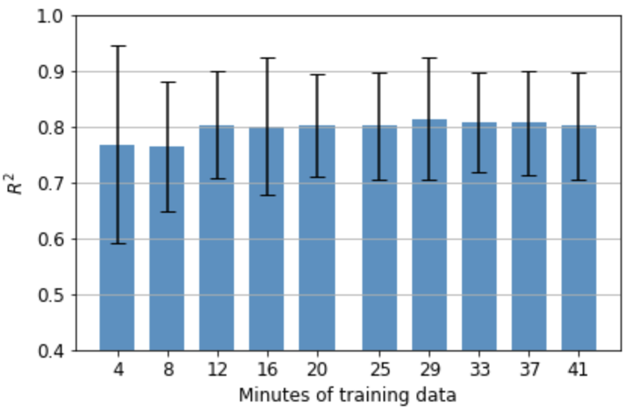
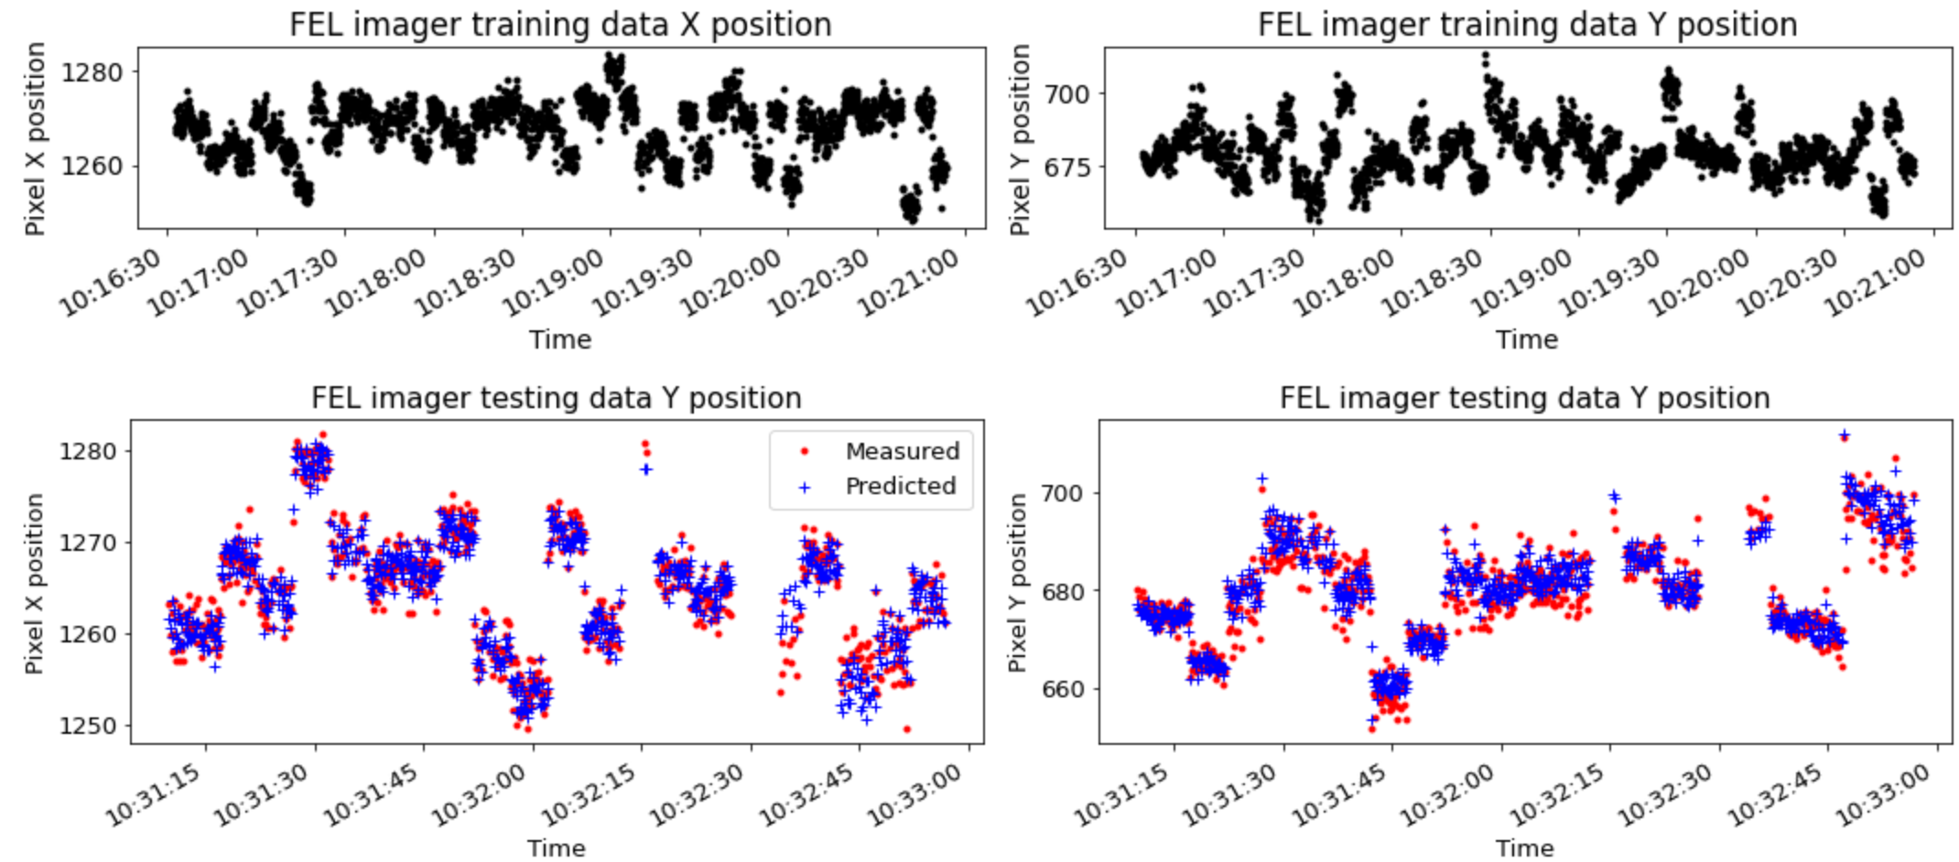
Achievements in the past year: Prediction
First predictions show good results within the same run
both training and test distinct but from the same day
Finetuning training data collection (work in progress)
Started exploration of prediction across runs (work in progress)

Slide 5
Deviations from plan
A combined effort to gather both electron and photon data was undertaken in collaboration with SPB/SFX
Transfer of experimental data had significant lag
Personal change in SPB/SFX lead to shift of priorities in the group
Efforts to be more self-sustaining were undertaken resulting in data collection, storage and post-processing now being performed by resources supplied under the umbrella of the virtual FEL R&D framework. Modeling of the photon beam transport will not be within the scope anymore (was expected to be handled by SPB/SFX personal)
Reflects well on our remodeled data acquisition strategy (lots of small acquisitions vs one large exploration)

Slide 6
Timeline of this R&D activity
Date / Period | Milestone Description | New Date/ Period
Q2/2021 | Both postdocs: hired and onboarded. Experience shows that the ML might require more time to be hired. Phys: learning simulation tools in MXL/s2e/FPH/SPB/SFX ML: learning their way around Doocs/Karaboo/IPC | Done
Q4/2021 | Phys: First ensembles of pulses generated. Initial statistical characteristics concluded. First large-scale simulations underway. ML: Automate a way to retrieve machine information from both Karabo and Doocs for storage and further processing. | Done
Q3/2022 | Successful passing of data between all phases of the Start-to-End simulation, First paper draft(s). First prototypes of virtual diagnostics tools. Start categorizing and training surrogate models, take further input from Phys to improve upon this. | Adjusted and done
Q1/2023 | Fully automatize the data collection required for ML | Adjusted
Q3/2023 | Create a prediction model which of the photon beam pointing which does not require a retraining each week for a standard operation setting | Adjusted
Q1/2024 | Have a fully working virtual diagnostic tool which can be utilized in daily operation. | Adjusted
Q2/2024 | Further explore alternative virtual diagnostic possibilities | Adjusted

Slide 7
Risks to R&D Project
Major risks were averted by being more self sustainable
We still on systems maintained by other groups
Diagnostics
DAQ (Karaboo & Doocs)
Network storage

Slide 8
Publications
Grech, C. ; Guetg, M. ; Geloni, G. Machine Learning Applied for the Calibration of the Hard X-Ray Single-Shot Spectrometer at the European XFEL Proceedings of the 13th International Particle Accelerator Conference, IPAC2022, Bangkok, Thailand, 13th International Particle Accelerator Conference, IPAC'22, Bangkok, Thailand, 12 Jun 2022 - 17 Jun 2022
Grech, C. ; Geloni, G. ; Guetg, M. ; Boesenberg, U. ; Kujala, N. ; Makita, M. ; Serkez, S. , Crystal-Based Absolute Photon Energy Calibration Methods for Hard X-Ray Free-electron Lasers, submitted to Journal of Synchrotron Radiation (Mar 2023)
Grech, C. ; Geloni, G. ; Guetg, M., Computer vision approaches for the absolute energy calibration of Bragg crystal setups, SPIE Optics + Optoelectronics, Prague, Czech Republic, 23 Apr 2023 - 28 Apr 2023
Grech, C. ; Jafarinia, F. ; Guetg, M.; Geloni, G; Guest, T, Virtual Photon Pulse Characterisation using Machine Learning methods International Particle Accelerator Conference, Venice, Italy, 7 May 2023 - 12 May 2023
F. Jafarinia, C. Grech, M. Guetg, G. A. Geloni, "SIMULATION STUDY ON A VIRTUAL DIAGNOSTICS CONCEPT FOR X-RAY PULSE CHARACTERISATION", in Proc. IPAC’23, Venice, Italy, May 2023.

Slide 9
Outlook
Fine tune and expand on data pipeline
Finetune the pointing prediction
As well as beam size and shape
Predict data from a different run
Extension of this project
Submitted proposal: Mixed Longitudinal Diagnostic for EuXFEL

