Slide 1
XFEL Accelerator R&D Status Report RP-323: Cathode Mean Transverse Energy
Sven Lederer, David Pavel Juarez-Lopez
2023-05-03

Slide 2
Scope of the R&D activity
Measurement of the mean transverse momentum of emitted electrons from a photocathode
Design and fabrication of a setup allowing for this measurements
Establishing measurement and data analysis procedure

Slide 3
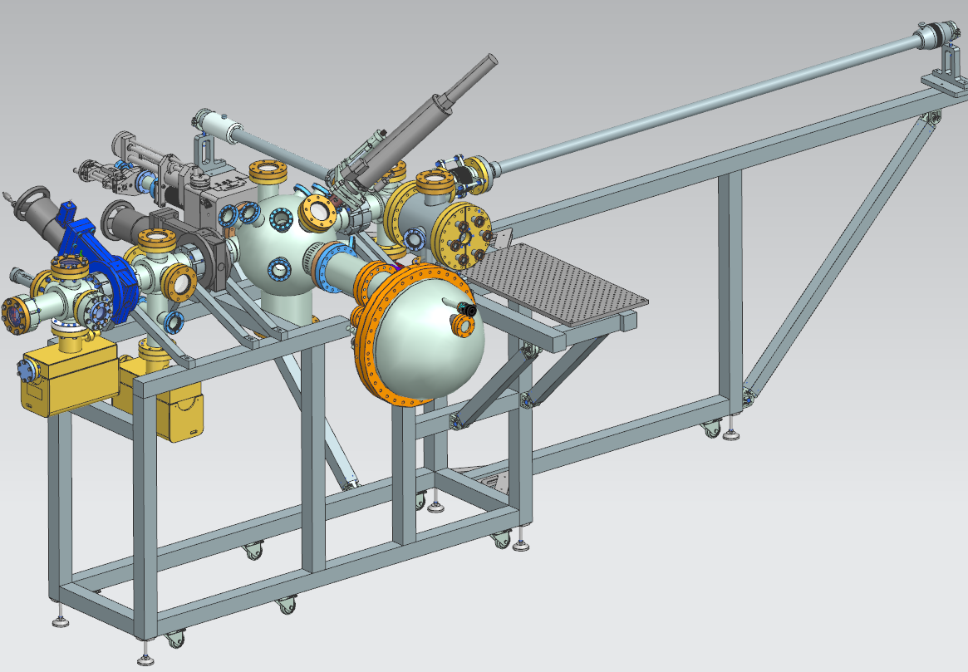
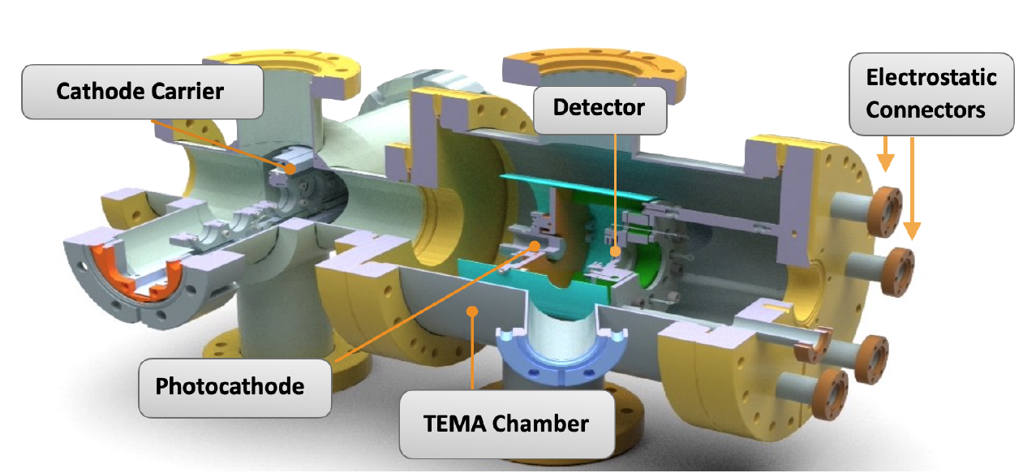
Achievements in the past year
For 2022 it was planned to finalize the design of the necessary mechanics design (vacuum system) as well as the optics design for the set-up.
The procurements of all components should be started in this year too.
Setup integrated into analysis system

Slide 4
Deviations from plan
Mechanics and optics design of the setup was finalized in 2022 but later as planned.
Procurement of all required components started could not be achieved in 2022.
Reasons for the delays are for instance insufficient feedbacks from the purchasing department in combination with delays at companies.
For instance, one of the central components of the electron detection system, is an MCP from Hamamatsu. The ordering process of this part was started in March 2022 but then actual placement of the order did happen in November 2022, only. Since the MCP design affects mechanics components too, the design and procurement of these ones are delayed too.

Slide 5
Timeline of this R&D activity
Proposed Date | Milestone Description | Updated Date
06/2022 | Mechanics and optics design of the setup finalized | Done
07/2022 | Procurement of all required components started | 04/2023
01/2023 | Installation and commissioning of the vacuum system of the setup | 08/2023
03/2023 | Installation and commissioning of the optics | Done
06/2023 | First measurement of electron distribution | 09/2023
09/2023 | System capable to routinely measure MTE | 10/2023

Slide 6
Risks to R&D Project
Broken key components like the tunable light source or the MCP might jeopardize the schedule

Slide 7
Outlook / Summary
Finalize the setup
Perform first measurements and data analysis
Publications:
IPAC2023 TUPL015

