Slide 1
XFEL Accelerator R&D Status / Final Report STERN
Francois Lemery
May 3, 2023
With support from F. Floettmann, Max Kellermeier, Martin Dohlus, Nina Golubeva, Michaela Marx, Vasili Tsakanov and Mikhail Ivanyan, Bernd Steffn, Nils Lockmann, Marie Kristin Czwalinna, Rui Pan, Winni Decking, Marc Guetg, Sergey Tomin, Shan Liu, Weilun Qin, Gianluca Geloni, Matthias Sholz, Takanori Tanikawa, Clemens Bosch, Philip Altmann, Torsten Wohlenberg, Lukas Mueller, Sven Lederer

Slide 2
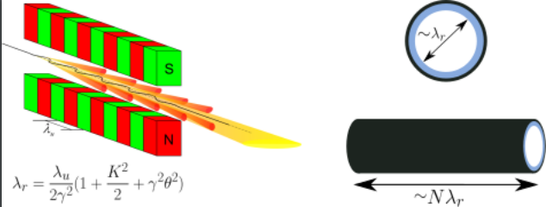
Scope of the R&D activity
Superradiant THz radiation generation (STERN) is investigating the development of a THz source for pump-probe science by using wakefields excited in dielectric-lined waveguides. The project so far has focused on the conceptual development, planning, and development of first THz wakefield structures.
Motivated in part by THz-user workshop at XFEL, from SLAC which reported Joule-level wakes excited in these waveguides and our own theoretical work.
[Zalden2018] P. Zalden et. al. Terahertz Science at European XFEL, XFEL.EU TN-2018-001-01.0 (2018).
O’shea et. Al. Nature Communications volume 7, 12763 (2016)
K. Floettmann, F. Lemery, M. Dohlus, M. Marx, V.Tsakanov and M.Ivanyan, Superradiant Cherenkov–wakefield radiation as THz source for FEL facilities. J. Synchrotron Rad. 28, 18-27 (2021).

Slide 3
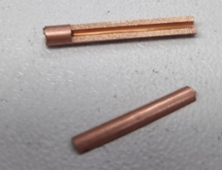
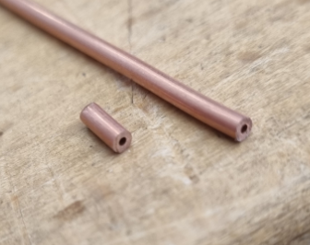
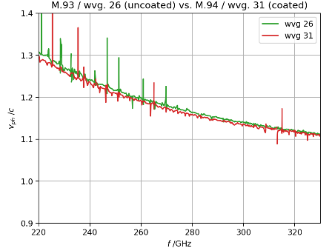
Achievements in the past year – High frequency waveguides
Conventional DLWs are conventionally fabricated by applying a copper coating fused silica waveguides; limited thicknesses of dielectrics limits the generated THz frequencies below ~ 1 THz. Going beyond, to the desired 30 THz requires very thin dielectric coatings, on the level of 1 micron.
During this conceptual phase we have developed a novel approach to produce very high frequency waveguides via atomic layer deposition (ALD) in a collaboration with Robert Zierold (CHyN). Here the layer thicknesses are on the order of Angstroms, the number of cycles determines the thickness.

Slide 4
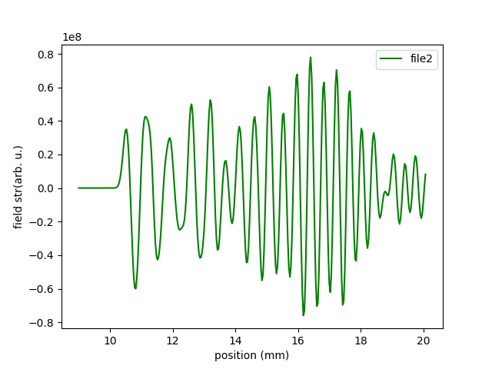
Achievements in the past year – Chirped pulses from tapered waveguides
Meeting all of the user demands (frequency and bandwidth) would be challenging with a large array of tubes.
Alternatively we are considering the development of tapered waveguides to generate chirped pulses. The generated THz could subsequently be filtered and/or compressed to enable a more continuous mode of operation to meet the various demands.
We have recently conducted first simulations with ECHO2D (Wakefield code from I. Zagorodnov) which shows that this is feasible. We have submitted a proposal to PIER SEED to support the development of these waveguides in collaboration with R. Zierold.

Slide 5
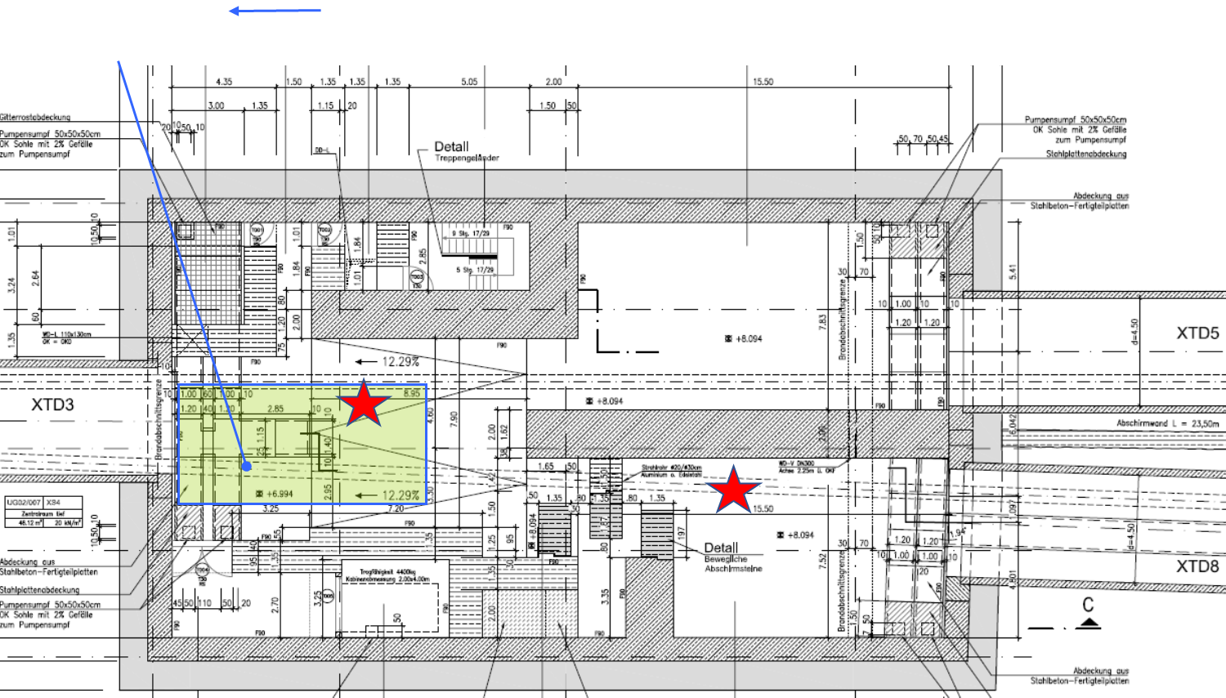
Achievements in the past year – Conceptual design
Location of STERN has changed from after SASE3 to XS4. Allowing us to transport THz to the empty and accessible XTD8 tunnel for diagnostics.
Difficulties in scaling Vlasov antennas to higher frequencies has shifted our plan to a series of holey mirrors to capture various THz frequency ranges.
A general schematic of the area is also shown with available diagnostics and infrastructure.

Slide 6
Deviations from plan
Hiring deviations
Postdoc in mind was unavailable.
The PI joined MXL.
Strong PhD candidate joining in July.
Technical note prerparation underway (STERN2)
STERN location moved to XS4, new optics simulations/design underway by Nina.

Slide 7
Timeline of this R&D activity
Proposed Date | Milestone Description | Updated Date
Q4/2020 | Hiring of Ph.D student and postdoc | 2022
Q4/2020 | Find suitable location for experimental campaign | 2022
Q4/2021 | Complete elegant studies to investigate new lattice configuration before beam dump to have appropriate beam sizes at the experimental location. | 2021
Q4/2021 | Development and simulation of TM to TM or TM to TE couplers for waveguide-to-free space. | 2021
Q4/2022 | Completion of site survey and development of note/document to be submitted to XFEL for an experimental campaign. | 2023
Q4/2022 | Complete simulation studies for waveguide coupling schemes and conduct an experimental verification with either laser-based or beam-based methods. | 2022

Slide 8
Risks to R&D Project
Large losses in waveguides
Could lead to heating and other issues. Needs to be investigated experimentally.
Intrabunch timing/scynchronization will be challenging
Xrays and THz come from different pulses. X-ray delay lines are very challenging, therefore THz delay lines will be necessary.

Slide 9
Outlook / Summary
Preparation for installation in 2025
Finalizing lattice, layout, preparing and testing waveguides, etc.
Do you plan a follow-up proposal
Yes, this is underway.
list of publications
L. Genovese et. al., Selective phase filtering of charged beams with laser-driven antiresonant hollow-core fibers. Phys. Rev. Research 5, 013096 (2023).
F. Lemery, G. Andonian, S. Doebert, G. Ha, X. Lu, J. Power and E. Wisniewski,, Drive beam sources and longitudinal shaping techniques for beam driven accelerators.JINST 17 P05036 (2022).
M. Kellermeier, F. Lemery, K. Floettmann, R. Aßmann, and W. Hillert, Self-calibration technique for characterization of integrated THz waveguides. Phys. Rev. Accel. Beams 24, 122001 (2021)
K. Floettmann, F. Lemery, M. Dohlus, M. Marx, V.Tsakanov and M.Ivanyan, Superradiant Cherenkov–wakefield radiation as THz source for FEL facilities. J. Synchrotron Rad. 28, 18-27 (2021).
F. Mayet, R. Assmann, and F. Lemery, Longitudinal phase space synthesis with tailored 3D-printable dielectric-lined waveguides. Phys. Rev. Accel. Beams 23, 121302 (2020).
F.Lemery et. al. Highly scalable multicycle THz production with a homemade periodically poled macrocrystal. Commun Phys 3, 150 (2020). https://doi.org/10.1038/s42005-020-00421-2

