Slide 1
RP-416: Seed Laser
Joint DESY FS-LA and EuXFEL LAS
I. Hartl – with the project team:
Yi Hua, Yuxuan Ma, (laser optics)
Caterina Vidoli, Angad Swiderski, (optomechanics)
Uwe Grosse-Wortmann, Henrik Tünnermann, Christian Mohr (controls)
Sebastian Schulz + team (synchronization)
Max Lederer + colleagues at EuXFEL.
May 3, 2023.

Slide 2
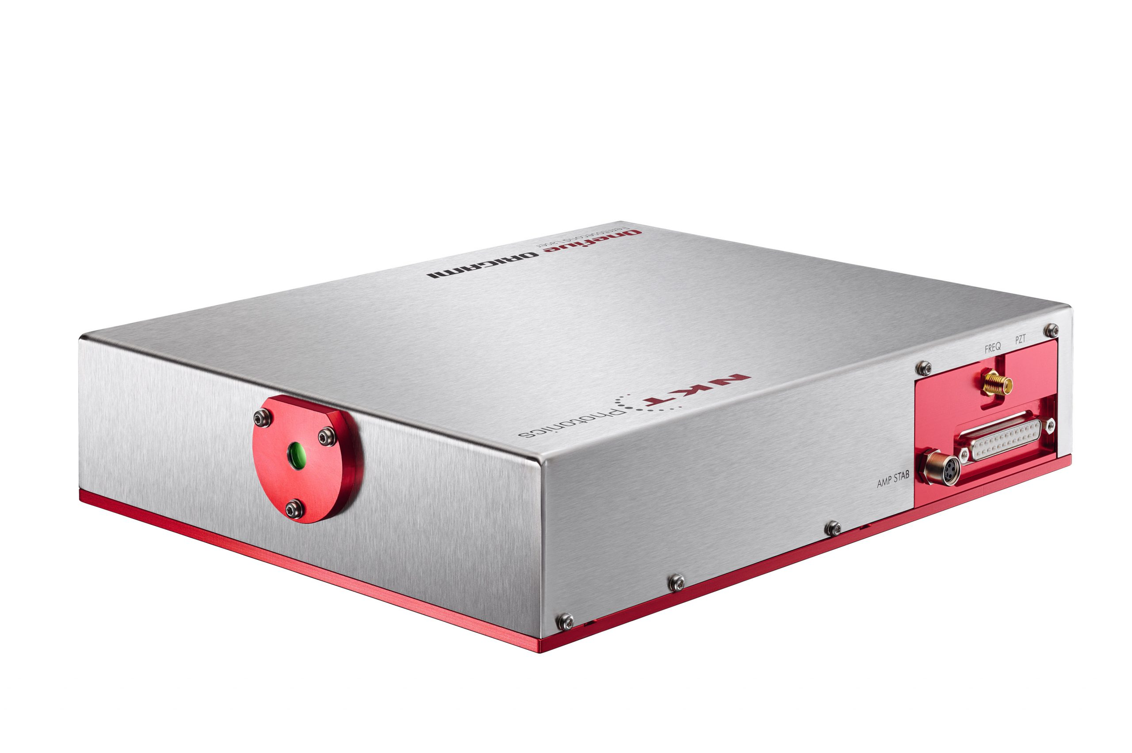


Project Background and Project Goals
All laser systems at EuXFEL and FLASH rely critically on 1µm seed laser oscillators operating at 54 MHz
~ 10 years supplier (One-Five, Switzerland) was selected – based on best timing-jitter performance
Initial high reliablity degrades in aging units. High risk not to start after power-cut. Long repair time
One-Five was purchased by NKT (Denmark). Key staff left company
→ High operational risk for DESY and EuXFEL.
Low-noise seed laser
All fiber Front end system
High Power Laser Systems (pump-probe / seeding)
Low noise
Turn key operation
Suitable laser parameters
Lack of reliability (aging)
Long repair time
Loss of critical staff at NKT
54-MHz Commercial oscillator

Slide 3
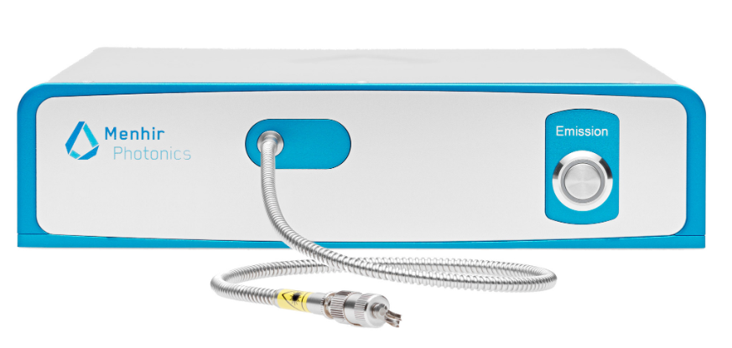
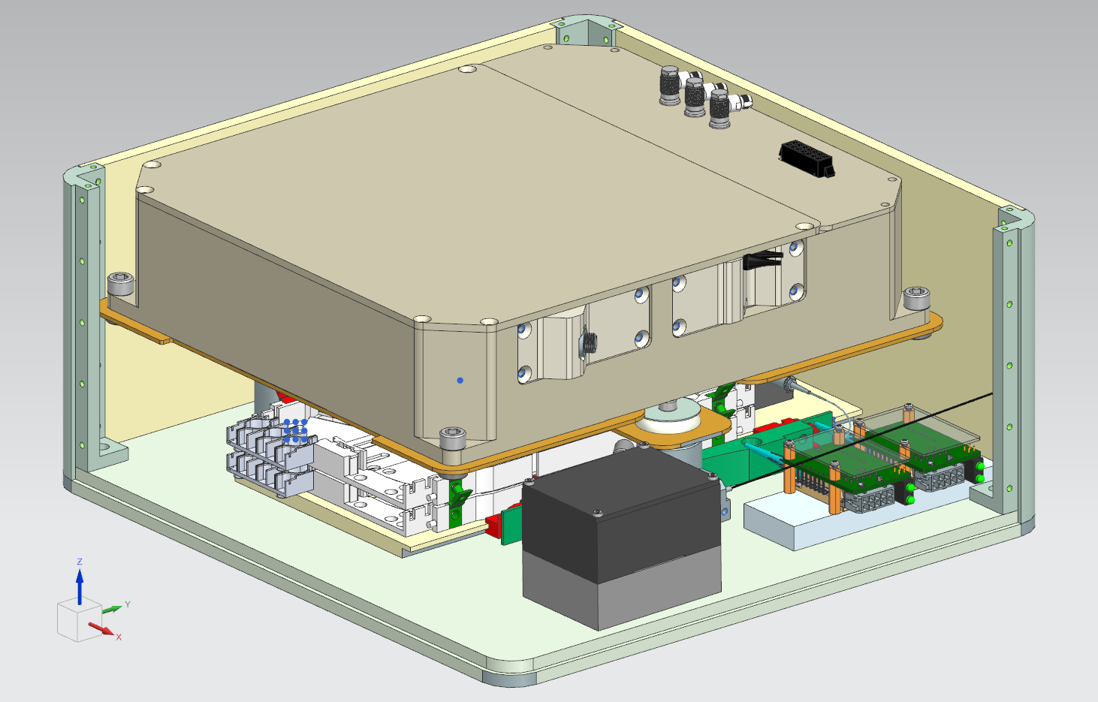
RP-416: Develop 2nd Source + Be Ready for Future Facility Upgrades
Plan A: Ultra-stable low-noise 216-MHz solid state seed oscillator at 1030 nm
(XFEL-LAS) + Pulse picker and fiber amplifier (54MHz)
216-MHz
216 MHz
54 MHz
54 MHz
Pulse picker
Amp
54-MHz Commercial oscillator
Plan B: Ultra-stable low-noise 54-MHz fiber seed laser at 1030 nm
(DESY FS-LA)
Lack of reliability
Short working lifetime
Long service process
Low noise
Improving Reliability
Matching laser parameters
54 MHz
Compressor
54-MHz
Oscillator
Amp
Notes:
The pic of cNALM fiber laser

Slide 4
Existing Systems
Plan A (EuXFEL-LAS) work with alternative commercial supplier
need drop-in replacement
for this component
key specs:
1.3 GHz / 24 = 54.166 MHz rep-rate
1030 nm center wavelength
< 200 fs pulse duration
> 100 mW output power
< 13 fs free running timing jitter (1kHz – 1MHz)
Plan B (DESY FS-LA) in-house development

Slide 5
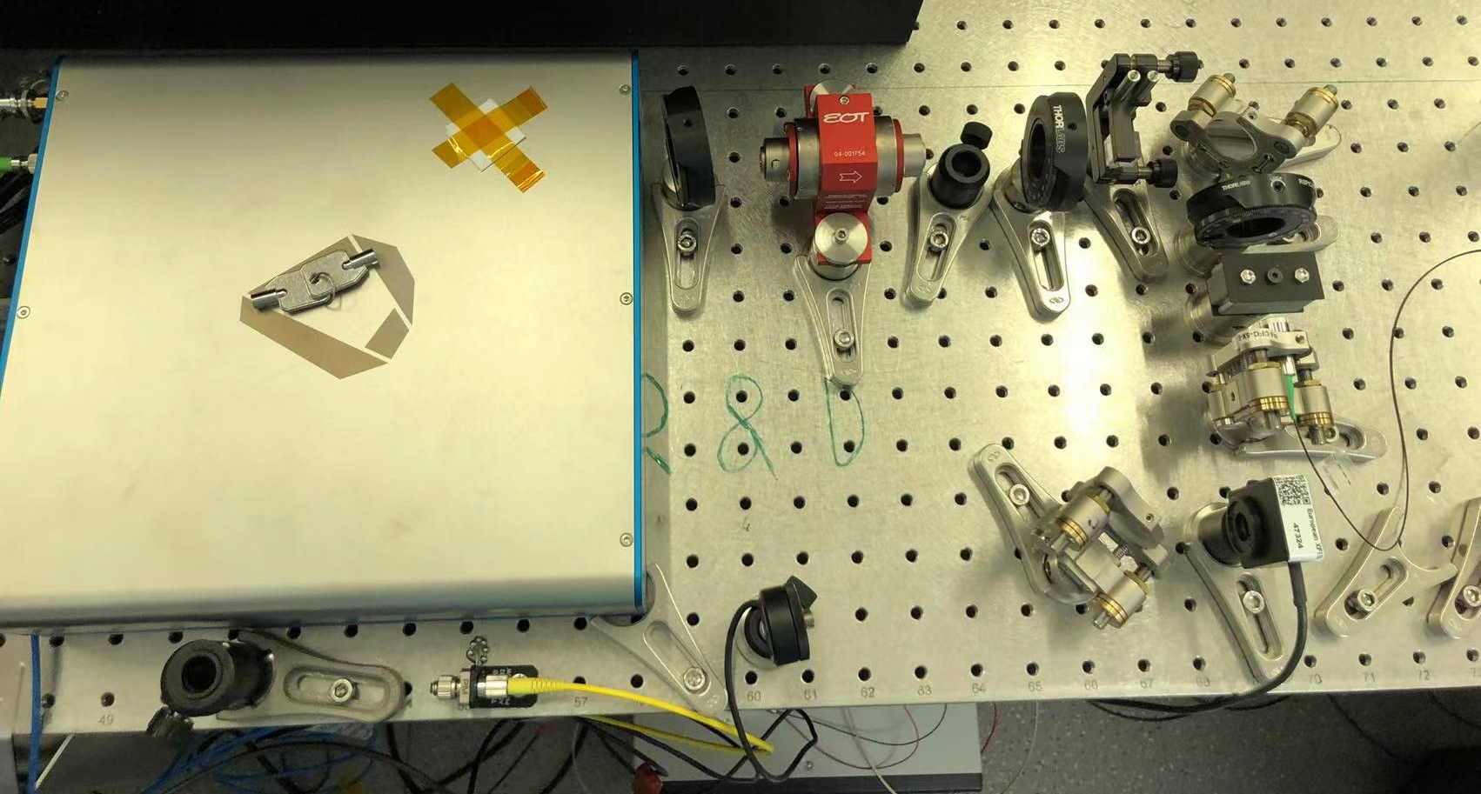
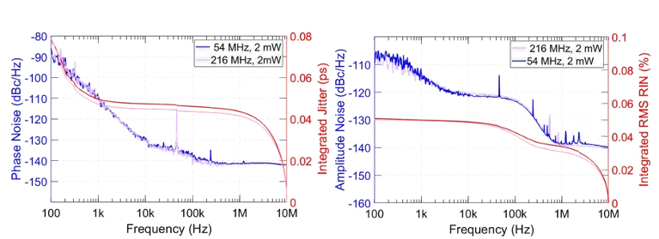
Results : Plan A
MENHIR: developed 1µm 216 MHz solid state oscillator
3rd prototype is proven to be stable & reliable
build 3 prototypes
3rd prototype
in specifications
and reliable
tested with EuXFEL
R&D laser amplifier
→ overall success
in-house : development of pulse-picker (pick every 4th pulse)
no degradation of phase & amplitude noise observed

Slide 6
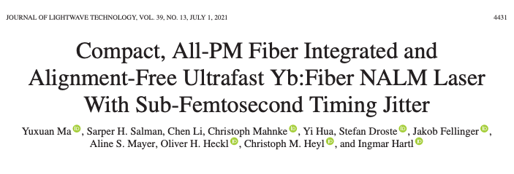
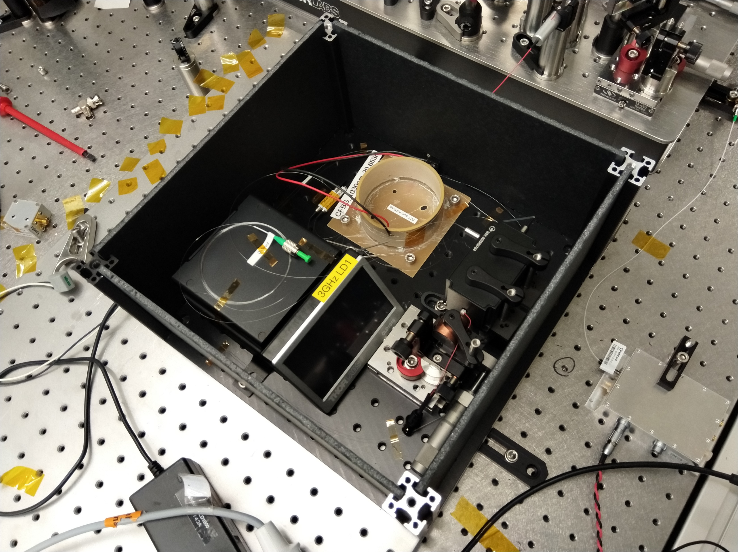
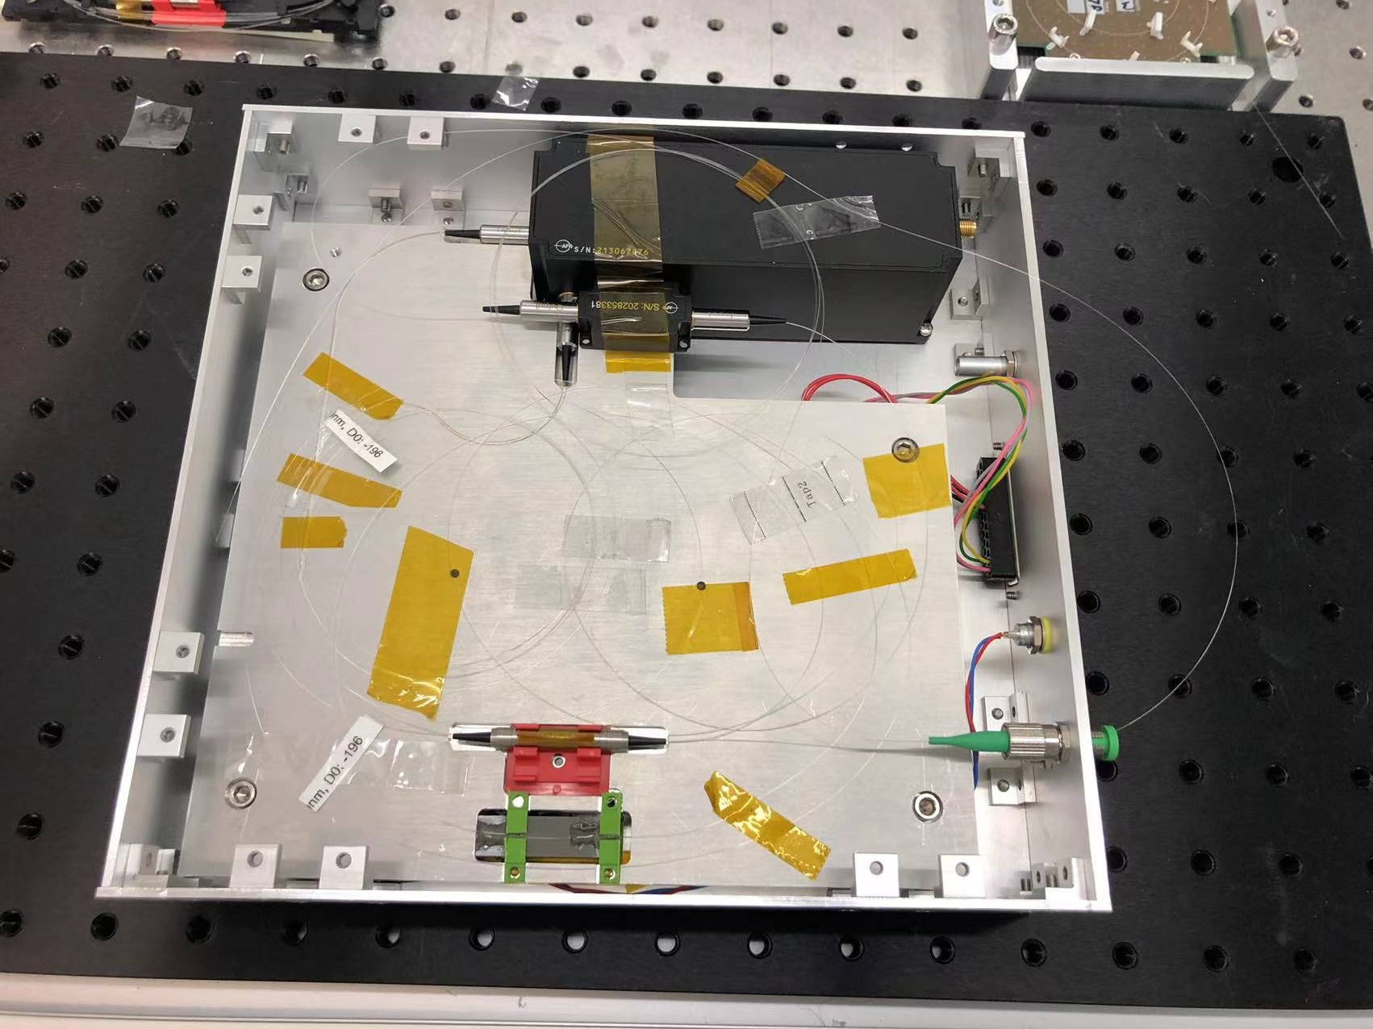
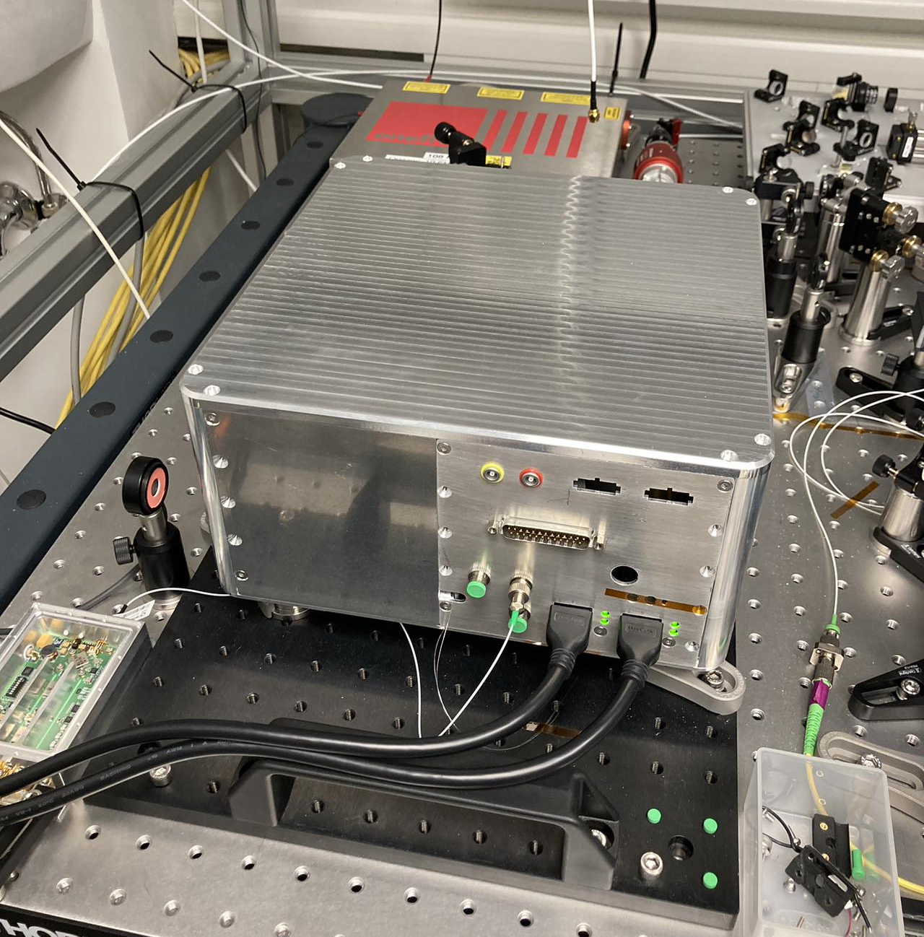
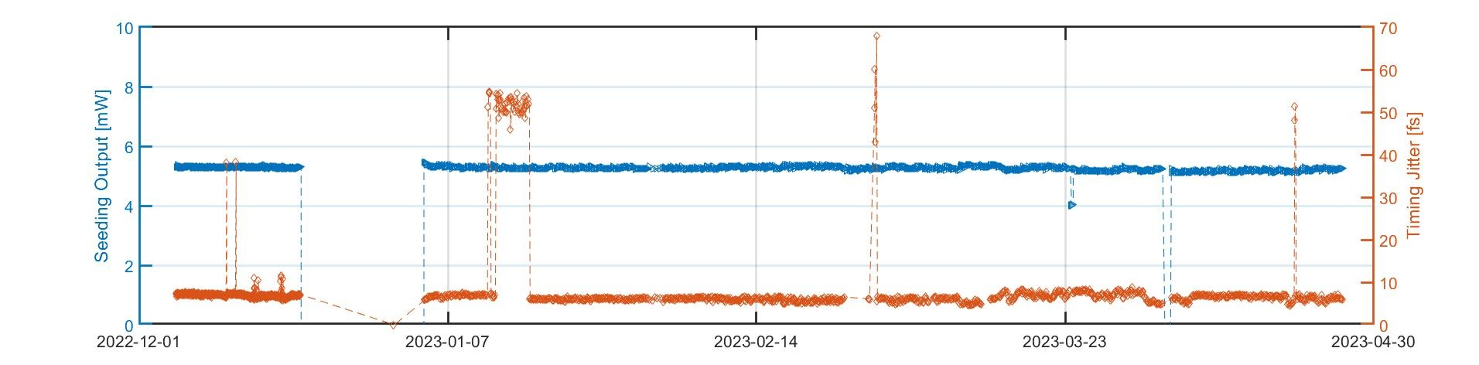
Results : Plan B
PT1
2021
Y. Ma et al., doi: 10.1109/JLT.2021.3070208.
https://ieeexplore.ieee.org/document/9392237/media#media
PT2
2022
Build upon ongoing
R&D (NALM-oscillator)
Packaged systems
Developed reliable
manufacturing process
in specifications
and reliable
tested at FLASH
pump-probe laser
→ overall success
PT3
2023
PT2 operates in FLASH2 since 4 months

Slide 7
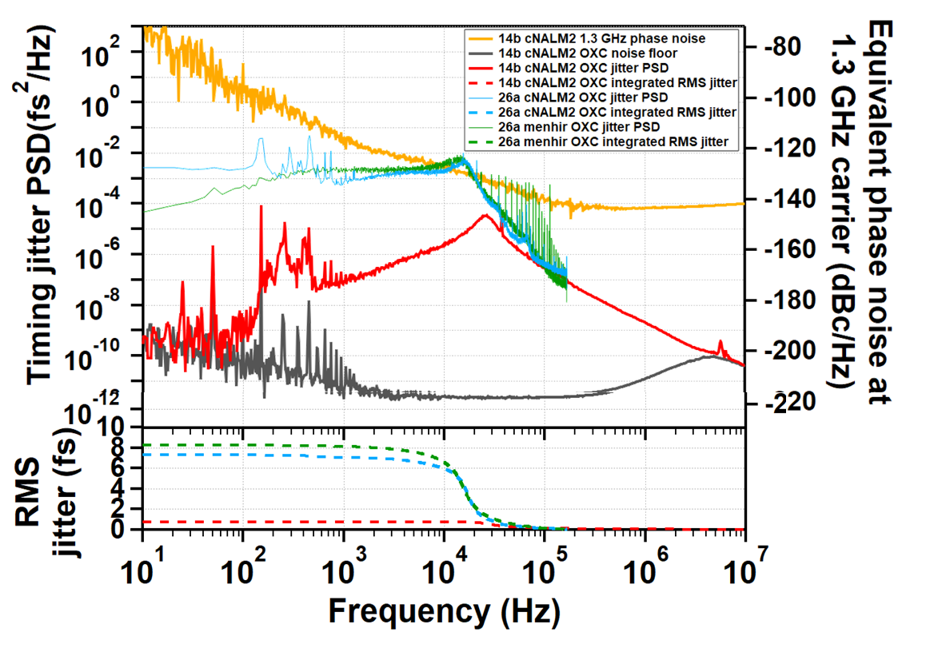
Results : Timing Jitter Performance – Well Within Requirements
Plan A
Plan B
Plan B, higher
feedback bandwidth
Instrument
noise level

Slide 8
Summary
 | Origami 10 | NALM fiber laser (DESY) | Menhir + fiber amp with Pulse picker (XFEL)
Center wavelength | 1030±1 nm | 1030±1 nm | 1030±1 nm
Rep rate | 54.1667 MHz | 54.1667 MHz | 216.667 MHz → 54.1667 MHz
Average power | > 130 mW | > 130 mW | > 130 mW
Pulse duration | 155 fs (TL) | 130 fs (TL) | 200 fs (TL)
Spectrum Bandwidth | 7.7 nm | 20 nm | 5.5 nm
Timing jitter (free-running) | < 13 fs (1 kHz~1 MHz) | <13 fs (1 kHz~1MHz) | < 13 fs (1 kHz~1MHz)
Notes:
Comparesion of three different laser PSD

Slide 9
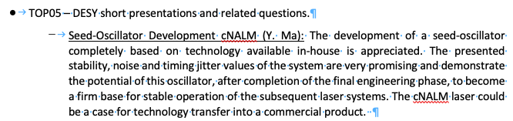
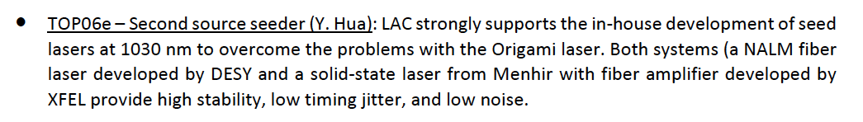
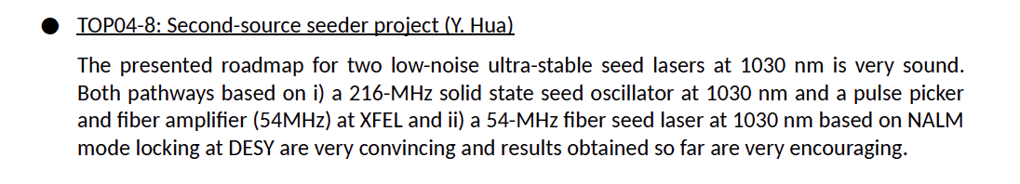
LAC #11
LAC #12
Technology Transfer:
LLE (Rochester)
ELI (Prague)
CYCLE (DESY spin-off)
LAC #13

Slide 10
Conclusions
All goals achieved – only very minor deviations from original plan.
Both plans were successful → Will be implemented at FLASH and EuXFEL
→ EuXFEL (and FLASH) pump-probe (+ seeding) laser operationional risks are mitigated
In-house development will be crucial component for ASPECT (CEP stablity)
also other facilities are interested in our technology
Follow-up projects exisit ( front-end (XFEL) , ASPECT ) which buld upon technology
Yi Hua will will be EuXFEL employee starting August - working on a follow up-projects
Manufacturing documentation will help to keep critical knowledge in house.
Cycle migth be interesting in commercializing design.

Slide 11
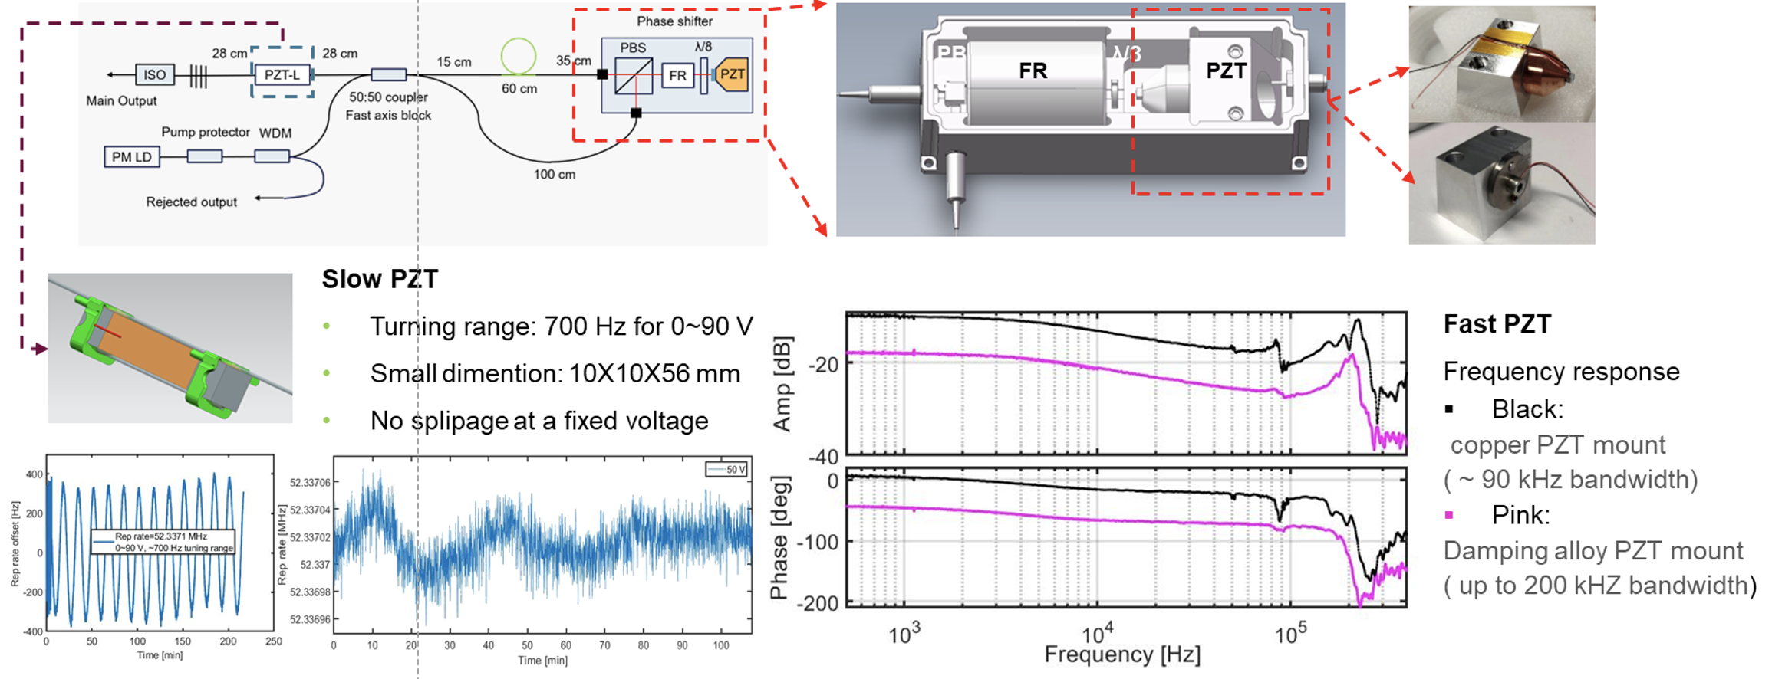
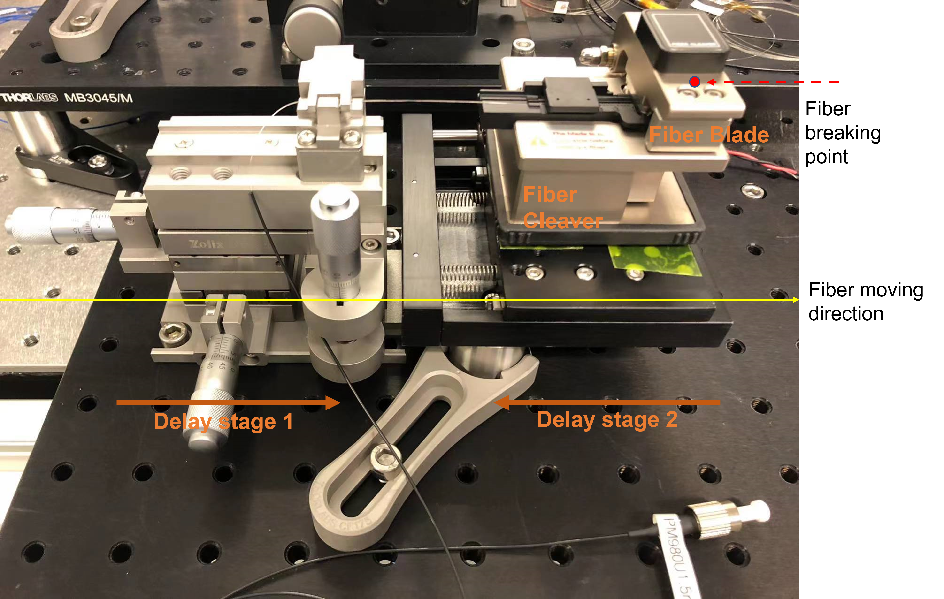
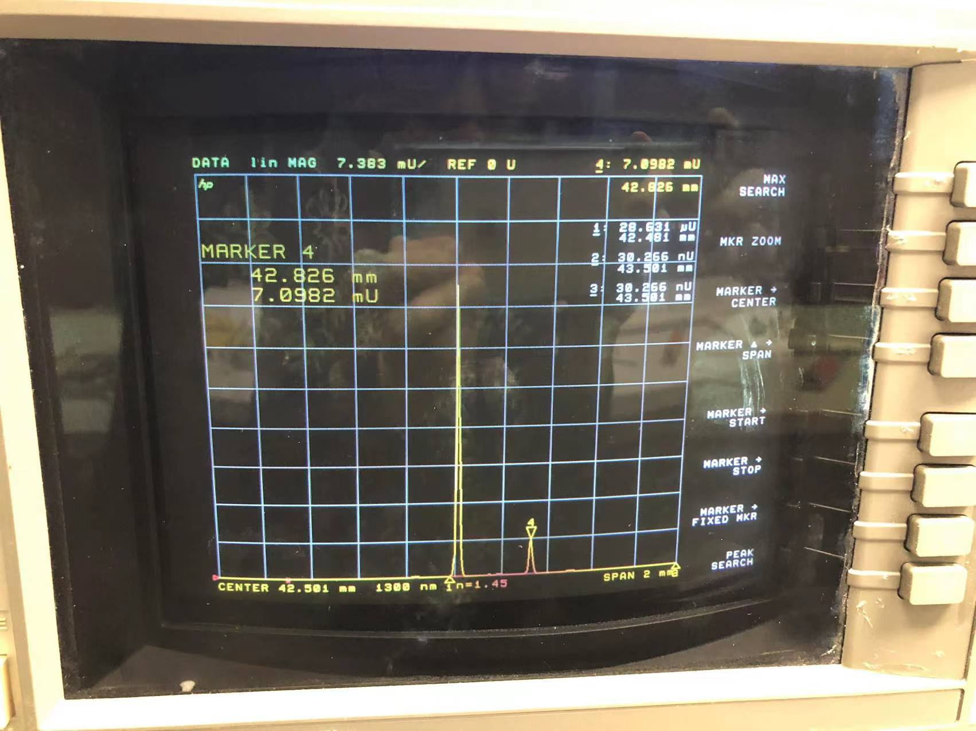
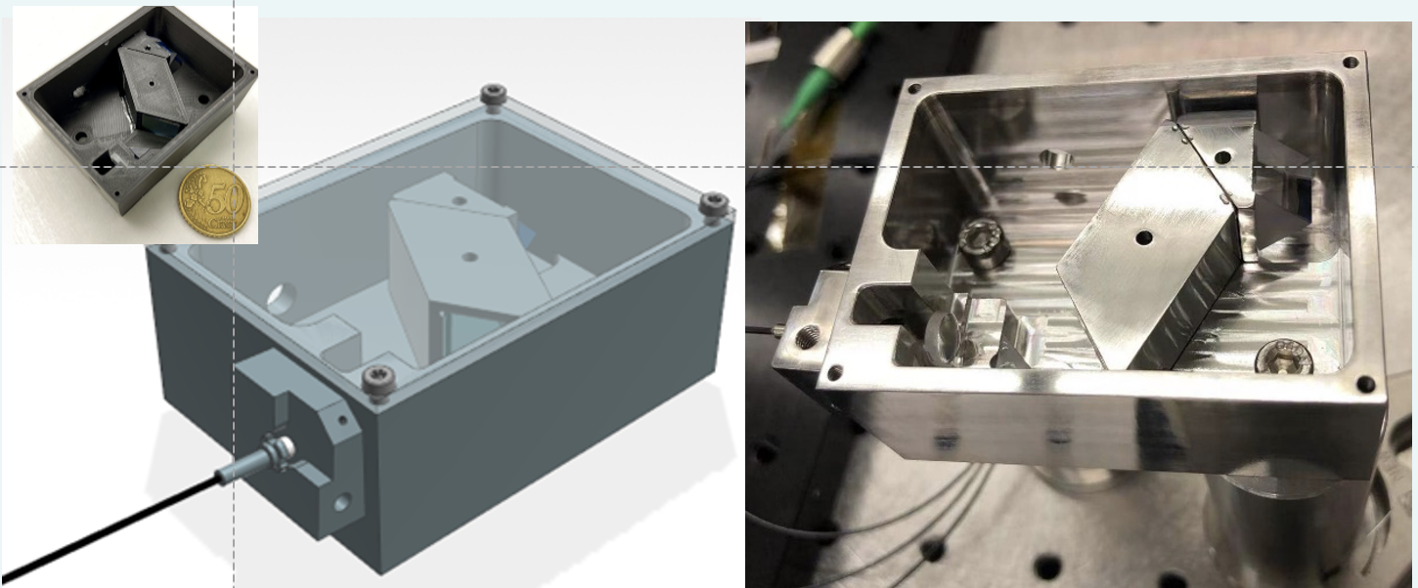
Piezo tuner design
precision fiber cutting set-up
compact compressor design

