Slide 1
XFEL Accelerator R&D Status Report RP-417: SCU in Hall3
Riko Wichmann
03. May 2023
Pictures and info regarding time plan
courtesy Serena Barbanotti (MKS), Sara Casalbuoni / Mikhail Yakopov (XFEL UND)

Slide 2
Scope of the R&D activity
administrative / accounting package without own activities
program is led by XFEL UND group
XFEL builds 2 test stand for their Super Conducting Undulator (SCU) programm in DESY‘s hall3
vertical test stand reusing the available cryostat for SC coils (SUNDAE-1)
(new) horizontal test stand for complete SCU module (SUNDAE-2)
prototype module: S-PRESSO
set-up of the test stands relies on support by DESY groups
cost incurred by DESY groups are covered by XFEL Acc. R&D funds as RP-417
Goal of „Hall 3 Activity“:
provide functional SCU prototype module to install behind SASE2
alignment of the two 2 m long SCU coils in the 5 m long cryostat, mechanical tolerances, implementation of the module in the accelerator
SUNDAE: Superconducting UNDulAtor Experiment
S-PRESSO: Superconducting undulator PRE-SerieS mOdule

Slide 3
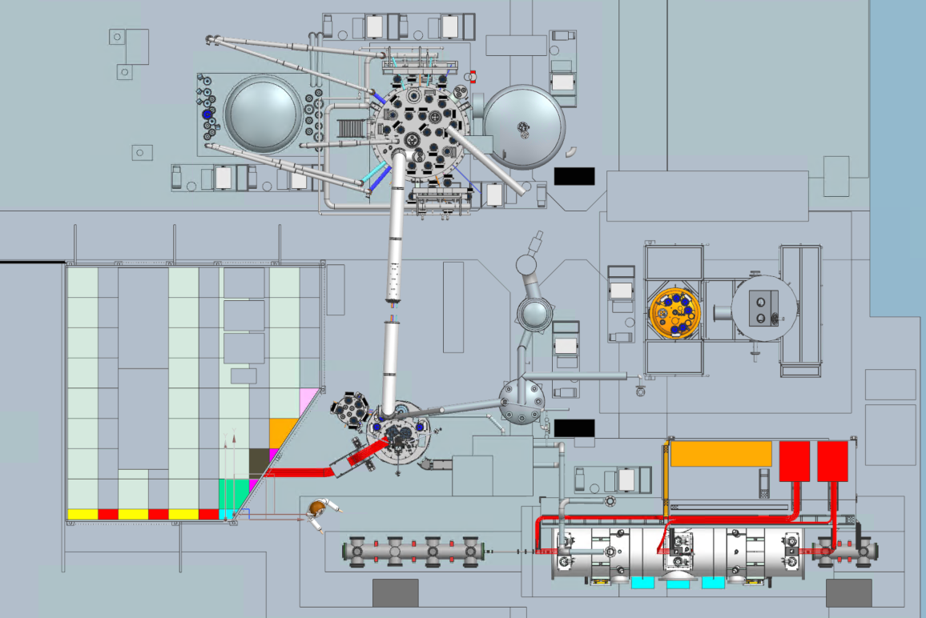
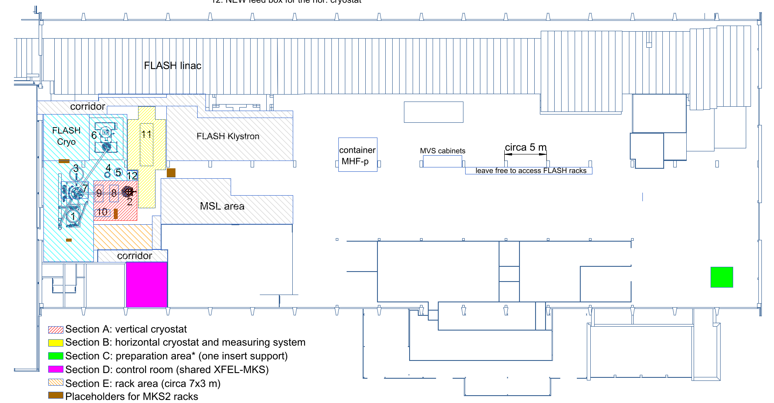
Scope of the R&D activity
Hall 3 / Geb. 28 - FLASH / Cav. Infratsructure
SUNDAE1 cryostat
SUNDAE1 main power supplies
S-PRESSO
correction coils
power supplies
S-PRESSO
Six cryocooler’s compressors
S-PRESSO control rack
SUNDAE1 correction coils
power supplies
S-PRESSO main
power supplies
SUNDAE2 diagnostic chamber 1
SUNDAE2 diagnostic chamber 2

Slide 4
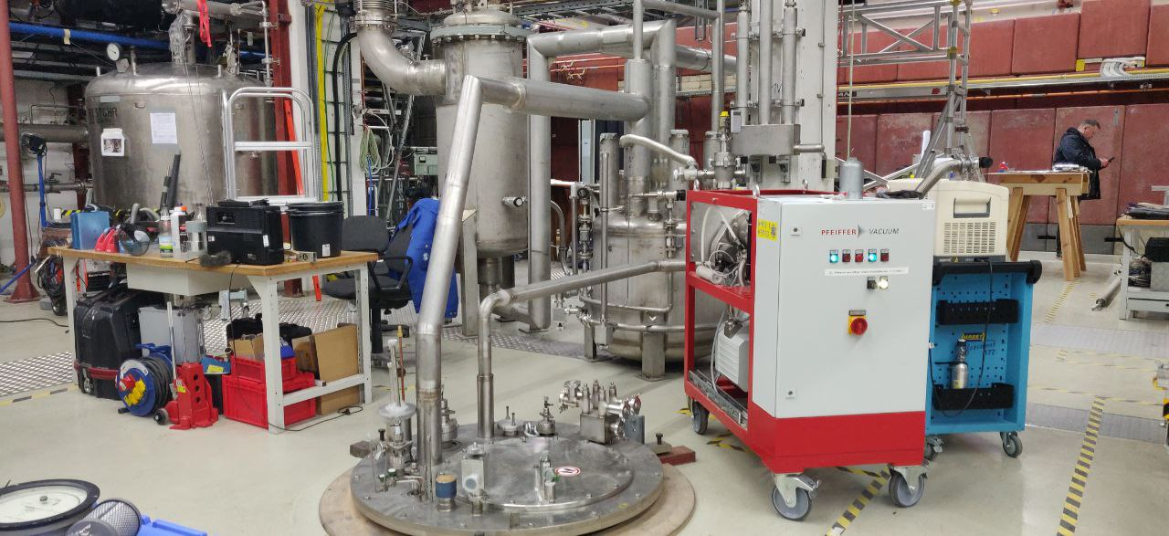
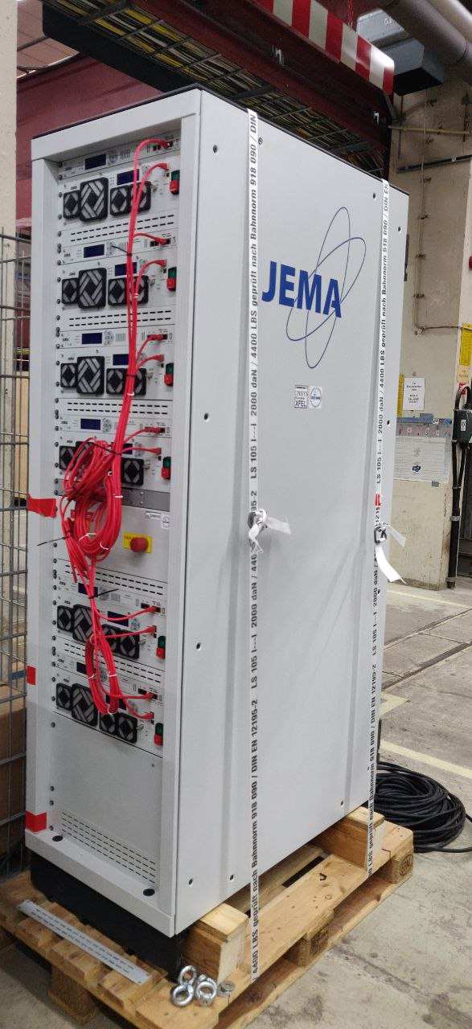
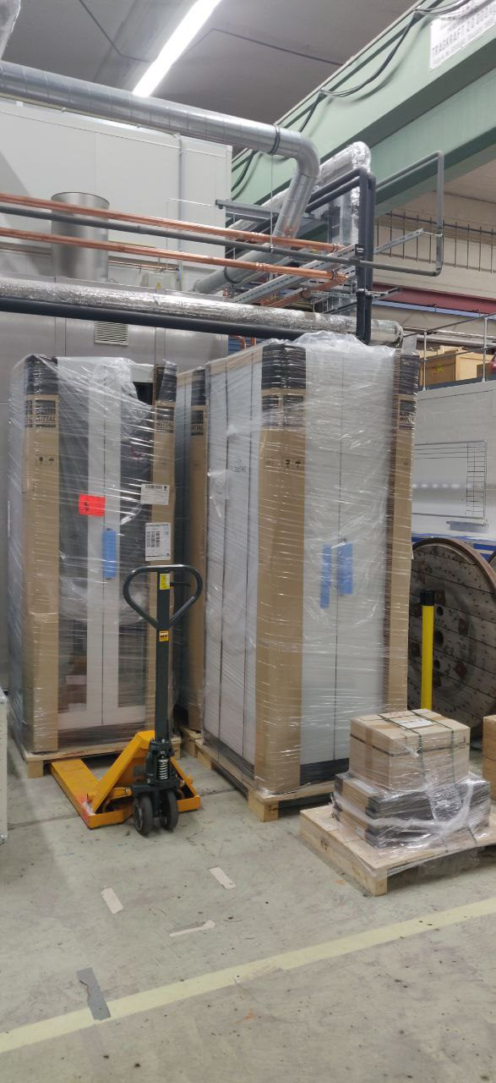
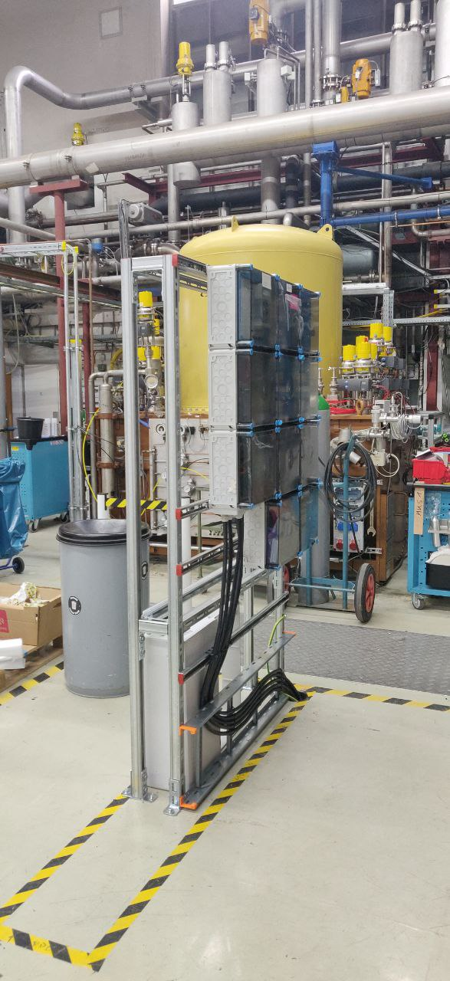
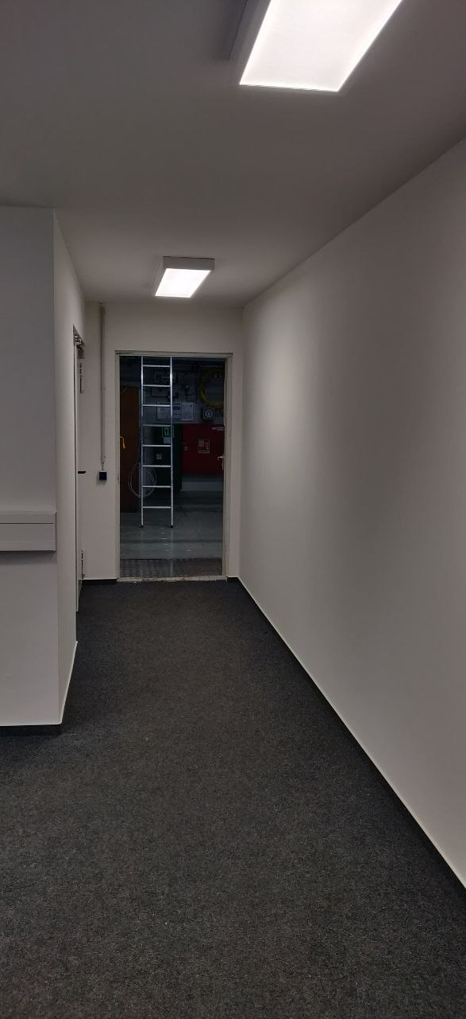
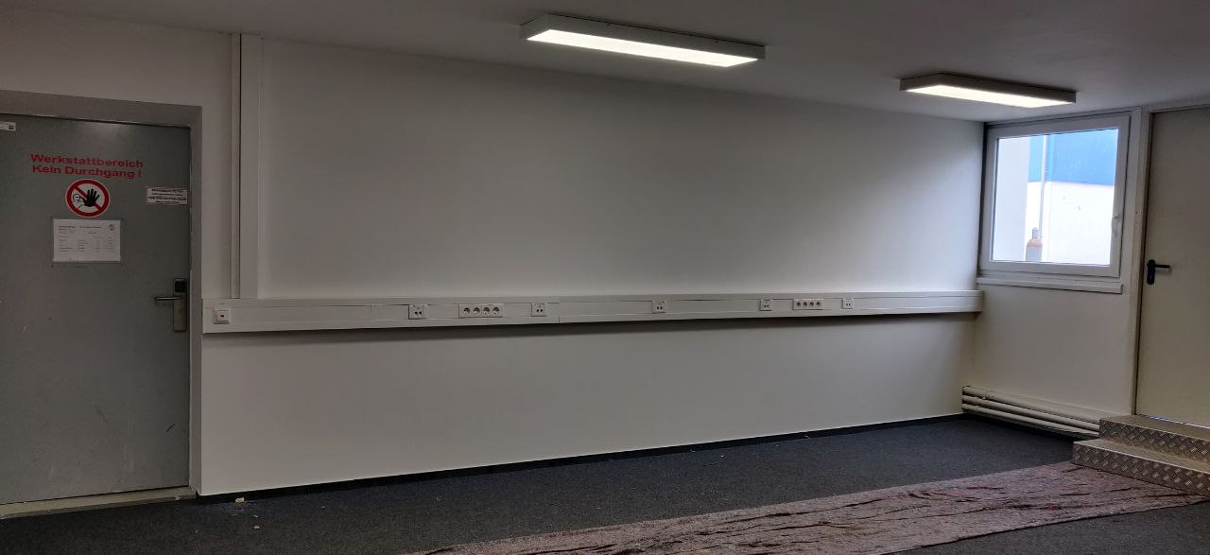
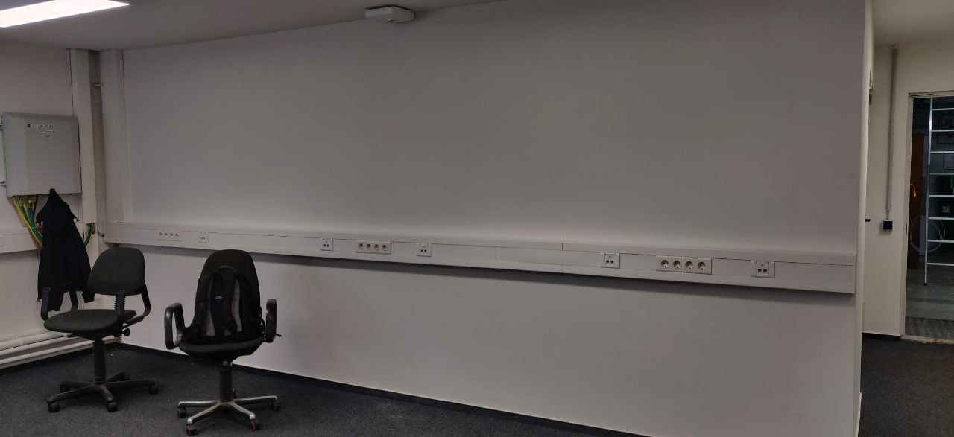
Achievements so far
SUNDAE1 cryostat piping is ongoing
SUNDAE1 correction coils
power supply delivered. First tests have been started
IT and diagnostics racks delivered
Power distribution box installed
Control room is ready to be equipped with the furniture

Slide 5
Timeline of this R&D activity
in total 6 - 12 month delay
difficulty in coordination between DESY groups and XFEL responsibles
scope change refurbishment 900W cryo plant
high work-load of involved infrastructure groups (e.g. FLASH shutdown)
Proposed Date | Milestone Description | Updated Date
09/2021 | Contracts for distribution box assigned | 05/2022
06/2022 | Refurbishment of the infrastructure for the vertical AND horizontal test stands is completed | 06/2023
12/2022 | Renewal cryogenic plant is completed | 07/2023
01/2023 | Installations of major components for the vertical test-stand | 08/2023
03/2023 | Commissioning SUNDAE-1 at 2K done | 10/2023
 | Delivery S-PRESSO | 12/2024
 | Start commissioning | 01/2025

Slide 6
Risks to R&D Project
high work-load
supply chain issues with long delivery times / high cost
AFAIK: no technical challenges in sight for the infrastructure

Slide 7
Outlook
complete the infrastructure and start commissioning SUNDAE-1
with commissioning of both test stands this RP will be closed
no follow-up expected
out-of-scope and already ongoing
define operation model and fix contractually
in particular: define which parts (electricity consumption) is operated by DESY personnel and what by XFEL.eu personnel

