Slide 1
XFEL Accelerator R&D Status Report XFEL Oscillator (CBXFEL) Demonstrator (RP-418)
Patrick Rauer / Winfried Decking
3rd of May, 2023

Slide 2
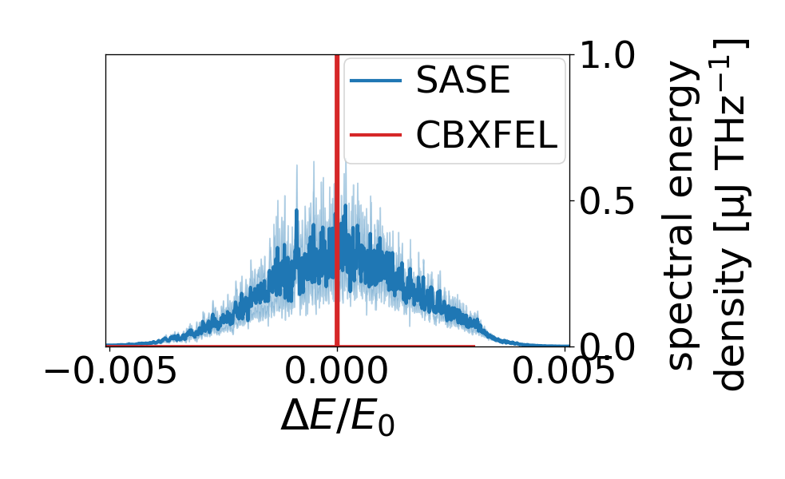
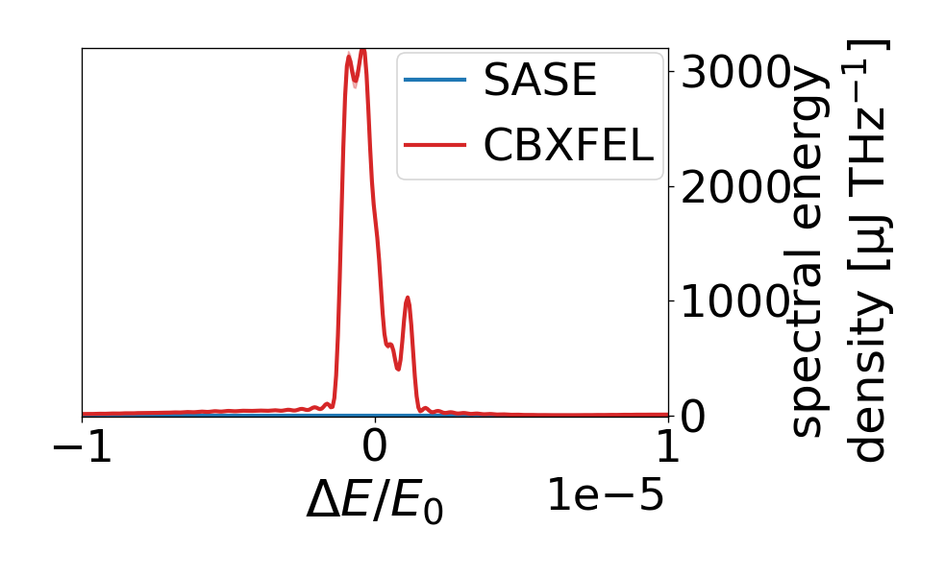
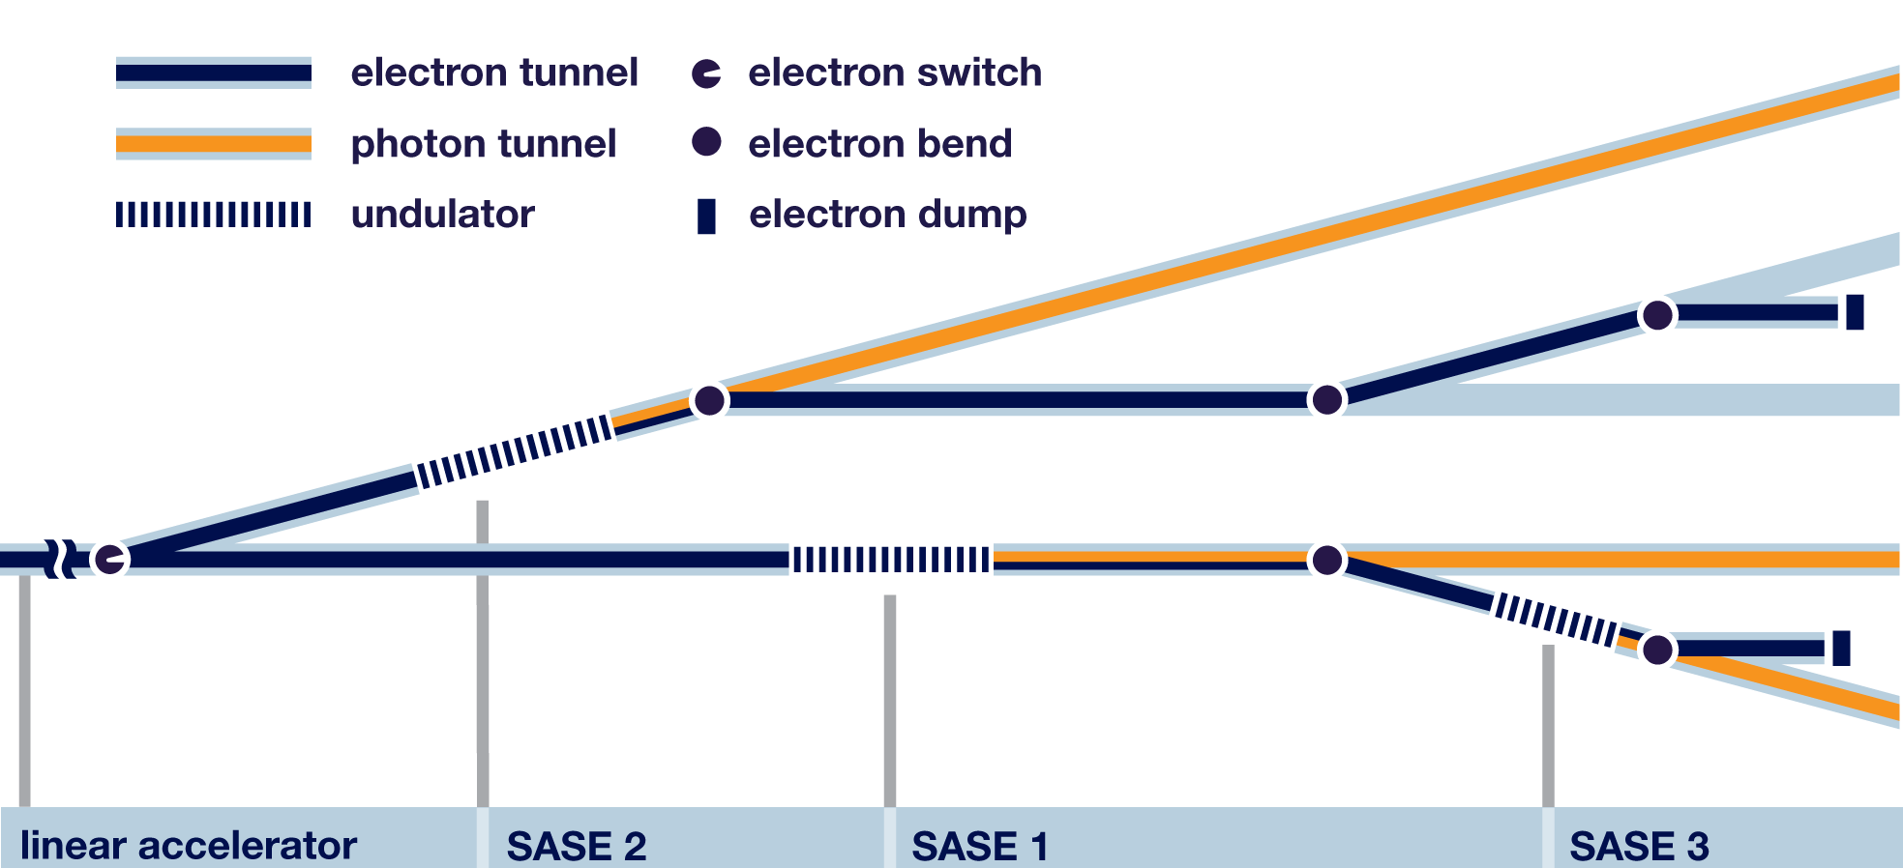
Scope of the R&D activity
CBXFEL
R&D project to realize a proof-of-concept Cavity Based X-ray FEL demonstrator at the EuXFEL.
Located at the end of the SASE1 tunnel
Using last four (typically not used) undulators
Based on 2.25 MHz repetition rate ↔ 132 m roundtrip length
Interface: XFELO Oscillator Project on photon side (XRO)
Deliverable: A as “simple” as possible demonstrator to realize working principle = seeding!

Slide 3
Achievements in the past year
DESY side of the project only is to provide (existing) infrastructure, later operation and one PostDoc for support and simulation!
Bulk (and especially hardware) of the project on photon side. ← will be (partially) included here.
Together with EuXFEL hardware components were specified and optimized to yield to the high demands of the alignment
Backed by simulation (and analytics) assisted tolerance studies as well as stability measurements in the SASE1
Step by step alignment concept (and experimental plan) was designed (see ) and presented at last MAC
Simulation framework was improved (and is being improved) and pushed to open domain ( )
Paper remains to be written

Slide 4
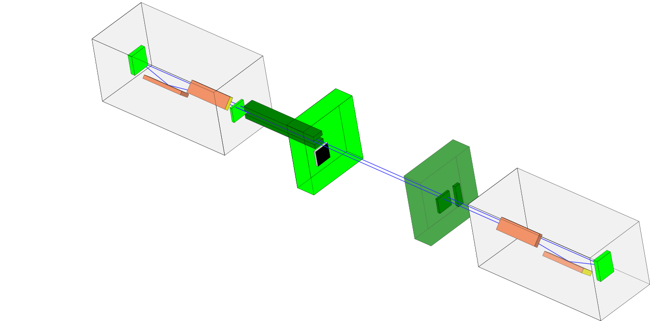
Achievements in the past year
Installed (undulators, diagnostic chamber + camera +scintillator, data infrastructure [racks, cables])
Available, not installed (crystals, diode chamber, chicane)

Slide 5
Deviations from plan
Adjustments in the necessary hardware (especially crystal mirrors and Montel/KB-mirrors)
Strong delays in the delivery chain (simple motors/stages take multiple months to be delivered)
Delays caused by (external) manufacturers (Mirror chambers were supposed to be delivered latest last November)
Installation of main hardware not finished by next summer maintenance period

Slide 6
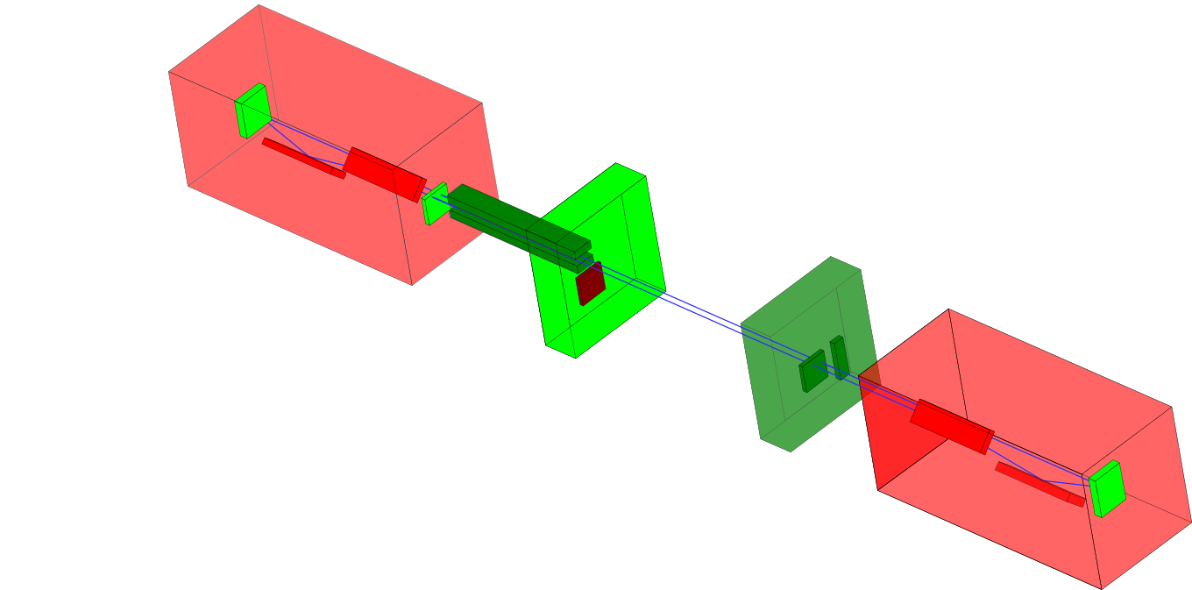
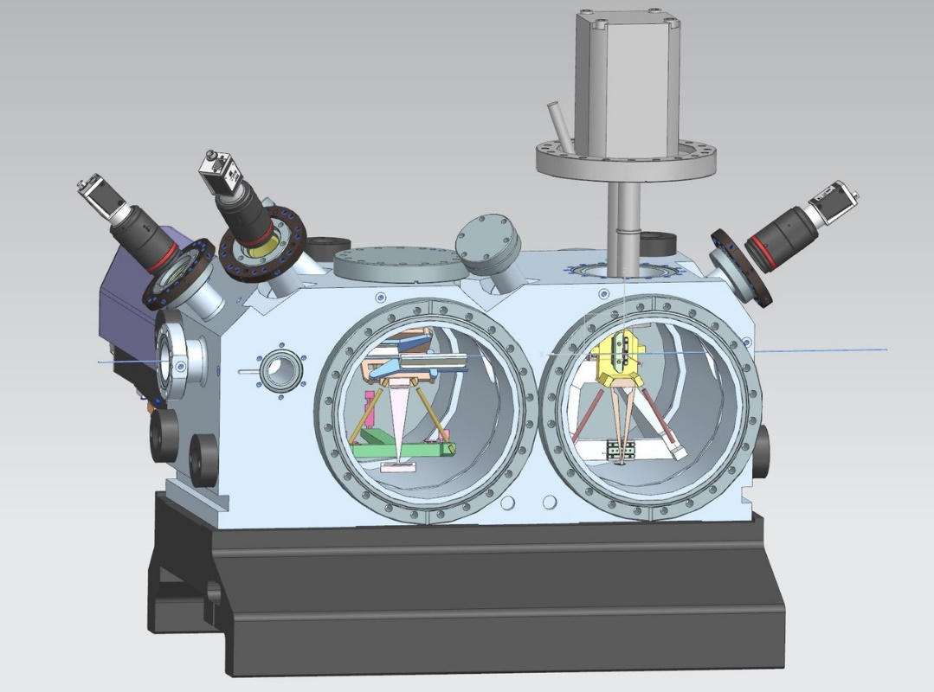
Deviations from plan
Ordered, in procurement (mirror chambers, KB mirrors, chamber mechanics, cryogenic coolers)
Not yet ordered (Photodiode, z-translation stage)
All missing components to be installed in Winter Maintenance Period 2023/2024

Slide 7
Timeline of this R&D activity
Date / Period | Milestone Description | New Date/ Period
Q4/2021 | Support of installation plans | Q4/2022
Q2/2022 | Refined simulations and transfer of software into open domain
Q4/2022 | Definition of experiment plan
Q2-3/2022 | Installation of main components in SMP 23 | WMP 23/34
Q2/2023 | Execution of beam experiments | Q1/2024
Q4/2023 | Analysis of results | Q3/2024
Q2/2024 | Documentation and publication of results | Q4/2024
(95%)

Slide 8
Risks to R&D Project
Chamber and KB mirrors will not arrive by next November → Cannot be installed by next WMP
Massive shift of time-line
Alignment will be very time-consuming. How much beamtime will we actually get to proceed with the project
LCLS also wants to commission their demonstrator in 2024…

Slide 9
Outlook / Summary
Installation of main hardware in next winter maintenance period
Start of commissioning in Q1/2024
list of publications:
P. Rauer, et al. "Cavity based x-ray free electron laser demonstrator at the European X-ray Free Electron Laser facility." Physical Review Accelerators and Beams 26.2 (2023): 020701.
P. Rauer. A Proof-Of-Principle Cavity-Based X-Ray Free-Electron-Laser Demonstrator at the European XFEL. Diss. Deutsches Elektronen-Synchrotron DESY, 2022

Slide 10
Backup

Slide 11
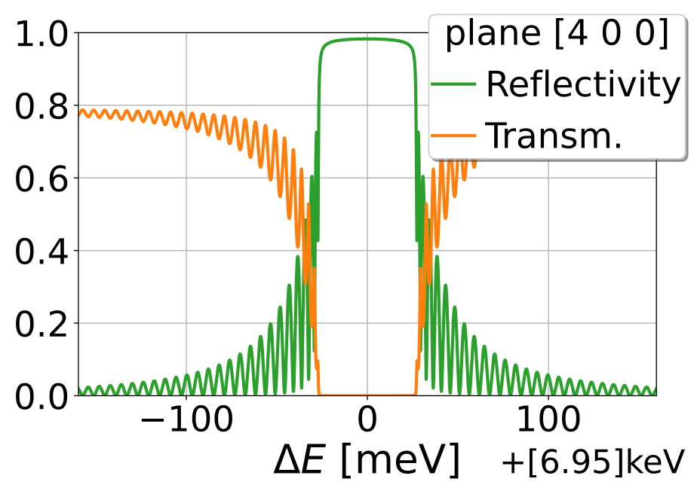
Scope of the R&D activity
CBXFEL/XFELO = X-ray Free Electron Laser Oscillator with monochromatizing crystal mirrors
Bragg’s law:
$$nλ≈2d∙sinθ$$
Monochromatic X-ray Seed at each round trip

Slide 12
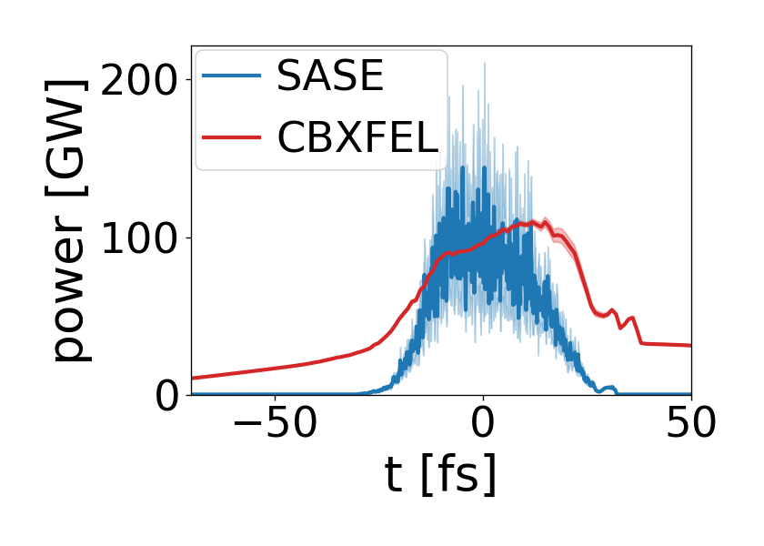
Scope of the R&D activity
CBXFEL/XFELO = X-ray Free Electron Laser Oscillator with monochromatizing crystal mirrors

Slide 13
Scope of the R&D activity
CBXFEL/XFELO = X-ray Free Electron Laser Oscillator with monochromatizing crystal mirrors
R&D project to realize a proof-of-concept CBXFEL demonstrator at the EuXFEL.
Main goal is to prove that seeding is possible! .
Build X-ray cavity with losses lower than four undulator gain
Align X-ray cavity with ~5 µm and ~100 nrad precision to achieve sufficient FEL gain

