Slide 1

XFEL Accelerator R&D Status Report
Fault Diagnosis for the LLRF control system
Julien Branlard
With Lynda Boukela, Nur Zulaika Jumhari and Annika Eichler
May 3, 2023

Slide 2
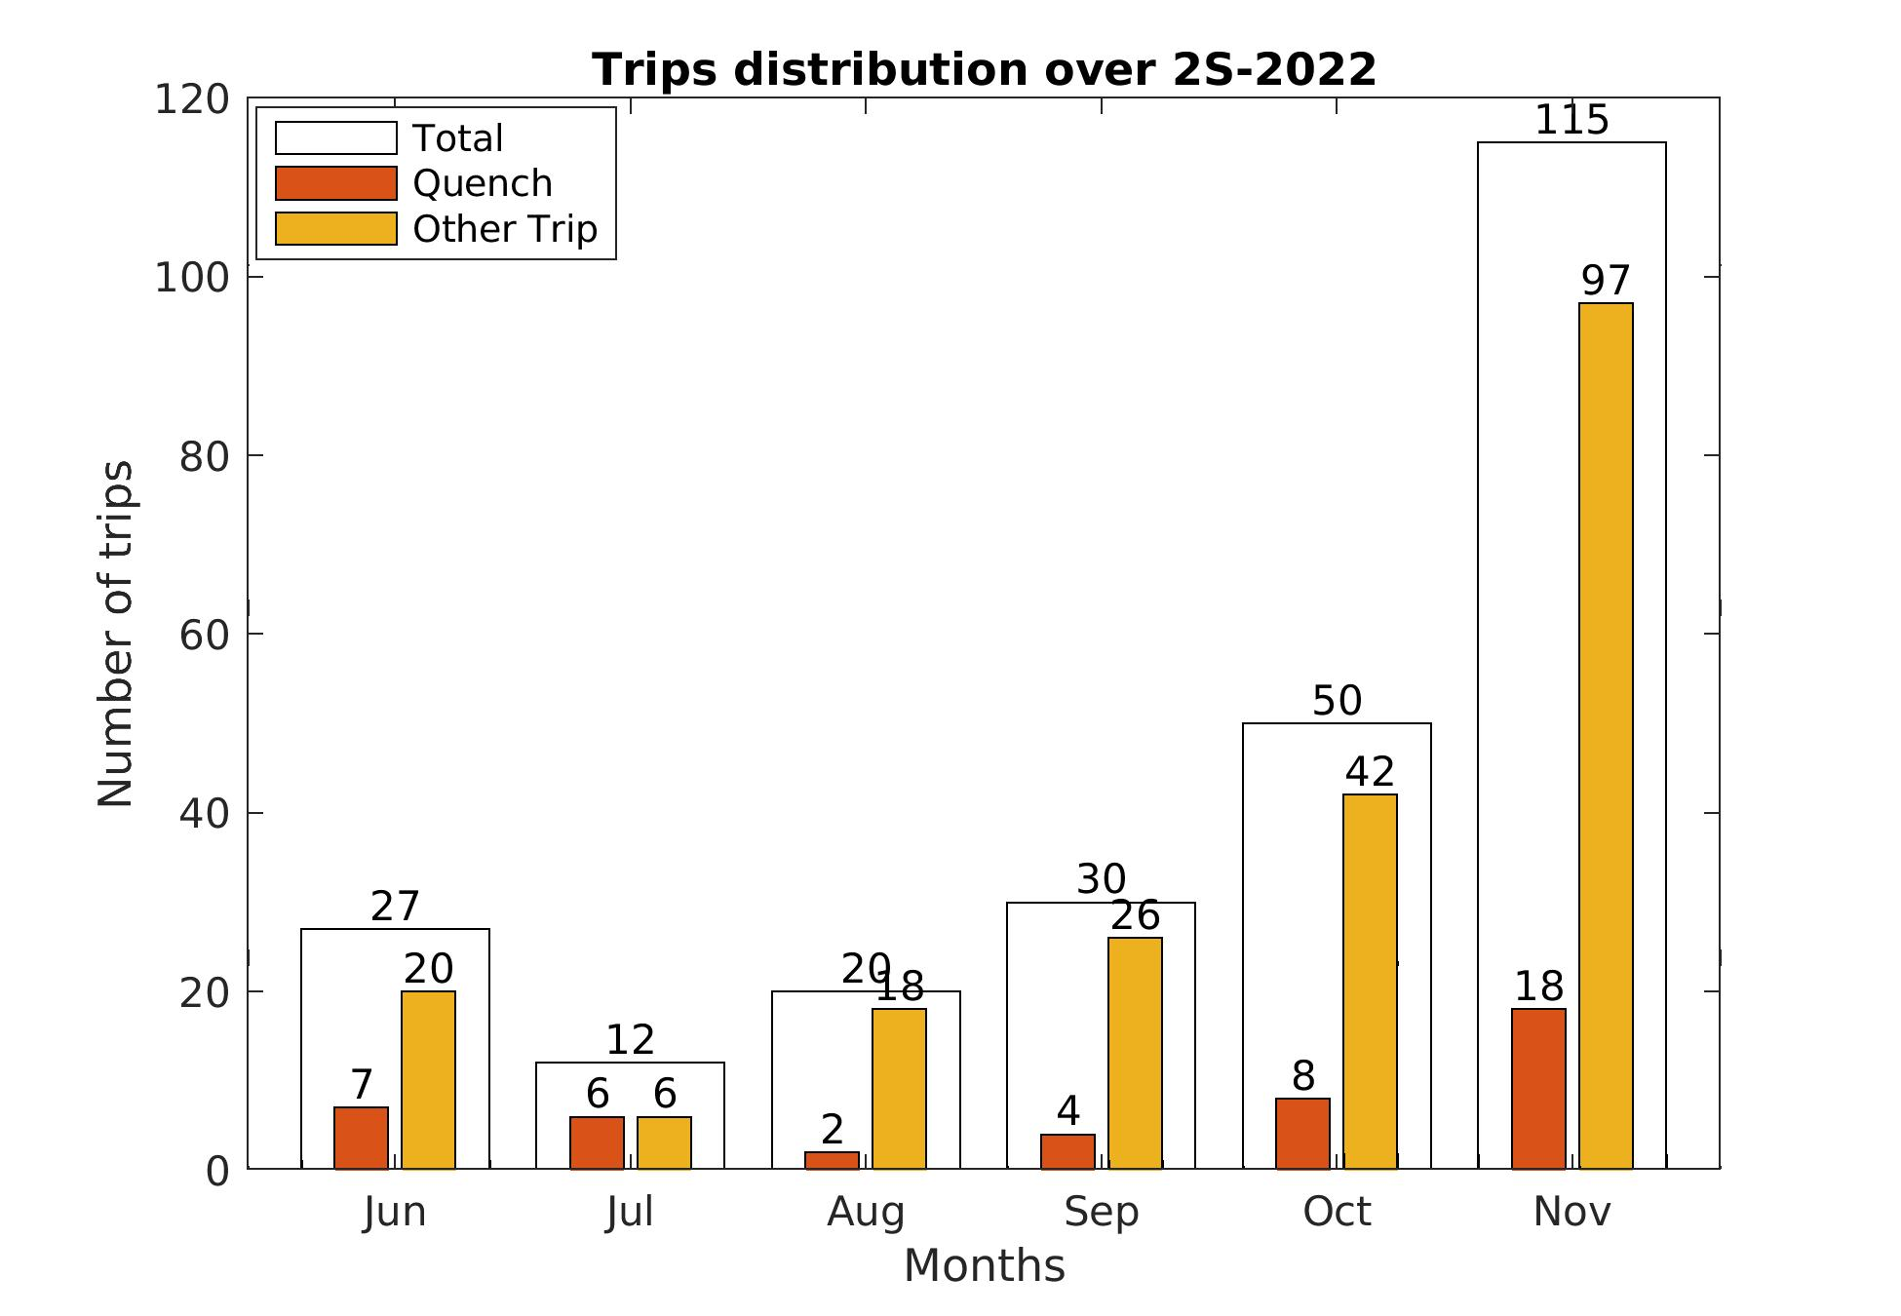
Scope of the R&D activity
Trips and Quenches
  Significant downtime
  System degradation
  Energy and financial costs
Fault diagnosis
  Reliability study
  Significant impact
  Opportunity for enhancement
Notes:
give a short summary of what your project is about
if you have any interfaces with other XFEL R&D or operation activities both on the accelerator and/or photon system side, mention them here
if you promised any deliverables, list them here

Slide 3
Scope of the R&D activity
Fault Diagnosis
AI
Online
Recovery
Rep
Scientific work
  Online operation
  ML-based algorithm for quench detection
  Fault prevention & system recovery
  Communication and reporting
  Resources management
Trips and Quenches
  Significant downtime
  System degradation
  Energy and financial costs
Fault diagnosis
  Reliability study
  Significant impact
  Opportunity for enhancement
Notes:
give a short summary of what your project is about
if you have any interfaces with other XFEL R&D or operation activities both on the accelerator and/or photon system side, mention them here
if you promised any deliverables, list them here

Slide 4
Timeline of this R&D activity
Proposed Date | Milestone Description | Updated Date
Q1/2022 | Module integration of signal calibration (PostDoc) | Q4/2023
Q3/2022 | Online implementation of the trip event logger (PostDoc) | Q2/2023
Q4/2022 | Scalability analysis of online implementation (PostDoc) —> changed to: In-depth offline analysis
Q4/2022 | Online analysis of the cavity module (PostDoc) | Q3/2023
Q4/2022 | Hire phd student —> changed to: Hire PostDoc
Q3/2023 | Scalable solution of the infrastructure (PostDoc)
Q4/2023 | Fault detection and isolation algorithms developed for further subsystems (PhD)
Q3/2024 | Infrastructure updates for feedback to allow system recovery and fault prevention (PostDoc)
Q4/2024 | Algorithms developed for recovery and/or fault prevention (PhD)
Q2/2025 | Analysis of the overall system with regard to all modules and capabilities (PostDoc + PhD)

Slide 5
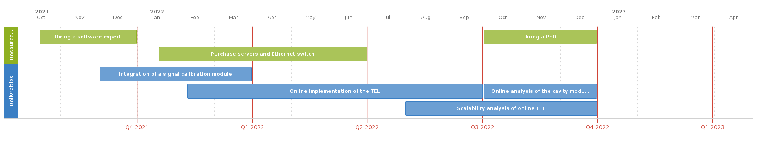
Achievements in the past year
Planned Achievements
Resource
Hiring a software expert
Hiring a PhD
Purchase servers and Ethernet switch
Integration of a signal calibration module
Deliverables
Online implementation of the TEL
Online analysis of the cavity mod…
Scalability analysis of online TEL
Notes:
this matches your summary in the written report
depending on the amount of presentation time assigned to your report, you can use up to 3 slides on this topic
if this is your final report, give the achievements of the entire R&D project
Hire a software expert
Online implementation of the previously developed trip event logger
Integration for other modules like signal calibration.

Slide 6
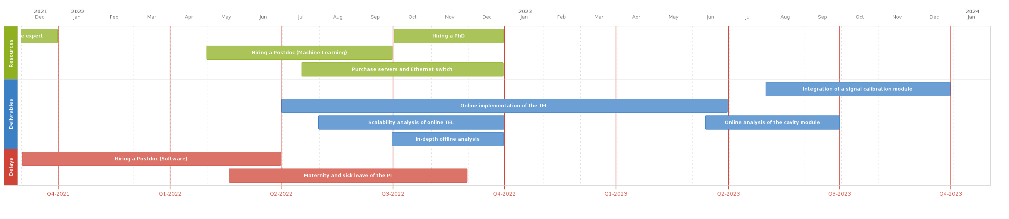

Achievements in the past year
X
X
Hiring a PhD
Resources
Hiring Postdoc (Machine Learning)
Purchase servers and Ethernet switch
Integration of a signal calibration module
Deliverables
Online implementation of the TEL
X
Scalability analysis of online TEL
Online analysis of the cavity module
In-depth offline analysis
Delays
Hiring a Postdoc (software)
Maternity and sick leave of the PI
Achievements
  Two postdocs were hired
    Nur Zulaika Jumhari, software expert, June 2022
    Lynda Boukela, ML and fault detection, October 2022
  Familiarization of the new staff
  In-depth offline analyses
  Online prototype implementation
  Data storage, Ethernet switch, servers
  Publications
Deviations from plan
  Visa problem and hiring process difficulties
  Delays occurred in the project between May and November 2022, absence of the PI due to maternity and sick leave.
Notes:
this matches your summary in the written report
depending on the amount of presentation time assigned to your report, you can use up to 3 slides on this topic
if this is your final report, give the achievements of the entire R&D project
Hire a software expert
Online implementation of the previously developed trip event logger
Integration for other modules like signal calibration.

Slide 7
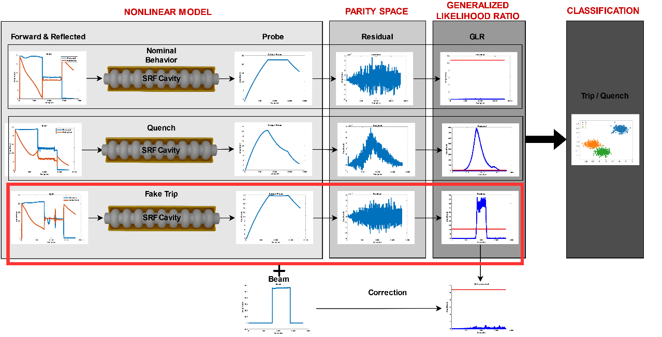
Achievements in the past year
Notes:
this matches your summary in the written report
depending on the amount of presentation time assigned to your report, you can use up to 3 slides on this topic
if this is your final report, give the achievements of the entire R&D project

Slide 8
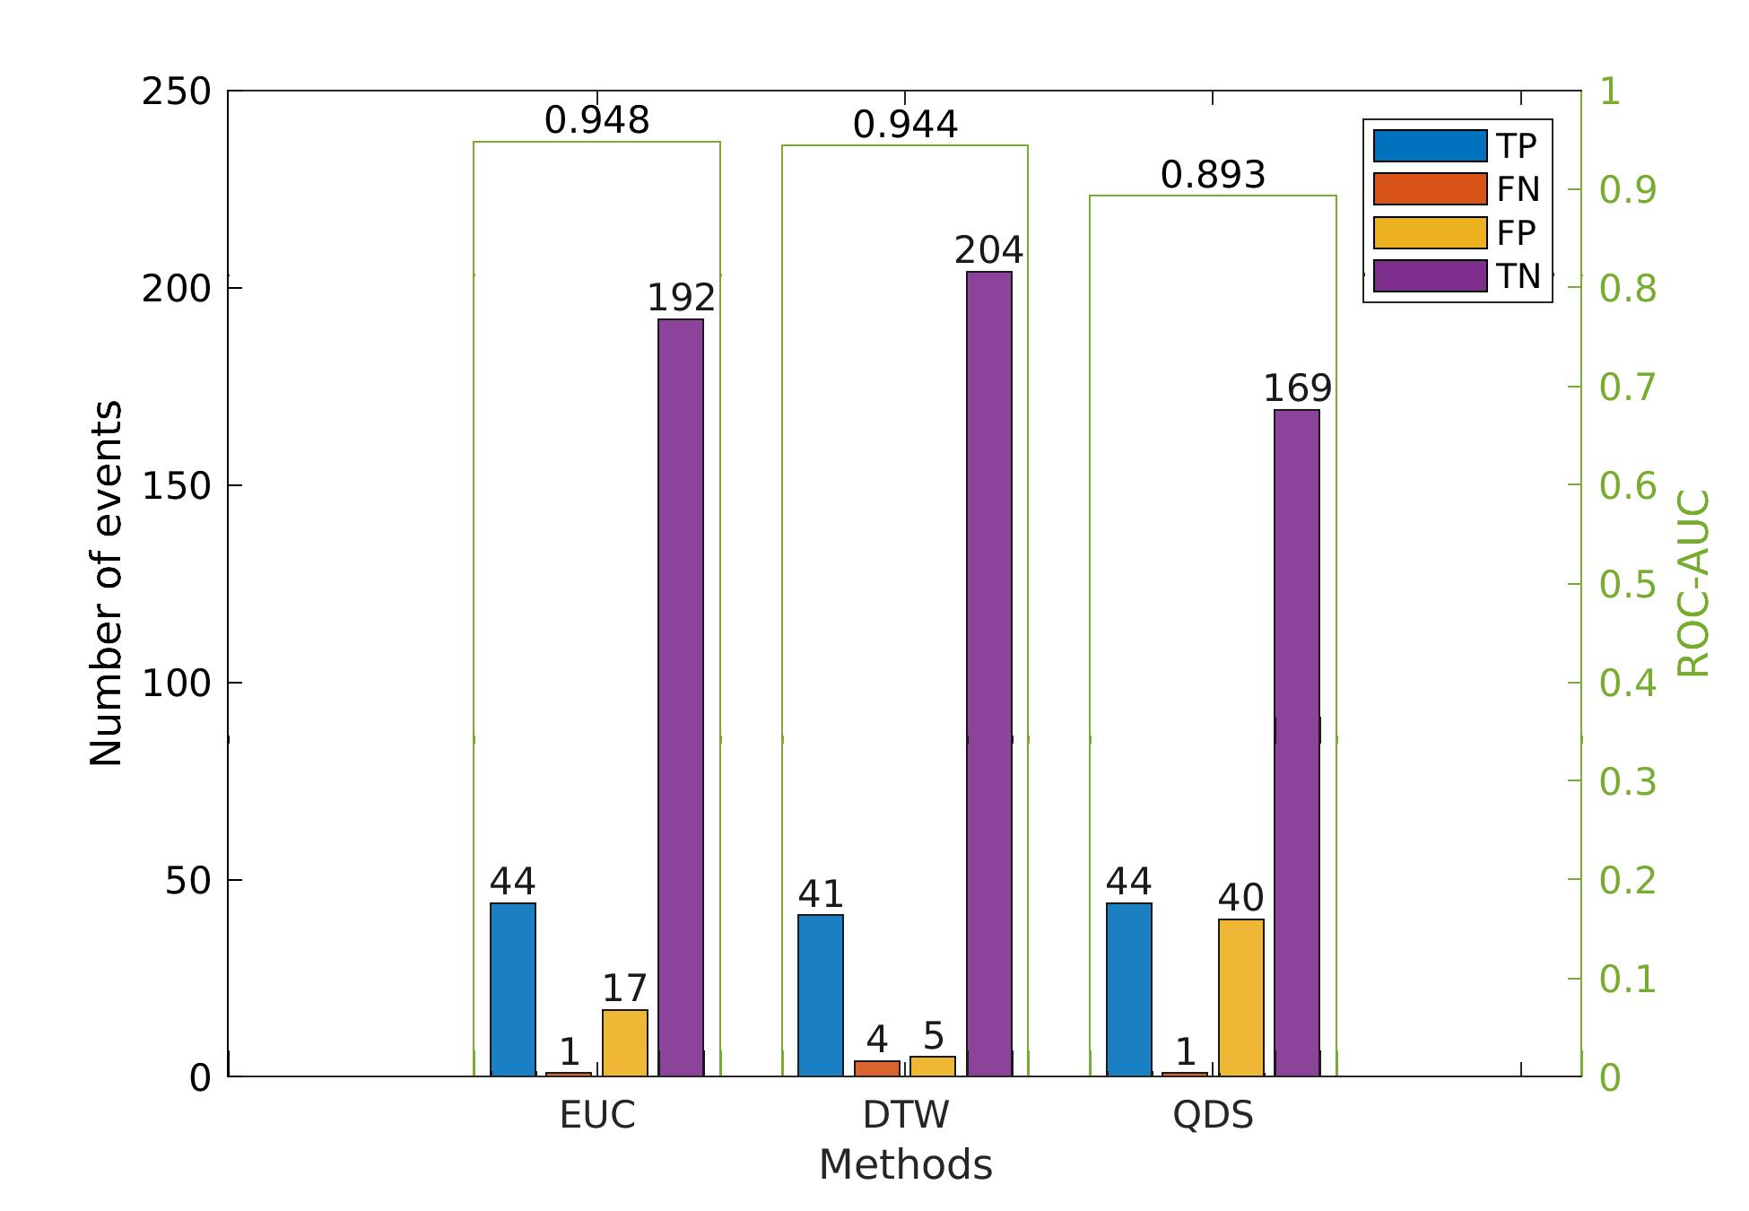
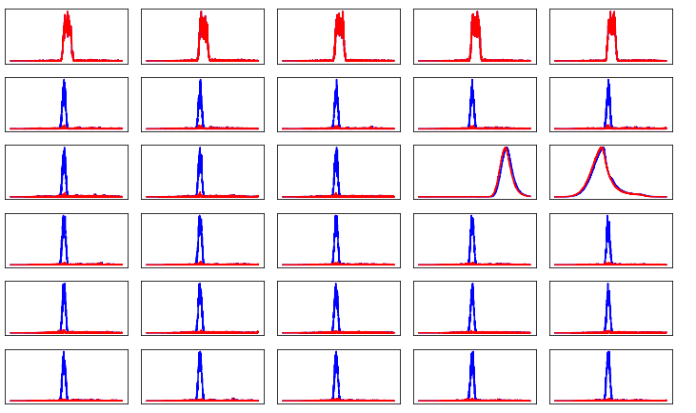
Achievements in the past year
Improved Detection
Beam information inclusion
GLR
Samples
TP : true positive (accurately detected a quench)
TN : true negative (accurately recognized a trip was not a quench)
FP : false positive (a “fake” quench)
FN : false negative (algorithm failed to identify a real quench)
Notes:
this matches your summary in the written report
depending on the amount of presentation time assigned to your report, you can use up to 3 slides on this topic
if this is your final report, give the achievements of the entire R&D project

Slide 9
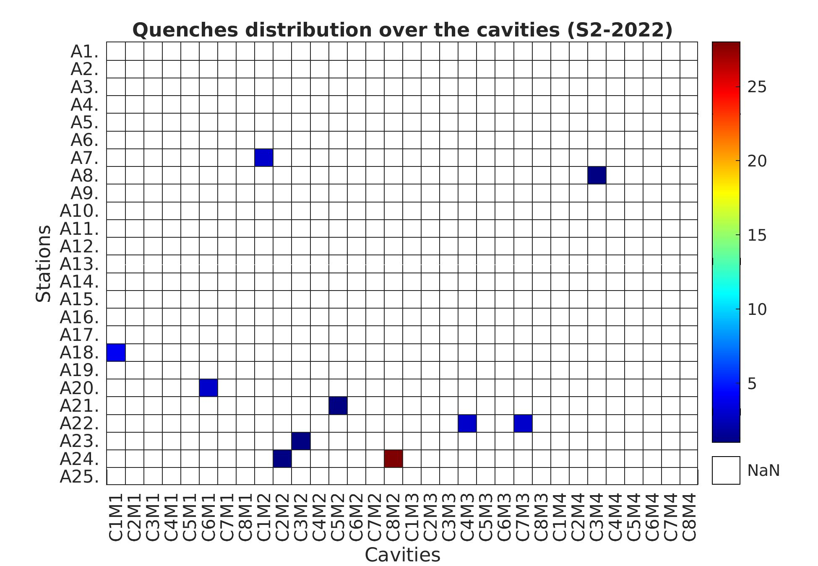
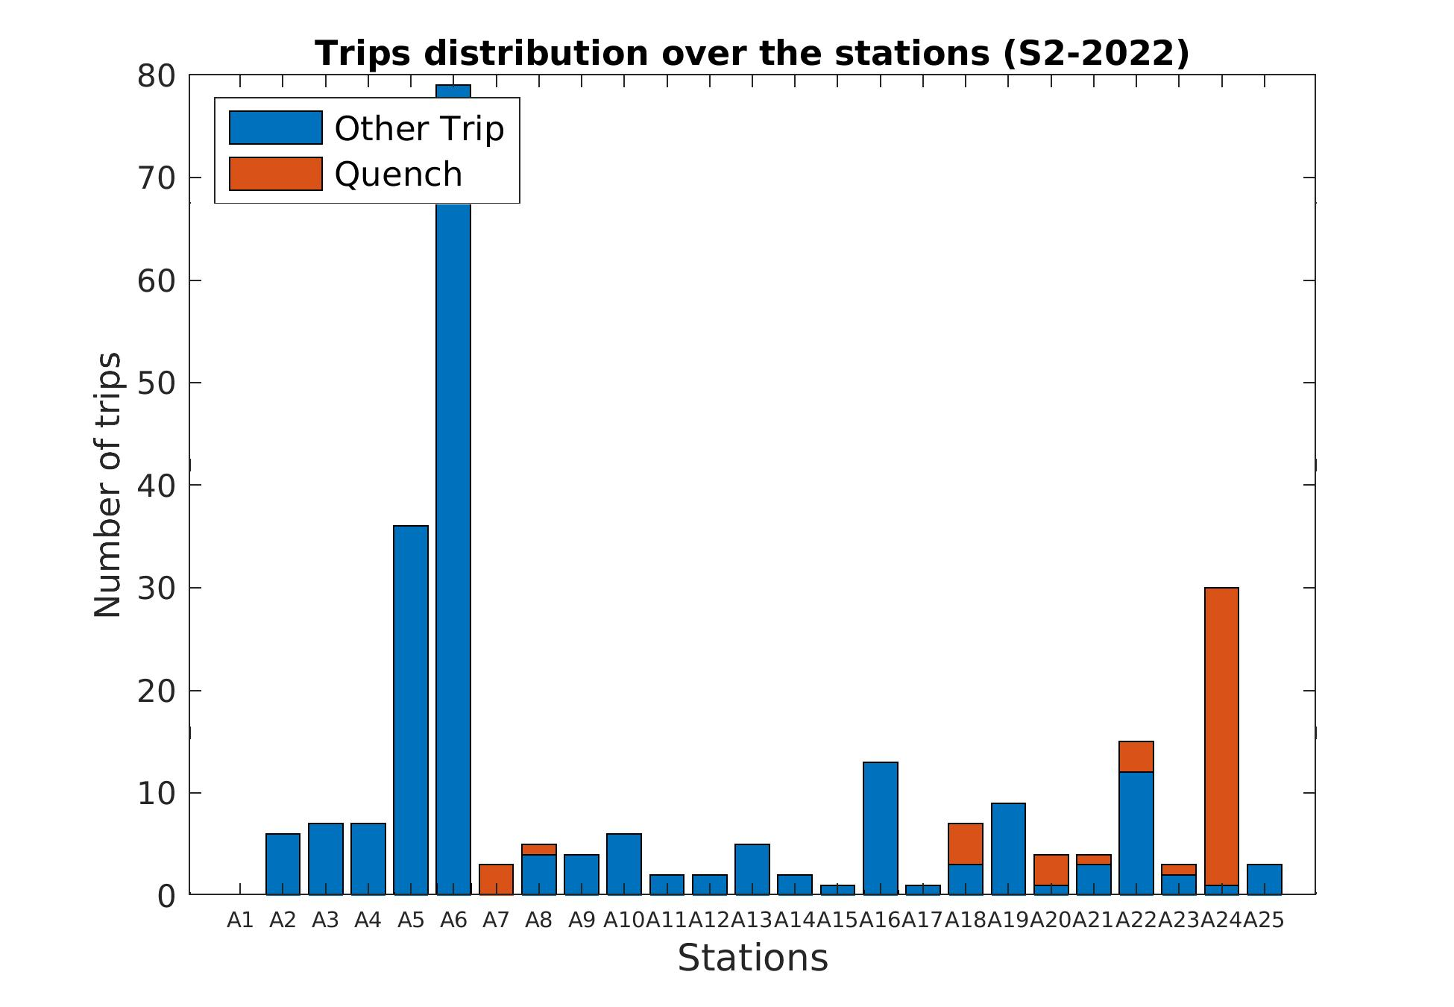
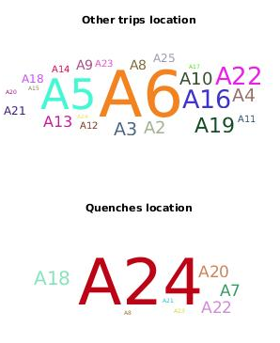
Achievements in the past year
Notes:
this matches your summary in the written report
depending on the amount of presentation time assigned to your report, you can use up to 3 slides on this topic
if this is your final report, give the achievements of the entire R&D project

Slide 10
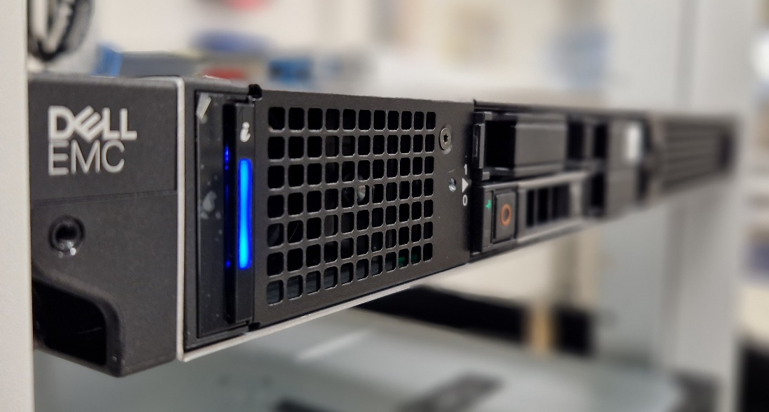
Risks to R&D Project
Online analysis needs new hardware in the tunnel (is already bought)
  Test phase with A24 (installation in summer shutdown)
  Goal is seamless integration with existing LLRF systems
  Therefore, as many offline tests as possible (+ staged approach)

Slide 11
Outlook / Summary
Online testing
Signal calibration
Scalability
Publications
  [1] J. Branlard, A. Eichler, J. Timm and N Walker, “Machine Learning Assisted Cavity Quench Identification at the European XFEL“, LINAC2022, Liverpool, UK, 2022, doi:10.18429/JACoW-LINAC2022-THPOPA26
  [2] A. Eichler, J. Branlard, and J. H. K. Timm, „Anomaly detection at the European X-ray Free Electron Laser using a parity-space-based method“, Physical Review Accelerator and Beams, vol. 26, no. 1, pp. 012801, 2023, doi:10.1103/PhysRevAccelBeams.26.012801
Notes:
describe the planned activities for the this year
are there any risk that may challenge this plans
if this is your final report, summarize the achievements of the entire R&D project
give list of deliverable
give a short summary of its planned content
do you plan a follow-up proposal
give a short summary of its planned content for the follow-up

