Slide 1
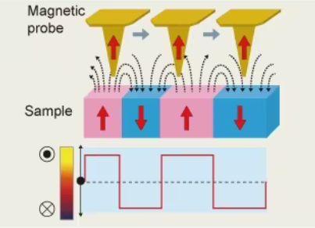
F-Praktikum INF13: MFM magnetic force microscopy

Slide 2
Specific points of reflection
Scientific contest
How is the experiment linked to the scientific bachelor program?
Added value to the experiment to the lectures
Scanning Probe Methods
specifically AFM (atomic force microscopy) and even
more specifically MFM (magnetic force microscopy)
Magnetism
specifically micromagnetism

Slide 3
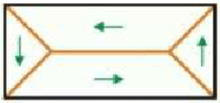
Specific points of reflection
Aim of the experiment
What is the emphasis of the experiment? (data analysis, experimental method, systematic study, precision measurement, discovery…)
Which aspects of the experimental method are particularly important?
How does it compare to state of the art experiments in the research field?
Understand concept of scanning probe methods
including experimental setup, different measurement modes, use of feedback loop
Basic understanding of magnetism
including types of magnetism, in particular ferromagnetism,
specifically the interplay of different energies
(exchange, stray field, magnetocrystalline anisotropy, Zeeman energy)
Data storage in magnetic bits

Slide 4
Specific points of reflection
Experimental setup (The black box)
Do students have the possibility to assemble the setup?
Can they modify parameter? What is the largest systematic effect?
Do they learn how is the measurable “signal” obtained?
Note: also for experiments based on already available data it is essential that the students gain understanding of the setup that generated their data, difference between raw data and calibrated data, systematic effects
Students need to insert samples and cantilevers into the microscope
and adjust the laser and detector
choice of parameters during measuremnts is crucial for the quality of the measurements
students get an introduction on all of them and are encouraged to play around

Slide 5
Specific points of reflection
Data analysis method (The other black box)
Is data analysis a key aspect of this experiment?
What are the challenges?
Ideally students should analyse the data with own written code
If this is not the case, they still should gain understanding of what the provided code does.
Particular attention to statistical treatment of data: error treatment, binning, fit quality, …
Images are analyzed with SPM software such as WSxM or Gwyddion
Different data channels must be treated differently
(e.g. no planefit or offset for absolute data)
Taking line profiles to measure distances and height differences
(different reliability with respect to direction due to thermal drift)
Evaluating the storage density of a magnetic tape (and hard disk drive)
Evaluation of the distance dependence of the magnetic signal strength

Slide 6
Specific points of reflection
Key scientific results
What do students learn from this experiment?
What is the precision achieved ? How does it compare to literature / state of the art?
What is the emphasis of the experiment?
Which skills do students learn?
measurement and description of a grid
characterization of a magnetic tape (and hard disk drive) regarding the storage density
evaluation of the distance dependence of the magnetic signal strength

Slide 7
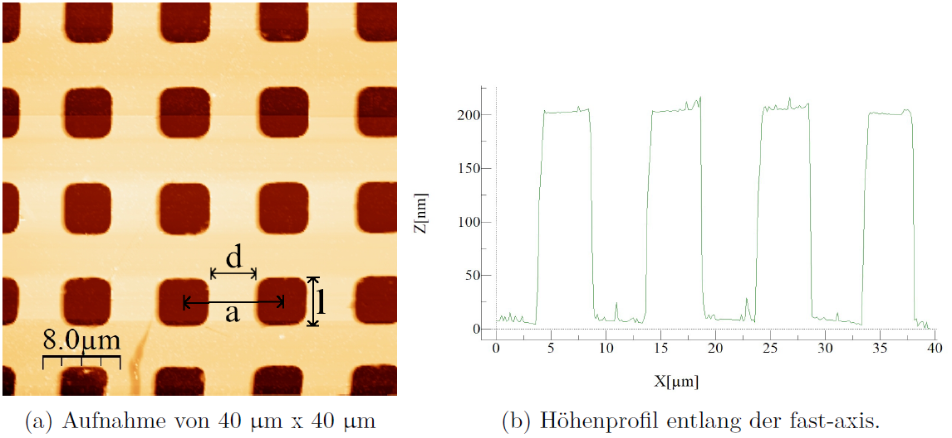
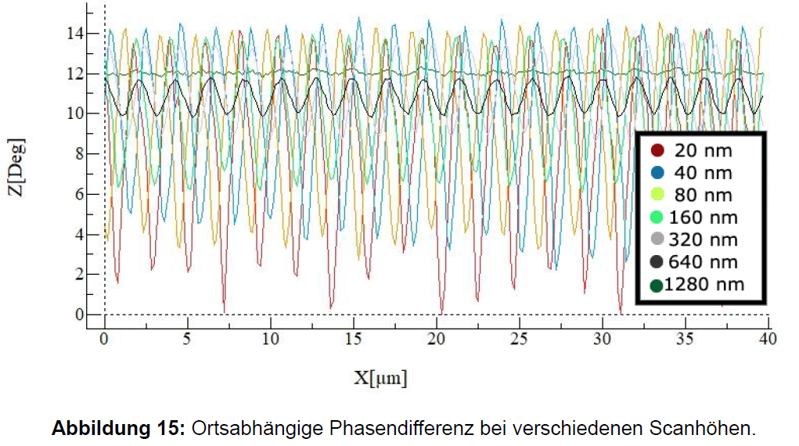
(very good) data … (from recent reports)
2 measurements of the same pit,
with the fast scan axis rotated by 90°.
Due to thermal drift the images
are distorted.
Consider this during the analysis
or the data regarding the reliability
of your measured distances!

Slide 8
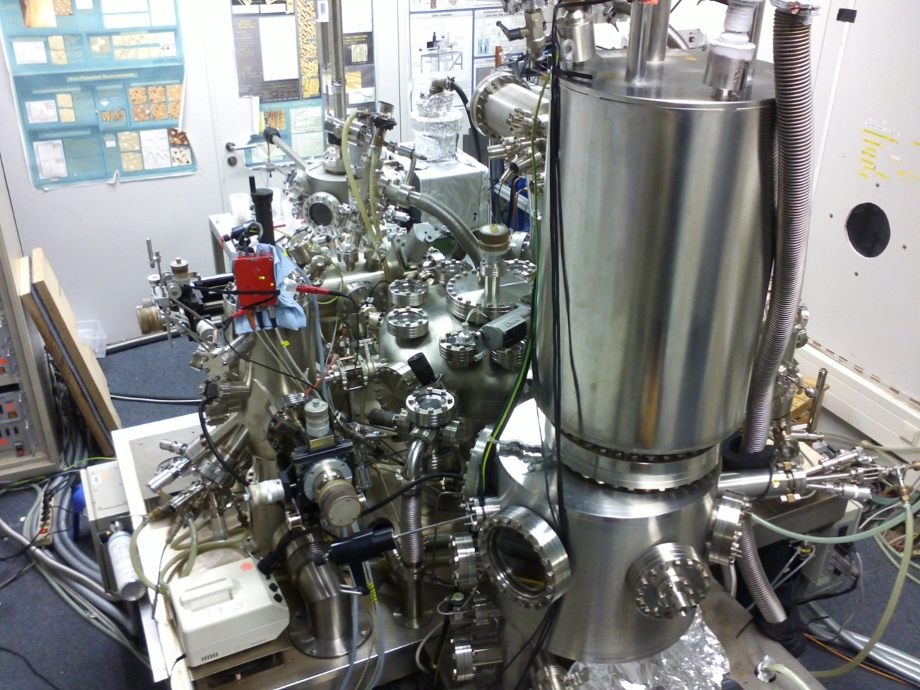
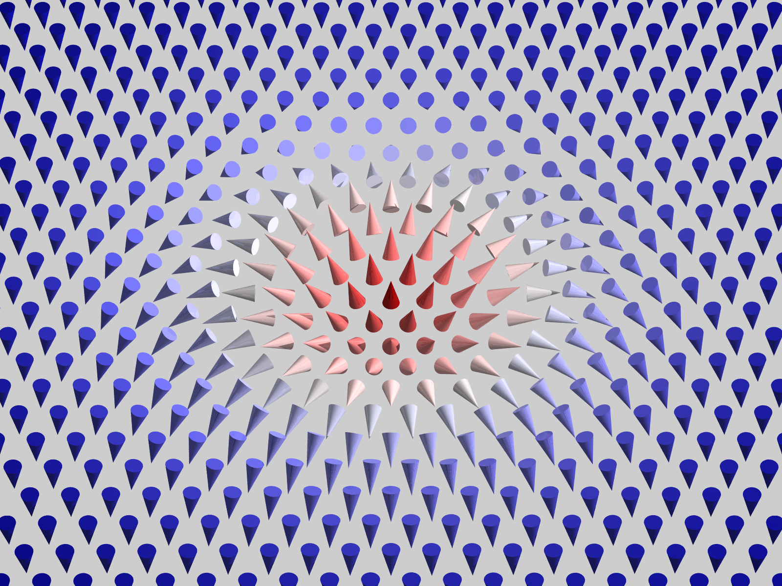
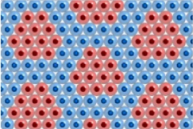
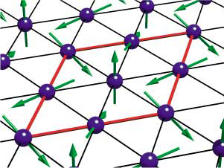
Specific points of reflection
Link to modern research in the physics department
(if applicable links to clusters of excellence)
What is the modern application of this technologies / experimental methods
In which group are these technologies / experimental methods applied
What skills do the students gain which can be used in the research group?
What is the difference between state of the art equipment and the F-praktikum setup?
Magnetic Skyrmions as data storage entities
interplay of different magnetic interactions giving rise to complex magnetic order
scanning probe methods (in UHV at low T and in high B)

Slide 9
Grade your experiment
Each F-praktikum experiment accounts for 2.5 LP (= 2.5 Semester Wochen Stunden)
This should correspond to:
3 full days Lab in presence [à 8h] for data taking & fast analysis [24 h]
Analysis and Protocol (<20 page) [14 h]
Grade the complexity of the various aspects of your experiment in a scale from 1-5 where 1 is high and 5 low
Theory / preparation | Setup / experimental | Data taking | Analysis | Protokol
3? | 2? | 3? | 2? | 3?

Slide 10
Fortgeschrittene Praktikum
Leistungs Punkte (12 LP)
Statistik & Computer (2 LP)
Lectures 5 days [3 h/ day]
Exercise 5 days [3 h/ day]
3x Versuche (2.5 LP)
Festkörper- Teilchen- und Laserphysik
3 days Lab in presence: data taking & fast analysis [24 h]
Analysis and Long Protocol (<20 page) [14 h]
KV (1.5 LP)
1 day Lab in presence: data taking & analysis [8 h]
Short protocol (<10 pages) [6 h]
Seminarvortrag (1 LP)
15 min talk + rehearsal [12 h]
1 LP = 14 h work
10

