Slide 1
F-Praktikum Review Day
INF 19
Charakterisierung von Fluorophoren/Characterization of Fluorophores
Malte van Heek & Tomke Glier
AG Rübhausen

Slide 2
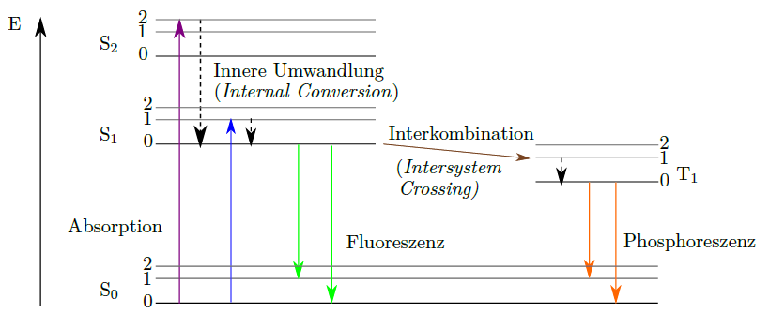
TSCPC Fluorescence
The experiment:
Understanding the fluorescence properties of coumarin dyes
Used experimental techniques:
Dilution Series
UV/Vis spectroscopy,
Emission spectroscopy,
Time-correlated single photon counting (TCSPC)
Notes:
Aim of the experiment
What is the emphasis of the experiment? (data analysis, experimental method, systematic study, precision measurement, discovery…)
Which aspects of the experimental method are particularly important?
How does it compare to state of the art experiments in the research field?

Slide 3
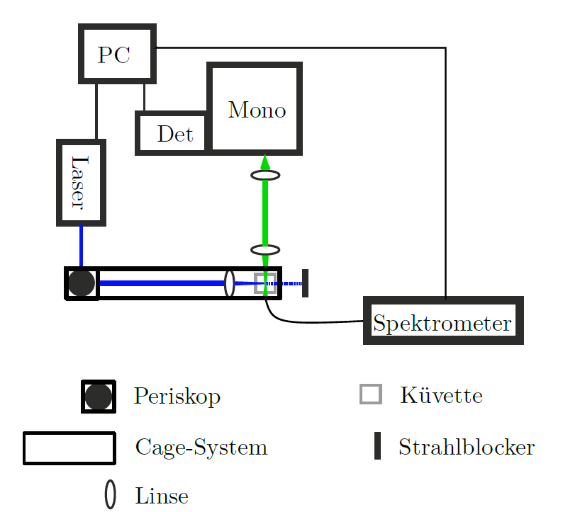
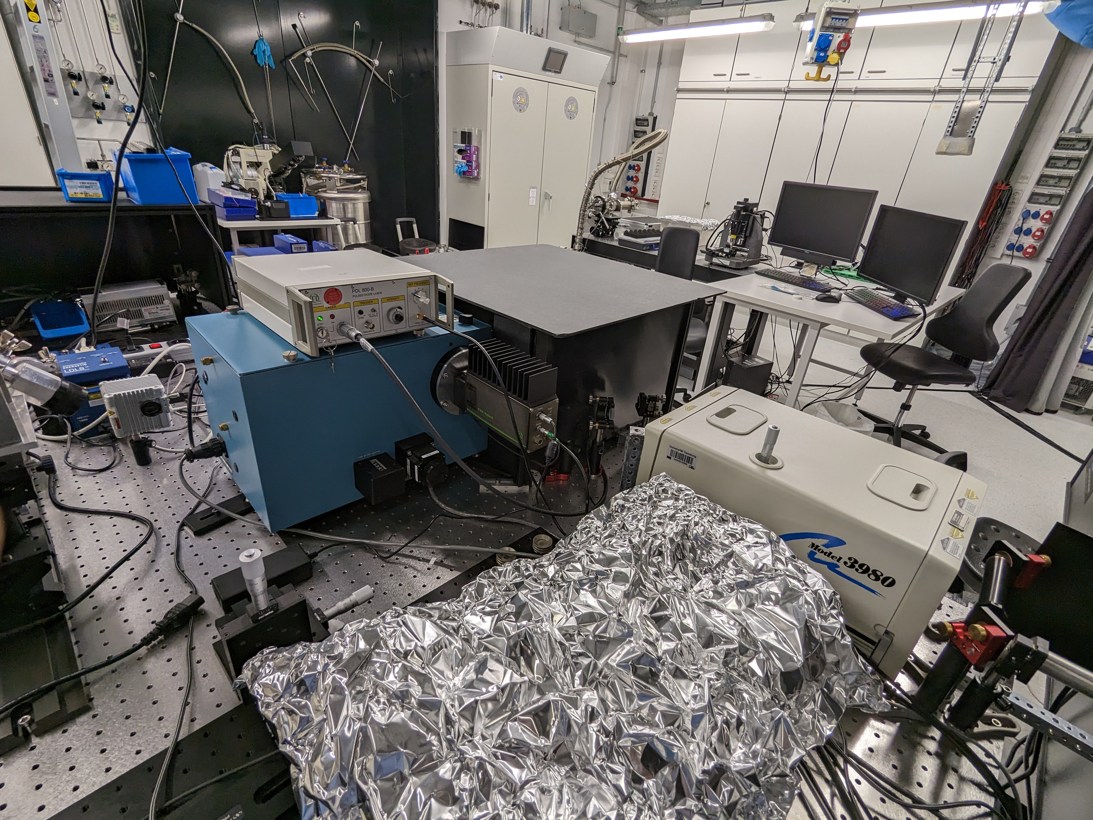
Setup
Experimental Time-Resolved Fluorescence Setup
Foto
The setup and all essential parts can be easily viewed, explained and understood.
Notes:
Experimental setup (The black box)
Do students have the possibility to assemble the setup?
Can they modify parameter? What is the largest systematic effect?
Do they learn how is the measurable “signal” obtained?
Note: also for experiments based on already available data it is essential that the students gain understanding of the setup that generated their data, difference between raw data and calibrated data, systematic effects

Slide 4
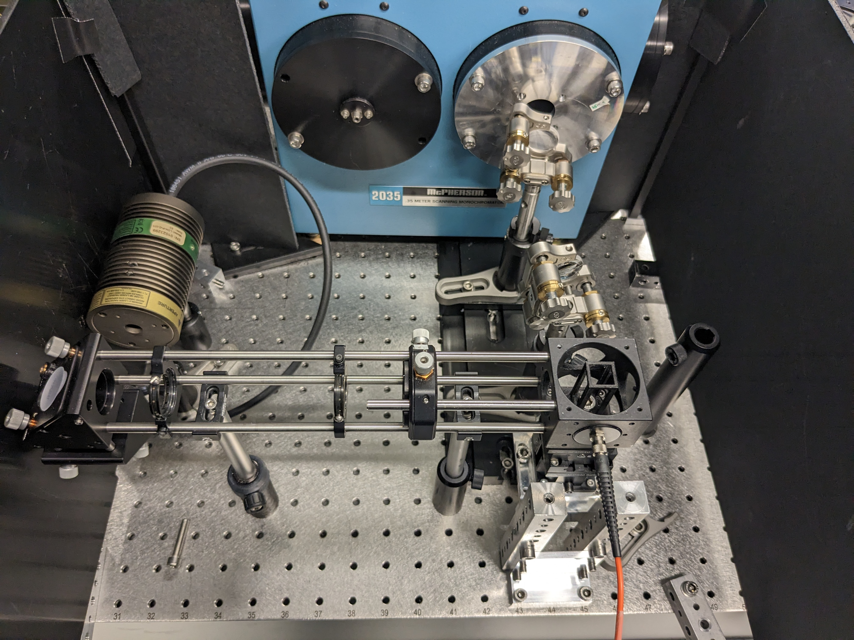
Setup
Experimental Time-Resolved Fluorescence Setup
Foto
The setup and all essential parts can be easily viewed, explained and understood.
Notes:
Experimental setup (The black box)
Do students have the possibility to assemble the setup?
Can they modify parameter? What is the largest systematic effect?
Do they learn how is the measurable “signal” obtained?
Note: also for experiments based on already available data it is essential that the students gain understanding of the setup that generated their data, difference between raw data and calibrated data, systematic effects

Slide 5
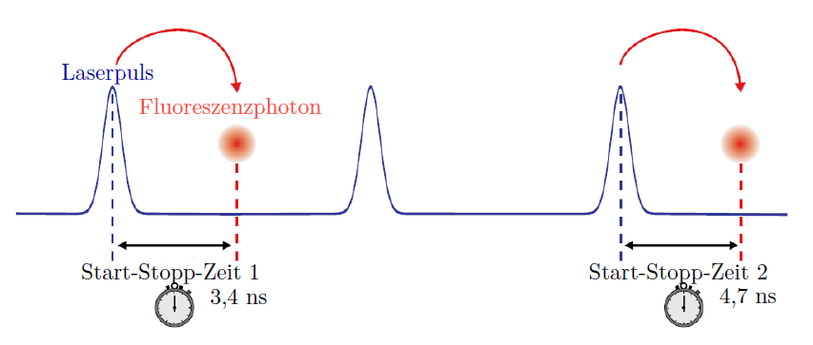
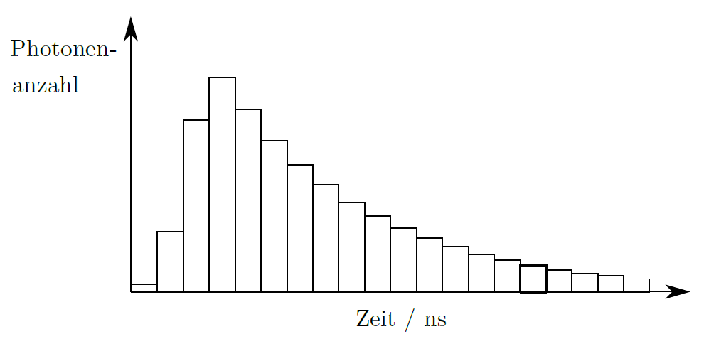
Aim and precision
Measurement Technique
Time correlated single-photon counting (TCSPC):
Live view on histogram development over time
Students gain practical understanding of an important standard technique
Precision: ca. 10ps; state of the art
Notes:
Experimental setup (The black box)
Do students have the possibility to assemble the setup?
Can they modify parameter? What is the largest systematic effect?
Do they learn how is the measurable “signal” obtained?
Note: also for experiments based on already available data it is essential that the students gain understanding of the setup that generated their data, difference between raw data and calibrated data, systematic effects

Slide 6
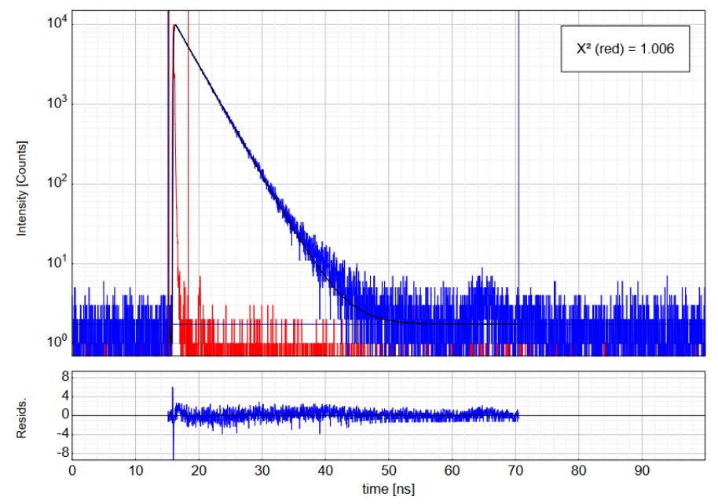
Specific points of reflection
Data Analysis
… is a key aspect of the experiment.
(1) Fit of the exponential decays directly in the lab and deconvolution of the instrumental response function (-> Fitting software provided)
Notes:
Data analysis method (The other black box)
Is data analysis a key aspect of this experiment?
What are the challenges?
Ideally students should analyse the data with own written code
If this is not the case, they still should gain understanding of what the provided code does.
Particular attention to statistical treatment of data: error treatment, binning, fit quality, …

Slide 7
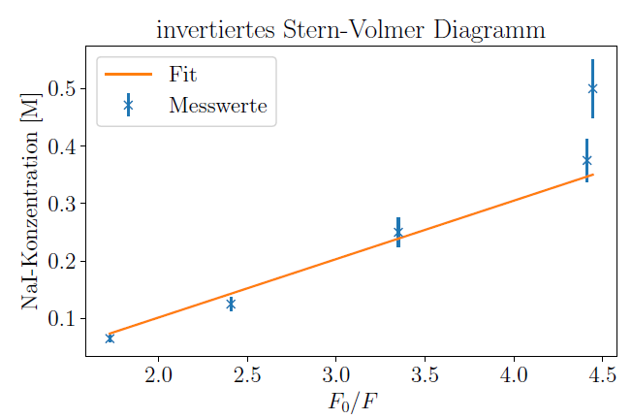
Specific points of reflection
Data Analysis
(2) Application of theories to the data after the experimental phase (Analysis phase).
E.g. linear fit to fluorescence intensity as a function of quencher concentration. Often deviations from linear behavior at high concentrations. Students have to evaluate and discuss this.
Notes:
Data analysis method (The other black box)
Is data analysis a key aspect of this experiment?
What are the challenges?
Ideally students should analyse the data with own written code
If this is not the case, they still should gain understanding of what the provided code does.
Particular attention to statistical treatment of data: error treatment, binning, fit quality, …

Slide 8
Specific points of reflection
Key scientific learnings
Students learn:
How to work in a chemistry room? (Sample preparation, Handling of solvents, etc.)
How does a laser laboratory look like? (Applied Optics Group: Resonance, time resolved, nanofocus Raman Spectroscopy, time resolved Fluorescence)
How to record meaningful datasets (inkl. reference measurements, instrumental response,…)
How does single photon counting work?
Application of theoretical models towards a fit function. From the simplest model to more complex ones…
Notes:
Key scientific results
What do students learn from this experiment?
What is the precision achieved ? How does it compare to literature / state of the art?
What is the emphasis of the experiment?
Which skills do students learn?

Slide 9
Grade your experiment
Theory: different Laws and dependencies, interdisciplinary
Setup: stretching over 2 labs (chemistry/optics), everything hands-on
Data taking: on site-analysis and adjustment, references…,
Analysis: Using different theoretical models to fit, non-model behaviour of samples
Theory / preparation | Setup / experimental | Data taking | Analysis | Protocol
3 | 2 | 3 | 2 | 2-3

Slide 10
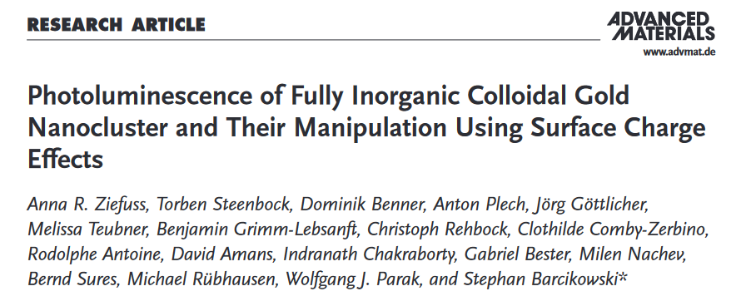
Specific points of reflection
Link to modern research in the physics department
Notes:
Link to modern research in the physics department
(if applicable links to clusters of excellence)
What is the modern application of this technologies / experimental methods
In which group are these technologies / experimental methods applied
What skills do the students gain which can be used in the research group?
What is the difference between state of the art equipment and the F-praktikum setup?

Slide 11
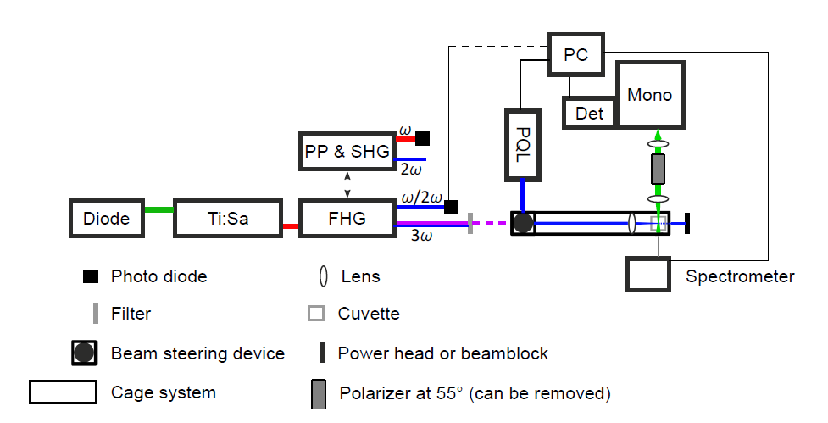
Specific points of reflection
Our State of the Art Setup
F-Praktikum Setup
Same setup, with a simplified laser system. However, the full laser system is visible and presented to the students during a lab tour.
Notes:
Link to modern research in the physics department
(if applicable links to clusters of excellence)
What is the modern application of this technologies / experimental methods
In which group are these technologies / experimental methods applied
What skills do the students gain which can be used in the research group?
What is the difference between state of the art equipment and the F-praktikum setup?

Slide 12
Specific points of reflection
Strengthen the research/INF connection
Including Nanoparticles:
Plasmonic
Confined/semiconductor
Solvent/ligand effects
Size
Scattering
Notes:
Link to modern research in the physics department
(if applicable links to clusters of excellence)
What is the modern application of this technologies / experimental methods
In which group are these technologies / experimental methods applied
What skills do the students gain which can be used in the research group?
What is the difference between state of the art equipment and the F-praktikum setup?

