Slide 1
Der Mößbauereffekt
Georg Steinbrück
10.5.2023, 2023

Slide 2
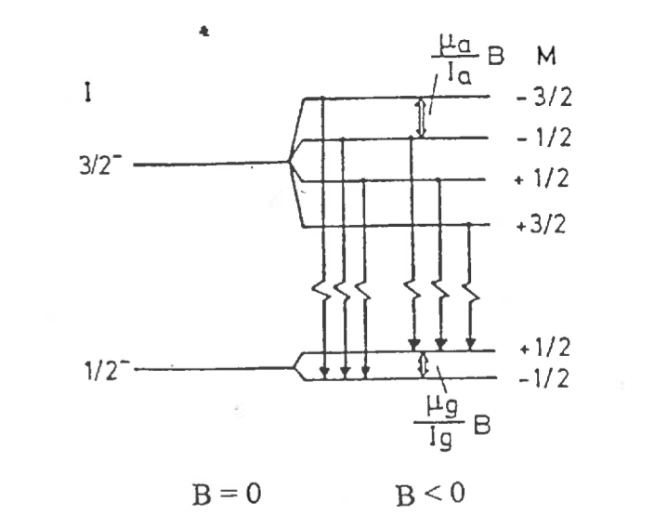
Scientific Content
Mößbauer-Effect
Resonant recoil free nuclear emission and absorbtion in atomic nuclei bound in a solid
Used for precision spectroscopy of hyperfine structure of Fe-57 making use of the Doppler effect
How is the experiment linked to the scientific bachelor program?
  Linked directly to Physics 5 (Nuclear Physics part of the lecture)
Added value to the experiment to the lectures
  Shows how one can measure very small effects with high precision (hyperfine structure: neV, Fe-57 transition: 14 keV) with a relatively simple setup
  Gaining in-depth understanding of one particular area of nuclear physics

Slide 3
Aim of the Experiment
What is the emphasis of the experiment?
  To get to know an ingenious experimental method to study neV effects making use of the Doppler effect: = O(mm/s) velocities →neV effects for keV transition: extreme precision
  Data analysis uses an analysis template in Igor,
  main challenge: take the fit results and arrive at the quantities to measure: parameters for the hyperfine structure (B-field, µ_A, etc.) plus their uncertainties
Which aspects of the experimental method are particularly important?
  Energy calibration of the gas proportional counter, calibration of the velocity spectrum of the Mössbauer drive
How does it compare to state of the art experiments in the research field?
  Mössbauer spectroscopy itself is a classic method and has been around for a while. It is still used for material analysis and in Chemistry today
  Has been used on the Mars rover Opportunity
  Used at Petra accelerator in a modified setup → Group of Ralf Röhlsberger

Slide 4
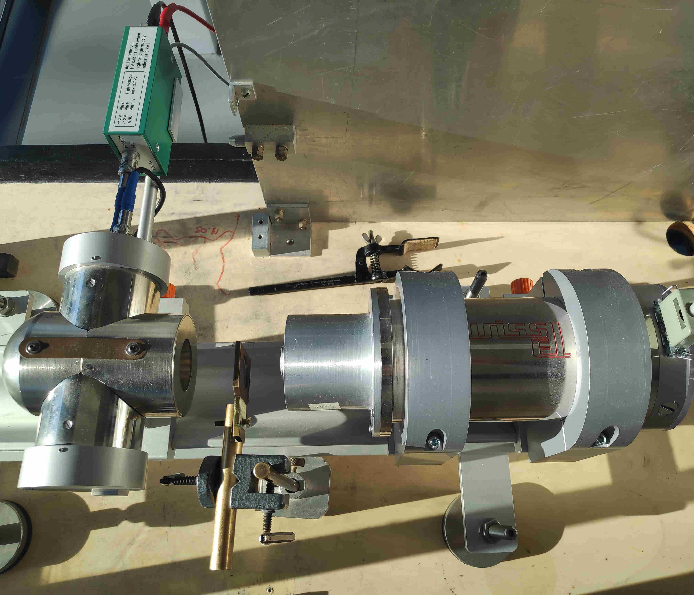
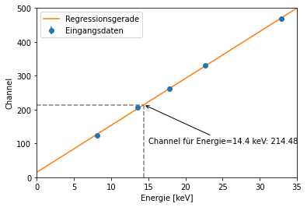
Experimental Setup
Setup based on components and readout software from WissEl
Readout via usb-based ADC/MCS unit (not shown)
Analysis software: template in Igor pro, provided by WissEl
1) Energy calibration of gas proportional counter using Am-241
source: k_alpha lines of various metals
→selection of Mößbauer transition line
Objectives: understand how a proportional counter
works, E-calibration using the tool the students choose
2) Measure Mößbauer spectra with different absorbers in two velocity ranges
Pre-amp
gas proportional counter
Mößbauer drive
Co-57 source
absorber

Slide 5
Experimental Setup
Do students have the possibility to assemble the setup?
  No. Since this experiment uses a rather compact setup with a usb-based DAQ rather than NIM components and cables, there is no real point in disassembling and assembling the setup
Can they modify parameter? What is the largest systematic effect?
  Yes, they first do an energy calibration of the gas proportional counter, select an energy window for the Mößbauer-transition and take data with two different velocity settings
  Largest systematic: velocity precision of Mößbauer drive
  →This can directly be measured by the students using an oscilloscope
Do they learn how is the measurable “signal” obtained?
  Yes, they learn about the entire signal chain

Slide 6
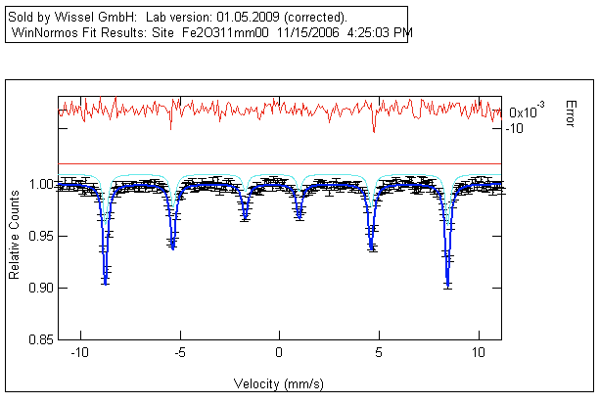
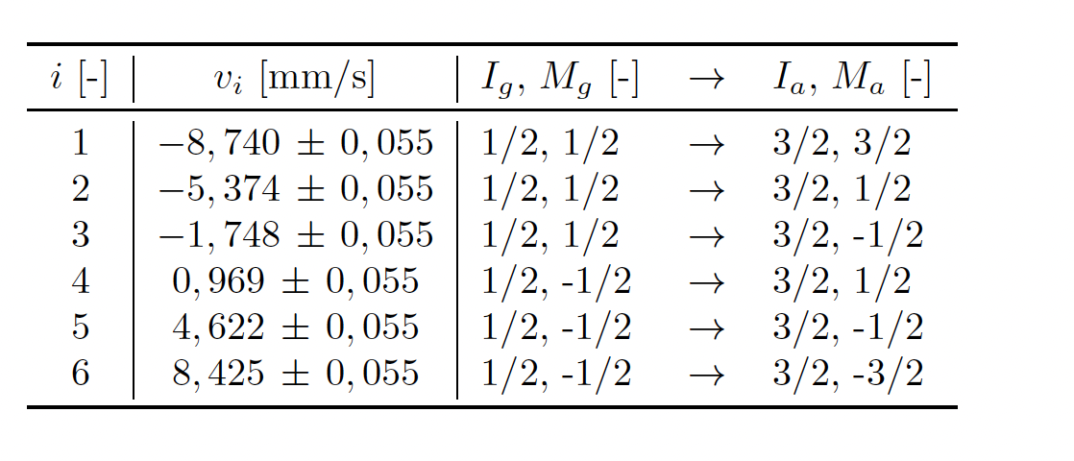
Data Analysis Methods
The students measure the hyperfine structure of Fe-57 compounds:
B-field, magnetic moment of excited state µA, quadrupole term E_el and V_zz, isomeric shift
lifetime of the excited state tau_A using single line absorbers
Debye Waller factor (probability for recoil free transition)

Slide 7
Data analysis method
Is data analysis a key aspect of this experiment?
  yes
What are the challenges?
  Data analysis for this experiment is done in several steps. The first step is an energy calibration of the Mößbauer drive using an Fe-57 absorber with known parameters
  The second step is to fit spectra using a fit-template in Igor to extract the velocities of the resonant absorption peaks
  The third step is to extract the measurable quantities for the hyperfine structure →This step is done “by hand” by solving a system of linear equations and calculations.
  The errors are also calculated by hand

Slide 8
Key scientific results
What do students learn from this experiment?
  They learn about the theory (hyperfine structure of Fe-57) and how this can be measured using the Doppler effect, including the DAQ chain: pre-amp, amp, ADC/MCS They learn how to deduce the basic hyperfine parameters from velocity spectra
What is the precision achieved ? How does it compare to literature / state of the art?
  The parameters for the neV hyperfine structure effects can be measured with % precision. With the same kind of setup, one could probably reduce the uncertainties even more with measures like much longer measurement times (to reduce stat. uncertainties), a new Mössbauer drive (?), new absorbers (relevant for a part of the experiment), a sine- instead of a linear velocity scale
What is the emphasis of the experiment?
  To get to know a classic experiment in nuclear physics and to gain in-depth understanding of the underlying theory needed to extract the measured quantities
Which skills do students learn?
  Energy calibration of a detector, extraction of fundamental parameters of the hyperfine structure from velocity spectra, estimation of systematic uncertainties

Slide 9
Link to modern research in the dep.
What is the modern application of this technologies / experimental methods
  See p3.
In which group are these technologies / experimental methods applied
  Photon science: Röhlsberger et. al for example
What skills do the students gain which can be used in the research group?
  Critical error analysis, determination of basic physics quantities from a measured spectrum
What is the difference between state of the art equipment and the F-praktikum setup?
  The F-Praktikum setup is in fact used regularly at Petra by the Röhlsberger group (in a modified way)

Slide 10
Grade your experiment
Each F-Praktikum experiment accounts for 2.5 LP (= 2.5 Semester Wochen Stunden)
This should correspond to:
3 full days Lab in presence [à 8h] for data taking & fast analysis [24 h]
Analysis and Protocol (<20 page) [14 h]
Grade the complexity of the various aspects of your experiment in a scale from 1-5 where 1 is high and 5 low
Theory / preparation | Setup / experimental | Data taking | Analysis | Protokol
1 | 3 | 3 | 1-2 | 1-2

Slide 11
Backup

Slide 12
To cover
From Email:
scientific content
aim of the experiment
experimental setup: emphasis on challenges and teaching objectives
data analysis method: emphasis on tools and teaching objectives
key scientific results and their relevance: precision compared to state of the art research
link to modern research in the physics department (if applicable links to clusters of excellence)

