Slide 1
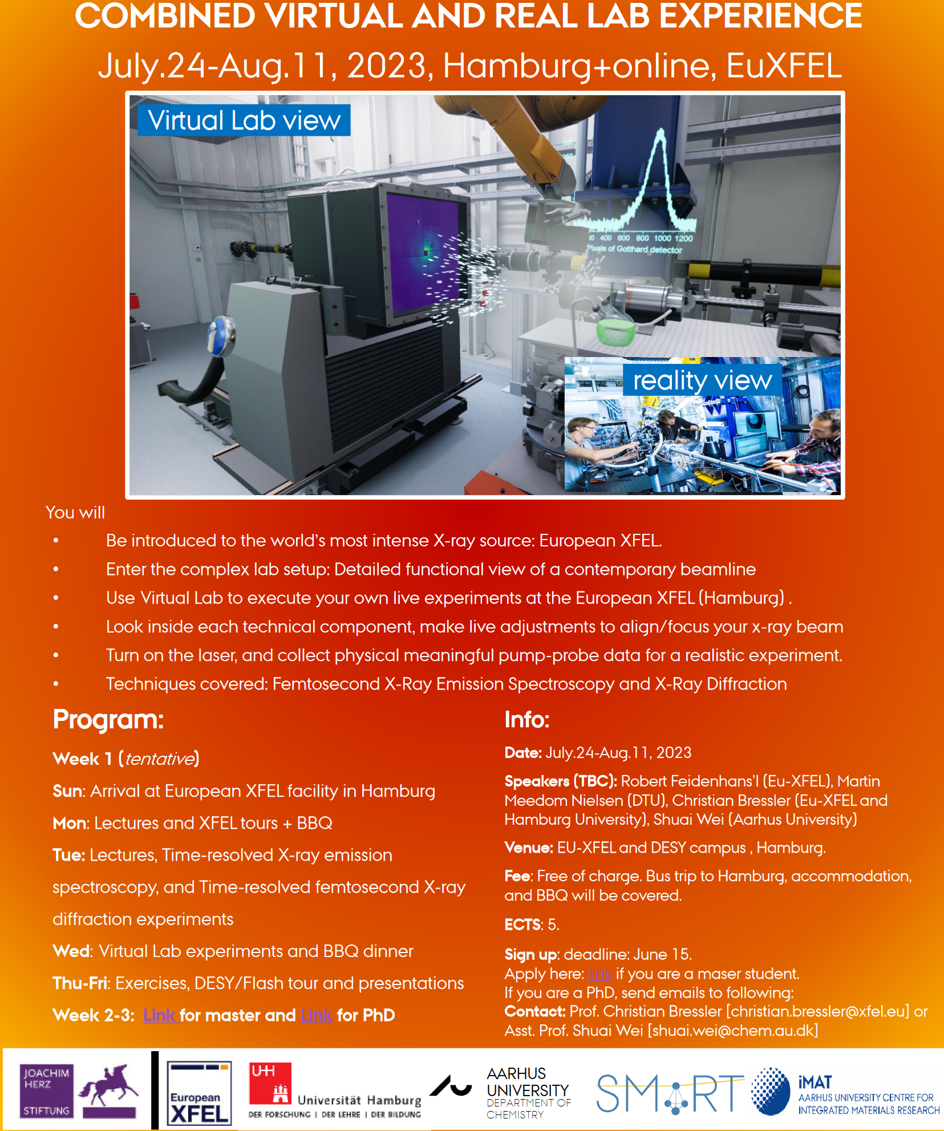
F-Praktikum Review Day: EXP21 “Femtosecond X-Ray Experiments”, now in “Atom-, Molekül-und Laserphysik”, and no longer in “Themenübergreifend”
EXP21 represents a new teaching tool for experimental physics. We are also starting to blend it into a Masterstudent course (with partner university Aarhus):

Slide 2
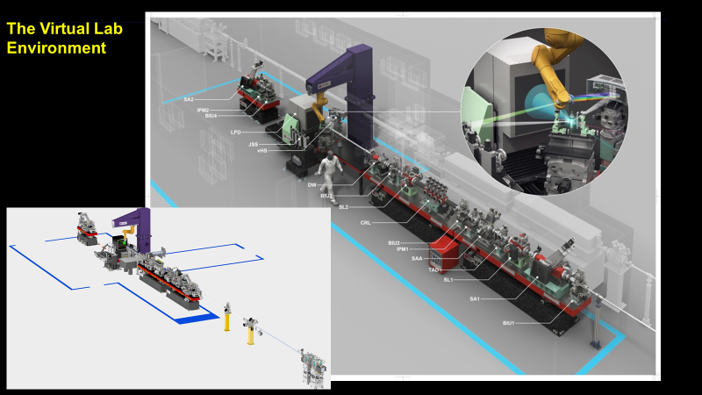
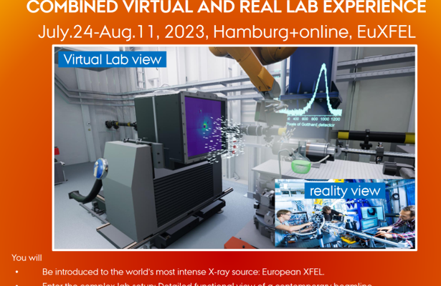
EXP21 “Femtosecond X-Ray Experiments”
Scientific contest
How is the experiment linked to the scientific bachelor program?
Not so much for the Bachelor Course Lectures (yet… suggestions welcome)
Added value to the experiment to the lectures
Provides a first deep insight into a complex and modern experiment
Provides a deep look into the basics of a typical SR beamline (FLASH, PETRA III, EuXFEL)
Brings them super-close to contemporary experiments at EuXFEL

Slide 3
Specific points of reflection
Aim of the experiment
What is the emphasis of the experiment? (data analysis, experimental method, systematic study, precision measurement, discovery…)
in priority order: Experimental Method, systematic study, data analysis, discovery
Which aspects of the experimental method are particularly important?
Basic aspects from large-scale light sources, from undulator source to experiment, Basic beamline Alignment, identifying basic beam properties (intensity, spectrum, spot sizes) for the experiment, light-matter interactions,…
How does it compare to state of the art experiments in the research field?
EXP21 is very close to a real EuXFEL beamline (digital twin), the (published) experimental data are actually fully extractable in VLab

Slide 4
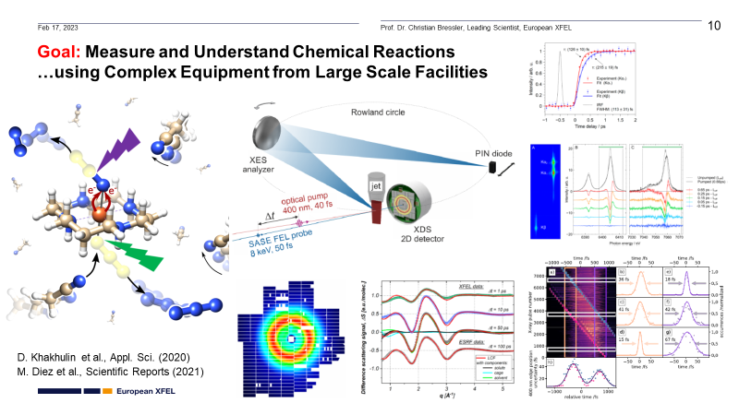
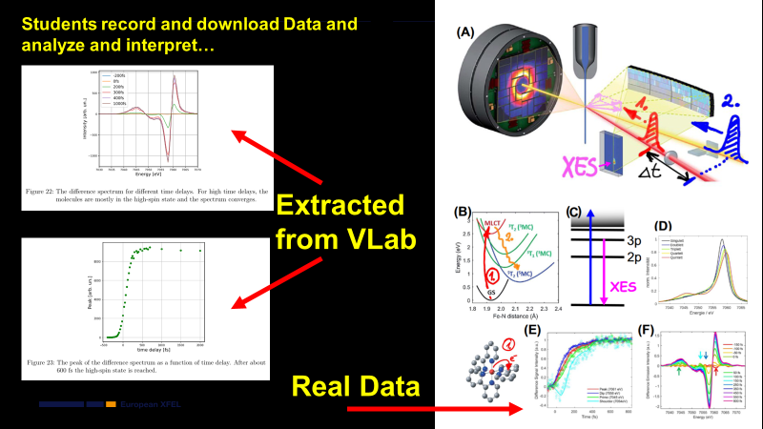
Aim of the experiment

Slide 5
Specific points of reflection
Experimental setup (The black box)
Do students have the possibility to assemble the setup?
Can they modify parameter? What is the largest systematic effect?
Do they learn how is the measurable “signal” obtained?
Note: also for experiments based on already available data it is essential that the students gain understanding of the setup that generated their data, difference between raw data and calibrated data, systematic effects
No self-assembly (yet…), ample control of most parameters, decides whether they observe anything, noisy data, or useful data. The script stepwise guides them to understand/document every bit of the setup.
They modify parameters to receive better or worse signals, they learn about the basic input (flux, spot size), but Vlab is currently underway to implement more detector-related characteristics.

Slide 6
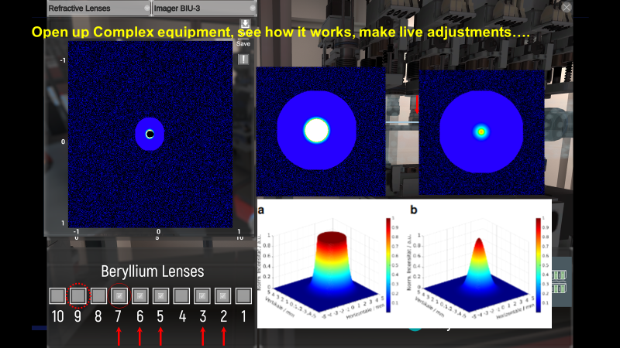
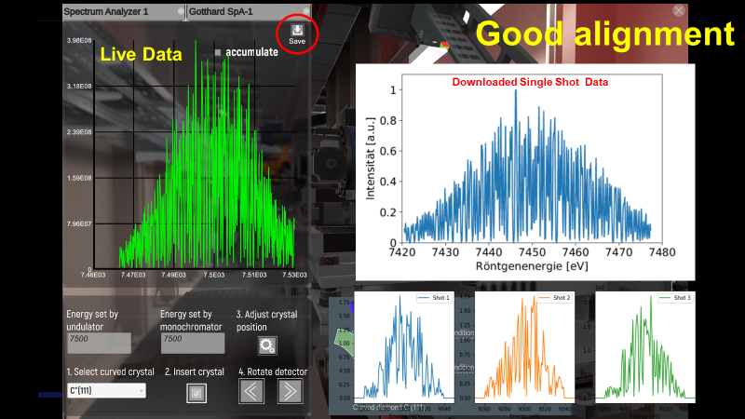
Experimental setup (The black box)
1 km to x-ray source
(virtual undulator)

Slide 7
Specific points of reflection
Data analysis method (The other black box)
Is data analysis a key aspect of this experiment?
What are the challenges?
Ideally students should analyse the data with own written code
If this is not the case, they still should gain understanding of what the provided code does.
Particular attention to statistical treatment of data: error treatment, binning, fit quality, …
Basic plotting of usefully extracted data, 2D plots with false-color scales, currently part/part: some do the above themselves, others depend on delivered python codes
Statistics: currently further under development, few case examples implemented but more relevant ones underway in VLab

Slide 8
Specific points of reflection
Key scientific results
What do students learn from this experiment?
What is the precision achieved ? How does it compare to literature / state of the art?
What is the emphasis of the experiment?
Which skills do students learn?
How to think all the way through a “real” SR beamline and design of an experiment. E.g. need to characterize the beam along the entire beampath (record data…)
Results reflect (recent!) published results with that experimental precision
Emphasis: experience an experiment without the usual boundaries in Fprak-experiments, learn how to reliably establish a functional experimental environment, understand that selected XES tools aim to reveal otherwise inaccessible information (e.g., fs laserlab experiments)
Skills: all of the above

Slide 9
Specific points of reflection
Link to modern research in the physics department
(if applicable links to clusters of excellence)
What is the modern application of this technologies / experimental methods
In which group are these technologies / experimental methods applied
What skills do the students gain which can be used in the research group?
What is the difference between state of the art equipment and the F-praktikum setup?
- EXP21 is already a modern research experiment in the physics department
- Represents a digitial twin of an existing EuXFEL beamline, several UHH and CUI groups use these methods (and variants of): Huse, Martens, Rübhausen, Chapman, …
pump-probe, XAS, XANES, XES, (powder diffraction, EXAFS…)
Hardly any difference in methodology to contemporary experiments, details still scarce, but growing over time

Slide 10
Grade your experiment
Each F-praktikum experiment accounts for 2.5 LP (= 2.5 Semester Wochen Stunden)
This should correspond to:
3 full days Lab in presence [à 8h] for data taking & fast analysis [24 h]
Analysis and Protocol (<20 page) [14 h]
5 days of experimenting/pre-analysis/pre-protocol (according to experience)
Ca 1-2 days of post-analysis and protocol
Grade the complexity of the various aspects of your experiment in a scale from 1-5 where 1 is high and 5 low
Theory / preparation | Setup / experimental | Data taking | Analysis | Protokol
3 | 1-2 | 2 | 2 | 3

Slide 11
Fortgeschrittene Praktikum
Leistungs Punkte (12 LP)
Statistik & Computer (2 LP)
Lectures 5 days [3 h/ day]
Exercise 5 days [3 h/ day]
3x Versuche (2.5 LP)
Festkörper- Teilchen- und Laserphysik
3 days Lab in presence: data taking & fast analysis [24 h]
Analysis and Long Protocol (<20 page) [14 h]
KV (1.5 LP)
1 day Lab in presence: data taking & analysis [8 h]
Short protocol (<10 pages) [6 h]
Seminarvortrag (1 LP)
15 min talk + rehearsal [12 h]
1 LP = 14 h work
11

