Slide 1

ILP9 - Single Photon Sources
An Introduction to Quantum Optics
F-Praktikum Review Day
Koen Sponselee & Christoph Becker
10-05-2023

Slide 2
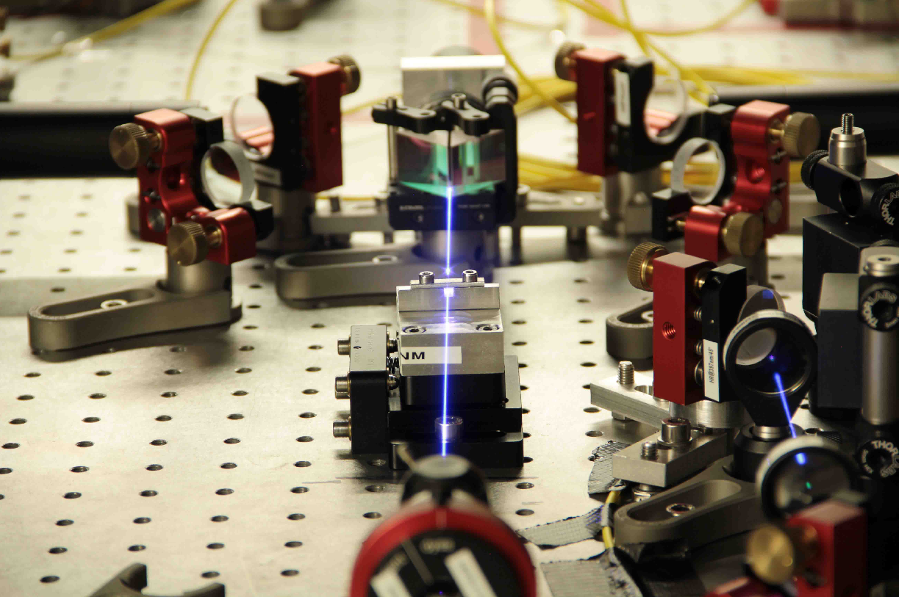
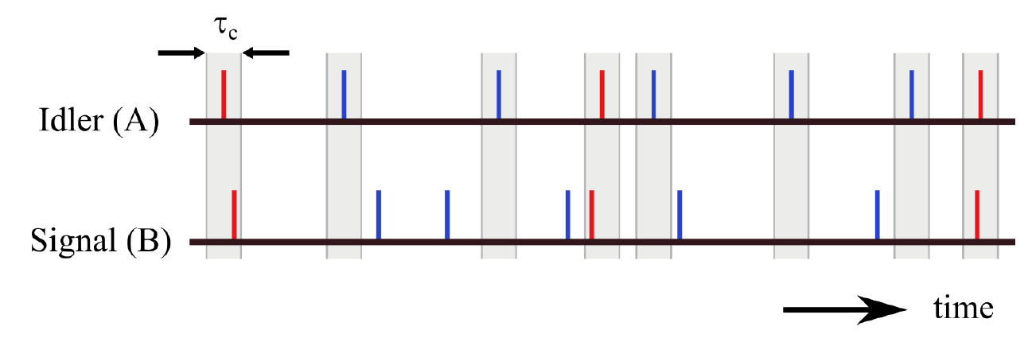
Overview
Overview
Laser pumps non-linear crystal, creating entangled single photon pairs.
Charactise setup, first and second-order correlations
Scientific Context
Quantum optics & technologies
Goals
Quantum character of light
Work in a laser lab (fundamental optics measurements, align interferometer, fibre coupling, polarisation control)
Correlation functions
Coincidence measurements
Minor: non-linear optics
1/8

Slide 3
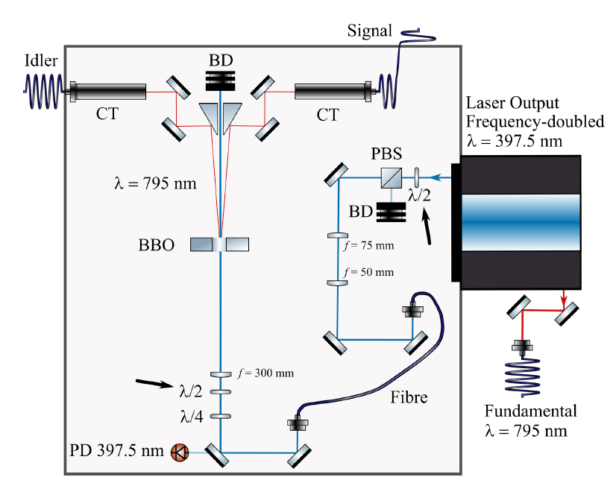
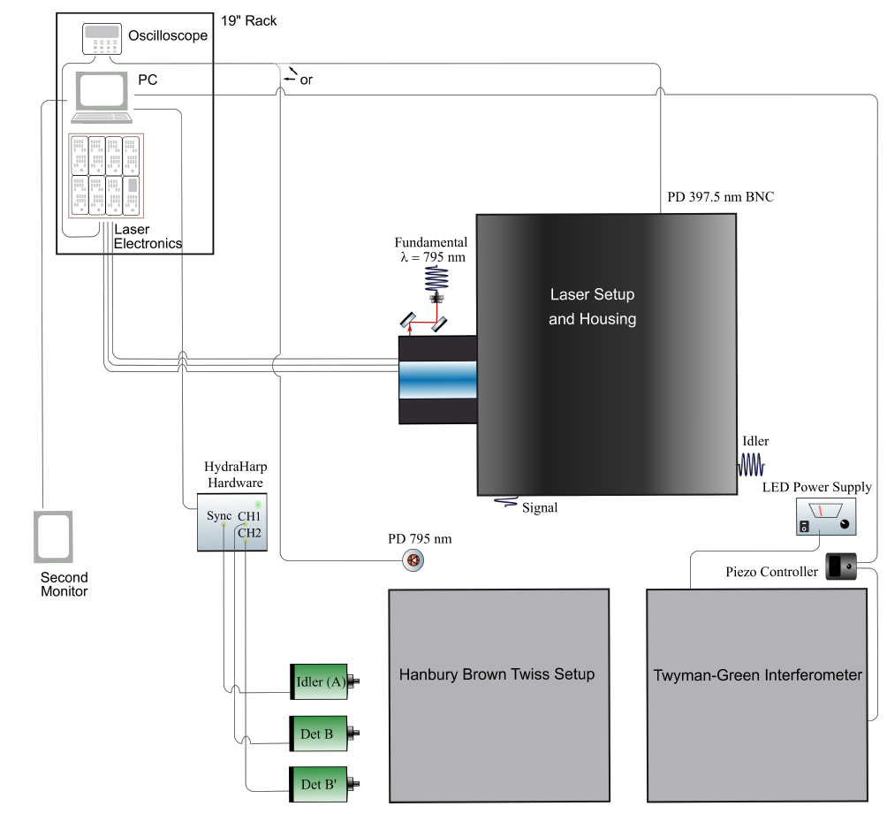
Experimental Setup
Day 1: Characterise the single-photon source
Laser at 397.5 nm pumps a non-linear crystal (BBO), type 1 phase-matching
Exercises:
Coincidence window
Coincidences as a function of pump power
Coincidences as a function of polarisation
1.5 hours: colloquium
0.5 hour: showing the lab
1-2 hours: measurements
Rest: time for analysis
2/8

Slide 4
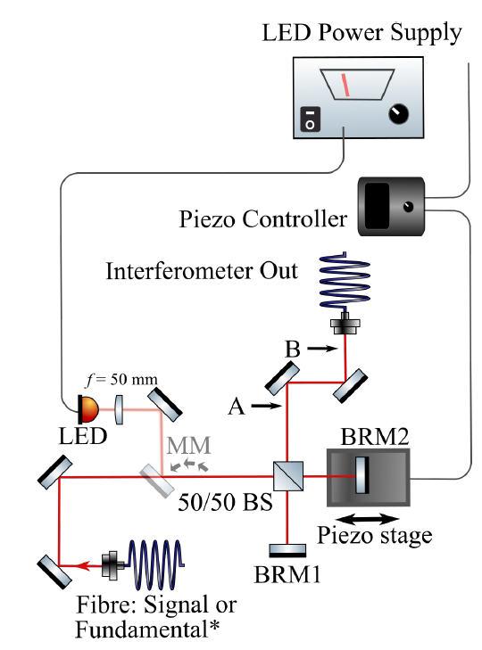
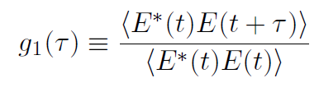
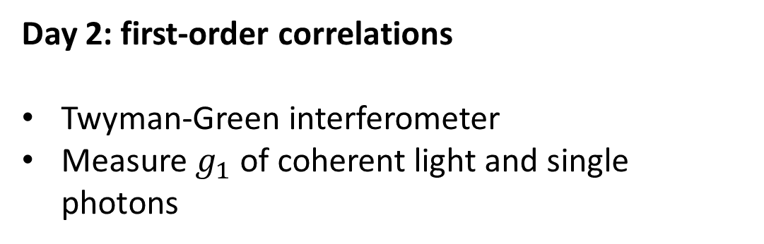
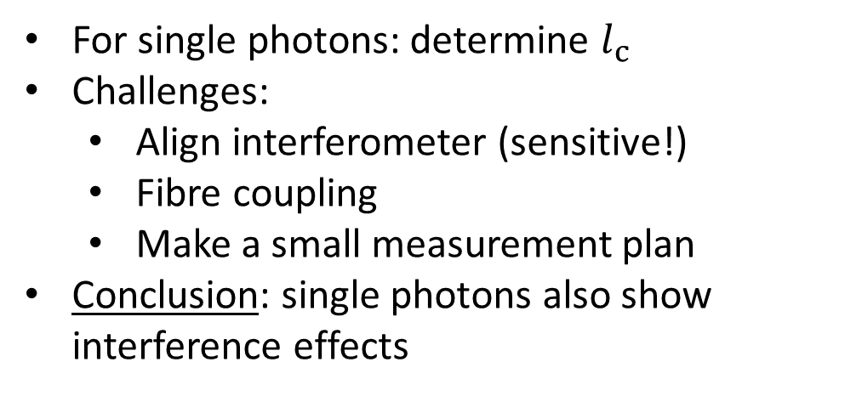
Experimental Setup
Day 2: first-order correlations
Twyman-Green interferometer
Measure $g_{1}$ of coherent light and single photons
For single photons: determine $l_{c}$
Challenges:
  Align interferometer (sensitive!)
  Fibre coupling
  Make a small measurement plan
Conclusion: single photons also show interference effects
2-3 hours: alignment
3-4 hours: measurement
3/8

Slide 5
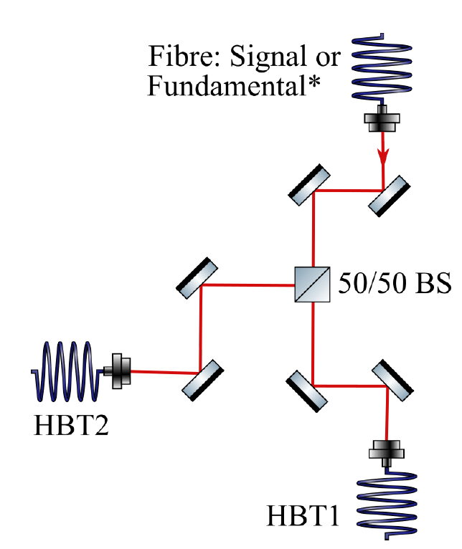
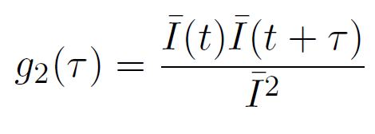
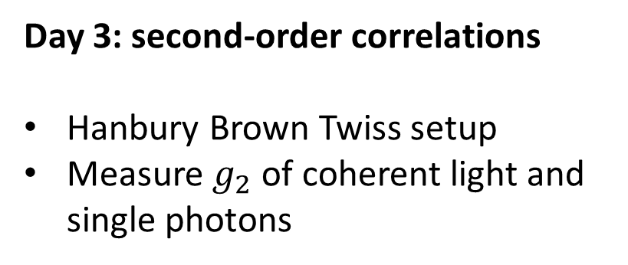
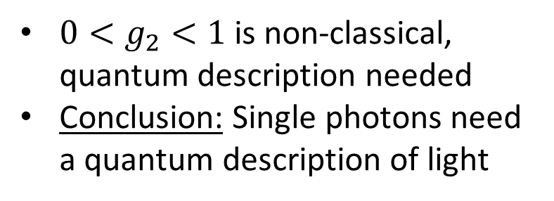
Experimental Setup
Day 3: second-order correlations
Hanbury Brown Twiss setup
Measure $g_{2}$ of coherent light and single photons
$0<g_{2}<1$ is non-classical, quantum description needed
Conclusion: Single photons need a quantum description of light
0.5 hour: discussion
0.5-1 hour: alignment
0.5 hour: measurement
Rest: time for analysis
4/8

Slide 6
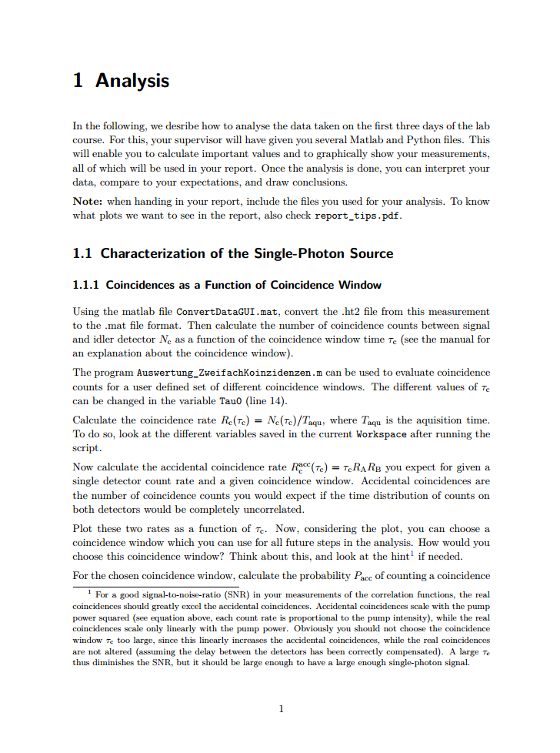
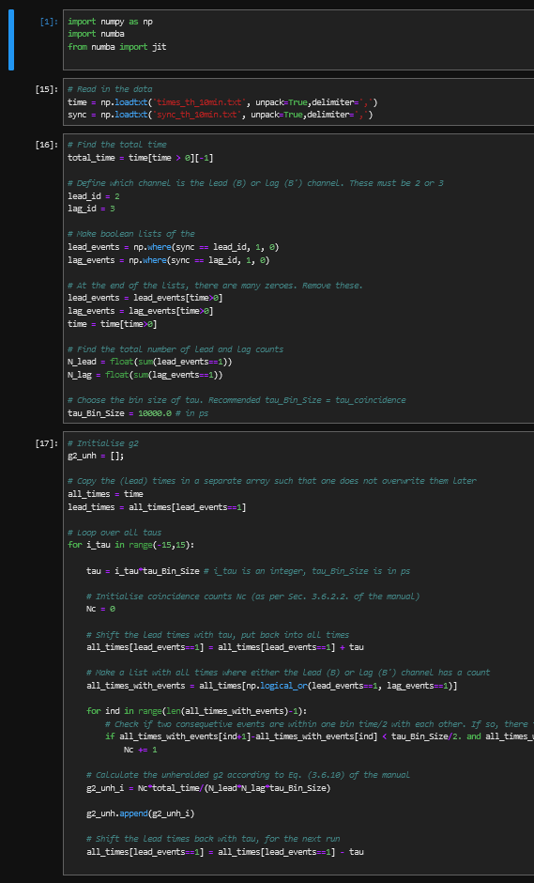
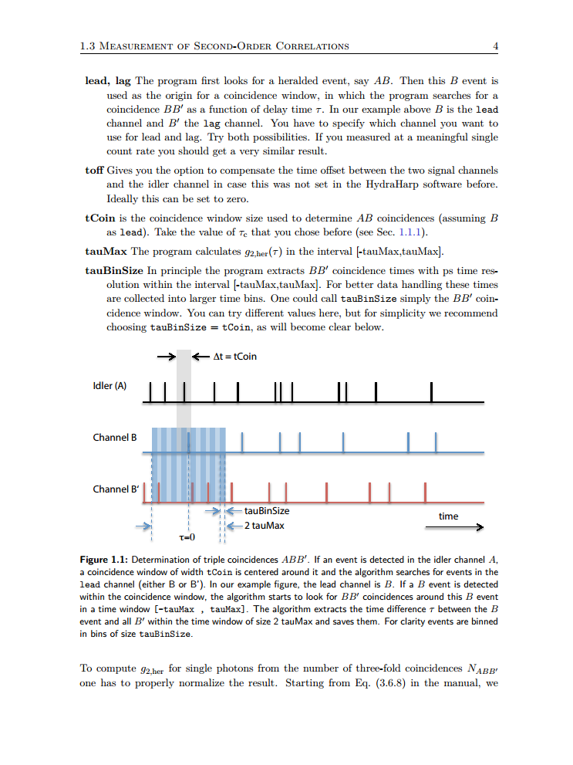
Data Analysis
Day 4-5
PC in lab can be used for analysis
Python code provided up to and including plotting
Students have to do fitting and error propagation themselves
  Day 2: correlated error propagation is needed
Analysis tips document provided (shortens main manual)
5/8

Slide 7
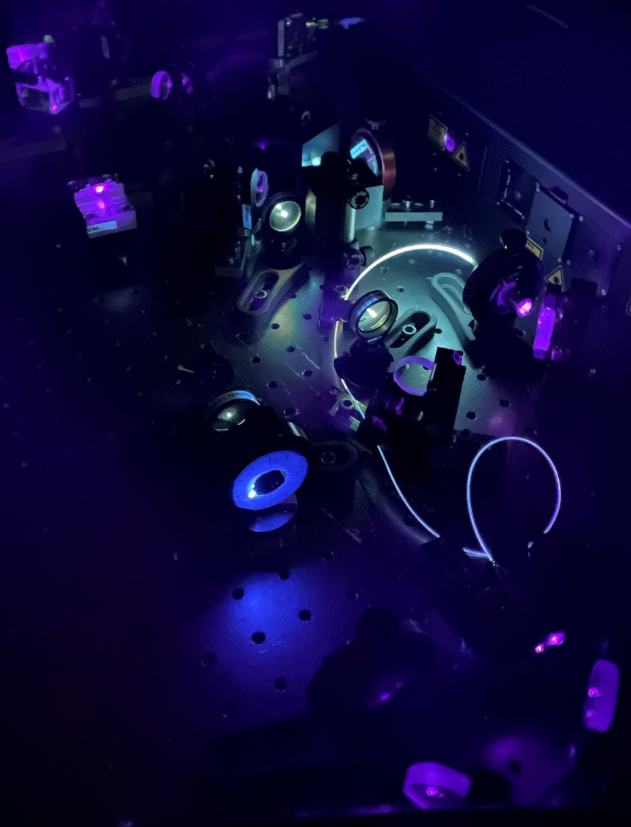
Improvements
Changes made over last few years:
Switched Matlab → Python
Less recipe-like, more self-critical thinking
1) Answer questions
2) Discuss with supervisor
3) Measure
Separate documents with analysis and protocol tips (shortens manual)
Students have to hand in their scripts (easier to see if analysis is correct)
In progress:
  Supervisor document with answers on questions
  Supervisor analysis with correct statistics
6/8

Slide 8
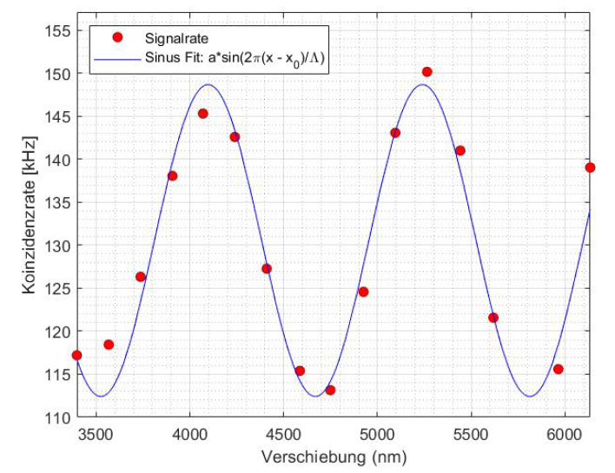
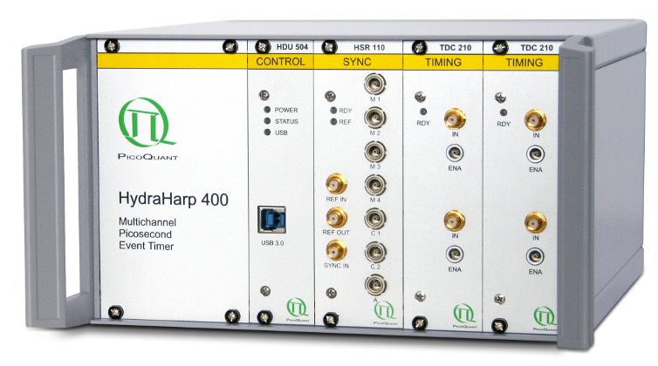
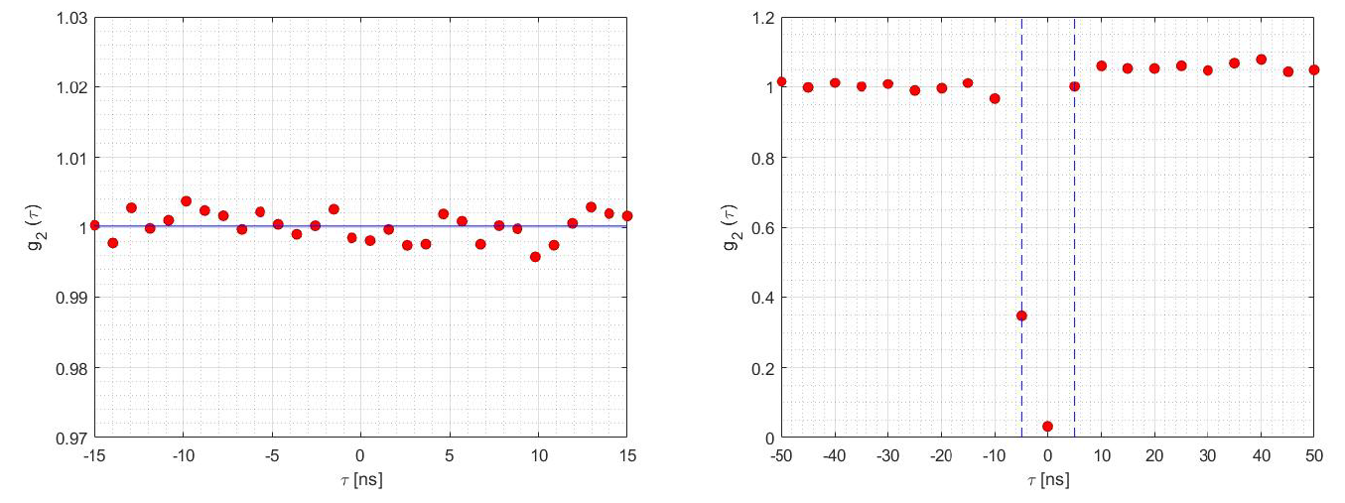
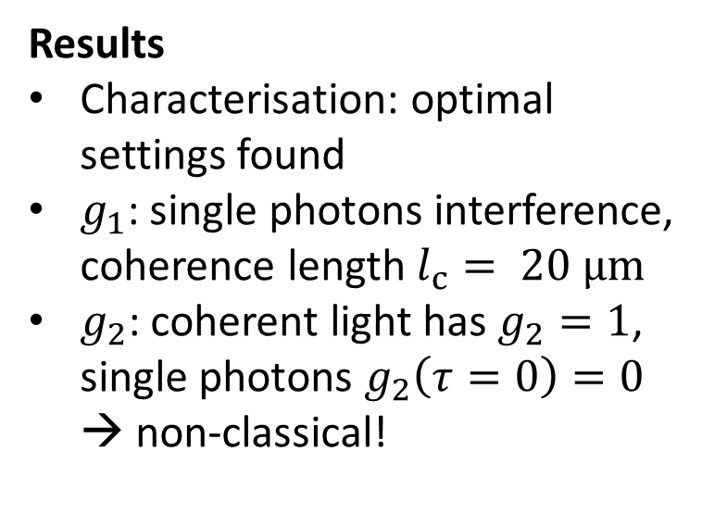
Results & Relevance
Results
Characterisation: optimal settings found
$g_{1}$: single photons interference, coherence length $l_{c}= 20 μm$
$g_{2}$: coherent light has $g_{2}=1$, single photons $g_{2}\left(τ=0\right)=0$ → non-classical!
Equipment state-of-the-art
Relevance
Essential building block for photon-based quantum technologies, quantum computing & communications
7/8

Slide 9
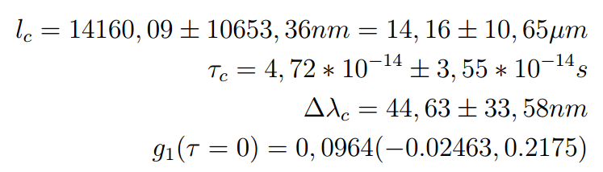
Our Observations
General
No one…
… cites correctly
… knows writing conventions (units, equations in sentences, etc)
… makes good plots
… makes a paper-like outline (order: all theory, then all experiments, then all results, then all discussions)
Example
Statistics
No one…
… can round correctly
… can quantitatively check if two values are significantly different
… can do error propagation with correlations (without correlations 50/50)
Physik6 Requirement & F-Praktikum
P6 is required for ILP9
Many people sign up for P6, but do not come to P6 at all
Makes planning very hard
8/8

