Slide 1
Hybrid semiconducting materials for photoelectrochemical energy conversion
Dr. Francesco Caddeo
f.caddeo@physnet.uni-hamburg.de
Institute for Nanostructure & Solid State Physics (INF)
Center for Hybrid Nanostructures (CHyN)
F-Praktikum Review
10/05/2023

Slide 2
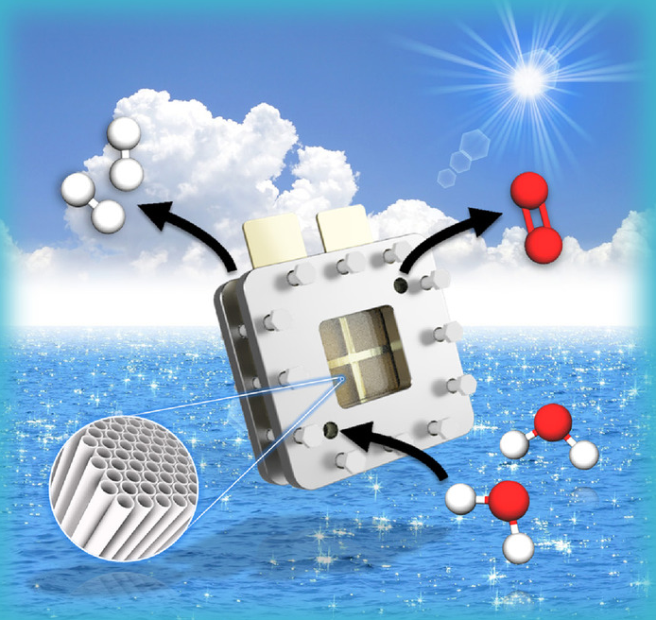
Semiconductor thin-films for PEC water splitting
PEC water splitting: storing solar energy into chemical bonds – fossils to renewables energy transition.
Link to bachelor program? Solid State Physics (Physik IV) – crystal structure, X-ray diffraction, semiconductor physics and devices
Emphasis of the experiments? Characterization of emerging photoactive materials in terms of crystalline phase, morphology, PEC properties.
Equipment: hands-on with state-of-the-art PXRD, SEM and PEC setup (PEC cell, potentiostat, solar simulator, LED light sources)
Aim of the course: Studying the PEC properties of emerging materials in PEC water splitting.
  Deposition of thin-films (e.g. metal-oxides) on a conductive substrate.
  Characterization using XRD, SEM
  Evaluation of PEC properties of the films in a PEC cell
  Data analysis – comparison with available literature
ChemSusChem, 2019, 12(9), 1925-1930

Slide 3
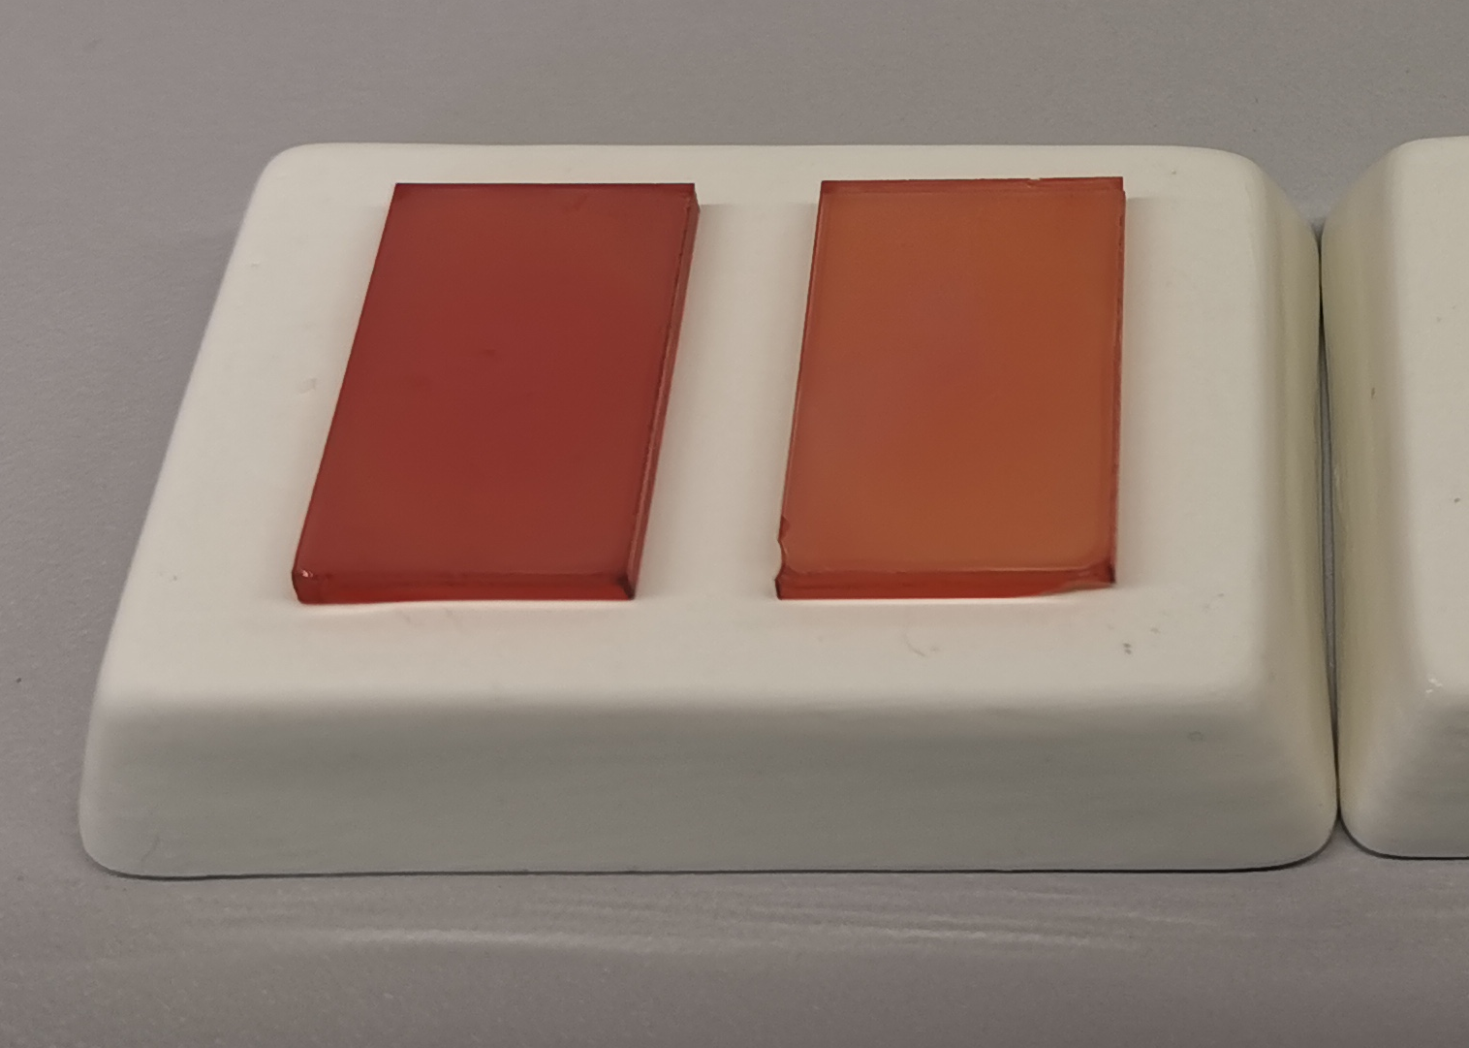
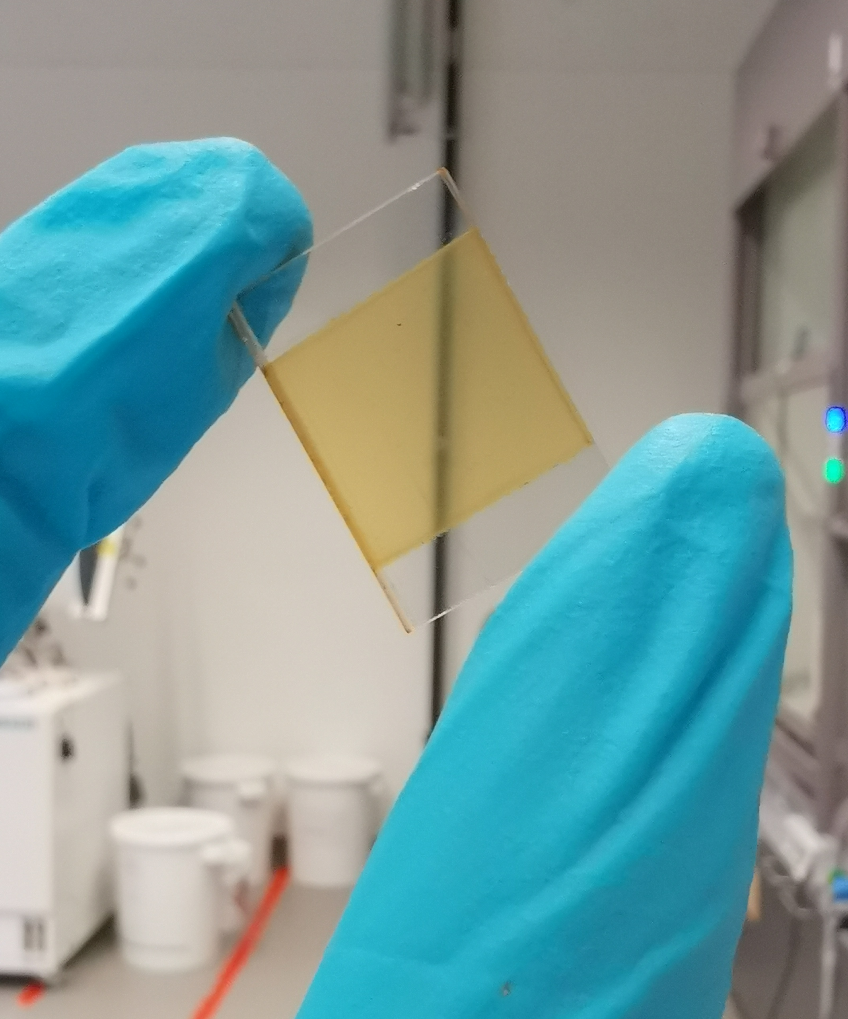
Day 1 – Deposition of thin-films on a conductive substrate
Metal-oxide thin films on conductive substrate
Planning of the synthetic strategy – preparation of precursor solution – deposition via spin-coating
Learn how to obtain uniform film depositions
Preparation of films with different thicknesses and morphology
50 nm
500 nm
2μm

Slide 4
Day 2: Characterization of the films
SEM
XRD
Crystalline and morphological characterization of the films
Learn how to obtain the PXRD pattern of the films
Comparison with references – evaluation of purity of crystalline phase
Learn how to obtain SEM images (top view + cross section)
2μm
870 nm
1μm

Slide 5
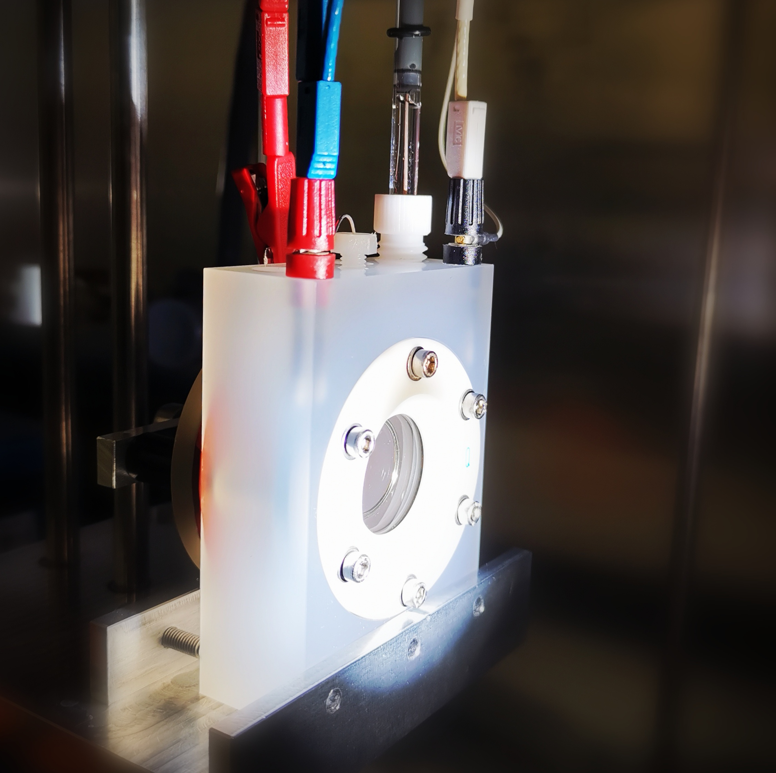
Day 3 – Evaluation of the PEC properties
Learn how to use state-of-the-art PEC setup – PEC cell, potentiostat, solar simulator, LED light source.
Calibration of the different light sources (power output and spectrum)
Assembly of PEC cell components – connection of WE, RE, CE and understanding of their function
Understanding the role of the 3-electrode setup and reference electrode – the Ag/AgCl vs. RHE scale – comparability of experimental data with literature.
Carry out basic PEC diagnostic measurements: OCP, LSV, Chronoamperometry, Cyclic voltammetry (ECSA).
Carry out measurements changing light source – solar simulator vs. LED light with different wavelength – how do these affect the photocurrents? And why?
Carry out long-term stability test (chronoamperometry) – discussion about stability of the prepared films – possible source of instability? Photocorrosion?

Slide 6
After the lab – data analysis
Data analysis and figure of merits:
Crystallinity – phase purity via PXRD – comparison with standards from the literature
Evaluation of morphology – thickness of the film via SEM
Determine n-type / p-type semiconductive behaviour via chopped-light OCP
Determine on-set potential and photocurrents achieved (LSV) – measurement of multiple sample for statistical data treatment
Determination of the electrochemically active surface area (ECSA, cyclic voltammetry)
Evaluation of the long-term stability of the film (chronoamperometry)
Theory / preparation | Setup / experimental | Data taking | Analysis | Protokol
1-2 | 3 | 3 | 3 | 1-2

