Slide 1
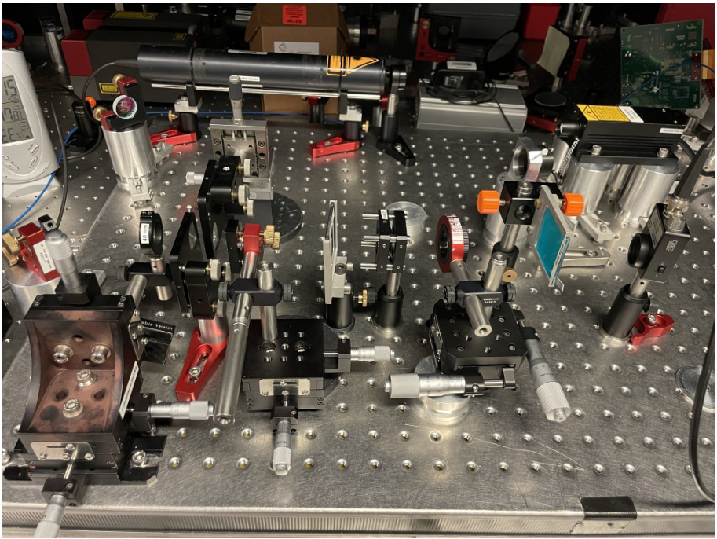
ILP4 Nd:YAG Laser
F-Praktikum Review Day 10.5.23
Luca Asteria
Research Group Sengstock/Weitenberg

Slide 2
Goals
Make students familiar with important concepts of laser sources
Provide them with an idea of how it‘s like to work in a quantum optics lab (many such labs in AIM cluster)
Measure and perform analysis of the data using error propagation, data fitting,
comparison with expected models and existing literature

Slide 3
Final setup
808nm
Pump Laser
1064nm
532nm
Nd:YAG laser
filter
Non-linear crystal
filter

Slide 4
Setup with adjustement laser
632nm
Adjustment laser
808nm
Pump Laser

Slide 5
Nd:YAG laser setup
632nm
Adjustment laser
808nm
Pump Laser
mirror
Hemispherical mirror
1064nm
lens
Nd:YAG crystal

Slide 6
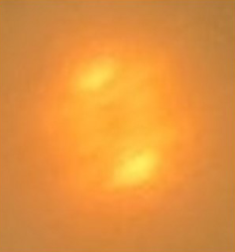
Selecting the resonator mode
808nm
Pump Laser
1064nm
Fluorescence
on a IR viewer card

Slide 7
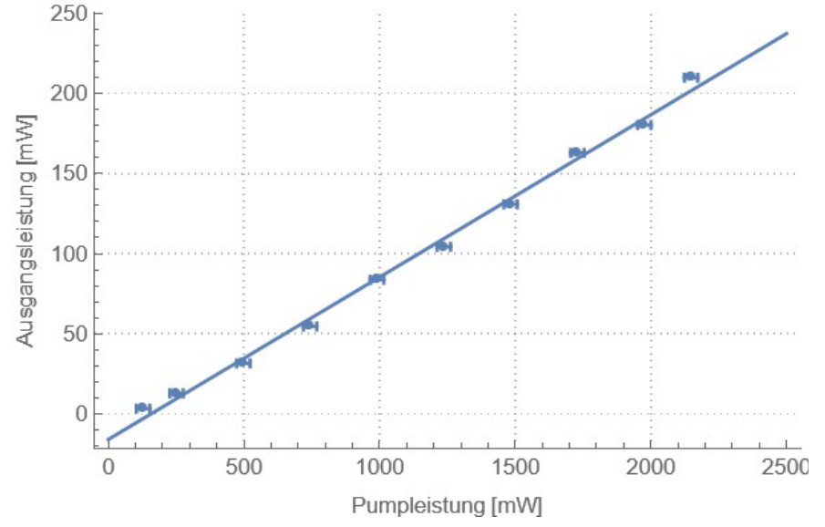
Nd:YAG laser setup
Example of a power curve
(Power out vs Power in)
Observation and discussion
of laser threshold

Slide 8
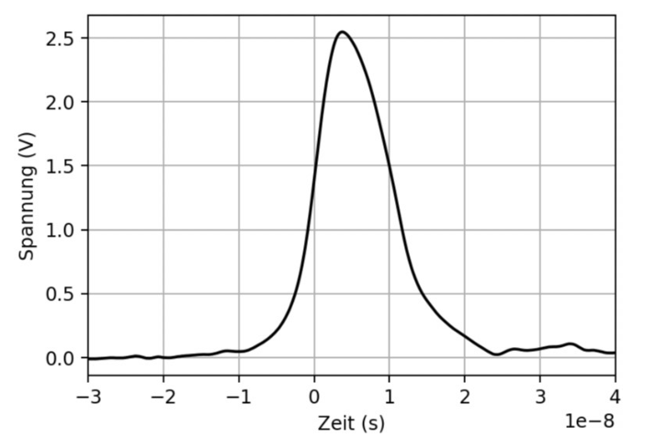
Q-switching
Characterize pulse length and pulse repetition rate
808nm
Pump Laser
1064nm
Fast photo diode
Saturable absorber
filter

Slide 9
Setup for second harmonic generation
808nm
Pump Laser
1064nm
532nm
Non-linear crystal
filter
filter

Slide 10
Theory
Theory: radiation-matter interaction, inversion of the internal levels population,
Optical resonators and resonator modes, Q-Switching, second harmonic generation
Connections made between theory and experiment (during initial discussion the first day, during the week, and
In the protocol)

Slide 11
Practical skills acquired
Practice: measurement of optical power, laser thresholds. Fitting and discussing experimental data.
Extracting from data quantities that can not be measured directly
Skills acquired: basic alignement of optical setups and of a simple optical resonator,
selecting the fundamental resonator mode
Get feedback on how to report experimental values and errors and how to write a protocol more like
a real „scientific publication“.

Slide 12
Feedback
Preparation of the students is usually adequate, even though not always „perfect“.
Some concepts (usually related to more detailed quantum mechanical notions) usually understood on a
qualitative level
Groups can usually perform the measurement and take the data mostly „on their own“, with moments
of discussion and help for the laser adjustment from the supervisor
Students give positive feedback on this experiment („learned a lot“, „very interesting“,…)
Sometimes it can be frustrating for them in the initial stages not to being able to start the
laser operation probably due to a not optimal alignment, of which they are not aware.

