Slide 1
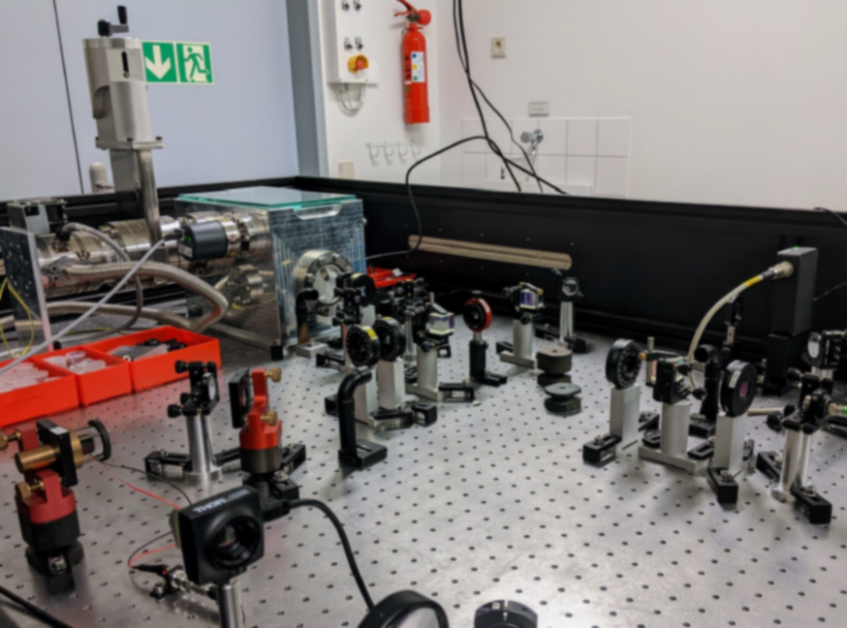
ILP 8 - Interferometrische Messung der thermischen Bewegung einer Membran auf Pikometer-Skala
Pascal Gewecke

Slide 2
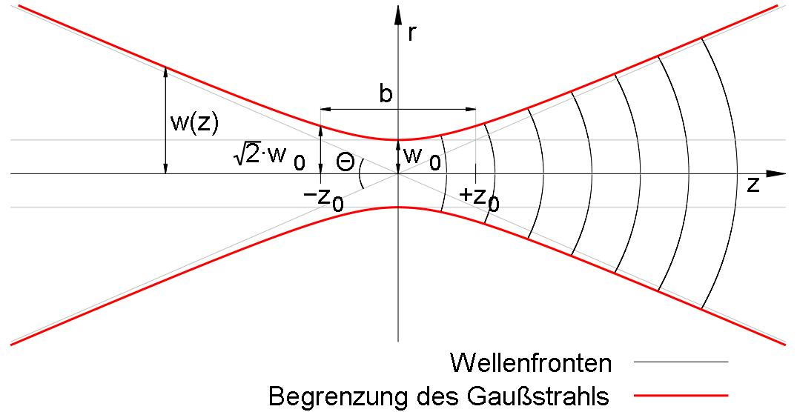
Scientific context
ILP 8
Optics and interference
Gaussian beams
Physics II, III, VI

Slide 3
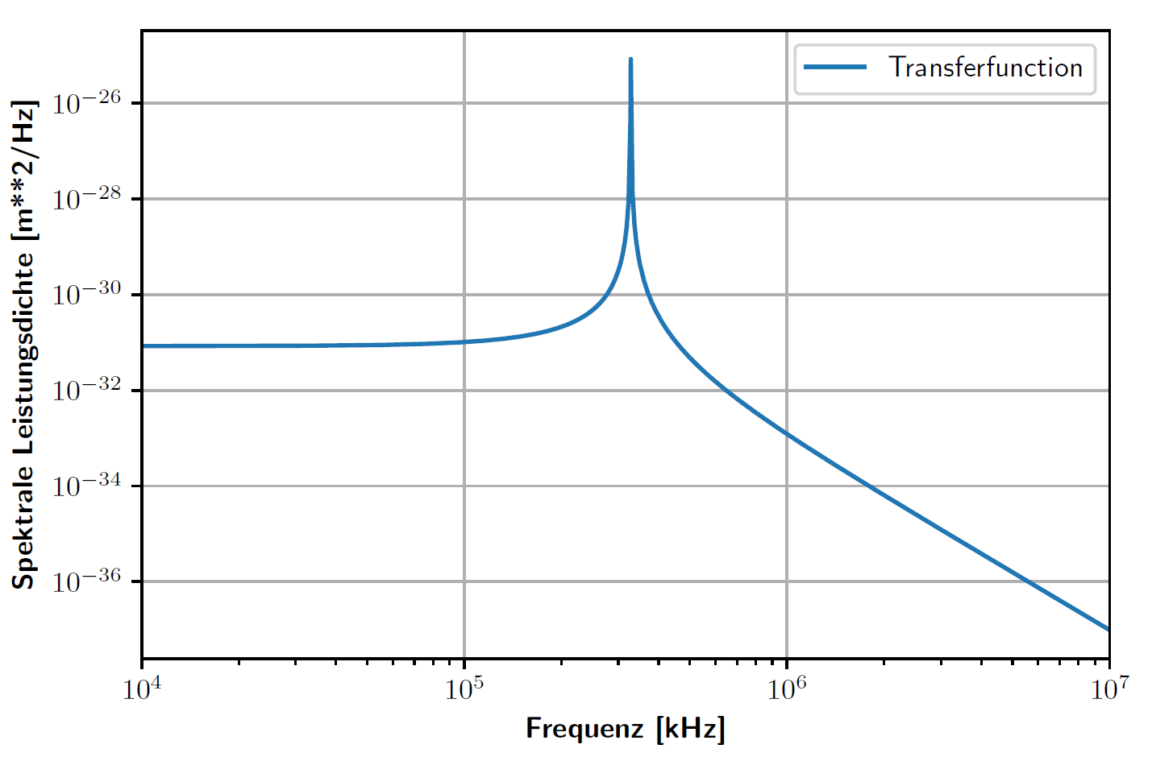
Scientific context
ILP 8
Optics and interference
Gaussian beams
Transferfunctions
Damped harmonic oscillator
Physics II, III, VI
Physics II, III

Slide 4
Scientific context
ILP 8
Optics and interference
Gaussian beams
Additionally the
students learn:
Transferfunctions
Damped harmonic oscillator
- Working with a
vacuumsystem
- Locking schemes and
feedback loops
- Birefringence
- Photodiodes
Physics II, III, VI
Physics II, III

Slide 5
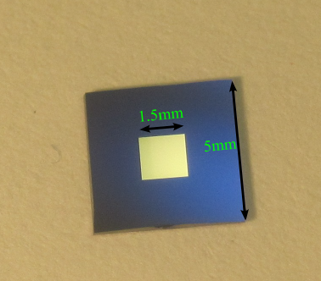
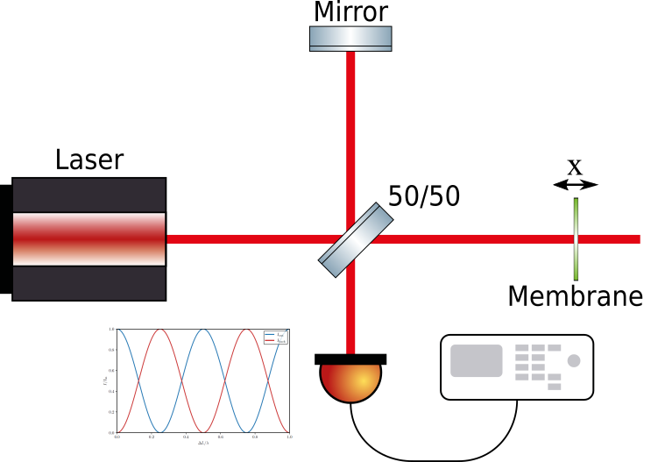
Aim of the experiment
Membrane
Detection of the thermal motion of a silicon-nitride membrane in an interferometric setup
Measure resonances
of the membrane
Spectrum-
analyzer

Slide 6
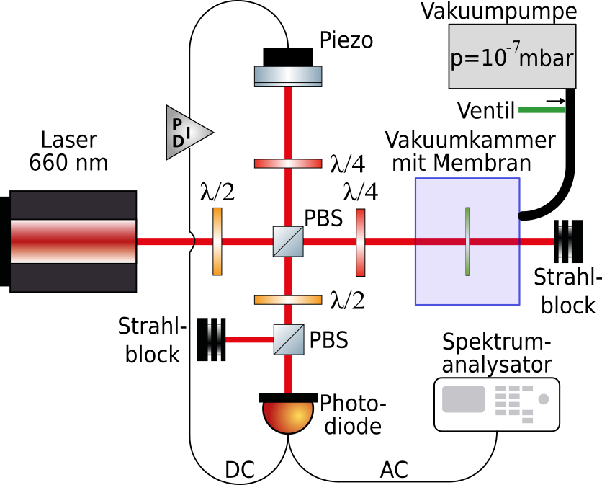
Experimental setup
First stage: Set up of the interferometer
Regel-
schleife

Slide 7
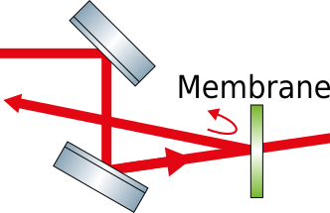
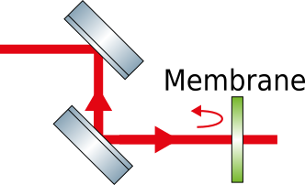
Experimental setup
First stage: Set up of the interferometer
Beam walking for aligning retro-reflective beam using mirrors (and lenses)
Regel-
schleife

Slide 8
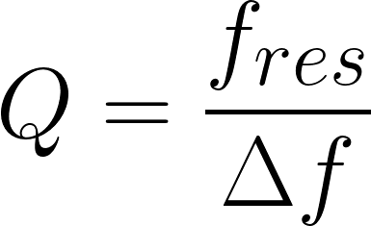
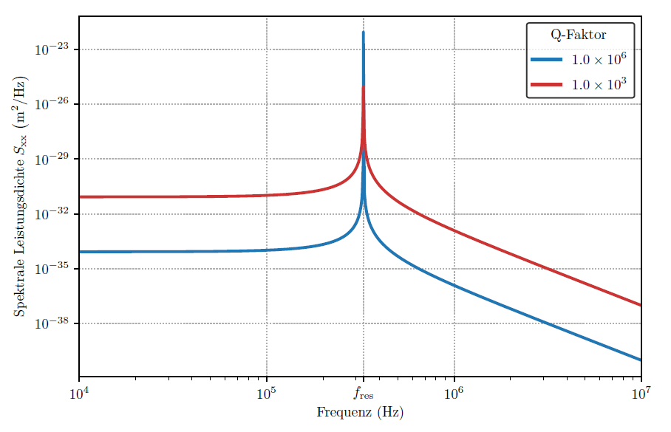
Experimental setup
Second stage: Characterization of the membrane
Quality-factor:
Regel-
schleife
High pressure
Low pressure

Slide 9
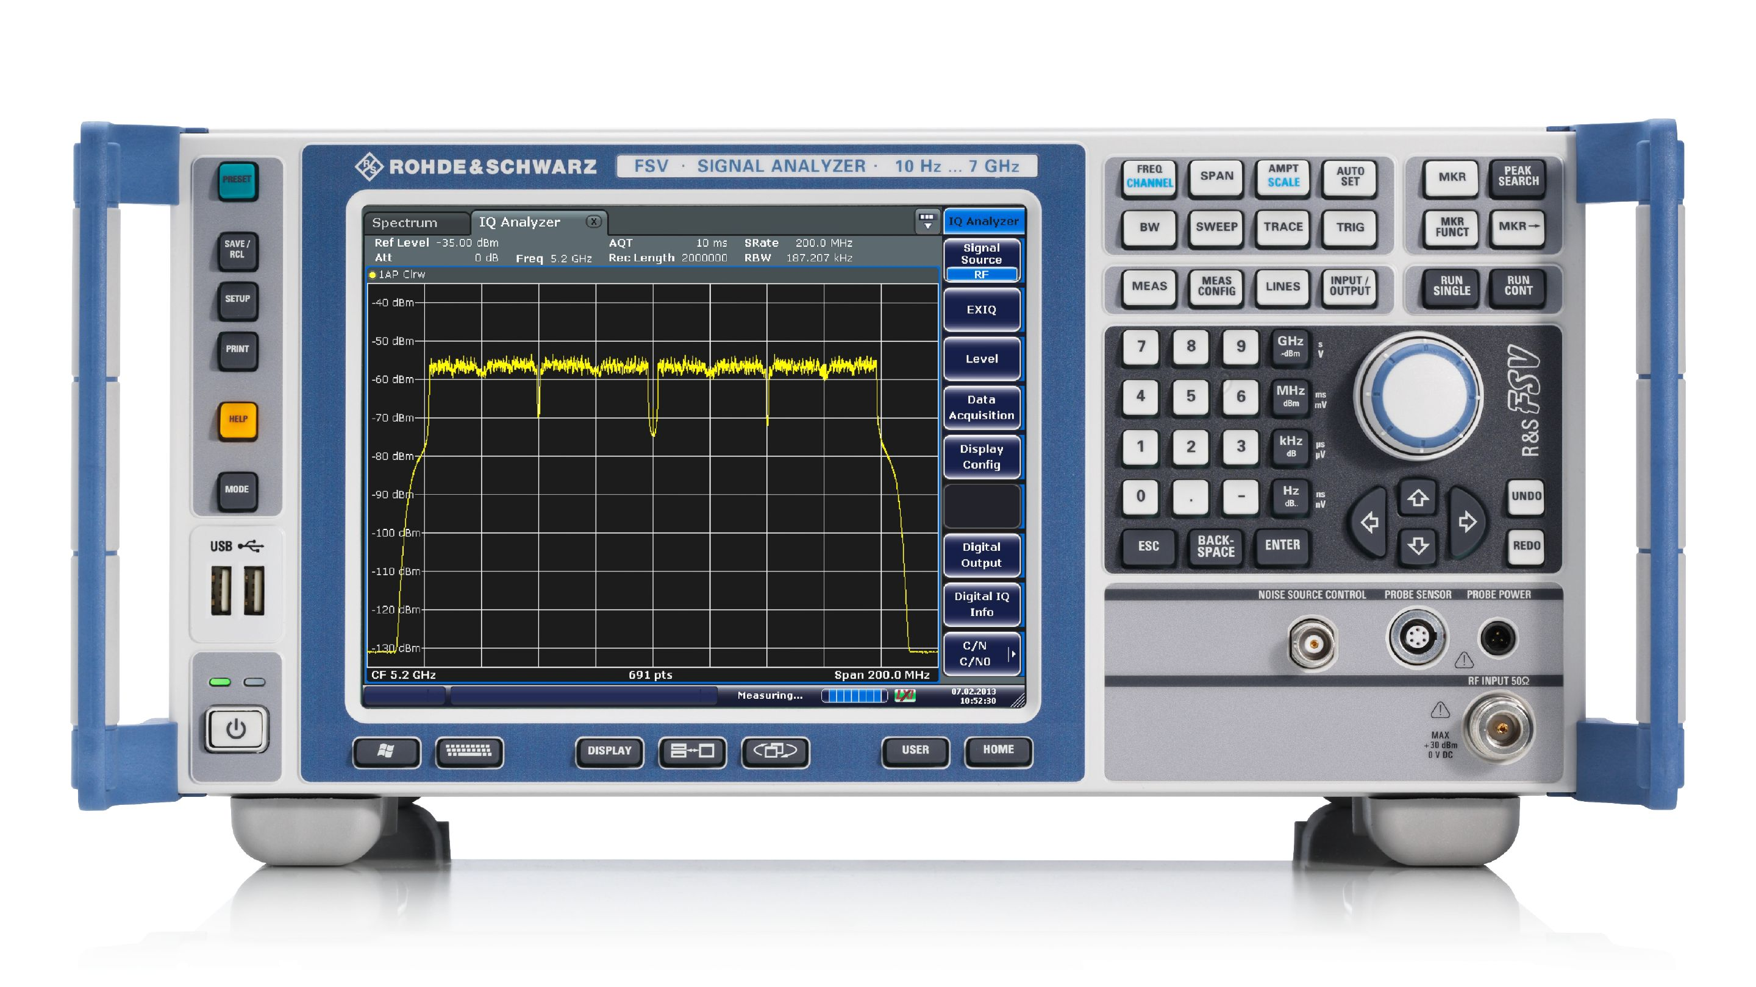
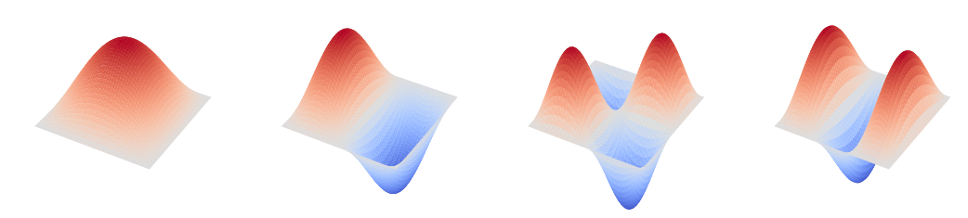
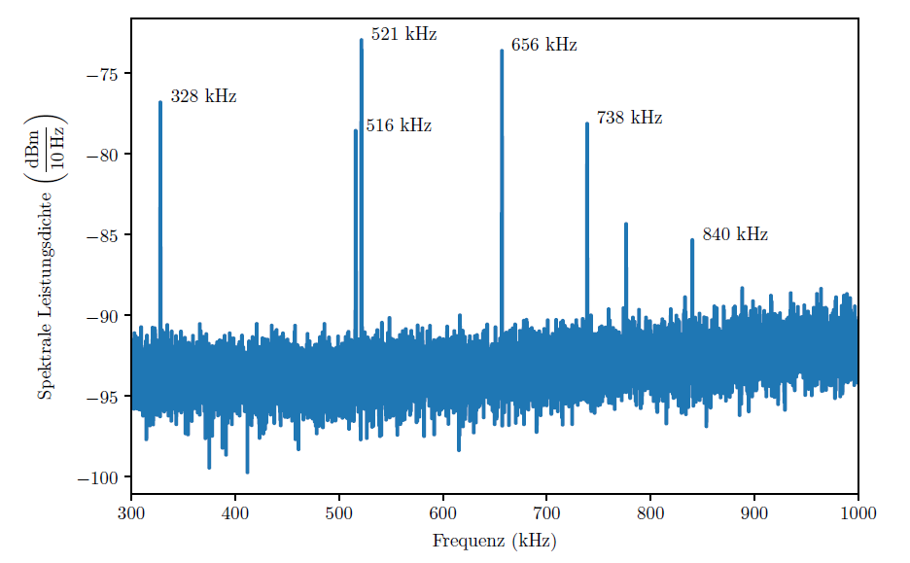
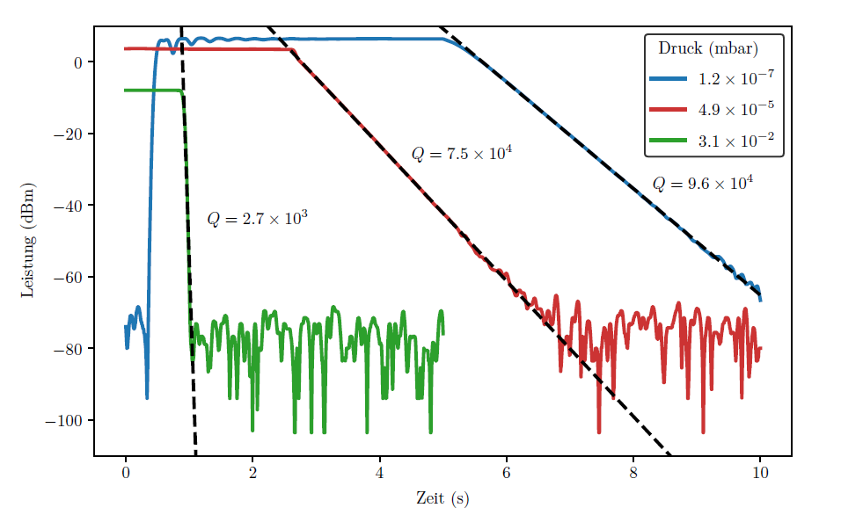
Data analysis with the spectrum analyzer
Spectrum analyzer:
Very important tool to measure signals
Can measure spectra or time series
Spectrum

Slide 10
Data analysis with the spectrum analyzer
Ring-down
1. Externally exciting the membrane
2. Measure dissipation of energy
3. Q-factor is proportional to slope
4. Repeat for different pressures
Spectrum analyzer:
Very important tool to measure signals
Can measure spectra or time series
Time-series

Slide 11
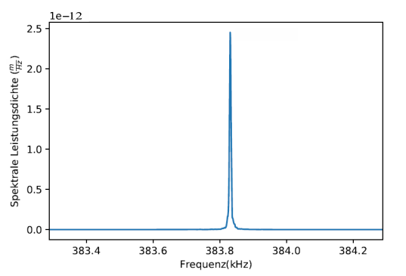
Key results
What the students learn:
Interferometers are simple but very precise detectors
The reached sensitivity is comparable to state of the art experiments
Skills: Beam walking, working with a spectrum analyzer, general working in the laboratory
Path length difference
x =2.5 pm

Slide 12
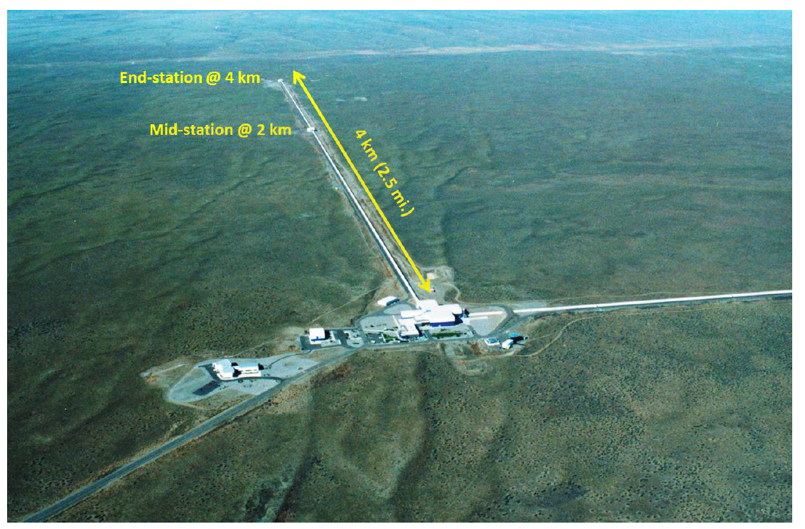
Link to modern day physics
Source: [Caltech/MIT/LIGO Lab]
GW-detector (very big interferometers): Can measure path length differences below 1am
SiNi-membranes: Microelectromechanical systems (MEMS) as cryogenic pressure sensors, accelerometers or gyroscopes
Noble prize in 2017

Slide 13
Grading
Theory / preparation | Setup / experimental | Data taking | Analysis | Protokol
2-3 | 2 | 4 | 3 | 3
1 = very complex
5 = very easy

Slide 14
Thank you for your attention!

Slide 15
Link to modern day physics
SiNi-membranes are used in various applications
Microelectromechanical systems (MEMS) as pressure sensors, accelerometer or gyroscope

Slide 16
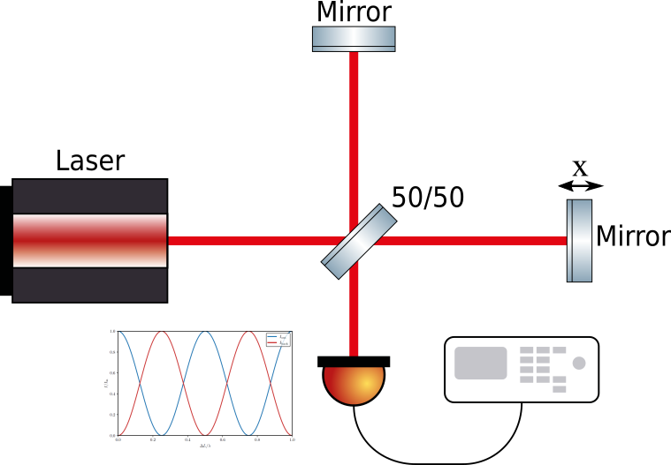
Interferometry
- Important technique with various physical applications to detect small path length changes
- Most famous recent example: GW detectors (LIGO,VIRGO)

Slide 17
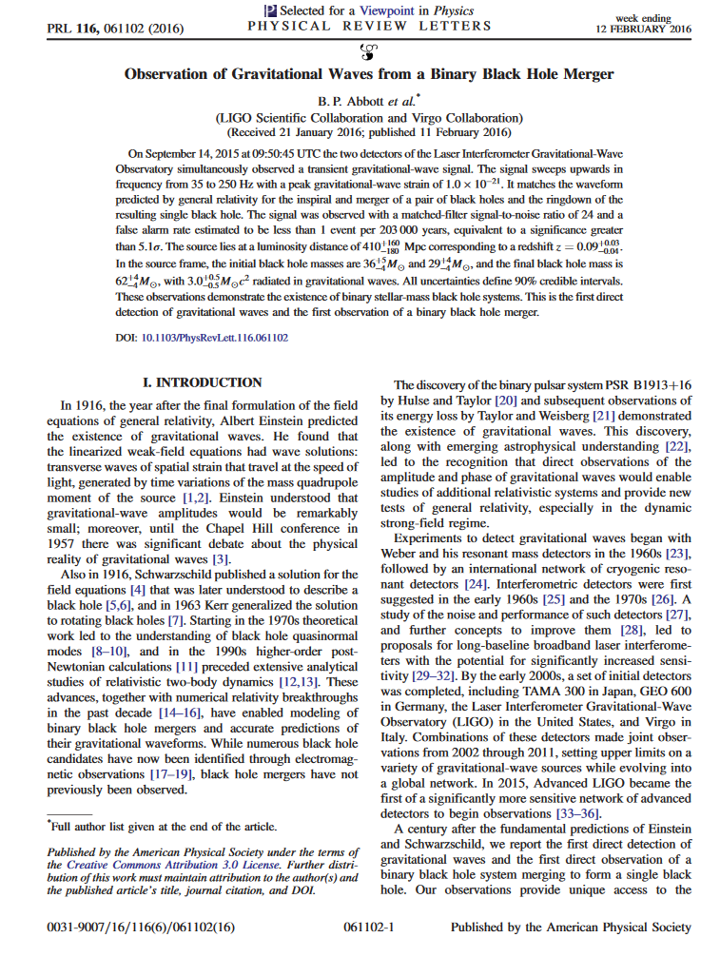
Interferometry
- Important technique with various physical applications to detect small path length changes
- Most famous recent example: GW detectors (LIGO,VIRGO)
-> Detection of the merger between two black holes
-> Noble prize in 2017

Slide 18
Mechanical membrane

Slide 19
Mechanical membrane
Silicon-nitride membrane
High Q-factor
High resonance frequency (around 100 kHz)
Rather cheap and easy to handle

Slide 20

What the students do for the setup
1-2 Days: Set up the interferometer:
- Beam walking for aligning beam path
- Learn to work with waveplates

Slide 21
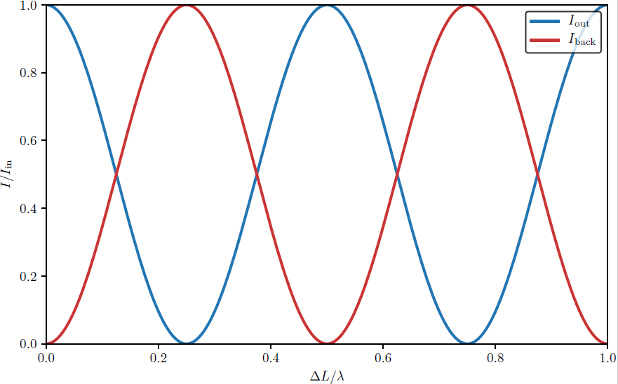
What the students do for the setup
1-2 Days: Set up the interferometer:
- Beam walking for aligning beam path
- Learn to work with waveplates
- Measure and optimize the interference signal

Slide 22
What the students do for the setup
2 Days: Characterize membrane:
- Measure a spectrum showing the vibrational modes of the membrane

Slide 23
What the students do for the setup
2 Days: Characterize membrane vibrations:
- Measure a spectrum showing the vibrational modes of the membrane
- Characterize the peaks
at different pressures:
  Q-Factor
  Ring-down
Low pressure
High pressure

Slide 24
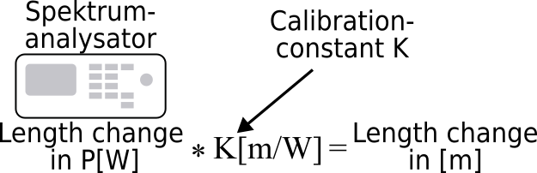
What the students do for the setup
2 Days: Characterize membrane vibrations:
- Measure a spectrum showing the vibrational modes of the membrane
- Characterize the peaks
at different pressures:
- Calibration constant

Slide 25
Data analysis
- Plot and analyze the spectrum
  Spot the higher order modes
  Compare them with theoretical prediction
1,1
2,1 /
1,2
2,2
3,1

Slide 26
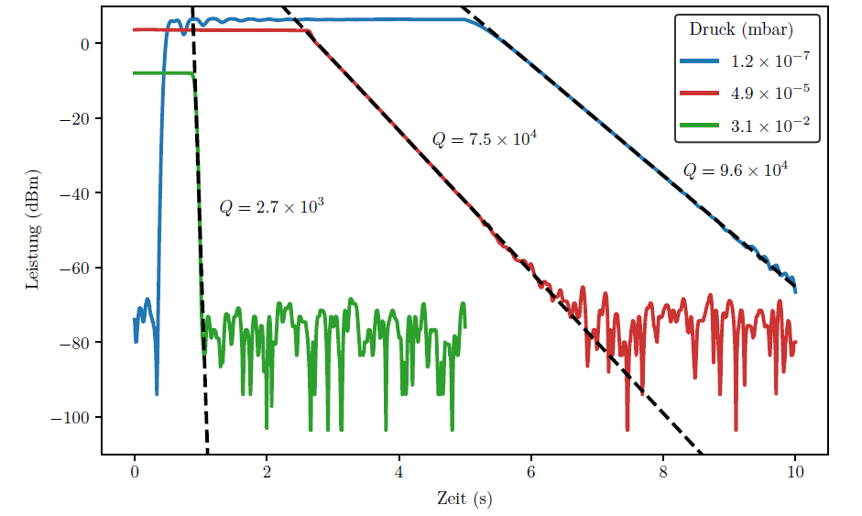
Data analysis
- Plot and analyze the spectrum
- Ring down for Q-factor
  Lin. Reg. for all traces
  Slope to calculate Q-Factor

Slide 27
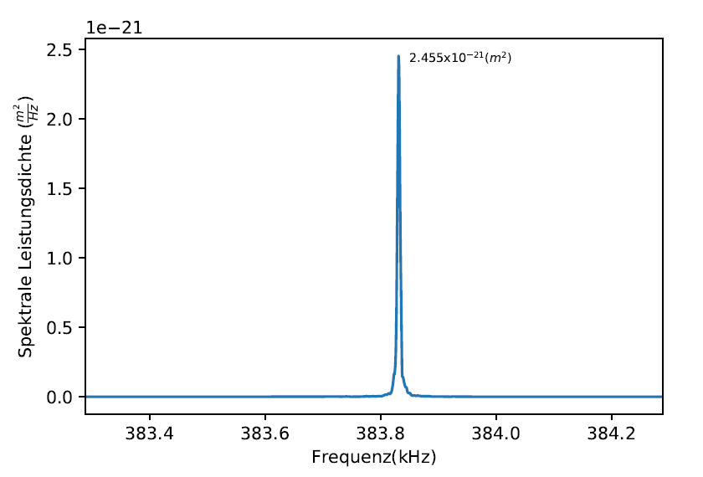
Data analysis
- Plot and analyze the spectrum
- Ring down for Q-factor
- Use calibration constant to measure the path length change in pm
12
Path length difference
x =2.5 pm

