Slide 1
TB22 data analysis
MPV distribution for Si and GaAs sensors
Veta Ghenescu, Alina Neagu, Mihai Potlog
Institute of Space Science, Bucharest
ECAL meeting - 12/04/2023

Slide 2
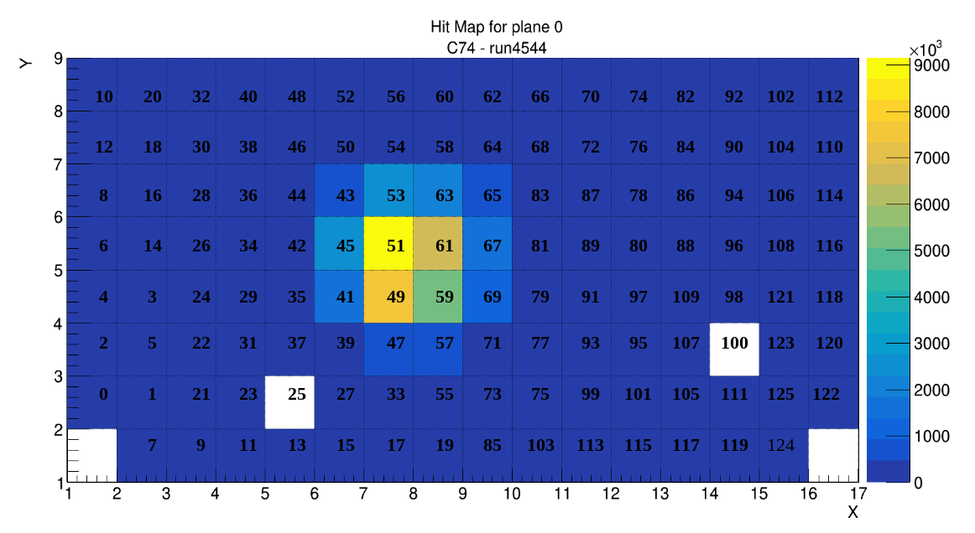

Slide 3
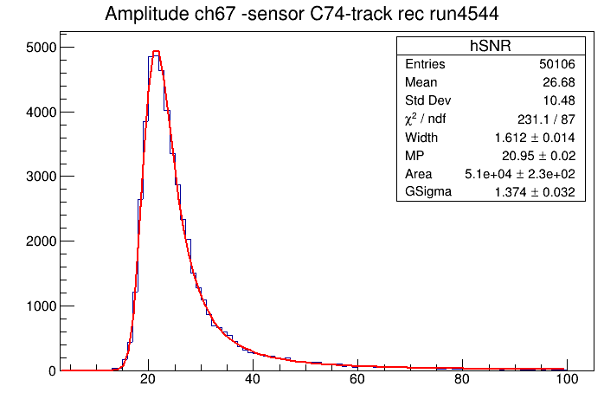
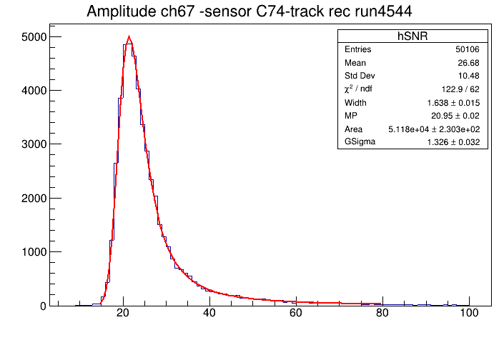
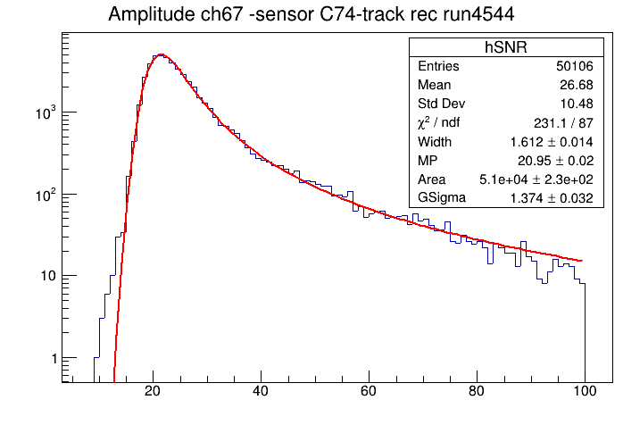
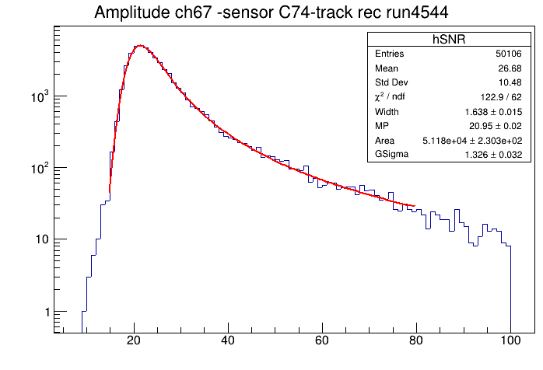
Fit windows [ADC]: 0 – 100; 14 – 80;
chisqr/ndf = 2.66
chisqr/ndf = 1.99

Slide 4
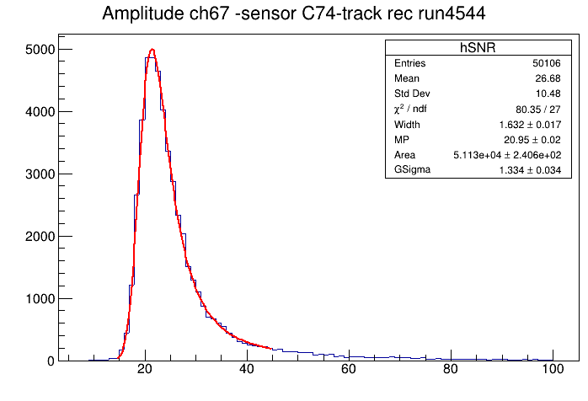
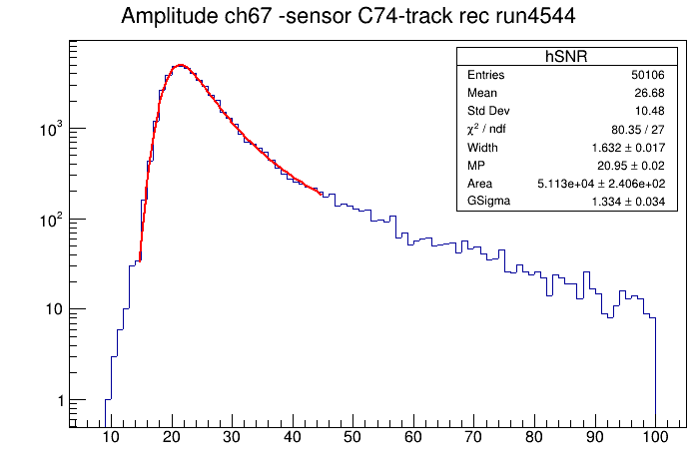
Fit window [ADC]: 1 – 100; 14 – 45;
chisqr/ndf = 2.97
chisqr/ndf = 2.66

Slide 5
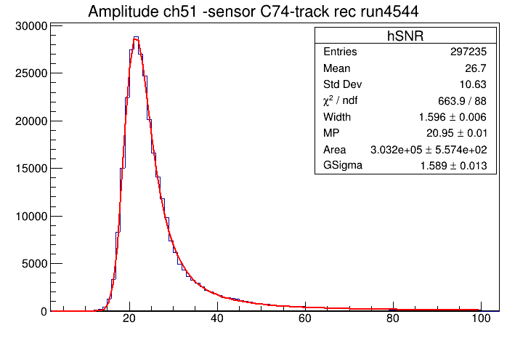
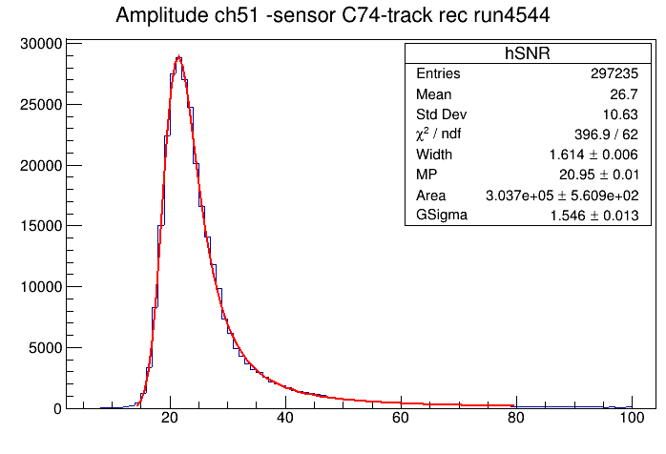
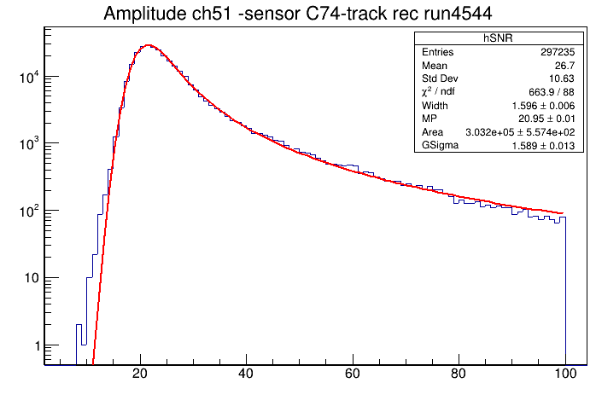
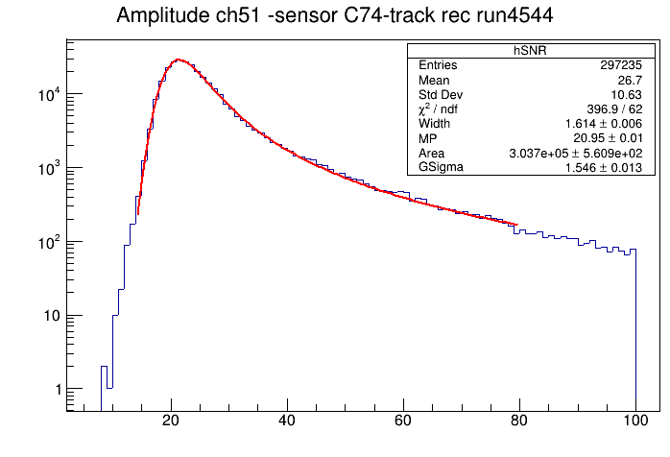
Fit windows [ADC]: 0 – 100; 14 – 80;
chisqr/ndf = 7.54
chisqr/ndf = 6.4

Slide 6
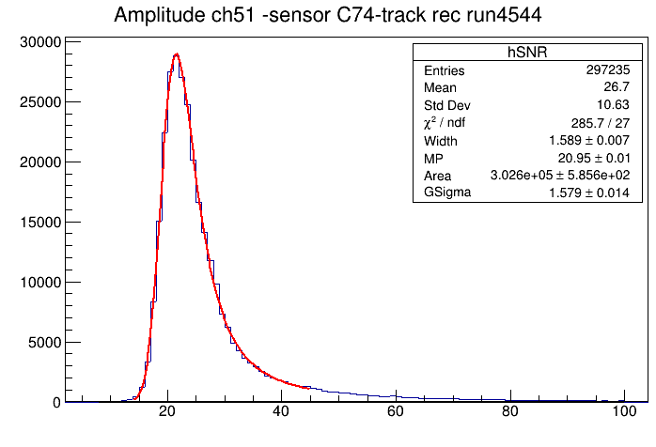
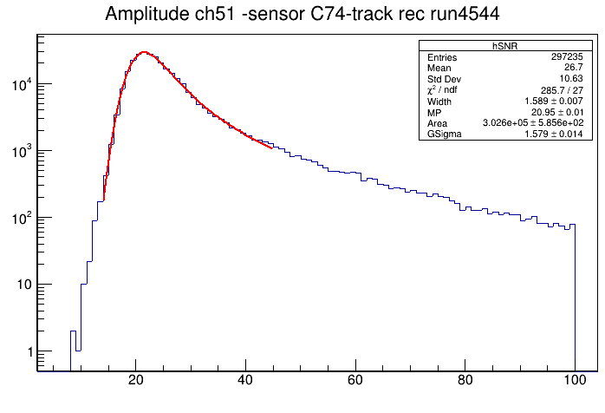
Fit windows [ADC]: 0 – 100; 14 – 45;
chisqr/ndf = 7.54
chisqr/ndf = 9.58

Slide 7
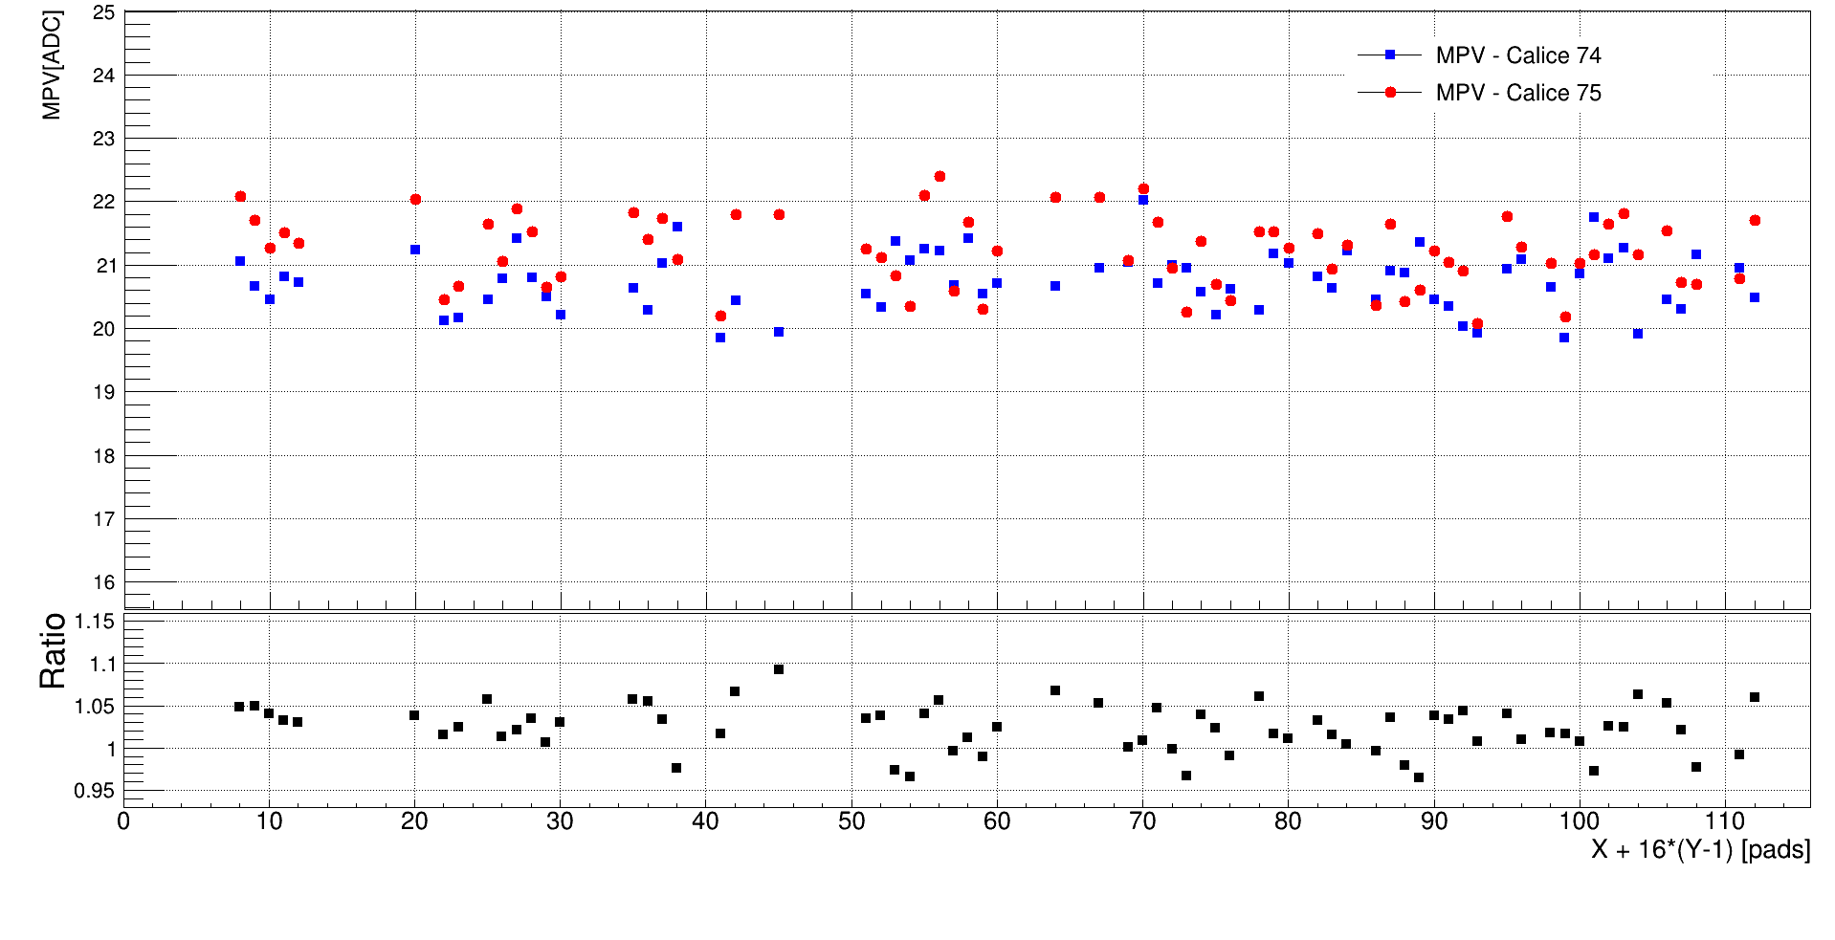
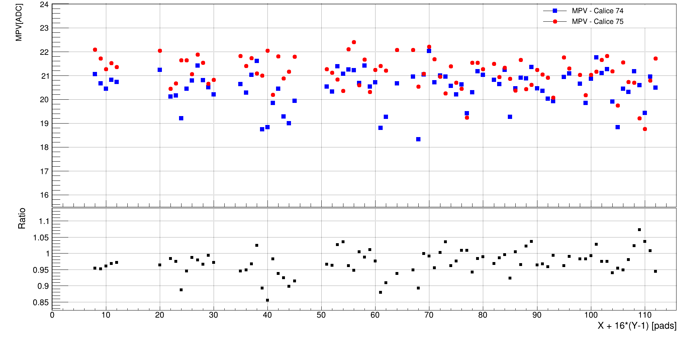
MPV of signal distribution for C74 and C75 Si sensors at 5 GeV electron beam.
Bad channels have been removed.

Slide 8
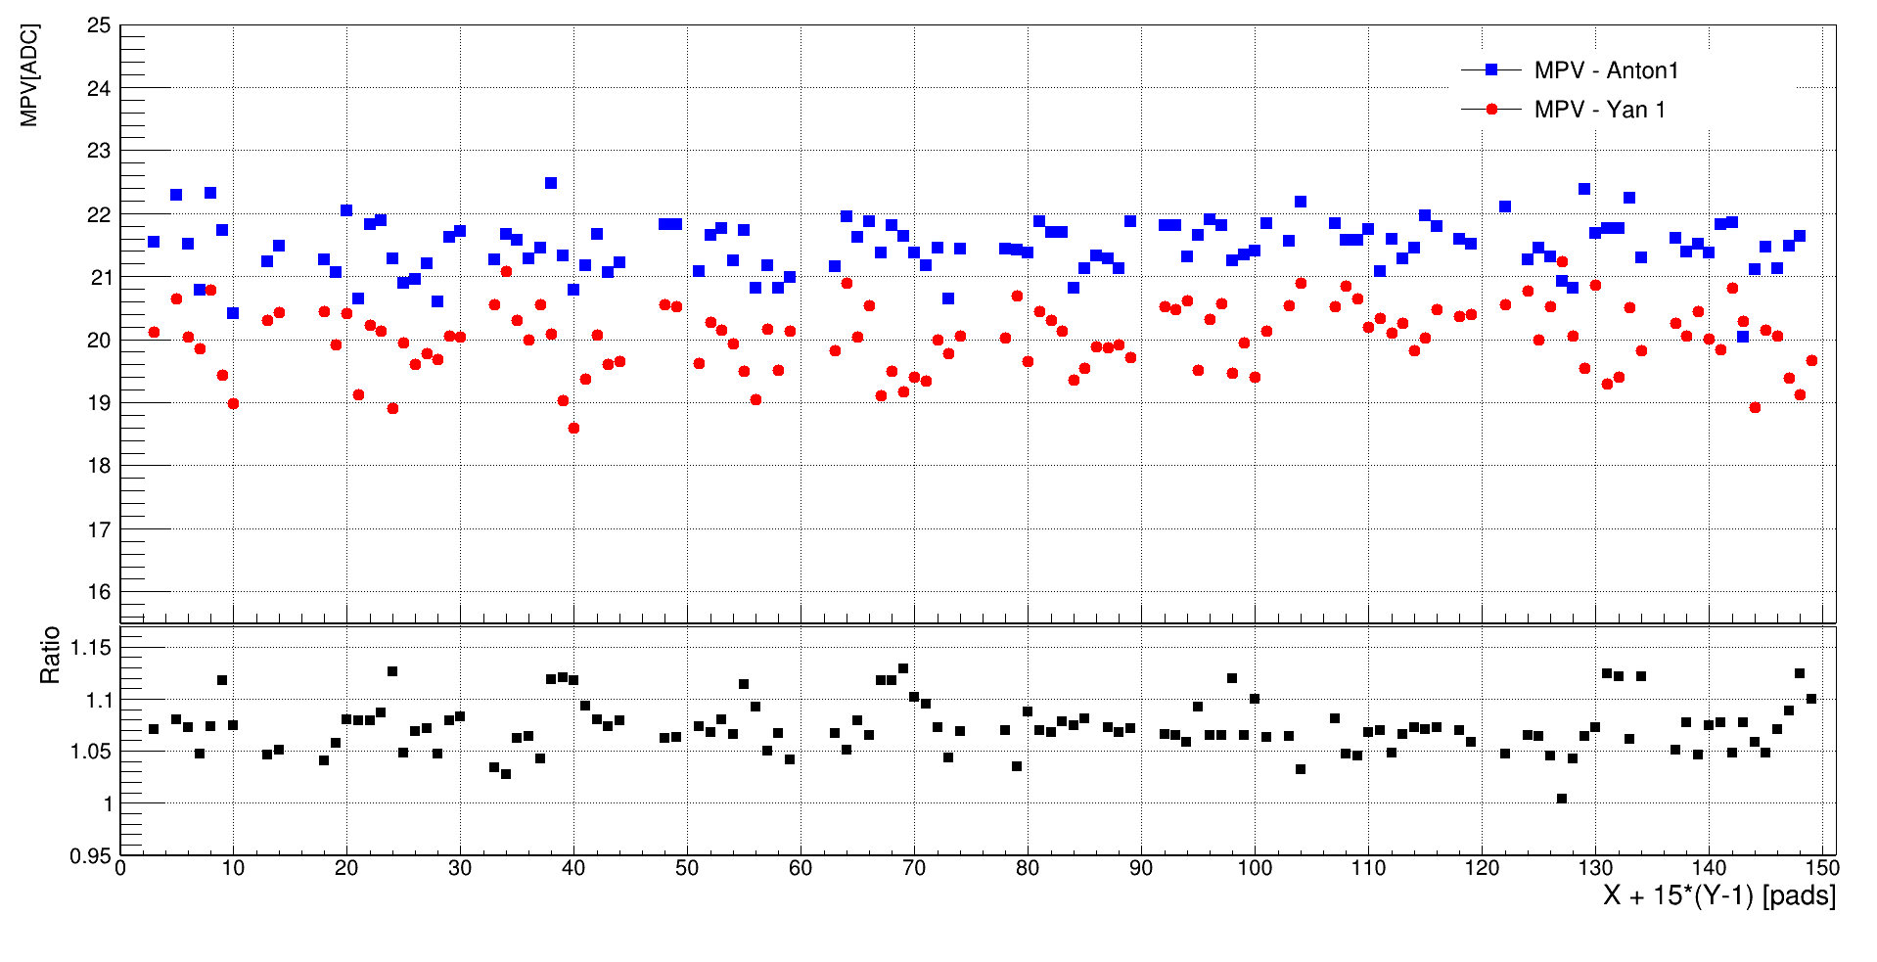
MPV of signal distribution for Anton1 and Yan1 GaAs sensors at 5 GeV electron beam

Slide 9
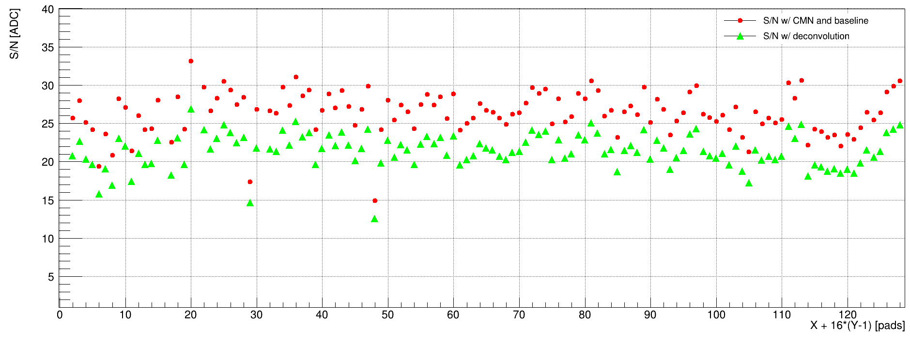
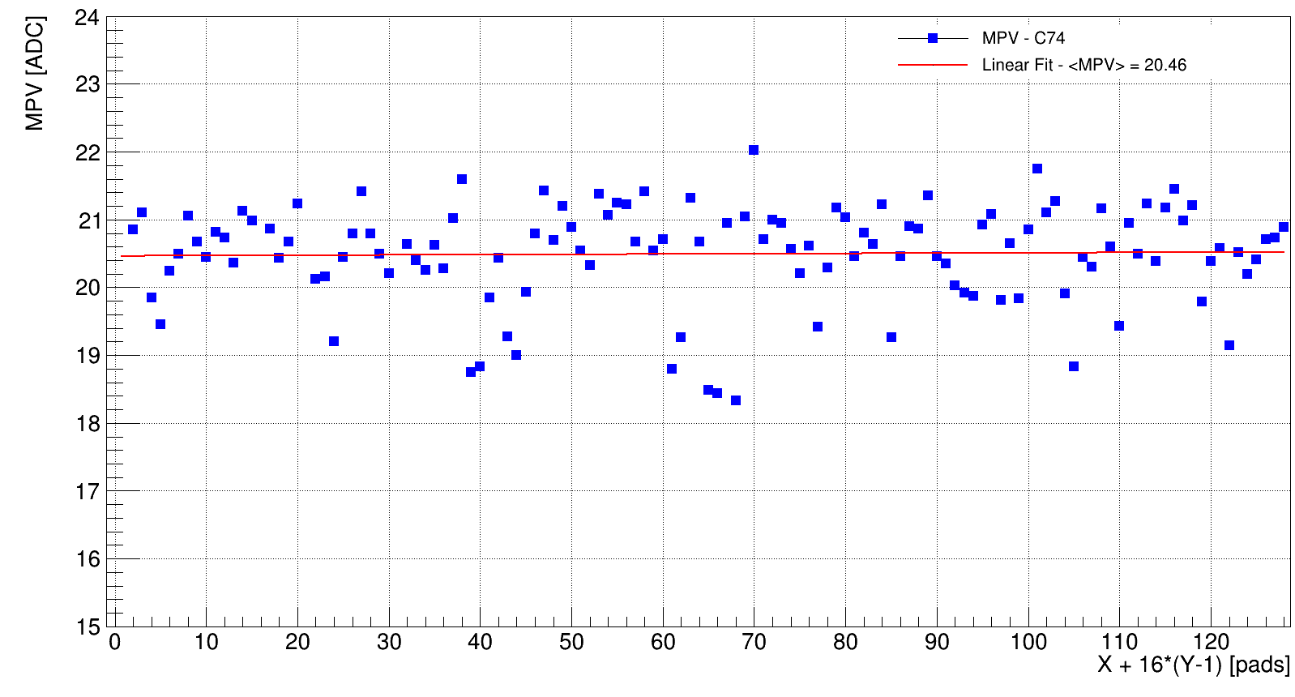
Signal to noise ration for C74 silicon sensor, 5GeV electron beam
S/N = MPVsignal /σpedestal

Slide 10
Conclusion:
For silicon sensors:
        Ratio between C74 signal and C75 signal on each channel is less than 10% after removed bad channels ;
        Signal from C75 sensor is bigger than signal from C74 sensor;
For GaAs sensors:
        Anton1 signal is bigger than Yan1 signal on each channel;
        The ration between them is about 5 ÷ 15 percents.

