Slide 1
ARES Operation Meeting
Summary of week 15 / 2023
SHUTDOWN EDITION
Frank Mayet, on behalf of the ARES crew

Slide 2
Summary of week 15
Mon. 10th April | Tue. 11th April | Wed. 12th April | Thu. 13th April | Fri. 14th April
 | MSK shift (Investigation of ripples on the TWS RF pulses; Installation of a new attenuator for TWS2 in the tunnel (FWD Power Probe)) TLD samples for D3 shift installed | D3 TLD irradiation shift → CANCELLED (see below) MDI ICT tests 13:00 Tunnel open / ARES in shutdown | SHUTDOWN | SHUTDOWN
 | x2Timer module not working in the laser sync crate → Temp. FIXED PHAROS beam pointing stabilizer motor controller not reachable → FIXED | x2Timer module not working in the laser sync crate → Temp. FIXED BLM electronics needed to be restarted (jumpy signal)
Tunnel open
Achievements
Difficulties
Notes

Slide 3
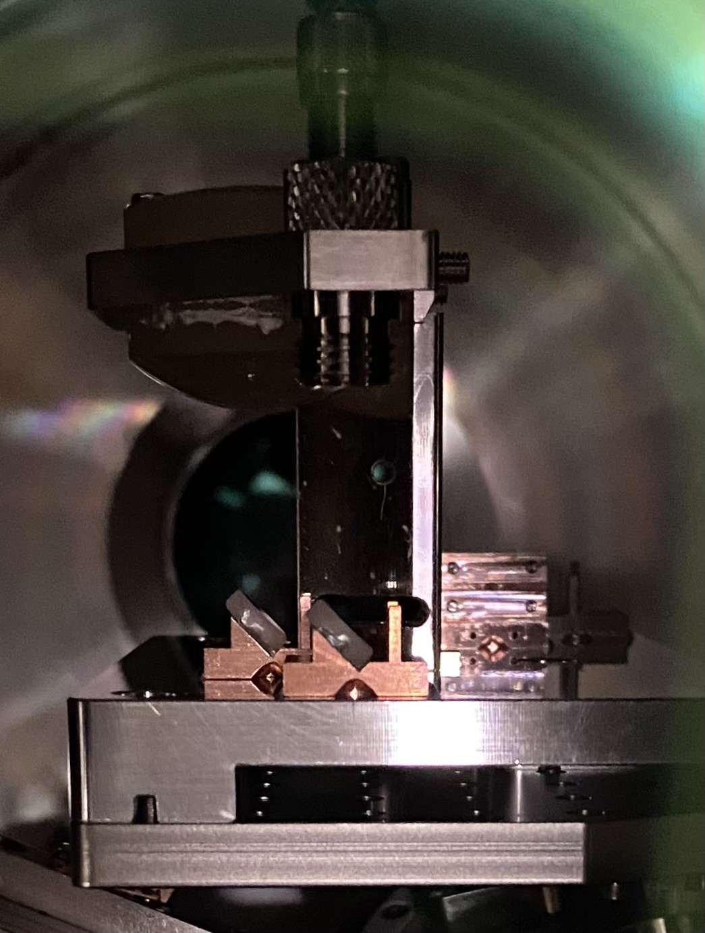
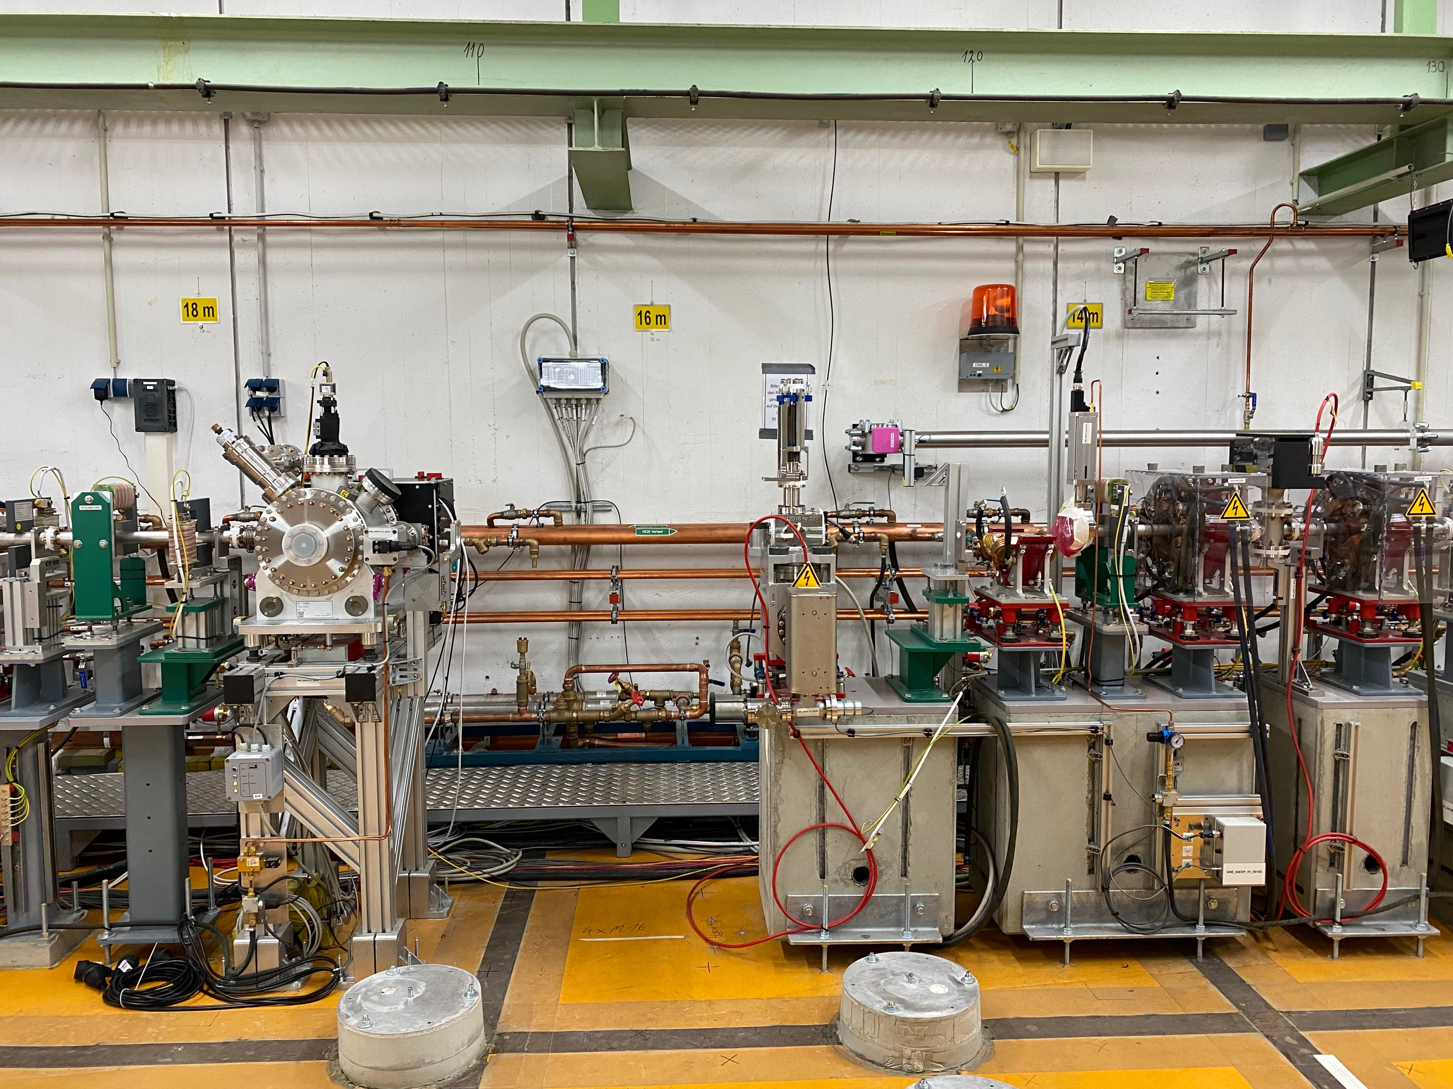
Week 15 – Shutdown Progress
FL section → Breadboard table removed
EA section
  Laser table secured and removed
  Timing setup removed
  Silver mirror installed into the ExpChamber
  Beam pipe upstream of the chamber removed
  AREAMQZM3 opened (pipe removal)
  AREABSCR1 prepared for relocation

Slide 4
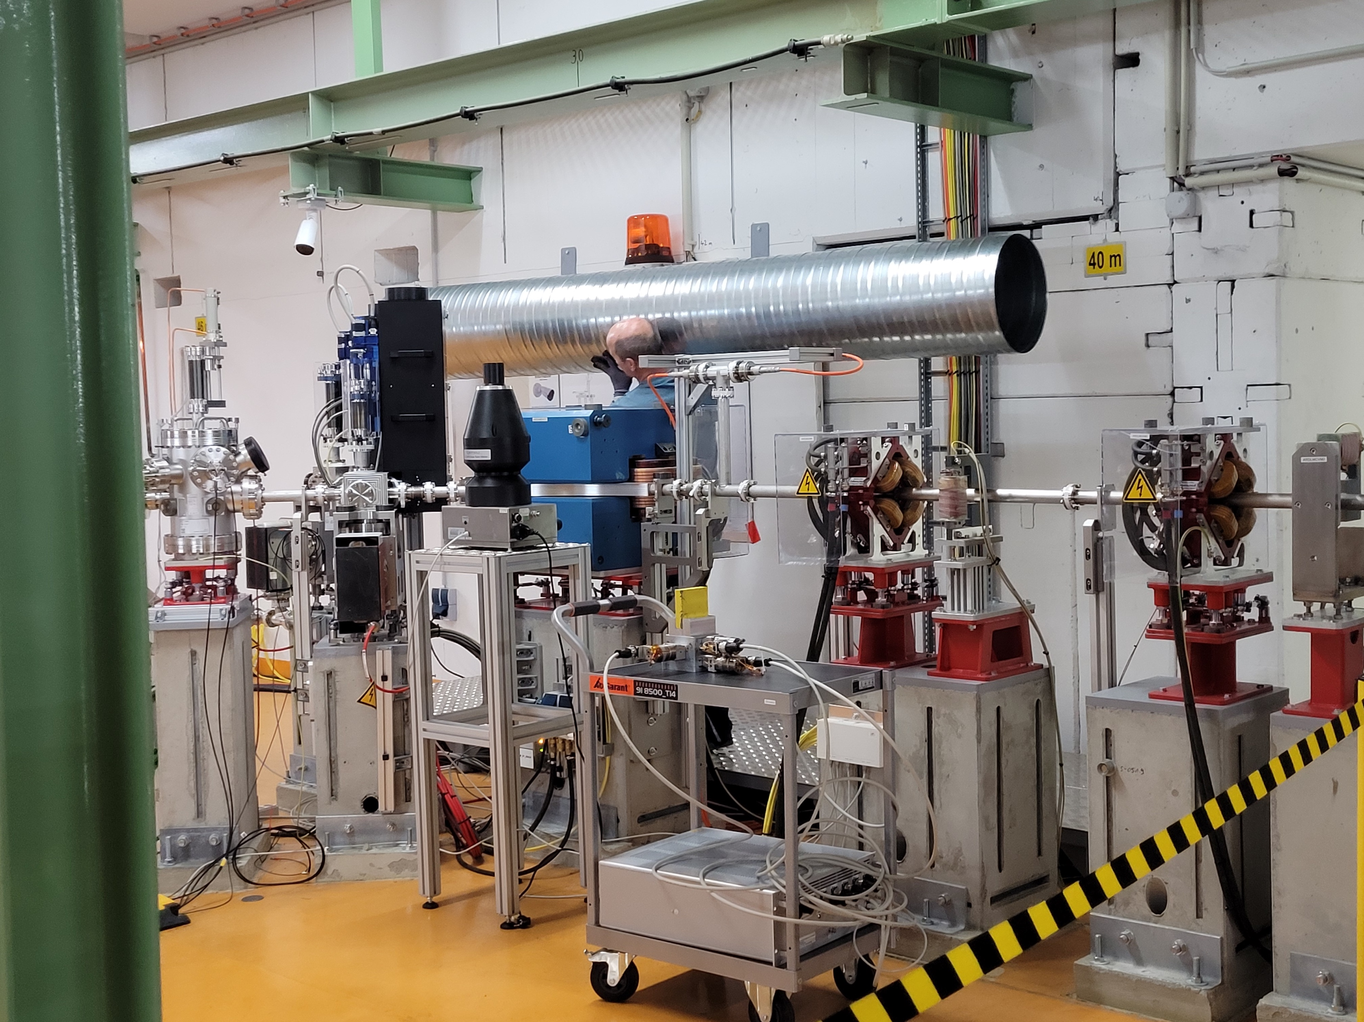
Plan for week 16
Today:
- start of ventilation work (see photo) (MKK3 and comp. Milz)
- hole drilling for concrete supports (MEA)
- installation of concrete blocks (MEA)
- water works for TDS (MKK2)
- start commissioning of precision water cooling for TDS (MKK4)
Tomorrow:
- concrete under supports (BAU)
Afterwards:
- Survey team for positions on the concrete blocks
- Magnet support installation
Wednesday (19.4.): TÜV

Slide 5
Schedule
Week 16
Date | Shift Leader
17.04. | -
18.04. | -
19.04. | -
20.04. | -
21.04. | -
SHUTDOWN
If you want to learn or join the shift: please give the shift leader a call (BKR 2840 / SINBAD Box 2454)

