Slide 1
GPTFEL - A frequency-based GPT extension for FEL interactions
Andrew Fisher
FLASH2020+ 4th Start to End Simulation Workshop
29, June 2023
FLASH2020+ 4th Start to End Simulation Workshop

Slide 2
Outline
General Particle Tracer (GPT) by Pulsar Physics
GPT-FEL (custom function)
Field representation and mode evolution
Input and Output
Free space/waveguide examples
Other types of operation
Time-Independent (single frequency)
Source Dependent Expansion (SDE)
Notes:
Bas questions:
No Laguerre polynomial function for c++?
Updated version of GPTFEL?
Did he write script for reading gdf into matlab?
Energy conservation somewhere?

Slide 3
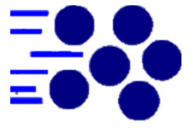
General Particle Tracer (GPT)
About GPT
Proprietary code in development since 1996
3D particle tracking in time domain (adaptive stepsize)
Macroparticles
Complete freedom in particle distribution and beamline element orientation
Use custom fieldmaps
Users can create customized elements (not black box)
Learning curve
Detailed manuals with examples
GUI interface available for Windows

Slide 4
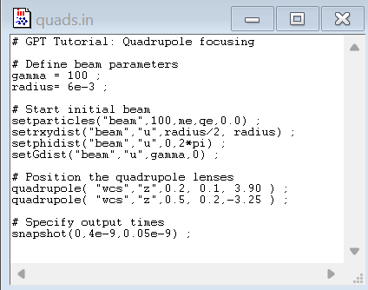
Code Structure
Input file
Define/read beam
Position beamline elements in world coordinate system, “wcs”
Define output format
Batch file
Run simulation
Compute statistics (avg/std at each timestep)
Convert filetype
Parameter Scans
Notes:
Can read from ascii, astra

Slide 5
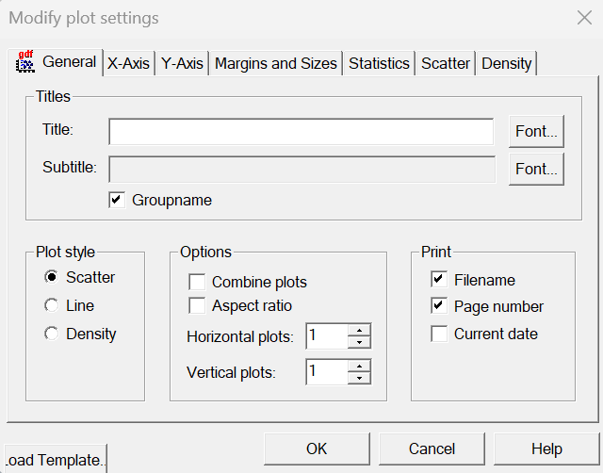
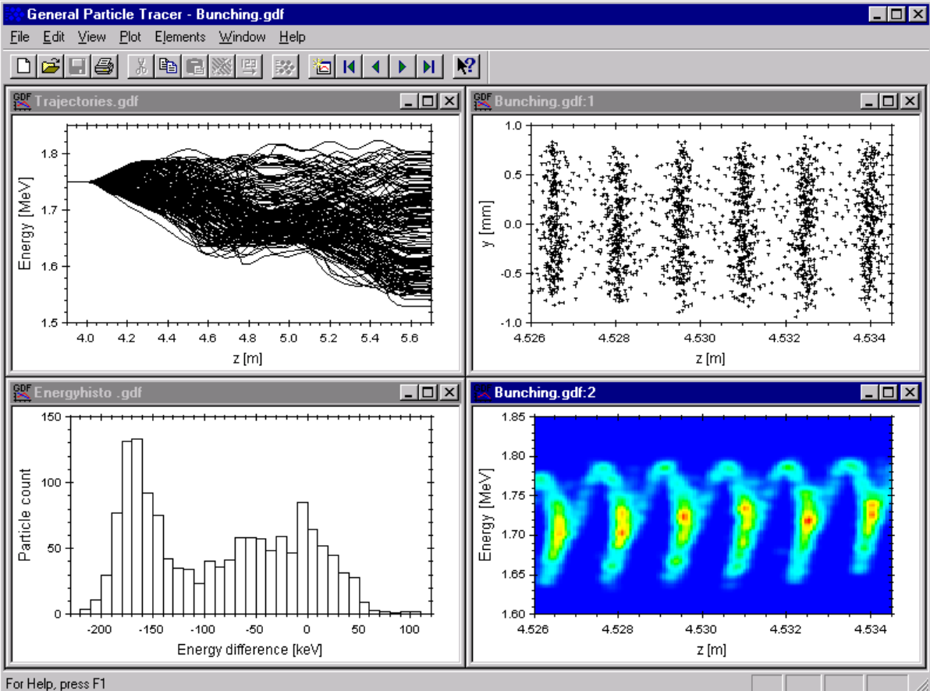
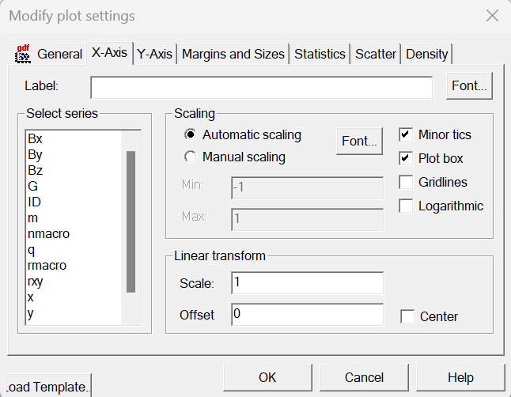
GUI Plotting
https://www.pulsar.nl/gpt/gptwin

Slide 6
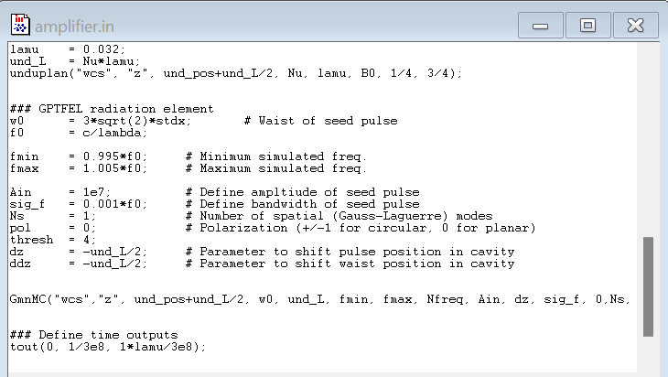
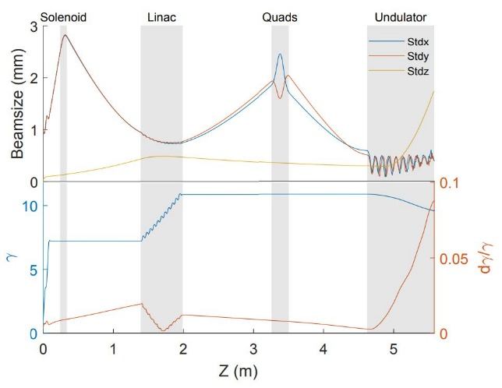
GPT-FEL as custom element
Motivation for development at UCLA
3-14 MeV Student-run Beamline
Interfaces with beam transport and photoinjector simulation
Space charge, field maps, waveguide dispersion
Improvement of existing G00mf function
Collaborations
PAX at SLAC
Israeli THz FEL
GPT-FEL
THz Waveguide FEL at UCLA
Notes:
PAX – wanted to confirm bunching was implemented correctly in genesis
Built in function Gauss00mf
Space charge, field maps, waveguide dispersion

Slide 7
GPT-FEL Basics
$$A_{q}=∬{\left|Θ_{q}\right|}^{2}d\vec{x}$$
$$\hat{n}=\hat{x} or\frac{\hat{x}±i\hat{y}}{\sqrt{2}}$$
Field representation
Frequency and transverse modes (q)
Complex amplitude
Mode area and dispersion
Complex polarization
Evolving mode amplitudes
Independently derived from Maxwell’s equations or energy conservation
$$\vec{E}\left(\vec{x},z,t\right)=\sum_{q}{a_{q}}Θ_{q}\left(\vec{x},k,t\right)e^{(ik_{q}z−iω_{q}t)} \hat{n}$$
Dispersion relation
$$k_{q}(w_{q})$$
$$a_{q}=u_{q}+iv_{q}$$
$${\dot{a}}_{q}=−\sum_{j}{\frac{q_{j}}{2ε_{0}A_{q}}\left({\vec{v}}_{j}⋅Θ_{q,j}^{∗}{\hat{n}}^{∗}\right)e^{−ik_{q}z_{j}+iω_{q}t} }$$
Sum over macroparticles
$$\vec{v}⋅\vec{E}$$

Slide 8
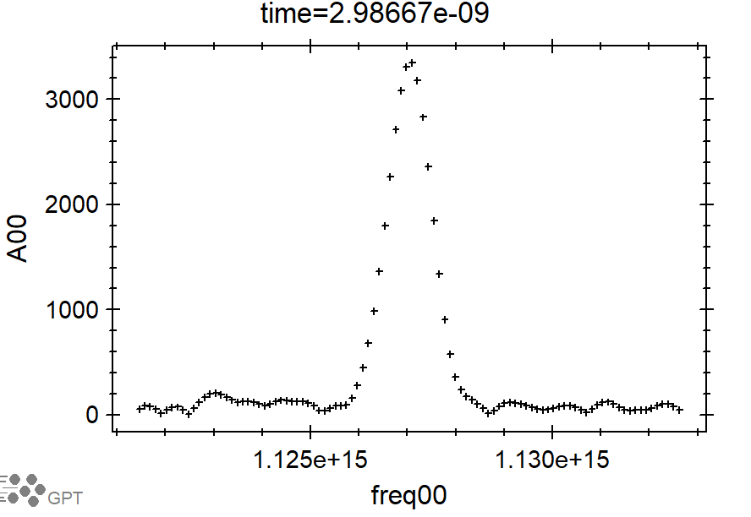
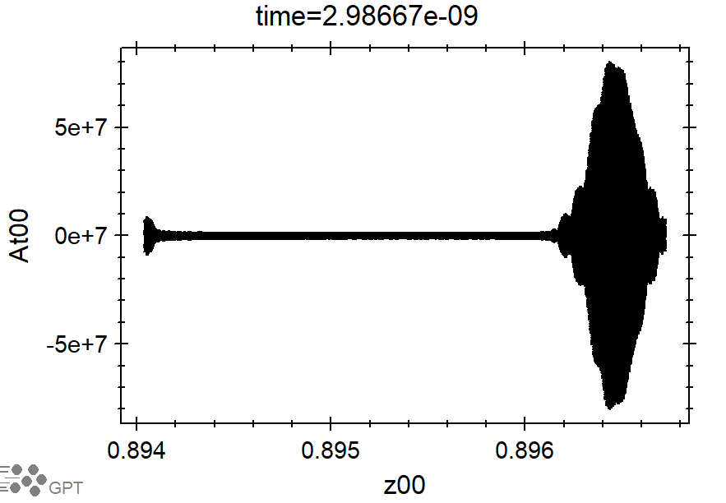
Frequency Modes
Simulate modes ${(N}_{m})$
$$ΔN=\frac{N_{all}}{N_{m}}$$
Specify range and number of simulation frequencies
Data saved to gdf file
Spectral: freq00, lam00, A00, phi00, W00, alphar00, rw00
Temporal (periodic): z00, At00, Pt00
Cavity modes ${(N}_{all})$
$$(a_{q}=u_{q}+iv_{q})$$
Freq
fmin
fmax
$$Δt=\frac{2L}{cΔN}=\frac{N_{m}}{f_{MAX}−f_{MIN}}$$
Notes:
Mention good plots to look at trouble shooting.
Spectrum to see if resolving peak

Slide 9
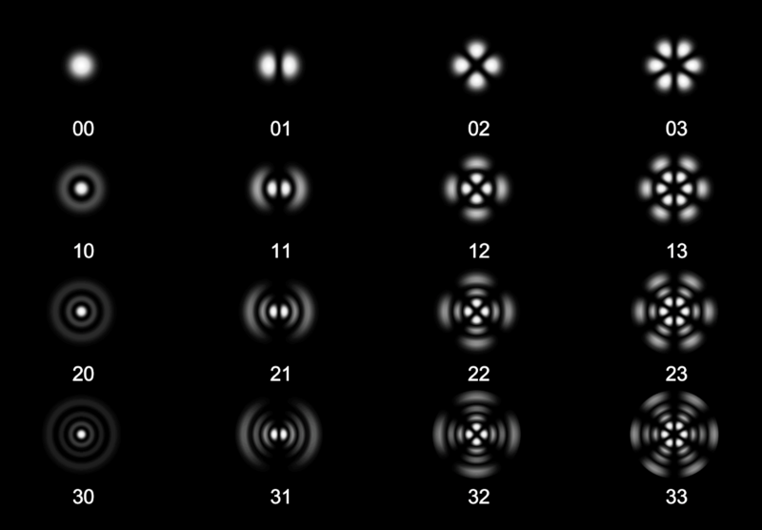
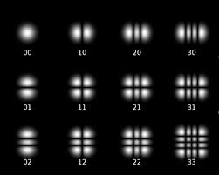
Spatial Modes (free space)
Laguerre-Gaussian Modes
Hermite-Gaussian Modes
Notes:
Lowest order is gaussian in both

Slide 10
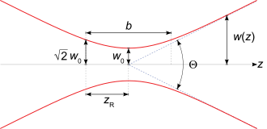
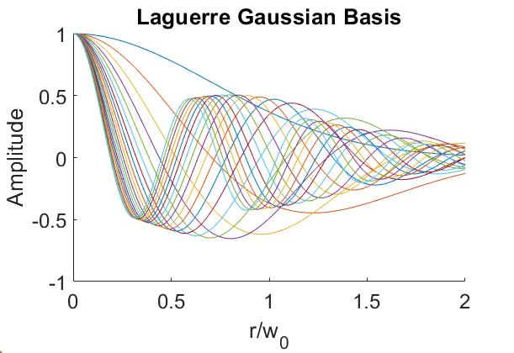
Free Space
Laguerre-Gaussian Basis
Utilize radial symmetry
Easier SDE implementation
Modes defined by waist size ($w_{0}$) and position ($z_{0}$)
$$α\left(z\right)=\frac{z−z_{0}}{z_{r}} w\left(z\right)=w_{0}\sqrt{1+α^{2}}$$
$$k_{q}\left(ω_{q}\right)=\frac{ω_{q}}{c}$$
$$\vec{E}\left(\vec{x},z,t\right)=\sum_{q}{a_{q}}Θ_{q}\left(\vec{x},k,t\right)e^{(ik_{q}z−iω_{q}t)} \hat{n}$$
$$Θ_{q}=Θ_{n,m}=\frac{1}{\sqrt{1+α_{n}^{2}}}L_{m}\left(\frac{2r^{2}}{w_{n}^{2}}\right)e^{−r^{2}/w_{n}^{2}}e^{\frac{iα_{n}r^{2}}{w^{2}}−i\left(2m+1\right)ψ_{n}}$$
Frequency index
$$A_{q}=∬{\left|Θ_{n,m}\right|}^{2}d\vec{x}=\frac{πw_{0,n}^{2}}{2}$$
Spatial index
Notes:
Q: Is it okay to allow different frequencies to have spatial bases with different waist sizes?
A: Even in fixed case, different frequency gaussians diffract differently.
Widen plot, change title to Laguerre-Gaussian

Slide 11
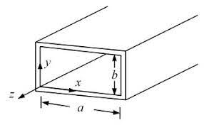
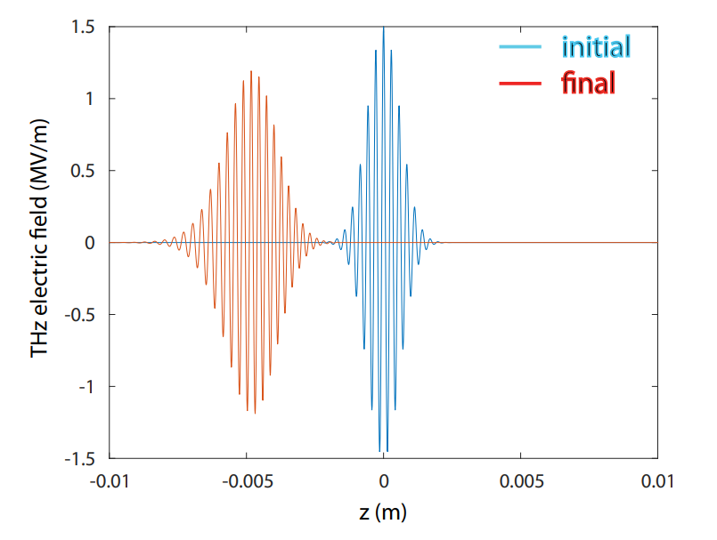
Waveguide Example (TE modes)
$$k_{q}\left(ω_{q}\right)=\sqrt{{\left(\frac{ω_{q}}{c}\right)}^{2}−k_{⊥,q}^{2}}$$
Choose spatial basis
Compute mode area
Define dispersion
Example of propagation
$$\vec{E}\left(\vec{x},z,t\right)=\sum_{q}{a_{q}}Θ_{q}\left(\vec{x},k,t\right)e^{(ik_{q}z−iω_{q}t)} \hat{n}$$
$Θ_{q}\hat{n}{=Θ}_{n,(m_{x},m_{y})}\hat{n}=−\frac{iω_{q}μ}{k_{⊥,q}^{2}}\left(\hat{z}×∇_{⊥}H_{z}\right)$
where $H_{z}=H_{0}\cos\left(\frac{m_{x}πx}{a}\right)\cos\left(\frac{m_{y}πy}{b}\right)$
$$A_{q}=∬{\left|Θ_{q}\right|}^{2}d\vec{x}={\left(\frac{{ω_{q}μH}_{0}}{k_{⊥,q}}\right)}^{2}\left(\frac{ab}{2}\right)$$

Slide 12
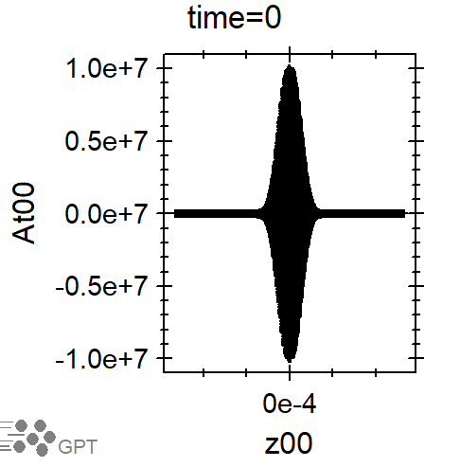
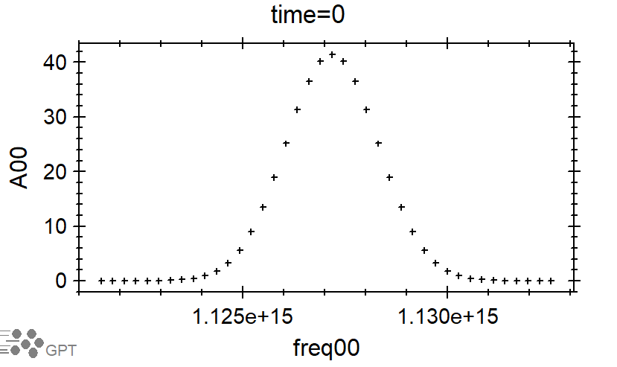
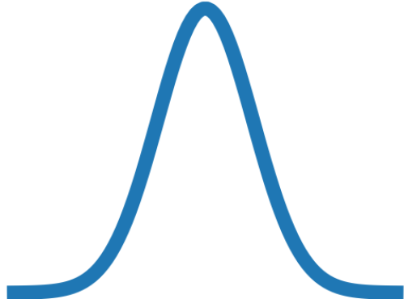
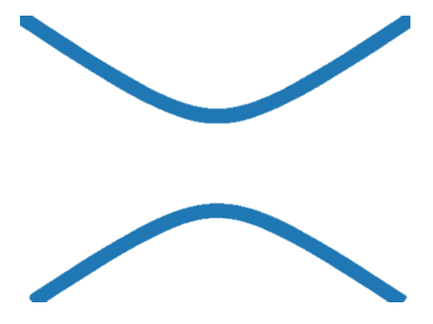
Radiation Seeding
$$A_{in}=1e7$$
$$σ_{f}=1.1e12$$
Parameters
Peak field
Bandwidth
Temporal pulse location
Transverse waist location
Starting from noise
Quiet start algorithm
Temporal pulse
Beam
Transverse waist
Undulator
Notes:
Figure showing examples of these.
At00 vs z00, peak field equaling Ain with given bandwidth
rw00 vs avgz, for “pulse shifted” and “pulse and waist shifted”
Assume gaussian seed

Slide 13
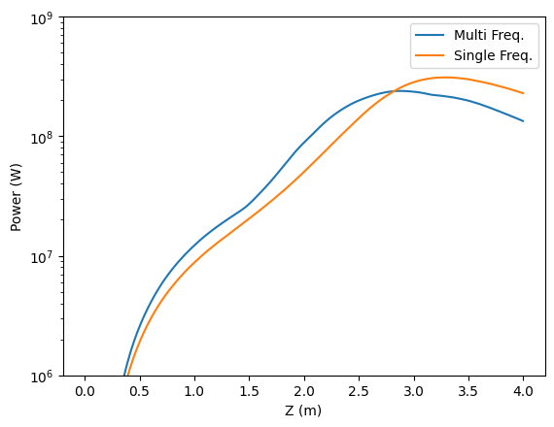
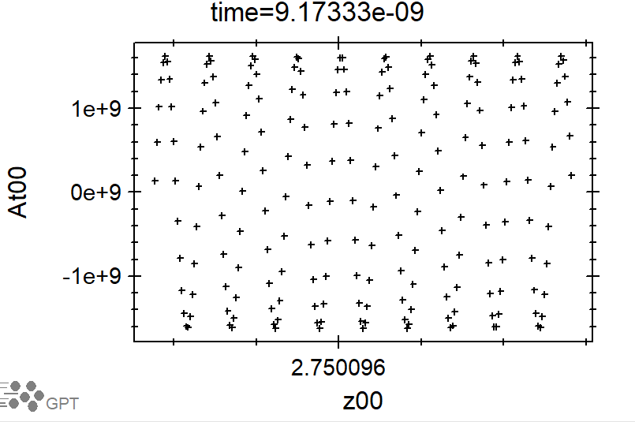
Time-Independent
Faster, single frequency simulation
Define total charge as for single bunch
W00 is power, not energy
Notes:
Show figure of multifrequency and single frequency simulations giving same power results.
Show input file

Slide 14
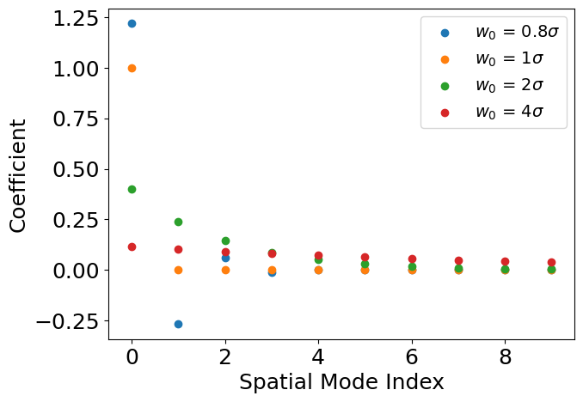
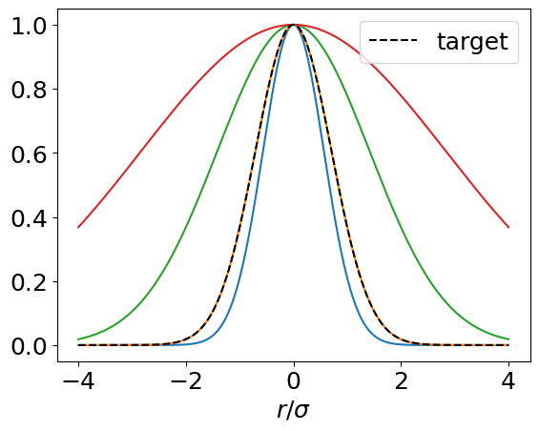
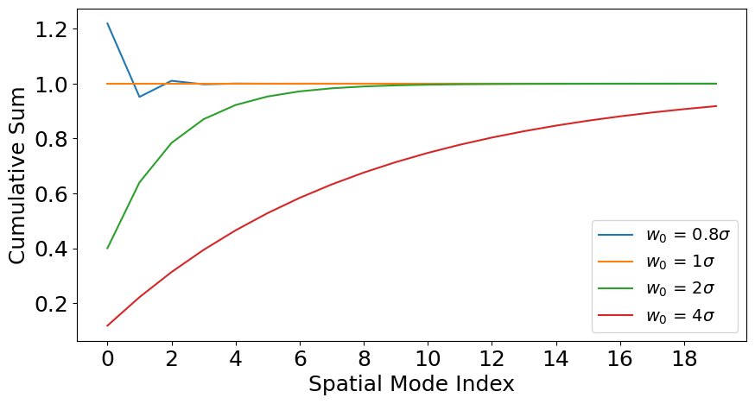
SDE Motivation
Convergence as function of $w_{0}$
Fit target gaussian with Gauss-Laguerre spatial modes
Mismatching waist requires more modes
Trouble when simulating FEL amplifier with gain-guiding
Choose to minimize over undulator
Notes:
Change label in bottom right figure.

Slide 15
Source Dependent Expansion
$$\left(∇_{⊥}^{2}−k^{2}+\frac{ω^{2}}{c^{2}}+\frac{2iω}{c}\frac{∂}{∂t}\right)\left\{\sum_{m}{a_{m}\left(t\right)Θ_{m}\left(α\left(t\right), w\left(t\right)\right)}\right\}=source$$
Allow mode parameters to vary
Sprangle et al.
Recursive structure
Polynomial identities
B parameter
Controls mode evolution $\left(Δz\sim \frac{c}{\left|B\right|}\right)$
Recover previous in limit $B→0$
Need constraint to specify B?
$${\dot{a}}_{m}=f_{1}\left(B\right)a_{m}+f_{2}\left(B\right)a_{m−1}+f_{3}\left(B\right)a_{m+1}+F_{m}$$
beam interaction
$$\frac{∂α}{∂t}=\frac{2\left(1+α^{2}\right)c^{2}}{ωw^{2}}+f_{4}(B)$$
$$\frac{∂w}{∂t}=\frac{2c^{2}α}{ωw}+f_{5}(B)$$
Normal mode diffraction

Slide 16
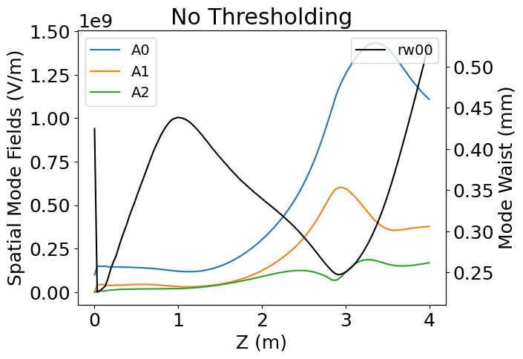
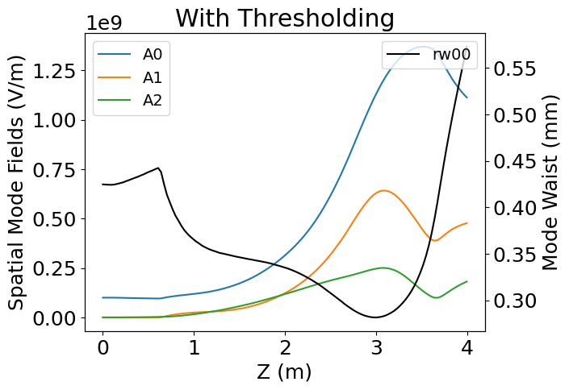
Adding a constraint
0
0
0
$${\dot{a}}_{M}=f_{1}\left(B\right)a_{M}+f_{2}\left(B\right)a_{M−1}+f_{3}\left(B\right)a_{M+1}+F_{M}$$
A number of spatial modes (M) accurately describe field if $a_{m≥M}=0$
Use threshold to set B=0 when $a_{M−1}≈0$
Plots show 3 SDE modes for increasing thresholds
$$B=\frac{F_{M}e^{−2i\tan^{−1}(α) }}{Ma_{M−1} }$$
IF $a_{M−1}>0$
ELSE
$$B=0$$
Notes:
Figure of amplifier where mode diverges
Still want to set w_0 accurately, so B=0 (fixed mode) case works and method doesn’t have to work hard/do large changes
Why seed with only zeroth order if the is not a “stable” configuration under SDE evolution?
Post saturation dip

Slide 17
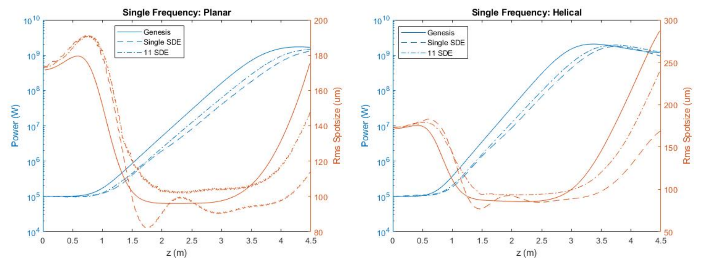
SDE Benchmarking
FEL amplifier with radiation seed
Compare to theoretical gain length
~15% error for single SDE, ~8% error for 11 SDE

Slide 18
Summary
Inputs
Dimensions
Beamline position, cavity length
Frequency modes
Number of modes
Simulation bandwidth (fmin, fmax)
Spatial modes
Number of modes
Waist size
Waist position (shift from center of cavity)
SDE
B threshold
Seed radiation (gaussian)
Peak Field
Seed bandwidth
Shift seed pulse
GPT-FEL improves ability of GPT to simulate FEL interactions
Parallel processing over multiple-cores
Single-frequency and SDE to reduce modes and simulation time
Benchmarked against Genesis and experiment (waveguide)
Notes:
Similar results to Genesis for PAX and high efficiency experiments.
How long do simulations take?

