Slide 1
F O M O: A Start-to-End Simulation Tool for the FERMI Free-Electron Laser
FERMI
Online
MOdel
Alex Brynes
FLASH2020+ 4th Start to End Simulation Workshop
30/05/2023
Notes:
Slide 2: Title of the Presentation
Before you start editing the slides of your talk change to the Master Slide view:
Microsoft Office :Menu: View > Slide Master;
Macintosh – View > Master > Slide Master
Edit the following items:
On the Slide Master (first master slide) – lower area
a) On the left Delete the text and write the title of the event/Conference, Location
b) On the right delete the text and write the name and surname of the speaker and the date (day, month , year)
Close Master View
To start adding slides insert a new slide and select a Layout:
For Title & Subtitle
For text with bullet points
For Text
For Picture, graphs, visuals
Two columns
Blank

Slide 2
Overview
Goals and Current Status
Simulation Procedure
Simulation Database
First Results
Future Work

Slide 3
Goals and Current Status
Goals: Provide a start-to-end framework for performing simulations of the linac and FEL lines, and for storing the data in a standardised format in a common location.
General requirements:
Allow configuration of all machine parameters.
Read the lattice:
From a lattice file.
Live from the control system.
From a measurement file.
Custom setups.
Save parameters to a database and a common location.
Scan single parameters.
Optimise parameters.
Motivations:
It is hard to keep track of all your simulations and to store them logically.
Interfacing between the machine and tracking codes is useful for benchmarking.
Files are not often saved consistently and in a common format.
Simulations are run differently by different people.
Comparisons between codes can be laborious.
E-Beam:
Include collective effects.
Generate initial bunch, or load from file (measured or simulated).
Injector simulation.
FEL:
Send files to cluster and execute.
Load electron beam profile.
Transition between GENESIS and OCELOT/ELEGANT for chicanes / drifts.
All polarisation states available.
One4one simulations.
Two seeds available.
Exotic configurations (ultrafast polarisation switching, attosecond pulses....).
Available
In progress
Not available

Slide 4
Layout & Codes Used
ELEGANT
Base lattice
A brief introduction to FERMI:
Two seeded FEL lines.
HGHG on both lines.
Currently being upgraded to enable EEHG.
Energy up to 1.5 GeV.
1.8 GeV after upgrade.
50 Hz.
OCELOT
Manipulate
All other codes
Convert
INJECTOR
Photoemission from a cathode
3D space-charge
Up to 100MeV
Configuration fixed
LINAC, BUNCH COMPRESSORS & SPREADER
0.1 – 1.8 GeV
LSC, CSR, wakes
Laser heater
Configuration changes often
FEL
Two lines
Seeded
HGHG or EEHG (or both)
Dispersive sections
Configuration changes often

Slide 5
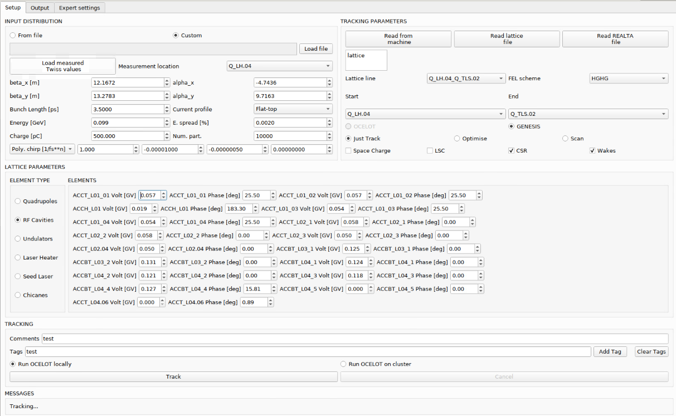
User Interface
This is how the simulation is set up:
Input distribution.
Start & end locations.
FEL scheme.
Lattice parameters.
Collective effects.
Track / Scan / Optimise.
Comments / Tags
Other parameters are configured in the “Expert” tab.

Slide 6
Simulation Procedure
Define beam
Define lattice
E-beam code
Collective effects
Run e-beam simulation
Simulation type
Num. particles and bins
Time window
Use e-beam profile?
Run FEL simulation
Add to database
Send to storage

Slide 7
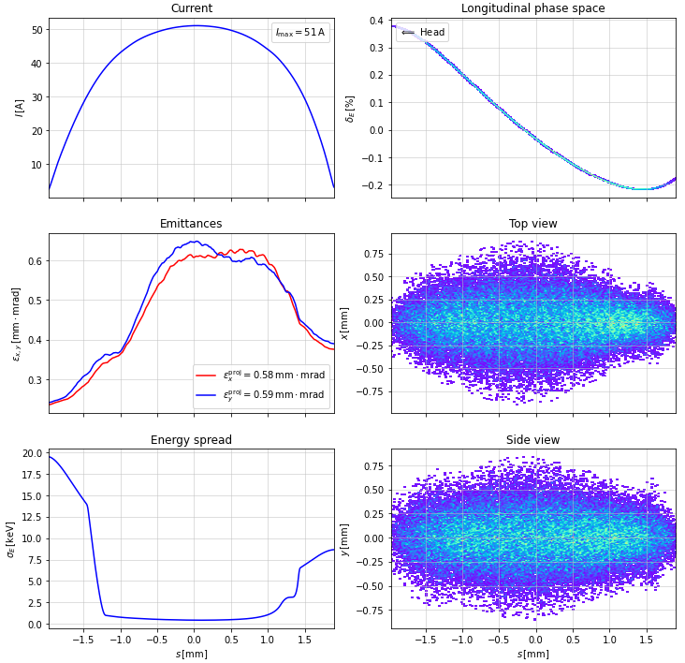
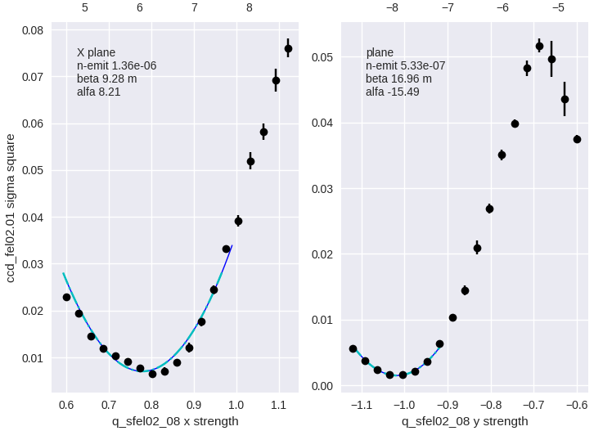
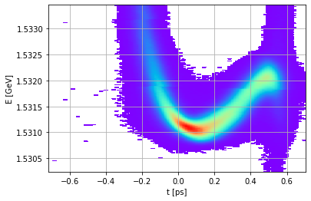
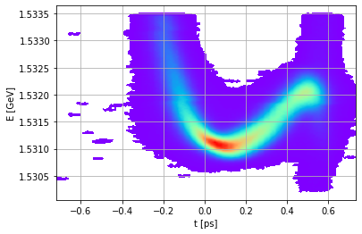
Input Distribution
MEASURED
SIMULATED
Twiss parameters
Longitudinal phase space
Full 6D phase space generated by ELEGANT, GPT, OCELOT or ASTRA
Smoothing
USER-GENERATED
Number of particles
Twiss parameters
Bunch length
Energy
Chirp
Charge
Energy spread
Num. particles
6D phase space generated

Slide 8
Loading the lattice
REAL-TIME DATA
OCELOT
ELEGANT
Magnets
Quadrupole strengths
Dipole bend angles
Dispersive magnets
Undulators
Harmonic
Polarization
Taper
All parameters are defined in the lattice file
Laser heater
Pulse energy
Undulator gap
Pulse length
Seed laser
Wavelength
Energy
Pulse length
Chirp
Available
Conversion required
Not available (Defined externally)
RF
Energy gain
Phase
Parameter Scans
R56
LH attenuator
......
Diagnostics
Trajectory
Compression factor

Slide 9
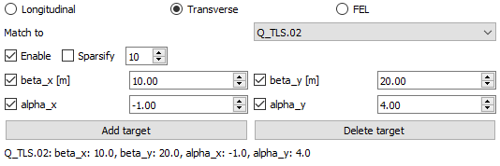
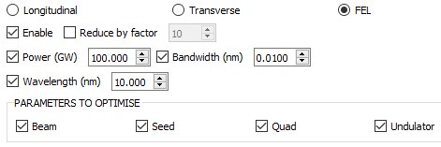
Optimisation
LONGITUDINAL
TRANSVERSE
FEL
Preliminary tests of electron beam parameter optimisation are promising (OCELOT only for now).
We use the MOGA module in OCELOT for this.
FEL optimisation is more complicated – particularly when including the electron beam parameters.
A work in progress! Suggestions are appreciated ☺

Slide 10
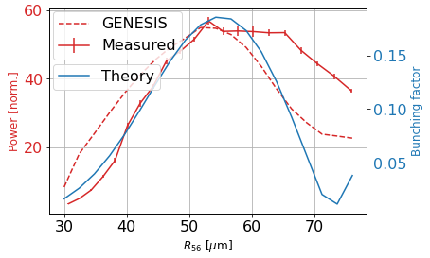
Scanning
It is possible to perform 1D scans over various lattice and FEL parameters.
Here, we compare results from a scan of the first dispersive section strength on FEL2:
Measured FEL intensity.
1D theory.
Time-dependent GENESIS simulation.
Despite the low particle number used, the agreement is reasonable.
New possible features:
Scanning electron beam properties.
Multidimensional scans?

Slide 11
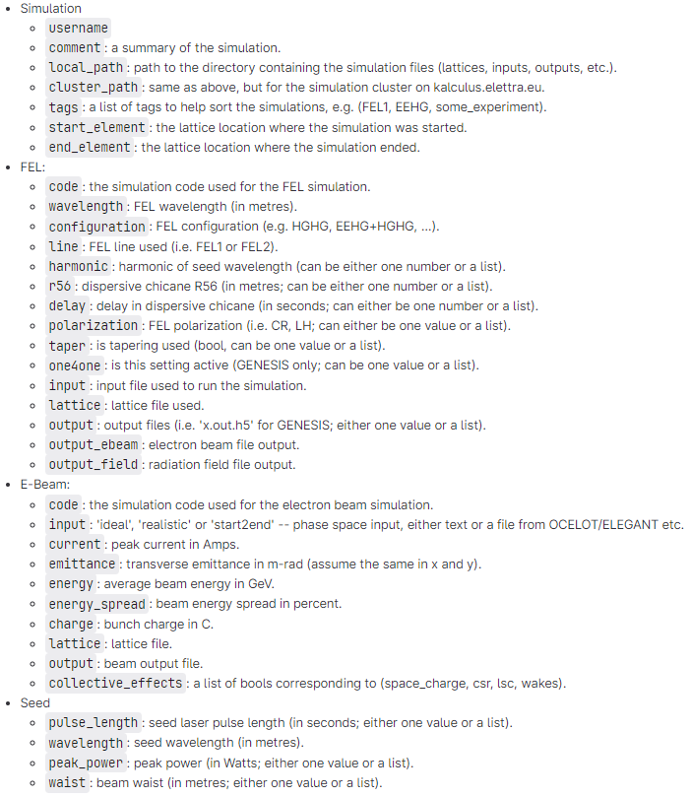
Database
All simulation settings and outputs are saved to a local server, tagged by timestamp / lattice / FEL scheme.
More detailed information can be saved in comments / tags.
Additional simulation settings are shown on the right.
All of this information is also stored in a database.
Simulations run not using this framework can also be added to the database, if enough information is provided.

Slide 12
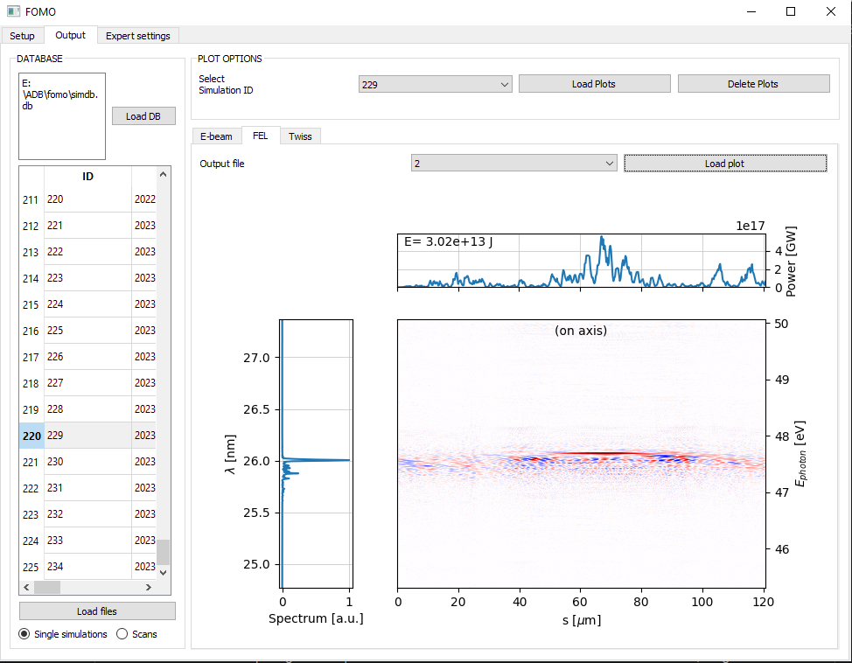
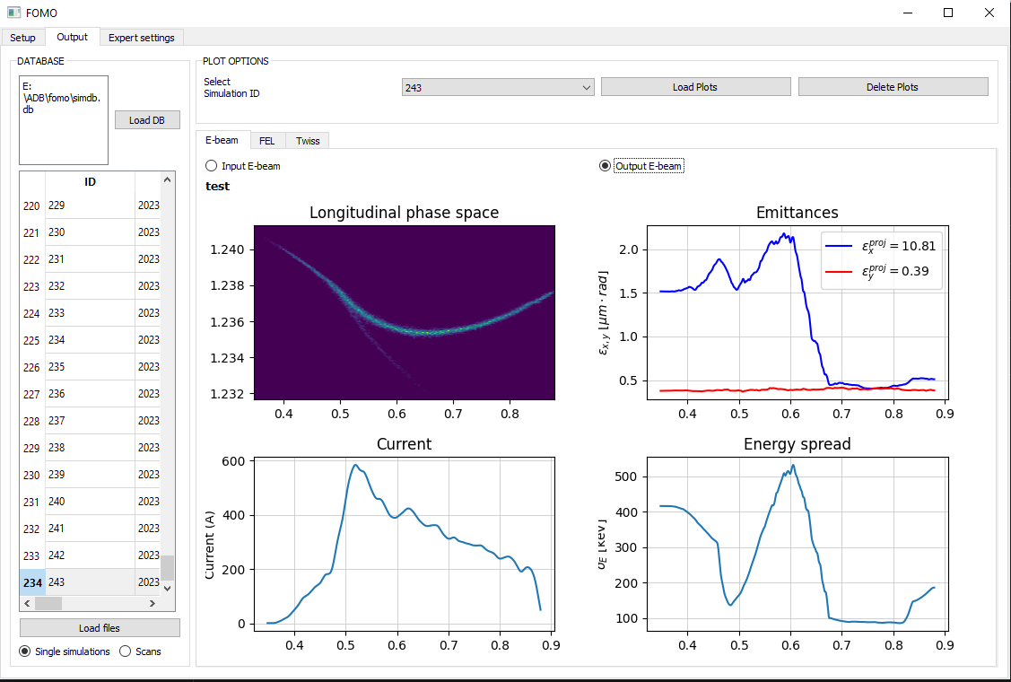
Output
A general overview of the output of each simulation in the database can be loaded from the GUI.
E-beam properties:
Longitudinal phase space
Emittance
Energy spread
Current profile
Twiss parameters
FEL:
Wigner distribution.
Power along the pulse.
More detailed analysis can be done offline.

Slide 13
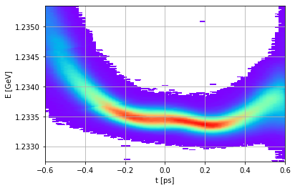
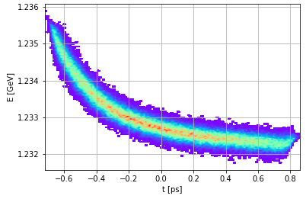
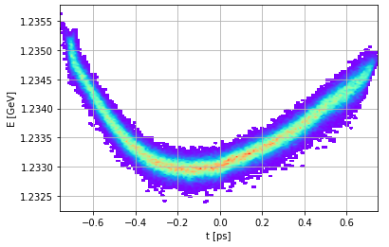
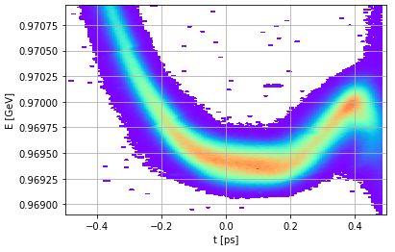
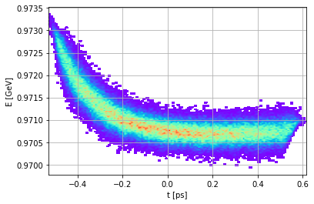
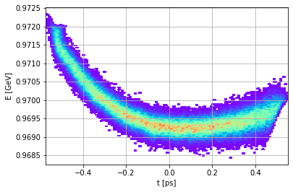
Linac Tracking
Despite small differences between the simulated results and the measurements, there is decent agreement.
Perhaps we could expect to reproduce the beam chirp better if we have an accurate injector bunch...
Qualitatively, ELEGANT can reproduce the chirp in the bunch better than OCELOT.
By reading in the lattice corresponding to a measurement, we can compare the output between codes and measurements.
The injector bunch properties were assumed based on previous simulations.
Measured
OCELOT
ELEGANT

Slide 14
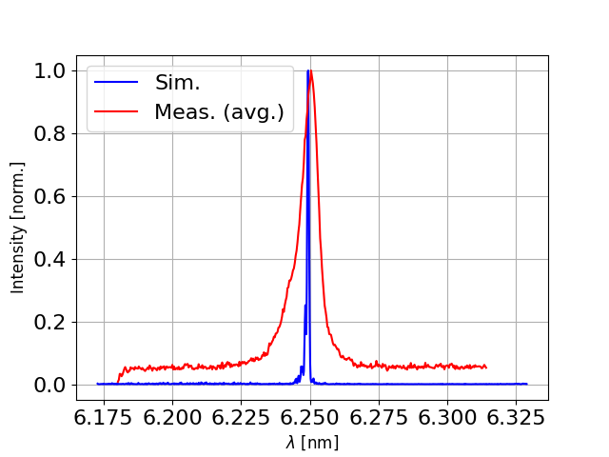
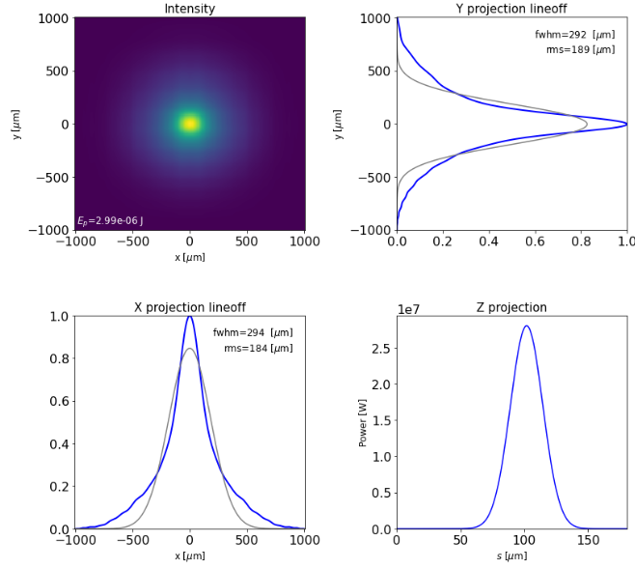
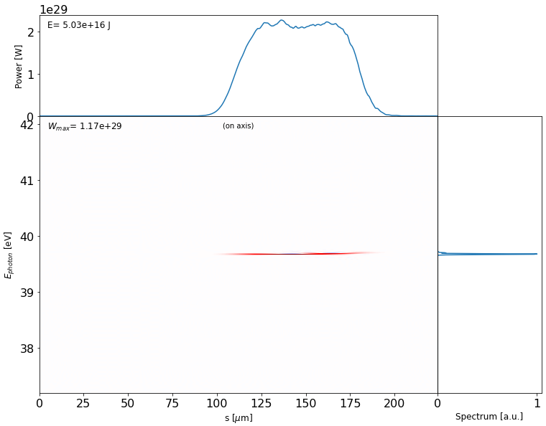
FEL Tracking
Simulations can be run locally or executed on a cluster.
File transfer between a local PC and the cluster, and execution of the GENESIS simulation, is automatic.
By reading in the lattice and seed laser settings, GENESIS input and lattice files are generated.
E-beam input:
Generate GENESIS beam internally.
Use average e-beam properties.
Load in the particle distribution.
Interleaving GENESIS with OCELOT/ELEGANT to simulate CSR/LSC in chicanes and drifts.
The separate lattices and input files can be generated, but....
Loading an SDDS file is not adequate!
A converter has been written to convert output from ELEGANT to GENESIS.
In progress: converting from GENESIS to ELEGANT (currently very slow).

Slide 15
Future Plans
Improve code switching in FEL section.
Injector simulation in GPT.
All polarisation states available in GENESIS.
Check that all FEL schemes work as expected.
Set up optimisation of FEL parameters.
Enable jitter studies (possible in principle now....).
Load more REALTA file types (more parameter scans).
Adapt OCELOT to do seeded FEL simulations???
Photon transport to beamlines.
Check that everything works on Mac (only tested on Windows and CR Linux machines).

