Slide 1
QuarkNet Cosmic Ray
Long-term collaboration with High Schools. Hundreds of detectors (CRMDs) Worldwide.
Cosmic Watches - QuarkNet built 48 (MIT design). Every student in class will have a detector. Activities: singles vs pair triggering; muon rates vs vertical separation; rate vs time; rate vs zenith angle; and rate at various locations (different floors). Prototyping usage this summer.
e-Lab statistics for 2022: 6,180 data uploads from 70 users in 6 countries; 7,630 analyses run; 318k logins; 2,107 Teacher accounts
Number of days each Analysis type was run: Flux (260); Lifetime (180); Performance (105); Shower (140); Time of Flight (115); 47k data files used

Slide 2
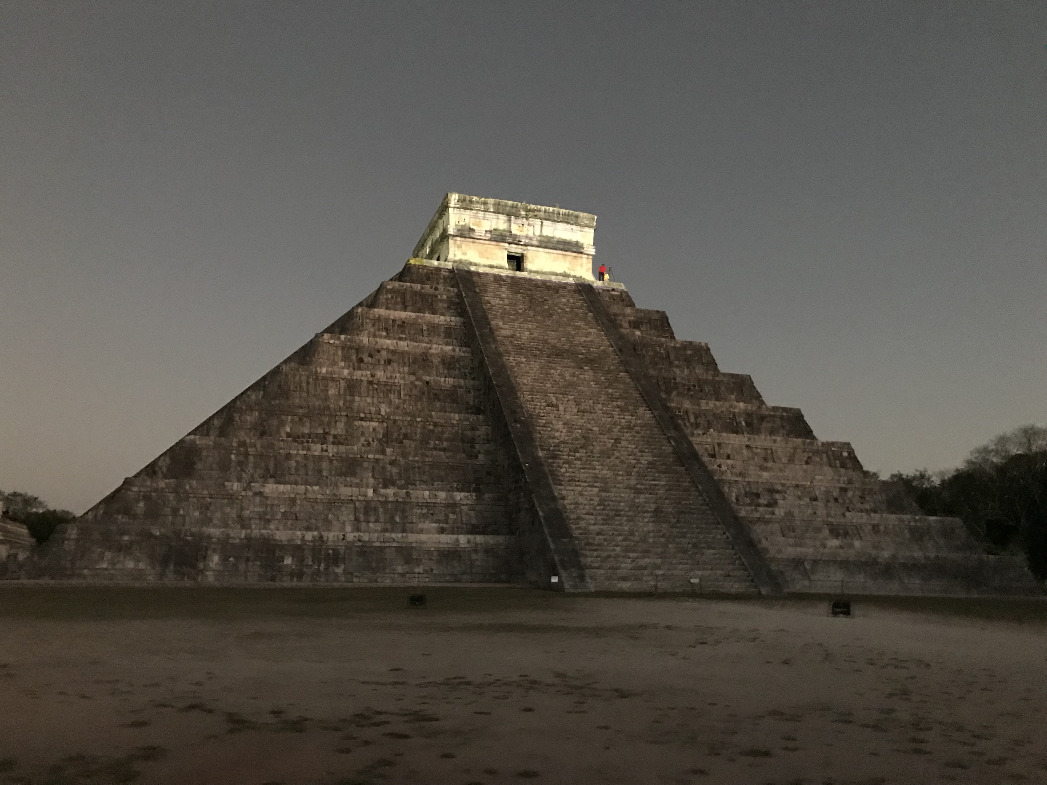
Special Projects
International Muon Week February 14–23, 2023: measure cosmic ray rate; 24 participants in 8 countries. Results at: https://www.google.com/maps/d/u/0/edit?mid=1_b7XvLvx9iIJ9A-NJeDPvtP3pOAhgX0&ll=3.0643583764248064%2C0&z=2
and in a Global 3D plot:
https://www.youtube.com/watch?v=DNAg1mYPKRU
Special Cosmic Ray Projects:
Summer Workshops at Centers
Simple experiments with existing data for teachers without CRMDs
Jupyter Notebook code work for further analysis (e.g. upward muon search)
Storm tracking across the US Midwest
Search for the Moon’s muon shadow
Cosmic activities integrated into Portfolio activities
Pyramid – Muography at Chichen Itza – search for hidden chambers
QuarkNet plans to host data and develop event displays and analyses
for the public

