Slide 1
Cosmic Outreach at DESY, Zeuthen
Summary International Cosmic Day 2022
CosmicLab activities 2023
Carolin Gnebner
8 May 2023
IPPOG Meeting

Slide 2
Summary International Cosmic Day 2022

Slide 3
About the team
ICD Team:
1 coordinator
2 scientists as consultant
1 event managers for organizational things in the background like e.g. Head quarter
2 - 3 students for website, e-mails, support work
ICD extended team:
press 1 person
technology, photo
20 weeks before the event Safe the Date given out
11 Week before event day started with planning in team

Slide 4
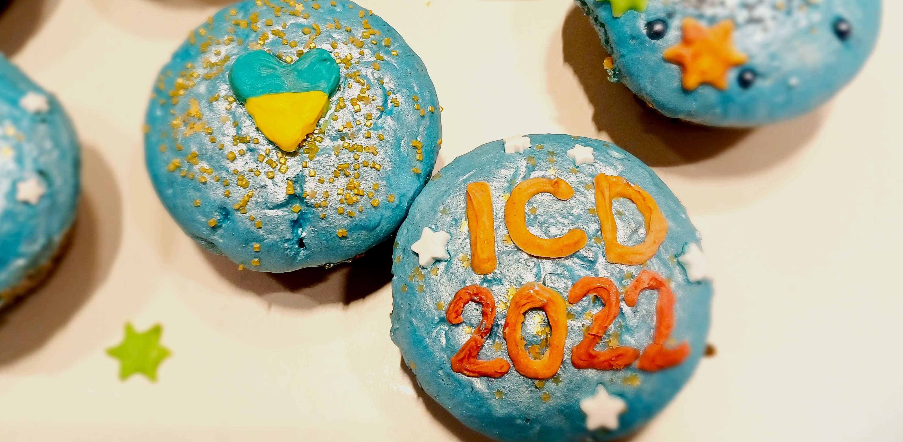
What took place?
On the Day
Welcome Call, prerecorded
Video Calls, from 8 to 19 CET
Selfie- and Drawing-Contest
Quiz on Kahoot
Live Stream
At DESY:
Online event
Visit in school
In advance
Internal workshop to kick off
Training of moderators and host video calls
Lending and advice on experiments (CosMO, Cloud Chambers and Cosmic@Web)
Nora Feigl, DESY

Slide 5
Particpants
98 groups from 23 countries
Heike Prokop, DESY

Slide 6
Video Calls
12 video calls, about 700 young people, 51 groups
3-5 groups in one slot, duration 45 - 60 minutes
2 people (moderator and host) are optimal to lead a video call
makes the most effort in organizing the ICD
are very popular and an integral part of the day
Susann Niedworok, DESY
Carolin Gnebner, DESY

Slide 7
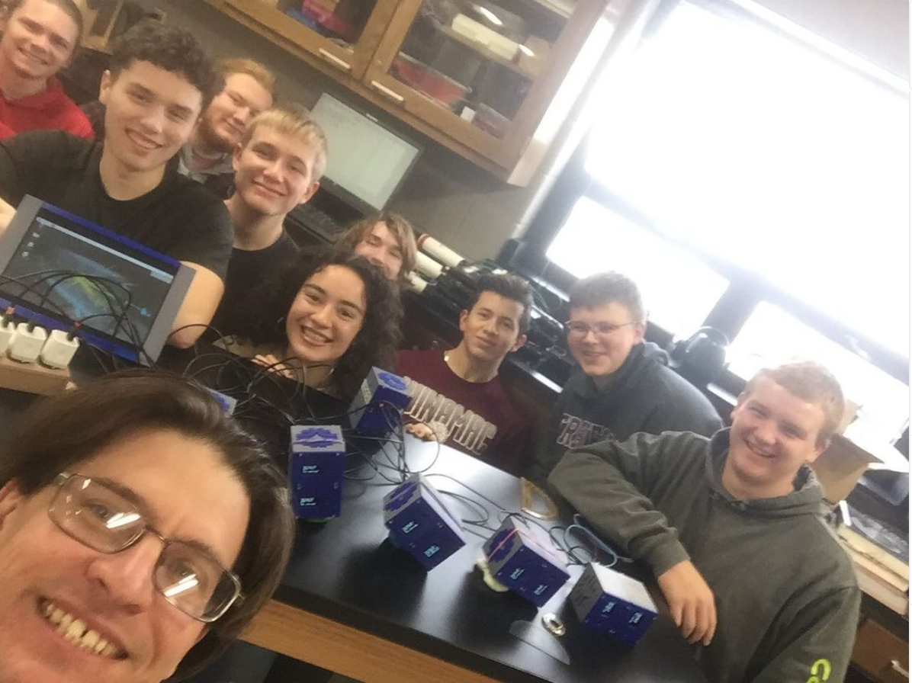
Video Calls
at online event everyone comes individually into call
feeling one has heard 8 presentations, although it was only one, because different people present
that need more time
in the evening rather less people in call
feeling audience missing
in the evening rather more groups in one call
some dial in to Zoom rooms at various times to test apparently
need to create individual sessions
test calls the day before
© American School „Winamac Community High School “
© Elisabetta Bissaldi, INFN/OCRA

Slide 8
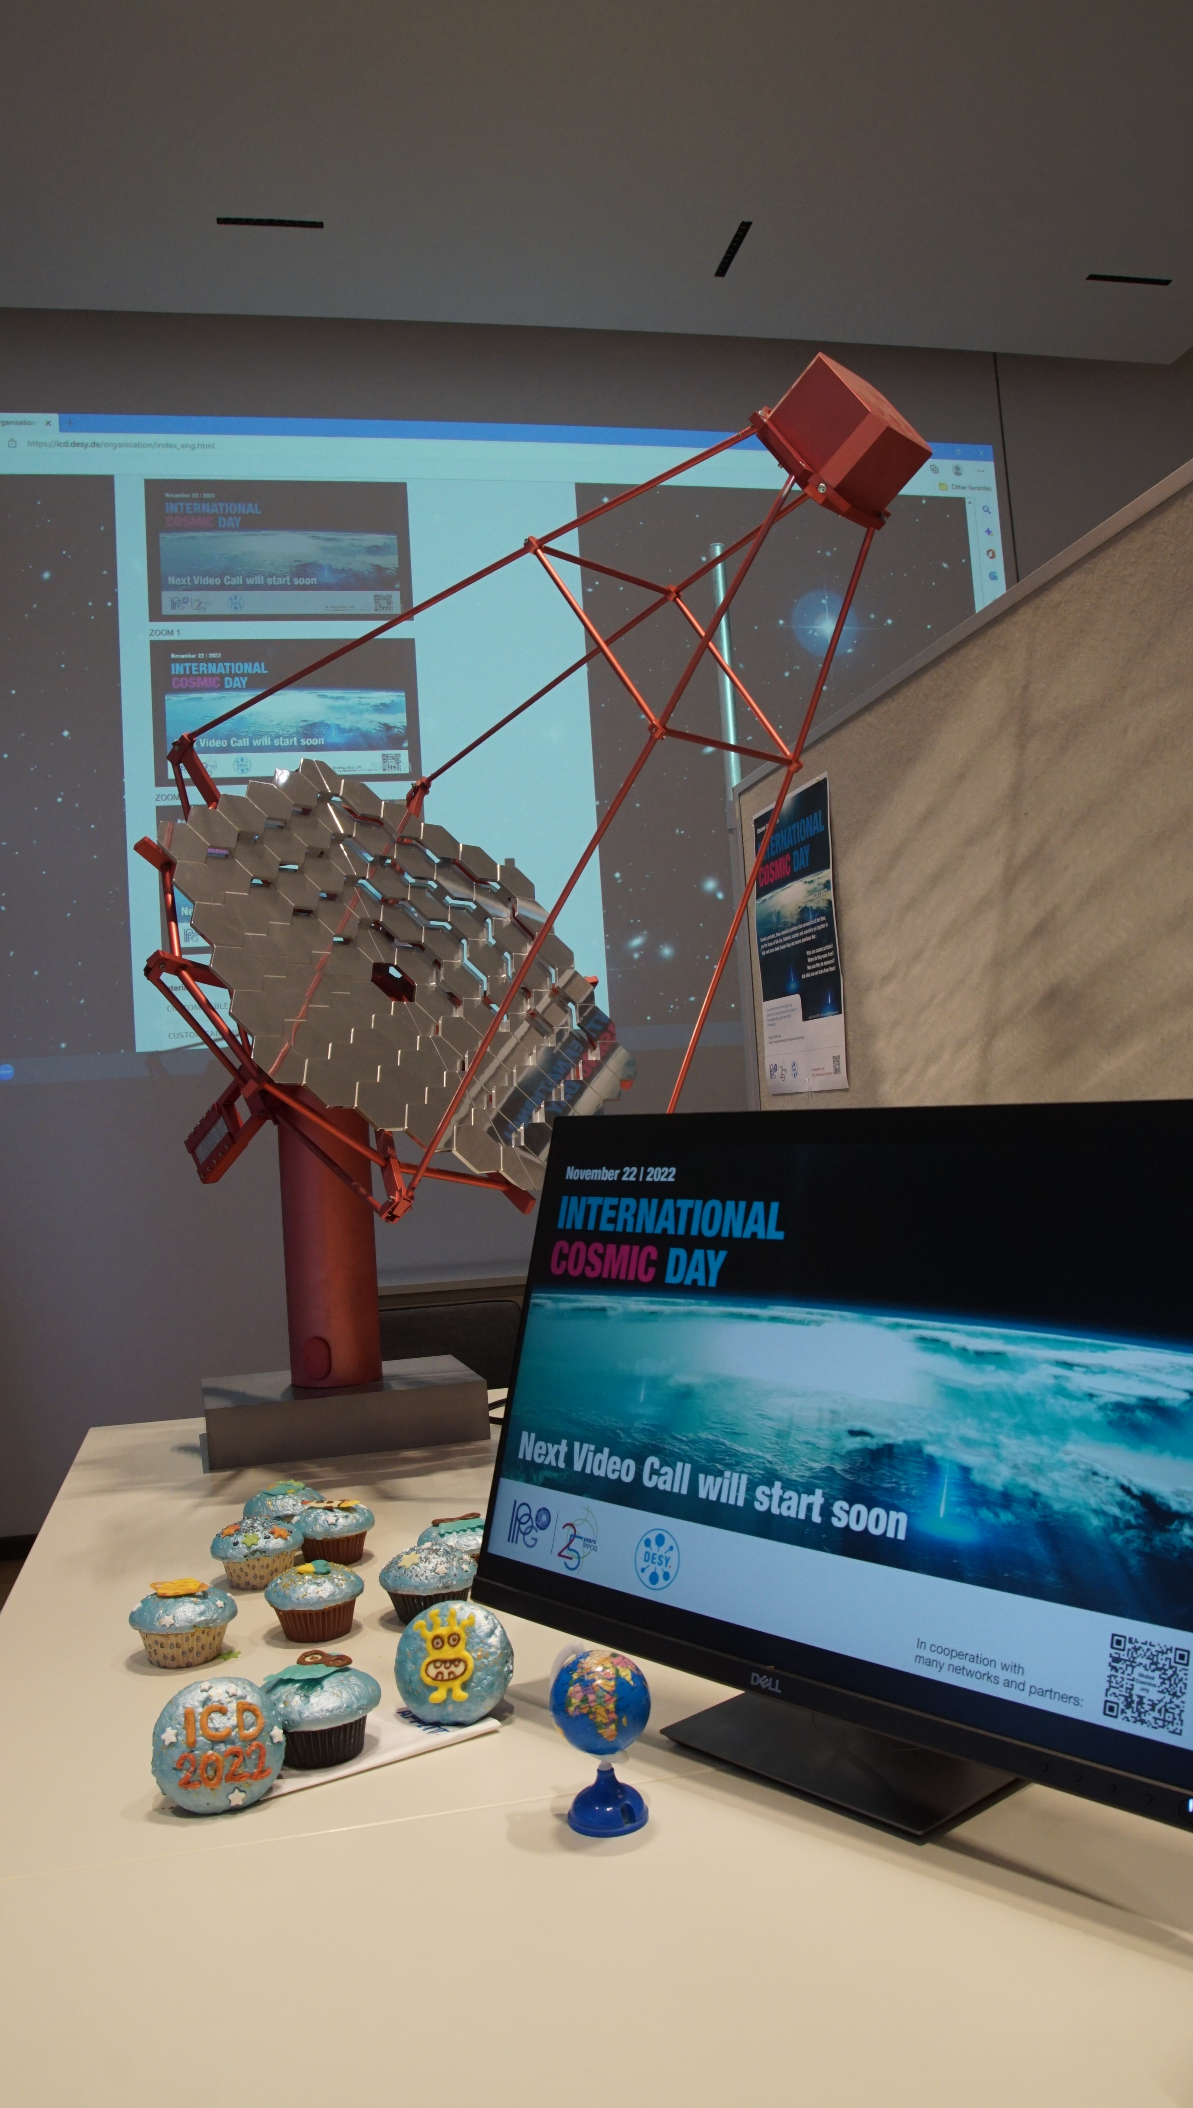
Live Stream and Webseite
Live stream always over 38 visits
on website 90 hits peak
Organization area was well used
Heike Prokoph, DESY

Slide 9
Welcome Call
special guest: Dr. Becky, Oxford University
made available on YouTube
180 views one day after event (for comparison: last year: 152)
for comparison: video on home page for 10th anniversary: 980 views

Slide 10
Kahoot Quiz 2022
16 questions about cosmic rays, universe, electromagnetic radiation, neutrinos, black holes and more...
On average 61% correctly answered questions
140 players (compare 62 players in 2021!!!):
25 players answered 100% of the questions correctly
36 players needed help
46 players did not finish the game
Easier questions (e.g. Cosmic Rays) were answered correctly more often than more difficult questions (e.g. Electromagnetic Spectrum/Wavelength).
Access data for the quiz were published on the website the evening before ICD at 20h, quiz was closed on 25.11.22 at 20h (3 days after the event)

Slide 11
CosmicLab

Slide 12
Goals for 2023
Redesign of CosMO III detectors
Further development of Cosmic@Web
Summer Camp Balloon Mission 2023
CosmicWatch building for the first time
Test of the Auger Masterclass at the ICD

