Slide 1
2nd NOVALIS meeting
Lehrstuhl für
Oberflächen- und
Werkstofftechnologie
Dr. Aleksandr Zubtsovskii, Prof. Xin Jiang
LOT, Institut für Werkstofftechnik, Universität Siegen
2 June 2023, Hamburg

Slide 2
Lehrstuhl für
Oberflächen- und
Werkstofftechnologie
Tasks of the NOVALIS project (at Uni Siegen)
Deposition studies: Nb, NbN, NbTiN, Nb₃Sn as well as MgB₂ sputter-coatings on Nb and Cu flat samples and ALD-coated flat samples
Substrate preparation: Cu and Nb samples
Sample characterization: microstructure, SC and RF properties
Developments and upgrades

Slide 3
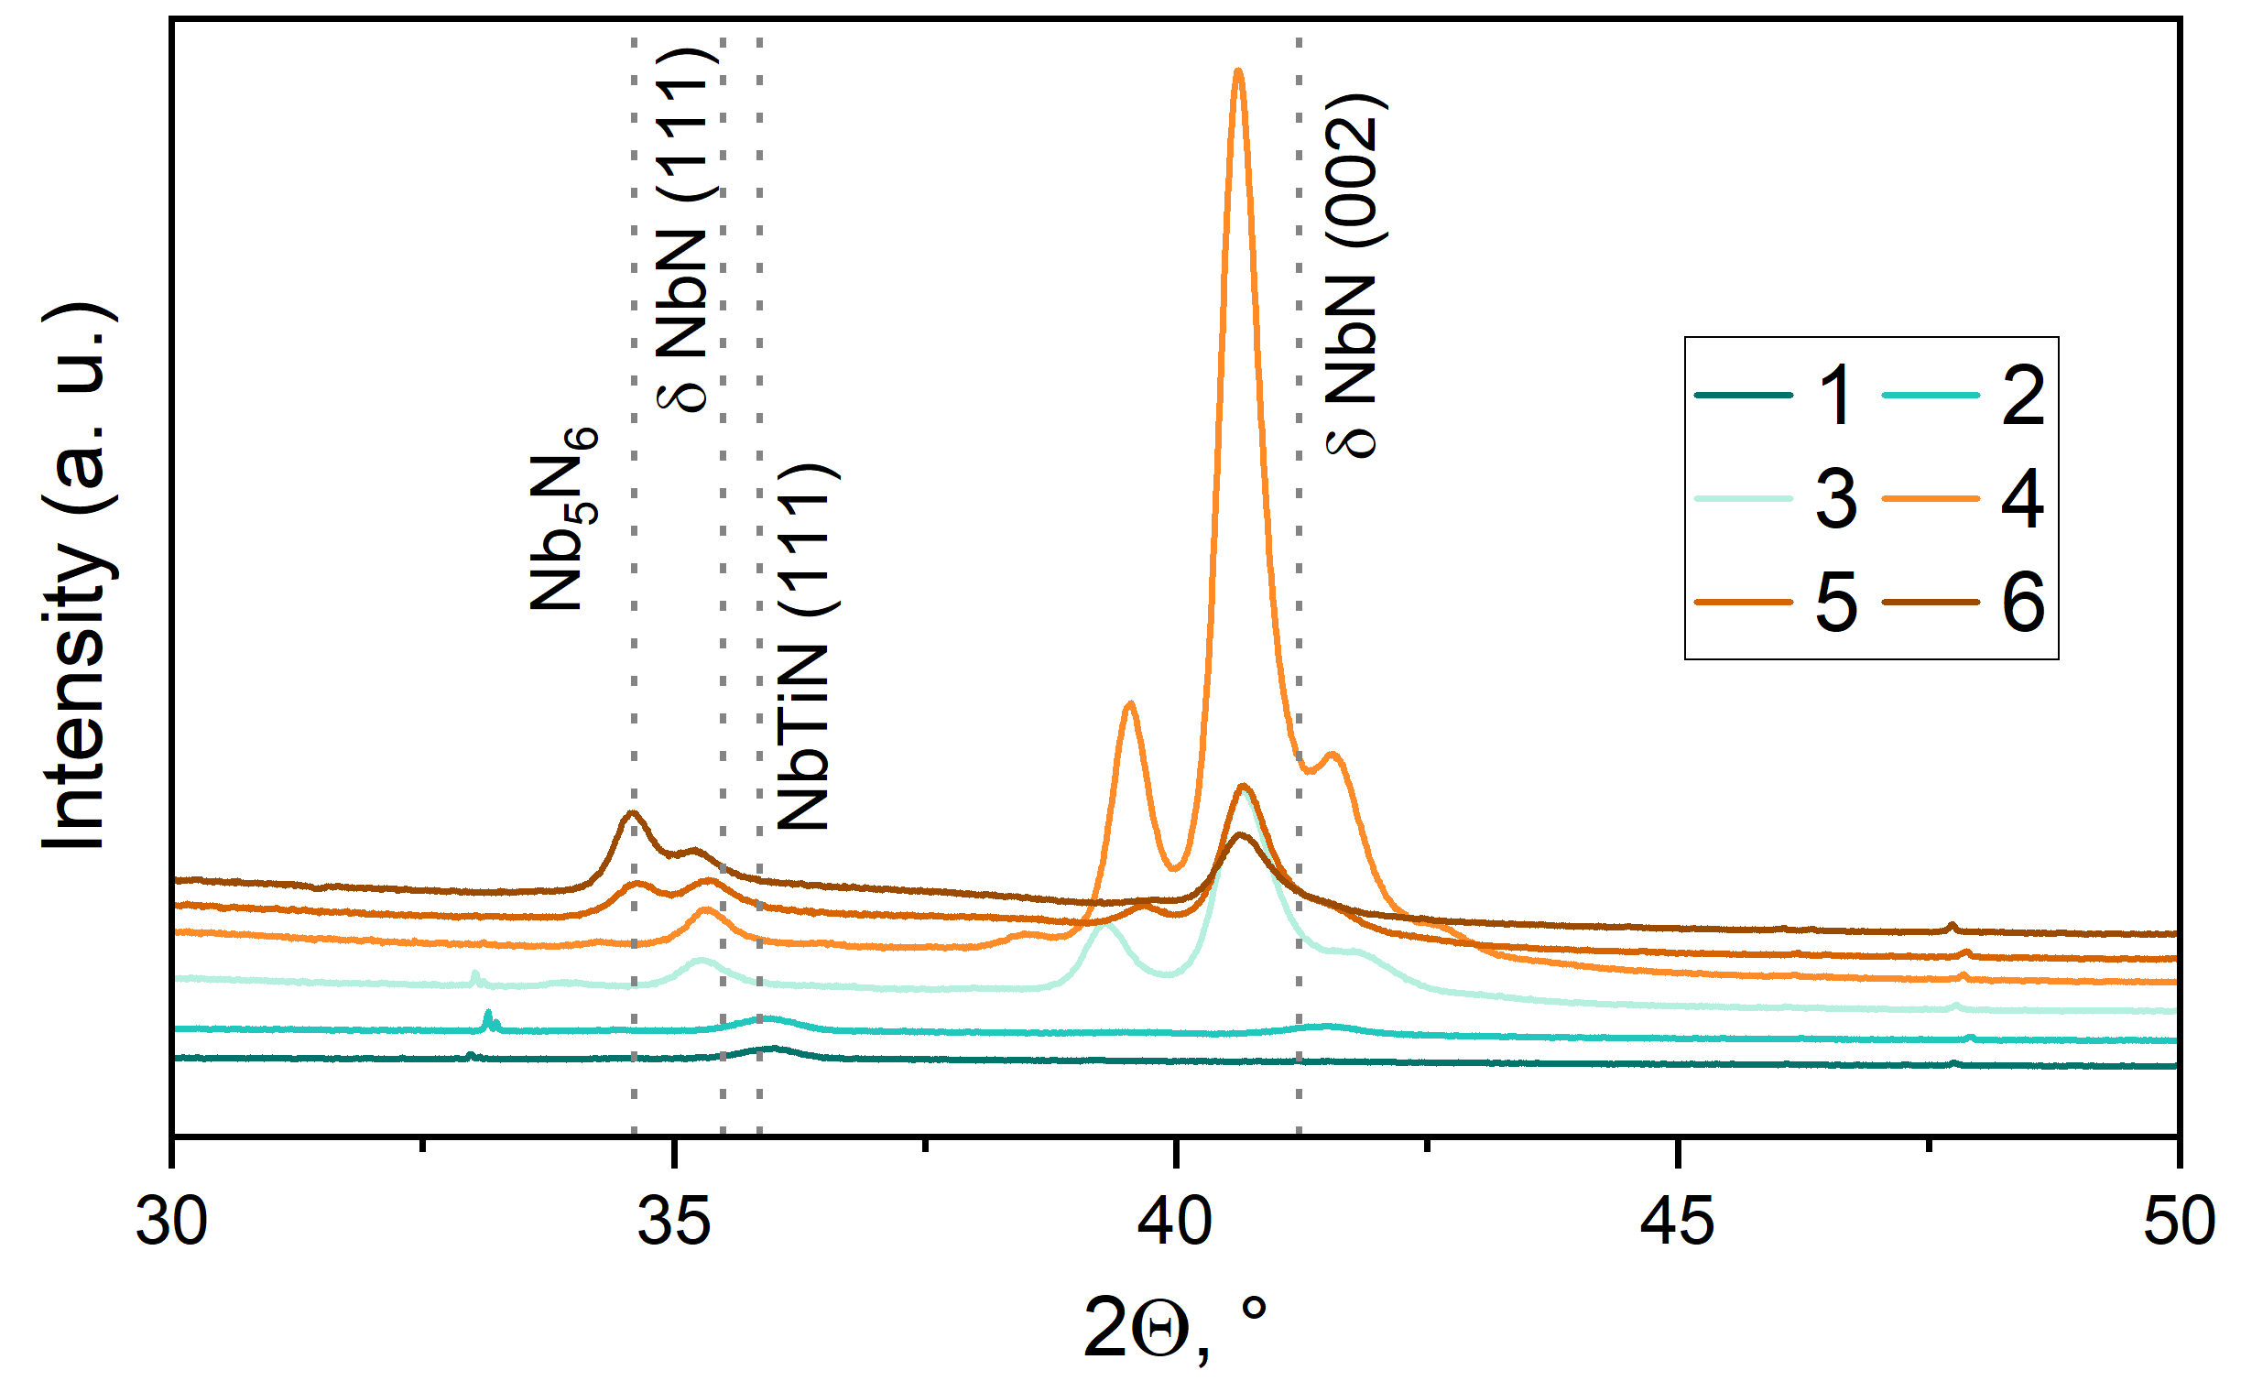
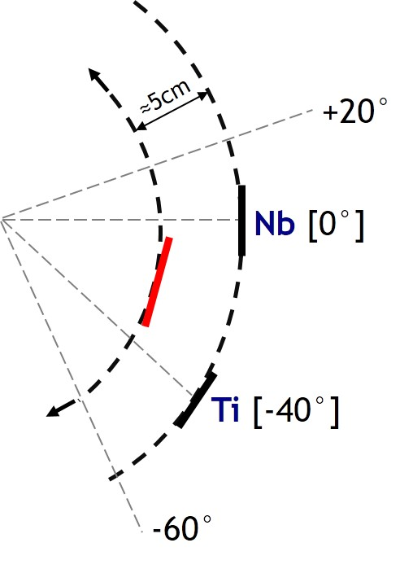
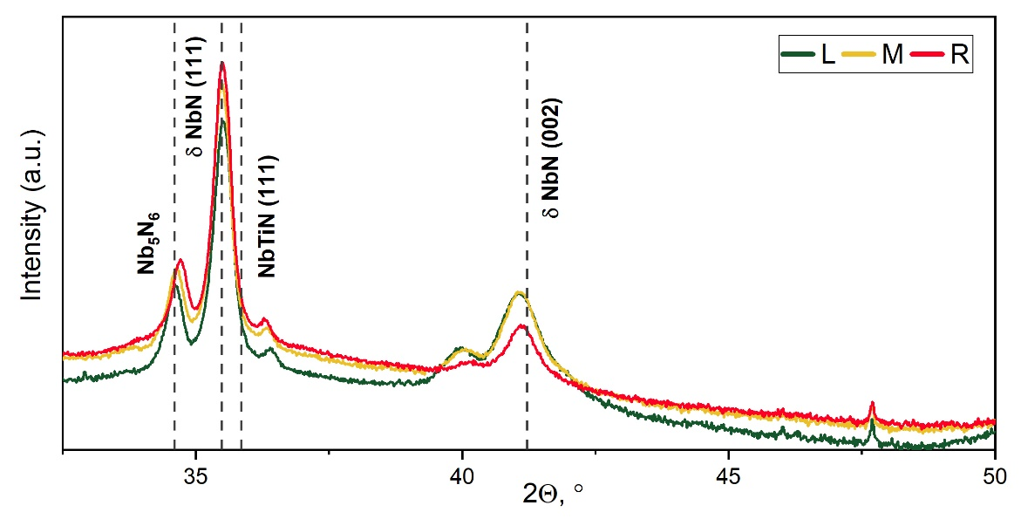
Lehrstuhl für
Oberflächen- und
Werkstofftechnologie
1a. Co-sputtering of NbTiN: rocking angle
-40°↔ 0°
1 2 3 4 5 6
Sample stage 120mm
Rocking angle
-40 | 0
-45 | +5
-55 | +15
-60 | +20
-65 | +25
-70 | +30
SAZ_024
-60°↔ +20°
P(Nb) = 650 W
P(Ti) = 300 W

Slide 4
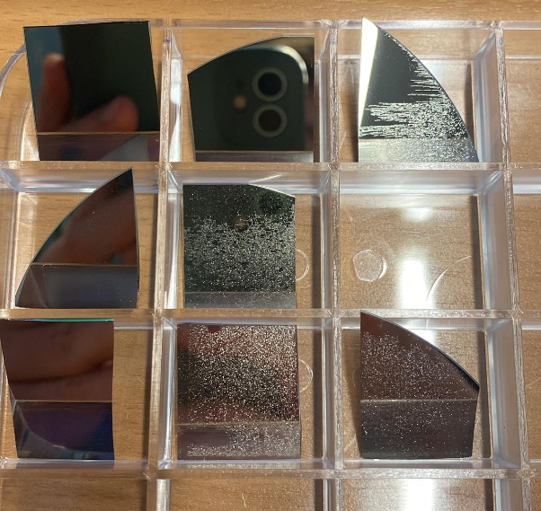
Lehrstuhl für
Oberflächen- und
Werkstofftechnologie
1a. Co-sputtering of NbTiN: phase mixing
Too much power on Nb target:
Delamination of films
Unstable work of HiPIMS
Growth of NbN phases

Slide 5
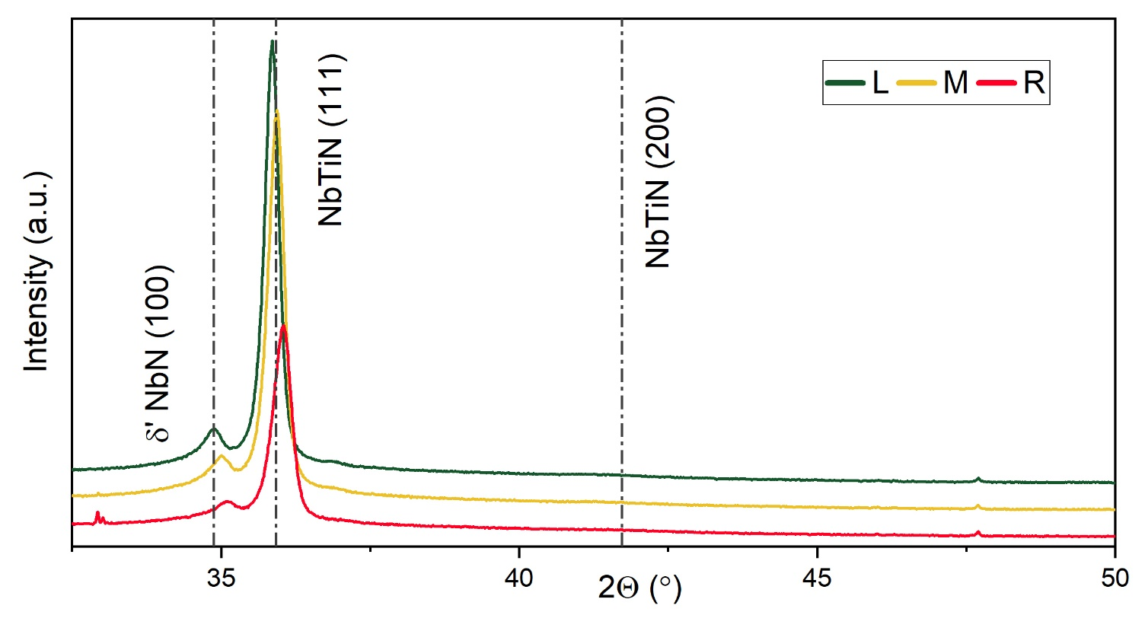
Lehrstuhl für
Oberflächen- und
Werkstofftechnologie
1a. Co-sputtering of NbTiN: phase mixing
Too much power on Nb target:
Delamination of films
Unstable work of HiPIMS
Growth of NbN phases
SAZ_026
-55°↔ +15°
P(Nb) = 300 W
P(Ti) = 500 W
Change the Ti/Nb power ratio:
Optimum around 500W/300W
Rocking angle [-60°↔ +20°]
Needs to vary other parameters: p, Ar/N₂, bias…

Slide 6
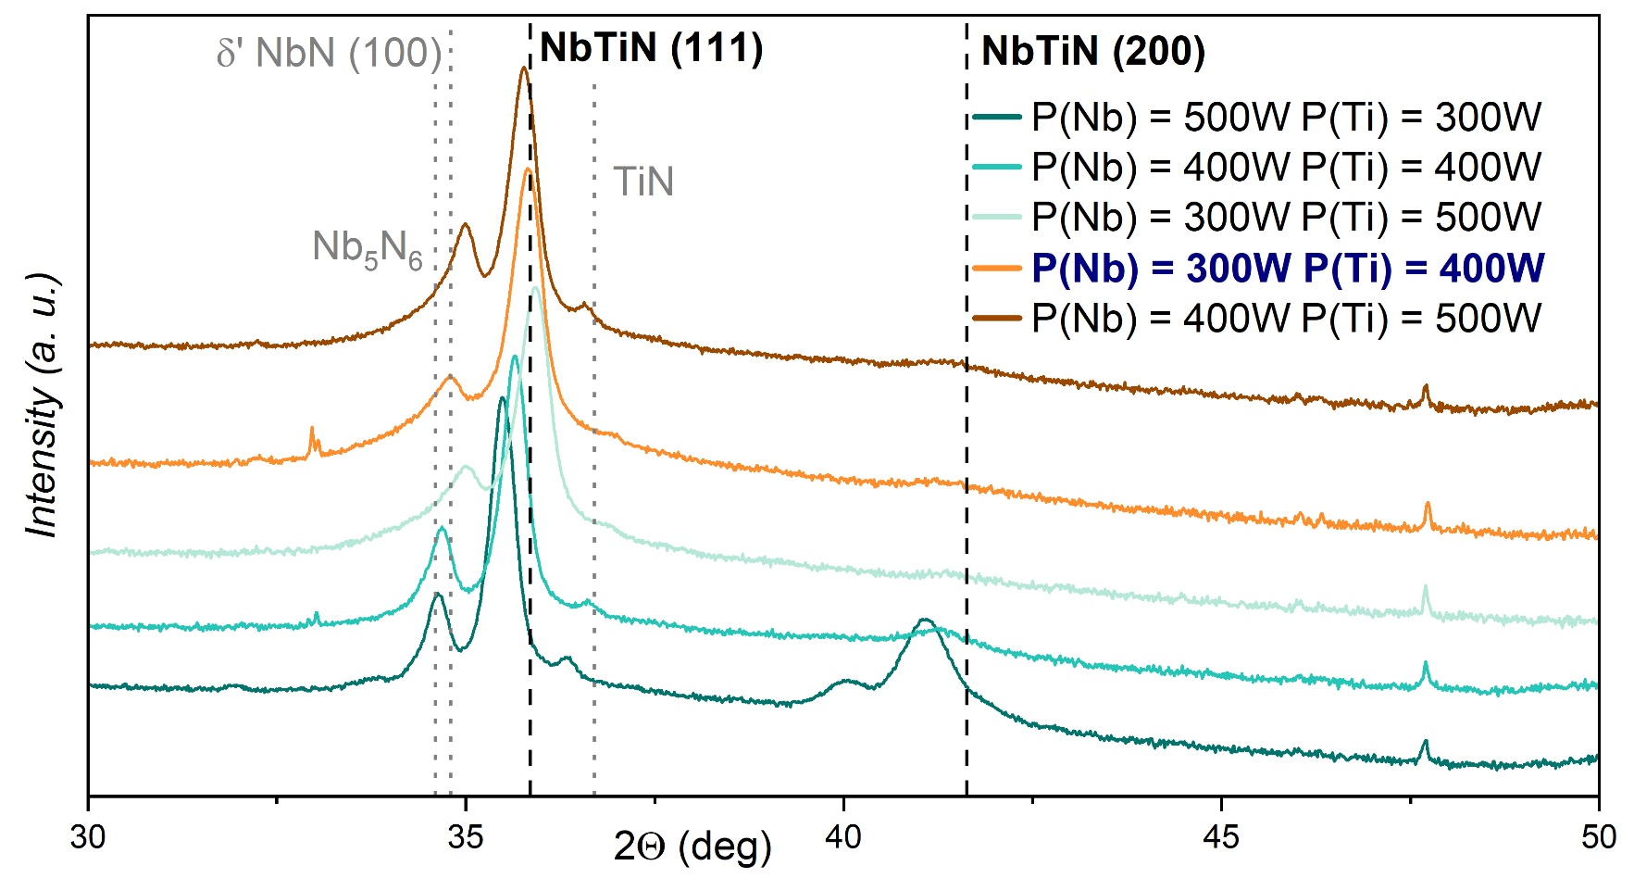
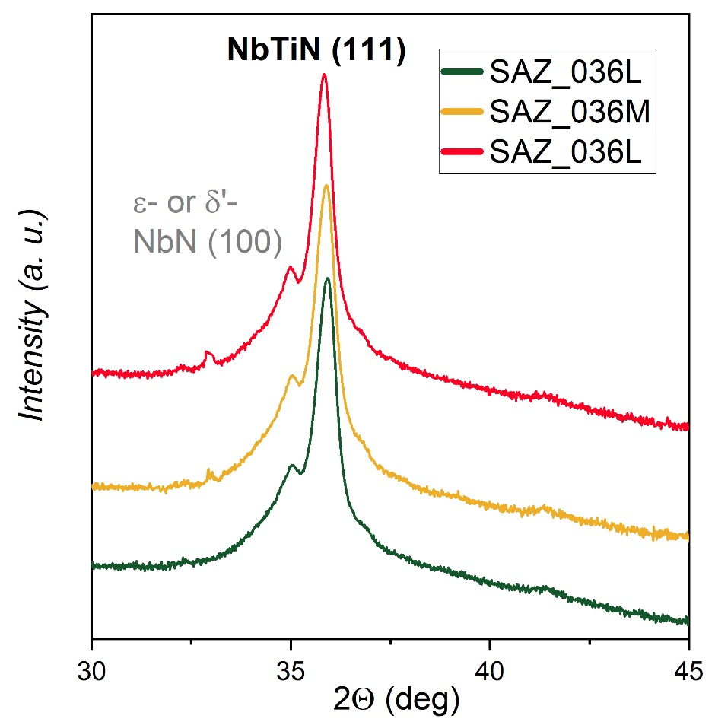
Lehrstuhl für
Oberflächen- und
Werkstofftechnologie
1a. Co-sputtering of NbTiN: cathode power
Impurity phase doesn’t depend on the sample position
Optimal ration: P(Nb) = 300W, P(Ti) = 400W

Slide 7
Lehrstuhl für
Oberflächen- und
Werkstofftechnologie
1a. Co-sputtering of NbTiN: deposition pressure at Nb/Ti (300W/500W)
p ≈ 1.8∙10⁻² mbar
p ≈ 1.3∙10⁻² mbar
p ≈ 0.9∙10⁻² mbar

Slide 8
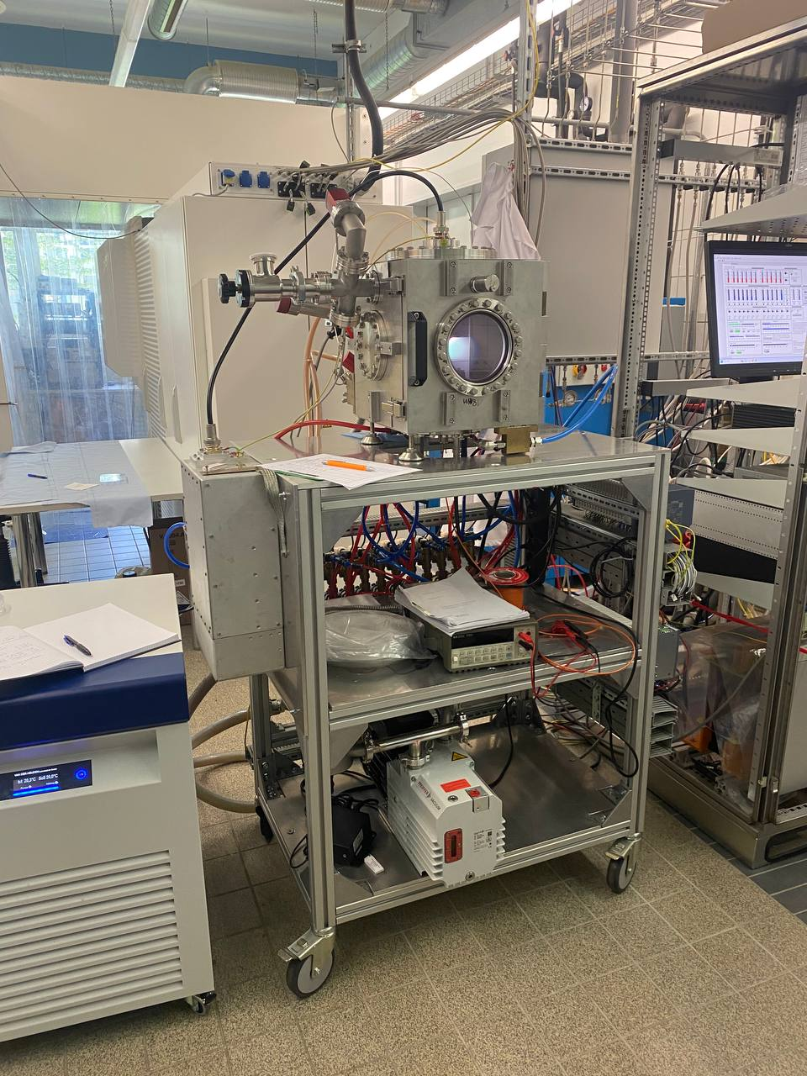
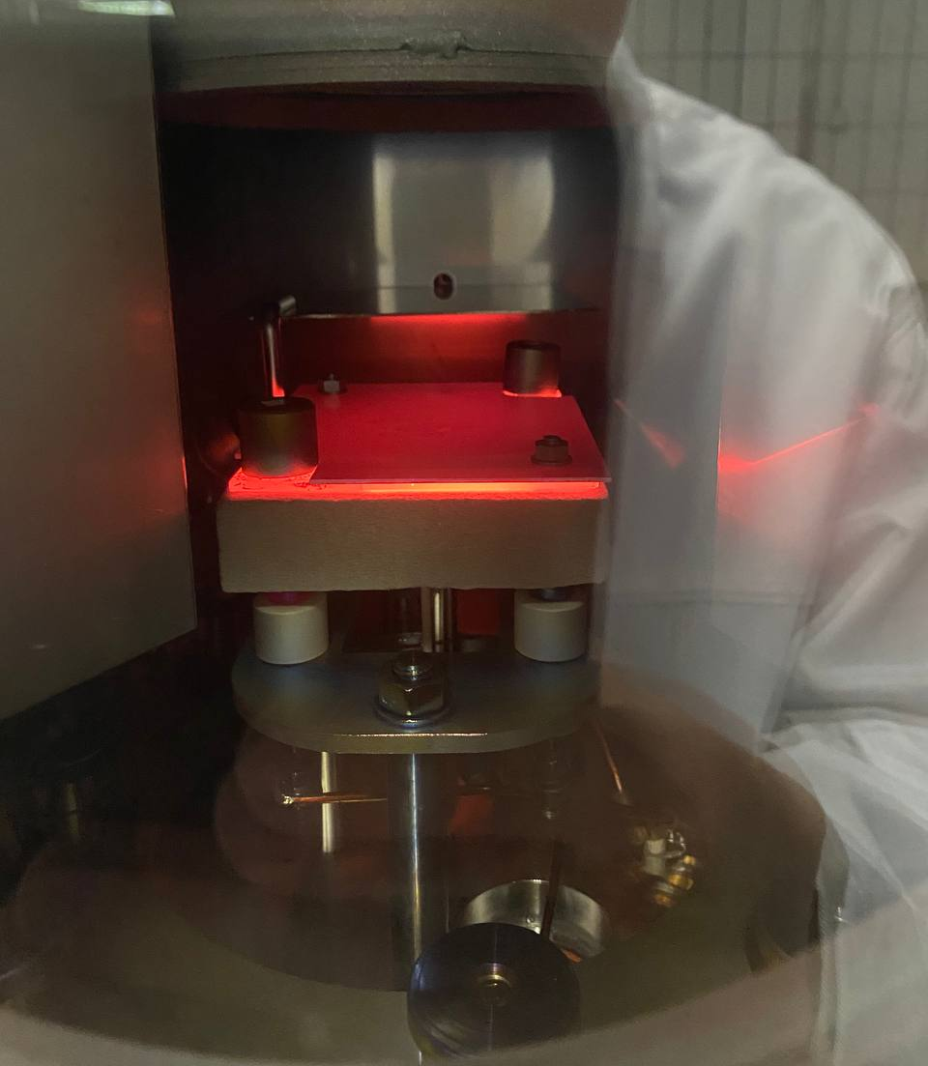
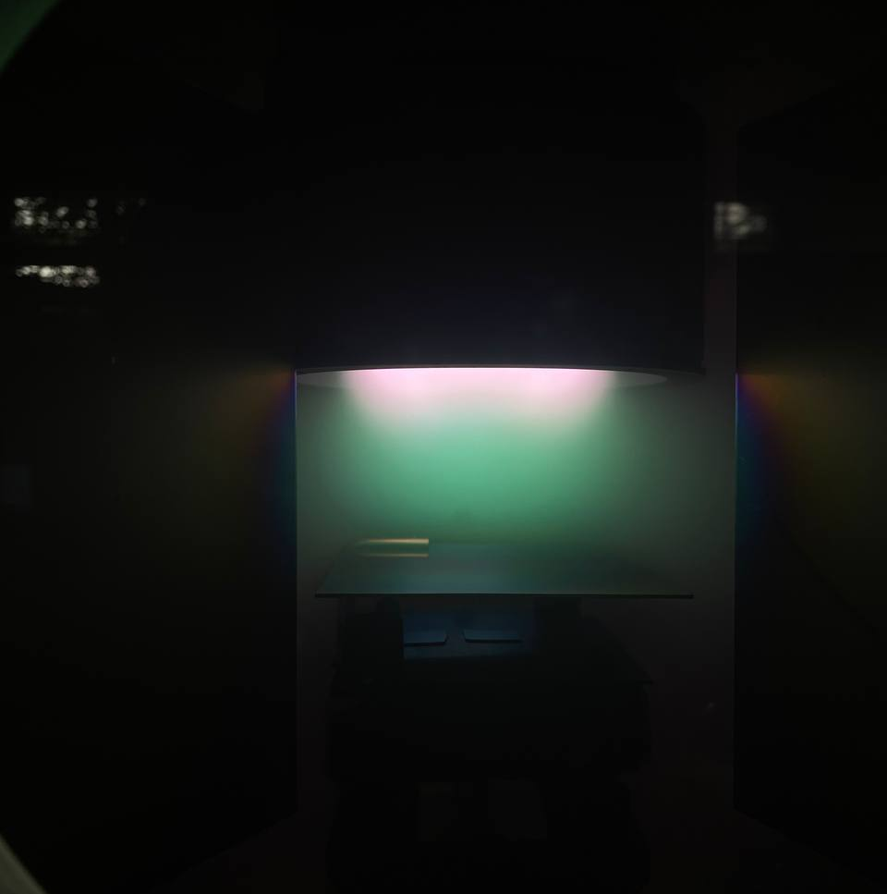
Lehrstuhl für
Oberflächen- und
Werkstofftechnologie
1b. RF-magnetron sputtering of MgB₂
MgB₂ sputtering in Ar
Substrate temperature up to 1500℃
→ but can’t be measured so far
BoxCoater works!!!

Slide 9
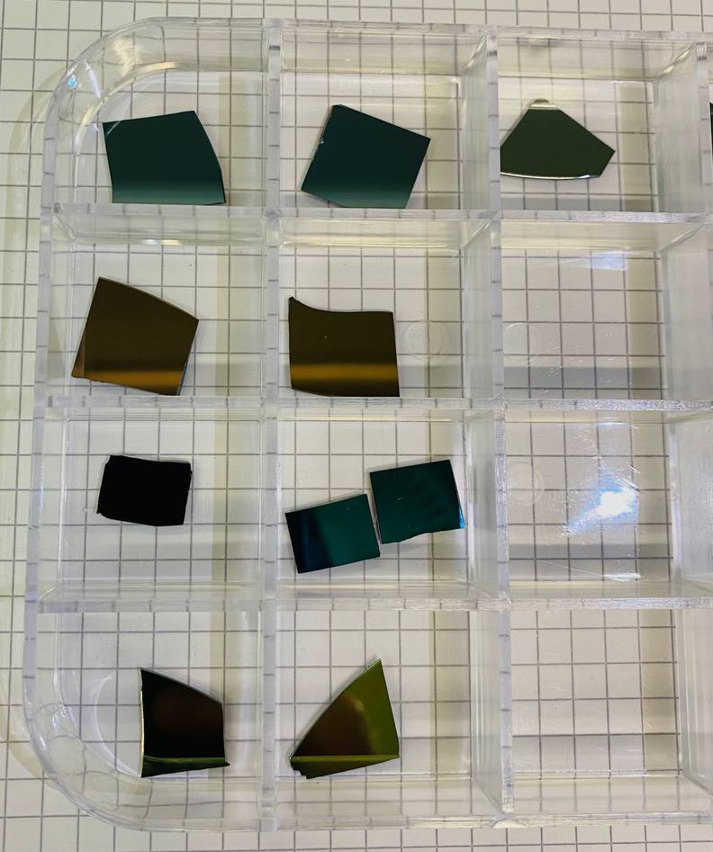
Lehrstuhl für
Oberflächen- und
Werkstofftechnologie
1b. RF-magnetron sputtering of MgB₂
P = 200W
P = 300W
P = 400W
P = 500W

Slide 10
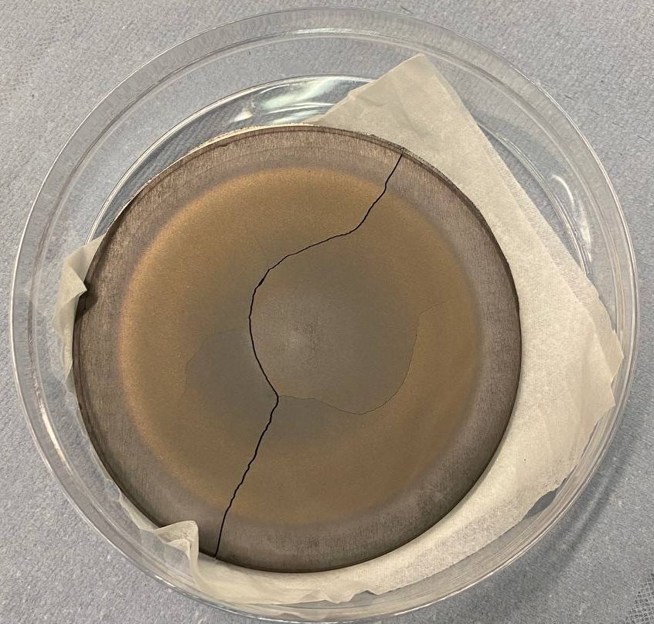
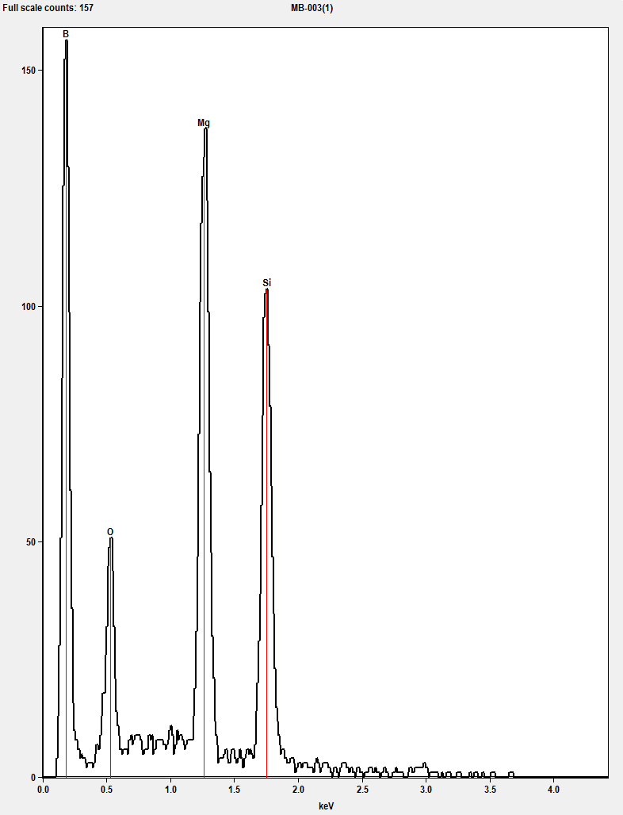
Lehrstuhl für
Oberflächen- und
Werkstofftechnologie
1b. RF-magnetron sputtering of MgB₂
Challenges of the MgB₂ sputtering:
Brittle material → deposition limits
Composition ↔ Cathode power
Oxygen contamination of the surface
Often high Mg vapor pressure is required...
P = 200W
P = 300W
SEM
B
Mg
EDX
P = 400W
Si
P = 500W
O

Slide 11
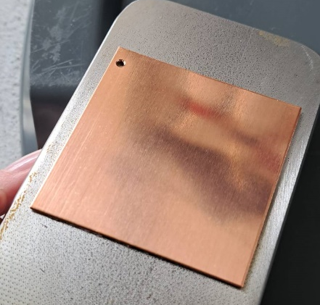
Lehrstuhl für
Oberflächen- und
Werkstofftechnologie
2. Sample preparation
50mm
50mm
@ Yvonne
untreated
2000 grit
4000 grit
Diamond polishing paste (3 μm)
Development of the surface pre-treatment (mechanical polishing) for large Cu substrates
Electropolishing of Cu substrates: standard procedure
Nb substrates: HF-H₂SO₄ solution treatment is rejected by the safety-at-work department → other options?

Slide 12
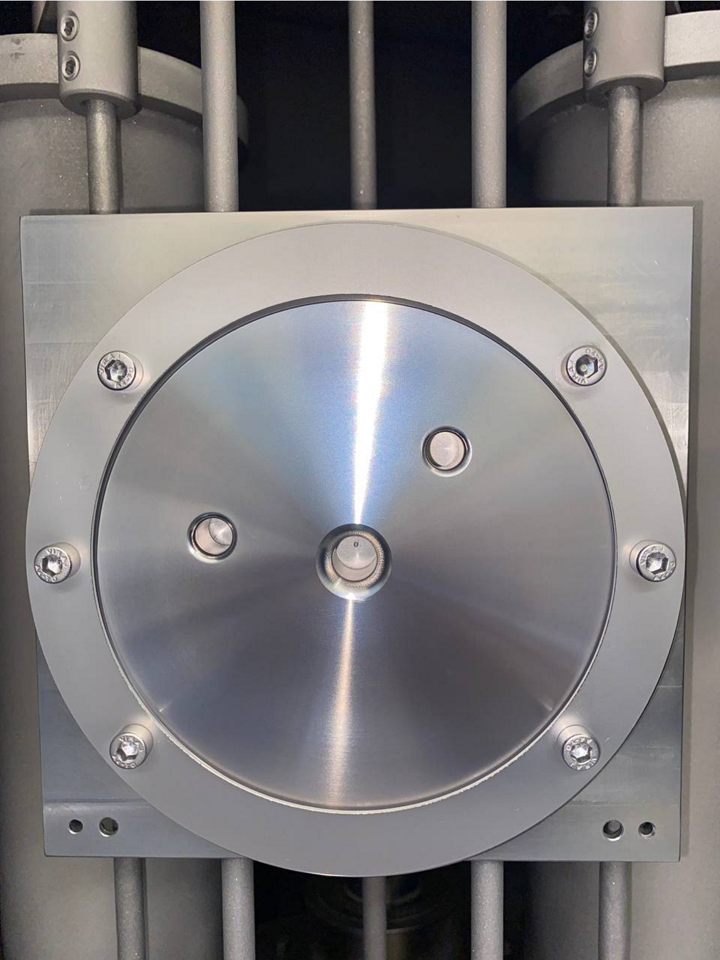
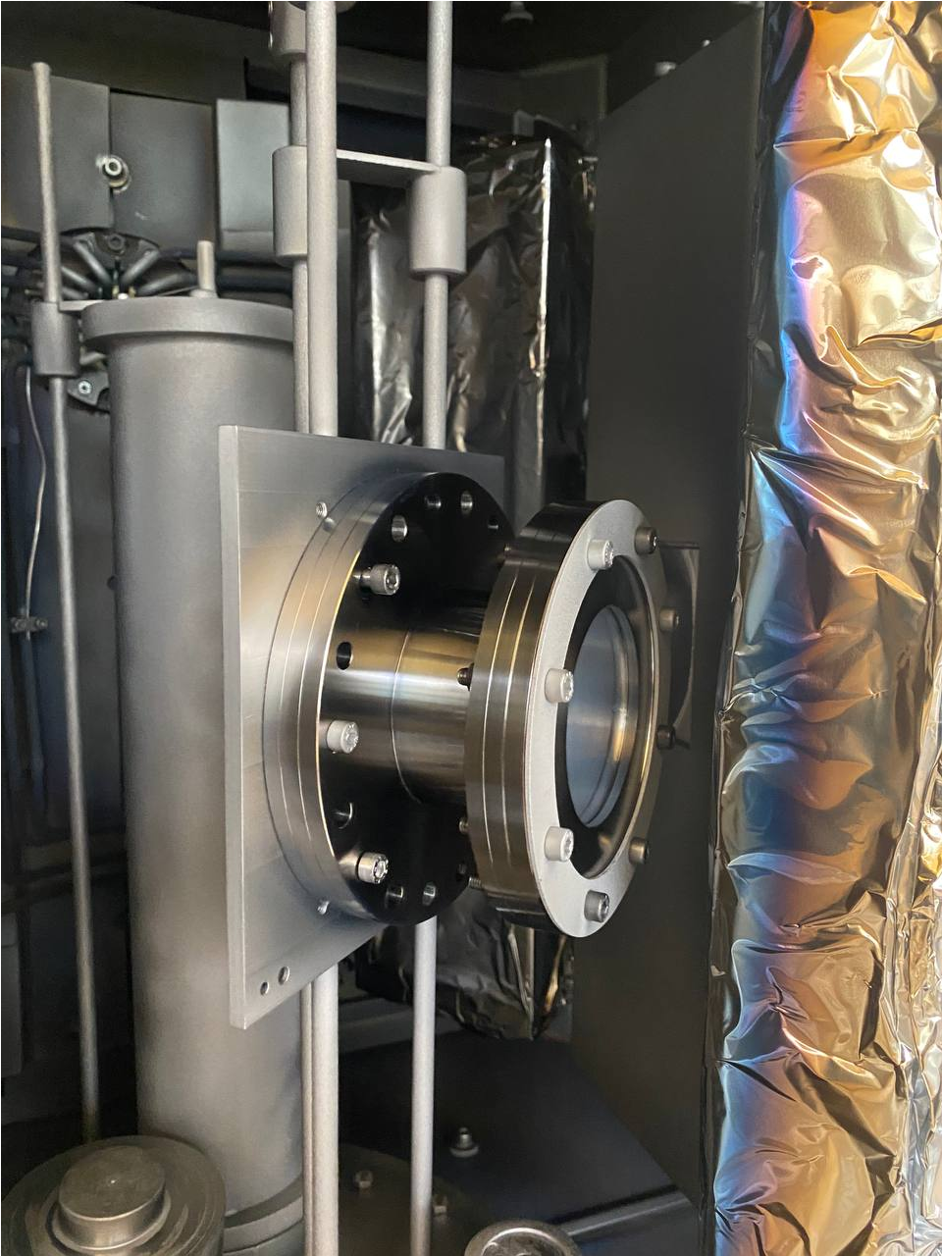
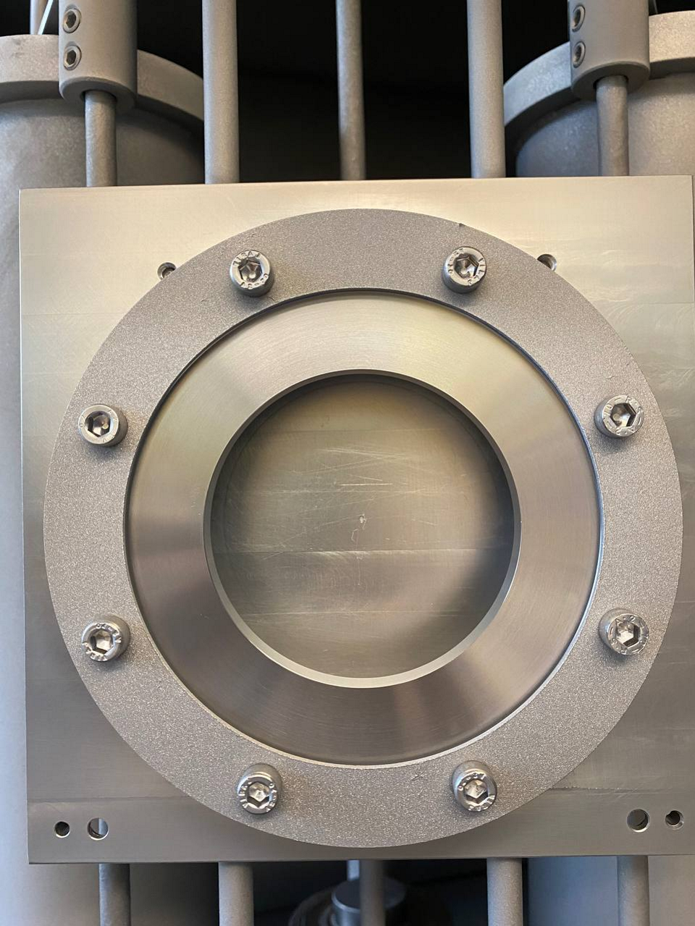
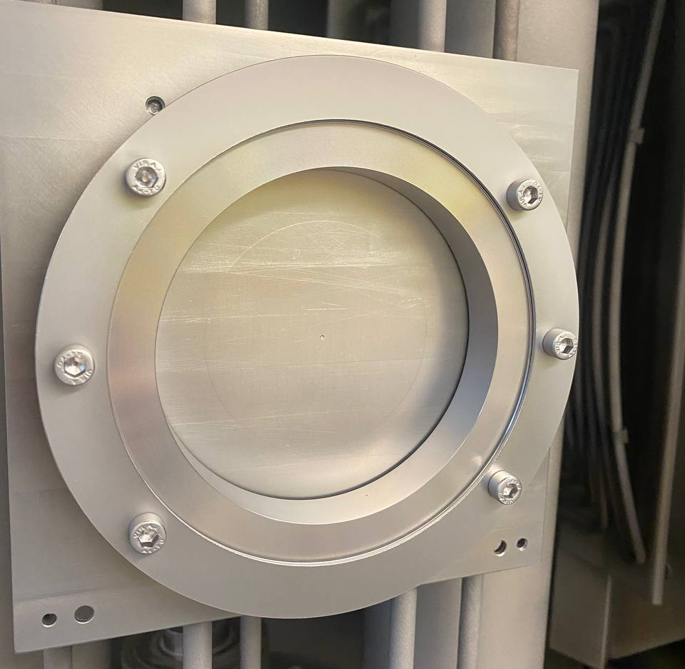
Lehrstuhl für
Oberflächen- und
Werkstofftechnologie
4. Coating of RaSTA parts
CF125 Top flange
Pre-treatment with ultrasonic bath (ammonia-based)
1st Proc. ID: 20210729 4µm Nb (with MF etching)
2nd Proc. ID: 20210801 12 µm Nb
Adapter CF125 to CF100
QPR sample adapter
CF125 Cavity flange

Slide 13
Lehrstuhl für
Oberflächen- und
Werkstofftechnologie
Plans and outlook
Reanimation of NbN and SIS direction
Co-sputtering of NbTiN on Cu substrates, tuning the deposition window, playing with coating parameters → deposition of multilayer (SS or SIS) structures
Sputtering from a single alloy NbTi target (to avoid big rocking angle) → usage of HiPIMS or DC cathodes
Development of MgB₂ deposition, improvement of the sputtering target?
Characterization by XRD, SEM, AFM, SIMS, … → good NbTiN films for SC properties
Improvement of MP + EP polishing technique for big Cu substrates, Nb substrates – looking for other sources

Slide 14
Lehrstuhl für
Oberflächen- und
Werkstofftechnologie
THANK YOU FOR YOUR ATTENTION!

