Slide 1
Status update Rasta
F. Kramer, S. Keckert, O. Kugeler, J. Knobloch
02.06.22
Rapid Sample Test Apparatus

Slide 2
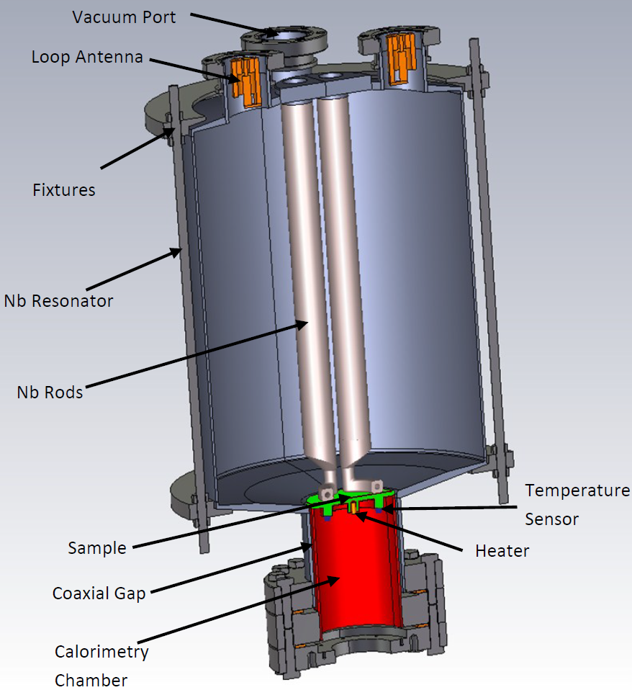
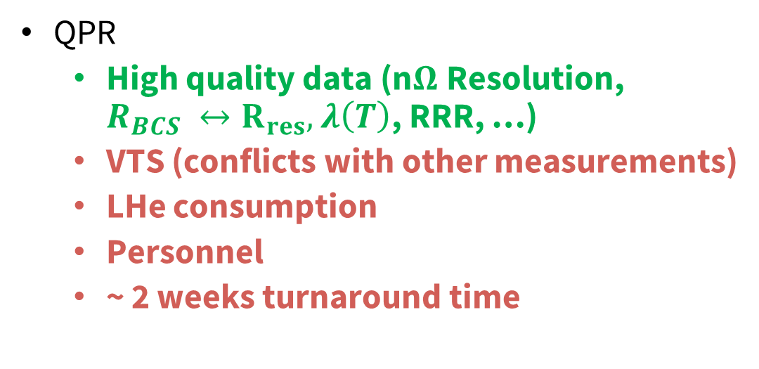
Existing Infrastructure
Introduction
QPR
  High quality data (n$Ω$Resolution, $R_{BCS} ↔R_{res},$ $λ\left(T\right)$, RRR, …)
  VTS (conflicts with other measurements)
  LHe consumption
  Personnel
  ~ 2 weeks turnaround time
Design new test cavity which can be less accurate, but faster and less elaborate

Slide 3
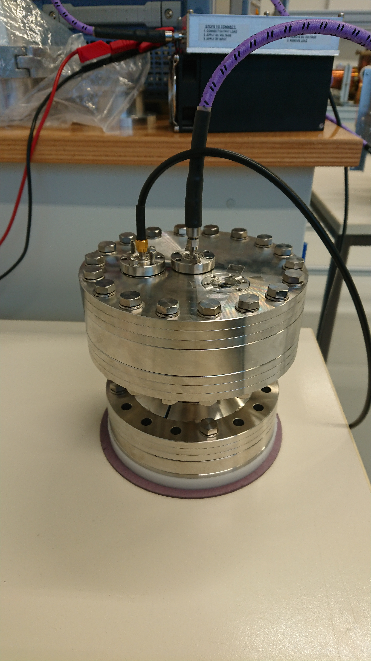
RaSTA – Rapid Sample Test Apparatus
Introduction
Complementary device to QPR
Identical Samples
Calorimetric measurement like in QPR
Simpler Infrastructure
  Low Power
  No radiation protection
  Small standalone cryostat
  Independent rapid testing
  Less LHe consumption
  High frequency (4.8 GHz)
  Probably higher parasitic losses
  Less accurate

Slide 4
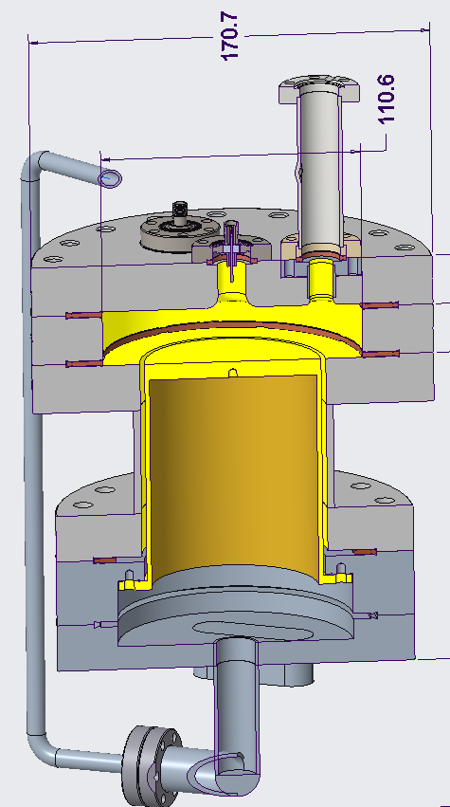
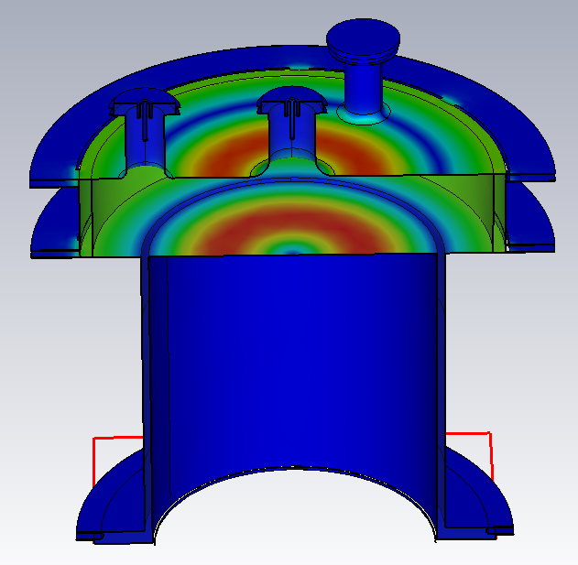
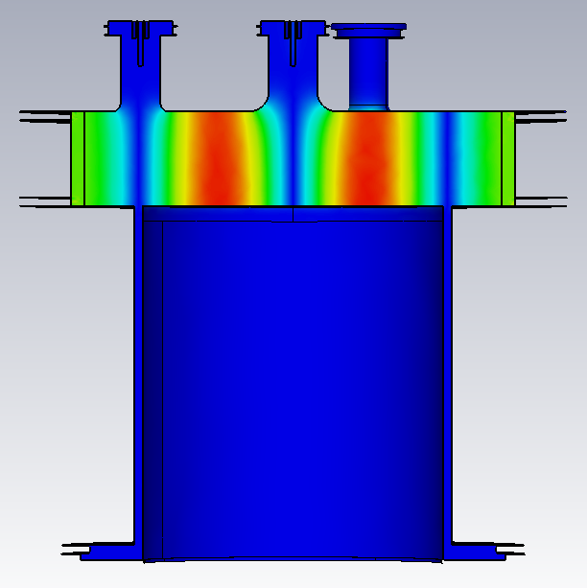
Concept: “Pillbox cavity” in TM₀₂₀
introduction
QPR sample as an endplate
Design cavity such that H-field zero crossing is at coaxial gap
Prototype from CF components
  Low cost
  Fast delivery
Bottom assembly identical to QPR
Assembly with special RF-gaskets to create pillbox geometry
Yellow Parts: Niobium
  Sample: Bulk or coated
  Cavity: Coated by Universtät Siegen
H field
H field

Slide 5
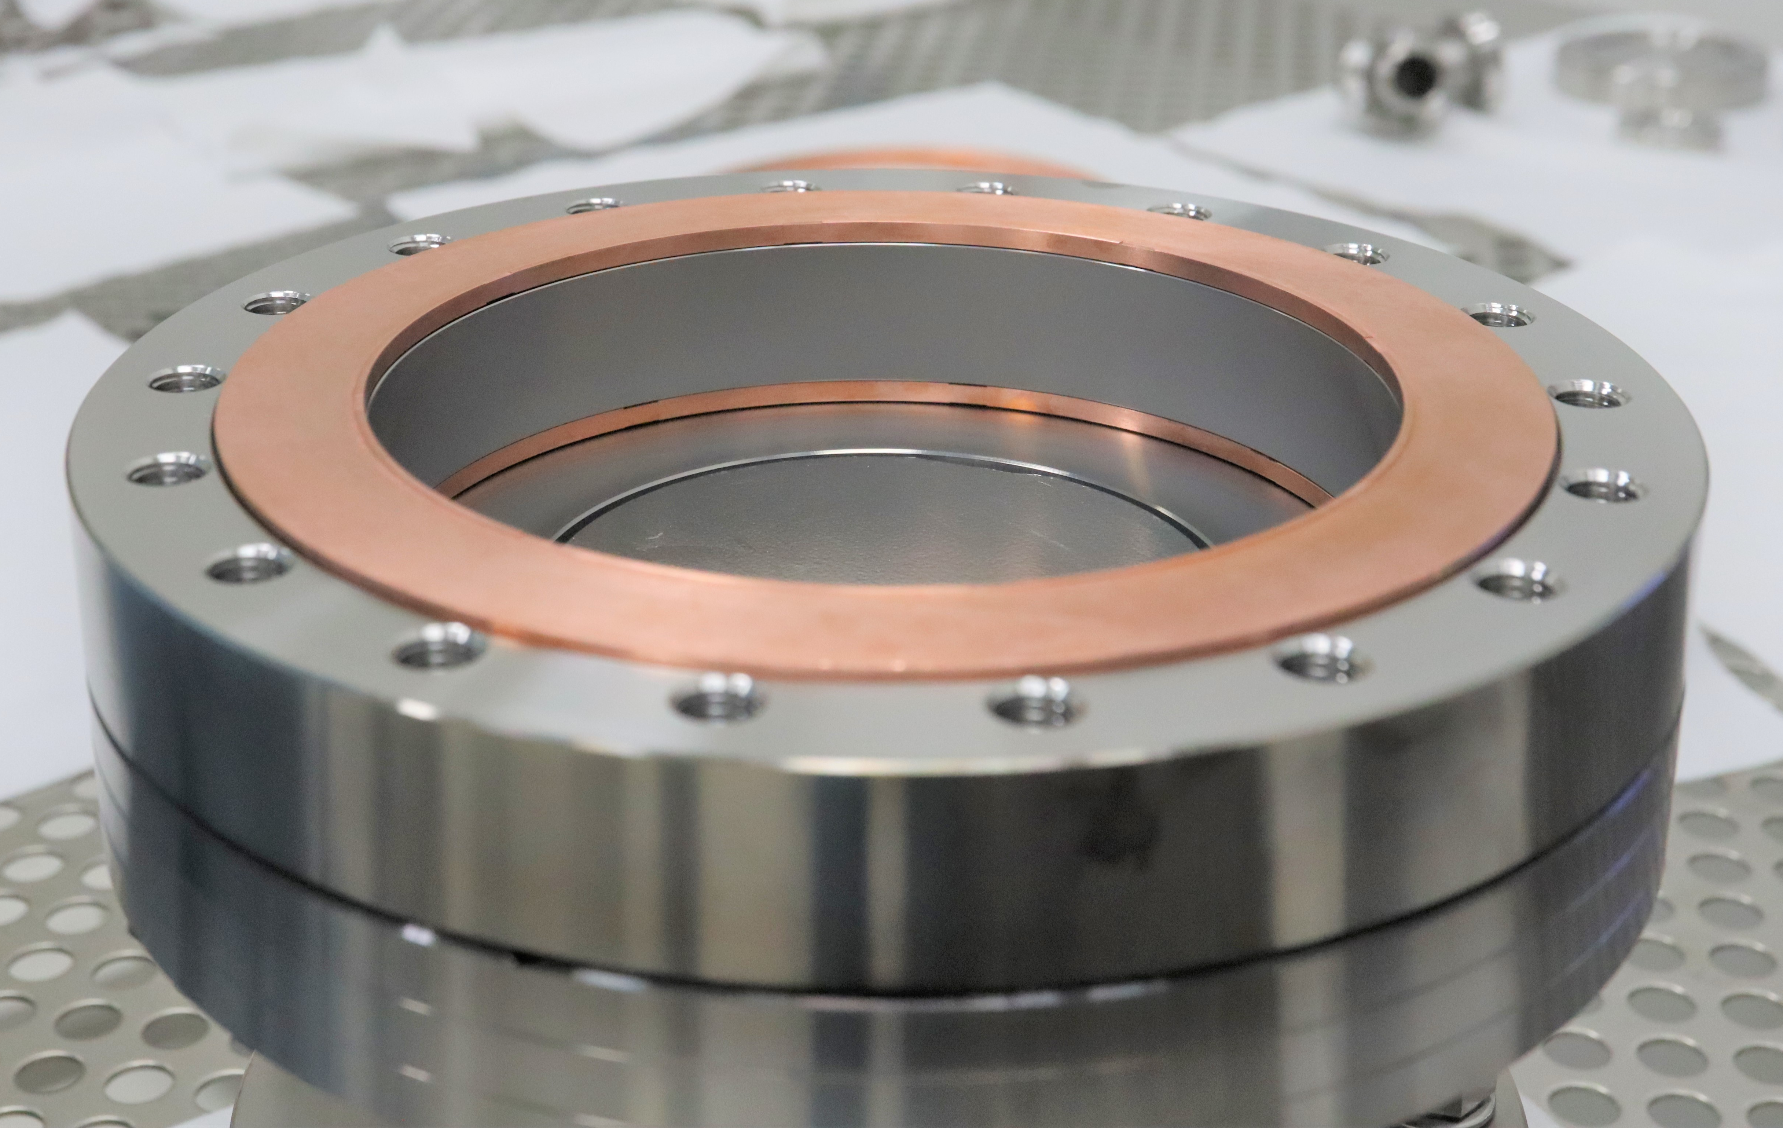
Progress since last meeting
Progress
Niobium Coating of cavity parts at Universität Siegen (20 µm)
Clean room assembly with QPR Baseline Sample (SS Flange)
1st cold test unsuccessful due to bad electrical contact of RF-gaskets
Re-assembly in clean room with freshly annealed gaskets with maximal achievable torque
2nd cold test successful

Slide 6
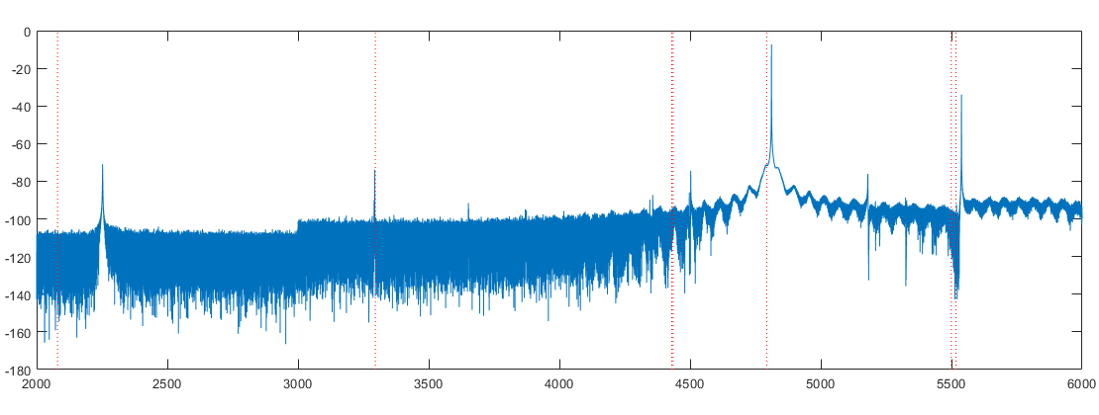
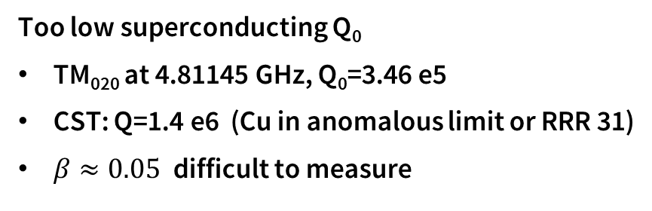
Mode Spectrum
Results
TM₀₁₀
TM₁₁₀
TM₂₁₀
TM₀₂₀
TM₃₁₀
Superconducting
PCB with AMR sensors
Mode Spectrum at Room Temperature as expected
TM₀₂₀ at 4.797 GHz, Q₀=6030
(CST: 4.794 GHz, Q=6068)
Too low superconducting Q₀
TM₀₂₀ at 4.81145 GHz, Q₀=3.46 e5
CST: Q=1.4 e6 (Cu in anomalous limit or RRR 31)
$β≈0.05$difficult to measure

Slide 7
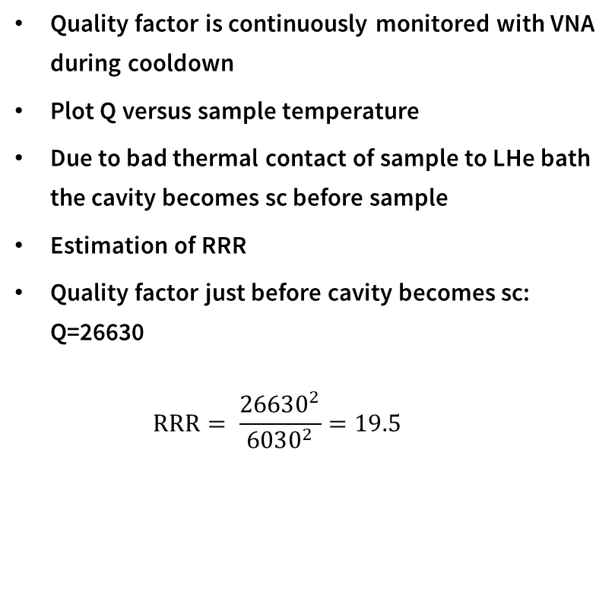
Superconducting Transition
Results
Quality factor is continuously monitored with VNA during cooldown
Plot Q versus sample temperature
Due to bad thermal contact of sample to LHe bath the cavity becomes sc before sample
Estimation of RRR
Quality factor just before cavity becomes sc: Q=26630
  $$RRR= \frac{{26630}^{2}}{{6030}^{2}}=19.5$$

Slide 8
Dissipated Power
Results
Quadratic increase with field
Higher losses at higher temperatures
Field in cavity is calculated using forward power

Slide 9
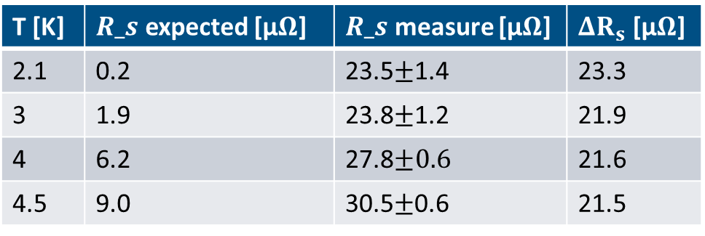
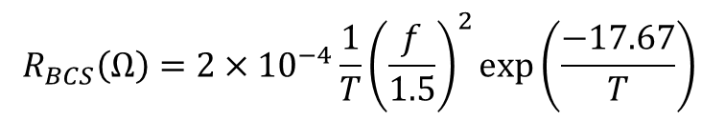
Surface Resistance
Results
RF system is not completed yet
No accurate power measurements possible at this state
Field in cavity is calculated using forward power
Large errors, especially at low fields
Right order of magnitude
Large parasitic losses
T [K] | $R_s$ expected [µ$Ω$] | $R_s$ measure [µ$Ω$] | $ΔR_{s}$ [µ$Ω$]
2.1 | 0.2 | 23.5$±$1.4 | 23.3
3 | 1.9 | 23.8$±$1.2 | 21.9
4 | 6.2 | 27.8$±0.6$ | 21.6
4.5 | 9.0 | 30.5$±$0.6 | 21.5
$$R_{BCS}\left(Ω\right)=2×{10}^{−4}\frac{1}{T}{\left(\frac{f}{1.5}\right)}^{2}\exp\left(\frac{−17.67}{T}\right)$$

Slide 10
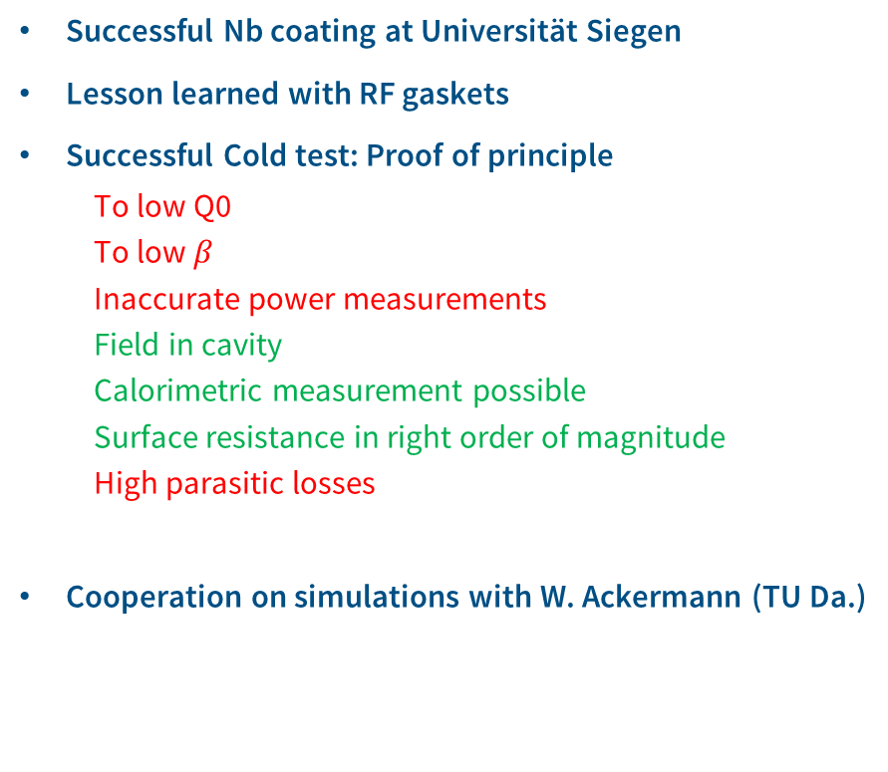
Conclusion
Conclusion & Outlook
Successful Nb coating at Universität Siegen
Lesson learned with RF gaskets
Successful Cold test: Proof of principle
  To low Q0
  To low $β$
  Inaccurate power measurements
  Field in cavity
  Calorimetric measurement possible
  Surface resistance in right order of magnitude
  High parasitic losses
Cooperation on simulations with W. Ackermann (TU Da.)
Outlook
Adjust input coupling
Build complete RF system
Test QPR sample with coated flange
Design RaSTA 2.0
  Smaller outer dimensions
  Switch from copper gaskets to indium?
  Switch to detachable samples in the future?

Slide 11
Surface resistance vs B from Pickup
Results

Slide 12
Versus forward power
Results

Slide 13
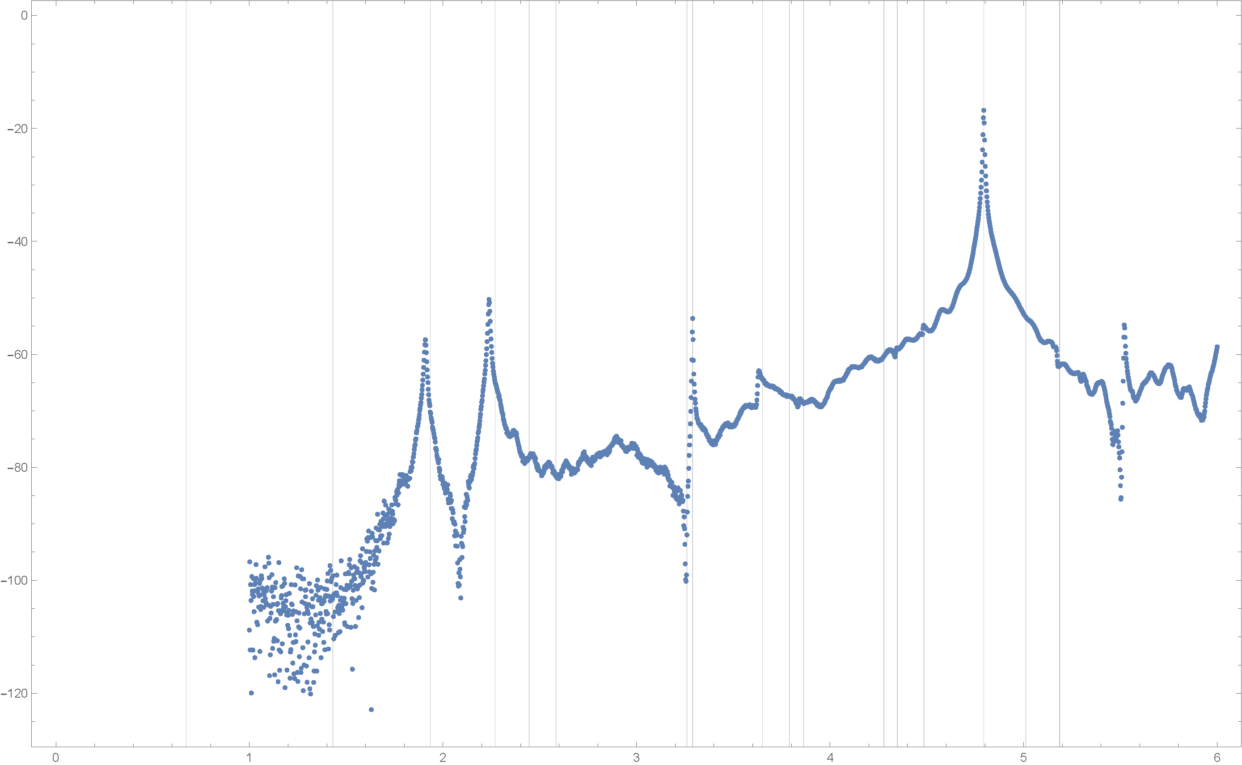
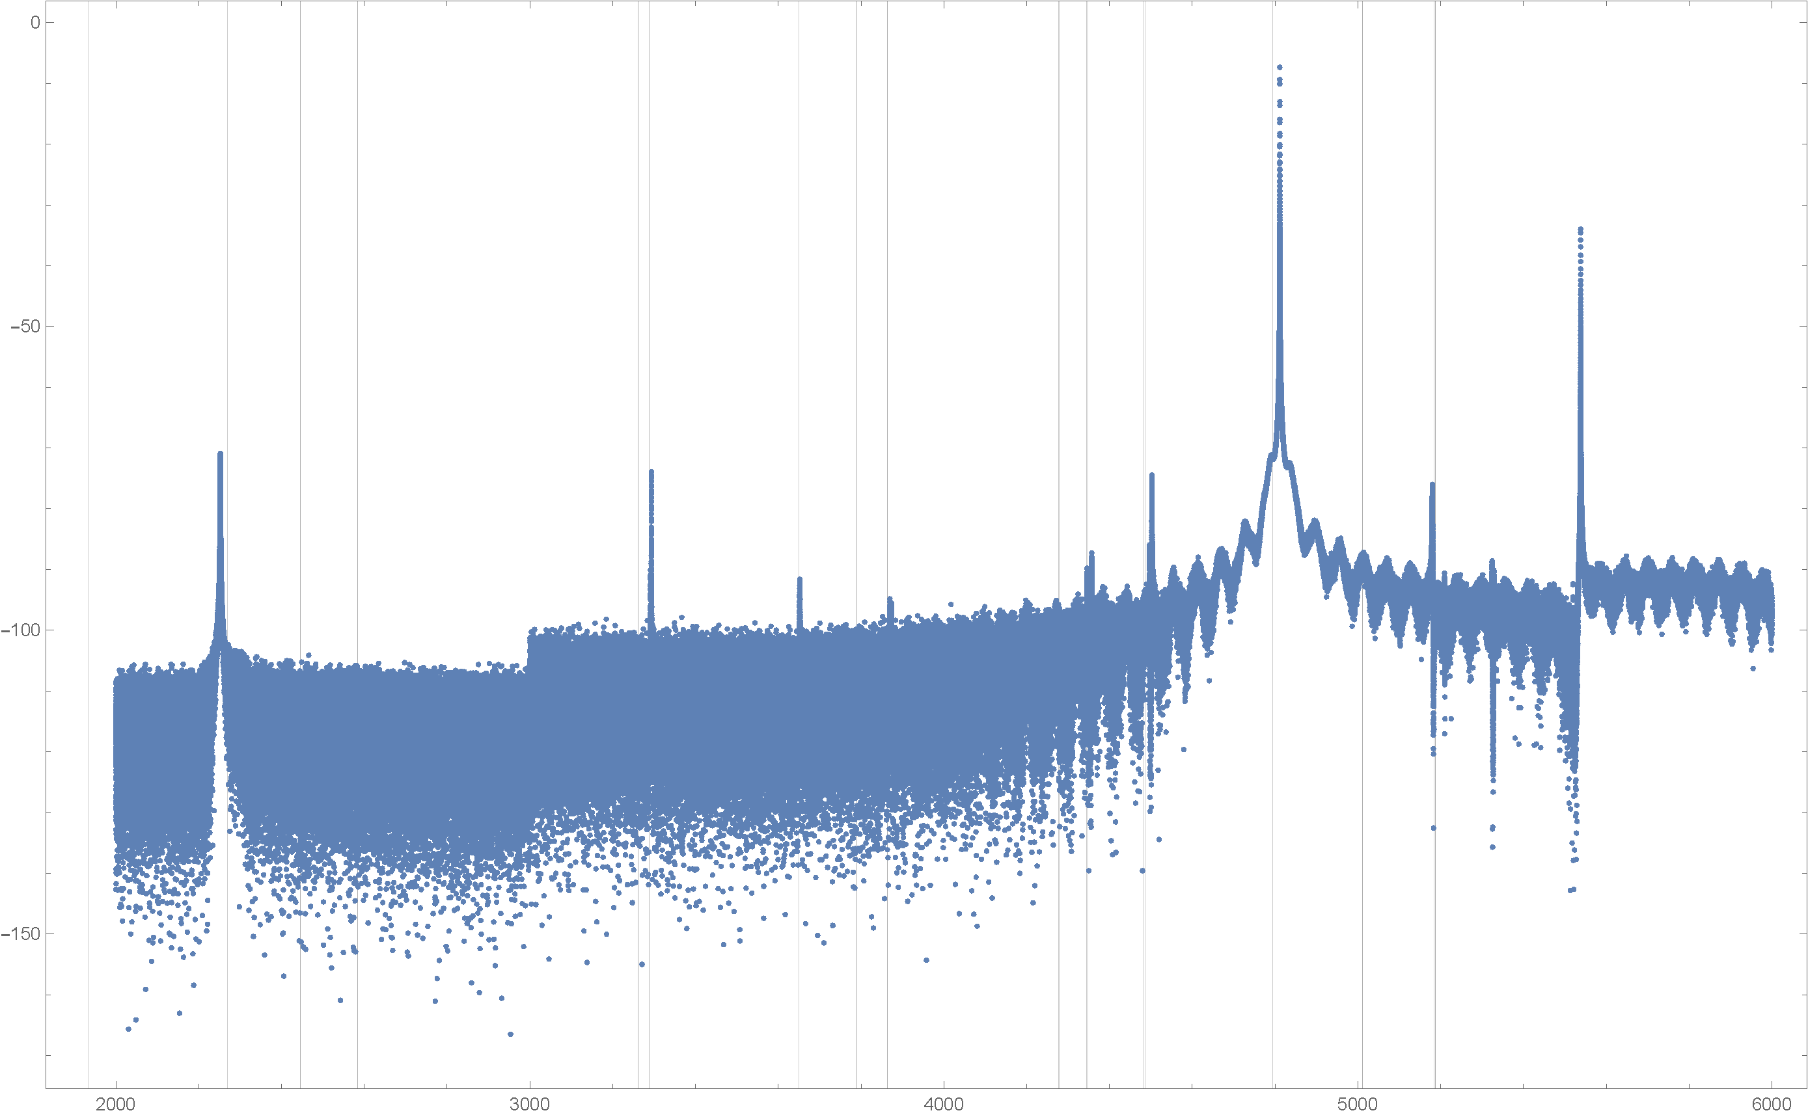
Simulations W. Ackermann
Results
Simulation
Measurement

Slide 14
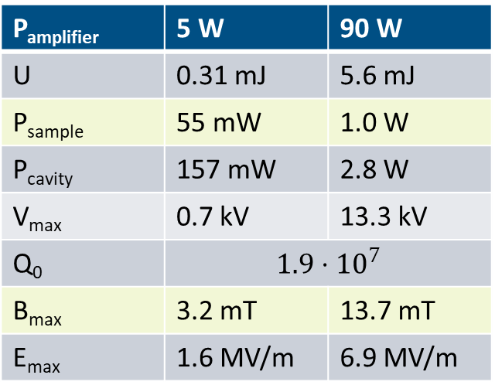
CST parameters
Rasta parameters
P_{amplifier} | 5 W | 90 W
U | 0.31 mJ | 5.6 mJ
P_{sample} | 55 mW | 1.0 W
P_{cavity} | 157 mW | 2.8 W
V_{max} | 0.7 kV | 13.3 kV
Q₀ | $$1.9⋅{10}^{7}$$
B_{max} | 3.2 mT | 13.7 mT
E_{max} | 1.6 MV/m | 6.9 MV/m
5 W input power available with low effort
  no radiation protection needed
55 mW should be sufficient for calorimetric R_{S} measurements
Q₀ dominated by copper gaskets
  Acceptable for first test
  Gaskets can be coated later
  Demountable parts for ‘easy’ cleaning, coating, tests …

Slide 15
Work packages
WP A | Film production | USI, UHH, HZB, DESY
A.1 | Sample preparation | Nb only?
A.2 | PE-ALD of 1-cell cavity | Up to 3 1-cell cavities, coupon cavity
A.3 | Sputtering studies on flat Nb samples | Flat Nb samples; Nb, NbN, NbTiN, Nb₃Sn
A.4 | MgB₂ studies | Sputtering on Nb and Cu
A.5 | SC upgrade of RaSTA
WP B | Microstructure properties | USI, UHH, BUW, HZDR, HZB
WP C | Field emission and SEY studies | USI, BUW
C.1 | Measurement of parasitic field emission
C.2 | SEY measurement
WP D | Positron spectroscopy of layered structures | USI, HZDR, UHH
D.1 | Development of an in-situ sputtering chamber | @ pELBE as part of AIDA-II
D.2 | Depth resolved defect analysis at ELBE
WP E | Numerical analysis of layered structures | TUDA, USI, BUW, HZB
E.1 | Design optimization, forensic analysis & SC upgrade of RaSTA
E.2 | Multipacting analysis based on measured SEY data
E.3 | Modelling of an SIS multilayer using a surface impedance representation
E.4 | Numerical analysis of the dielectric losses in the insulator of a multilayer device
WP F | BCS characterization of samples | UHH, HZB, DESY
F.1 | DC magnetometry of samples | PPMS and AMR magnetometry
F.2 | RF testing of samples | QPR & RaSTA
F.3 | Cavity testing | 1.3 GHz Q₀ vs. E_{acc} with AMR B-mapping

Slide 16
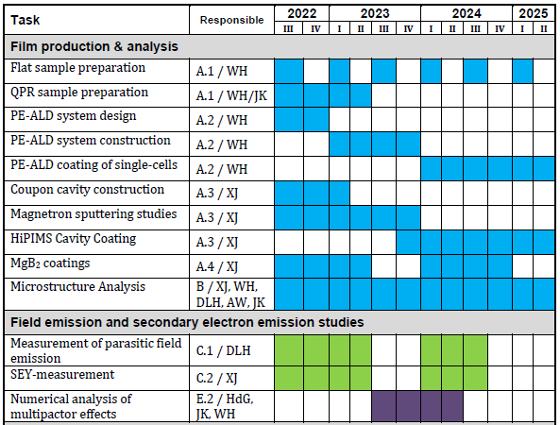
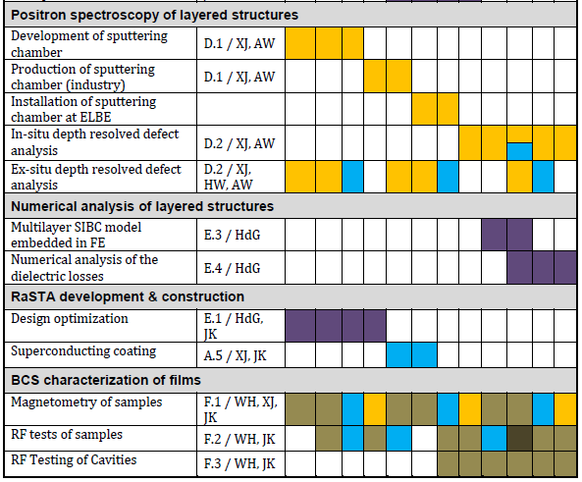
Milestones and deliverables

Slide 17
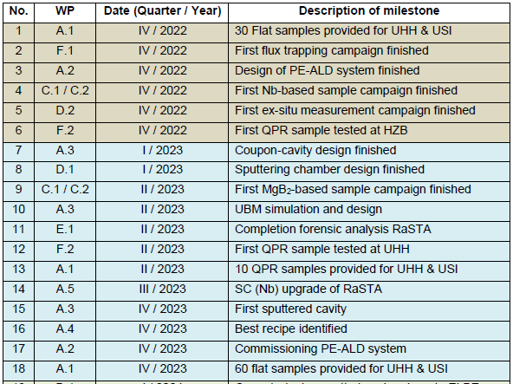
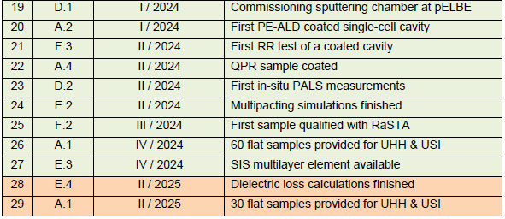
Milestones and deliverables

Slide 18
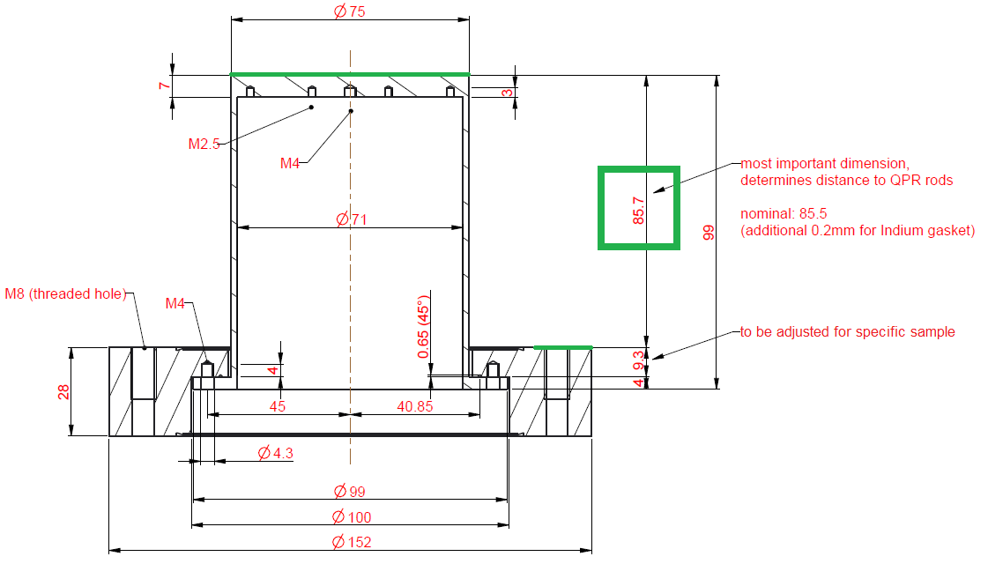
QPR sample interface definition
Qpr sample
RF sample surface
‚naked‘ (dismountable) sample or
assembly with DN100CF flange (double sided)
Final height: 85.5 mm
Attention:
CERN QPR differs by 3.5 mm in height !

