Slide 1
RaSTA
EM-Thermal Coupled Simulations
W. Ackermann, H. De Gersem, W. F. O. Müller
Institute for Accelerator Science and Electromagnetic Fields (TEMF), TU Darmstadt
NOVALIS Meeting
Hamburg
June 2, 2023

Slide 2
Outline
Motivation
  Modes in RaSTA vs. modes in a pillbox cavity
  Comparison of calculated frequencies to measurements
Numerical Modeling
  Visualization of selected field patterns
  Thermal surface losses in the stainless-steel flanges
  Temperature distribution in the modeled RaSTA setup
  Geometry simplification and its influence on the EM field
  Temperature increase due to partial thermal losses
Summary / Outlook

Slide 3
Outline
Motivation
  Modes in RaSTA vs. modes in a pillbox cavity
  Comparison of calculated frequencies to measurements
Numerical Modeling
  Visualization of selected field patterns
  Thermal surface losses in the stainless-steel flanges
  Temperature distribution in the modeled RaSTA setup
  Geometry simplification and its influence on the EM field
  Temperature increase due to partial thermal losses
Summary / Outlook

Slide 4
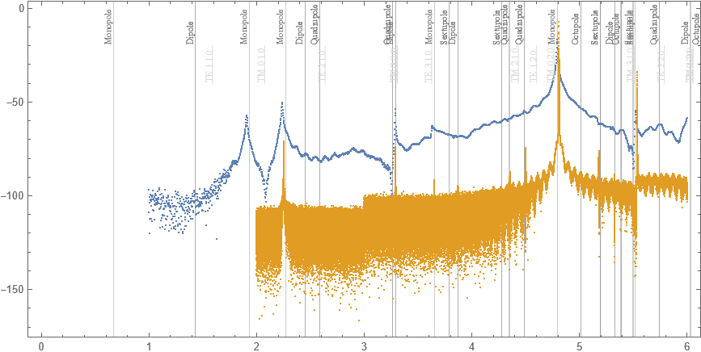
Motivation
RF Spectrum: Measurement vs. Simulation
warm
cold
Measurement data from Sebastian Keckert

Slide 5
Outline
Motivation
  Modes in RaSTA vs. modes in a pillbox cavity
  Comparison of calculated frequencies to measurements
Numerical Modeling
  Visualization of selected field patterns
  Thermal surface losses in the stainless-steel flanges
  Temperature distribution in the modeled RaSTA setup
  Geometry simplification and its influence on the EM field
  Temperature increase due to partial thermal losses
Summary / Outlook

Slide 6

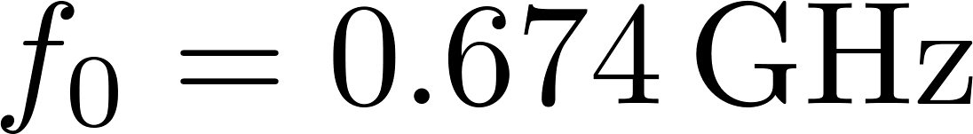
Numerical Modeling
Fundamental Mode (≠ pillbox TE 110)

Slide 7
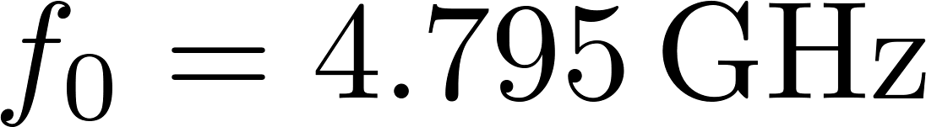
Numerical Modeling
Operational Mode (≈ pillbox TM 020)

Slide 8
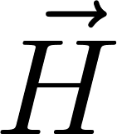
Numerical Modeling
Operational Mode (≈ pillbox TM 020)

Slide 9
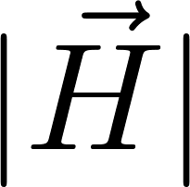
Numerical Modeling
Operational Mode (≈ pillbox TM 020)

Slide 10
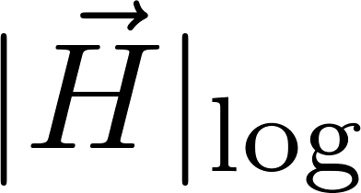
Numerical Modeling
Operational Mode (≈ pillbox TM 020)
finite
thickness
field in the gap is small but not zero

Slide 11
Numerical Modeling
Operational Mode (≈ pillbox TM 020)
rotationally symmetric field on the large scale
field not ideally rotationally symmetric

Slide 12

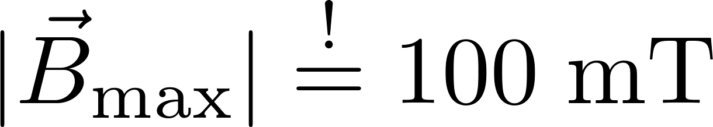
Numerical Modeling
Thermal Surface Losses (≈ pillbox TM 020)
top view

Slide 13
Numerical Modeling
Thermal Surface Losses (≈ pillbox TM 020)
cavity flange
probe flange

Slide 14


Numerical Modeling
Temperature Distribution (≈ pillbox TM 020)
only flanges are considered to be lossy

Slide 15

Numerical Modeling
Temperature Distribution (≈ pillbox TM 020)
probe flange

Slide 16
Numerical Modeling
Artificial Removal of Pump Port and Coupler
three-port setup
one-port setup

Slide 17
Numerical Modeling
Magnetic Field Strength - Comparison
three-port setup
one-port setup

Slide 18
Numerical Modeling
Thermal Surface Losses
three-port setup
one-port setup

Slide 19

Numerical Modeling
Temperature Distribution (≈ pillbox TM 020)
three-port setup
one-port setup

Slide 20
Outline
Motivation
  Modes in RaSTA vs. modes in a pillbox cavity
  Comparison of calculated frequencies to measurements
Numerical Modeling
  Visualization of selected field patterns
  Thermal surface losses in the stainless-steel flanges
  Temperature distribution in the modeled RaSTA setup
  Geometry simplification and its influence on the EM field
  Temperature increase due to partial thermal losses
Summary / Outlook

Slide 21
Summary / Outlook
Summary
  Obtained CAD data of the RaSTA cavity from HZB
  Adopted CAD data to be used for EM simulations
  Used material data from the successful QPR simulations
  (electric as well as thermal properties)
  Performed EM-thermal coupled simulations
  Obtained temperature distribution in the entre setup
Outlook
  Modes up to sextupole able to propagate in the coaxial gap
  Suppression of thermal heating or excitation of these modes

Slide 22
End

