Slide 1
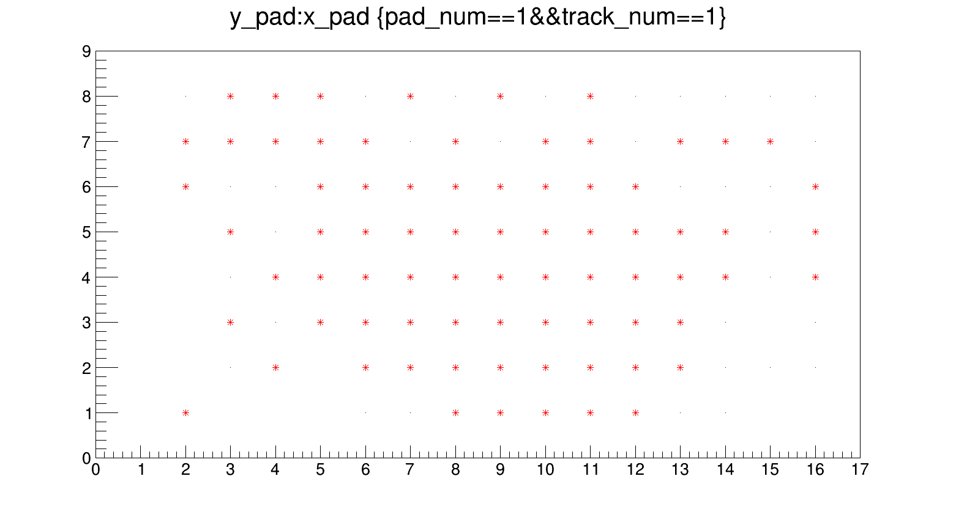
Slim run - Calice75
TB22 data analysis
MPV distribution for Si and GaAs sensors

Slide 2
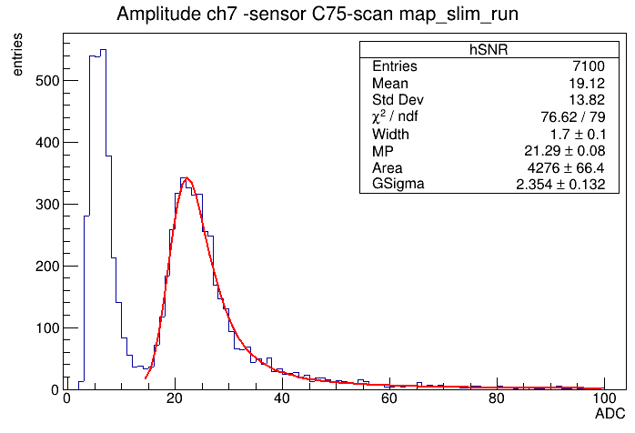
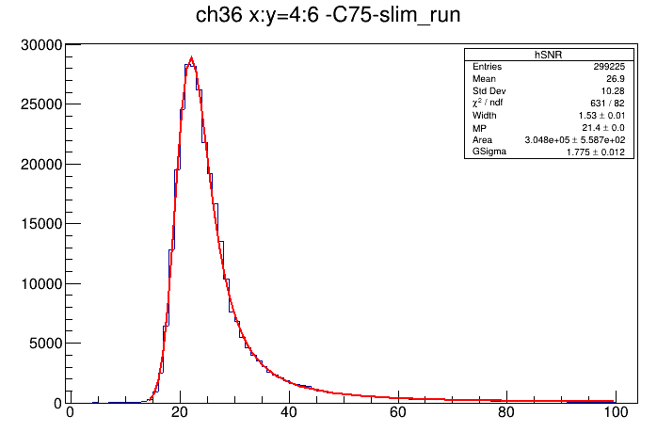
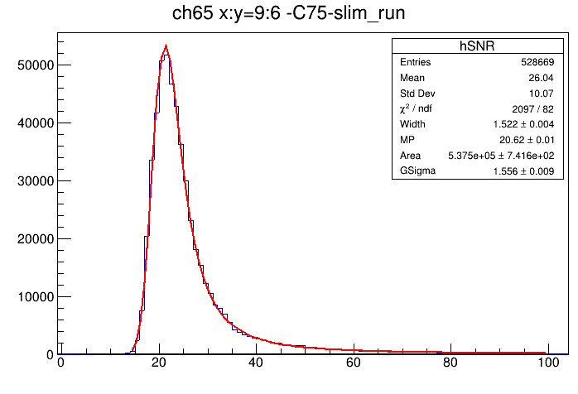
X:Y == 2:1

Slide 3
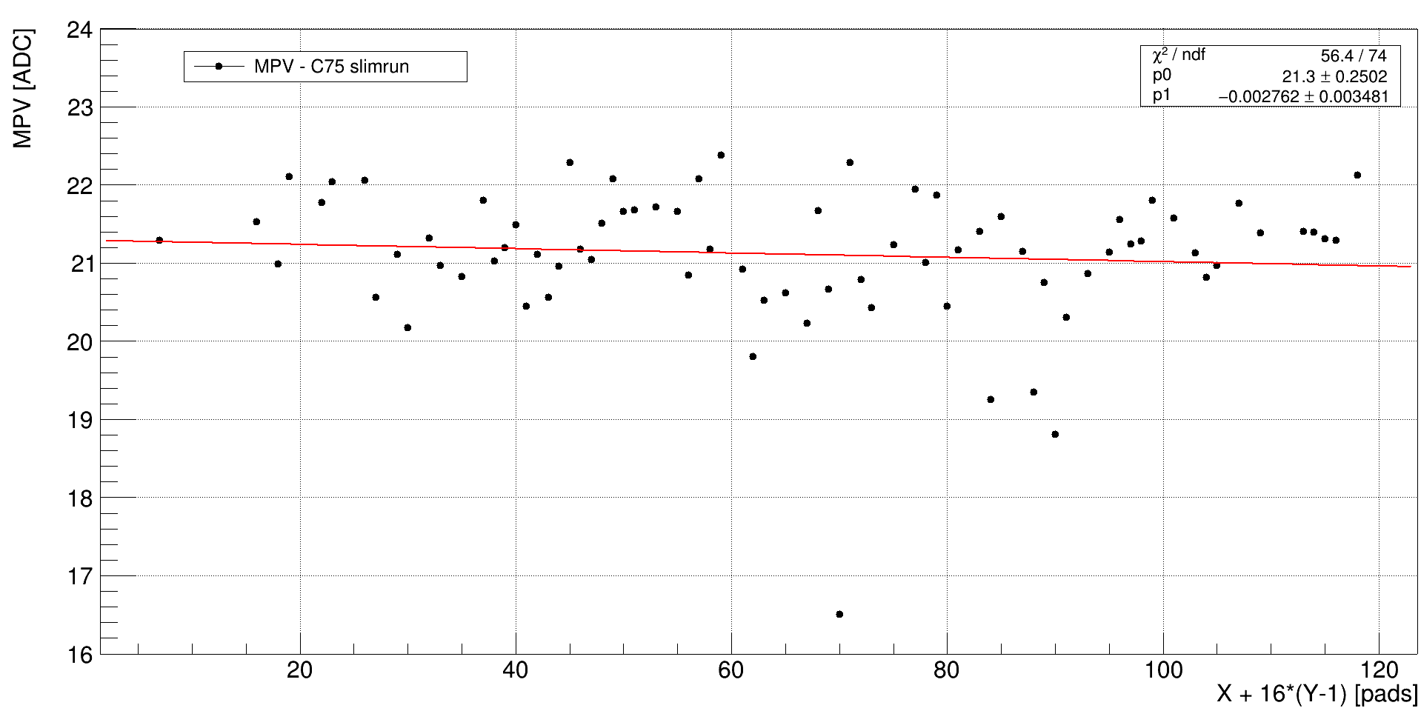

Slide 4
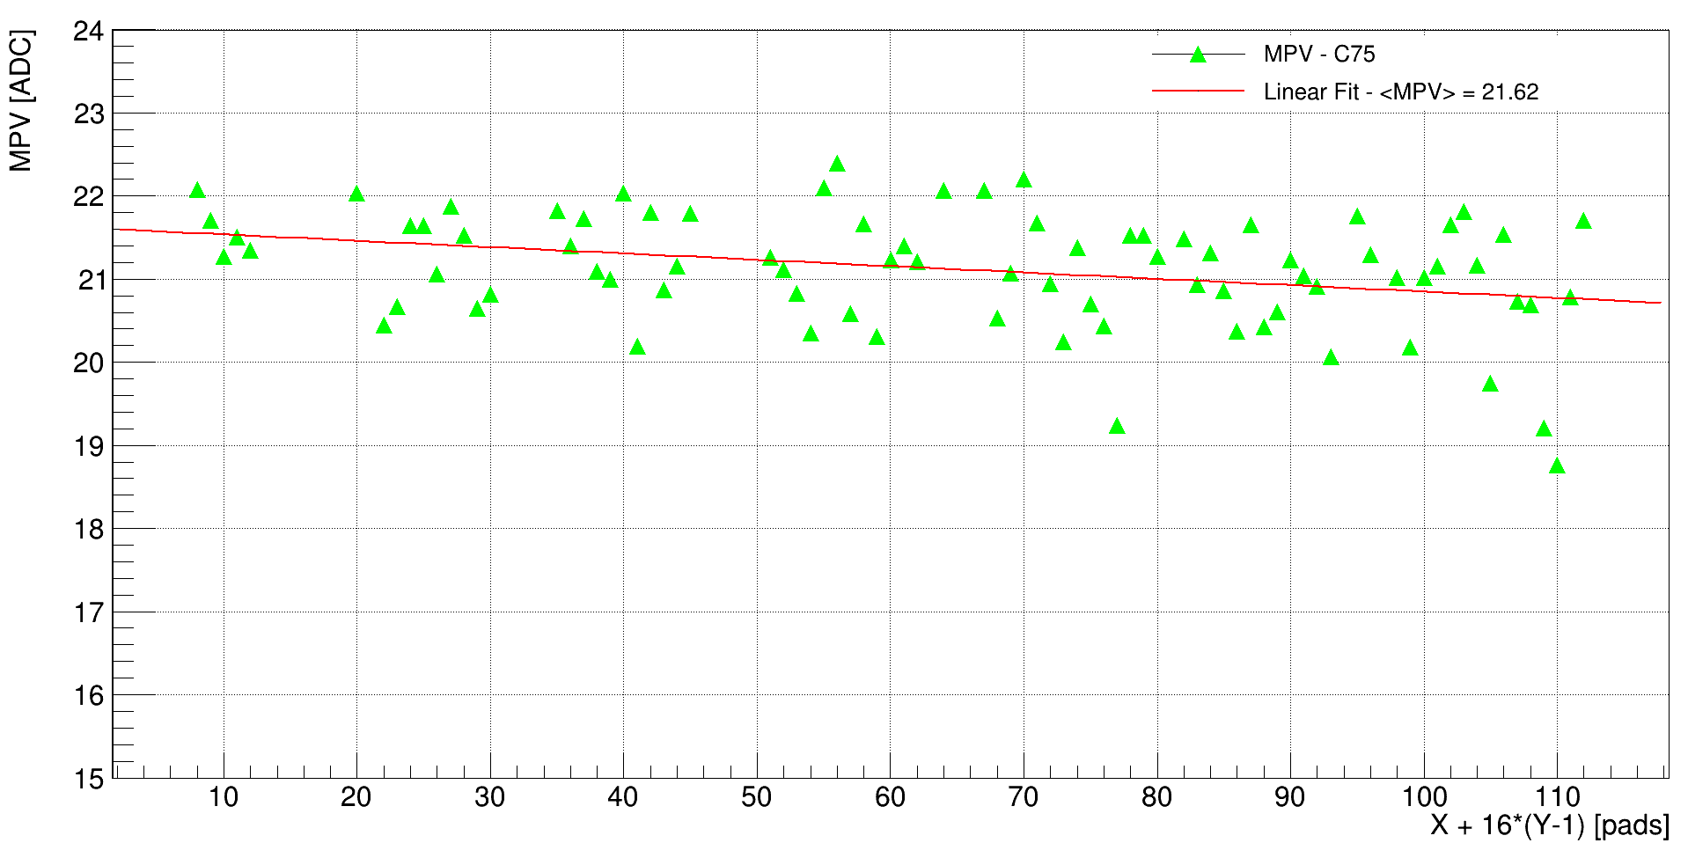

Slide 5
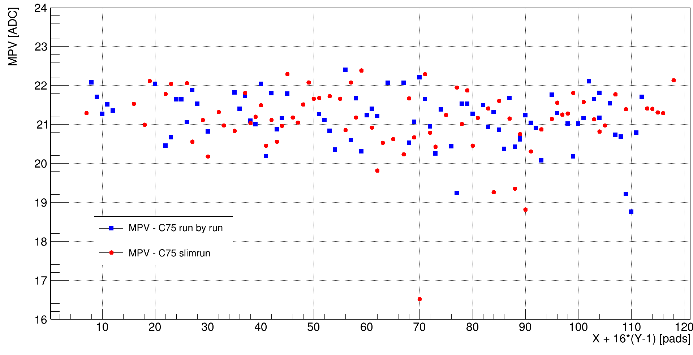
MPV of signal distribution for C75 Si sensor at 5 GeV electron beam.

Slide 6
