Slide 1
2023 European HDF User Group (HUG) plugins and data compression summit
Indico: https://indico.desy.de/event/39343/
Wifi: Science-Hotspot (no login required)
Eduroam

Slide 2
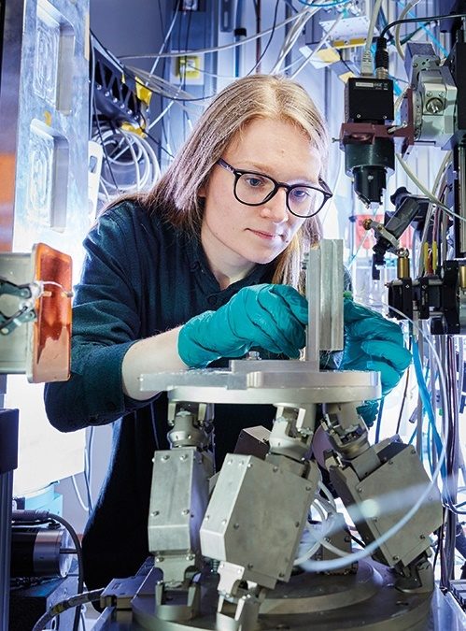
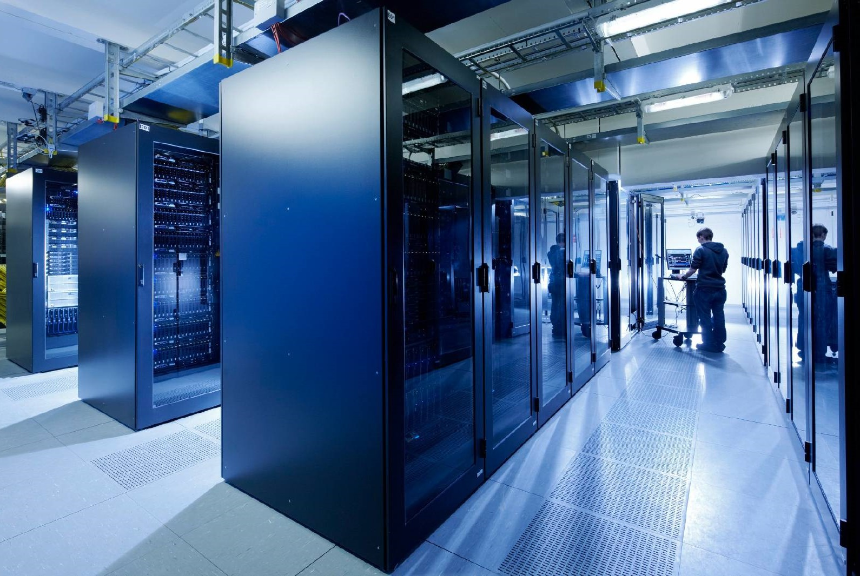
2023 European HDF User Group (HUG) plugins and data compression summit
Welcome - David Pennicard, DESY

Slide 3
Organising commitee
Andy Gotz, ESRF - General Chair
David Pennicard, DESY - Local Organising Chair
Thomas Vincent, ESRF - Technical Program Chair
Dana Robinson, HDF Group - Technical Program Chair
Gerd Heber, HDF Group - Executive Director of the HDF Group
Lori Cooper, HDF Group - Communication Chair

Slide 4
Sponsorship – LEAPS-INNOV
LEAPS – League of European Accelerator-based Photon Sources
LEAPS-INNOV – EU-funded project with 9 workpackages
Technological development, collaboration with industry
WP7 – Data reduction
https://gitlab.com/leaps-innov-wp7/

Slide 5
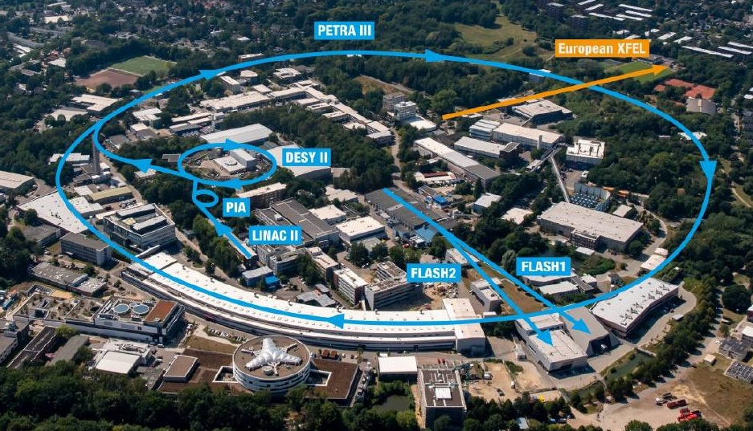
DESY
Accelerator research
Particle physics
Photon science
Astroparticle physics
plus many institutes (Uni Hamburg, Max Planck, EMBL, Hereon…)

Slide 6
Timetable at a glance
Tuesday 19
Wednesday 20
Thursday 21
Morning
Presentations
Presentations
Tutorials
Presentations + discussion
Discussion
Tutorials, tour (optional)
Afternoon
Evening
Restaurant (optional)

Slide 7
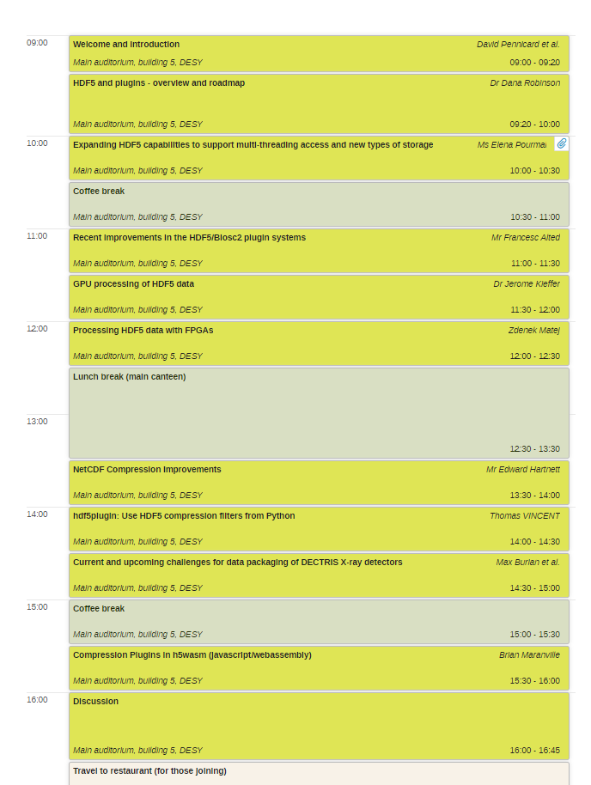
Daily schedule
https://indico.desy.de/event/39343/
Presentations generally 30 mins (incl. discussion)
Mid-morning and afternoon coffee breaks
Coffee also available after lunch
Lunch at DESY canteen (self paid)

Slide 8
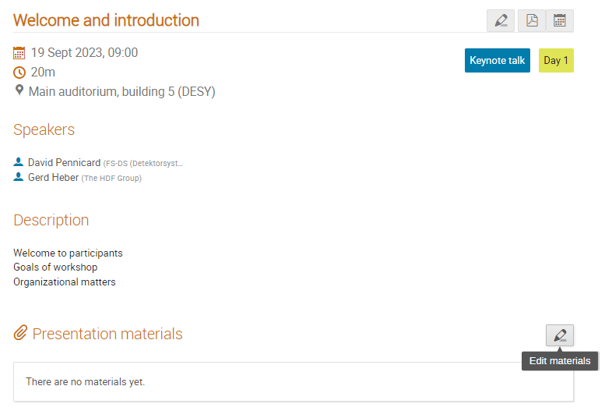
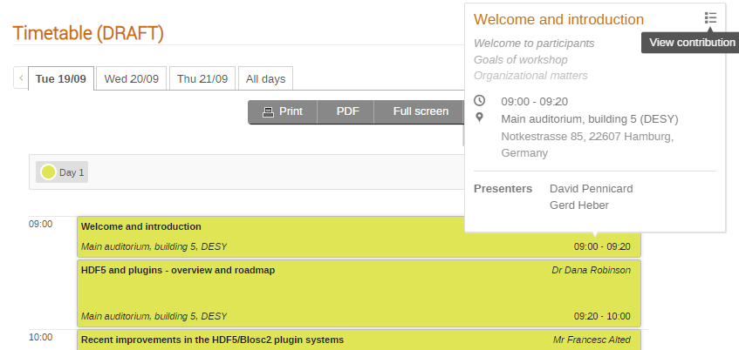
Giving presentations
Please upload slides to Indico or email to me if material can be shared
Remote participants present over Zoom
In-person – please upload slides, or transfer presentation to PC before session

Slide 9
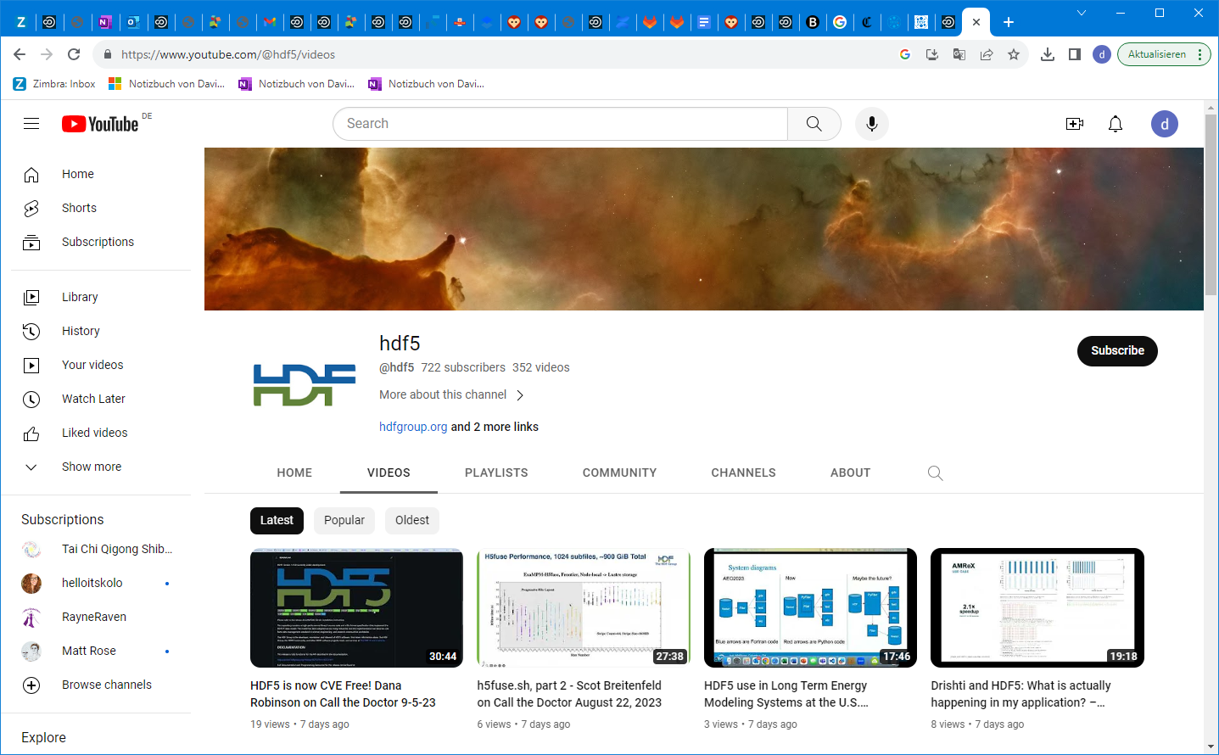
Zoom recordings
With permission, presentations will be recorded and put on HDF group Youtube channel
Upload only after signing consent form

Slide 10
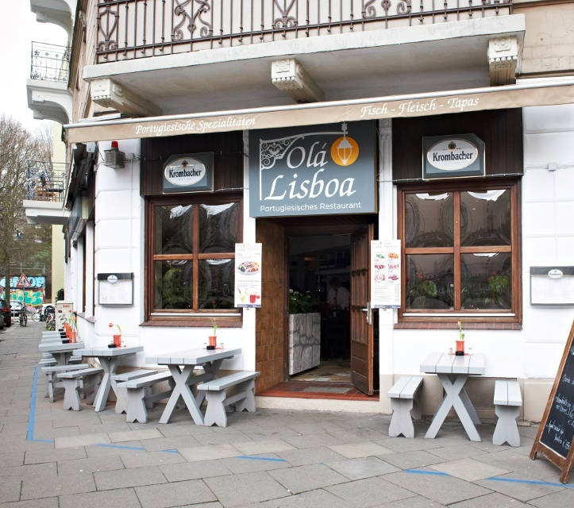
Today at 1800 - Restaurant Ola Lisboa (self paid)
https://ola-lisboa.de/

Slide 11
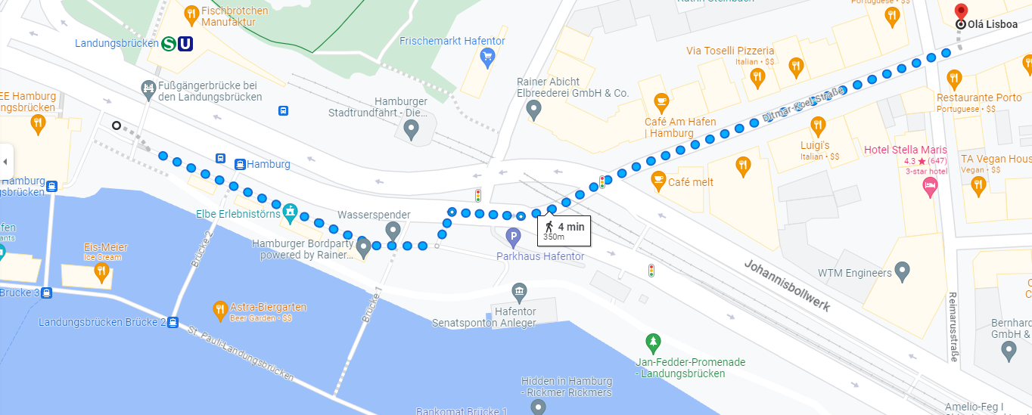
Departure for restaurant this evening
Everyone who requested (by email or registration) is booked
Session ends at 16:45, and we will leave from the foyer at 16:55 – booking at 18:00
Travelling by public transport (bus and train) – tickets can be bought on bus

Slide 12
DESY tour – Thursday at 1500
Tour of PETRA-III synchrotron
Sign-up sheet available at coffee breaks

Slide 13
Thanks for joining
Any problems – ask or email david.pennicard@desy.de

